Slide 1

Ola & Uber: Ride Booking & Cancellation Analysis (July 2024)
This report analyses ride booking and cancellation patterns to enhance operational efficiency and revenue generation for July 2024.

Slide 2

Dataset Overview & Scope
Our analysis leverages approximately 103,000 anonymised ride records exclusively from July 2024. Each record represents a unique ride request, providing a granular view of platform activity.
The dataset includes critical information such as Booking_ID, Date, Booking_Status, Booking_Value, and Payment_Method, enabling a comprehensive evaluation of ride dynamics.

Slide 3
Key Performance Indicators
103K+
~27%
₹ 57M
₹ 548.75
Total Rides Booked
Cancellation Rate
Total Revenue
Avg Revenue/Ride
Volume of ride requests processed during July 2024.
Percentage of booked rides that were subsequently cancelled.
Aggregated revenue from completed rides.
Average earnings per successfully completed journey.
These KPIs are crucial for assessing platform health, identifying areas for operational improvement, and understanding financial performance.

Slide 4
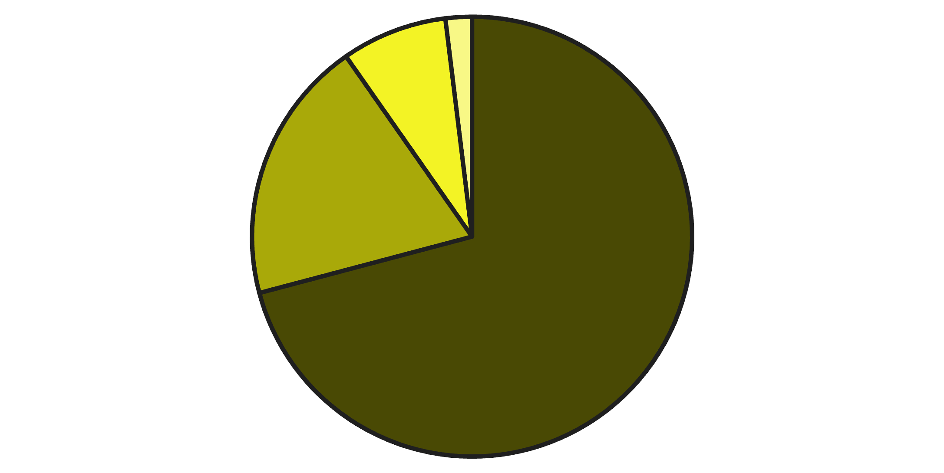
Booking Status Distribution
The distribution of booking statuses reveals a significant challenge posed by driver-related failures. Cancellations initiated by drivers and instances where a driver could not be found account for a substantial portion of unfulfilled requests.
This indicates a supply-side constraint impacting service reliability and customer satisfaction, representing a key area for strategic intervention.
Successful
Cancelled by Driver
Cancelled by Customer
Driver Not Found

Slide 5

Deep Dive: Cancellation Analysis
Customer Changed Mind
Driver Unavailable
Long Wait Time
App Error
A focused examination of cancelled rides highlights that driver-related issues are the primary contributors. This suggests a systemic problem with driver availability, routing efficiency, or matching algorithms rather than customer-initiated changes.
Addressing these driver-centric cancellation reasons presents the most direct path to improving ride completion rates and overall service quality.

Slide 6


Hidden Revenue Loss & Opportunity
Average Revenue Per Successful Ride
Each completed ride contributes positively to our revenue streams. However, every cancelled ride represents lost income without any additional marketing or acquisition costs.
The current cancellation rate translates directly into a substantial amount of unrealised revenue. By reducing cancellations, we can significantly boost total revenue without needing to generate new demand.
Reducing cancellations by just 5% could unlock millions in additional annual revenue.

Slide 7

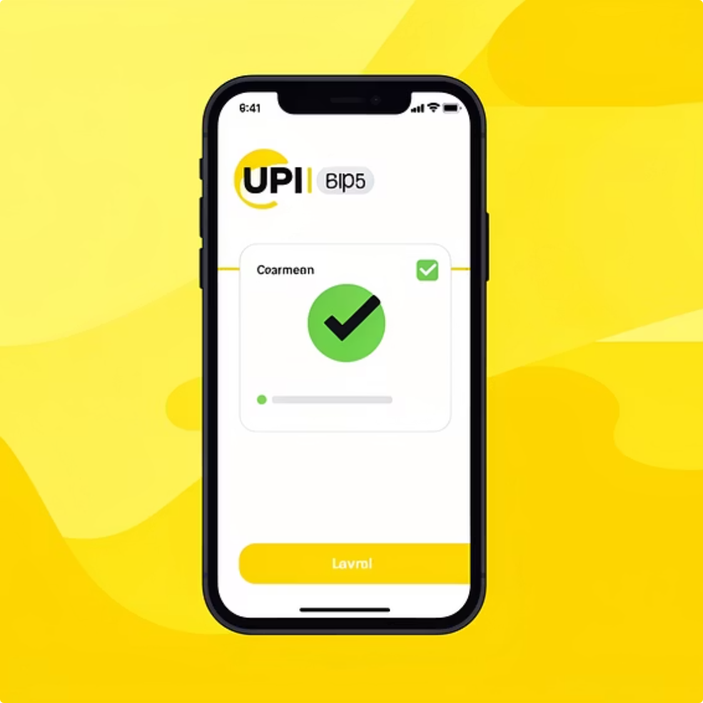

Payment Method Insights
Cash
UPI (Unified Payments Interface)
Cards & Other Digital Wallets
Dominant in specific markets, offering flexibility but requiring driver float.
Growing rapidly, preferred for its convenience and instant transactions.
Consistent usage, offering secure and trackable transactions.
While payment methods vary, the data suggests they are not a primary driver of ride cancellations. The cancellation issue appears largely independent of how customers intend to pay.

Slide 8
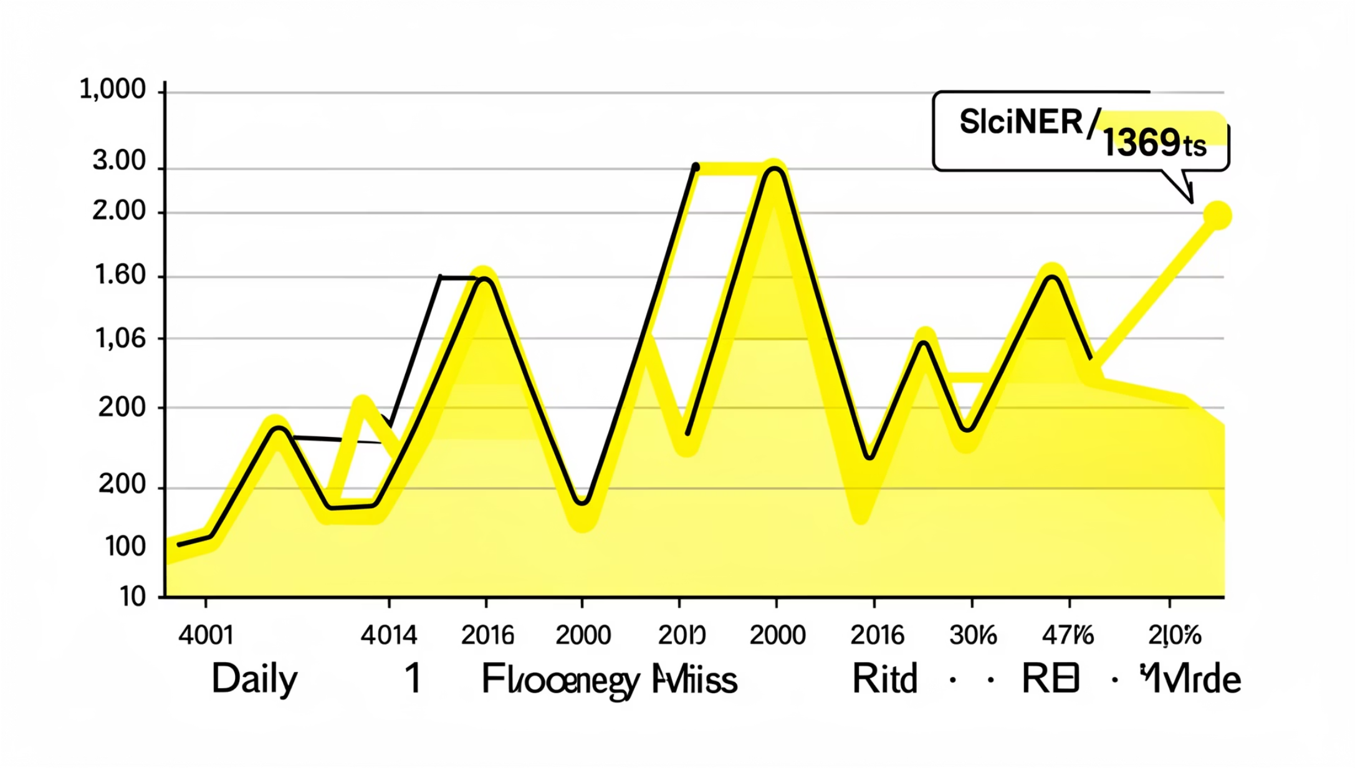
Daily Booking Trends & Volatility
Analysis of daily booking volumes reveals significant volatility throughout July. Peaks and troughs in demand present operational challenges, often contributing to driver unavailability during surge periods.
Managing this fluctuating demand effectively is crucial for maintaining service levels and reducing cancellations, particularly during high-demand windows where supply often lags.

Slide 9




Strategic Recommendations
Optimise Driver Availability
Address Driver Cancellations
Implement dynamic incentives during peak hours to ensure sufficient driver supply.
Introduce penalties for frequent driver-initiated cancellations to encourage commitment.
Incentivise Ride Completion
Enhance Matching Algorithms
Reward drivers for high completion rates and consistent service quality.
Refine ETA accuracy and driver-rider matching logic to minimise "Driver Not Found" instances.

Slide 10

Conclusion & Forward Outlook
Our analysis for July 2024 unequivocally points to supply-side issues as the primary driver of ride cancellations. Addressing driver availability, reducing driver-initiated cancellations, and improving matching efficiency are critical for unlocking significant business value.
By focusing on these operational improvements, we can enhance customer satisfaction, increase revenue from existing demand, and strengthen our market position. There is also considerable scope for future predictive analytics to anticipate demand fluctuations and pre-empt supply-side challenges.

