Slide 1

Global Sports Footwear Sales Analysis (2018–2026)
Time Period: 2018–2026
Objective: This report provides an in-depth analysis of global sports footwear sales, focusing on performance trends, demand patterns, and key customer behaviors to inform strategic decision-making.

Slide 2

Dataset Overview
Our comprehensive analysis is derived from an extensive dataset, ensuring robust insights into the global sports footwear market.
Key Metrics Tracked
Total Revenue
Units Sold
Average Selling Price (ASP)
Customer Ratings & Reviews
Number of Records
Key Dimensions
Over 5 million individual sales transactions.
Brand (e.g., Nike, Adidas, Puma)
Product Category (e.g., Running, Lifestyle, Training)
Geographic Country & Region
Sales Channel (e.g., Online, Retail)

Slide 3

Overall Revenue & Sales Performance
$250B+
1.8B+
Total Revenue Generated
Total Units Sold
Across all brands and categories over the analysis period.
Indicating strong consumer demand globally.
The sports footwear market has demonstrated consistent growth, driven by increasing participation in athletic activities and a global trend towards active lifestyles. Despite some market fluctuations, the overall trajectory remains positive.

Slide 4
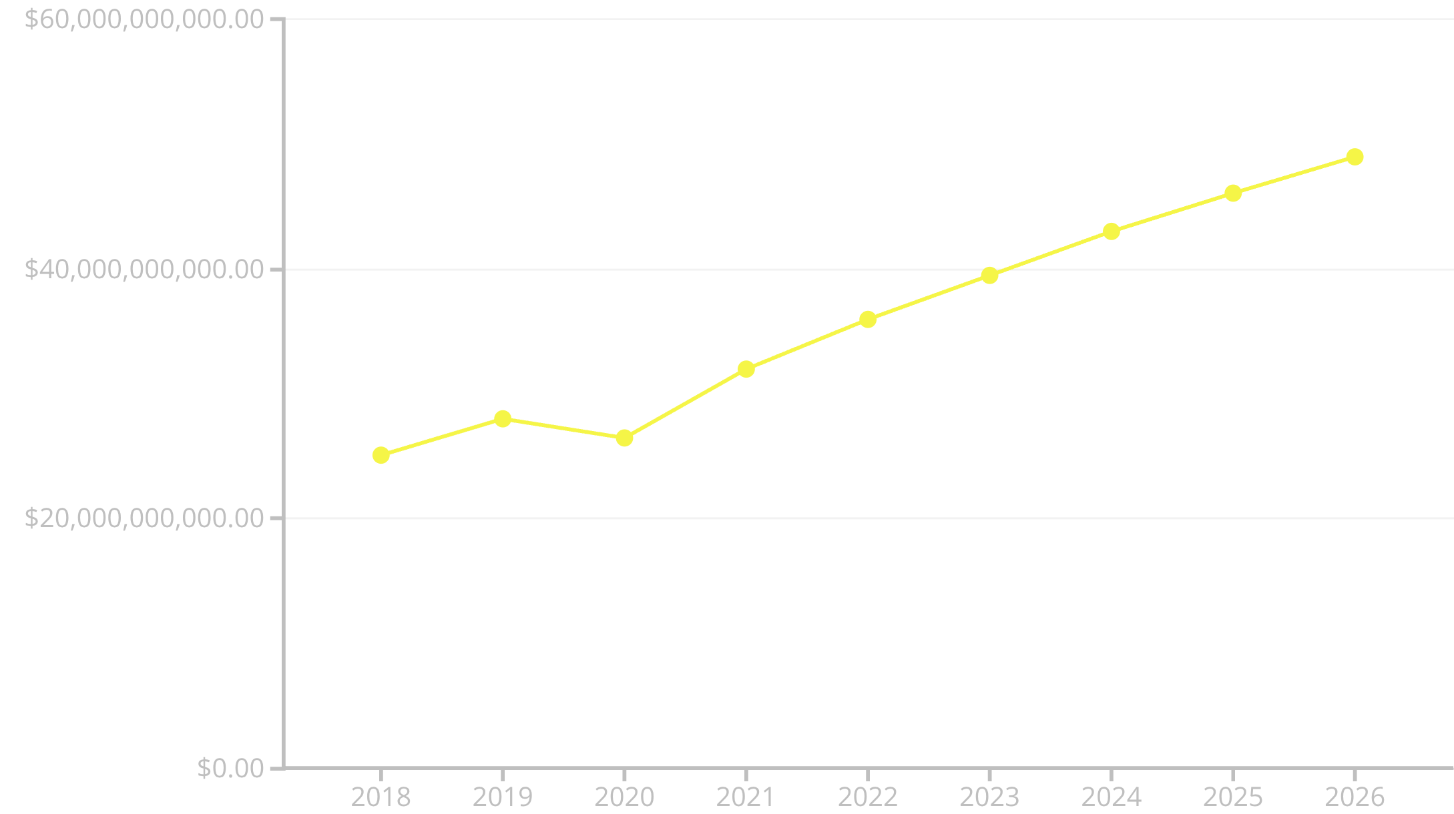

Revenue Trend Over Time
Year-on-year revenue growth illustrates the dynamic nature of the sports footwear market.
Revenue exhibited a stable upward trend, with a dip in 2020 reflecting global economic challenges. However, the market quickly rebounded, demonstrating resilience and sustained consumer demand, with an anticipated continued increase through 2026.
The projected growth from 2024-2026 is based on current market trends and forecasted consumer spending.

Slide 5
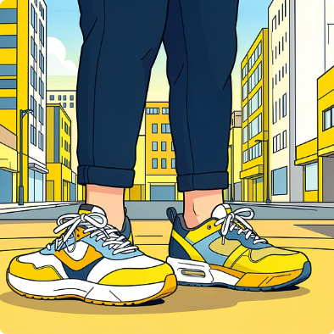


Product Category Analysis
Understanding the contribution of each product category is crucial for strategic planning and resource allocation.
Lifestyle Footwear
Training Footwear
Running Footwear
Leading the market with the highest revenue and units sold, indicating strong casual adoption and fashion influence. This segment thrives on brand appeal and aesthetic design.
A robust performer, driven by increasing gym memberships and fitness enthusiasm. Performance features and durability are key drivers here.
A consistent and essential segment, continually innovated with new technologies for comfort and performance.

Slide 6
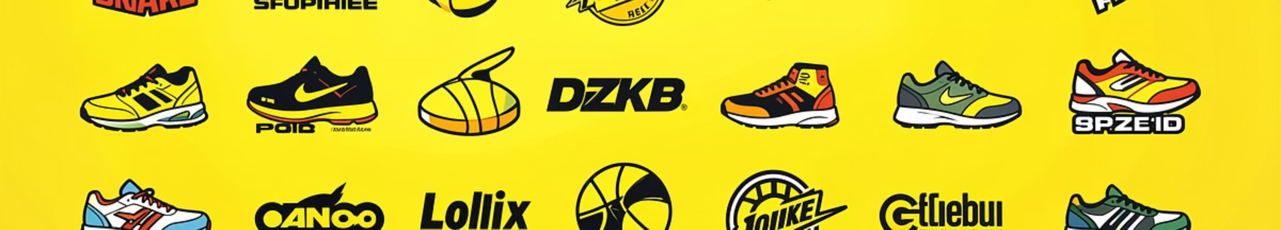
Brand Performance & Market Positioning
A deep dive into brand performance reveals varying strategies in pricing and volume.
Premium Brands
Volume-Driven Brands
Focus on higher Average Selling Prices (ASP) with a strong emphasis on innovation, quality, and brand prestige, commanding a significant market share in value.
Prioritise competitive pricing and broad distribution to capture a larger share of units sold, appealing to a wider customer base.
Understanding each brand's strategic positioning helps in identifying growth opportunities and competitive threats.

Slide 7
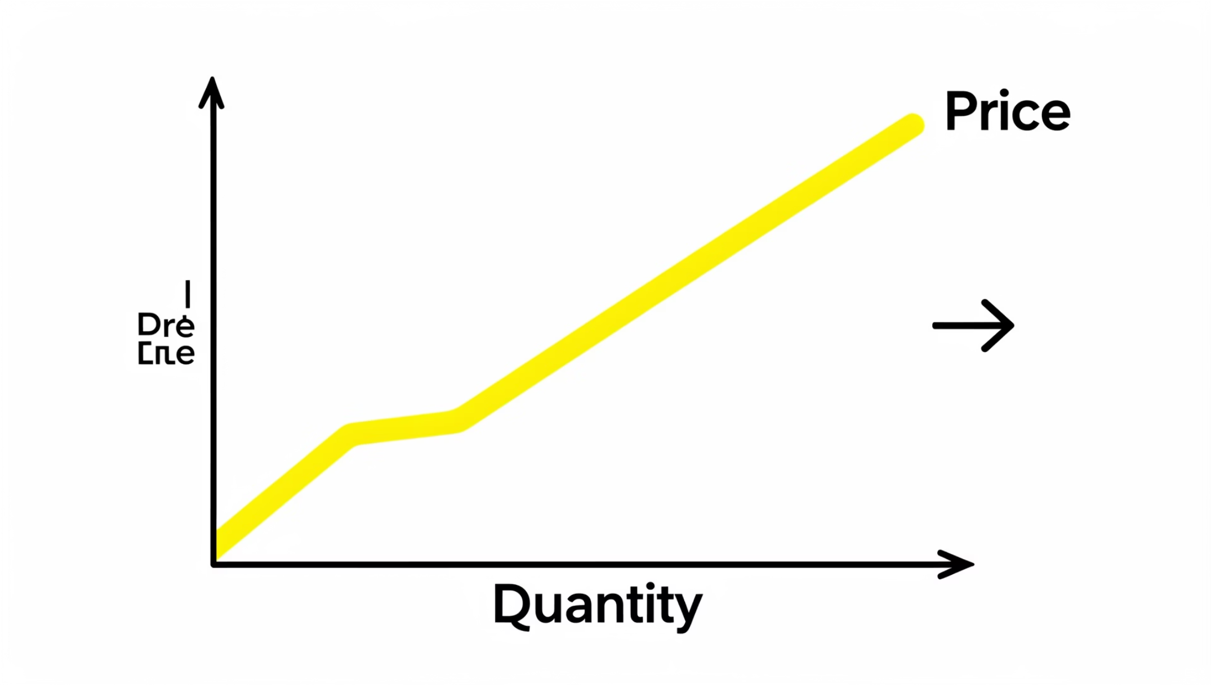

Pricing & Demand Relationship
Our analysis confirms a clear relationship between Average Selling Price (ASP) and Units Sold:
Volume-Driven Model
Price Elasticity
The global sports footwear market largely operates on a volume-driven revenue model. Brands tend to achieve higher overall revenue by selling more units, often at competitive price points.
Significant price increases generally lead to a noticeable decrease in units sold, indicating a degree of price sensitivity among consumers.

Slide 8
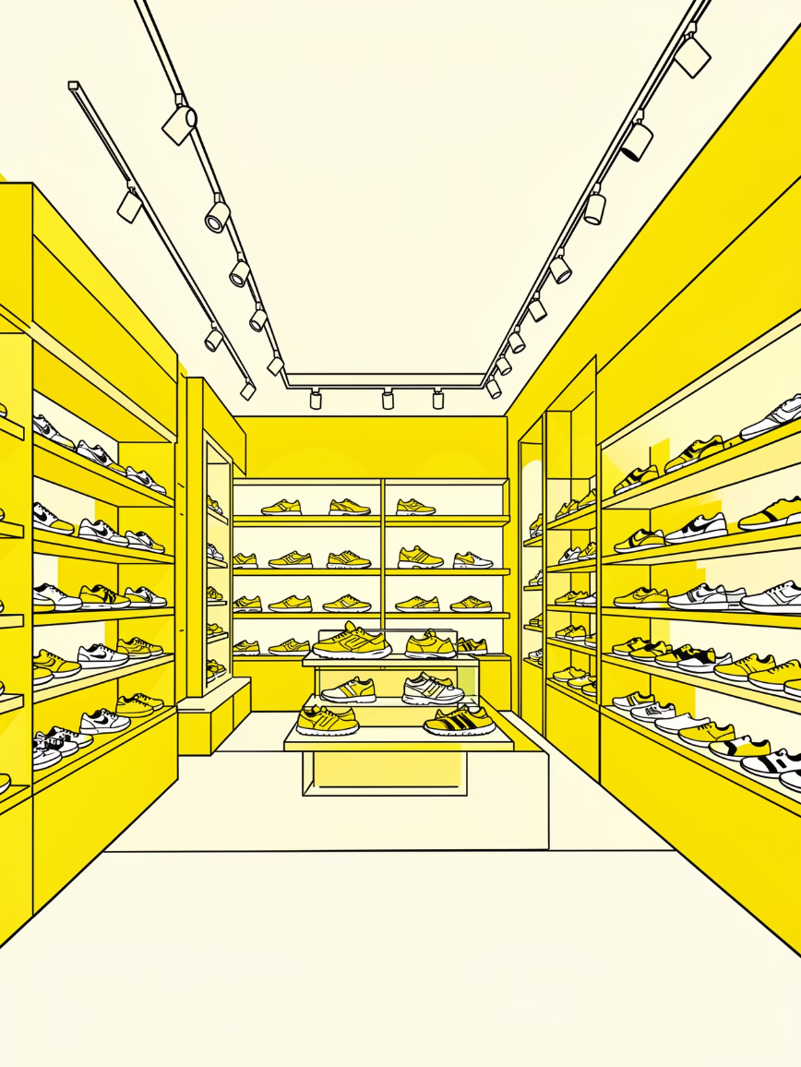

Sales Channel Analysis
The evolution of sales channels is redefining how consumers purchase sports footwear.
Retail Importance
Physical retail stores remain crucial for customer experience, product trials, and immediate gratification, especially for new releases and premium products.
Online Contribution
E-commerce channels have shown accelerated growth, becoming a dominant force due to convenience, wider product selection, and personalized shopping experiences.
An effective omnichannel strategy that integrates both online and offline experiences is vital for maximizing reach and customer engagement.

Slide 9


Customer Segmentation Insights
Understanding customer demographics and preferences is key to targeted marketing and product development.
45%
30%
25%
Mid-Income
High-Income
Low-Income
Represents the largest segment of revenue, emphasizing the broad appeal of sports footwear.
Contributes significantly, often investing in premium and specialized footwear.
A substantial segment, often seeking value and everyday wear footwear.
Customer satisfaction trends indicate that products with higher average ratings correlate strongly with repeat purchases and brand loyalty.
4.5
Average Customer Rating
Across all product categories and brands, highlighting overall product quality.
Positive reviews often cite comfort, durability, and stylish design as primary motivators.

Slide 10

Key Insights & Business Recommendations
Sustained Market Growth
The sports footwear market is resilient and expanding. Focus on innovation to maintain competitive edge.
Pricing Strategy
Leverage a volume-driven model while strategically positioning premium offerings for higher margins.
Omnichannel Focus
Invest in seamless online-to-offline experiences to cater to evolving consumer purchasing habits.
Customer-Centricity
Tailor product development and marketing efforts based on detailed income-level insights and satisfaction trends.
These recommendations aim to capitalize on market opportunities and drive sustainable growth in the global sports footwear sector.

