Slide 1

Title
Machine Learning Model
Subtitle
Predicting Crystal Structures
based on chemical properties
MINOR-PROJECT
M ANEESH
822112 , MME , Btech-2yr

Slide 2
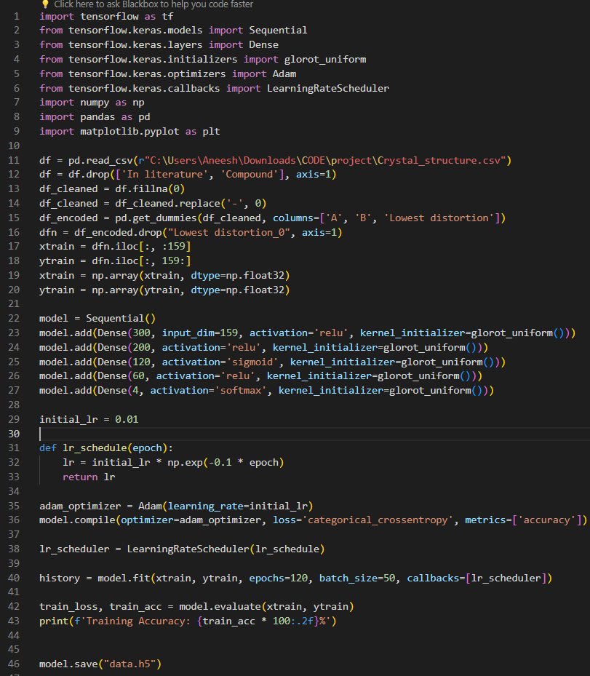
MODEL SETUP AND ARCHITECURE
A total of 5329 chemical compounds and their properties are used.
A deep neural network of 4 layers with 700 neurons is used
A learning rate decay is applied at every epoch on Adam optimizer and parameters are initialized using Xavier initialization
Input is one-hot encoded of (1,159) dimensions and output gives probabilities of crystal structures of 4 different types
Sigmoid are added in between the layers to avoid exploding gradients and final layer has softmax activation

Slide 3
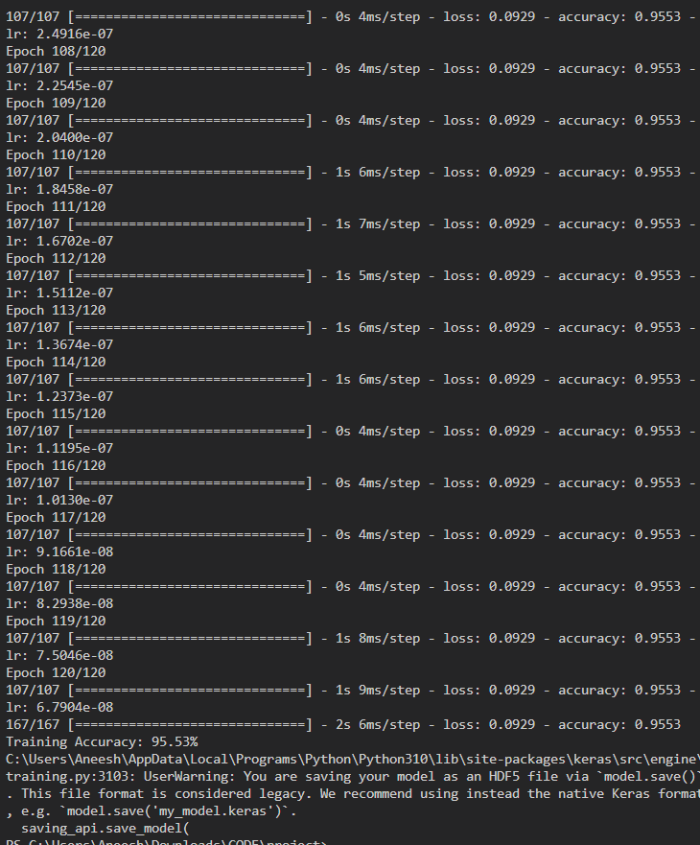
TRAINING RESULTS
Training is performed on 120 epochs with batch size of 50
Accuracy of 95.53% was achieved on just a single training job
The model weights are saved in a h5 file for predicting

Slide 4
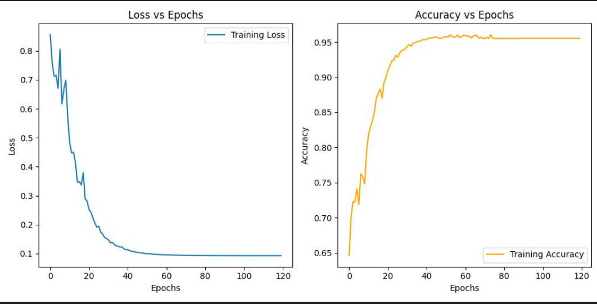
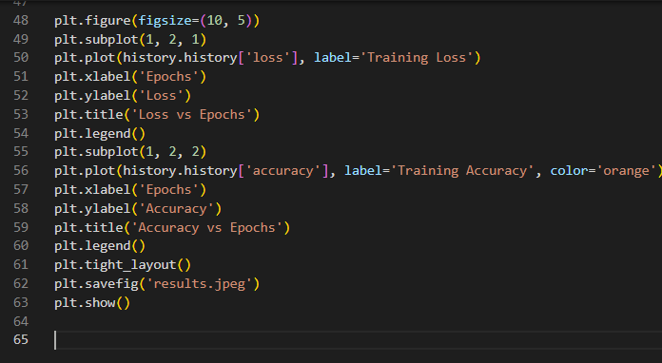
TRAINING GRAPHS
The following code snippet is used to get the results using matplotlib to plot the graphs

Slide 5
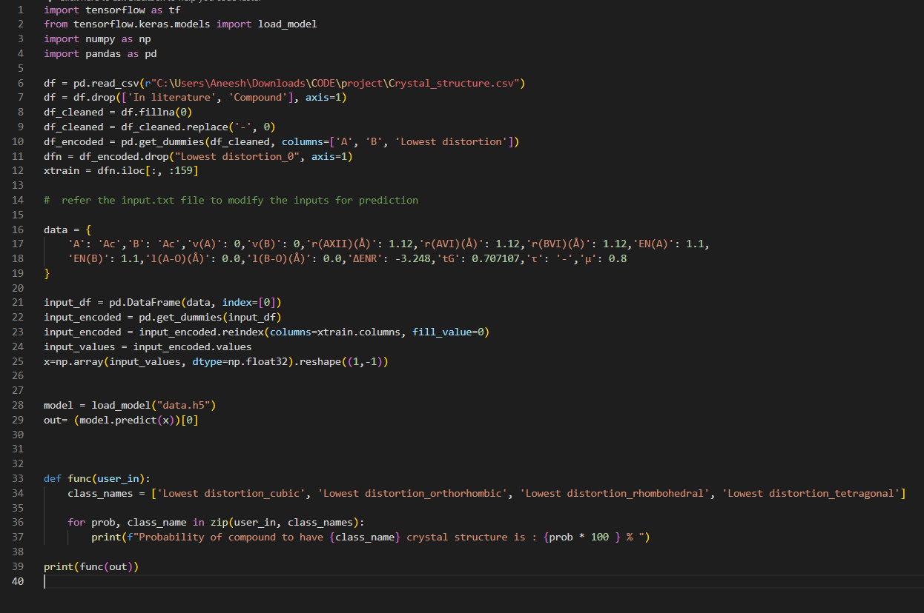
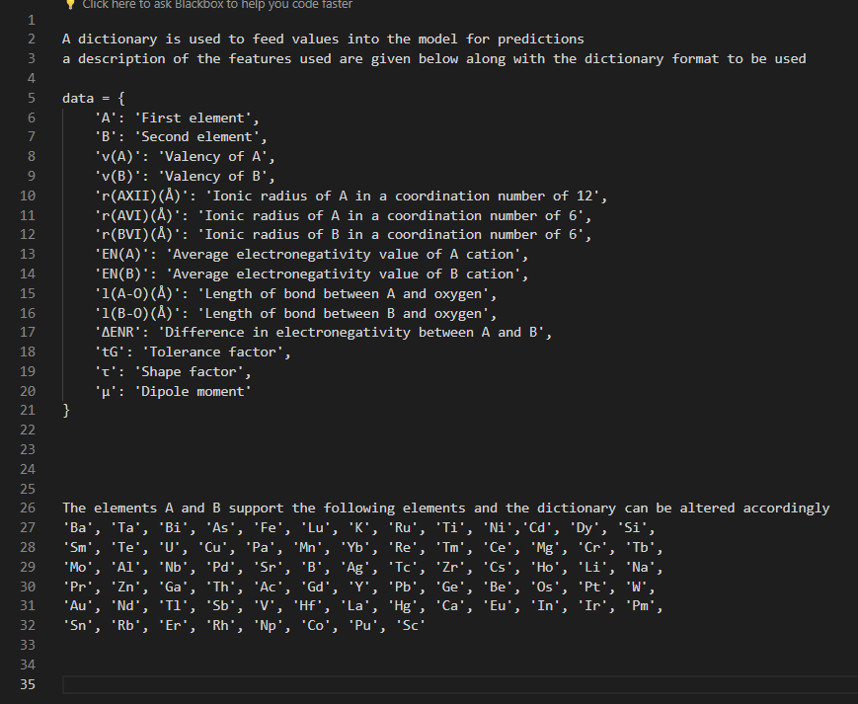
INSTRUCTIONS FOR CUSTOM PREDICTIONS
The following txt file and code snippet contains details on how to use the model for predictions on the desired chemical properties

Slide 6


CODE REPOSITORY
Checkout the GitHub repo for details on my project and for the code
aneeshm11/Minor-Project-822112 (github.com)

