Slide 1
Detect Retina Damage From OCT Images
IST 718: Big Data Analytics
Group No: 5
Group Members:
1) Aneesh Phatak
2) Xuaranran Ji
3) Avin Deshmukh

Slide 2
Motivation Behind the Project
To help ophthalmologist identify the retinal diseases more accurately and efficiently in less time
Types of diseases could be helpful from this project:
Age related muscular degeneration (most of the senior citizens suffer from AMD)
Diabatic retinopathy(DR)
Glaucoma (Can cause 9-12 % blindness)
Early detection of this diseases
To make the image analysis of retinas less tedious

Slide 3
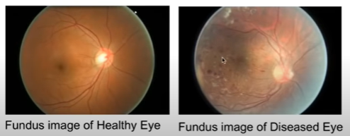
Image of Retina in Fundus Photography

Slide 4
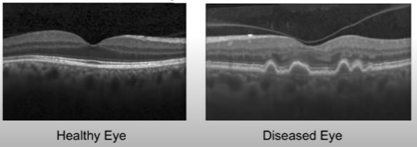
Image of Data in Optical Coherence Tomography
Capable of imaging cross-sectional view of the retina
Can construct 3D image of the retina
Retinal optical coherence tomography (OCT) is an imaging technique used to capture high-resolution cross sections of the retinas of living patients.

Slide 5
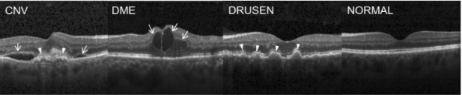
Types of Diseases focused in this project
choroidal neovascularization (CNV)
Diabetic macular edema (DME)
Multiple Drusen

Slide 6
Overview of the data
Training – 83,484 images which was pre-classified as follows:
NORMAL – 26,315
CNV – 37,205
DME – 11,348
DRUSEN – 8,616
Validation – 8 images in each category(32 total)
Test – 242 images in each category (968 total)

Slide 7
Transfer Learning
Used to prevent training of deep neural network from scratch, which would require a significant amount of data, power and time.
It's often convenient to use a pretrained model and just finetune its performance to simplify and speed up the process.
We used three keras models pre-trained on the ImageNet dataset and based on CNN architecture which use the concept of transfer learning
VGG-16
InceptionV3
ResNet50
Before we move on to apply models, it is necessary to pre-process the image data

Slide 8
Pre-processing
Images were not of uniform size or orientation.
ImageDataGenerator rescales and accounts for data which is rotated or horizontally flipped.
Processed training data is fed to the CNN network in specified batch sizes and dimensions

Slide 9
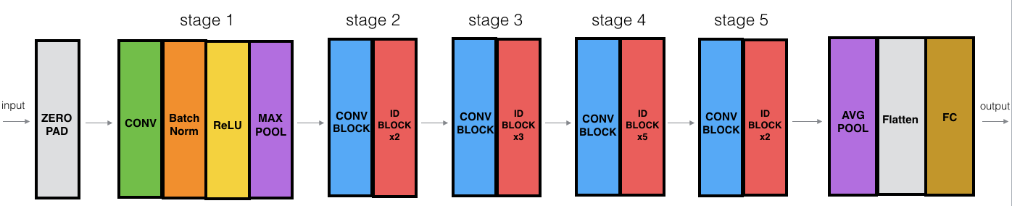
ResNet50 Model
Each convolution block has 3 convolution layers and each identity block also has 3 convolution layers. The ResNet-50 has over 23 million trainable parameters.
However, the accuracy achieved on the test dataset was 0.85 which is much lesser than the other two models.
Consists of 5 stages, 50 layers.

Slide 10
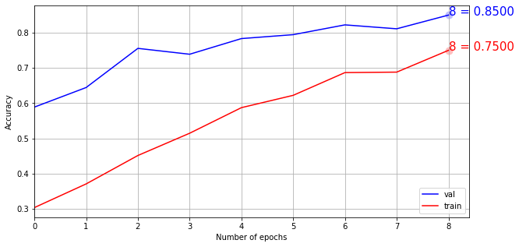
Increasing accuracy of ResNet50
Increasing number of epochs
Initializing model with pre-trained weights

Slide 11
VGG16 Model
CNN(Convolutional Neural Network) : One of class in deep neural networks that mostly used to analyze visual images.
Idea of CNN: people respond to visual stimuli only in restricted region. The receptive fields of restricted region overlap on each other.
VGG-16: A convolutional neural network that is 16 layers deep.

Slide 12
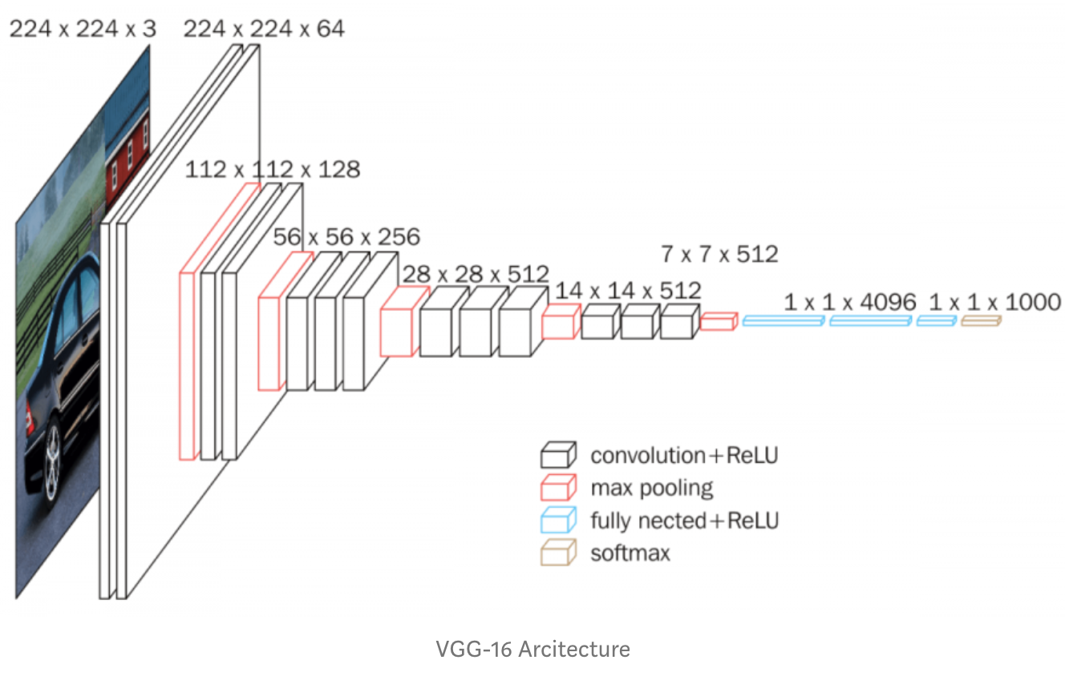
VGG16 Model
A CNN has 4 types of layers
Convolutional layers
ReLU layers
Pooling layers
a Fully connected layer

Slide 13
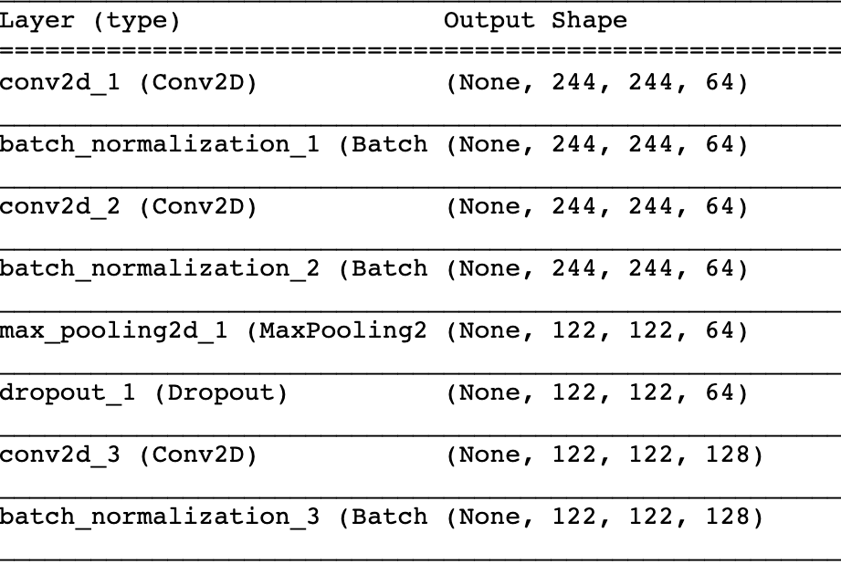
vgg16_model().summary()

Slide 14
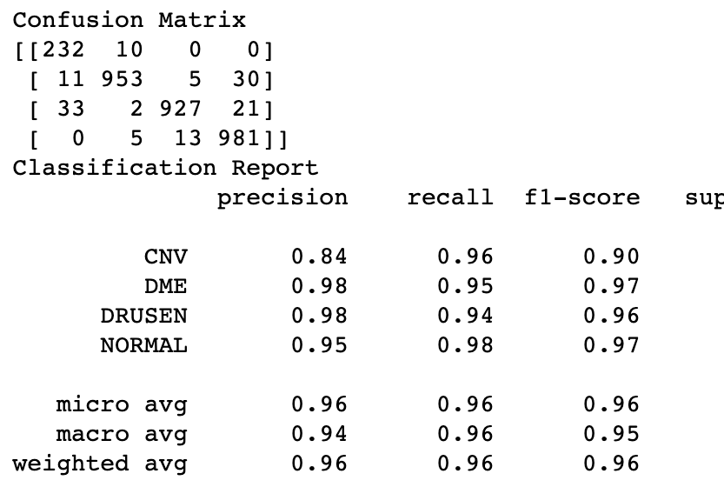
Evaluate VGG16 Model

Slide 15
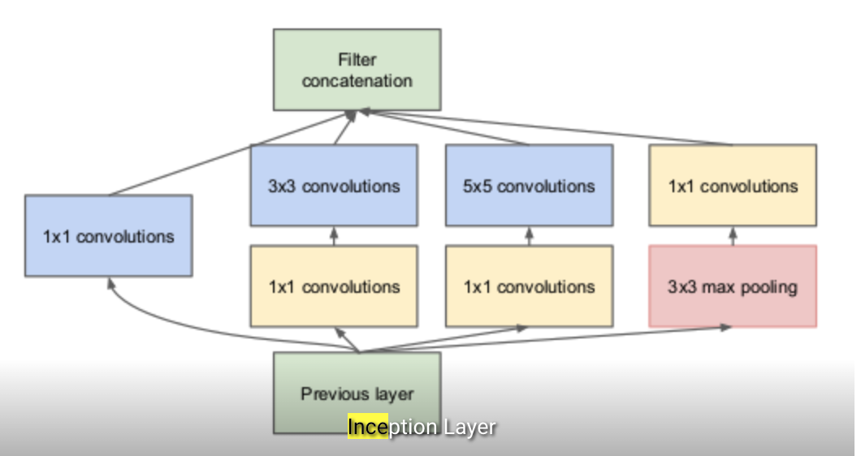
Inception V3 Model
The idea:
Inception Layer is a combination of 1×1 Convolutional layer, 3×3 Convolutional layer, 5×5 Convolutional layer, by concatenated their output into a single output vector.

Slide 16
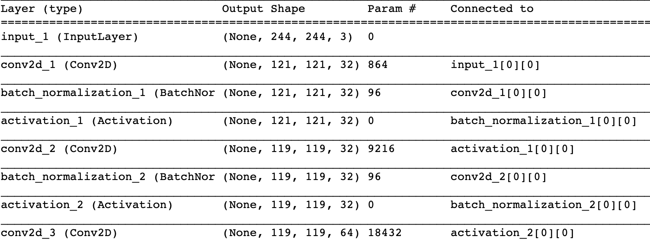
Model Summary

Slide 17
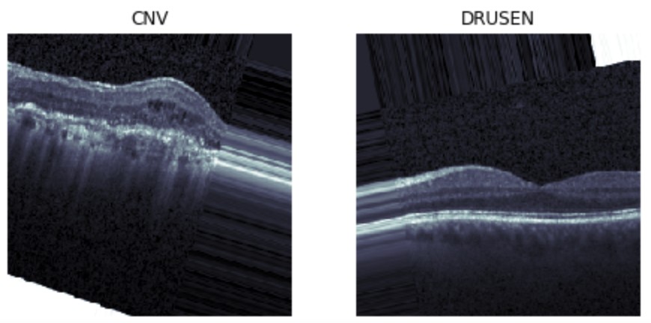
Test the mode to identify CNV, DME,DRUSEN, Normal
Correctly identified CNV and DRUSEN by using the V3 Model
Model Accuracy 0.92

