Slide 1

Spotify Data Analysis -Warehouse and Pipelines
Insights into User Engagement with Spotify Albums -Anees Saheba Guddi

Slide 2
Abstract
Spotifyzer analyzes Spotify data to uncover patterns in music trends, listener behavior, and audio feature impact.
Built with a robust ETL pipeline and cloud data warehouse (AWS and Snowflake) for scalable data processing.
Power BI dashboards visualize key insights like most played tracks, listening patterns, and artist popularity.
Helps artists, labels, and marketers make data-driven decisions to predict and promote hit songs.

Slide 3
Problem Statement
There are vast amount of user interaction data generated on platforms like Spotify, stakeholders in the music industry lack an integrated, data-driven tool to analyze how audio features, user behavior, and track popularity intersect.
Spotifyzer aims to fill this gap by building a comprehensive data warehousing and analytics solution that converts raw streaming data into actionable insights.

Slide 4
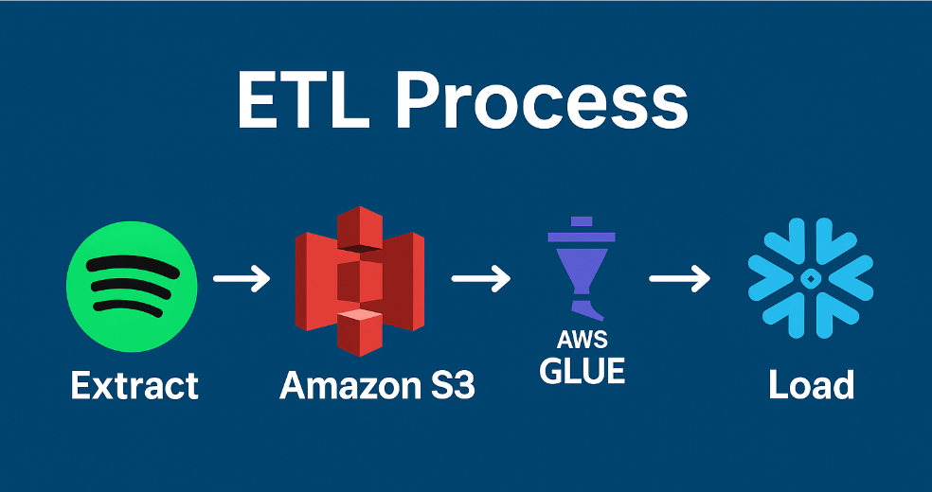
DASHBOARD OVERVIEW
•Three panels: Albums, Artists, Tracks
•Platform slicer allows device-based behavior filtering (Android, Mac, Windows)
•Visuals include listening trends, top items, and weekday/weekend engagement
•Year-over-Year comparison for deep trend analysis

Slide 5
ETL Process in Spotifyzer
Extract (E)
Source: Spotify Web API
Data Retrieved:
Track metadata: name, artist, album, release date
User interaction data: popularity, play count, device type
Tool Used: Python (requests, spotipy)
Frequency: Daily/weekly ingestion
Transform (T)
Environment: AWS Glue + Python (Pandas)
Steps Performed:
Data Cleaning: Removed nulls, standardized formats
Feature Engineering:
Created mood-based categories using sentiment + audio features
Data Enrichment: Joined with external data (e.g., genre, mood tags)
Normalization: Standardized numerical features for analysis

Slide 6
Data Cleaning and Preparation
Removed null, blank, or missing records to ensure data quality.
Standardized column names (e.g., converted to lowercase, replaced spaces with underscores).
Filtered and dropped duplicate entries to maintain unique and accurate records.
Converted date columns into consistent datetime formats. Ensured numeric columns were stored with appropriate data types (e.g., ms_played as integer). Verified data consistency across columns such as artist, album, and track names.

Slide 7
ETL Process in Spotifyzer
Load (L)
Destination: Snowflake (Data Warehouse)
Partitioned by: year, genre, and sentiment score
Schema:
Fact Table: Streaming Events (plays, timestamps, track ID)
Dimension Tables: Tracks, Artists, Audio Features, Users
Purpose: Fast querying, aggregation, and Power BI dashboarding
Automation & Logging
ETL orchestrated using AWS Glue Jobs + Crawler
Logs and errors tracked in CloudWatch

Slide 8
Dashboard Overview
Three panels: Albums, Artists, Tracks
Platform slicer allows device-based behavior filtering (Android, Mac, Windows)
Visuals include listening trends, top items, and weekday/weekend engagement
Year-over-Year comparison for deep trend analysis

Slide 9
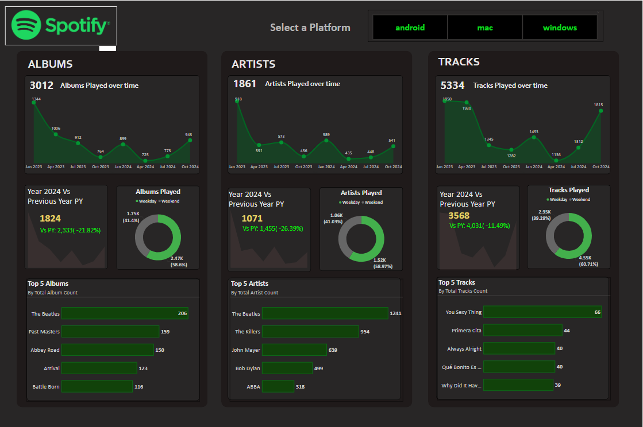

Slide 10
Albums Insights
Total albums played: 3012
2024 saw 1,824 albums played vs. 2,333 in previous year (↓21.82%)
59% of album plays occurred on weekends
The Beatles' albums dominated top plays (e.g., 206 plays for top album)
Seasonal dip in mid-2023, recovery by late 2024

Slide 11
Artists Insights
Total artists played: 1,861
2024 artist count dropped by 26.39% compared to previous year
Listening activity stronger on weekends (59%)
The Beatles lead artist plays with 1,241 listens
Reflects user loyalty and popularity of legacy artists

Slide 12
Tracks Insights
Total tracks played: 5,334
2024 saw 11.49% fewer tracks played compared to 2023
60.71% of track plays happened on weekends
Top track: 'You Sexy Thing' with 66 plays
High frequency suggests repeated listening habits

Slide 13
Listening Patterns
Heatmap shows peak listening hours between 6 PM – 2 AM, especially weekends
Scatterplot reveals most tracks played 10–25 times with 2–4 min avg. listen time
Behavior filters like Shuffle, Skipped enhance segmentation
Identifies high/low engagement tracks through quadrant analysis

Slide 14
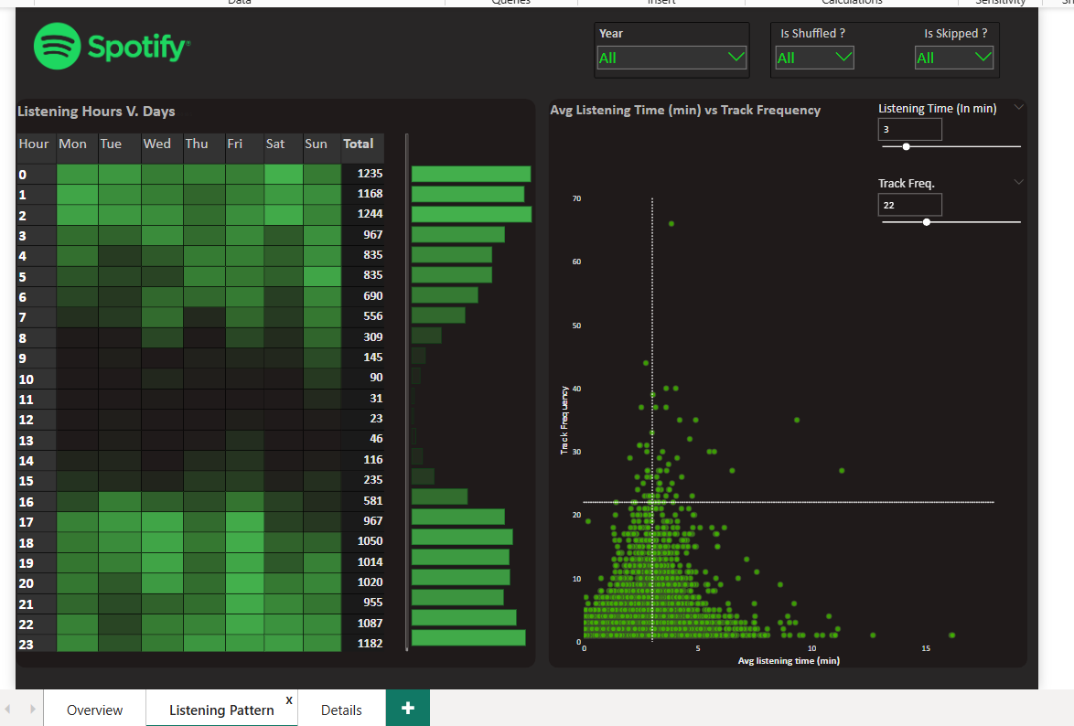

Slide 15
Details Grid Features
Grid displays Album, Artist, Track, and Listening Time
Supports drill through and data export (CSV)
Enables drill down/up navigation across album-track-artist hierarchy
Helpful for identifying patterns in album engagement

Slide 16
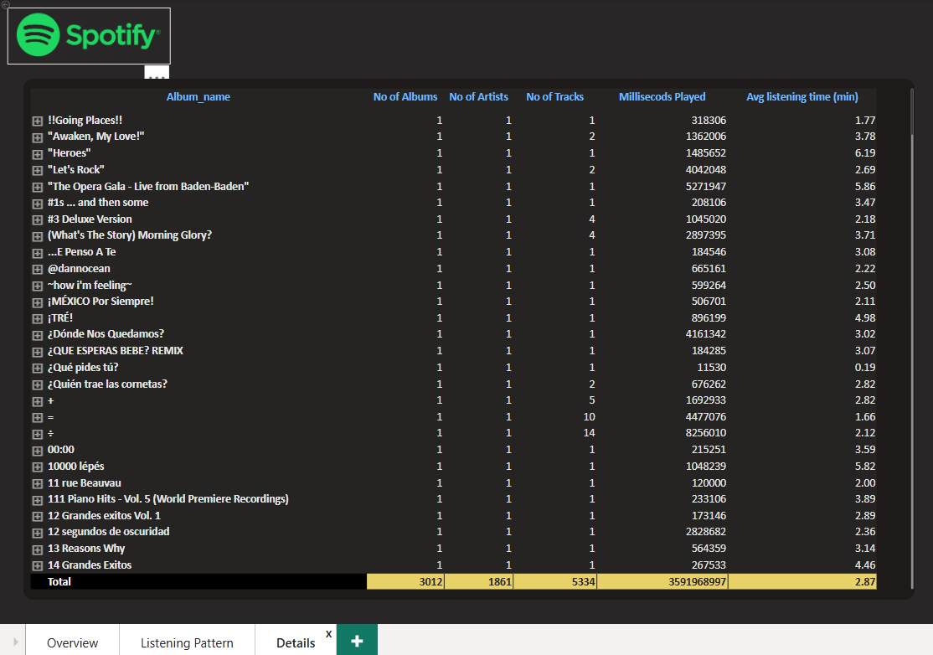

Slide 17
Key Insights Summary
~59% of listening happens on weekends
Peak listening occurs between 6 PM and 2 AM
The Beatles remain the most played artist and album
Average track play duration is 2–4 mins, repeated 10–25 times

Slide 18
Key Learning/ Lesson Learned
Data Engineering: We gained practical experience while working with ETL pipelines, starting from extracting till storing on cloud.
Scalability Challenges: Learned how important it is to design pipeline that can deal with large-scale, real-time data smoothly.
Visualization: Understood how to build dashboards in Power BI that turns data into story.
Collaboration: Experienced strong team coordination using Git, task sharing and regular team catch-ups.

Slide 19
Technical Experience
ETL Pipeline Creation: Designed and implemented a full ETL flow from Spotify API to Snowflake using Python.
Data Transformation: Used AWS GLUE for cleaning, normalizing, and feature engineering on high-volume music data.
Data Warehousing: Built and maintained schema in Snowflake to support analytical queries and dashboard integrations.
Visualization: Developed interactive dashboards in Power BI to display music trends, popular artists, and feature-based insights.
API Handling: Overcame real-time API rate limits and implemented retry/backoff logic for scalable extraction.

Slide 20
THANK YOU

