Slide 1
Programming Fundamentals in C++
(Practical#13)

Slide 2
Objective: Graphics
graphics.h graphics library used to draw lines, rectangles, ovals, arcs, polygons, images, and strings on a graphical window.
library is used to include and facilitate graphical operations in program.
graphics.h functions can be used to draw different shapes, display text in different fonts, change colors and many more.
Using functions of graphics.h you can make graphics programs, animations, projects and games. You can draw circles, lines, rectangles, bars and many other geometrical figures.
<graphics.h> is very old library. It's better to use something that is new
Here are some 2D libraries (platform independent) for C/C++
SDL
GTK+
Qt
Also there is a free very powerful 3D open source graphics library for C++
OGRE

Slide 3
<graphics.h> is very old library. It's better to use something that is new
Here are some 2D libraries (platform independent) for C/C++
SDL
GTK+
Qt
Also there is a free very powerful 3D open source graphics library for C++
OGRE

Slide 4
First graphics program (Draw a line)
#include<graphics.h>
#include <conio.h>
int main() {
int gd = DETECT, gm;
initgraph(&gd, &gm, "C:\\TC\\BGI");
circle(300,300,50);
closegraph();
getch(); }
#include<graphics.h>
#include <conio.h>
int main()
{
int gdriver=DETECT, gmode;
initgraph(&gdriver,&gmode, "C:\\TC\\BGI");
delay(2000);
line(100,100,200,100);
getch();
closegraph();
}

Slide 5
Explanation of Code :
include<graphics.h>
The first step in any graphics program is to include graphics.h header file.
The second step is initialize the Initializes the graphics system. i.e
graphics drivers on the computer using initgraph method of graphics.h library.
void initgraph(int *graphicsDriver, int *graphicsMode, char *driverDirectoryPath));
The initgraph function- Initializes the graphics system.
In C++ Program execution starts with main() similarly Graphics Environment Starts with this function.
initgraph() initializes the graphics system by loading a graphics driver from disk (or validating a registered driver) then putting the system into graphics mode.

Slide 6
void initgraph(int *graphicsDriver, int *graphicsMode, char *driverDirectoryPath));
initgraph initializes the graphics system by loading a graphics driver from disk (and putting the system into graphics mode.
graphicsDriver : It is a pointer to an integer specifying the graphics driver to be used. It tells the compiler that what graphics driver to use or to automatically detect the drive. In all our programs we will use DETECT macro of graphics.h library that instruct compiler for auto detection of graphics driver.
graphicsMode : It is a pointer to an integer that specifies the graphics mode to be used. If *gdriver is set to DETECT, then initgraph sets *gmode to the highest resolution available for the detected driver.
driverDirectoryPath : It specifies the directory path where graphics driver files (BGI files) are located. If directory path is not provided, then it will search for driver files in current working directory directory. In all our sample graphics programs, you have to change path of BGI directory accordingly where you Turbo C++ compiler is installed.

Slide 7
we have passed three arguments to initgraph function first is the address of gdriver, second is the address of gmode and third is the path where your BGI files are present (you have to adjust this accordingly where you Turbo C compiler is installed).
Initgraph function automatically decides an appropriate graphics driver and mode such that maximum screen resolution is set,
getch helps us to wait until a key is pressed,
closegraph function closes the graphics mode, and finally return statement returns a value 0 to main indicating successful execution of the program.
After you have understood initgraph function then you can use functions to draw shapes such as circle, line , rectangle, etc.,

Slide 8
closegraph deallocates all memory allocated by the graphics system, then restores the screen to the mode it was in before you called initgraph. (The graphics system deallocates memory, such as the drivers, fonts, and an internal buffer, through a call to _graphfreemem.)
-lbgi
-lgdi32
-luser32
-lcomdlg32
-luuid
-loleaut32
-lole32

Slide 9
line Function Draws Line From (x1,y1) to (x2,y2) .
Syntax : line(x1,y1,x2,y2);
x1 - X Co-ordinate of First Point
y1 - Y Co-ordinate of First Point
x2 - X Co-ordinate of Second Point
y2 - Y Co-ordinate of Second Point
At the end of our graphics program, we have to unloads the graphics drivers and sets the screen back to text mode by calling closegraph () function.

Slide 10

Examples:
For line 1, Input : x1 = 150, y1 = 150, x2 = 450, y2 = 150
For line 2, Input : x1 = 150, y1 = 200, x2 = 450, y2 = 200
For line 2, Input : x1 = 150, y1 = 250, x2 = 450, y2 = 250
Output :

Slide 11
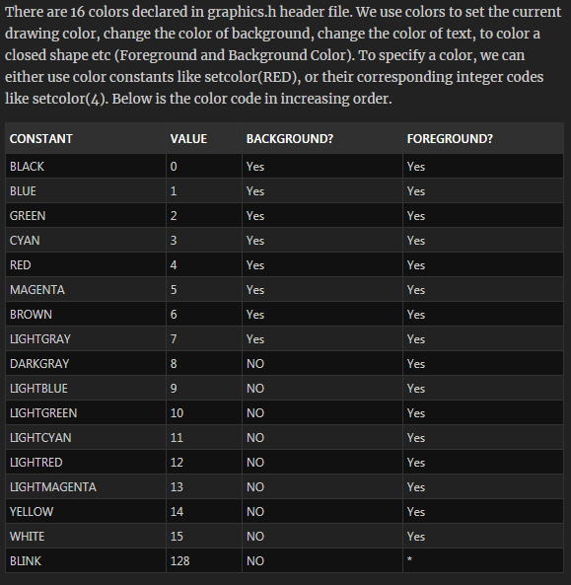
Colors in C++ Graphics Programming
***** To display blinking
characters in text mode,
add BLINK to the foreground
color. (Defined in conio.h)

Slide 12
int initwindow(int width, int height, const char* title="Windows BGI", int left=0, int top=0, bool dbflag=false, closeflag=true);
Description
The initwindow function is available in the winbgim implementation of BGI graphics.
The function initializes the graphics system by opening a graphics window of the specified size. The first two parameters (width and height) are required, but all other parameters have default values.
The title parameter is the title that will be printed at the top of the window (with a default of "Windows BGI".) If this is set to the empty string (no characters), then the window will be opened without a title bar or border (typically used for a popup message that the user can then close by clicking),
and the user will not be able to move this window. If you want a title bar with no visible title, then set the title to a string containing one space.
The left and top parameters determine the screen coordinates of the left and top sides of the window.
The dbflag parameter determines whether double-buffering for the window is automatically turned on as described in the swapbuffers function (true means that double-buffering will be turned on).
If the closeflag parameter is true, then the user can click on the window's close button to shut down the entire program.

Slide 13
The Borland Graphics Interface, also known as BGI, is a graphics library bundled with several Borland compilers for the DOS operating systems since 1987.
BGI was also used to provide graphics for many other Borland products including the Quattro Pro spreadsheet.
The library loaded graphic drivers (*.BGI) and vector fonts (*.CHR) from disk in order to provide device independent graphics support.
It was possible for the programmer to embed the graphic driver into the executable file by linking the graphic driver as object code with the aid of a utility provided by the compiler (bgiobj.exe).
There were graphic drivers for common graphic adapters and printers of that time, such as CGA, EGA and VGA. There also were BGI drivers for some kinds of plotters.

Slide 14
<graphics.h> is very old library. It's better to use something that is new
Here are some 2D libraries (platform independent) for C/C++
SDL
GTK+
Qt
Also there is a free very powerful 3D open source graphics library for C++
OGRE

Slide 15
windows.h is a Windows-specific header file for the C and C++ programming languages which contains declarations for all of the functions in the Windows API, all the common macros used by Windows programmers, and all the data types used by the various functions and subsystems. It defines a very large number of Windows specific functions that can be used in C. The Win32 API can be added to a C programming project by including the <windows.h> header file and linking to the appropriate libraries. To use functions in xxxx.dll, the program must be linked to xxxx.lib (or libxxxx.dll.a in MinGW). Some headers are not associated with a .dll but with a static library (e.g. scrnsave.h needs scrnsave.lib).

Slide 16
There are a number of child header files that are automatically included with windows.h.
Many of these files cannot simply be included by themselves (they are not self-contained), because of dependencies.
windows.h may include any of the following header files:
excpt.h – Exception handling
stdarg.h – variable-argument functions (standard C header)
windef.h – various macros and types
winnt.h – various macros and types (for Windows NT)
basetsd.h – various types
guiddef.h – the GUID type
ctype.h – character classification (standard C header)
string.h – strings and buffers (standard C header)
winbase.h – kernel32.dll: kernel services; advapi32.dll:kernel services(e.g. CreateProcessAsUser function),
access control(e.g. AdjustTokenGroups function).
winerror.h – Windows error codes
wingdi.h – GDI (Graphics Device Interface)
winuser.h – user32.dll: user services
winnls.h – NLS (Native Language Support)
wincon.h – console services
winver.h – version information
winreg.h – Windows registry
winnetwk.h – WNet (Windows Networking)
winsvc.h – Windows services and the SCM (Service Control Manager)
imm.hhh – IME (Input Method Editor)

