Slide 1
C#.net team project Super Mario 3D (game)
design by: Qian gao
& Anita Mirshahi

Slide 2





description of Game
This is a 3D game designed for all age groups to entertain themselves, using the Unity 3D with C# script and some tools as left.

Slide 3
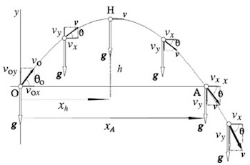
Main features & functionalities
Logic:
Game logic
Physical logic
gravity, collider, friction, mass, speed parabola

Slide 4
Main features & functionalities
AI
NPC (non-player character) interactive
Audio
Music: menu, background
Sound: Jumping, moving, running, coin, plants

Slide 5

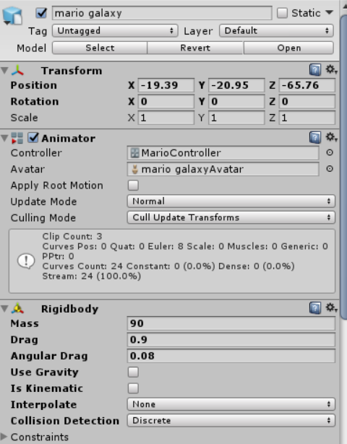
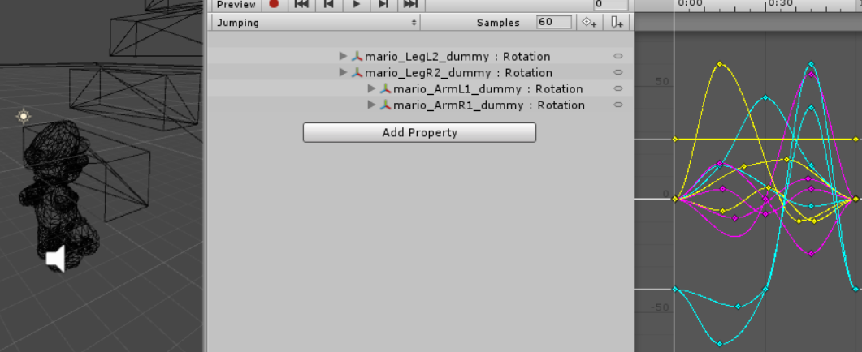
Main features & functionalities
Display
Animation System: Control the animation
Underlay rendering; generating photorealistic or non-photorealistic image from 3D model and display on screen

Slide 6
Challenges
3D models(collada)
Design & makes the characters, maps
Animation design
C# script implement the kinematic

Slide 7

Solutions and technologies:
SketchUp, Maya
Mecanim Animation System
Audio processing

Slide 8
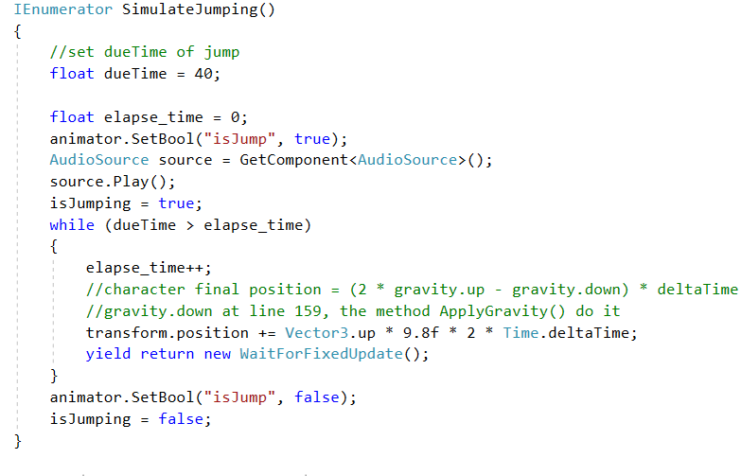
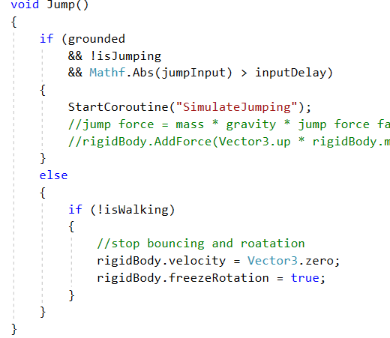
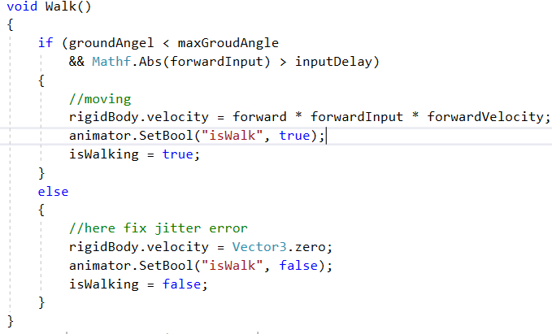
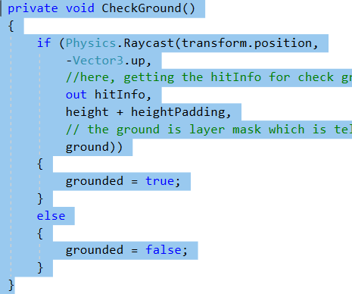
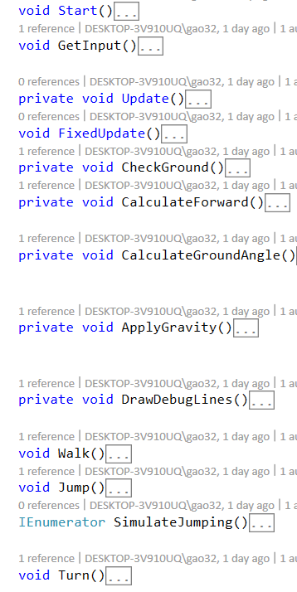
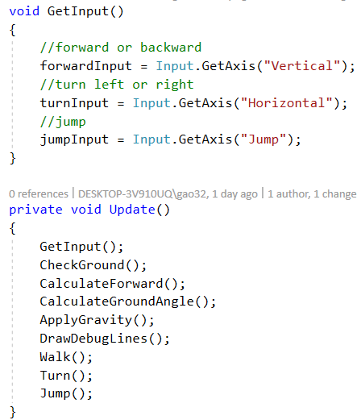
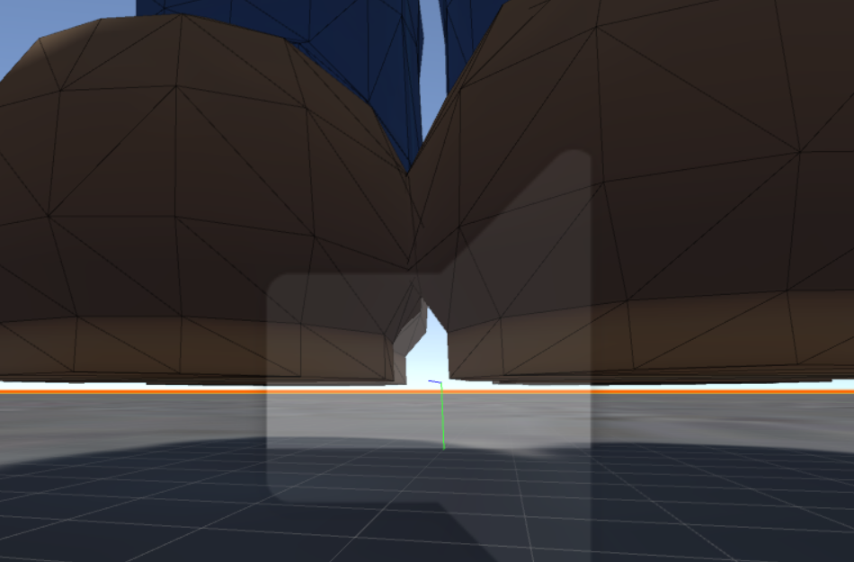
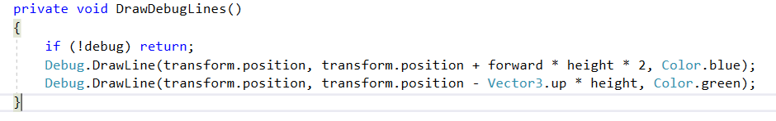
Code

Slide 9
What we learned
Using C # to make a 3D game
Learned Unity 3D(game engine), Tiled map editor, Maya, SketchUp, Mecanim animation system.

Slide 10
Future work
User can play with another player as online video game
1
User can store and retrieve game data
2
Expand the game logic and map
3

Slide 11
Conclusion
“Great question. Any other questions ?”

