Slide 1
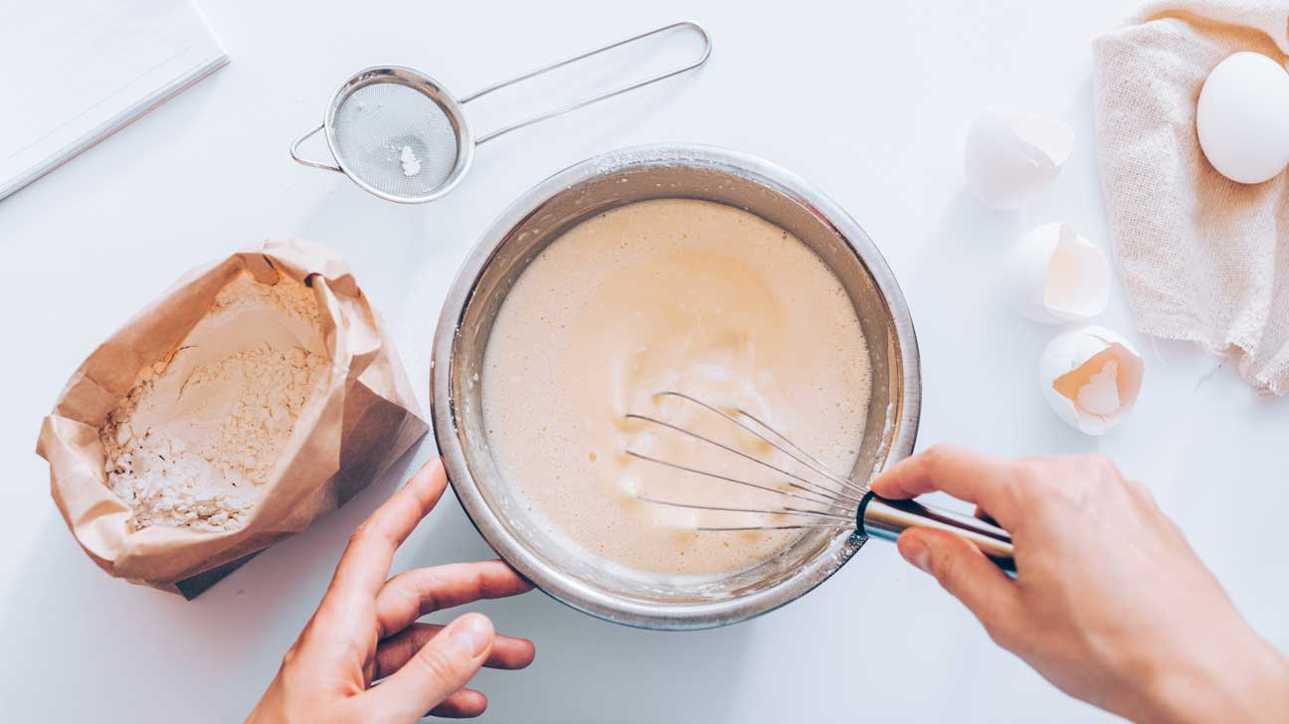
BAKERS LOUNGE
By
Aneeta L R
Under The Guidance Of
Mrs. Minnu Martha

Slide 2
INTRODUCTION

Slide 3
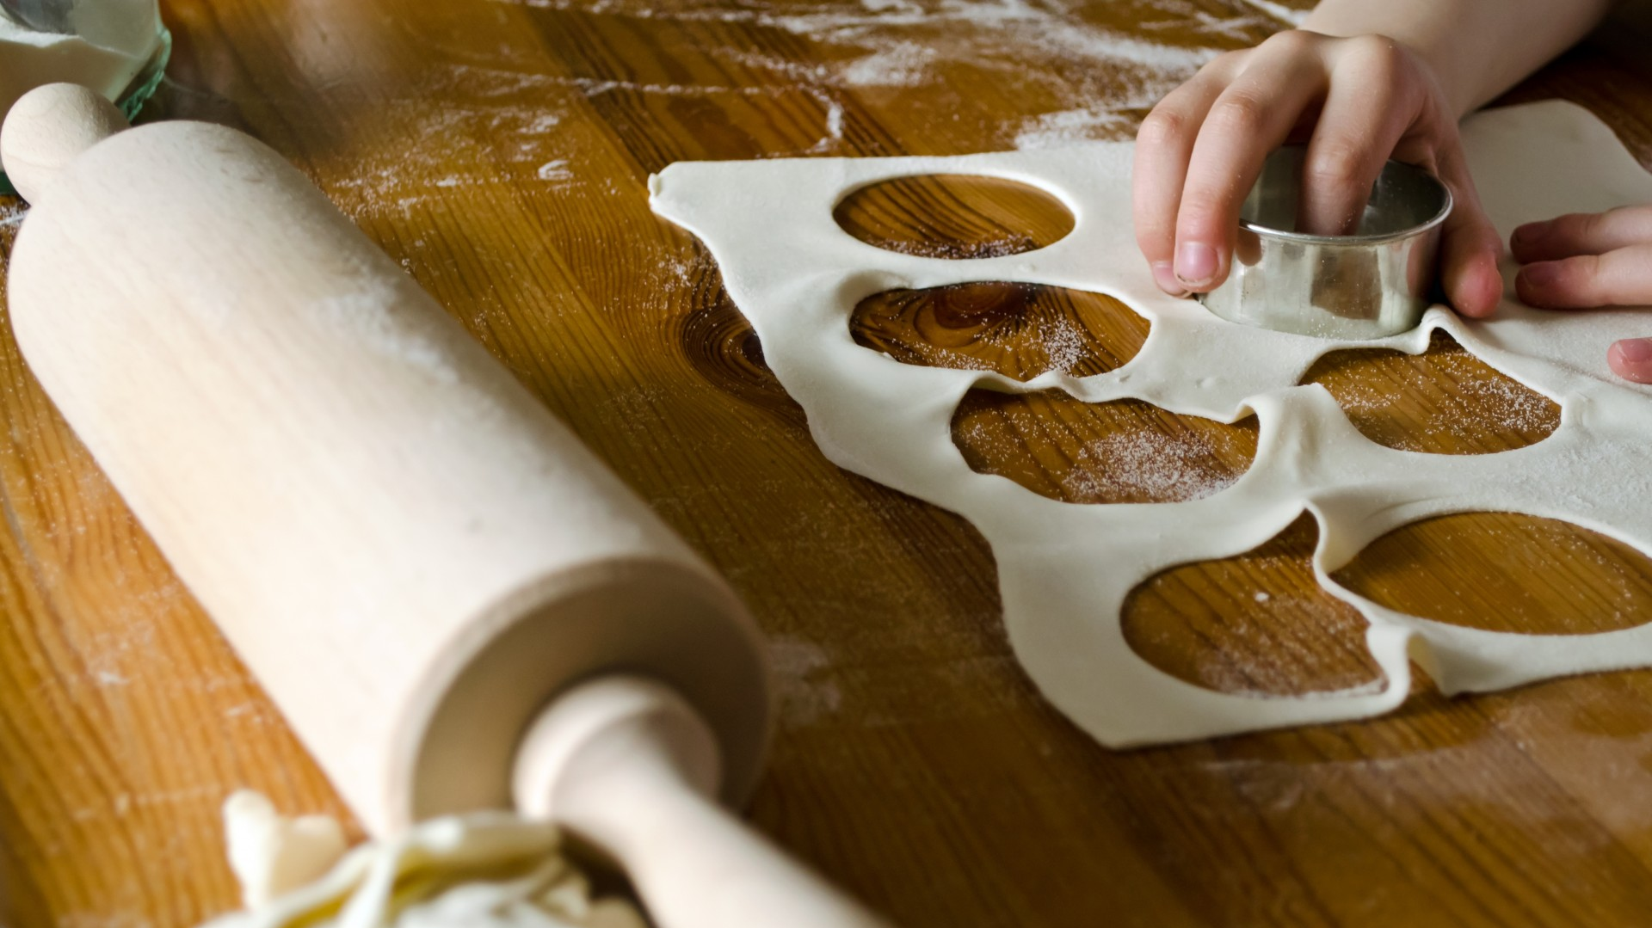
Bakers lounge is a website mainly for encouraging people who are good at baking
Shops selling baking products and tools can upload them here
Help bakers to buy ingredients and tools without leaving the house
Help bakers and shops to start and improve their business
Help customers to find bakers and book products and cakes in advance
Customers can book customized cakes
Provide delivery facility
People who are willing to work as delivery boy can register here

Slide 4
EXISTING SYSTEM

Slide 5
There are many websites that help people to buy bakery items
These websites help shops(bakery) to grow their income
These websites focus on shops rather than bakers
These websites also provide delivery facility

Slide 6
ADVANTAGES OF EXISTING SYSTEM
Can find almost all things at one place(one shop)
Helps grow shop’s business
Customers can easily find shops near by them
Provide jobs to people who are willing to work as delivery boy
DISADVANTAGES OF EXISTING SYSTEM
Doesn’t help individual bakers to start or grow their business
Some shops don’t make customized cakes

Slide 7
PROPOSED SYSTEM

Slide 8
Help people who are baking at home earn money
Focus is on individual bakers rather than bakeries(shops)
Bakers can easily find and buy any type of ingredients and tools for baking easily through this website
Bakers can find shops near by them to buy things for baking
Customers can book customized cakes
They can find bakers near by them or by location
Items booked by both bakers and customers will reach the delivery address through delivery team

Slide 9
ADVANTAGES OF PROPOSED SYSTEM
Help both individual bakers and shops selling products used in baking to earn more money
By providing tools and ingredients baking becomes easier for home bakers
Help customer order customized products
Find shops and bakers according to location and book products
Provide jobs to people who are willing to work as delivery boy
Delivery team will help bakers and shops to make their order’s delivery easy

Slide 10
DISADVANTAGES OF PROPOSED SYSTEM
Sometimes customers can’t find all their needed product from one baker
Bakeries can’t register

Slide 11
MODULE DESCRIPTION

Slide 12
BAKERS LOUNGE
ADMIN
GUEST
BAKER
SHOP
DELIVERY BOY

Slide 13
ADMIN
Login
Dashboard
Add district
Add place
Add cake type
Add product type
Add complaint type
Verify shop registration
View bakers
Verify delivery boys
View customers
View feedback
Complaints and response
Bakers
Shops
Customers
Deliver boys

Slide 14
GUEST
Shop registration with payment
Customer’s registration
Baker’s registration
Delivery boy's registration
Login
About us
Contact us
Gallery

Slide 15
BAKER
Login
Homepage
Privacy
My profile
Edit profile
Change password
Upload products
Category
Description
Picture
Price
Gallery
Upload cake
Category
Description
Picture
Quantity
Price
Gallery
Order ingredients and tools
Order items
Quantity
Total amount
Order status
Search shops
According to location
View customer orders
Product or cake details
Customer details
Order details
Order verification
View customized orders
View customized order review

Slide 16
SHOP
Login
Homepage
Privacy
My profile
Edit profile
Change password
Manage ingredient
Quantity
Expiry date
Price
Images
Managing stock
Manage tools
Description
Image
Price
Managing stock
View order
Bakers details
Ingredient or tool details
Order details
Order verification

Slide 17
CUSTOMER
Login
Homepage
Privacy
My profile
Edit profile
Change password
Search bakers
According to location
Search products
Search cake
Order products
Product
Quantity
Total amount
Order status
Delivery status
Order cake
Cake
Quantity
Caption
Total amount
Order status
Delivery status
Order customized cake
Cake
Quantity
Caption
Total amount
Order status
Delivery status
Add review
Add feedback
Add complaint

Slide 18
DELIVERY BOY
Login
Homepage
Privacy
My profile
Edit profile
Change password
View assigned works
From shop
From baker
Verify delivery status

Slide 19
DATA FLOW DIAGRAM(DFD)

Slide 20
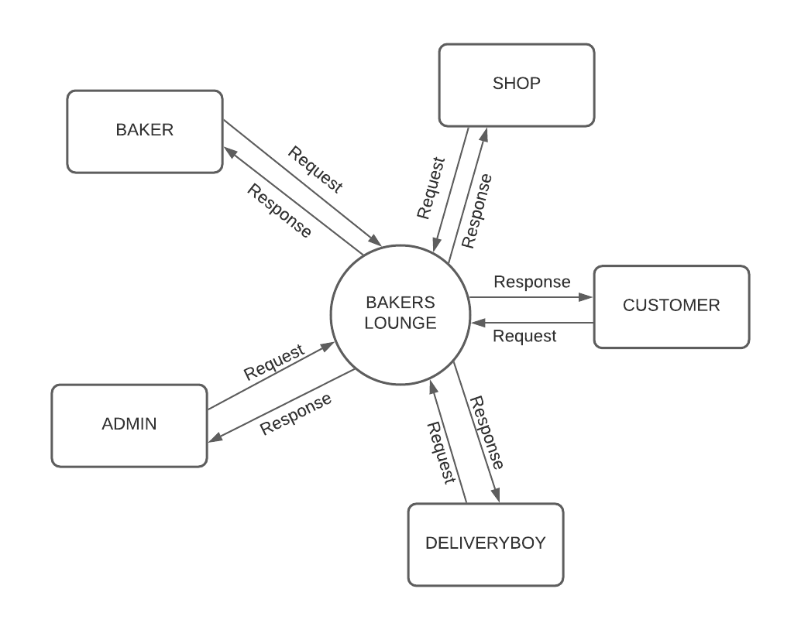
LEVEL 0 DFD

Slide 21
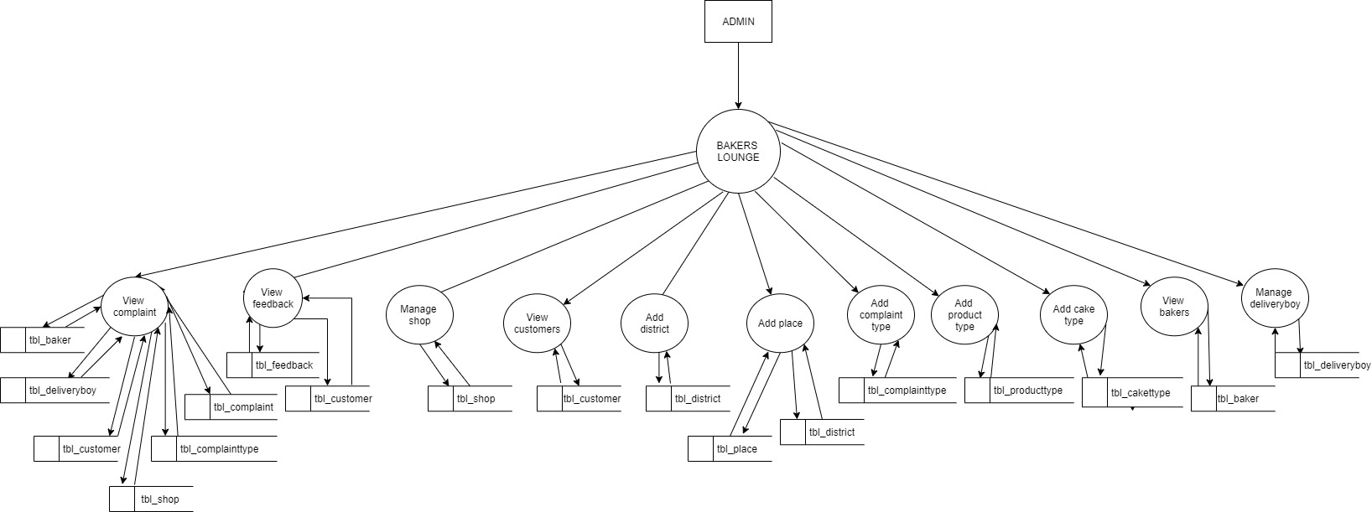
LEVEL 1 DFD ADMIN

Slide 22
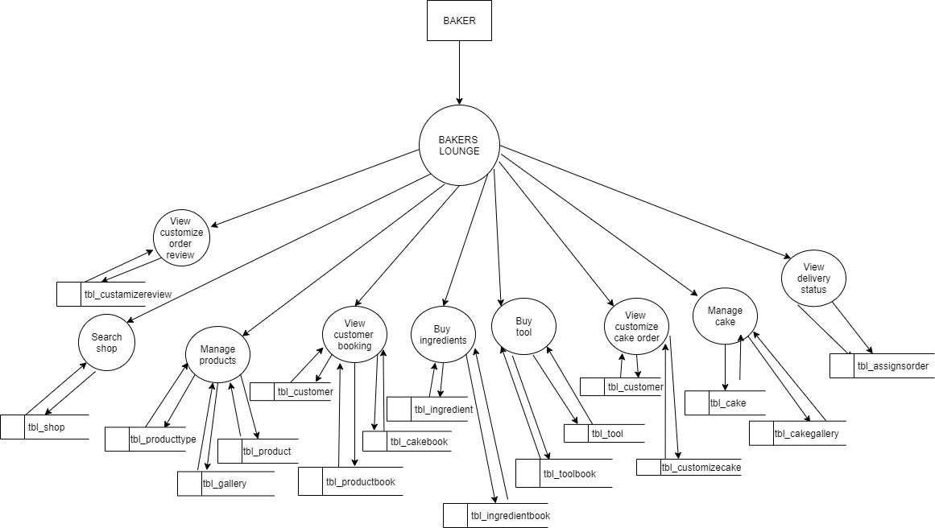
LEVEL 1 DFD BAKER

Slide 23
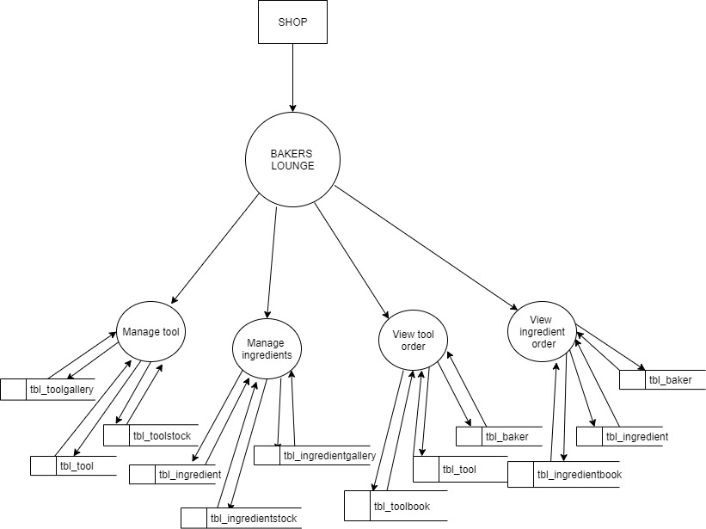
LEVEL 1 DFD SHOP

Slide 24
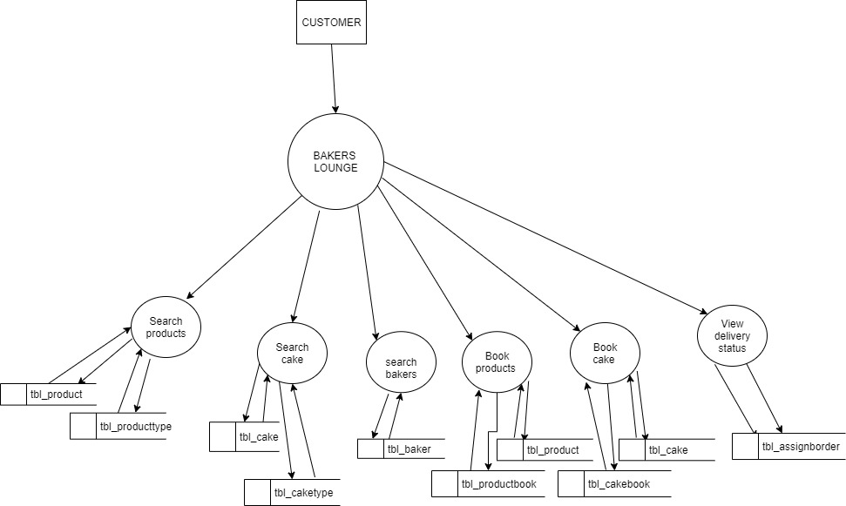
LEVEL 1 DFD CUSTOMER

Slide 25
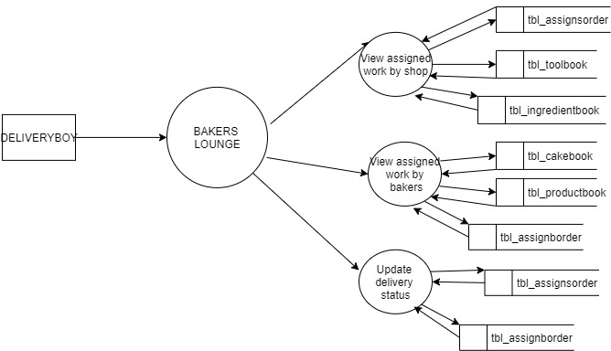
LEVEL 1 DFD DELIVERY BOY

Slide 26
TABLE DESIGN

Slide 27
tbl_producttype
Name | Datatype | Size | Comment
producttype_id | Int |  | Primary key
producttype_name | nvarchar | 50
tbl_district
Name | Datatype | Size | Comment
district_id | Int |  | Primary key
district_name | nvarchar | 50
tbl_caketype
Name | Datatype | Size | Comment
caketype_id | Int |  | Primary key
caketype_name | nvarchar | 50
tbl_place
Name | Datatype | Size | Comment
place_id | Int |  | Primary key
place_name | nvarchar | 50
district_id | int |  | Foreign key
tbl_complainttype
Name | Datatype | Size | Comment
complainttype_id | Int |  | Primary key
complainttype_name | nvarchar | 50

Slide 28
tbl_shop
tbl_deliveryboy
Name | Datatype | Size | Comment
shop_id | Int |  | Primary key
shop_name | nvarchar | 50
shop_logo | nvarchar | 50
shop_address | nvarchar | 50
shop_proof | nvarchar | 50
shop_licno | nvarchar | 50
shop_contact | nvarchar | 50
shop_email | nvarchar | 50
shopowner_name | nvarchar | 50
shopowner_addr | nvarchar | 50
shopowner_contact | nvarchar | 50
shopowner_proof | nvarchar | 50
shop_username | nvarchar | 50
shop_password | nvarchar | 50
place_id | Int |  | Foreign key
shop_status | nvarchar | 50
Name | Datatype | Size | Comment
deliveryboy_id | Int |  | Primary key
deliveryboy_name | nvarchar | 50
deliveryboy_address | nvarchar | 50
deliveryboy_contact | nvarchar | 50
deliveryboy_gender | nvarchar
deliveryboy_photo | nvarchar
deliveryboy_email | nvarchar | 50
deliveryboy_proof1 | nvarchar
deliveryboy_proof2 | nvarchar
deliveryboy_username | nvarchar | 50
deliveryboy_password | nvarchar | 50
place_id | Int |  | Foreign key
deliveryboy_status | nvarchar

Slide 29
tbl_customer
tbl_baker
Name | Datatype | Size | Comment
user_id | Int |  | Primary key
user_name | nvarchar | 50
user_address | nvarchar | 50
user_contact | nvarchar | 50
user_email | nvarchar | 50
user_username | nvarchar | 50
user_password | nvarchar | 50
place_id | Int |  | Foreign key
Name | Datatype | Size | Comment
baker_id | Int |  | Primary key
baker_name | nvarchar | 50
baker_gender | nvarchar | 50
baker_address | nvarchar | 50
baker_proof | nvarchar | 50
baker_photo | nvarchar | 50
baker_contact | nvarchar | 50
baker_email | nvarchar | 50
baker_username | nvarchar | 50
baker_password | nvarchar | 50
place_id | Int |  | Foreign key
baker_status | nvarchar | 50
tbl_tool
Name | Datatype | Size | Comment
tool_id | Int |  | Primary key
tool_name | nvarchar | 50
tool_description | nvarchar | 50
tool_price | nvarchar | 50
tool_image | nvarchar | 50
shop_id | Int |  | Foreign key

Slide 30
tbl_ingredient
tbl_toolgallery
Name | Datatype | Size | Comment
ingredient_id | Int |  | Primary key
ingredient_name | nvarchar | 50
ingredient_description | nvarchar | 50
ingredient_price | nvarchar | 50
ingredient_image | nvarchar | 50
ingredient_expiry | nvarchar | 50
shop_id | Int |  | Foreign key
Name | Datatype | Size | Comment
toolgallery_id | Int |  | Primary key
toolgallery_image | nvarchar | 50
tool_id | int |  | Foreign key
tbl_ingredientstock
Name | Datatype | Size | Comment
instock_id | Int |  | Primary key
instock_quantity | nvarchar | 50
tool_id | int |  | Foreign key
tbl_toolstock
Name | Datatype | Size | Comment
toolstock_id | Int |  | Primary key
toolstock_quantity | nvarchar | 50
tool_id | int |  | Foreign key
tbl_ingredientgallery
Name | Datatype | Size | Comment
ingallery_id | Int |  | Primary key
ingallery_image | nvarchar | 50
tool_id | int |  | Foreign key

Slide 31
tbl_product
tbl_cake
Name | Datatype | Size | Comment
product_id | Int |  | Primary key
product_name | nvarchar | 50
product_description | nvarchar | 50
product_price | nvarchar | 50
product_image | nvarchar | 50
product_quantity | nvarchar | 50
baker_id | Int |  | Foreign key
producttype_id | Int |  | Foreign key
Name | Datatype | Size | Comment
cake_id | Int |  | Primary key
cake_name | nvarchar | 50
cake_description | nvarchar | 50
cake_price | nvarchar | 50
cake_image | nvarchar | 50
cake_quantity | nvarchar | 50
baker_id | Int |  | Foreign key
caketype_id | Int |  | Foreign key
tbl_gallery
tbl_cakegallery
Name | Datatype | Size | Comment
gallery_id | Int |  | Primary key
gallery_image | nvarchar | 50
product_id | int |  | Foreign key
Name | Datatype | Size | Comment
cakegallery_id | Int |  | Primary key
cakegallery_image | nvarchar | 50
cake_id | int |  | Foreign key

Slide 32
tbl_productbook
tbl_cakebook
Name | Datatype | Size | Comment
productbook_id | Int |  | Primary key
productbook_totalamount | nvarchar | 50
productbook_date | nvarchar | 50
productbook_deliverydate | nvarchar | 50
productbook_paddress | nvarchar | 50
productbook_daddress | nvarchar | 50
productbook_quantity | nvarchar | 50
productbook_pstatus | nvarchar | 50
productbook_dstatus | nvarchar | 50
user_id | Int |  | Foreign key
product_id | Int |  | Foreign key
Name | Datatype | Size | Comment
cakebook_id | Int |  | Primary key
cakebook_totalamount | nvarchar | 50
cakebook_date | nvarchar | 50
cakebook_deliverydate | nvarchar | 50
cakebook_paddress | nvarchar | 50
cakebook_daddress | nvarchar | 50
cakebook_quantity | nvarchar | 50
cakebook_pstatus | nvarchar | 50
cakebook_dstatus | nvarchar | 50
cakebook_caption | nvarchar | 50
user_id | Int |  | Foreign key
cake_id | Int |  | Foreign key

Slide 33
tbl_toolbook
tbl_ingredientbook
Name | Datatype | Size | Comment
toolbook_id | Int |  | Primary key
toolbook_totalamount | nvarchar | 50
toolbook_date | nvarchar | 50
toolbook_deliverydate | nvarchar | 50
toolbook_daddress | nvarchar | 50
toolbook_quantity | nvarchar | 50
tooltbook_pstatus | nvarchar | 50
toolbook_dstatus | nvarchar | 50
baker_id | Int |  | Foreign key
tool_id | Int |  | Foreign key
Name | Datatype | Size | Comment
inbook_id | Int |  | Primary key
inbook_totalamount | nvarchar | 50
inbook_date | nvarchar | 50
inbook_deliverydate | nvarchar | 50
inbook_daddress | nvarchar | 50
inbook_quantity | nvarchar | 50
inbook_pstatus | nvarchar | 50
inbook_dstatus | nvarchar | 50
baker_id | Int |  | Foreign key
ingredient_id | Int |  | Foreign key

Slide 34
tbl_customizecake
tbl_complaint
Name | Datatype | Size | Comment
ccake_id | Int |  | Primary key
ccake_caption | nvarchar | 50
ccake_shape | nvarchar | 50
ccake_flavour | nvarchar | 50
ccake_orderdate | nvarchar | 50
ccake_deliverydate | nvarchar | 50
ccake_amount | nvarchar | 50
baker_id | Int |  | Foreign key
Name | Datatype | Size | Comment
complaint_id | Int |  | Primary key
complaint_subject | nvarchar | 50
complaint_date | nvarchar | 50
complaint_detail | nvarchar | 50
complaint_reply | nvarchar | 50
complaint_status | nvarchar | 50
baker_id | nvarchar | 50
shop_id | nvarchar | 50
deliveryboy_id | nvarchar | 50
user_id | Int |  | Foreign key
complainttype_id | Int |  | Foreign key
tbl_customizereview
Name | Datatype | Size | Comment
customizereview_id | Int |  | Primary key
customizereview_review | nvarchar | 50
ccake_id | int |  | Foreign key
customizereview_date | nvarchar | 50

Slide 35
tbl_assignborder
tbl_assignsorder
Name | Datatype | Size | Comment
assignorder_id | Int |  | Primary key
assignorder_date | nvarchar | 50
assignorder_status | nvarchar | 50
productbook_id | Int |  | Foreign key
deliveryboy_id | Int |  | Foreign key
cakebook_id | Int |  | Foreign key
Name | Datatype | Size | Comment
assignorder_id | Int |  | Primary key
assignorder_date | nvarchar | 50
assignorder_status | nvarchar | 50
inbook_id | Int |  | Foreign key
toolbook_id | Int |  | Foreign key
deliveryboy_id | Int |  | Foreign key
tbl_feedback
Name | Datatype | Size | Comment
feedback_id | Int |  | Primary key
feedback__data | nvarchar | 50
user_id | int |  | Foreign key
feedback__date | nvarchar | 50

