Slide 1
MINI PROJECT
TEAM MEMBERS:
ANEETA ROY
ANGEL JOY
ANJALI NAIR
ANJALI VK

Slide 2
INDEX
1. TOPIC
2. INTRODUCTION
3. DESIGN
4. IMPLEMENTATION
4.1 DESIGN
4.2 PROGRAM SCRIPT
4.3 OUTPUT

Slide 3
TOPIC
DISPLAY ENVIRONMENT VARIABLES
CORRESPOINDING TO A GIVEN PROCESS

Slide 4
INTRODUCTION
*This program is used to display environment variables in a given process.An
Environment variable is a dynamic named value that can affect the way of running a processes.
*In all unix and unix like systems each process has its own separate set of environment variables By default, when a process is created, it inherits a duplicate environment of its parent process, except for explicit changes made by the parent when it creates the child. At the API level, these changes must be done between running fork and exec. Alternatively, from command shell such as bash a user can change environment variables for a particular command invocation by indirectly invoking it via env or using the
ENVIRONMENT_VARIABLE=VALUE <command> notation. A running program can access the values of environment variables for configuration purposes.

Slide 5
DESIGN
BASICALLY THIS PROGRAM HAS PYTHON CODE.HERE GRAPHICAL USER INTERFACE (GUI) IS DESIGNED USING PYQT. FOR THE COMMAND LINE,OS MODULES ARE USED
AND IT IS ALSO USED FOR EXECUTING THIS PROGRAM.THE ENVIRONMENT VARIABLES CORRESPOINDING TO USER ENTER PROCESS ID(PID)IS DISPLYAED IN
A TEXTBOX.

Slide 6
PROGRAM SCRIPT
import os
import sys
from PyQt4.QtCore import *
from PyQt4.QtGui import *
def main():
app = QApplication(sys.argv)
w = MyWindow()
w.show()
sys.exit(app.exec_())
class MyWindow(QWidget):
def __init__(self, *args):
QWidget.__init__(self, *args)
label = QLabel(self.tr("Enter PID and Press ENTER"))
self.le = QLineEdit()
self.te = QTextEdit()

Slide 7
layout = QVBoxLayout(self)
layout.addWidget(label)
layout.addWidget(self.le)
layout.addWidget(self.te)
self.setLayout(layout)
self.connect(self.le, SIGNAL("returnPressed(void)"),
self.run_command)
def run_command(self):
cmd = 'cat /proc/1531/environ'
stdouterr = os.popen4(cmd)[1].read()
self.te.setText(stdouterr)
if __name__ == "__main__":
main()

Slide 8
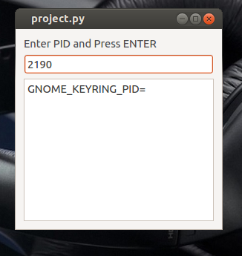
OUTPUT

Slide 9
END

