Slide 1
INDIA RUNS
Data & AI Challenge
AI Candidate Ranking System
KOTTACKATTU ANEETTA VINU
Date: 01-07-2026

Slide 2
Problem Statement
• Recruiters rely heavily on keyword matching.
• Good candidates are often missed.
• Need an AI system that understands job requirements and candidate profiles semantically.

Slide 3
Objectives
• Understand job descriptions
• Rank candidates intelligently
• Use semantic embeddings + scoring
• Generate explainable recommendations

Slide 4
Dataset
File | Purpose
candidates.jsonl | Candidate profiles
job_description.docx | Job requirement
candidate_schema.json | Dataset schema
sample_submission.csv | Expected output
validate_submission.py | Submission validation

Slide 5
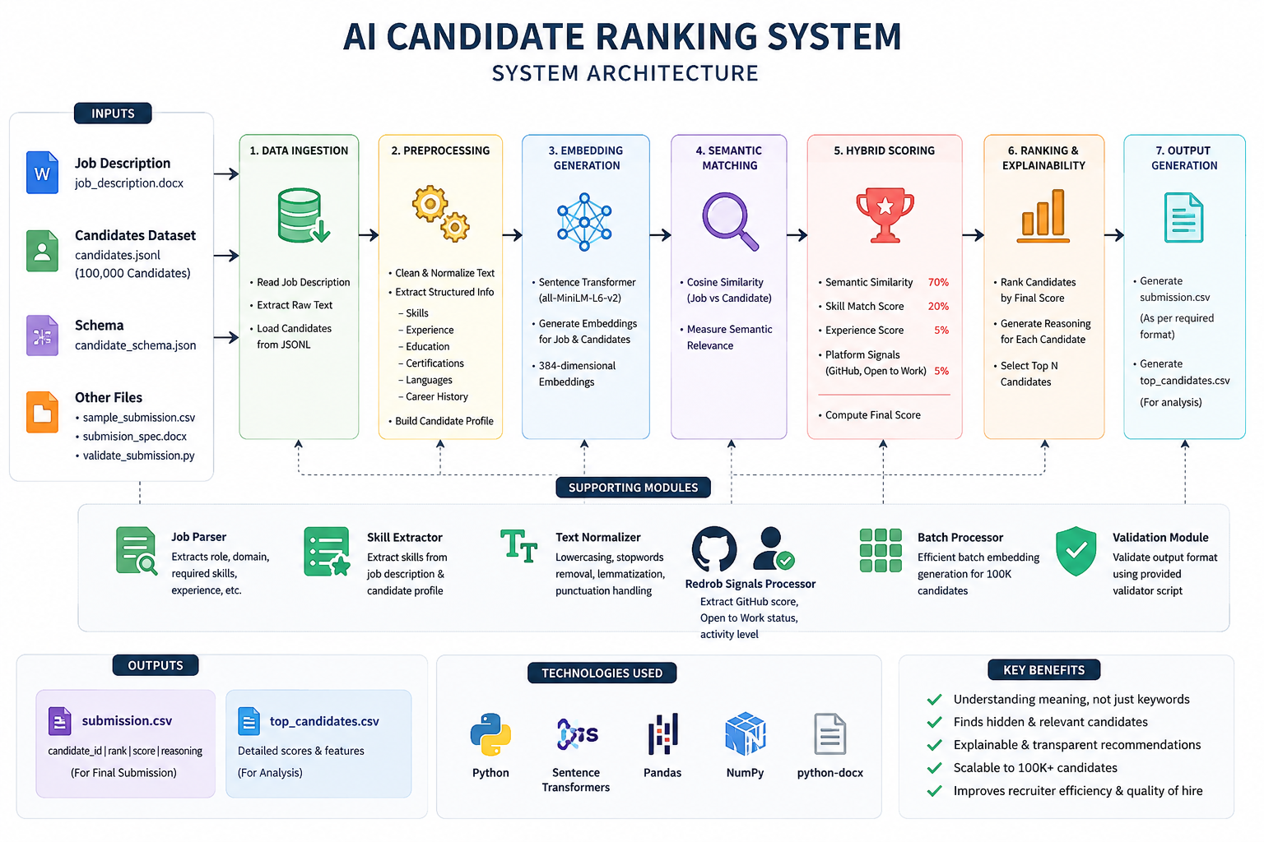
Solution Architecture

Slide 6
Technology Stack
Python
Sentence Transformers
Transformers
Scikit-learn
Pandas
NumPy
python-docx

Slide 7
Workflow
1. Load candidates
2. Read Job Description
3. Generate embeddings
4. Compute similarity
5. Skill matching
6. Weighted scoring
7. Explainable ranking
8. Generate submission.csv

Slide 8
Scoring Strategy
Semantic Similarity - 70%
Skill Match - 20%
Experience - 5%
GitHub/Profile/Open-to-Work - 5%

Slide 9
Explainable AI
Every recommendation includes:
• Similarity Score
• Skill Match
• Experience
• Platform Signals
• Human-readable Reasoning

Slide 10
Results
Outputs Generated:
• top_candidates.csv
• submission.csv
• Ranked candidates with reasoning
• Recruiter-ready shortlist

Slide 11
Scalability
Current:
• Handles 100K candidates
Future:
• Batch embeddings
• FAISS Vector Search
• LLM Re-ranking
• Streamlit Dashboard

Slide 12
Innovation
✓ Semantic understanding instead of keyword search
✓ Explainable AI
✓ Hybrid scoring
✓ Modular architecture
✓ Recruiter-friendly output

Slide 13
Future Enhancements
• Multi-language resumes
• Resume PDF parsing
• Interview recommendation
• Skill-gap analysis
• Live ATS integration

Slide 14
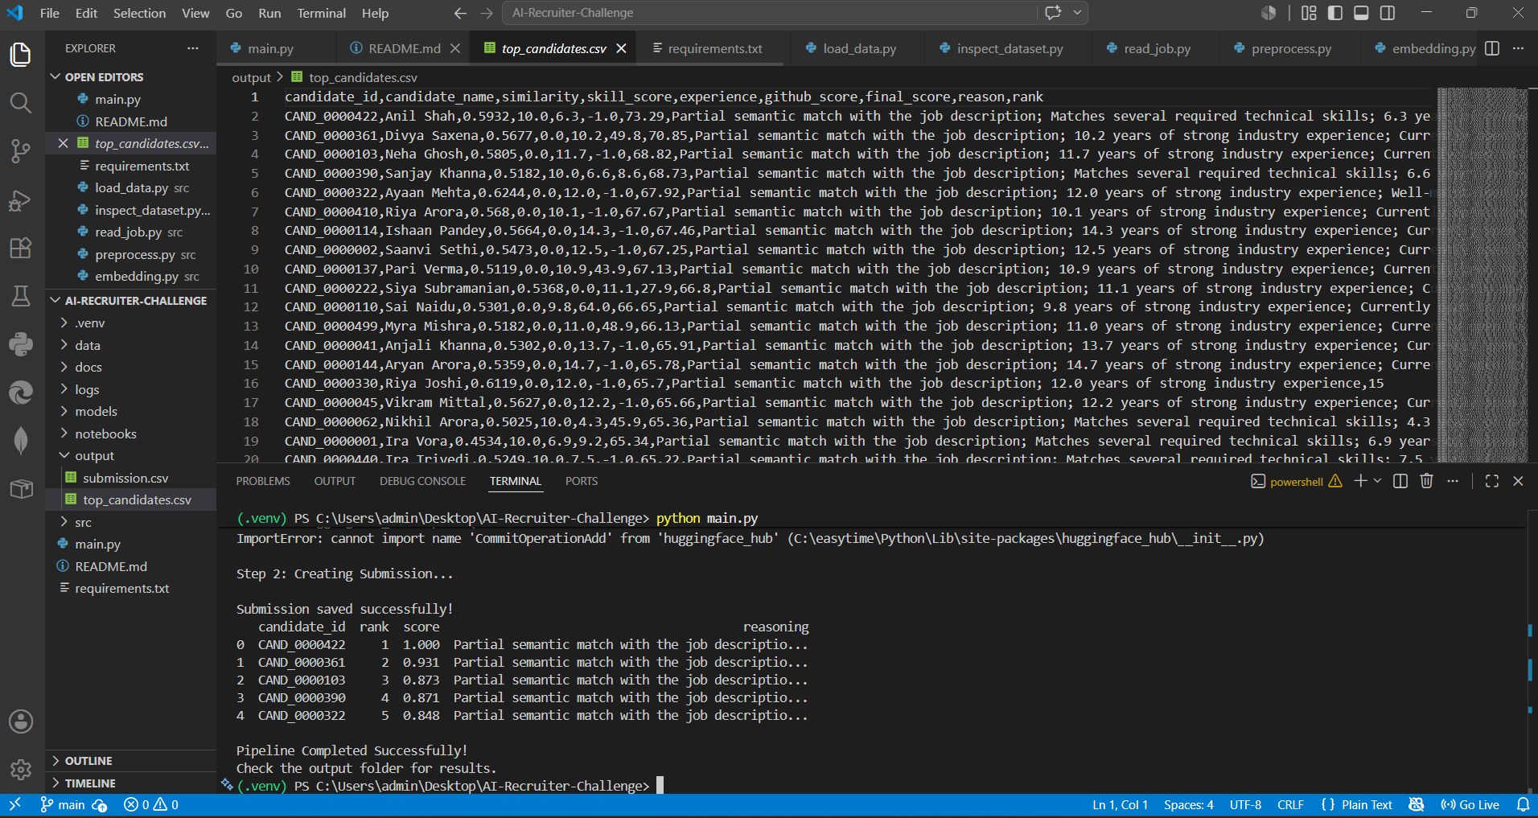
Output Screen

Slide 15
Conclusion
AI-powered semantic ranking improves hiring quality, transparency, and scalability while helping recruiters identify the best-fit candidates efficiently.

