Slide 1
Web Technologies
Week # 9: Responsive Web Page
Fall 2023

Slide 2
Today’s Objective
Recap
Bootstrap usage
CSS More properties

Slide 3
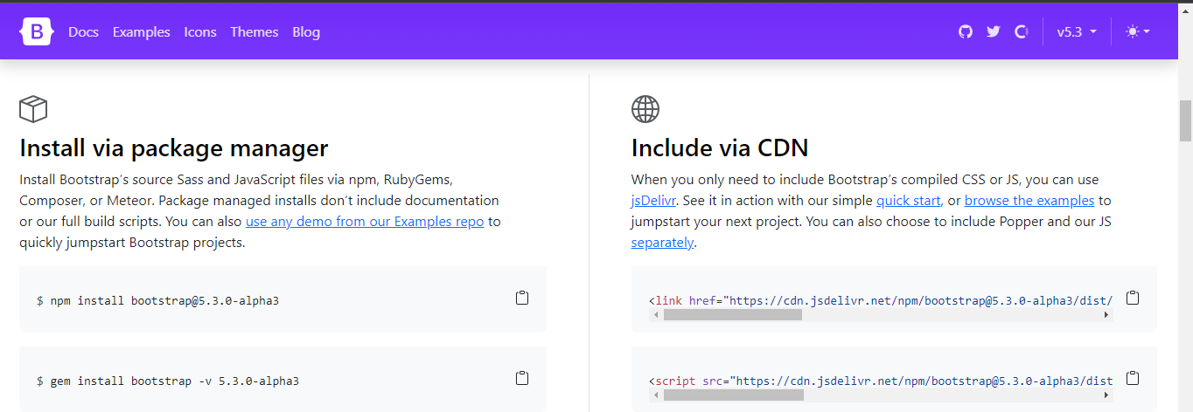
Introduction to Bootstrap
Bootstrap is a free front-end framework for faster and easier web development
Bootstrap includes HTML and CSS based design templates for typography, forms, buttons, tables, navigation, modals, image carousels and many other, as well as optional JavaScript plugins
Bootstrap also gives you the ability to easily create responsive designs
Can access Bootstrap from: https://getbootstrap.com/

Slide 4
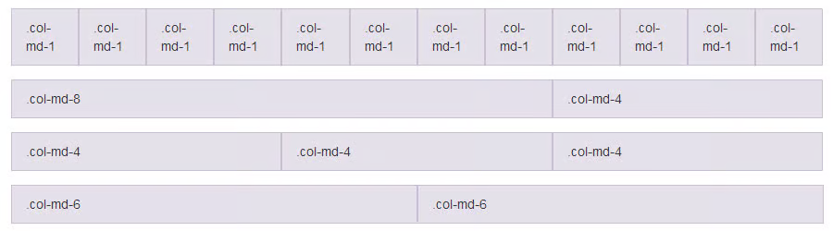
Bootstrap - Grid Layout

Slide 5
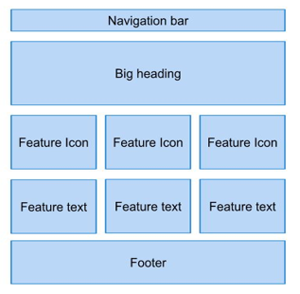
Class Activity # 1

Slide 6
Bootstrap Design (Activity # 2)
Create 2 web pages using HTML CSS and Bootstrap.
Both should be linked together.
Page 1 should have:
One header (covering complete width)
One navigation (covering complete width)
3 columns for content
One footer (covering complete width)
Page 2 should have:
One header (covering complete width)
One navigation (covering complete width)
One row with 80% + 20% containers
One footer (covering complete width)

Slide 7
Some more CSS topics to practice
Here are some few more CSS topics to practice:
CSS Animations
CSS Animations (w3schools.com)
CSS Transition
CSS Transitions (w3schools.com)
CSS Transform
CSS Gradient
CSS Shadow

Slide 8
That’s all for today…!
Notes:
<!DOCTYPE html>
<html>
<head>
<title>Bootstrap Form Example</title>
<!-- Bootstrap CSS -->
<link rel="stylesheet" href="https://maxcdn.bootstrapcdn.com/bootstrap/3.3.7/css/bootstrap.min.css">
</head>
<body>
<div class="container">
<form>
<div class="form-group">
<label for="name">Name:</label>
<input type="text" class="form-control" id="name" placeholder="Enter your name">
</div>
<div class="form-group">
<label for="email">Email:</label>
<input type="email" class="form-control" id="email" placeholder="Enter your email">
</div>
<div class="form-group">
<label for="message">Message:</label>
<textarea class="form-control" id="message" placeholder="Enter your message"></textarea>
</div>
<button type="submit" class="btn btn-primary">Submit</button>
</form>
</div>
<!-- Bootstrap JS -->
<script src="https://maxcdn.bootstrapcdn.com/bootstrap/3.3.7/js/bootstrap.min.js"></script>
</body>
</html>

