Slide 1
Employee burnout ANALYSIS
CAPSTONE PROJECT
Presented By:
Anegouni Bhanuprasad Goud
Mahaveer Institute of Science and Technology
CSE (AI & ML)

Slide 2
OUTLINE
Problem Statement
System Development Approach
Algorithm & Deployment
Result
Conclusion
Future Scope
References

Slide 3
Problem Statement
Employee burnout is a significant challenge faced by organizations, leading to reduced productivity, employee dissatisfaction, and higher turnover rates. Understanding and addressing burnout is critical for maintaining a healthy and efficient workforce. This project aims to analyze various factors contributing to employee burnout, using real-world data, to identify patterns and key indicators that influence an employee's burnout levels. By leveraging data-driven techniques, the goal is to provide insights into workplace stressors and offer predictive capabilities to preemptively address burnout among employees.

Slide 4
System Approach
System requirements :
Hardware Requirements :
A computer with at least 4 GB RAM (8 GB or more recommended).
Processor: Minimum dual-core, Intel i5 or higher.
Storage: At least 20 GB of free space.
GPU (Optional): For enhanced computation.
Software Requirements :
Operating System: Windows, macOS, or Linux.
Python 3.7 or later (recommended 3.9 or higher).
Integrated Development Environment (IDE): Jupyter Notebook, Google Colab, or any compatible Python IDE.
Microsoft Excel or equivalent (for dataset preview and analysis).

Slide 5
Library required to build the model
Data Handling :
Pandas
Data Visualization :
Matplotlib
Seaborn
Machine Learning :
Sklearn
Metrics and Performance Evaluation :
Sklearn.metrics

Slide 6
Algorithm & Deployment
Algorithm :
Data Loading and Exploration :
Load the dataset from Excel file using pandas.
Inspect the dataset for structure, data types , null values, and unique value counts
Data Preprocessing :
Null Value Handling :
Remove rows with null values to improve data quality and correlation.
Feature Selection :
Drop columns such as Employee ID and Date of Joining due to their low correlation with the target variable (Burn Rate).
Feature Encoding :
Convert categorical variables (Gender, Company Type, WFH Setup Available) into numerical form using one-hot encoding.
Correlation Anaysis :
Compute correlation coefficients to identify significant features.

Slide 7
Data Splitting :
Separate the dataset into features (X) and target (y).
Perform a train-test split to create training and testing datasets.
Data Standardization :
Use StandardScaler to normalize the feature data, ensuring all variables contribute equally to the model.
Model Building :
Choose a LinearRegression model from scikit-learn.Train the model using the training dataset.
Model Evaluation :
Test the model on the testing dataset.
Evaluate performance using metrics:
Mean Squared Error (MSE): 0.003162575622992666
Mean Absolute Error (MAE): 0.04605840467455547
R2 Score: 0.9182311349661126.
Prediction Function :
Implement a function to accept user input for new employee data and predict their Burn Rate using the trained model.

Slide 8
Deployment :
Environment Setup :
Install the required libraries (pandas, numpy, matplotlib, seaborn, scikit-learn) using pip.
Script Integration :
Integrate all preprocessing, training, and prediction steps into a Python script.
User Interaction :
Implement an interactive input mechanism for users to provide data for new predictions.
Validate user inputs to ensure they fall within acceptable ranges.

Slide 9
Deployment Options:
Local Deployment:
Run the script locally on a system with Python installed.
Cloud Deployment (Optional):
Deploy the model using platforms like Google Colab, AWS SageMaker, or Streamlit for web-based interaction.
Model Testing:
Test the deployment by providing sample inputs and validating the predicted outputs.
Documentation and Packaging:
Document the process, system requirements, and usage instructions.Package the Python script and dependencies for easy distribution.

Slide 10
Result
The Employee Burnout Analysis model successfully predicts the burn rate of employees based on key factors such as designation, resource allocation, mental fatigue score, gender, company type, and WFH setup availability.
Model Performance Metrics:
Mean Squared Error (MSE): 0.0032
Mean Absolute Error (MAE): 0.0461
R2 Score: 0.9182 (indicating a high degree of accuracy in predictions)
The model provides an efficient and reliable way to analyze employee burnout, enabling organizations to take proactive measures to address potential issues.

Slide 11
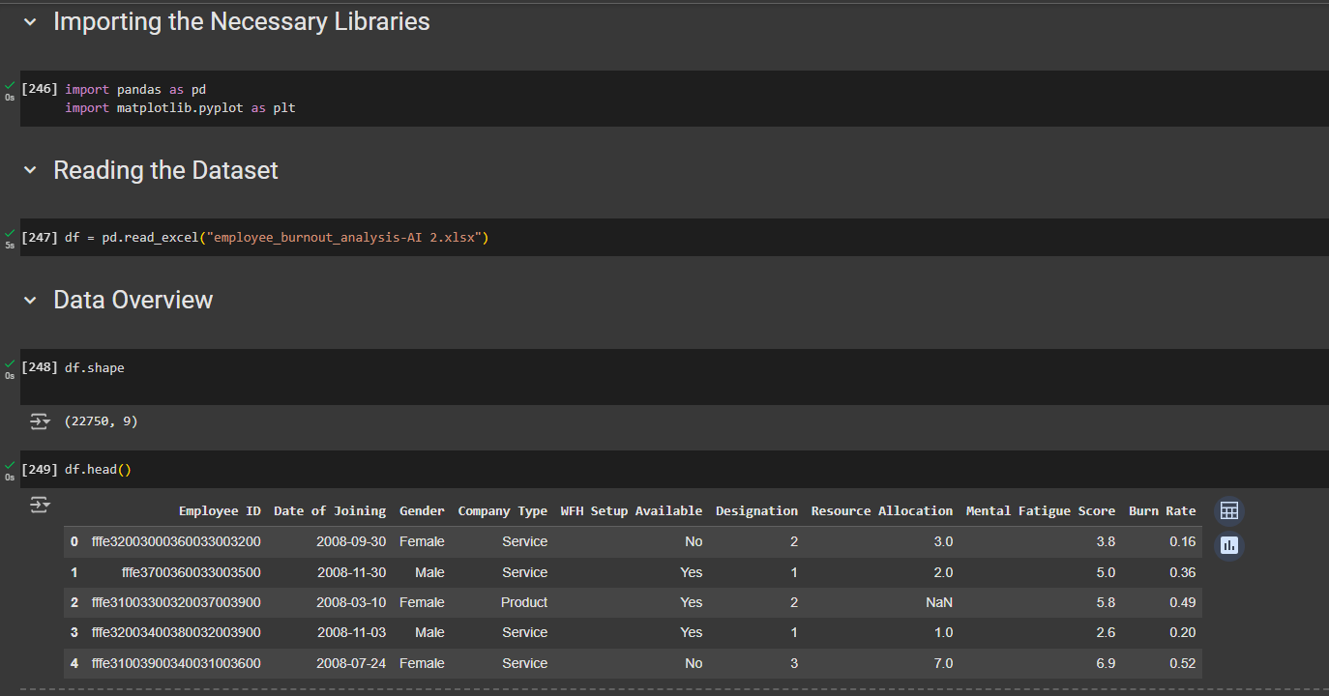
Image-1 : Data Overview

Slide 12
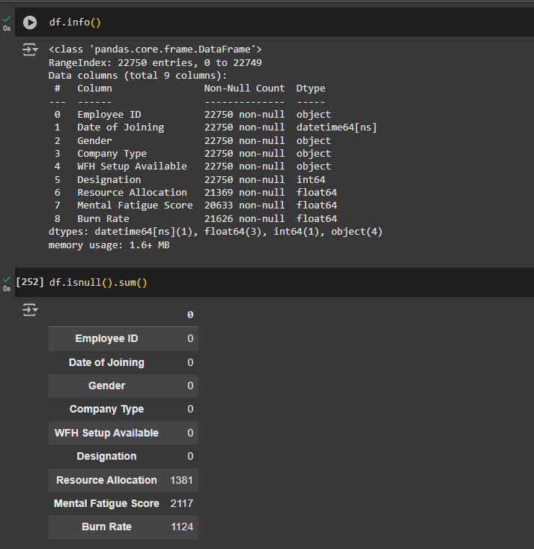
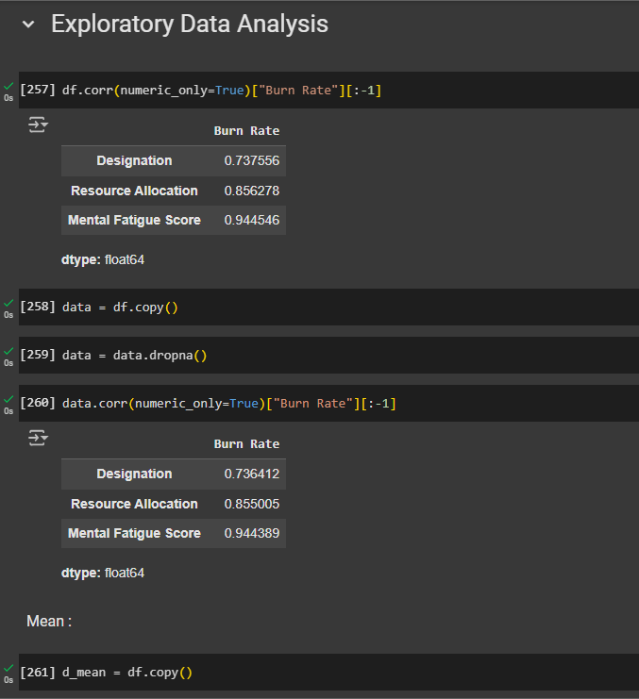
Image-2 : Data Analysis
Image-3 : Exploratory Data Analysis

Slide 13
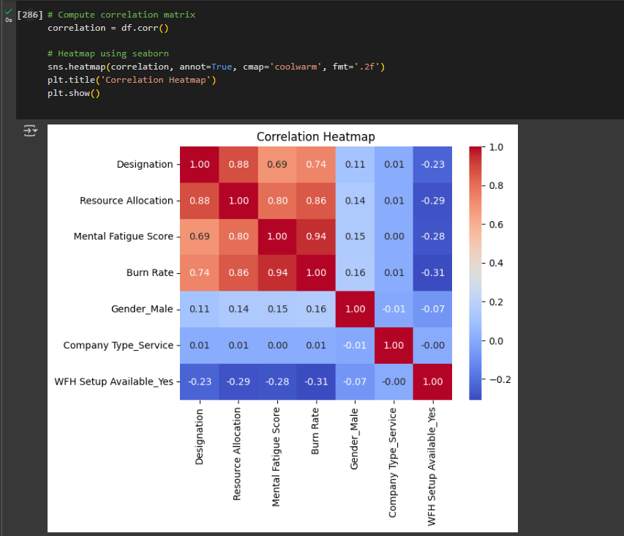
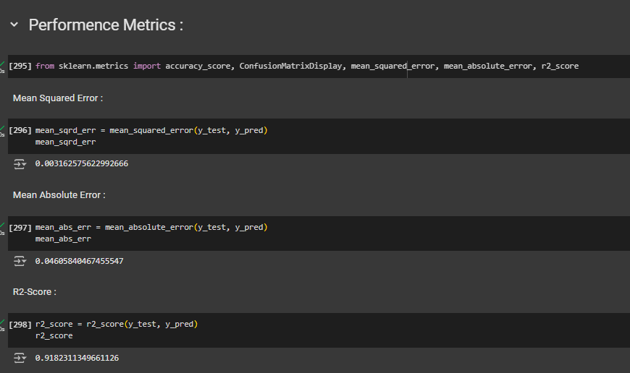
Image-4 : Data Correlation Graph
Image-5 : Performance Metrics

Slide 14
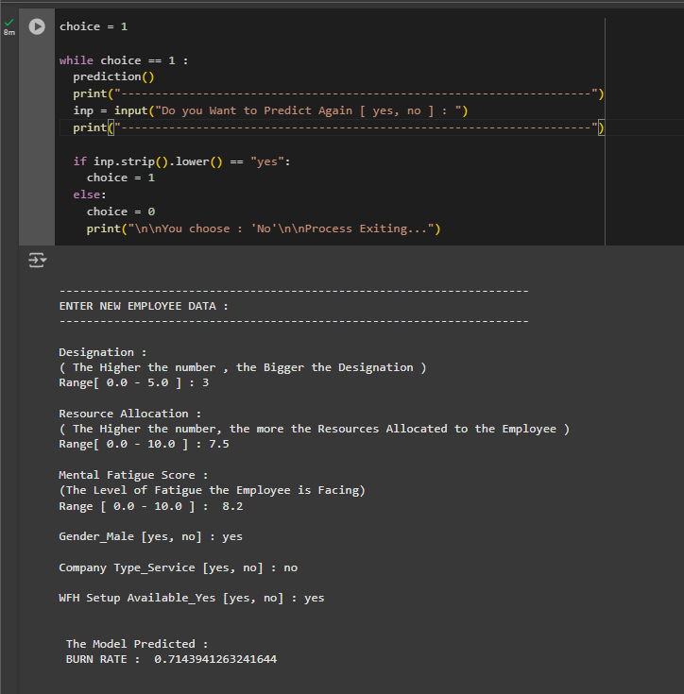
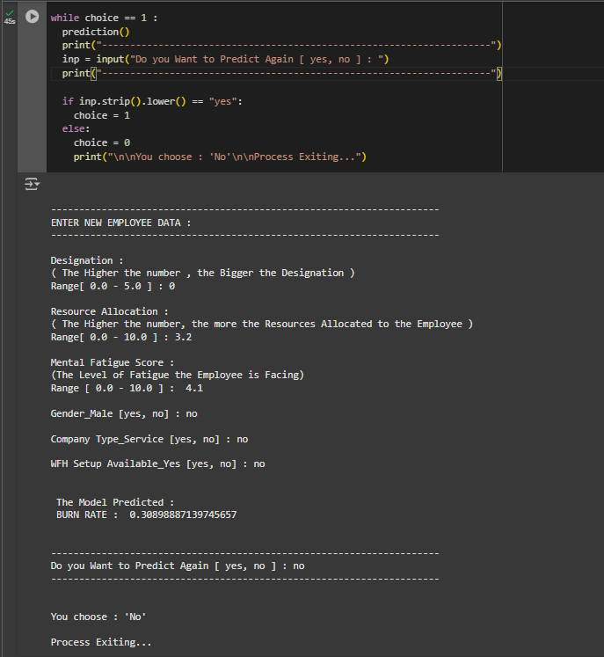
Image-6 : Predicting new Data
Image-7 : Predicting new Data

Slide 15
Github link:
https://github.com/anegouni-bhanuprasad-goud/Employee_Burnout_Analysis

Slide 16
Conclusion
This project effectively predicts employee burnout using key factors like designation, resource allocation, and mental fatigue scores, achieving a high R² score of 0.9182. Handling missing data by removing rows improved model accuracy. While the Linear Regression model performed well, future improvements could explore advanced models for non-linear relationships. Accurate burnout predictions are essential for fostering employee well-being and maintaining organizational productivity.

Slide 17
Future scope(Optional)
Add More Features: Integrate additional data like employee engagement, work-life balance, or health metrics for improved predictions.
Use Advanced Models: Explore models like Random Forest or Deep Learning to enhance accuracy and capture non-linear relationships.
Real-Time Prediction & Dashboard: Implement real-time burn rate prediction and a dashboard for monitoring and timely intervention.

Slide 18
References
Maslach, C., & Leiter, M. P. (2016).
"Burnout: A short history and future directions." Career Development International.
Discusses burnout and its key factors.
Bakker, A. B., & Demerouti, E. (2007).
"The job demands-resources model." Journal of Managerial Psychology.
Provides a framework for analyzing burnout.
Kahn, W. A. (1990).
"Psychological conditions of personal engagement and disengagement at work." Academy of Management Journal.
Explores engagement and disengagement in relation to burnout.
Chauhan, R., & Ranjan, A. (2019).
"Predictive analytics for employee retention and burnout." International Journal of Business Analytics.
Focuses on machine learning for predicting employee burnout.

Slide 19
THANK YOU

