Slide 1
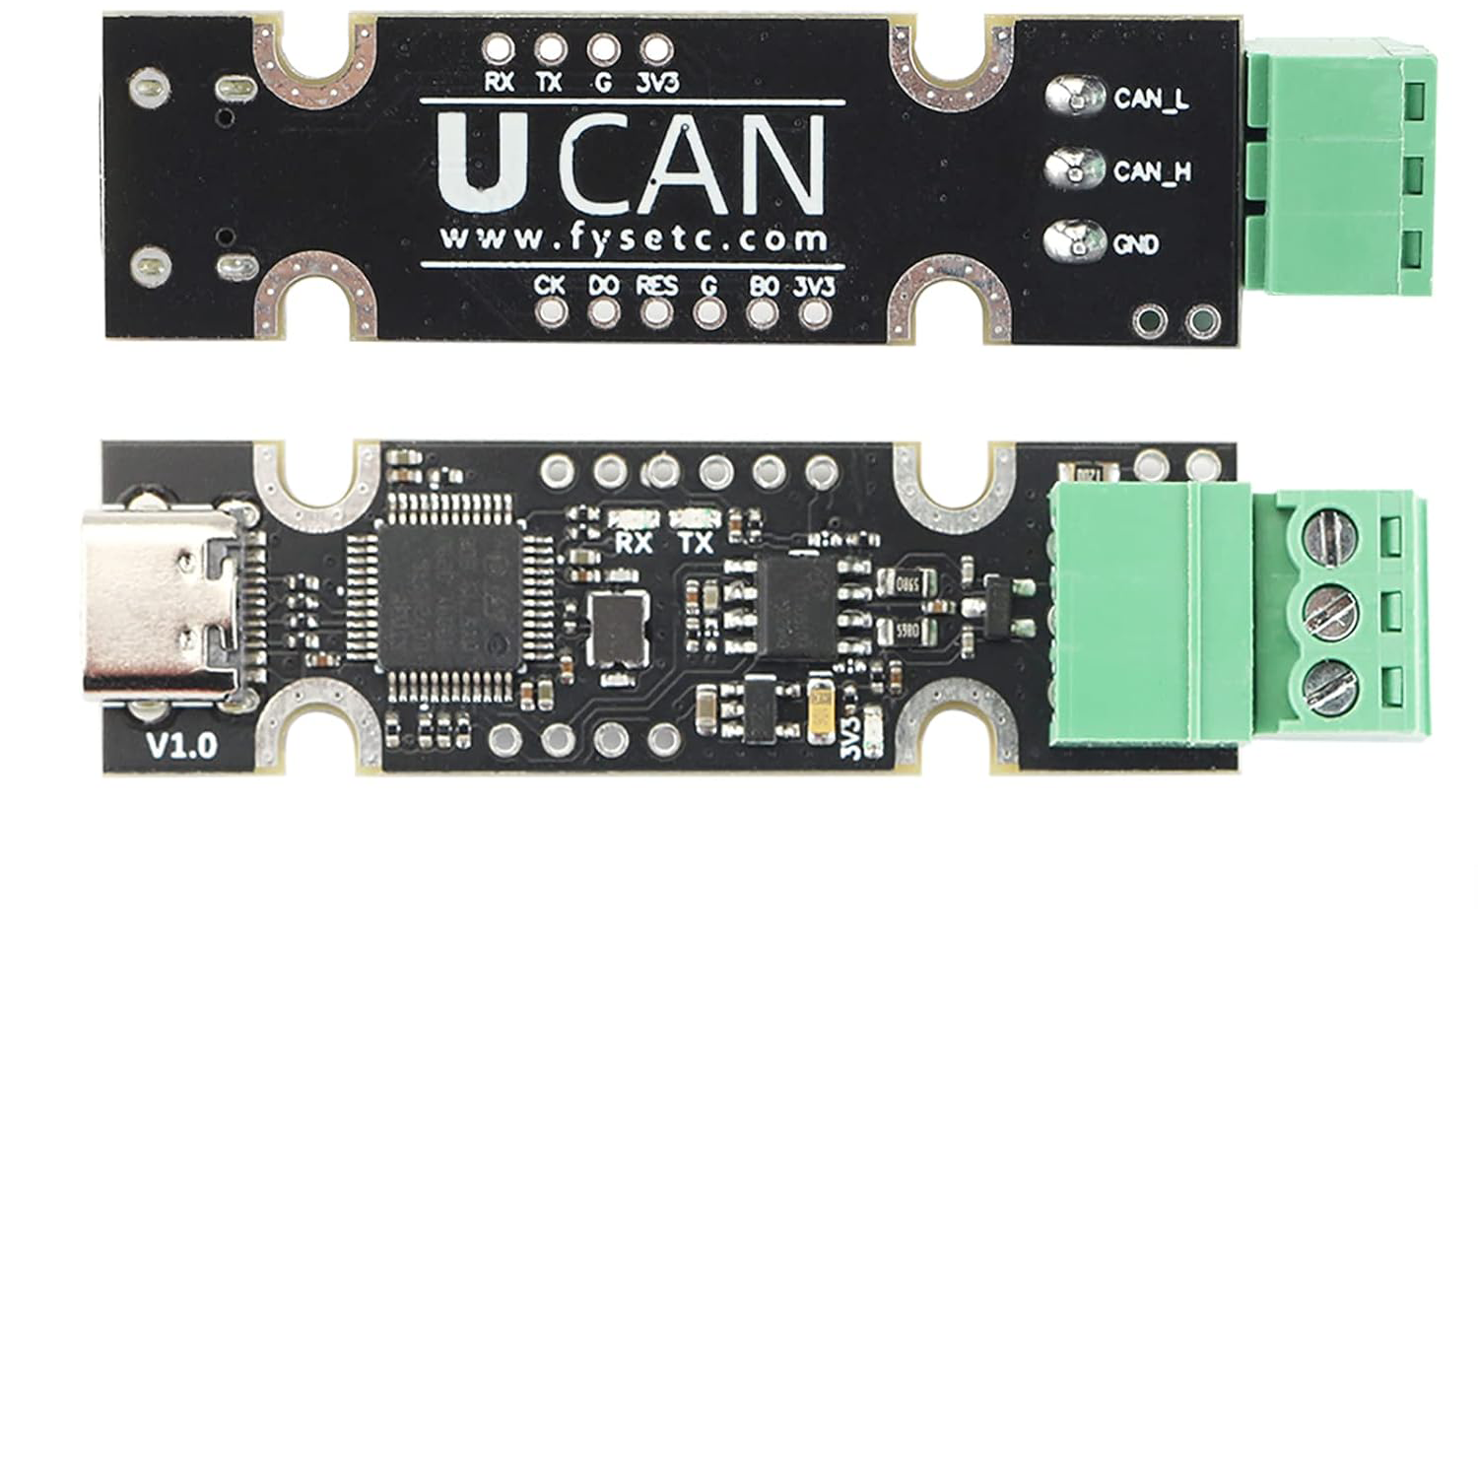
HALF DUPLEX SINGLE WIRE SERIAL CONNECTION ON SWCK PIN
BACCABLE MASTER
CAN
USB
TO C1 CAN BUS
OBD PORT PIN 6(H), 14(L)
Note: Ucan, or Canable, or DykbRadio Nano or candlelight is the same, if they mount st32f072 chip
TO USB HUB (+5V)
BACCABLE SLAVE
USB
TO BH CAN BUS
OBD PORT PIN 3(H), 11(L)
CAN

