Slide 1

Pollack ICES Area 8-Div9a Paz Sampedro

Slide 2

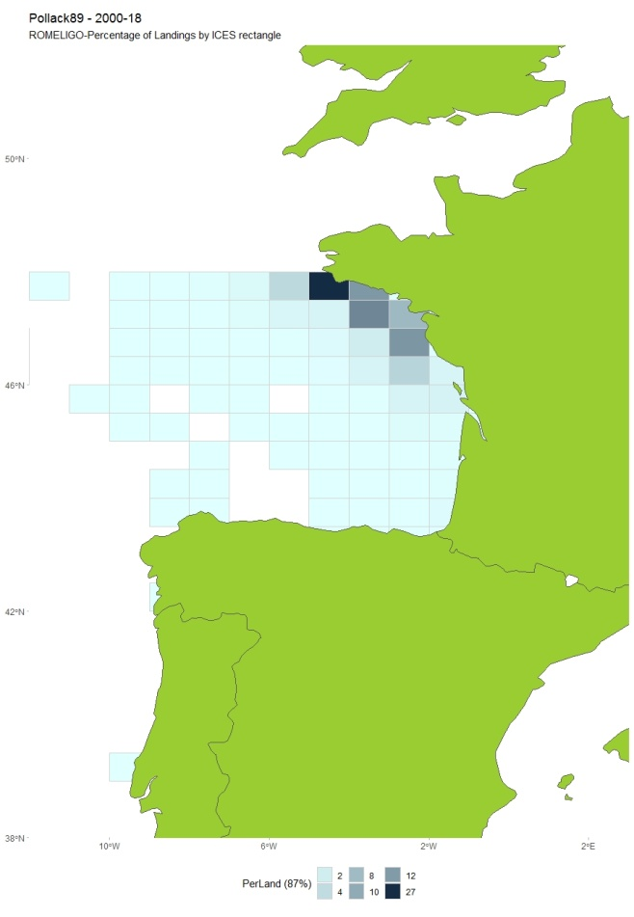
POLLACK: Biology & Exploitation
Bentho-pelagic species. Fam. Gadidae.
Bathymetric distribution: from coast to > 200 m.
Spawning shoals .
- Commercial and recreational fishery: No data for recreational landings.
- France, Spain and Portugal: 80%, 17% and 3%.
- Gillnetters, longliners and trawlers.

Slide 3
ASSESSMENT
ICES category: Pollack 8.9a category 5: only commercial catches. Precautionary approach.
Data available:
Commercial landings (annual): 1985-2018
One abundance index: standardized commercial LPUE: FR-GN>90.8a.2s (2005-2018)
No surveys
Length Composition (low quality): 2010 -2018
Objective: to explore SPiCT as a model to assess the stock status of pol.27.89a.

Slide 4
SPiCT: INPUT DATA
• Catch and abundance series are overlapped only for a short period of time (14 years).
• There is not contrast in catch series during 2005-2018.

Slide 5
Run 1. Default priors and all parameters estimated
Not converged. Model did not obtain proper convergence!
res_pol89aDefault <- fit.spict(pol89a)
Not enough information for all parameters being estimated
Run 2. Shorten Catch series to 2005-2018, overlapping with abundance index.
Not converged.
Shorten series gave totally unrealistic estimates, testing different configurations: priors for Bi/K and fixing B_{MSY}/K=0.5
Too short series, there is no contrast.

Slide 6
Run 3. Fix parameter to Schaefer production curve. Symmetric productive curve (BMSY/K=0.5)
Not converged.

Slide 7
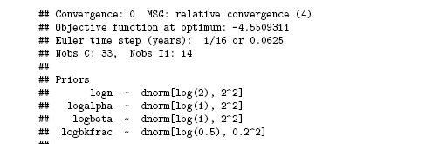
Pollack has been exploited since years before 1986:
Run 4. Set priors for the rate between initial biomass to K, mean of log(0.5) and sd of 0.2.
pol89aBkfrac <- pol89a
pol89aBkfrac$priors$logbkfrac <- c(log(0.5), 0.2, 1)
res_pol89aBkfrac <- fit.spict(pol89aBkfrac)
res_pol89aBkfrac

Slide 8
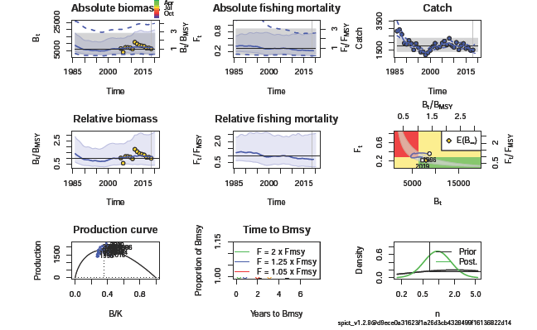
Run 4. ASSESSMENT RESULTS

Slide 9
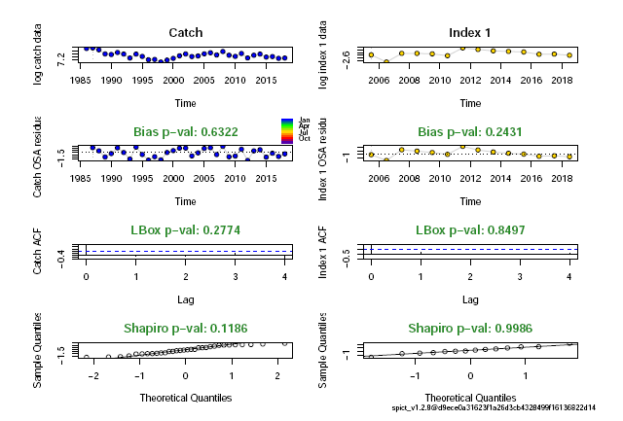
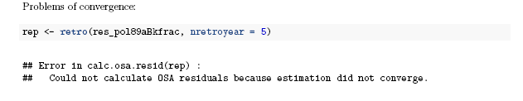
Run 4. DIAGNOSTICS
Run 4. RETROSPECTIVE

Slide 10
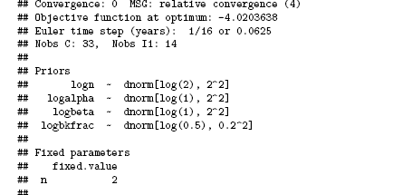
Run 5
• Fix parameter to Schaefer production curve (n=2)
• Set priors for the rate Bi/K : mean: log(0.5) and sd: 0.2

Slide 11
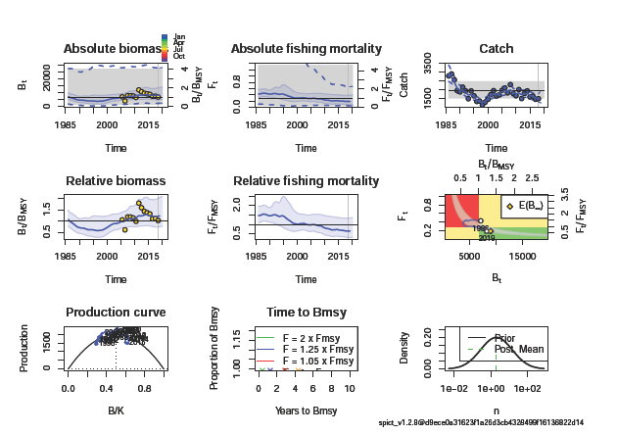
Run 5. ASSESSMENT RESULTS

Slide 12
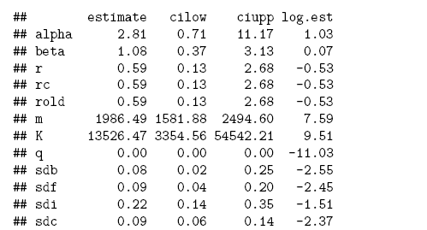
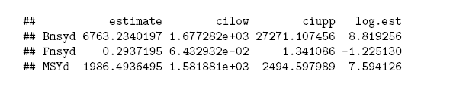
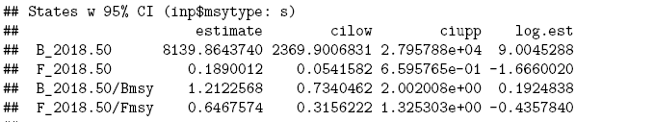
RUN 5.
SUMMARY OF ESTIMATES
REFERENCE POINTS
STOCK STATUS

Slide 13
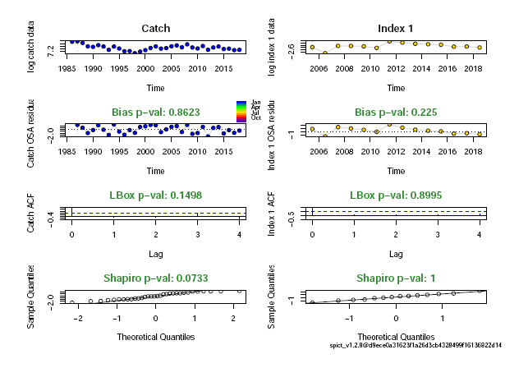
Run 5. Convergence Checks & Diagnostics
# Convergence
res_pol89aSchaefBkfrac$opt$convergence
## [1] 0
# All the sd were estimated
all(is.finite(res_pol89aSchaefBkfrac$sd))
## [1] TRUE
# No violation of assumptions: bias, correlation and normality:
res_pol89aSchaefBkfrac <- calc.osa.resid(res_pol89aSchaefBkfrac)
plotspict.diagnostic(res_pol89aSchaefBkfrac)

Slide 14
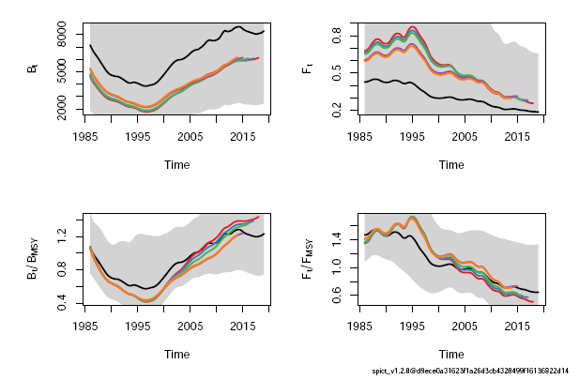
Run 5. RETROSPRECTIVE
No trends and all runs inside the confidence intervals .
Last year (black) is a bit strange.

Slide 15
RUN 5. Checking robustness to initial parameter values
All 30 runs converged. 18 runs with the same realistic estimates; but 12 converged models with unrealistic estimates.
Two optima:
## Distance m K q sdb sdf sdi sdc
## Basevec 0.00 1986.49 13526.47 0 0.08 0.09 0.22 0.09
## Trial 1 0.00 1986.49 13526.46 0 0.08 0.09 0.22 0.09
## Trial 2 0.12 1986.49 13526.59 0 0.08 0.09 0.22 0.09
## Trial 3 13108.71 3358.30 489.74 0 0.23 0.13 0.23 0.09
## Trial 4 0.03 1986.49 13526.50 0 0.08 0.09 0.22 0.09
## Trial 5 0.05 1986.49 13526.51 0 0.08 0.09 0.22 0.09
## Trial 6 0.06 1986.49 13526.53 0 0.08 0.09 0.22 0.09
## Trial 7 0.12 1986.49 13526.59 0 0.08 0.09 0.22 0.09
## Trial 8 0.00 1986.49 13526.47 0 0.08 0.09 0.22 0.09
## Trial 9 13108.71 3358.30 489.74 0 0.23 0.13 0.23 0.09

Slide 16
As conclusion:
RUN 5 (fixing BMSY/K= 0.5 and uses priors for B1/K):
Converged well
The output estimates are realistic
The model is sensitive to starting values
How to address the sensitivity to initial values?.
Need to solve:

