Slide 1

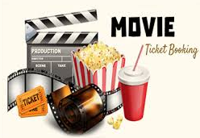
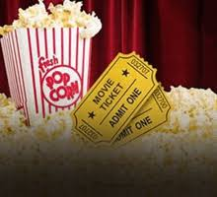
Designing An Efficient Machine Learning Based Approach for Prediction of Automated Movie Booking
Application Name - BoxOffice
Project Supervisor - Nagesh sharma

Slide 2

Team Members:-
NAME | ROLL NO | TASK
KARTIK ANEJA | 1613331082 | Back End, Documentation, Database
NITESH JAIN | 1613331127 | Front End Design , Database
MUKUL RAJ | 1613331111 | Front End Design , Documentation
RACHIT SHARMA | 1613313073 | Documentation, Information Resources

Slide 3
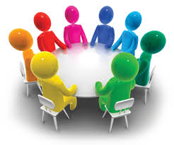

Contents
INTRODUCTION
LITERATURE SERVEY
IMPORTANCE OF BOX-OFFICE
TOOLS AND TECHNOLOGY
PROPOSED METHODOLOGY
CONCLUSION
FUTURE IMPROVEMENTS
REFERENCE & LINKS

Slide 4
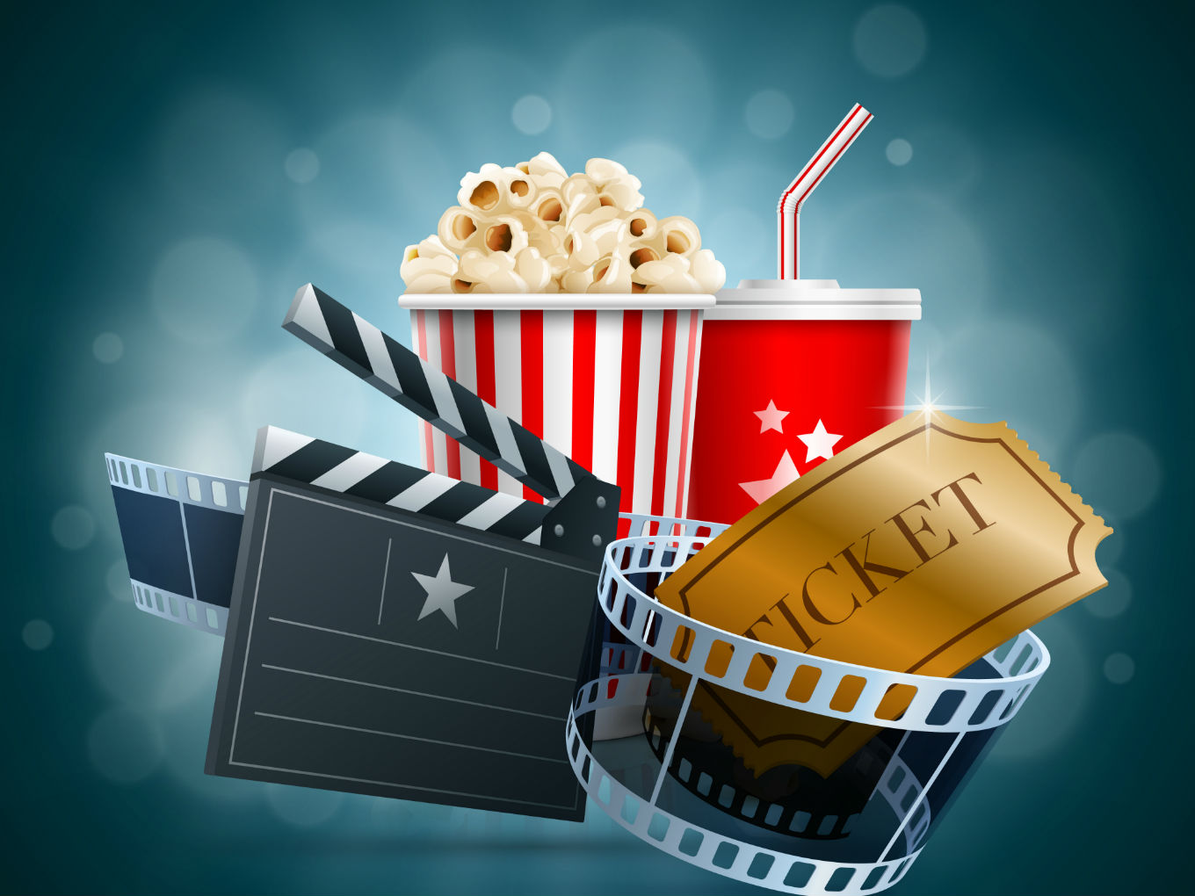
Introduction
Box-Office is project designed to provide book movie tickets or show customer preferred.
This project is developed to make customer experience better and growth in theatre tickets sale.
Current movie-booking system has become outdated in terms of technology the task is improvement on that area.
Box-Office works to book movie tickets from different theatre available.
A user can book movie tickets or show at there convenience.
Admin can make necessary changes to the movies like add a new movie or delete etc.
In this review/opinion of customer is most important aspect , as the machine learning algorithm works on customer requirements.

Slide 5
Literature Survey
Current Movie Booking System has managed to outdate the manual system of movie tickets.
As the technology grows even more the online move booking seems to lack customer specific system.
This case study is of finding places of improvement in current system to make customer experience of service more better.
Below are the current Web Application on which case study is done :-
Bookmyshow.com
Paytm.com
Justtickets.in
PVRCinemas.com

Slide 6
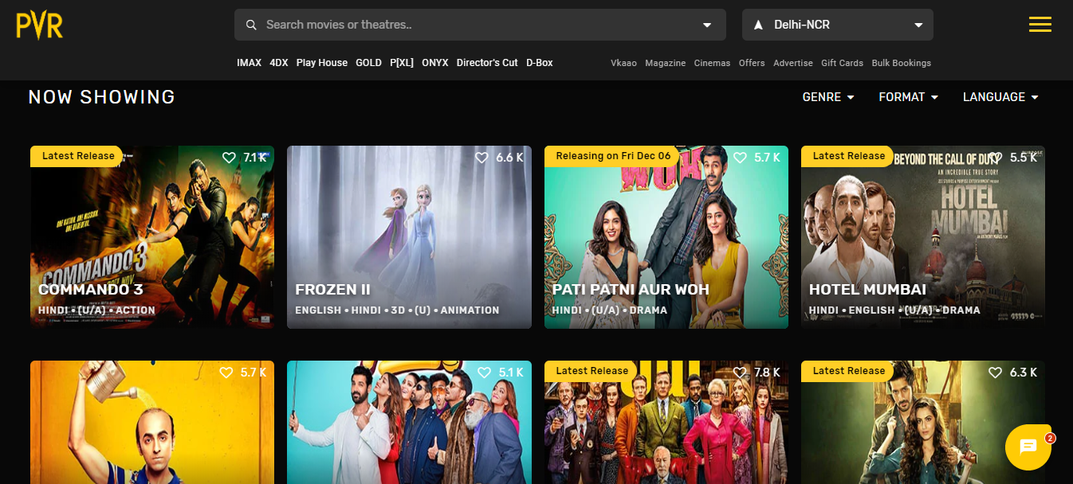
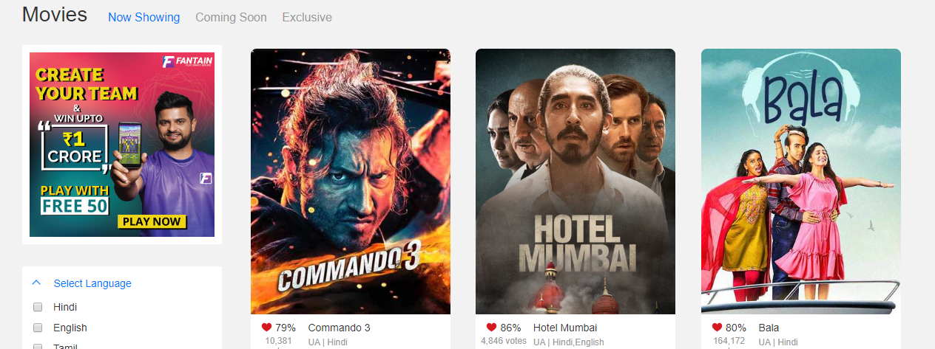
Issues With Current System
Generalized Customer View
As in the above web apps we can see the view which is not as per customer interests its just a general view.
One of the targets of current system is to overcome such issues by making display of movies according to customer’s area of interest.

Slide 7
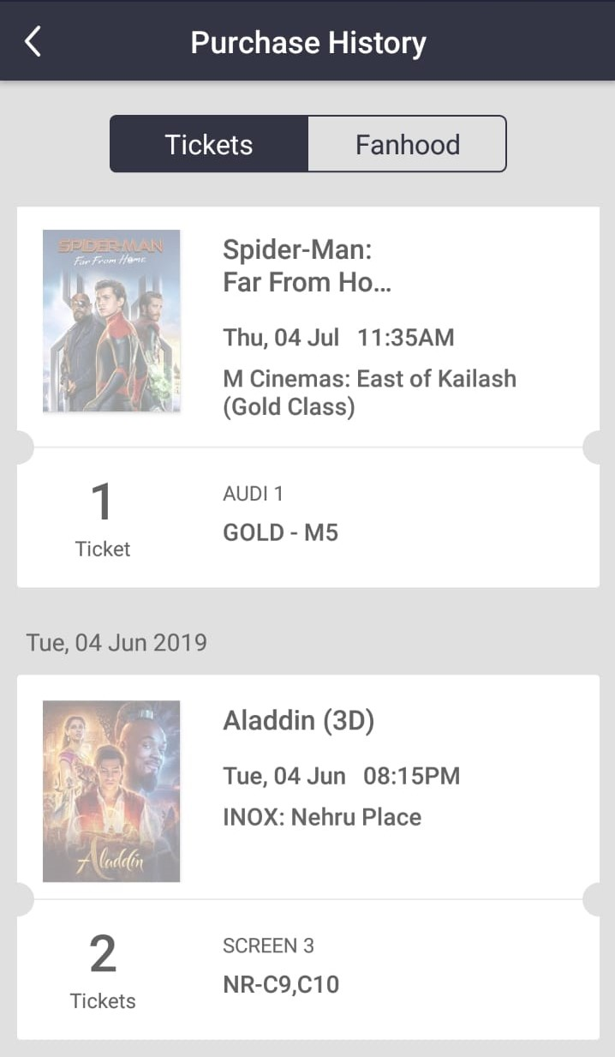
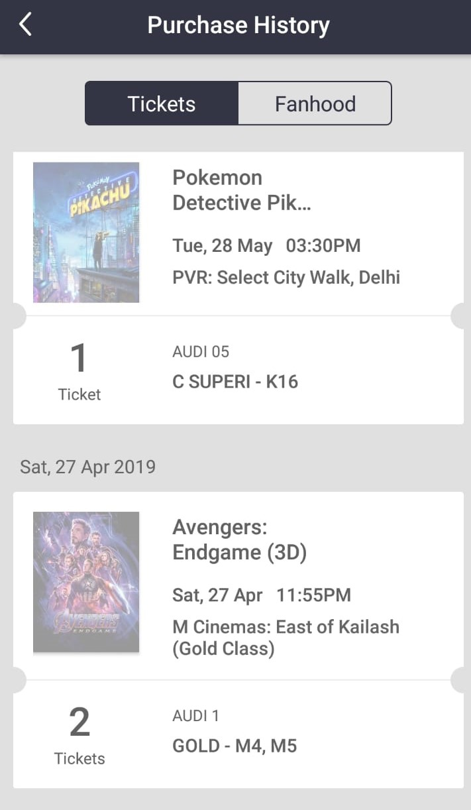
No Analysis of Customer’s Booking Data
Current system fails to analyse customer’s interest for an example which type of movies customer prefers action or romance etc.
Unable to give customer specific/exclusive discounts on the movies.
Doesn't understand current requirements of the customer bookings i.e. for system to guess how many tickets whether customer purchase for specific movie.
This sort of improvement will be done by applying Machine learning algorithms.

Slide 8
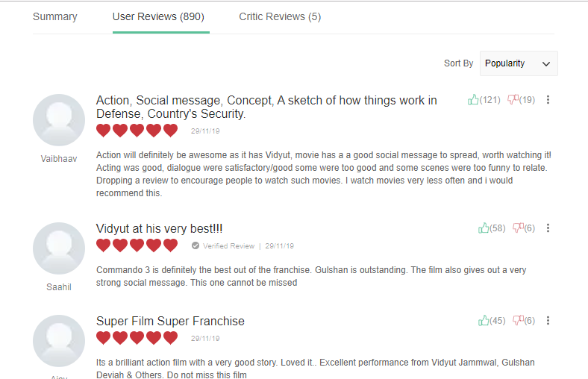
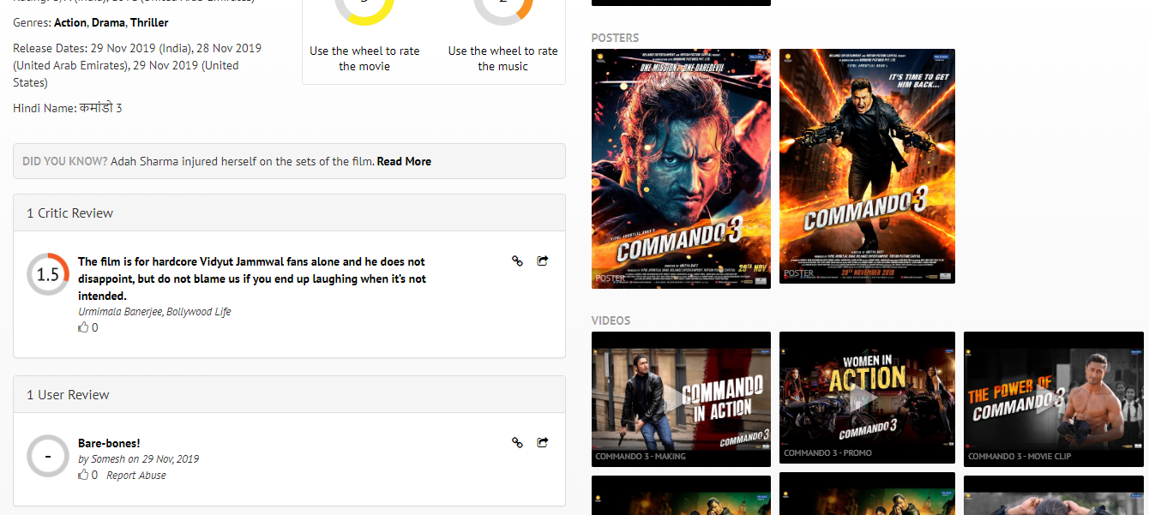
No Working On Customer’s Feedback
As customer finished watching a movie Feedback is the biggest weapon to improve the customer’s experience in the future.
Currently system is just for grading how good is the movie watched but doesn’t checks the reason for customer likes or dislikes in the movie.
No Proper Grading/working on the theatre-condition , content-watched or service received from the web app etc.

Slide 9
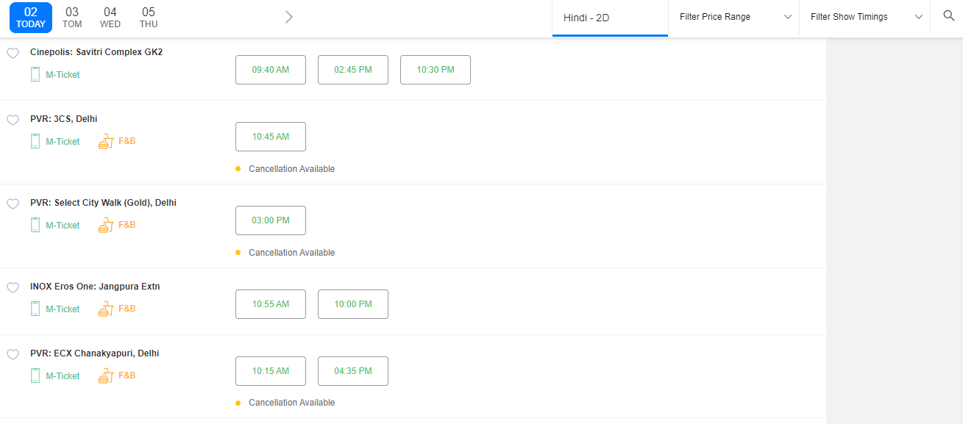
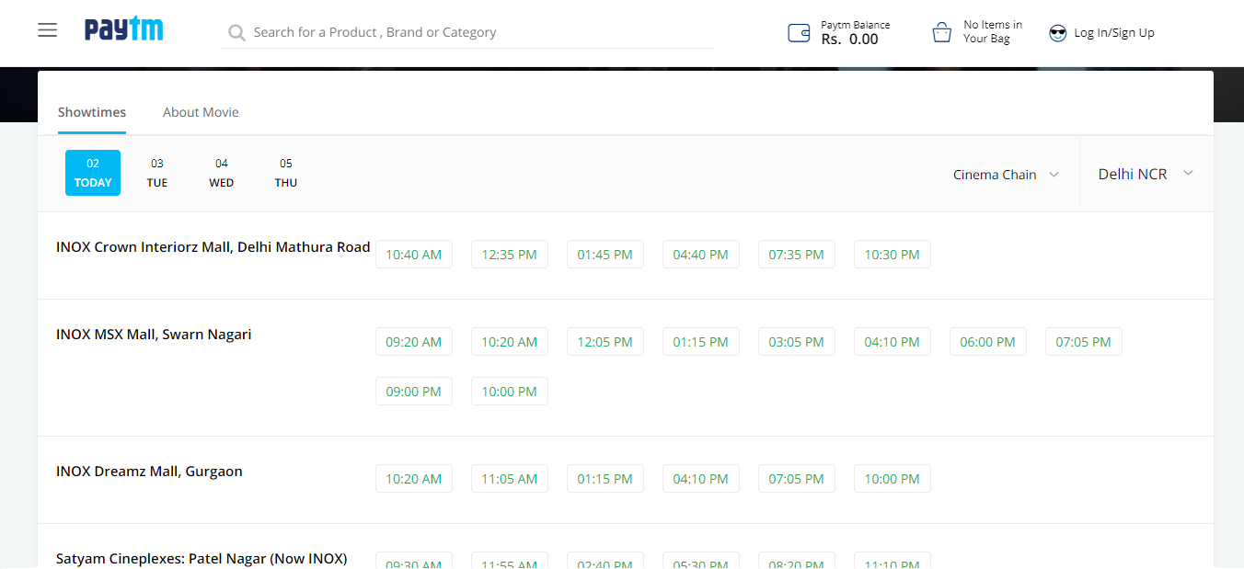
Theatre’s Improvement
Current System works only on movies but doesn’t understands the theatre condition or customer’s favourite theatre.
Our one of the main goals is to provide theatre way’s of improving their halls or growth in tickets sale.
By understanding customer interest we get to know which theatre are preferred by customer, hence through this analysis we provide theatre specific schemes or discounts to the customers.
Also we can provide theatre’s area of improvements in betterment of customer experience.

Slide 10
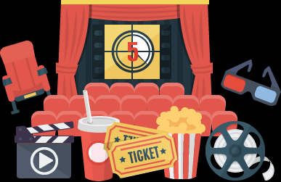
IMPORTANCE OF BOX-OFFICE :-
Saves Customer time from physically go to theatre to buy tickets.
Gives a variety of theatre to book tickets.
Review Each movie and theatre to improve experience next time.
Customer review enhance the system as machine learning works on the raw data.
Provide enhance movie experience for customer.
Gives the relevant movies according to customer review.

Slide 11
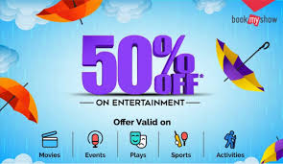
Tools & Technology :-
In Box-Office we have used following tools and technology :-
For front end :- Html , Cascading Style Sheet and Javascript
For Backend :- Python and Django
Movie Recommender System :- R and Machine learning algorithms
For Database- SQL Server(XAMPP , Sql lite)

Slide 12
Proposed Methodology
(linked To UML Diagrams)
Class Diagram
Component Diagram
Use case Diagram
Sequence Diagram
State diagram
Entity-Relationship Diagram
Data Flow Diagram :-
DFD Level-0
DFD Level-1

Slide 13
CONCLUSION:-
Box-office is further improvement on the old movie booking with the help of machine learning it increase growth of selling movie tickets.
From customer point of view box-office helps them find the relevant movie and discounts.
Movie recommender increases the growth of entertainment industry.
Each type of movie booking becomes customer specific.
More efficient way of using movie-booking system.

Slide 14
Future Improvements
Currently system supports machine learning with intervention of human to keep check on through the help of artificial intelligence we can completely automate system.
Movie booking system keeps each customer booking (supervised data) what if the system keeps track of unsupervised data that is keep track of cancellations and improve to customer preference.

Slide 15
References
Github –
https://github.com/mraduldubey/django-theatre-ticket-booking
Wikipedia –
https://en.wikipedia.org/wiki/MovieTickets.com
Slideshare –
https://www.slideshare.net/mrinnovater007/online-movie-ticket-booking
Tutorialspoint –
https://www.tutorialspoint.com/django
Kaggle – (dataset used)
https://www.kaggle.com/shivamb/netflix-shows

Slide 16
THANK YOU

