Slide 1

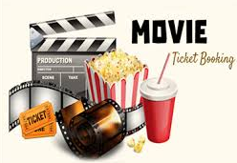
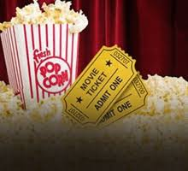
Designing An Efficient Machine Learning Based Approach for Prediction of Automated Movie Booking
Application Name - BoxOffice
Project Supervisor - Nagesh sharma

Slide 2

Team Members:-
NAME | ROLL NO | TASK
KARTIK ANEJA | 1613331082 | Back End, Documentation, Database
NITESH JAIN | 1613331127 | Front End Design , Database
MUKUL RAJ | 1613331111 | Front End Design , Documentation
RACHIT SHARMA | 1613313073 | Documentation, Information Resources

Slide 3


Contents
INTRODUCTION
LITERATURE SERVEY
IMPORTANCE OF BOX-OFFICE
TOOLS AND TECHNOLOGY
PROPOSED METHODOLOGY
CONCLUSION
FUTURE IMPROVEMENTS
REFERENCE & LINKS

Slide 4

Introduction
Box-Office is project designed to provide book movie tickets or show customer preferred.
This project is developed to make customer experience better and growth in theatre tickets sale.
Current movie-booking system has become outdated in terms of technology the task is improvement on that area.
Box-Office works to book movie tickets from different theatre available.
A user can book movie tickets or show at there convenience.
Admin can make necessary changes to the movies like add a new movie or delete etc.
In this review/opinion of customer is most important aspect , as the machine learning algorithm works on customer requirements.

Slide 5
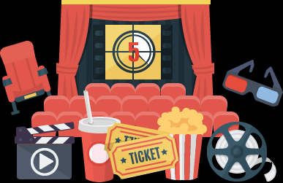
IMPORTANCE OF BOX-OFFICE :-
Saves Customer time from physically go to theatre to buy tickets.
Gives a variety of theatre to book tickets.
Review Each movie and theatre to improve experience next time.
Customer review enhance the system as machine learning works on the raw data.
Provide enhance movie experience for customer.
Gives the relevant movies according to customer review.

Slide 6
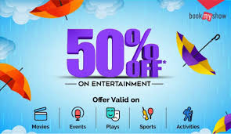
Tools & Technology :-
In Box-Office we have used following tools and technology :-
For front end :- Html , Cascading Style Sheet and Javascript
For Backend :- Python and Django
Movie Recommender System :- R and Machine learning algorithms
For Database- SQL Server(XAMPP , Sql lite)

Slide 7
Proposed Methodology
(linked To UML Diagrams)
Class Diagram
Component Diagram
Use case Diagram
Sequence Diagram
State diagram
Entity-Relationship Diagram
Data Flow Diagram :-
DFD Level-0
DFD Level-1

Slide 8
CONCLUSION:-
Box-office is further improvement on the old movie booking with the help of machine learning it increase growth of selling movie tickets.
From customer point of view box-office helps them find the relevant movie and discounts.
Movie recommender increases the growth of entertainment industry.
Each type of movie booking becomes customer specific.
More efficient way of using movie-booking system.

Slide 9
Future Improvements
Currently system supports machine learning with intervention of human to keep check on through the help of artificial intelligence we can completely automate system.
Movie booking system keeps each customer booking (supervised data) what if the system keeps track of unsupervised data that is keep track of cancellations and improve to customer preference.

Slide 10
References
Github –
https://github.com/mraduldubey/django-theatre-ticket-booking
Wikipedia –
https://en.wikipedia.org/wiki/MovieTickets.com
Slideshare –
https://www.slideshare.net/mrinnovater007/online-movie-ticket-booking
Tutorialspoint –
https://www.tutorialspoint.com/django
Kaggle – (dataset used)
https://www.kaggle.com/shivamb/netflix-shows

Slide 11
THANK YOU

