Slide 1
Garbage Classification Using Deep Learning Neural Networks
PRML Intermediate Report
Anek Anjireddy
ee22btech11007

Slide 2
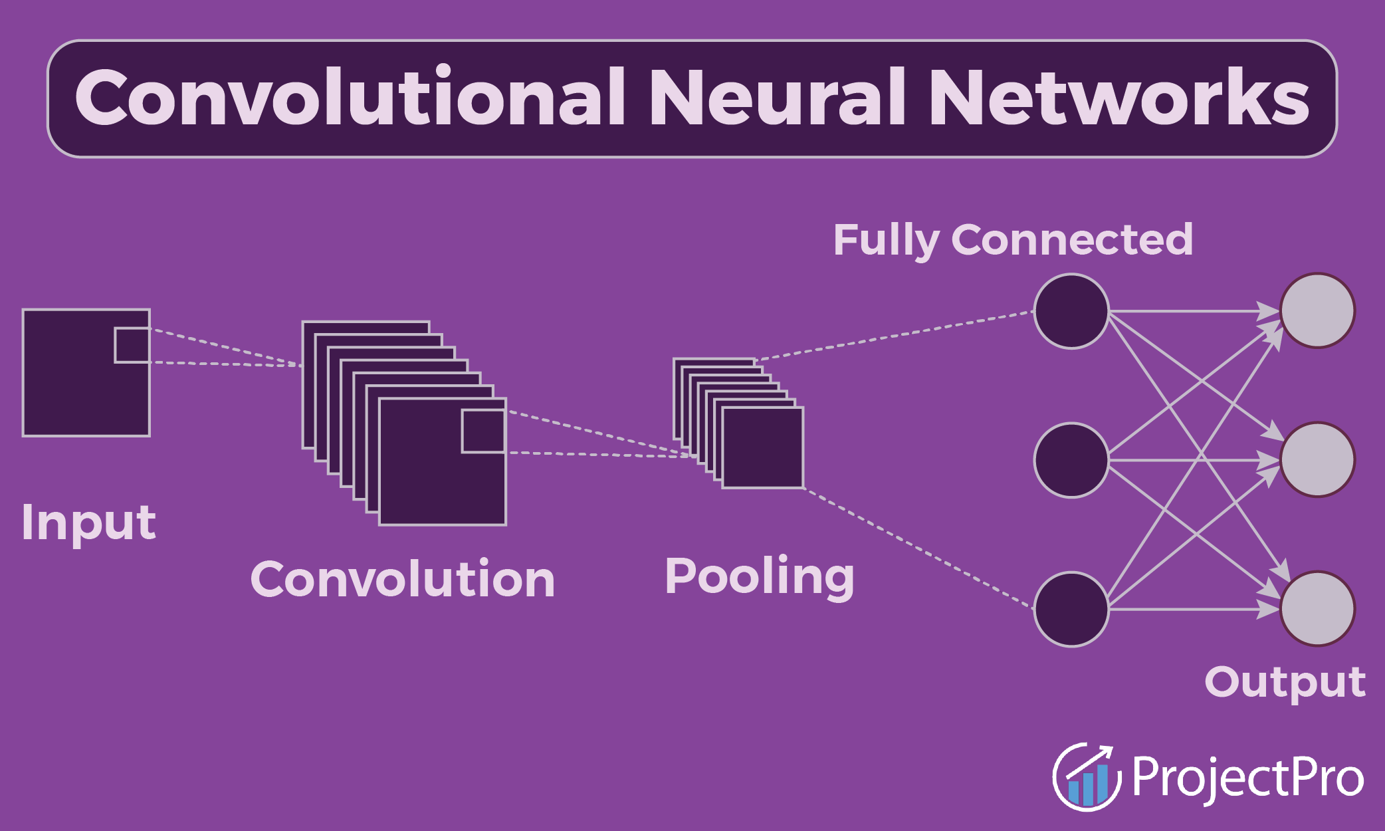
Motivation & Context
The problem of improper waste segregation remains a major challenge in sustainable urban management.
An efficient solution to this problem are deep learning neural networks such as Convolutional Neural Networks (CNNs).
CNNs are powerful models capable of learning spatial and visual patterns directly from image data.
The model takes input as waste images and predicts the category each image belongs to.
The goal is to build a deployable and efficient classification framework that generalizes across different datasets and real-world waste images.

Slide 3
Motivation & Context
Efficient waste management has become a global challenge, as manual segregation is slow, unsafe, and prone to errors.
Deep learning and computer vision enable automated waste classification, improving accuracy and efficiency in recycling and disposal processes.
The project addresses the challenge of robust waste classification using deep learning, aiming to improve generalization across diverse datasets and real-world waste images.
A key motivation is to develop an efficient yet deployable architecture that maintains high classification quality while reducing computational cost.

Slide 4
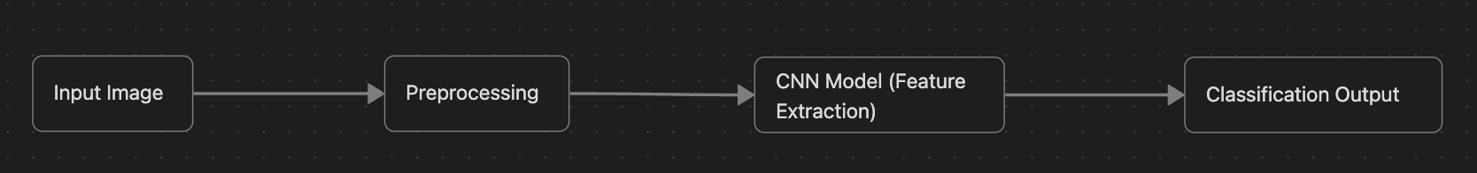
Problem Statement and Goals
Problem Statement: Automate the process of garbage classification using deep learning for accurate and scalable waste segregation.
Objective: Develop a model that can classify waste images into various categories. (Binary for now, to be expanded to 5-6 classes).
Goals
Build a baseline CNN model capable of achieving consistent performance on curated datasets.
Extend the framework to multi-class classification (5–6 categories) using diverse datasets.
Test the trained model on real-life waste images from the IITH campus to validate robustness.

Slide 5
Approach
Data Collection and Preprocessing:
The dataset is sourced from publicly available datasets. Images are resized, normalized, and augmented (rotation, flip, zoom, contrast) to improve generalization and simulate real-world variability.
Model Architecture (Version 1):
The baseline model is EfficientNetB0 trained for binary or limited-class classification. It serves as a foundation for performance benchmarking and metric tuning.
Model Optimization (Version 2):
The second version introduces deeper architectures, dropout regularization, and learning rate scheduling. Evaluation uses Precision, Recall, and F1-best threshold to optimize classification balance beyond raw accuracy.
Multi-Class Expansion:
The framework will be extended to handle 5–6 distinct classes (e.g., paper, plastic, metal, glass, organic, others).
Cross-Dataset and Real-World Testing:
The final model will be validated on unseen datasets and real images from the IITH campus, assessing robustness under varied lighting and background conditions.

Slide 6
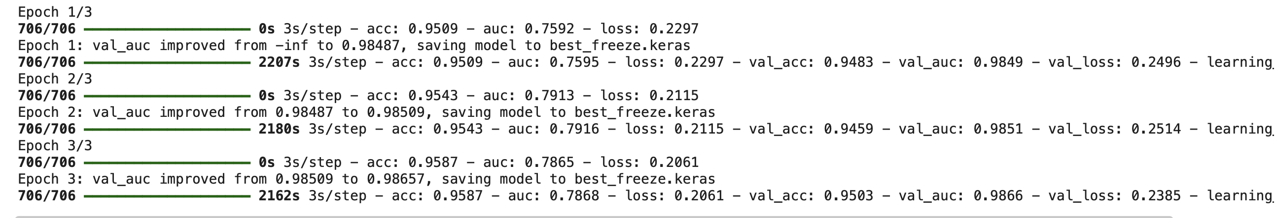
Intermediate Result
After running the model a couple of times with different learning rates and small modifications in neural network's layers, these are the best results i've gotten.
acc: 0.9587 , val_auc: 0.9866, loss: 0.2061
Here is the Output:
Improvements: Will check for other metrics like precision,recall,etc.

Slide 7
Learning
Learned (and learning) end-to-end workflow of data preprocessing, model tuning, and evaluation.
Faced a challenge where the dataset had no validation split — resolved by creating a custom, class-balanced split with fixed seed for reproducibility.
Dealt with class imbalance and low-quality images through augmentation and weighted loss functions.
Understood the value of optimizing models using F1-best threshold, not just accuracy, for balanced performance.
Gained insight into practical deployment trade-offs between model complexity, accuracy, and inference time.

Slide 8
Further Steps
The immediate nest step is to work on Version 2 and fine tuning the model. I'm looking to optimise the model on metrics (like Precision, Recall,etc.) other than just raw accuracy. To do so I plan on using the F1-best threshold metric.
Following this, I'll expand the project to multi-class classification.I'm currently aiming for 5-6 classes. I will train this model on various datasets to ensure generalization.
Test the model on real-life waste images from the IITH campus to assess real-world performance.
In the longer term, I aim to extend the framework toward object detection, using architectures such as YOLO or Faster R-CNN, enabling the system to not only classify but also locate and label individual waste items within an image.

Slide 9
Thank You

