Slide 1



Sistem Monitoring Data & Informasi Survey
Direktorat Sistem Informasi Statistik

Slide 2
This is Outlines
Usecase
ERD
Progress System
Schedule
Flowchart
Context Diagram

Slide 3

Our Schedule
Based on Agile Development
loading

Slide 4
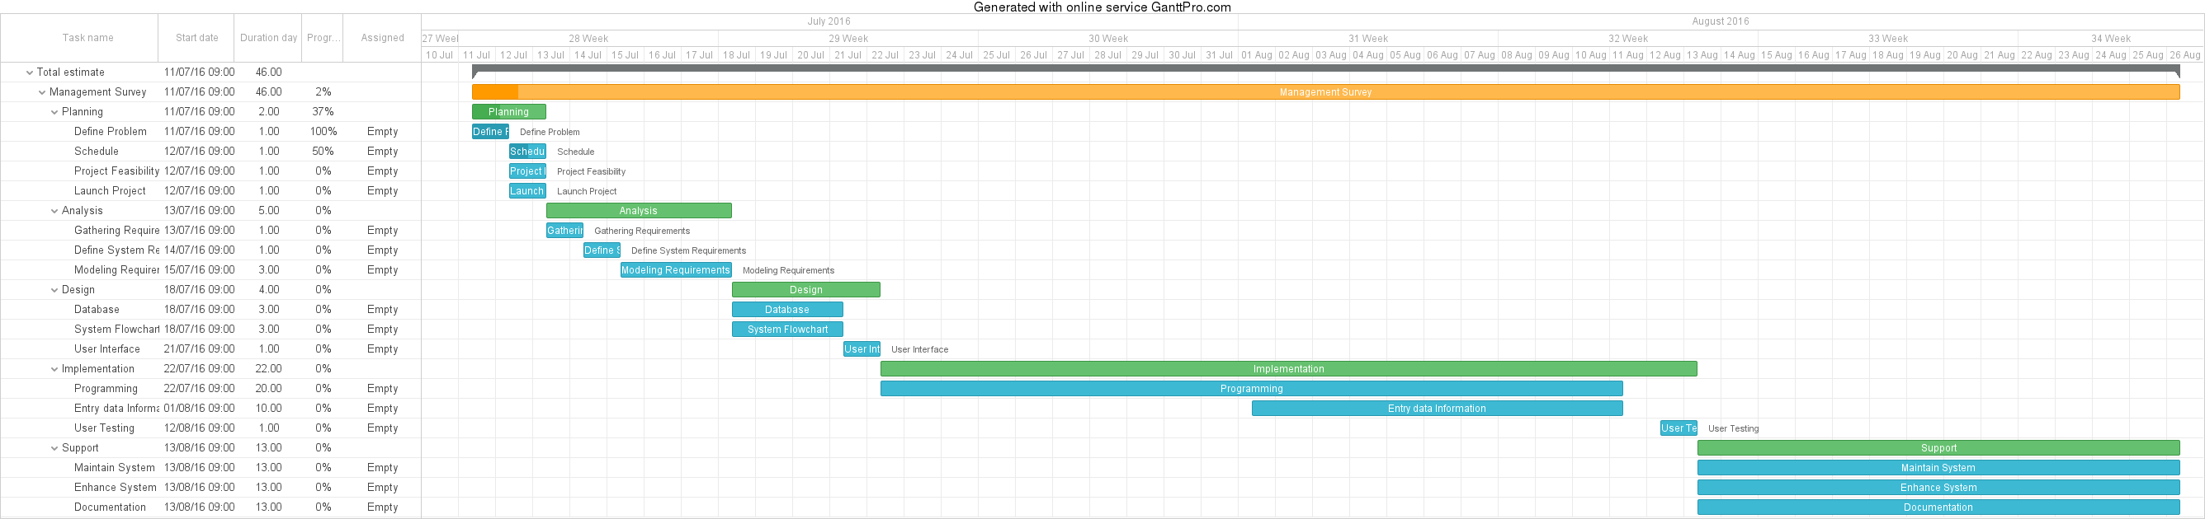
Development Schedule

Slide 5

USECASE
Explain our functional system
loading

Slide 6
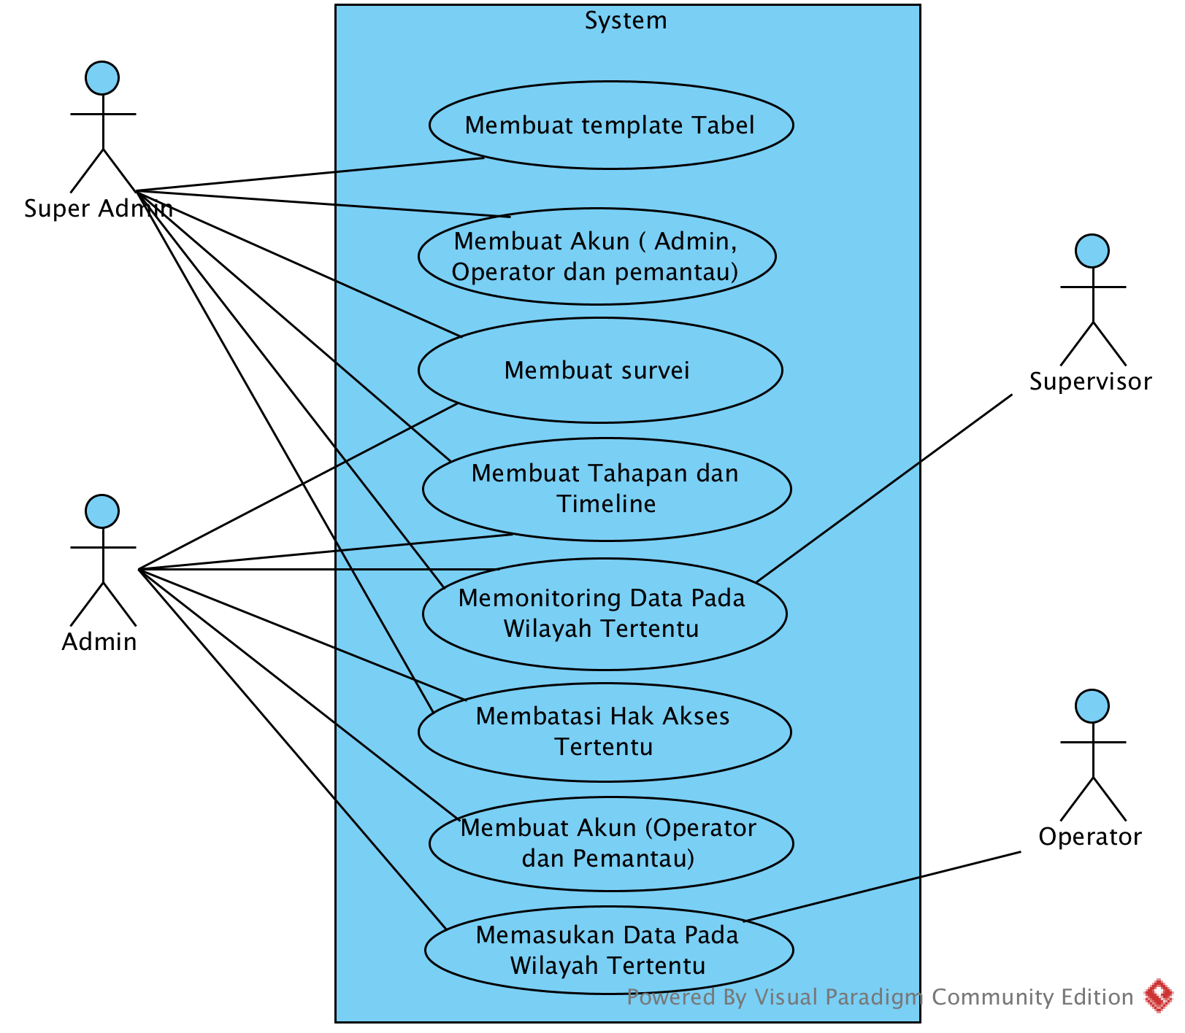

Slide 7

FLOWCHART
The steps as shape of various kinds
loading

Slide 8
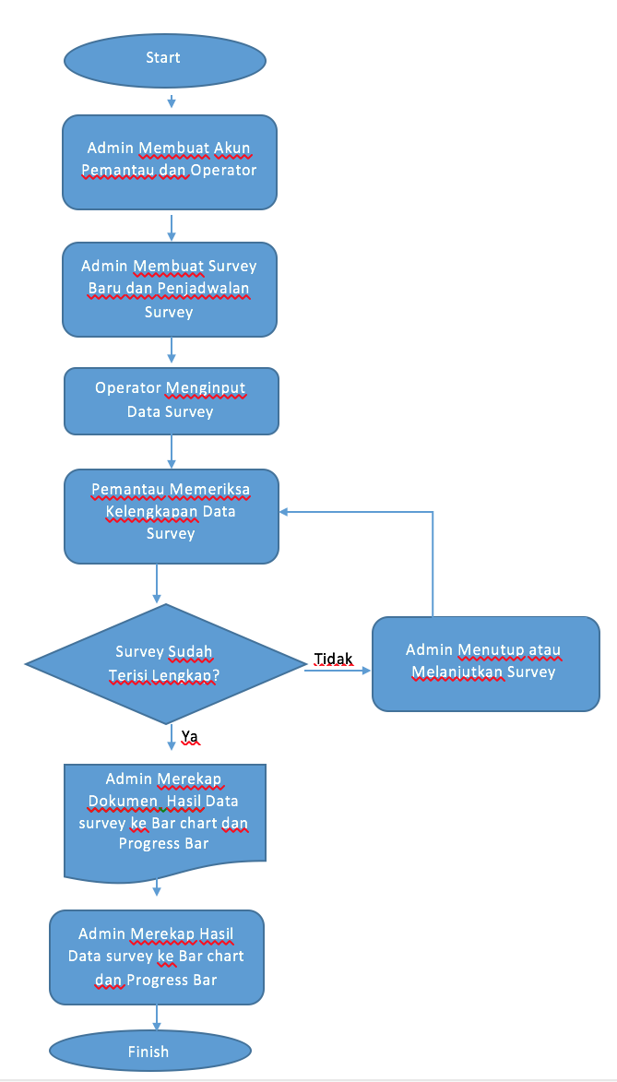

Slide 9

Entity Diagram
Data modelling technique
loading

Slide 11

User Interface
The steps as shape of various kinds
loading

