Slide 1
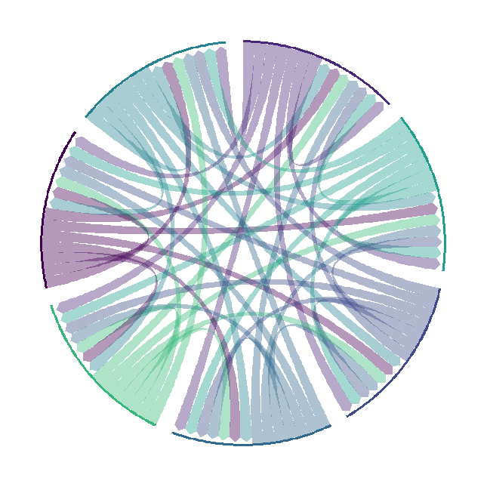
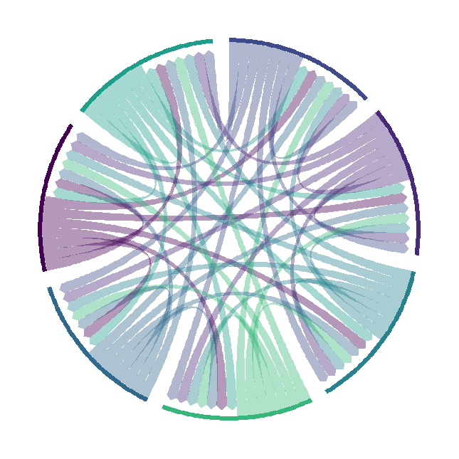
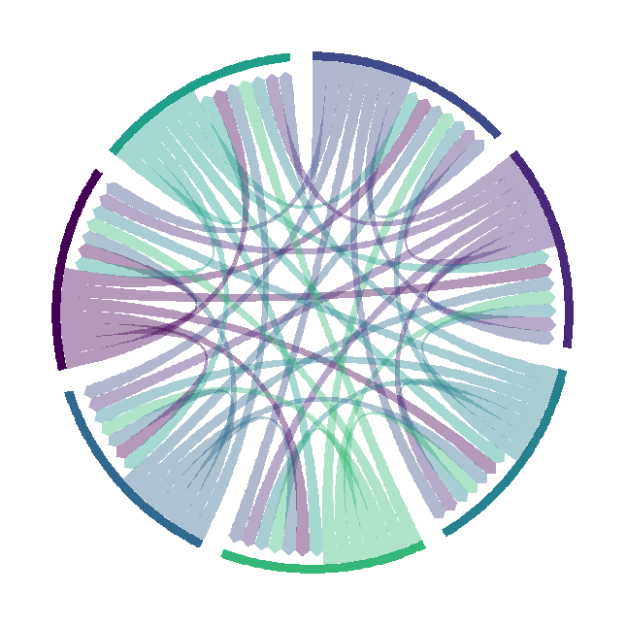
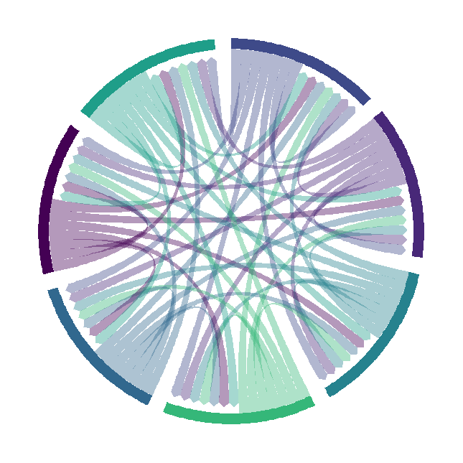
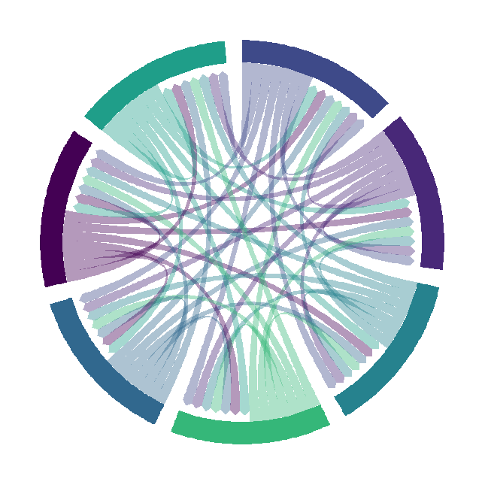
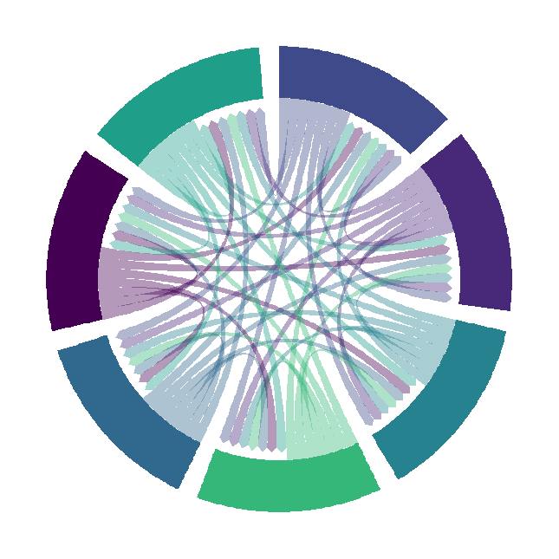
chordDiagram(
x = data_long,
grid.col = mycolor,
transparency = 0.6,
directional = 1,
direction.type = c("arrows", "diffHeight"),
diffHeight = -0.03,
annotationTrack = "grid",
annotationTrackHeight = c(0.1, 20),
link.arr.type = "big.arrow",
link.sort = TRUE,
link.largest.ontop = TRUE)
chordDiagram(
x = data_long,
grid.col = mycolor,
transparency = 0.6,
directional = 1,
direction.type = c("arrows", "diffHeight"),
diffHeight = -0.03,
annotationTrack = "grid",
annotationTrackHeight = c(0.2, 40),
link.arr.type = "big.arrow",
link.sort = TRUE,
link.largest.ontop = TRUE)
chordDiagram(
x = data_long,
grid.col = mycolor,
transparency = 0.6,
directional = 1,
direction.type = c("arrows", "diffHeight"),
diffHeight = -0.03,
annotationTrack = "grid",
annotationTrackHeight = c(0.05, 30),
link.arr.type = "big.arrow",
link.sort = TRUE,
link.largest.ontop = TRUE)

