Slide 1

Project 3 - Team 6
Data Boot Camp 2023-2024
Exploring Human Development Index (HDI) differences and trends from 1990 to 2021 with focus on maternal mortality rates and gender inequality data
Data Engineering Track using ETL (Extract, Transform and Load) Workflows
Andrea Hernandez, Mark Mason, Breona Lewis, Daniela Trujillo
Notes:
Presentation Flow:
Intro - Mark
Extract - Daniela
Transform & Load - Andrea
Data Ethics - Bre
Our team chose the data engineering track, so we used ETL Workflows to create a database to analyze and explore Human Development Index (HDI) differences and trends from 1990 to 2021 with added focus on maternal mortality rates and gender inequality indexes.

Slide 2
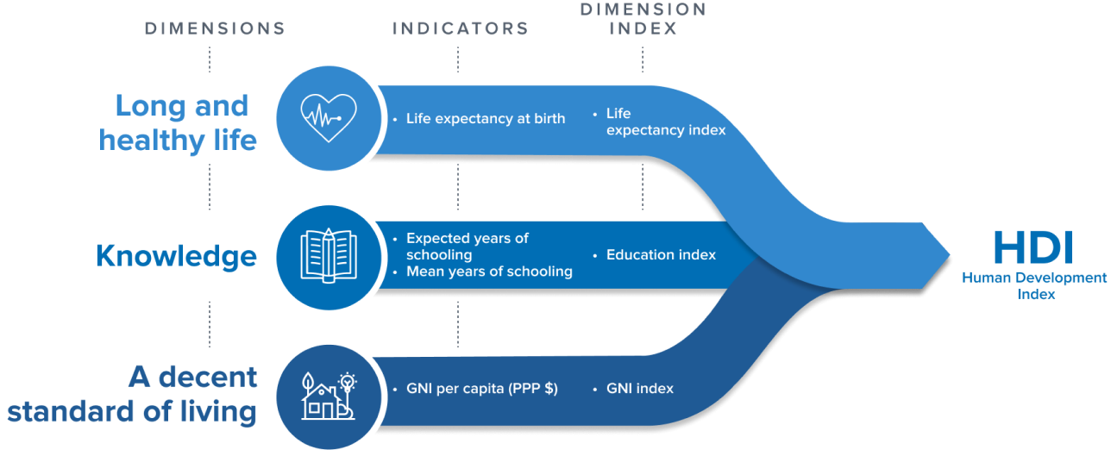
HDI - Human Development Index
Notes:
The United Nations developed the HDI to track, rank and compare a country’s relative success. This diagram explains how the HDI is calculated by combining 3 indexes, which are based on three dimensions: (1) a long and healthy life; with the indicator of life expectancy at birth, (2) knowledge; with the indicator of years of schooling, and (3) a decent standard of living; with the indicator of gross national income (GNI).
The HDI informs governments on public policy and what changes can be made to improve the quality of life for all humanity. However, the HDI does not include specific data related to maternal mortality or gender inequality.
Source: Data Center | Human Development Reports (undp.org)

Slide 3
Project Goal
Research Questions:
.
What developing regions have the highest maternal mortality and gender inequality rates?
Did this change from the 90’s to 2000’s?
What is the correlation between HDI rank and maternal mortality?
What is the correlation between HDI rank and gender inequality?
What are the differences in HDI rank, maternal mortality, and gender inequality between hemispheres?
Did this change from the 90’s to the 2000’s?
Notes:
In addition to the HDI, we gathered data related to maternal mortality and gender inequality indexes with a project goal to allow for further analysis and to help answer these research questions:
1) The highest maternal mortality and gender inequality rates per Developing region
2) The correlation between HDI rank and maternal mortality
3) The correlation between HDI rank and gender inequality
4) Differences in HDI rank, maternal mortality, and gender inequality between hemispheres

Slide 4

ETL (Extract, Transform and Load)
Extracted and Transformed data using Polars Library in Jupyter Notebook
https://docs.pola.rs/user-guide/
Very similar Dataframe Library to Pandas [supports common data formats]
Faster and less coding steps than Pandas
Example Code:
cols_to_mean=['Maternal Mortality Ratio (deaths per 100,000 live births) (1990)',
'Maternal Mortality Ratio (deaths per 100,000 live births) (1999)']
matmort90_mean=MaternalMort_df.select( MaternalMort_avg_1990Decade=pl.concat_list(cols_to_mean).list.mean())
Notes:
For this ETL project we use Polars which is very similar Pandas on how their functions work. They are easy to use and very efficient for either small or large sets of databases. Also polars its faster and have less coding steps than Pandas

Slide 5
Extract
Datasets:
The Maternal Mortality (Sourav Banerjee (Owner)) and Gender Inequality (Sourav Banerjee (Owner)) csv datasets were downloaded from Kaggle. The HDI Rank dataset came from the United Nation Human Development Reports Website.
The csv files were read into a jupyter notebook using Polars.
Maternal Mortality: https://www.kaggle.com/datasets/iamsouravbanerjee/maternal-mortality-dataset
Gender Inequality: https://www.kaggle.com/datasets/iamsouravbanerjee/gender-inequality-index-dataset
HDI Rank 2021: https://hdr.undp.org/data-center/documentation-and-downloads
Notes:
For the extraction process, we started by creating a Polars Dataframe Library which was used to read in the csv files and transformation. Matplotlib was also utilized for simple graphs to visually assess the data. The first step in this project was to extract all three datasets from their sources and read them into a jupyter notebook. The maternal mortality and gender inequality csv files were obtained from Kaggle and were created by Sourav Banerjee. The HDI rank (2021) dataset came from the UNDP website. This dataset was an excel spreadsheet that was cleaned up and transformed into a csv file prior to reading it into a jupyter notebook.

Slide 6
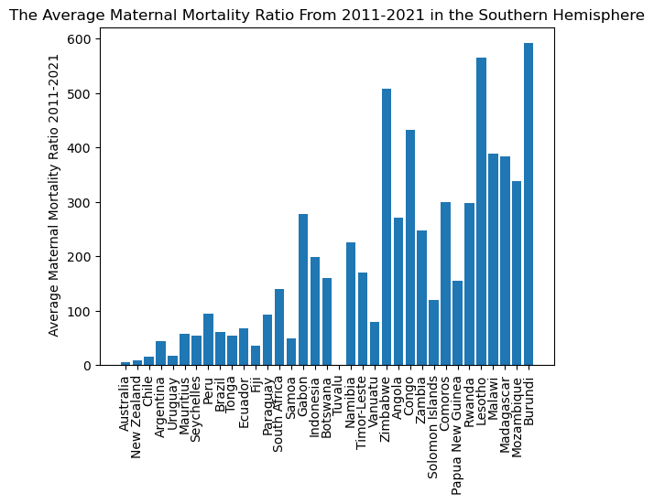
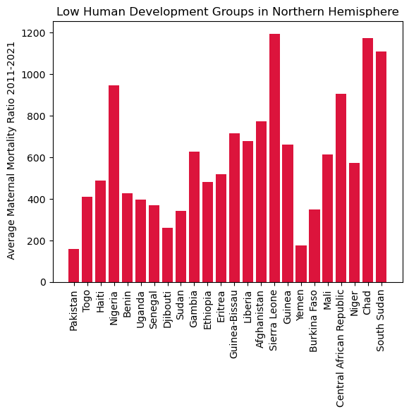
Transform
Maternal_Decade_Index=MaternalMort_df.with_columns(
pl.Series(name='Maternal Mortality Ratio (deaths per 100,000 live births) Average (1990-1999)', values=matmort90_mean),
pl.Series(name='Maternal Mortality Ratio (deaths per 100,000 live births) Average (2000-2010)', values=matmort00_mean),
pl.Series(name='Maternal Mortality Ratio (deaths per 100,000 live births) Average (2011-2021)', values=matmort21_mean)
Main Goals to answer Research Questions:
Transform the Maternal Mortality and Gender Inequality data to understand the change in these attributes from the 1990’s to 2021 by analyzing each decade.
Explore differences in Maternal Mortality and Gender Inequality rates in the Northern and Southern Hemispheres.
Notes:
We used the polars library for all of our transformation coding. Polars is a really user friendly library and being so similar to pandas made it a simple learning curve. The transformation of the datasets focused on taking the yearly maternal mortality ratios and gender inequality index values from 1990 to 2021 and averaging them by decades:
1990-1999
2000-2010
2011-2021.
To achieve this I used the columns to mean function in polars and then the concat_list

Slide 7
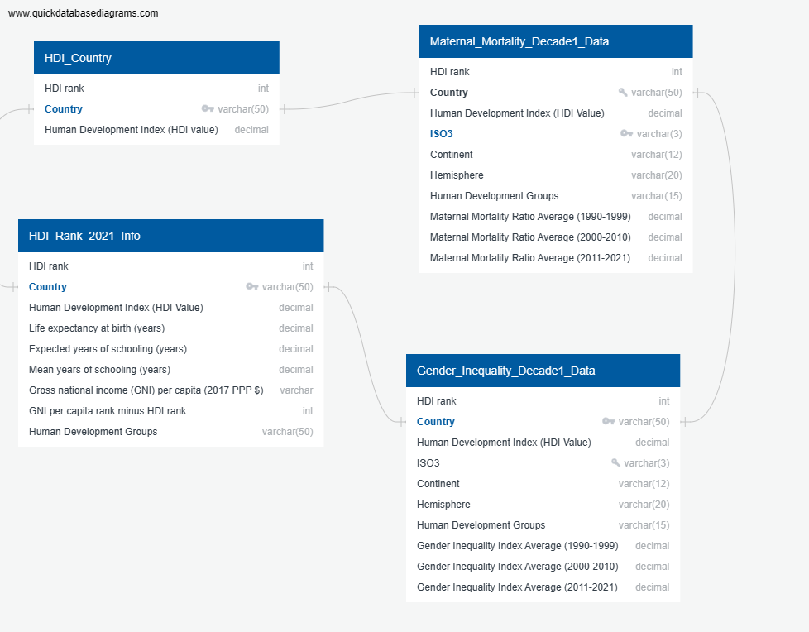
Load:
Postgres-SQL Database
We created an ERD using the quick DBD website and then uploaded that schema in a Postgres SQL database.
All datasets were imported into the created tables.
This database can now be used to further explore the relationships between Maternal Mortality and Gender Inequality decade data with other HDI values to find different correlations.
SELECT m."Country", m."HDI rank", m."Maternal Mortality Ratio Average (2011-2021)"
FROM public."Maternal_Mortality_Decade1_Data" m
JOIN public."HDI_Rank_2021_Info" h
ON (m.Country = h.Country)
WHERE h."Mean years of schooling (years)">5;

Slide 8

Data Ethics Considerations
And Concluding Thoughts
Polars is efficient, easy to learn, and simple to use; comparable to pandas.
We were able to transform the data into a simple and understandable format, despite minor errors.
Mortality Rate compared to gender inequality displayed an overall decrease in the last 30 years
Access to accurate information related to low developing regions may vary.
Notes:
The main takeaway from this ETL project was learning how useful the polars dataframe library can be for an ETL project. The library is efficient, fast, and easy to learn. It is very comparable to Pandas and has an ease to its coding that makes it painless for dataset transformation. The creation of the SQL database did present a few roadblocks with respect to creating primary and foreign keys. The HDI ranking system did have duplicate ranking positions so it could not be used as a one to one relationship, but using the country attribute fixed the problem. Also making sure the naming of columns was more precise without any spacing created issues. These issues showed the importance of concise data transformation for any project.
We were able to address our research questions, however more exploration using the SQL database is needed to fully understand the relationship between maternal mortality and gender inequality with specific HDI rank measurements. This project showed that developing regions in both the Northern and Southern Hemisphere have widespread variation in maternal mortality and gender inequality values, however across the board these rates decreased from the 1990's to 2021. Also it seems the Southern Hemisphere has a higher rate of maternal mortality and gender inequality compared to the Northern Hemisphere. The correlation between the HDI rank and maternal mortality/gender inequality is the lower ranked countries have lower rates in both maternal mortality and gender inequality and have consistently decreased from each decade throughout the last 30 years.

Slide 9
References
&
Data Sources
References:
· Human Development Index (HDI)
o Data Center | Human Development Reports (undp.org)
Data Sources:
· HDI Rank 2021 csv
o Human Development Index | Human Development Reports (undp.org)
· Gender Inequality csv
o Gender Inequality Index by Country (kaggle.com): https://www.kaggle.com/datasets/iamsouravbanerjee/gender-inequality-index-dataset
· Maternal Mortality csv
o Maternal Mortality Dataset (kaggle.com): https://www.kaggle.com/datasets/iamsouravbanerjee/maternal-mortality-dataset?select=Maternal+Mortality.csv

