Slide 1




MAchine learning
Diabetes dataset analysis
Anela Bašić
Tuzla, 2024

Slide 2
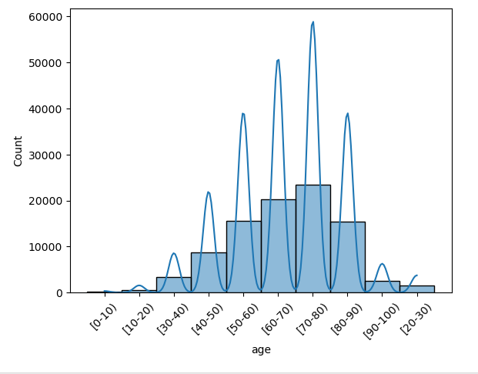
Visualization

Slide 3
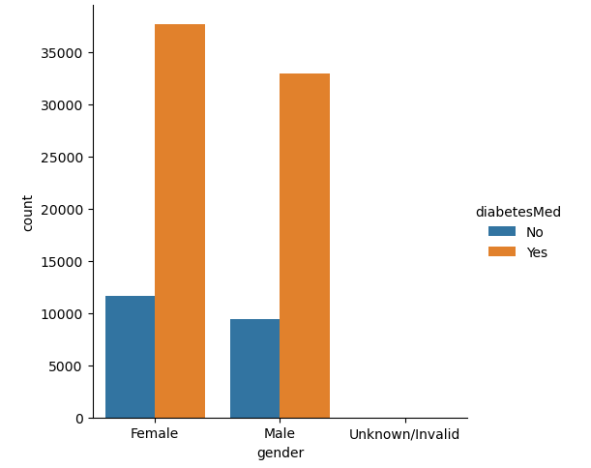
Visualization

Slide 4
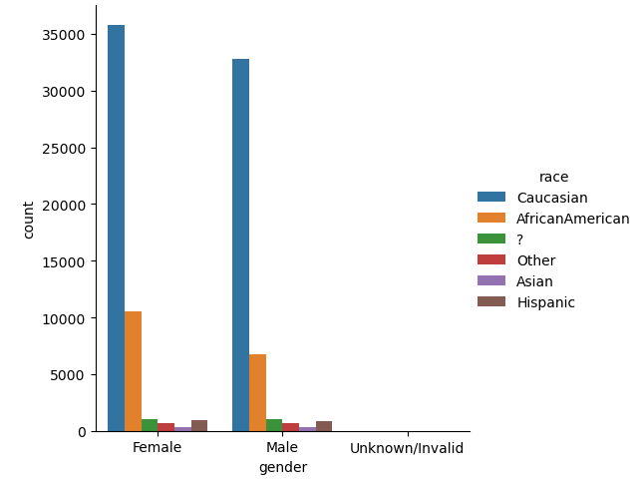
Visualization

Slide 5
Preprocessing
Drop irrelevant columns
Handle missing values
Remove irrelevant medication columns
Encode categorical columns
Standardize numerical columns
Handle outliers

Slide 6
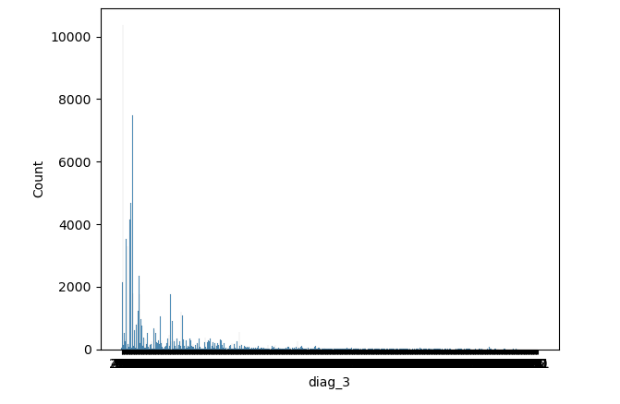
Preprocessing

Slide 7

Model training and Evaluation
Random Forest
Support Vector Machine - SVC
Linear Regression

Slide 8



Model training and Evaluation

Slide 9
Thank you!

