Slide 1

Clinical Natural Language
Technology for Health Care
Past, Present, and Future Approaches — NLP, OCR, Computer Vision, LLM, LMM
Anel Bazarbayeva
Cotiviti Intern Assessment — Generative AI Research Engineer | August 2026

Slide 2




What Is Clinical NLP?
The set of methods that turn unstructured health care information — clinician notes, faxed records, scanned forms, imaging reports — into a form software can act on. Cotiviti's payment-integrity work depends directly on reading exactly this kind of material.
NLP
OCR
Computer
Vision
LLM
LMM
Parsing free text
Digitizing scans
Reading images
Extraction & summary
Multimodal reasoning
For a healthcare informatics company processing high volumes of TPO content, the maturity of these technologies determines how much can be structured and acted on without manual review.
Cotiviti Intern Assessment | Anel Bazarbayeva | 2

Slide 3

Trends: Past, Present, and Future
Past
Present
Future
Rule-based pattern matching & curated dictionaries
Statistical models (CRFs) — one hand-built pipeline per use case
OCR on scanned/handwritten forms was separate & brittle (Rasmussen et al., 2012)
Domain-pretrained models: BioBERT, ClinicalBERT
General LLMs pass medical licensing benchmarks (Singhal et al., 2023)
One LLM call + structured schema replaces a custom pipeline — this POC's approach
Multimodal models (Med-PaLM M) reason over text + imaging + genomics jointly
One review pipeline instead of parallel OCR / NLP / CV systems
Cotiviti Intern Assessment | Anel Bazarbayeva | 3

Slide 4


Opportunities and Threats
Opportunities
Threats
Far more resilient to noisy OCR text than rule-based pipelines
No bespoke NER model to train per document type
Reduces manual abstraction burden on TPO reviewers
Measurable time savings already seen in ambient scribes (Aguilar, 2026)
Hallucination: fabricated details repeated in 50–83% of test cases (Omar et al., 2025)
Growing regulatory exposure: FDA AI/ML SaMD plan, HHS ePHI rules
Bias risk when models train on cost/utilization proxies (Obermeyer et al., 2019)
Cotiviti Intern Assessment | Anel Bazarbayeva | 4

Slide 5



Recommended Options for Cotiviti
1. Pilot a governed extraction service
Apply the OCR-plus-LLM pattern in this POC to a real, high-volume input Cotiviti already receives, scoped narrowly with a human reviewer in the loop.
2. Build the AI governance layer first
Hallucination spot-checks, bias audits, and a change-control process aligned to FDA SaMD and HHS ePHI expectations — before scaling, not after.
3. Track multimodal models as a medium-term bet
Monitor Med-PaLM-M-style systems as a path to a single text-plus-image TPO review pipeline over the next 2–3 years.
Cotiviti Intern Assessment | Anel Bazarbayeva | 5

Slide 6



Proof of Concept: How It Works
A minimal, working pipeline demonstrating the “present” pattern from the trends analysis: OCR handles the historical digitization problem, then a single Claude tool-use call does the structuring work that used to require a purpose-built NER pipeline.
Synthetic
scanned note
OCR
(pytesseract)
Claude tool-use
extraction
Structured
JSON output
Engineering rigor: 4 pytest tests cover the OCR wrapper and the Claude tool-call contract (mocked, no network dependency). Stack: FastAPI, pytesseract, Anthropic Python SDK, vanilla HTML/JS front end — no build step, by design, for a fast “hack.”
Cotiviti Intern Assessment | Anel Bazarbayeva | 6

Slide 7
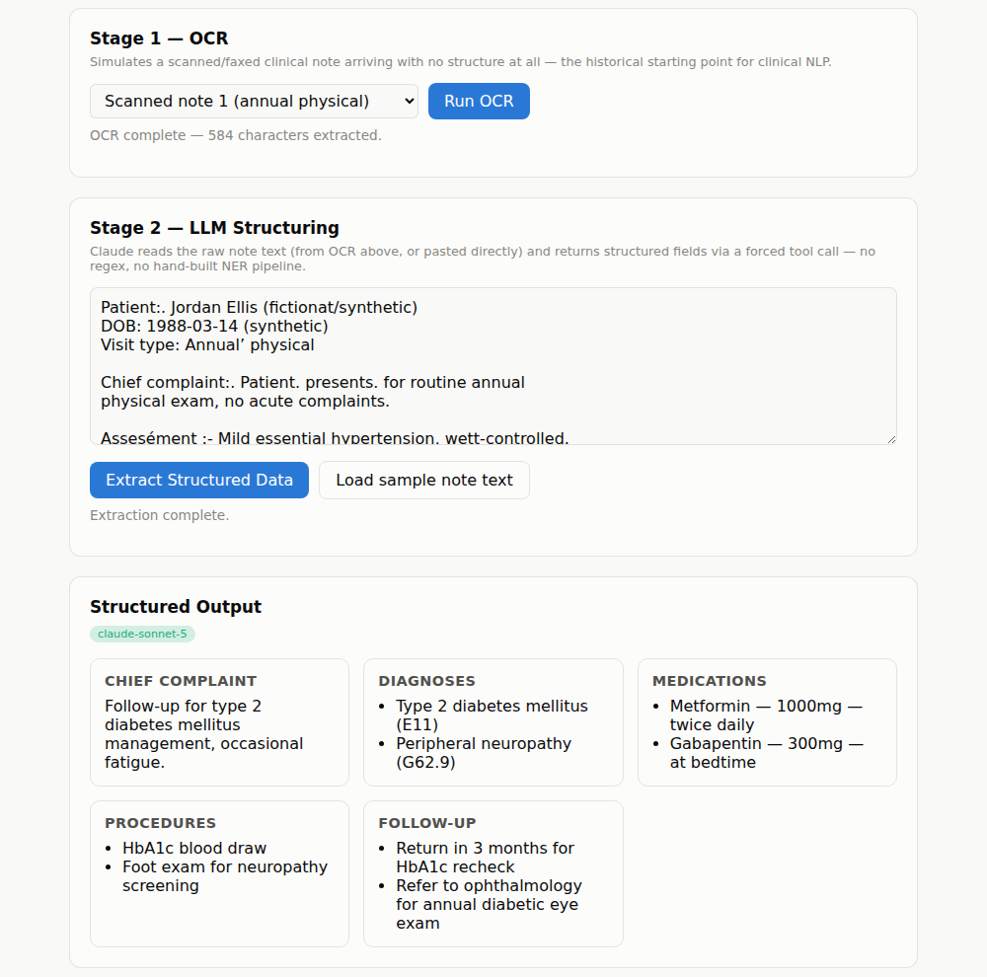
Proof of Concept: Live Demo
A synthetic scanned note goes through OCR, then Claude structures it into chief complaint, diagnoses, medications, procedures, and follow-up — no real patient data anywhere in this project.
See it live: run the demo yourself from the repo README, or watch the accompanying video recording.
Cotiviti Intern Assessment | Anel Bazarbayeva | 7

Slide 8

Thank You
Code, report, and this deck are all in the public repository below.
github.com/anelbazarbayeva95/cotiviti-clinical-nlp-poc
Anel Bazarbayeva | anelb195@gmail.com

