Slide 1
DUT • FACULTY OF ACCOUNTING AND INFORMATICS • SODM401 / SFEN301
AI Shopping for Budgeting and
Making Informed Shopping
Requirement Engineering & System Design for NSFAS-Funded Student Budgeting
Presentation 1 | Group Number: ____________
Date: 01 September 2026

Slide 2
OVERVIEW
Table of Contents
01
Introduction & Context
03
09
Functional Requirements
15–16
02
Identified Existing Challenges
04
10
Non-Functional Requirements
17
03
Literature Review
05–07
11
Standout System Features
18–19
04
Research Gaps
08
12
Use Case Diagram
20
05
Problem Statement
09
13
Risk Management & Mitigation
21
06
Project Scope
10
14
Project Timeline
22
07
Stakeholders
11
15
References
23
08
Business & User Requirements
12–14
AI Shopping for Budgeting and Making Informed Shopping
2

Slide 3
STUDY BACKGROUND
Introduction & Context
University students who rely on a periodic funding stream, such as South Africa's NSFAS scheme, must convert a single lump-sum allowance into continuous daily budgeting decisions across the semester. Their financial stability is shaped less by how much funding they receive than by how they manage and allocate it — making student budgeting behaviour, and the outcomes of specific budgeting practices, an active field of international study.
THE BUDGETING CHALLENGE
1
Lump-Sum Allowance
One NSFAS disbursement received per cycle
2
Daily Decisions
Dozens of spending choices made before next payout
Why it matters
3
Behaviour Gap
For NSFAS-funded students, financial behaviour — not funding level — determines whether the allowance lasts the full disbursement cycle.
Outcome depends on budgeting behaviour, not amount
AI Shopping for Budgeting and Making Informed Shopping
3

Slide 4
STUDY BACKGROUND
Identified Existing Challenges
1
Poor Financial Literacy & Budget Control
2
Inefficient Price Comparison & High Search Costs
NSFAS allowances are hard to split across fixed costs (rent, food, materials) and variable spending
No real-time tracking means students can't see how daily purchases affect their remaining allowance
Manually comparing prices, delivery fees and availability across sites and stores within a 25km radius is slow
Hidden shipping fees and multi-vendor charges make total costs unclear upfront
3
Irrelevant Personalisation & Decision Fatigue
4
Geographic & Logistics Constraints
Generic shopping sites bombard students with irrelevant items to sift through manually
Traditional engines ignore strict budget limits, past buying habits and personal preferences
Filtering products by proximity is difficult, leading to unexpected delivery delays or shipping costs that outweigh product price
AI Shopping for Budgeting and Making Informed Shopping
4

Slide 5
LITERATURE REVIEW
Methodologies in the Reviewed Studies
Seven studies on student budgeting behaviour and financial decision-support systems were reviewed. Quantitative survey methods dominate the field, appearing in five of the seven studies.
Study
Sample / Data
Methodological Approach
Masuku (2025)
358 SA university students
Descriptive stats, Welch's ANOVA, Pearson/Spearman correlations, chi-square
Le (2025)
105 Helsinki university students
Descriptive statistics and chi-square testing
Xie et al. (2026)
305 university students
K-means clustering, chi-square tests, t-tests
Rodríguez-Correa et al. (2025)
44 peer-reviewed publications (Scopus/WoS)
Systematic review — bibliometric & thematic analysis
Pancholi et al. (2026)
Synthetic transaction data
Bayesian demographic modelling & CTGAN; ~60% directional accuracy
AI Shopping for Budgeting and Making Informed Shopping
5

Slide 6
LITERATURE REVIEW
Data Sources & Performance Metrics
5 / 7
5 / 7
AI
Only Pancholi et al. (2026) applies AI — and only to investment price prediction, not everyday student budgeting.
studies drew data from university student cohorts (questionnaire samples)
studies used student behavioural statistics as their key performance measure
What this means
The reviewed literature focuses heavily on studying financial behaviour through self-report and survey instruments, rather than building systems that give students real-time budgeting or purchasing assistance. Sampling and generalisation bias appears in five studies, and self-report/recall bias in four — both consequences of relying on retrospective survey data instead of systems that capture real, transactional behaviour as it happens.
AI Shopping for Budgeting and Making Informed Shopping
6

Slide 7
LITERATURE REVIEW
Limitations & Study Selection Process
Limitations Identified
PRISMA Study Selection
Sampling / generalisability bias
5
Articles identified (IEEE Xplore)
10
Self-report & recall bias
4
7
Screened by title & abstract (3 excluded — unrelated)
Search-scope boundaries
1
7
Assessed for eligibility (0 excluded)
Algorithmic limitations
1
7
Studies included in review
AI Shopping for Budgeting and Making Informed Shopping
7

Slide 8
LITERATURE REVIEW
Research Gaps
1
2
3
Applied Systems Gap
Technological Application Gap
Methodological Gap
Masuku (2025), Le (2025) and Xie et al. (2026) each show that a student's chosen budgeting method affects their financial outcome — but none design, build or evaluate an intelligent system that helps students make better decisions in real time.
Pancholi et al. (2026) proves AI-based financial decision-support is feasible (~60% directional accuracy) — but only for investment choices. No equivalent AI application exists for the daily budgeting and purchasing decisions of NSFAS-funded students.
Five of the seven reviewed studies rely on survey responses, which are prone to self-report and recall bias. No research is grounded in real-time transactional data from active users of a budgeting and shopping assistance system.
Together, these gaps show that no existing research combines real-time budget tracking, AI-assisted comparative shopping and objective transactional data into one system for NSFAS-funded students — the combination this study proposes to address.
AI Shopping for Budgeting and Making Informed Shopping
8

Slide 9
PROBLEM STATEMENT
NSFAS-funded university students lack access to a comprehensive, intelligent system that combines real-time budget tracking with AI-assisted comparative shopping to support their spending decisions across the NSFAS disbursement cycle.
Existing literature offers substantial evidence on how budgeting habits and tools affect students' financial outcomes, and separately demonstrates the feasibility of AI-based financial decision-support. However, no research combines these two concepts into a single, real-time system grounded in objective transactional data rather than self-reported survey data. This study proposes to design and evaluate such a system — directly addressing the applied, technological and methodological gaps identified in the literature.
AI Shopping for Budgeting and Making Informed Shopping
9

Slide 10
SCOPE OF THE PROJECT
Project Scope: Boundaries & Clarity
✓
In Scope
✕
Out of Scope
Student-focused budgeting and shopping functions
User registration and authentication
Entering and tracking a monthly budget / shopping allowance
Searching products using natural language and keywords
Filtering by price, colour, size, brand, store, shipping, location & availability
Searching and comparing products from multiple sources
AI-driven product recommendations
Personalising recommendations using shopping history & preferences
Displaying information to support informed purchase decisions
Processing payments for products
Acting as a bank or replacing a student's banking app
Offering loans, credit or other financial services
Guaranteeing availability, delivery times or prices from external stores
Managing NSFAS funding or determining NSFAS policies
Replacing certified financial advisors
Taking control of the purchasing process
AI Shopping for Budgeting and Making Informed Shopping
10

Slide 11
STUDY BACKGROUND
Identifying Stakeholders
1
PRIMARY STAKEHOLDER
Enter their budget, location and preferences, and receive personalised product recommendations from the system.
Students / End Users
SECONDARY STAKEHOLDERS
Online Stores
Local & Physical Stores
Delivery & Shipping Providers
Supply product prices, availability & details used to generate recommendations
Benefit from having products promoted to nearby students
Delivery time and shipping cost influence which products get recommended
System Administrators
AI & Recommendation Providers
Product & Data Providers
Manage technical operation, user accounts and system settings
Supply the models, APIs and analytics that generate tailored suggestions
Provide descriptions, prices, ratings and store locations used by the system
AI Shopping for Budgeting and Making Informed Shopping
11

Slide 12
REQUIREMENT ENGINEERING
Business Requirements
1
Allowance Management
2
Efficiency
Help students systematically budget and allocate their monthly allowance to prevent deficits
Save time and effort when searching and comparing products between stores
3
Cost Transparency
4
Budget Prioritisation
Help students understand the true cost of a purchase, including delivery and other add-ons
Maximise purchasing utility under financial constraints by sorting results to the user's budget
5
Reduced Cognitive Overload
6
AI-Driven Personalisation
Show only relevant products instead of pages of unfiltered search results
Use AI to tailor the experience and help students make wiser, more reflective choices
AI Shopping for Budgeting and Making Informed Shopping
12

Slide 13
REQUIREMENT ENGINEERING
User Requirements
✓
Secure Onboarding
Create an account and log in securely; manage personal profile details
✓
Flexible Budget Input
Enter a monthly or available shopping budget
✓
Conversational Search
Search for items using natural-language commands (e.g. “find me a laptop under R8,000”)
✓
Multi-Criteria Filtering
Filter by price, colour, size, brand, store, shipping cost, location and availability
✓
Cross-Source Comparison
Compare product specifications and pricing across multiple online retailers
✓
True Cost Estimation
View a real-time total price estimate (base price + shipping) before buying
✓
Personalisation Profile
Save shopping history, past searches and explicit preferences to refine future recommendations
AI Shopping for Budgeting and Making Informed Shopping
13

Slide 14
REQUIREMENT ENGINEERING
Qualitative & Quantitative Requirements
Qualitative
Quantitative / Measurable
Easy to understand for users with varying financial literacy levels
Intuitive interface, easy to navigate, information displayed clearly
Recommendations tailored to each user, not general popular items
Budget impact on remaining allowance displayed clearly
Justification provided for recommendations wherever possible
Inclusive of different spending, shopping and financial abilities
Normal searches return results within ≈ 3 seconds
AI recommendations delivered within ≈ 5 seconds
Filters cover at least price, colour, size, brand, store, shipping, location & availability
Accommodates budgets up to R25,000, as stated in the project brief
Searches multiple sources, not just one store
Available 24/7, excluding necessary maintenance
AI Shopping for Budgeting and Making Informed Shopping
14

Slide 15
REQUIREMENT ENGINEERING
Functional Requirements (1 of 2)
User Account Management
Budget Management
Product Search
Allow users to register an account
Allow registered users to log in and log out securely
Allow authenticated users to manage profile and shopping preferences
Allow users to enter and update a monthly or available shopping budget
Display remaining budget after a selected/planned purchase
Warn users when a selected product exceeds their stated budget
Allow users to monitor spending against their available budget
Allow searches using keywords and natural-language descriptions
Interpret shopping constraints from a search, including budget and product characteristics
Compile, generate and display products matching the search criteria
AI Shopping for Budgeting and Making Informed Shopping
15

Slide 16
REQUIREMENT ENGINEERING
Functional Requirements (2 of 2)
Filtering & Comparison
AI Recommendations
Shopping History & Preferences
Filter results by price, colour, size, brand, store, shipping cost, location and availability
Display price, seller/store, availability and shipping information
Allow users to compare suitable products
Calculate/display total cost, including shipping where available
Recommend products based on the user's budget and stated preferences
Use previous buying/shopping history to improve recommendations
Use information from multiple product sources when recommending
Prioritise products meeting user requirements over general popularity
Store relevant shopping history for recommendation purposes
Allow users to save, update or delete product preferences
Use historical information to improve future searches and recommendations
AI Shopping for Budgeting and Making Informed Shopping
16

Slide 17
REQUIREMENT ENGINEERING
Non-Functional Requirements
1
Performance
2
Availability
3
Usability
Product search ≈ 3s; AI recommendations ≈ 5s response time
Continuous availability except for planned maintenance and unavoidable outages
Simple interface usable without specialised technical knowledge
4
Accessibility
5
Security & Privacy
6
Reliability
Readable text, clear labels; key info not colour-dependent
Auth data and personal data protected; history used only for authorised functions
Handles invalid searches / unavailable sources without crashing; gives clear feedback
7
Maintainability
Modular design so sources, recommendation logic and filters update independently
AI Shopping for Budgeting and Making Informed Shopping
17

Slide 18
SYSTEM DESIGN
Standout Features: Budget Protection
1
Quick Spend Log
2
Daily Budget Split (Stretch My Allowance)
3
Broke Week Mode (Survival Mode)
Log a purchase within seconds; the app auto-assigns a spending category, reducing reliance on memory.
Automatically works out how much a student may spend per day, so the allowance lasts until the next payout.
Detects when the daily limit drops below a survival threshold and restricts recommendations to essentials, nearby only.
4
No-Data Mode (SMS Budget Alerts)
5
Smart Savings (Save-a-Percentage)
A low-data, USSD/SMS-style path delivering balance, daily limit and low-balance warnings to students without smartphone data.
Automatically sets aside a chosen percentage of each allowance into a separate savings balance before the daily split is calculated.
AI Shopping for Budgeting and Making Informed Shopping
18

Slide 19
SYSTEM DESIGN
Standout Features: Shopping & Community
6
AI Shopping Recommendation Engine
7
Find Nearby Store (Closest Store & Directions)
8
Res-Mate Bulk-Buy Matching (Buy-Together Deals)
Generates product/store recommendations that fit the student's stated budget using rule-based filtering (price, distance, category).
Recommends the nearest store carrying a searched item and provides directions within a user-set search radius.
Matches nearby students wanting the same item so they can pool orders and share bulk pricing.
9
Res Spending Comparison (How I Compare)
10
Cooling-Off Period
Aggregates anonymised residence-level spend data so a student can see how their spending compares, without exposing individual records.
For non-essential purchases above a set amount, delays the purchase 24 hours and shows what else that money could do — a value-add design feature.
Feature #10 is a value-add design addition (not literature-derived).
AI Shopping for Budgeting and Making Informed Shopping
19

Slide 20
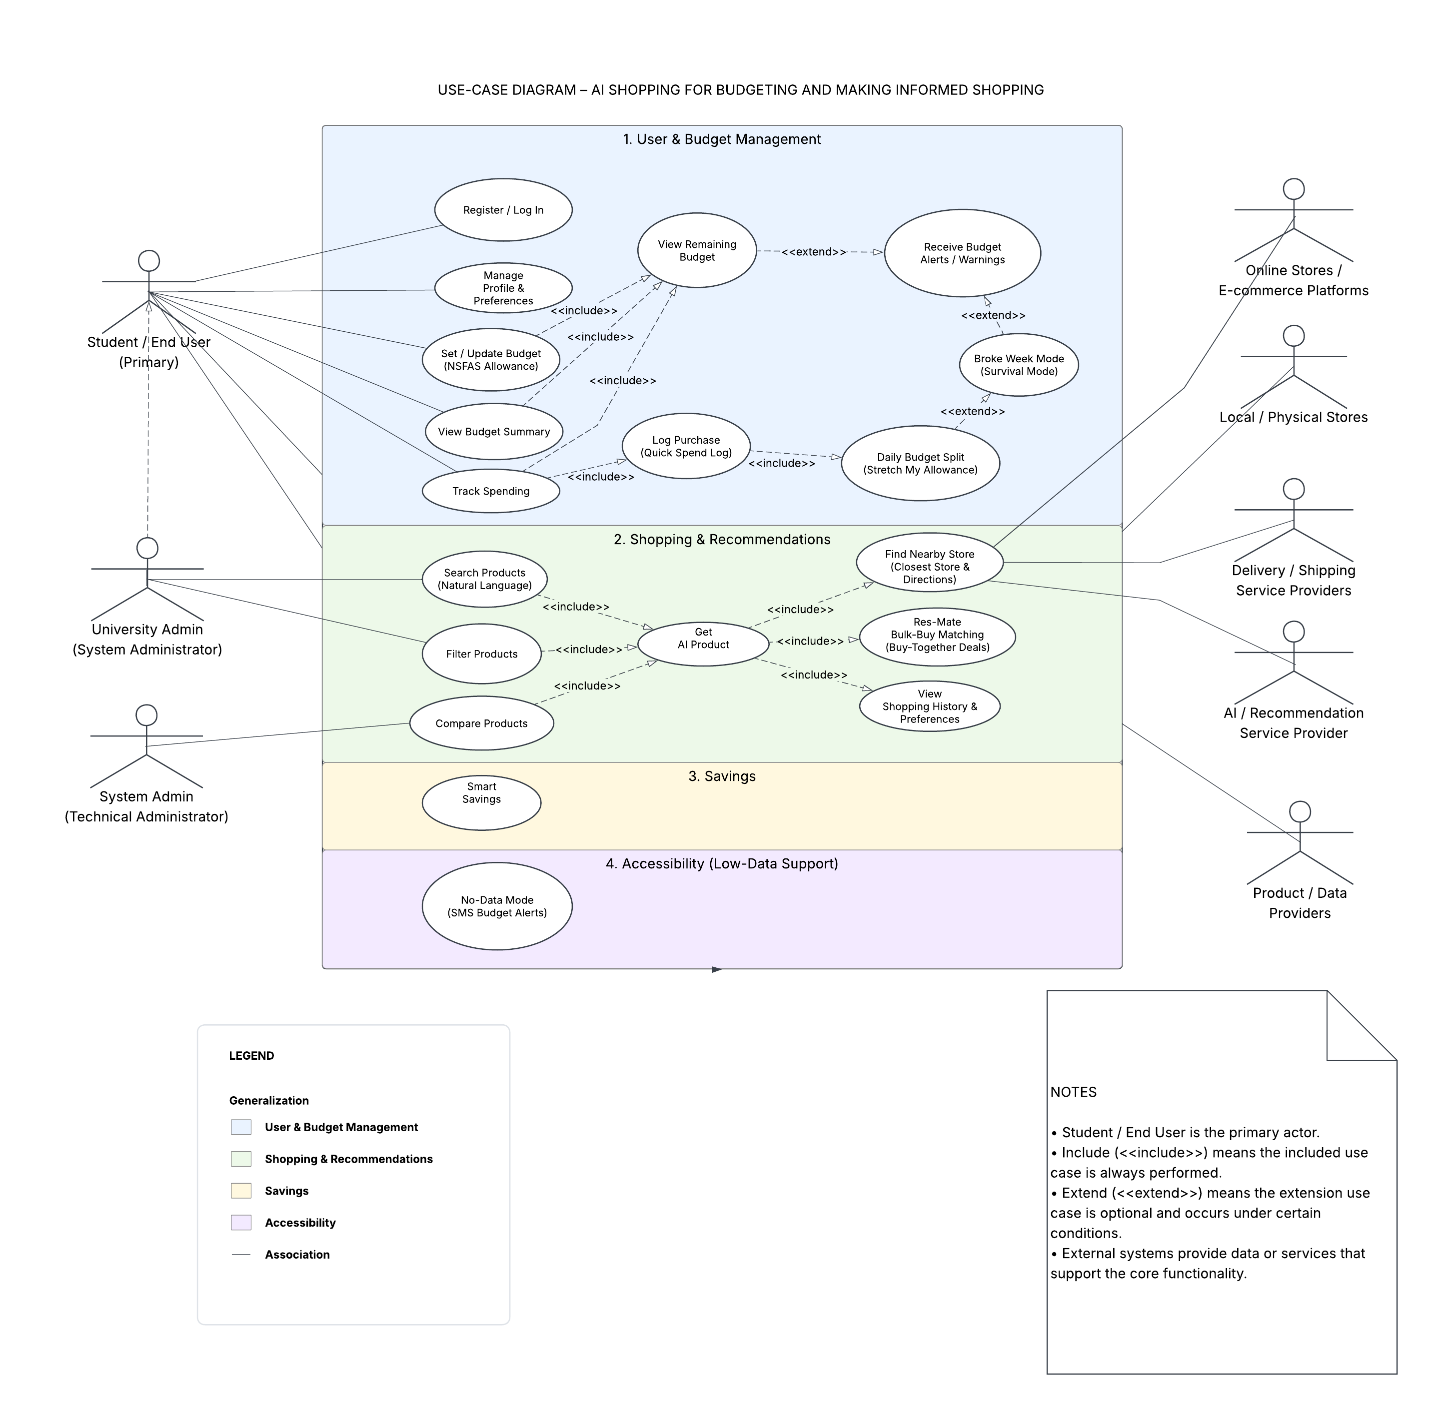
PROJECT PLAN & FEASIBILITY
Use Case Diagram (UML)
AI Shopping for Budgeting and Making Informed Shopping
20

Slide 21
PROJECT PLAN & FEASIBILITY
Risk Management & Mitigation
Risk
Area
Impact & Mitigation
Incorrect budget calculations
Budgeting
Students could exceed budget/run out of allowance; system must test budget logic and recalculate limits when transactions are recorded.
Maintainability
Maintenance
Updates could be time-consuming and introduce errors; use a modular architecture so components can update independently.
Incorrect AI recommendations
AI Recommendation
Students may overspend; system must apply filtering rules on price/category and test recommendation results.
Outdated product/price info
Retailer Data
Students shown unavailable or unaffordable products; regularly update source information.
Unavailable product sources
Reliability
Search/recommendation may fail; system must handle unavailable sources and give clear feedback to users.
External API / location failure
Integration
Nearby-store search or directions may fail; system must show an error when an external service is unavailable.
System downtime
Availability
Students temporarily lose access to budget information during outages.
Smart Savings calculation error
Financial
An incorrect percentage may be set aside; system must validate the selected percentage and test savings/budget calculations together.
AI Shopping for Budgeting and Making Informed Shopping
21

Slide 22
PROJECT PLAN & FEASIBILITY
Project Timeline
Member
Section
Start Date
End Date
Duration
Status
Bonolo Mtyotywa
Project Timeline
31 Aug
31 Aug
1 Day
Completed
Mohamed Khan
Introduction & Context
5 Aug
6 Aug
1 Day
Completed
Salma Vawda
Problem Statement
5 Aug
6 Aug
1 Day
Completed
Nozibusiso Cindi
Literature Review
6 Aug
8 Aug
2 Days
Completed
Husain Mosala
Research Gaps
8 Aug
8 Aug
1 Day
Completed
Siphumelele Nombewu
Identify Existing Challenges
9 Aug
9 Aug
1 Day
Completed
Ayanda Mkhize
Stakeholders
11 Aug
13 Aug
2-3 Days
Completed
Shahid Hoosan
Project Scope
14 Aug
14 Aug
1 Day
Completed
Simfumene Jiyane
Business & User Requirements
20 Aug
22 Aug
2-3 Days
Completed
Anelisa Nonxuba
Functional Requirements
23 Aug
23 Aug
1 Day
Completed
Bonolo Mtyotywa
Non-Functional Requirements
24 Aug
24 Aug
1 Day
Completed
Ayanda Mkhize
Standout Features
26 Aug
26 Aug
1 Day
Completed
Simfumene Jiyane
Use Case Diagrams
26 Aug
28 Aug
2 Days
Completed
Siphumelele Nombewu
Risk Management & Mitigation
28 Aug
29 Aug
1 Day
Completed
AI Shopping for Budgeting and Making Informed Shopping
22

Slide 23
BIBLIOGRAPHY
References (Harvard Style)
Le, [Author initials]. (2025) [Full source and publication details to be added].
Masuku, [Author initials]. (2025) [Full source and publication details to be added].
Pancholi, [Author initials] et al. (2026) [Full source and publication details to be added].
Rodríguez-Correa, [Author initials] et al. (2025) [Full source and publication details to be added].
Xie, [Author initials] et al. (2026) [Full source and publication details to be added].
Action needed
These 5 sources were cited by author and year in the submitted literature review, but full publication details (journal/publisher, volume, pages, DOI) were not provided and are not filled in above to avoid inaccurate citations. Complete each entry in full Harvard format and add further sources — the rubric requires a minimum of 10 references.
AI Shopping for Budgeting and Making Informed Shopping
23

Slide 24
Thank You
Questions & Discussion
AI Shopping for Budgeting and Making Informed Shopping | Group Number: ____________

