Slide 1


Software Carpentry Regenerative Medicine Centre for Doctoral Training The University of Manchester 8-9 March 2018

Slide 2









The Software Sustainability Institute
A national facility for cultivating better, more sustainable, research software to enable world-class research
Supported by EPSRC/ESRC/BBSRC grant EP/N006410/1, with additional project funding from Jisc and NERC

Slide 3
Schedule
Day 1
09:00 Automating tasks with the Unix shell
12:00 Lunch break
13:00 Building programs with Python
16:30 Wrap-up
17:00 END
Day 2
09:00 Building programs with Python (continued)
12:00 Lunch break
13:00 Version control with Git
16:30 Wrap-up
17:00 END

Slide 4
Best practices for scientific computing
Wilson G, Aruliah DA, Brown CT, Chue Hong NP, Davis M, et al. (2014) Best Practices for Scientific Computing. PLoS Biol 12(1): e1001745. http://dx.doi.org/10.1371/journal.pbio.1001745.
Let the computer do the work
Write programs for people, not computers
Use version control
Achieve more, in less time with less pain!
Notes:
Write programs for people, not computers.
A program should not require its readers to hold more than a handful of facts in memory at once.
Make names consistent, distinctive, and meaningful.
Make code style and formatting consistent.
Let the computer do the work.
Make the computer repeat tasks.
Save recent commands in a file for re-use.
Use a build tool to automate workflows.
Make incremental changes.
Work in small steps with frequent feedback and course correction.
Use a version control system.
Put everything that has been created manually in version control.
Don't repeat yourself (or others).
Every piece of data must have a single authoritative representation in the system.
Modularize code rather than copying and pasting.
Re-use code instead of rewriting it.
Plan for mistakes.
Add assertions to programs to check their operation.
Use an off-the-shelf unit testing library.
Turn bugs into test cases.
Use a symbolic debugger.
Optimize software only after it works correctly.
Use a profiler to identify bottlenecks.
Write code in the highest-level language possible.
Document design and purpose, not mechanics.
Document interfaces and reasons, not implementations.
Refactor code in preference to explaining how it works.
Embed the documentation for a piece of software in that software.
Collaborate.
Use pre-merge code reviews.
Use pair programming when bringing someone new up to speed and when tackling particularly tricky problems.
Use an issue tracking tool.

Slide 5
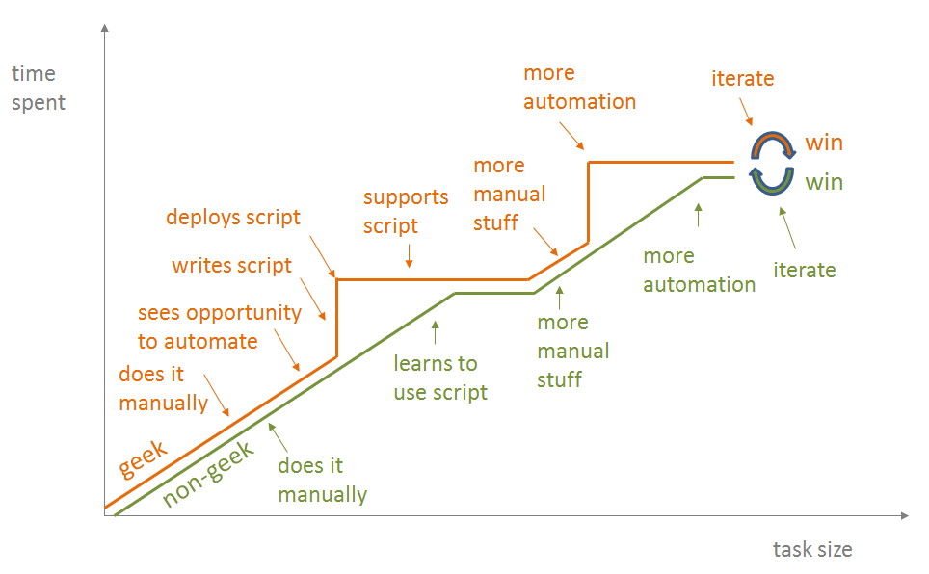
Let the computer do the work
https://blog.jonudell.net/2012/01/09/another-way-to-think-about-geeks-and-repetitive-tasks/

Slide 6
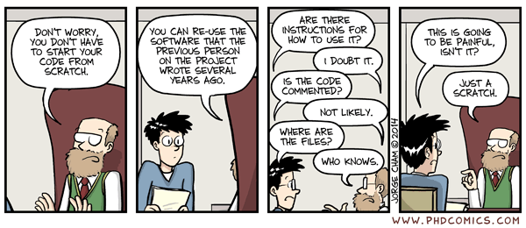
Write programs for people, not computers
http://phdcomics.com/comics/archive.php?comicid=1689

Slide 7
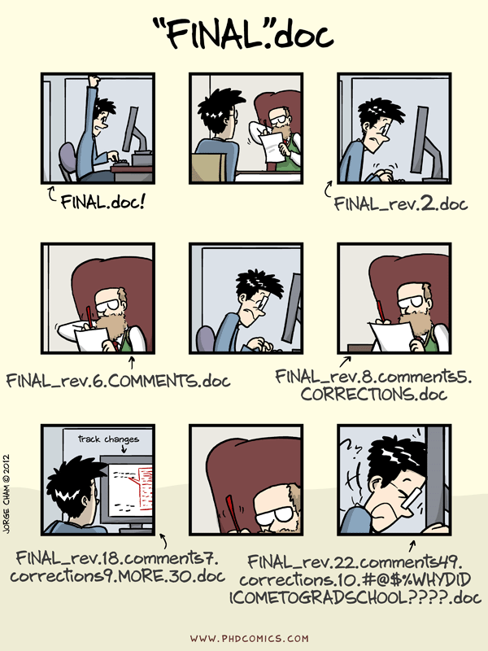
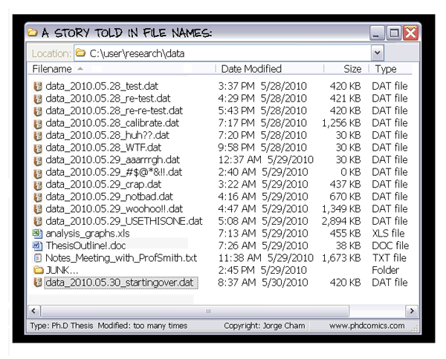
Use version control
http://phdcomics.com/comics/archive.php?comicid=1323
http://phdcomics.com/comics/archive.php?comicid=1531

Slide 8






Important bits and pieces
https://software-carpentry.org/conduct/
All images from https://icons8.com/license/
Creative Commons Attribution-NoDerivs 3.0 Unported (CC BY-ND 3.0) https://creativecommons.org/licenses/by-nd/3.0/

Slide 9

How to ask for help
Flag down a helper
Stick up your sticky note
Red – I’m stuck, help!
Green – I’m fine
All images from https://icons8.com/,
Creative Commons Attribution-NoDerivs 3.0 Unported (CC BY-ND 3.0) https://creativecommons.org/licenses/by-nd/3.0/

Slide 11
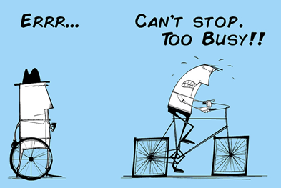
Image from Alan O’Rourke, https://audiencestack.com, Creative Commons Attribution 2.0 Generic (CC BY 2.0) https://creativecommons.org/licenses/by/2.0/

Slide 12
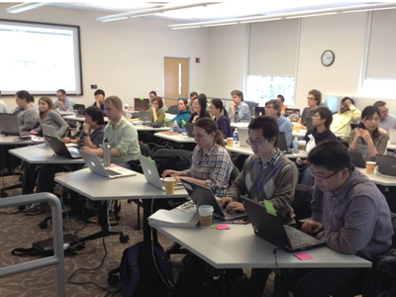
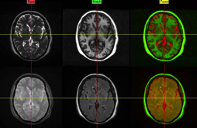

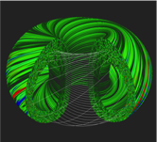
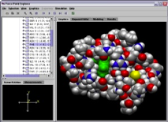
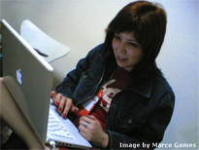

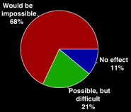
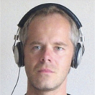
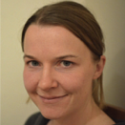
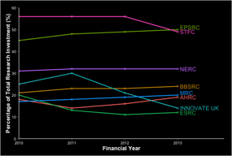
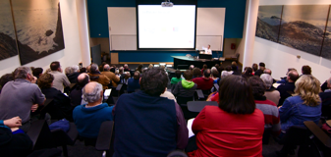
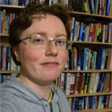

The Software Sustainability Institute
Software
Deliver essential software skills to researchers via CDTs, institutions and doctoral schools
Training
Help researchers to develop software that meets the needs of reliable, reproducible, and reusable research
Communications
Exploit our platform to enable engagement, delivery and uptake
Collect evidence on the use of research software and share results with stakeholders
Bring together the right people to understand and address topical issues
Policy
Community

Slide 13


The Carpentries
https://software-carpentry.org/
http://www.datacarpentry.org/

Slide 14
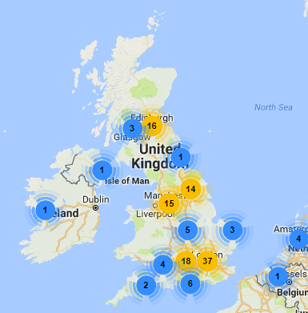

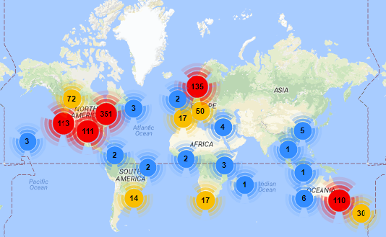


Get involved
https://software-carpentry.org/join/

Slide 15
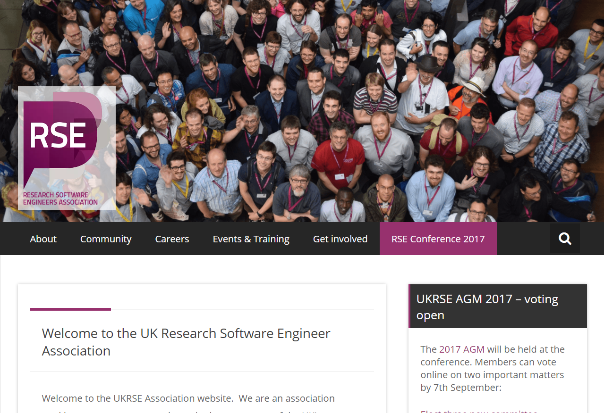
Research Software Engineer community
http://www.rse.ac.uk

Slide 16


Research IT at Manchester
Training courses
Advice and guidance on research software
Access to specialist support and consultancy e.g. code reviews, embedded RSEs
Access to HPC systems
Visualization and data analytics support
Get in touch via https://supportcentre.manchester.ac.uk
@UoM_eResearch

