Slide 1
ECE501- Digital Image Processing
Content-Based Image Retrieval (CBIR)
Group 6
Dhriti Gandhi | AU2340030
Aneri Kabrawala | AU2340041
Renee Vora | AU2340059
Pushti Sonak | AU2340082

Slide 2
Introduction
Due to an exponential increase of image data across every domain, there is a need of systems that retrieve images based on the actual visual characteristics (extracting features) to get meaningful searches.
Objective: To implement a CBIR system for a diverse dataset and retrieve similar images based on traditional methods using features like colour, texture, shape and similarity metrics.
Summary of work done before Mid-Sem:
The dataset was extremely varied as it consisted of 10 different domains.
Every feature was computed individually for extraction, like only edge or only colour or only feature fusion and then implemented for the dataset.
The methods we had used were HSV, LBP, Sobel and Euclidean distance for retrieval.
We didn’t work much on the accuracy and comparisons of the results obtained.

Slide 3
Outcomes and takeaways from initial work
The individual feature extraction was not adaptable after a certain extent as the results were inconsistent.
Its performance was domain-specific; it gave meaningful results only for few. Thus, 10 domains were too broad for this system.
Colour feature was dominant in giving wrong results for gray-scale images.
Improved Implementations Based on the Conclusions:
To improve the consistency, analyze performance and compare meaningfully, we kept three main domains: Brain MRI Scans, Natural, Paintings
By experimenting through trial and error we selected weights such that it balances the contribution of features during retrieval.
We numerically compared our results using standard evaluation metrics like recall, precision and F1-score.

Slide 4
Updated Methodology
The following flowchart shows the method:
Object Segmentation
Convert to HSV
Generate Foreground Mask
Extract Largest Connected Component
Feature Extraction
Color Features: HSV + LAB histograms
Texture Features: LBP
Shape Features: Hu moments
Input Preprocessed Dataset
Feature Fusion
Weighted combination of Color (0.4), Texture (0.4), Shape (0.2)
Save Results
Save retrieved images
Export evaluation metrics to Excel
Evaluation
Compute TP, FP, FN, TN
Calculate Precision, Recall, F1
Similarity Computation
Compute cosine similarity between query vector & dataset vectors
Retrieval
Retrieve Top-K most similar images

Slide 5
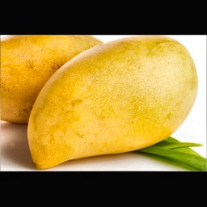
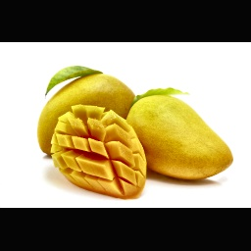
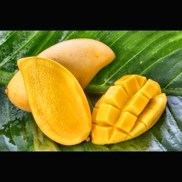
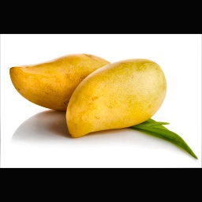
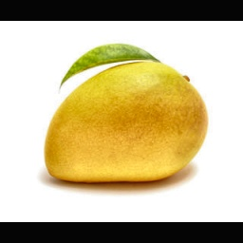
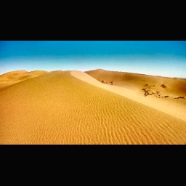
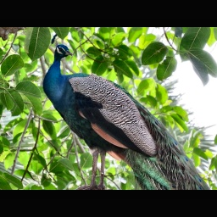
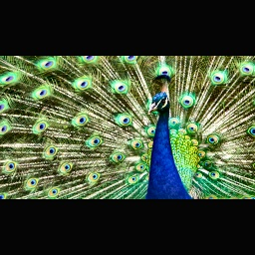
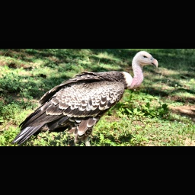
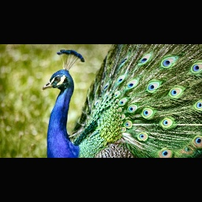
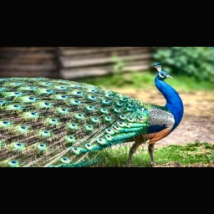
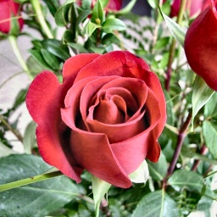
Results (Domain - Natural)
Query
Rank 1
Rank 2
Rank 3
Rank 4
Rank 5

Slide 6
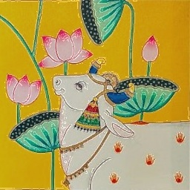
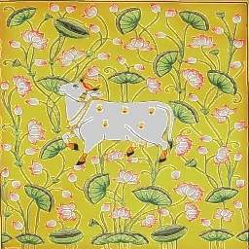
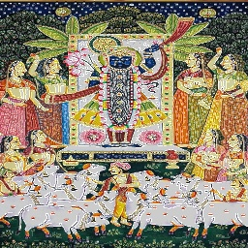
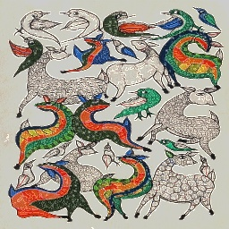
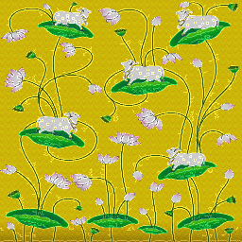
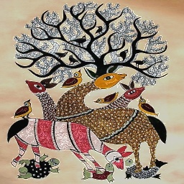
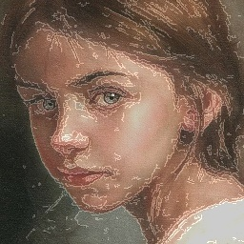
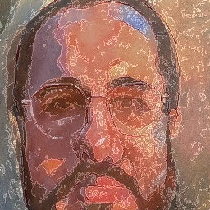
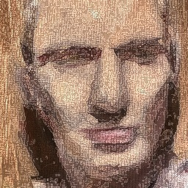
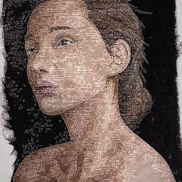
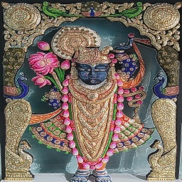
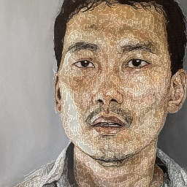
Results (Domain - Paintings)
Query
Rank 1
Rank 2
Rank 3
Rank 4
Rank 5

Slide 7
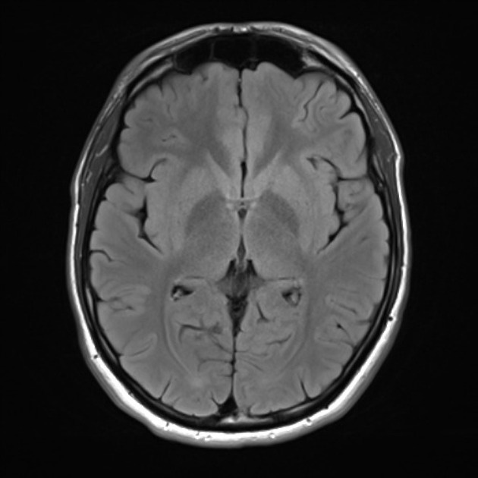
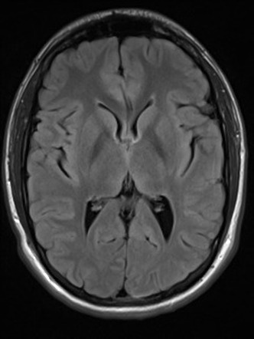
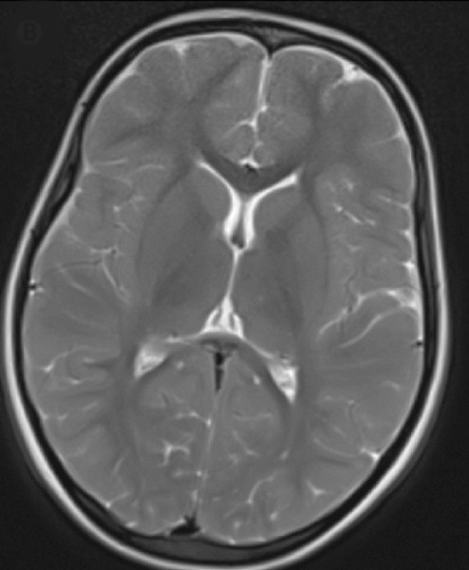
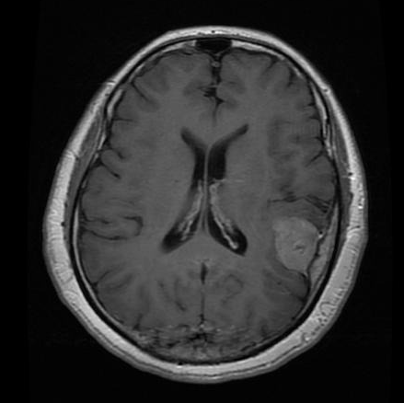
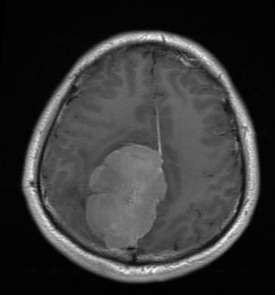
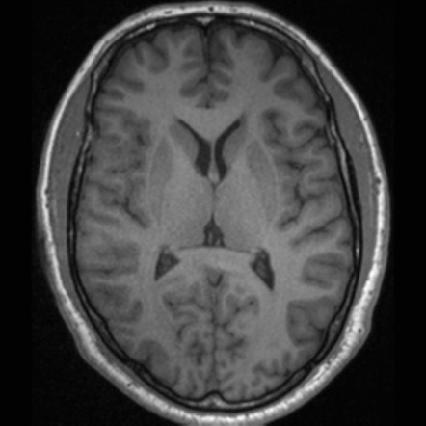
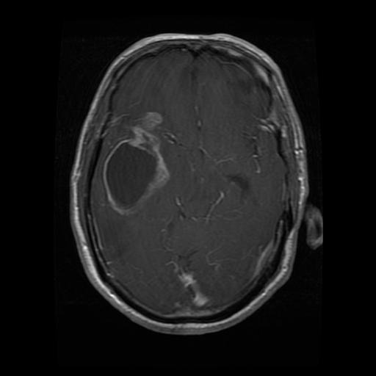
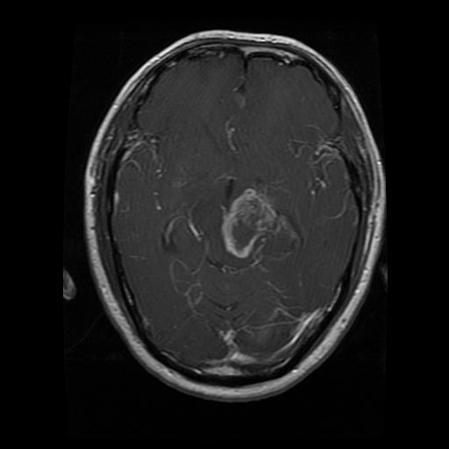
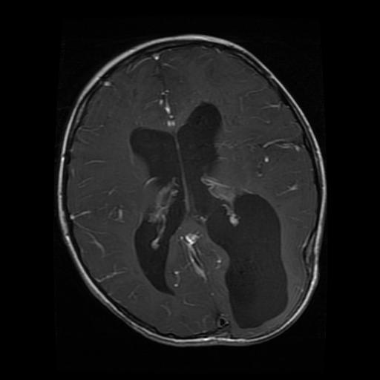
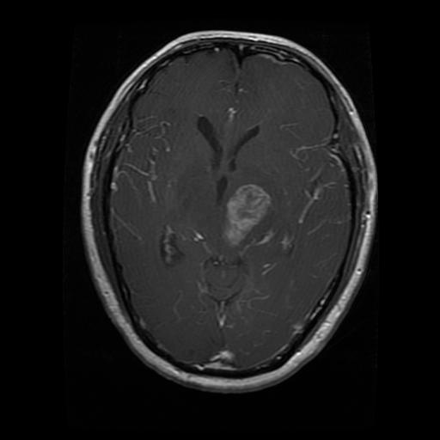
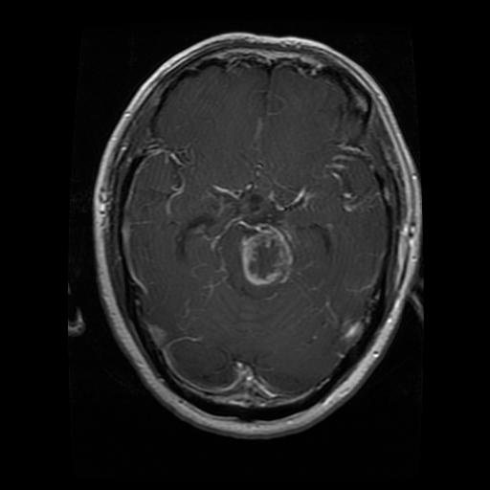
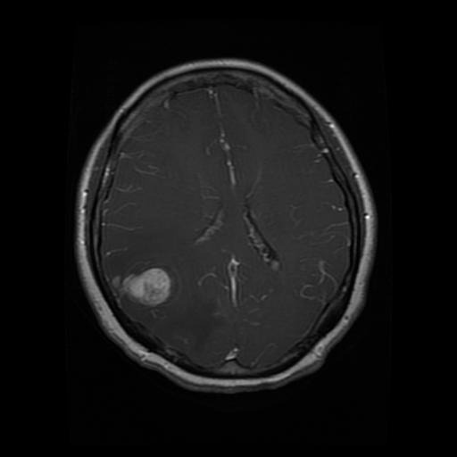
Results (Domain - Brain MRI)
Glioma
Query
Rank 1
Rank 2
Rank 3
Rank 4
Rank 5
No Cancer
Meningioma

Slide 8
Result - Evaluation Metrics
Optimal Weights for Different Domains
Methods | Precision | Recall | F1 score
Color Extraction | 0.74 | 0.27 | 0.35
Texture Extraction | 0.48 | 0.12 | 0.12
Concatenation | 0.44 | 0.12 | 0.16
Weighted Fusion | 0.80 | 0.30 | 0.39
Domains | Color | Texture | Shape | Precision
Natural | 0.4 | 0.4 | 0.2 | 0.76
Brain MRI | 0.1 | 0.6 | 0.3 | 0.77
Paintings | 0.3 | 0.3 | 0.4 | 0.85

Slide 9
Conclusions
Content Based Image Retrieval system retrieving similar images across three domains: Natural, Paintings and Brain MRI.
Extracted multiple visual features like color, texture and shape using weights to enhance retrieval performance.
No single feature performs best for all domains.
For MRI scans, system effectively detecting and matching cancer affected areas.
Successfully implemented an integrated pipeline including preprocessing, feature extraction, similarity computation and ranking.

Slide 10
References
[1] C. Knoblock, “An example of Content-Based Image Retrieval,” ResearchGate, [Online image]. Available: https://www.researchgate.net/profile/Craig-Knoblock/publication/221607221/figure/fig3/AS:305582780239874@1449868020143/An-example-of-Content-Based-Image-Retrieval.png. [Accessed: Oct. 12, 2025].
[2] H. Farsi and Sajad Mohamadzadeh, “Colour and texture feature‐based image retrieval by using Hadamard matrix in discrete wavelet transform,” IET Image Processing, vol. 7, no. 3, pp. 212–218, Apr. 2013, doi: https://doi.org/10.1049/iet-ipr.2012.0203.
[3] K. Haridas and A. Selvadossthanamani, “Efficient Content Based Image Retrieval System in Visual Words, Color and Edge Directive Descriptors and Fuzzy Color and Texture Histogram,” International Journal of Innovative Research in Computer and Communication Engineering (An ISO, vol. 3297, 2007, Accessed: Oct. 12, 2025. [Online]. Available: https://www.rroij.com/open-access/efficient-content-based-image-retrievalsystem-in-visual-words-color-and-edgedirective-descriptors-and-fuzzy-color-andtexture-histogram.pdf
[4] M. Singha and K. Hemachandran, “Content Based Image Retrieval using Color and Texture,” Signal & Image Processing : An International Journal, vol. 3, no. 1, pp. 39–57, Feb. 2012, doi: 10.5121/SIPIJ.2012.3104. Available: https://aircconline.com/sipij/V3N1/3112sipij04.pdf
[5] R. Kumar and N. Murthy M S, “Enhanced Content Based Image Retrieval Using Integrated Color and Texture Features,” International Journal on Science and Technology, vol. 16, no. 1, Jan. 2025, doi: https://doi.org/10.71097/ijsat.v16.i1.1418.

Slide 11
Dataset - References
[6] A. Achar. “CBIR-50 Dataset,” 2023. [Online]. Available: https://www.kaggle.com/datasets/ameyaditya/cbir-50. [Accessed: Nov. 15, 2025]
[7] Msoud Nickparvar. (2021). Brain Tumor MRI Dataset [Data set]. Kaggle. https://doi.org/10.34740/KAGGLE/DSV/2645886
[8] AJG. “Indian Paintings Dataset,” 2023. [Online]. Available: https://www.kaggle.com/datasets/ajg117/indian-paintings-dataset.[Accessed: Nov. 15, 2025]

