Slide 1
WEB PROJECT
INCUBATION PLATFORM

Slide 2
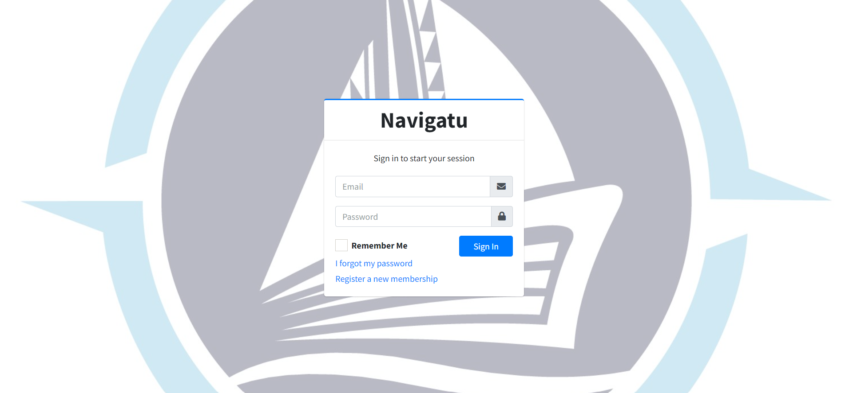
LOGIN FORM

Slide 3
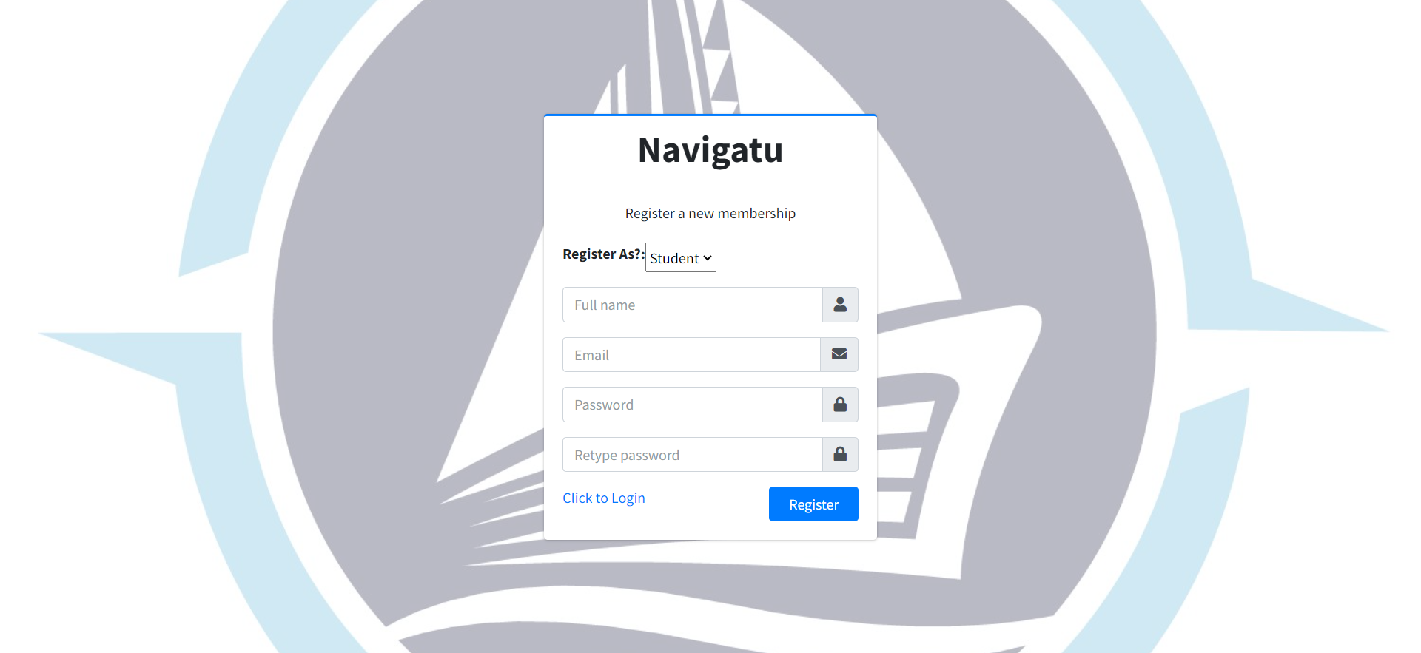
REGISTRATION FORM

Slide 4
ADMIN SIDE

Slide 5
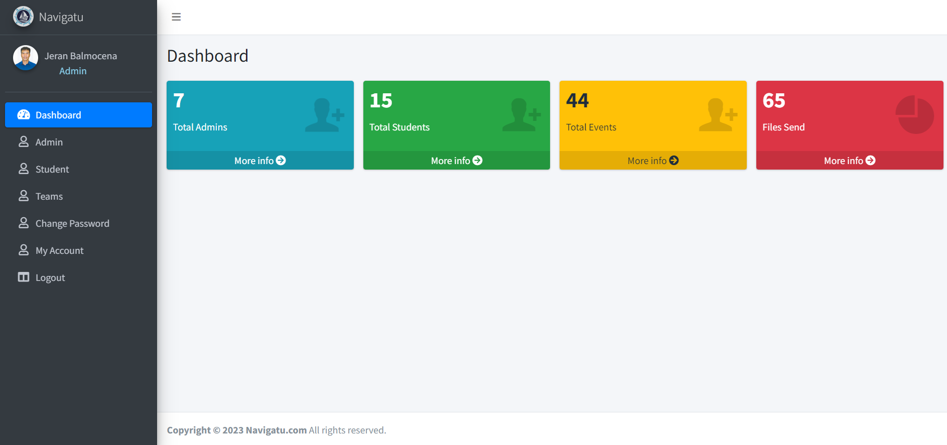
DASHBOARD

Slide 6
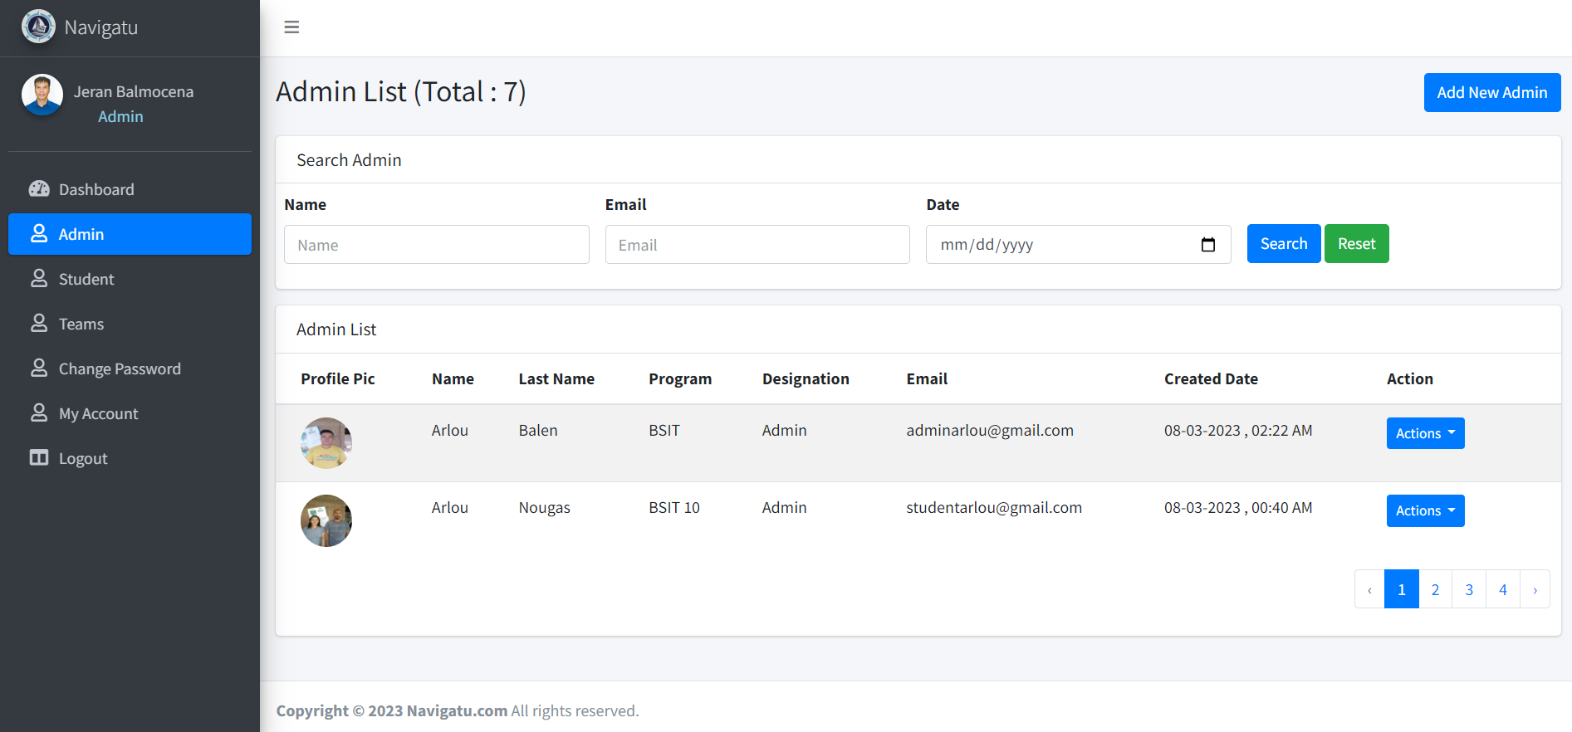
ADMIN LIST

Slide 7
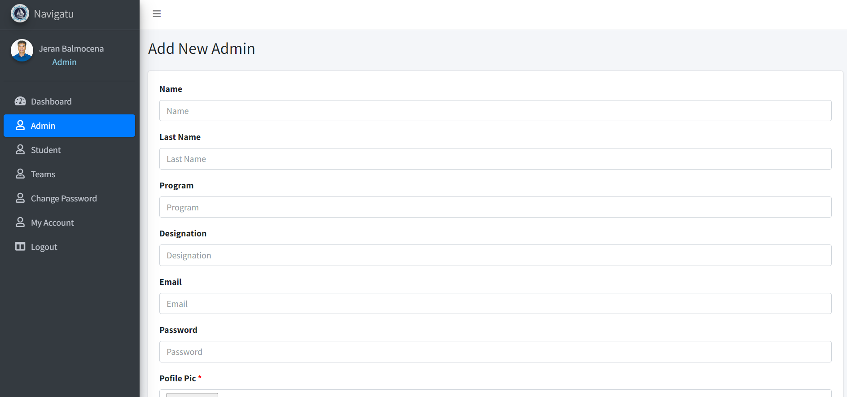
ADD NEW ADMIN

Slide 8
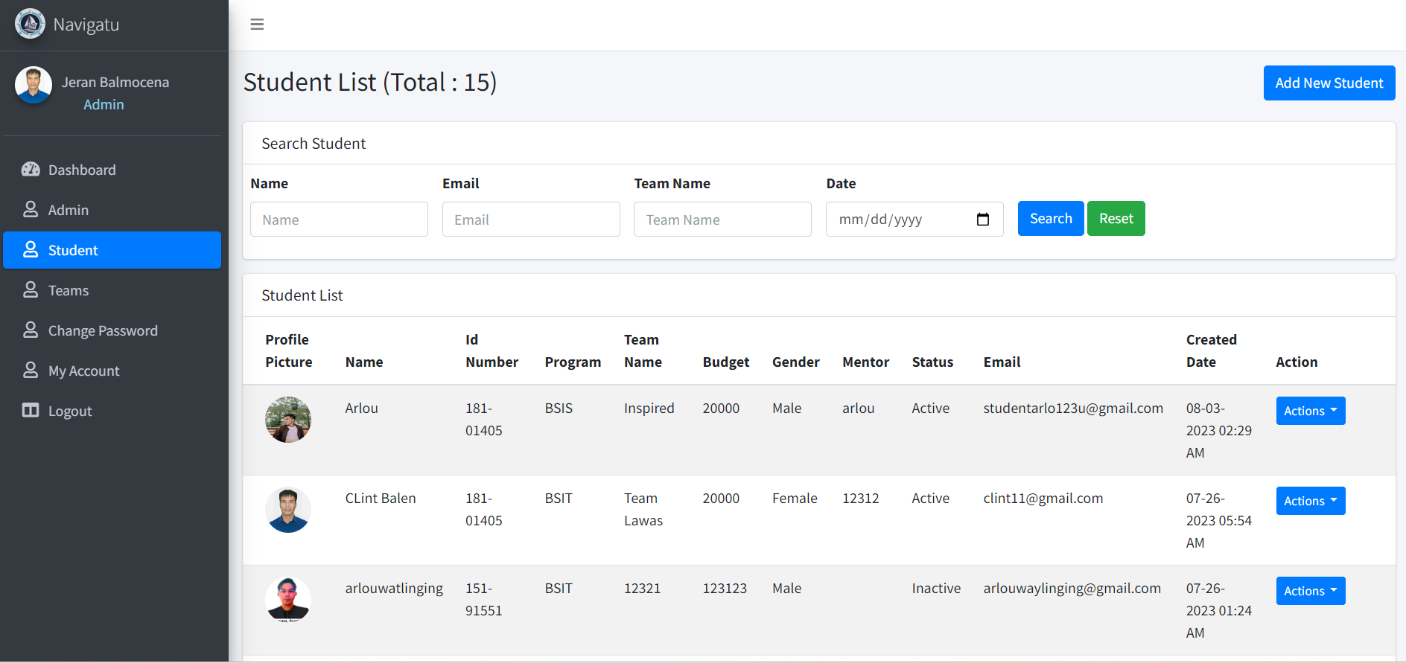
STUDENT LIST

Slide 9
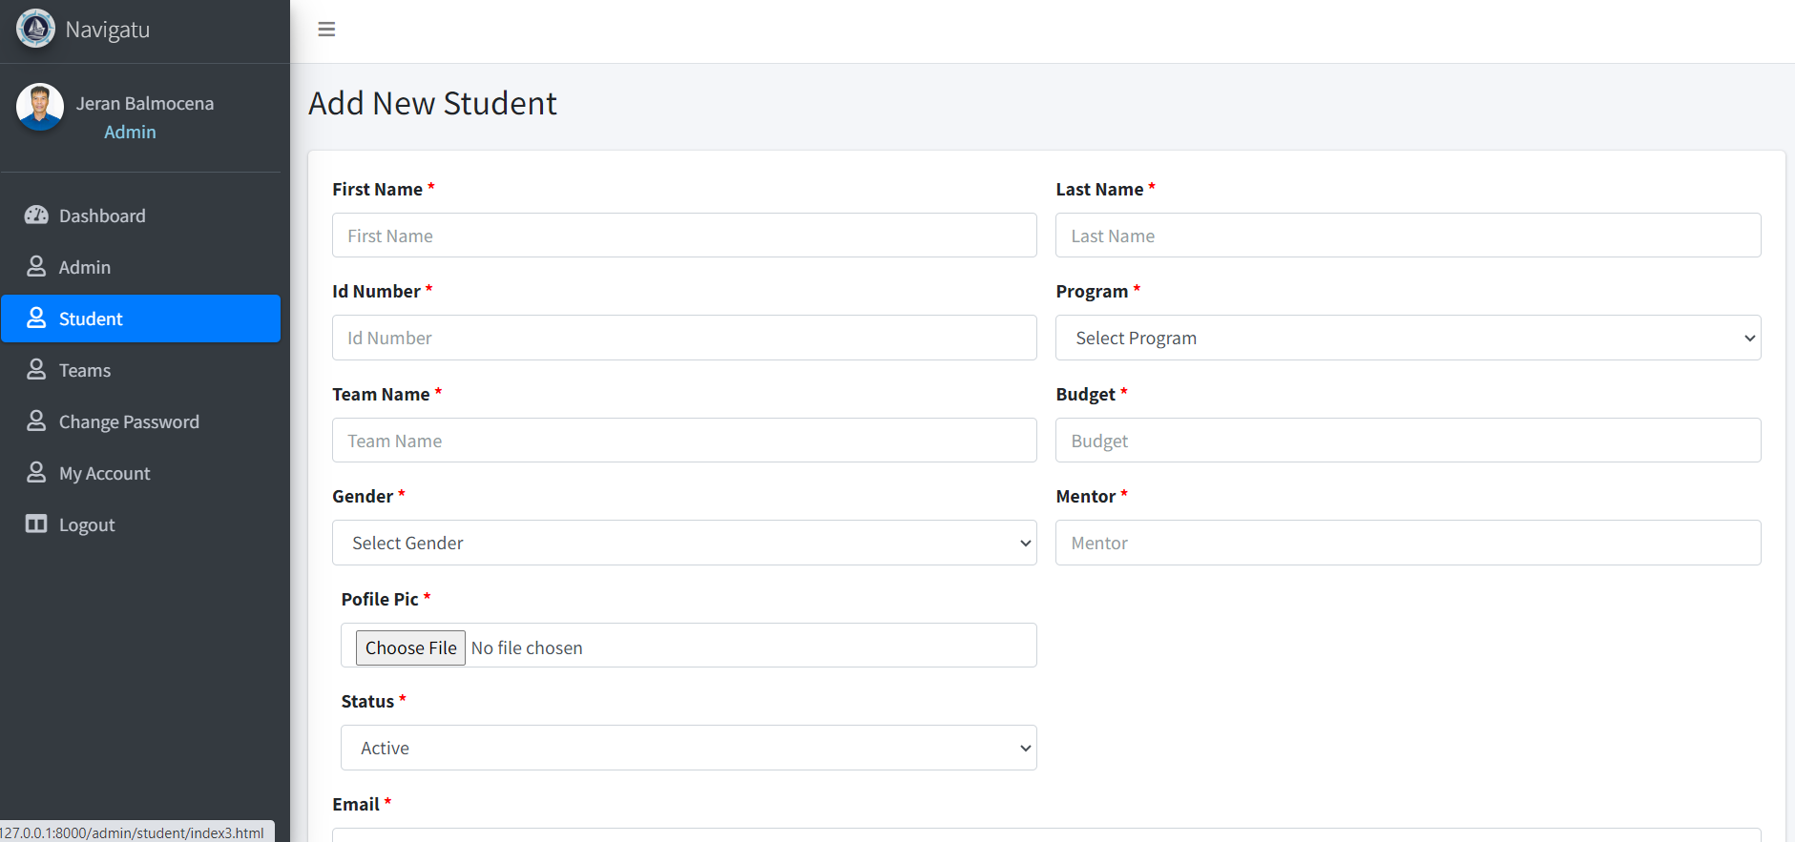
ADD NEW STUDENT

Slide 10
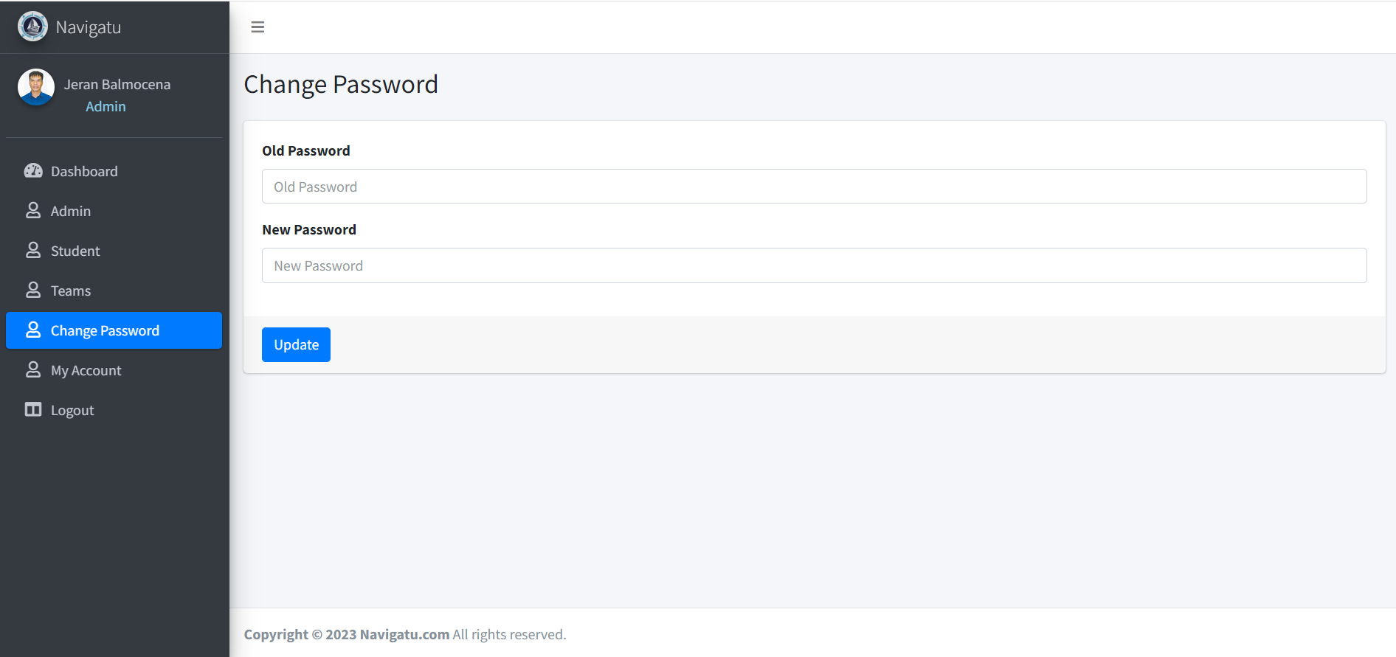
CHANGE PASSWORD

Slide 11
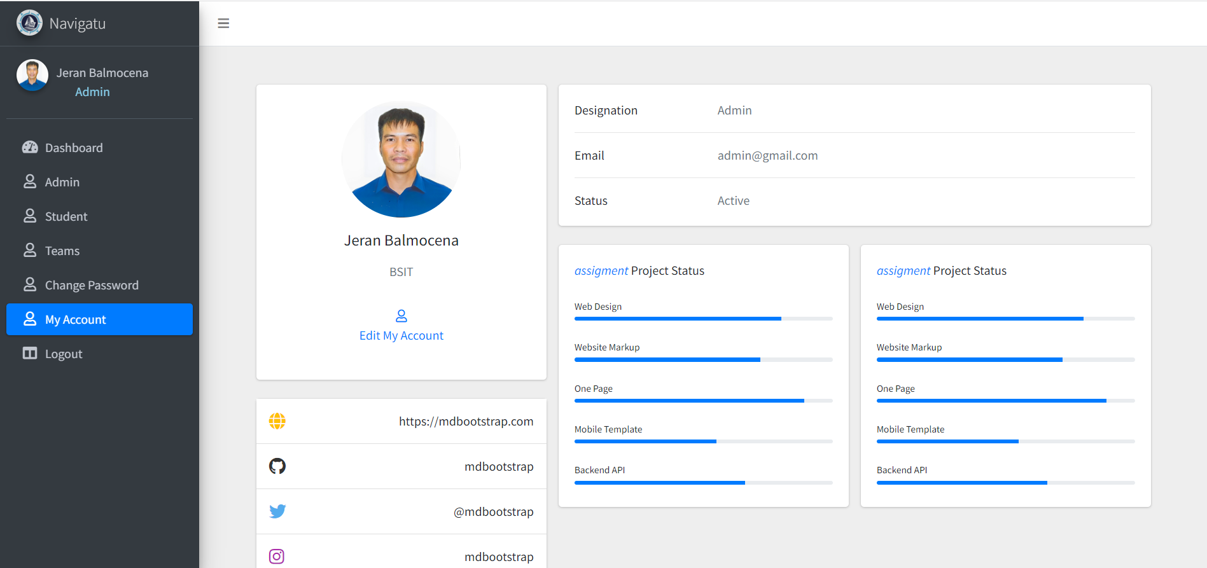
MY ACCOUNT

Slide 12
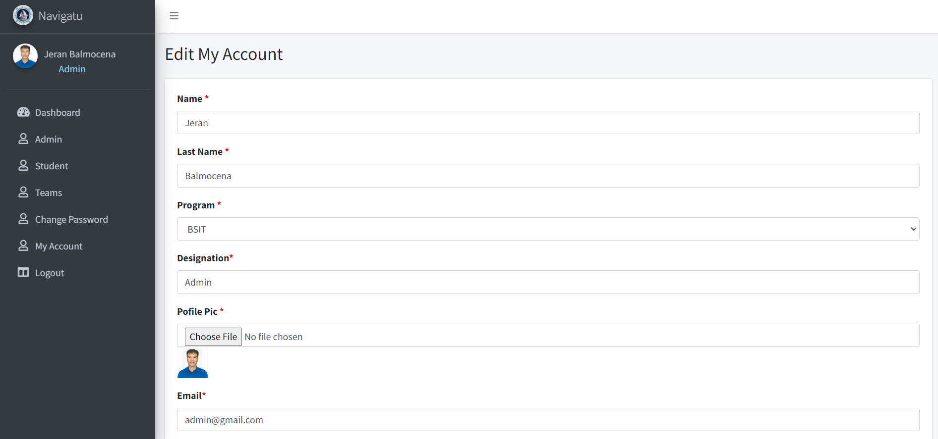
EDIT MY ACCOUNT

Slide 13
STUDENT SIDE

Slide 14
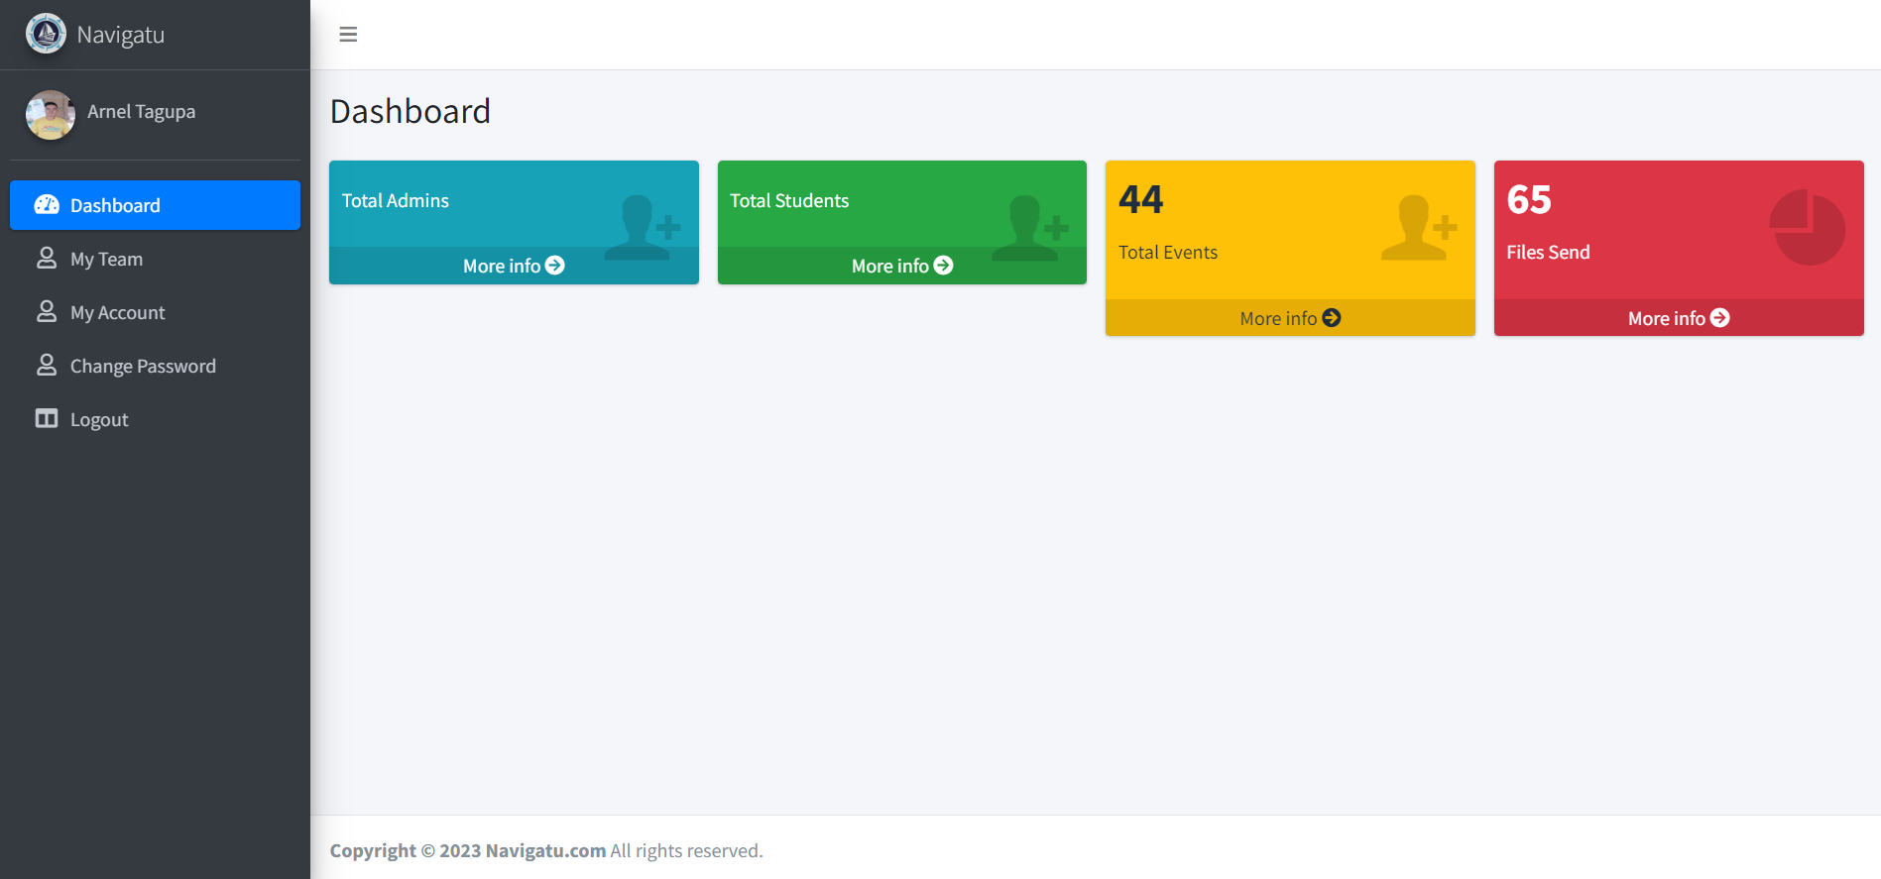
DASHBOARD

Slide 15
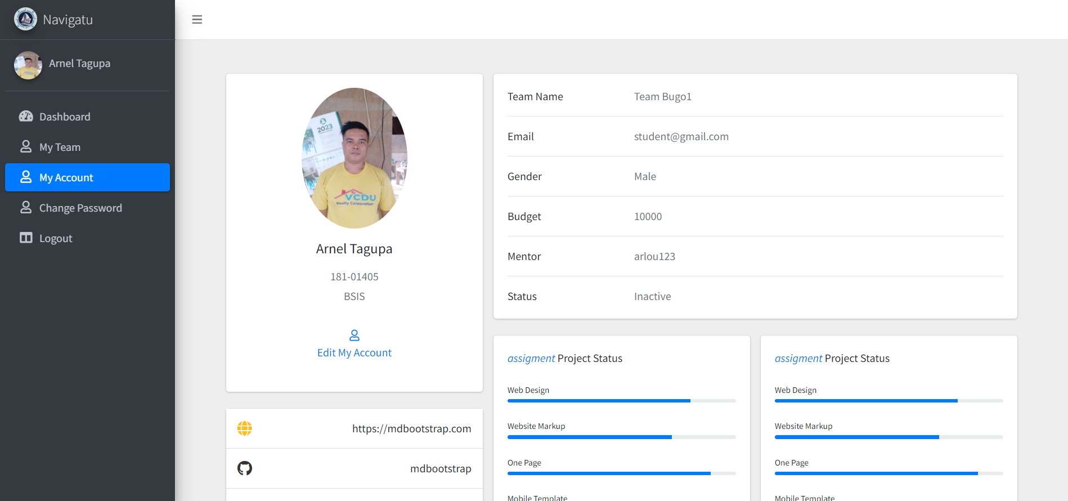
MY ACCOUNT

Slide 16
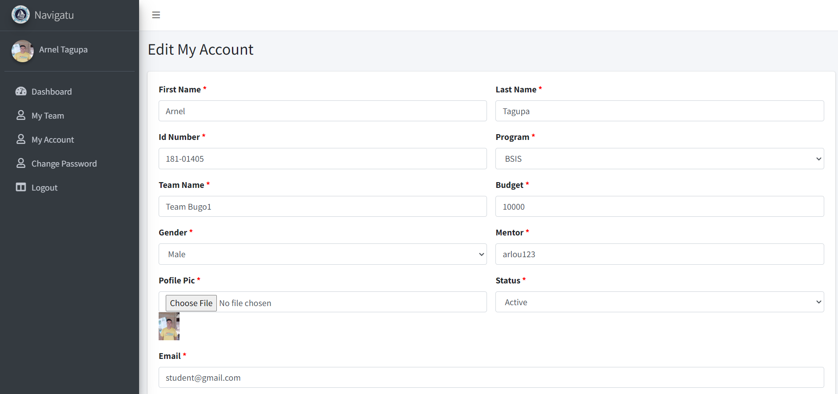
EDIT MY ACCOUNT

Slide 17
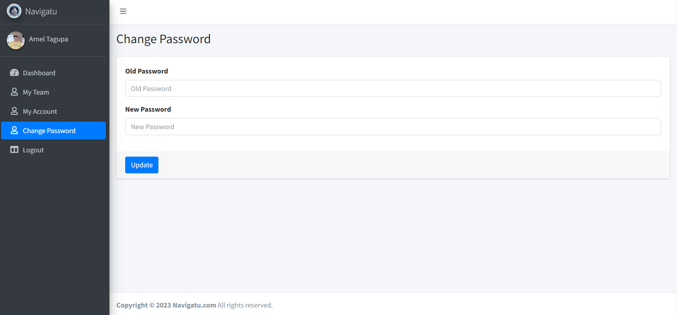
EDIT MY ACCOUNT

Slide 18
FEATURES UPDATE

Slide 19
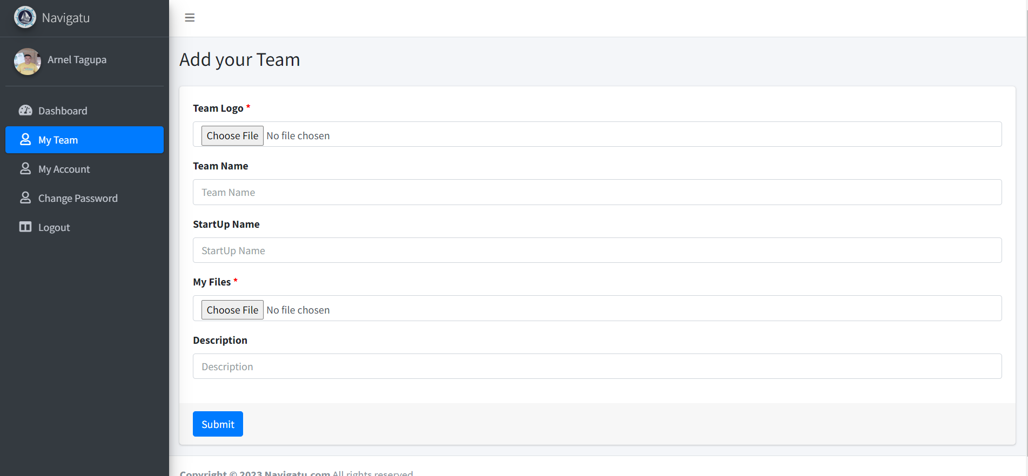
ADD TEAM FOR STUDENT

Slide 20
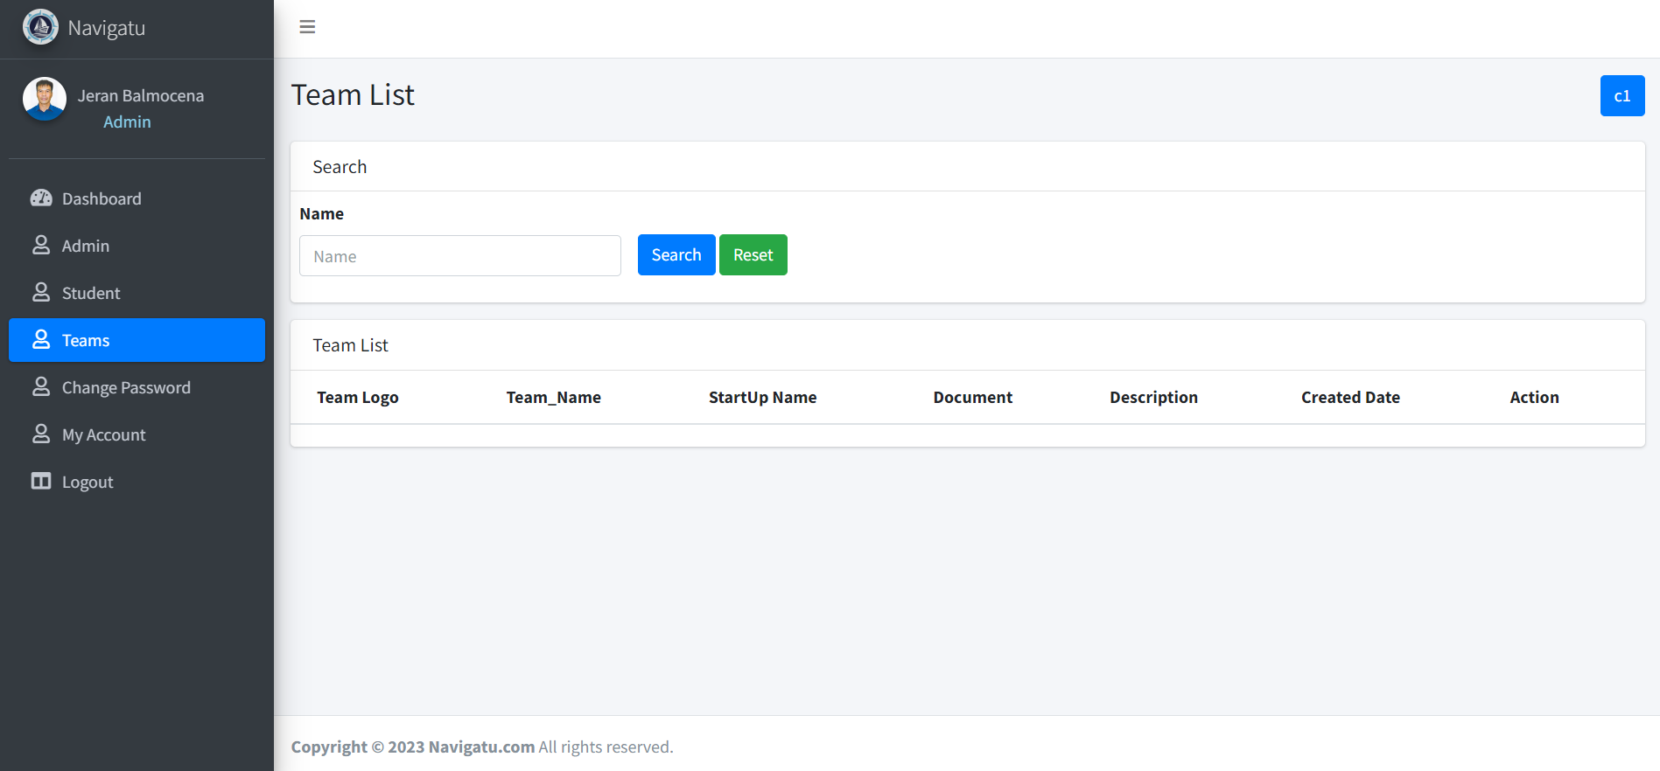
VIEW TEAM FOR ADMIN

Slide 21
THANKS!

