Slide 1


MEETING 2
LISTENING SKILLS

Slide 2

SKILL 7: LISTEN FOR NEGATIVE EXPRESSIONS
SKILL 8: LISTEN FOR DOUBLE NEGATIVE EXPRESSIONS
NEGATIVES
SKILL 9: LISTEN FOR “ALMOST NEGATIVE” EXPRESSIONS
SKILL 10: LISTEN FOR NEGATIVES WITH COMPARATIVES

Slide 3
SKILL 7: LISTEN FOR NEGATIVE EXRESSIONS
Negative expressions are very common in the short dialogue, and the most common kind of correct response to a negative statement is a positive statement containing a word with an opposite meaning.
Example :
On the recording, you hear :
(man) How did they get to their grandmother’s house in Maine in only five hours?
(woman) They didn’t drive slowly on the trip to Maine
(narrator) What does the woman say about the trip?
In your test book or on the computer screen, you read :
(A)They drove rather quickly
(B)They couldn’t have driven more slowly
(C)They wanted to travel slowly to Maine
(D)They didn’t drive to Maine
The correct answer is answer (A). If they didn’t drive slowly to Maine, this means that they drove rather quickly. Notice that the correct answer uses quickly, the opposite of slowly. The answers that use slowly are not correct.

Slide 4
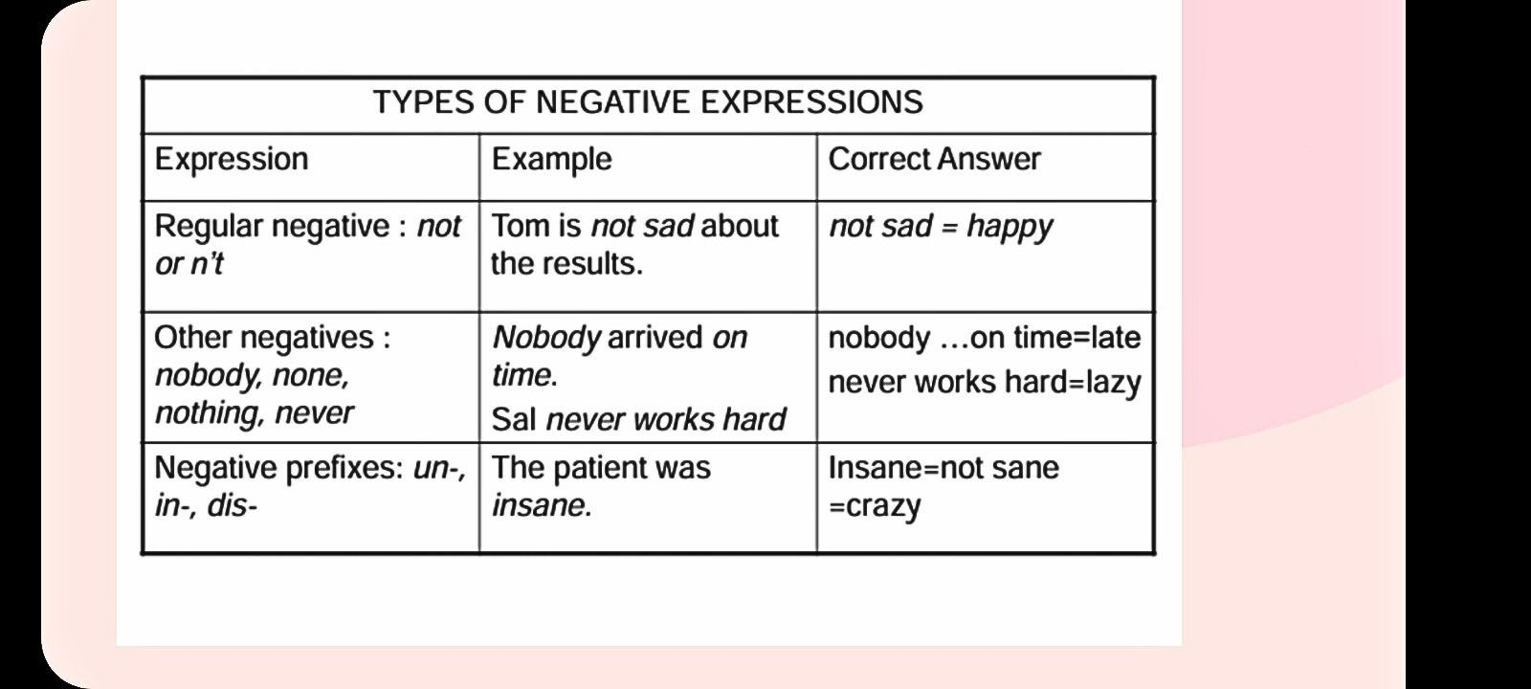
SKILL 7: LISTEN FOR NEGATIVE EXRESSIONS

Slide 5
EXERCISE 7
In this exercise, underline the negative in the last line of each short dialogue. Then read the question and choose the best answer to that question. Remember that the best answer is one that uses an opposite meaning.
1.
(man) I can’t seem to get the door unlocked
(woman) That isn’t the right key for the door
(narrator) What does the woman mean?
(A) The key in the drawer is on the right
(B) The man should write the message on the door
(C) The man has the wrong key
(D) The right key isn’t in the drawer

Slide 6
2.
(man) Were you pleased with last week’s convention?
(woman) Nothing went as planned
(narrator) What does the woman mean?
(A) The convention was disorganized.
(B) She didn’t plan to attend the convention.
(C) She planned the conversation last week.
(D) She wasn’t pleased with the last week of the conversation.
(woman) Are you planning to go to college next year?
(man) I’m really unsure about the idea
(narrator) What does the man mean?
(A) He definitely wants to go to college
(B) He is certain about his plans
(C) He’s hesitant about attending college
(D) His idea is to go to college
3.

Slide 7
TOEFL EXERCISE 7
In this exercise, listen carefully to each short dialogue and question on the recording, and then choose the best answer to the question. You should be particularly careful of negative expressions. Toefl Exercise 7.wav
1.
(A) She is very busy
(B) She has lots free time
(C) It is not necessary to take out the trash
(D) She will do it if she has time
(A) The interview is very important
(B) He is worried about the interview
(C) What he’s wearing to the interview is important
(D) He is not concerned about the interview
2.

Slide 8
3.
(A) He has almost all the notes
(B) His attendance was perfect
(C) He went to all the lectures but one
(D) He missed more than one psychology class
(A) They passed the library at 6:00
(B) The library opens at 3:00 in the summer
(C) The library closes at 6:00
(D) You can’t check out more than six books in the summer
(A) Water the plants once a day
(B) Give the plants no more water
(C) Water the plants often while the man is gone
(D) Give the plants a limited amount of water
(A) The service satisfied her
(B) The food was worse than the service
(C) She thought the service was bad
(D) Neither the food nor the service was satisfying
4.
5.
6.

Slide 9
7.
(A) He told his kids to leave
(B) He seriously wanted the woman to go
(C) He was joking when he told the woman to leave
(D) He left with the woman
(A) The project will take all their effort
(B) They have no other work to do
(C) It’s impossible to finish
(D) They aren’t even close to finishing the project
(A) She doesn’t mind and hour more
(B) She’d rather stay more than an hour
(C) It’s better to stay than go
(D) She prefer to leave
(A) The service at the hotel wasn’t too good
(B) This hotel gave excellent service
(C) The service at hotel could have been improved
(D) This hotel’s service was the same as the service at other hotels
8.
9.
10.

Slide 10
SKILL 8: LISTEN FOR DOUBLE NEGATIVE EXPRESSIONS
Example:
On the recording, you hear:
(man) I can’t believe the news that I heard about the concert.
(woman) Well, it isn’t impossible for the concert to take place.
(narrator) What does the woman say about the concert?
In your textbook or on the computer screen you read:
(A) There’s no possibility that the concert will take place.
(B) The concert will definitely not take place.
(C) The concert might take place.
(D) The concert can’t take place.
The correct answer to this question is answer (c). If it isn’t impossible for the concert to take place, then it is possible, and the modal might Indicates possibility.

Slide 11
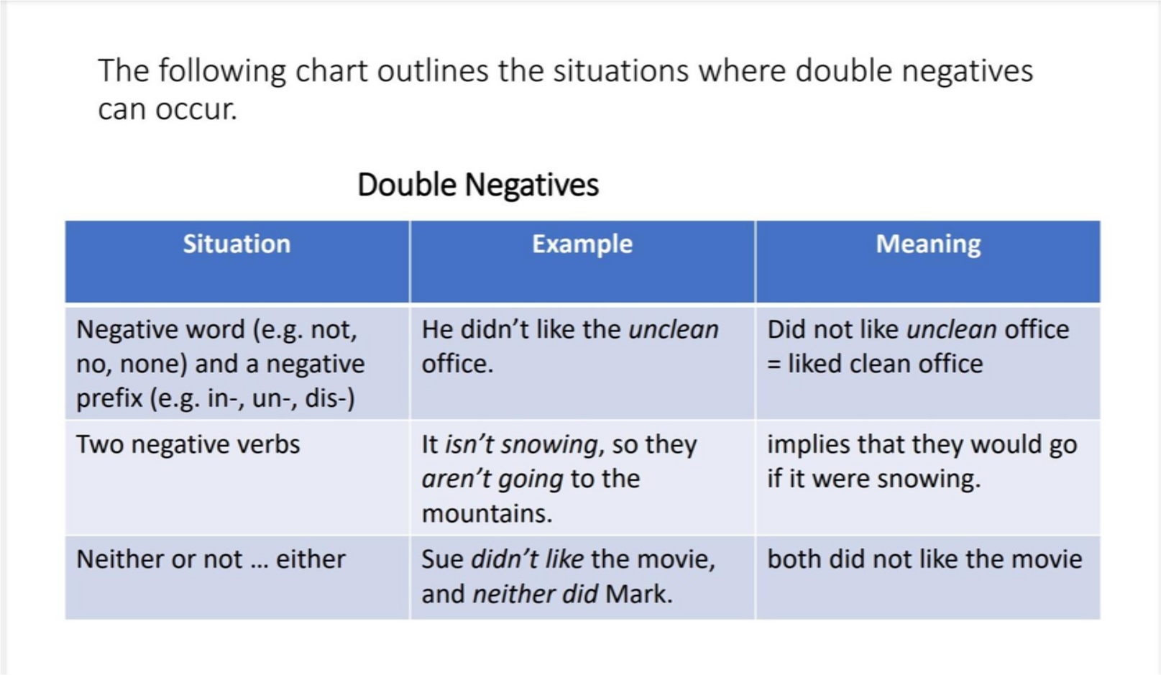
SKILL 8 : LISTEN FOR DOUBLE NEGATIVE EXRESSIONS

Slide 12
EXERCISE 8
In this exercise, underline the two negatives in the last line of each short dialogue. Then read the question and choose the best answer to that question. Remember that two negatives can make the sentence positive.
(man) Paula, you worked so hard setting up the field trip.
(woman) I hope no one’s unhappy with the arrangements.
(narrator) What does Paula mean?
(A) She hopes everyone will be pleased.
(B) She knows no one is happy with what she has done.
(C) She’s arranged to take a trip because she’s unhappy.
(D) Everyone’s happy with the condition of the field.

Slide 13
(woman) How was your history exam?
(man) I didn’t study enough, so I didn’t do well.
(narrator) What does the man mean?
(A) He studied a lot and passed.
(B) He failed in spite of his effort.
(C) He got a good grade even though he didn’t study.
(D) His grade was poor because of inadequate preparation
(man) Were your friends able to get tickets for the concert?
(woman) Mark couldn’t get tickets for the concert, and neither could Paul.
(narrator) What does the woman mean?
(A) Although Mark couldn’t get both tickets, Paul did
(B) Both were unable to obtain tickets.
(C) Neither Mark or Paul wanted to go to the concert.
(D) Mark tried to get tickets, but Paul didn’t.
2.
3.

Slide 14
SKILL 9: LISTEN FOR “ALMOST NEGATIVE” EXPRESSIONS
Example:
On the recording, you hear:
(Woman) Were you able to pay the electric bill?
(Man) I had barely enough money.
(Narrator) What does the man imply?
In your test book or on the computer screen, you read:
(A) He had plenty of money for the bill.
(B) He did not have enough money for the bill.
(C) He paid the bill but has no money left.
(D) He was enable to pay the bill.
In the men’s statement, the word enough indicates that there was enough, so he paid the bill. However, it was barely enough, so he almost did not have enough and certainly has no money left. The correct answer is therefore answer (C).

Slide 15
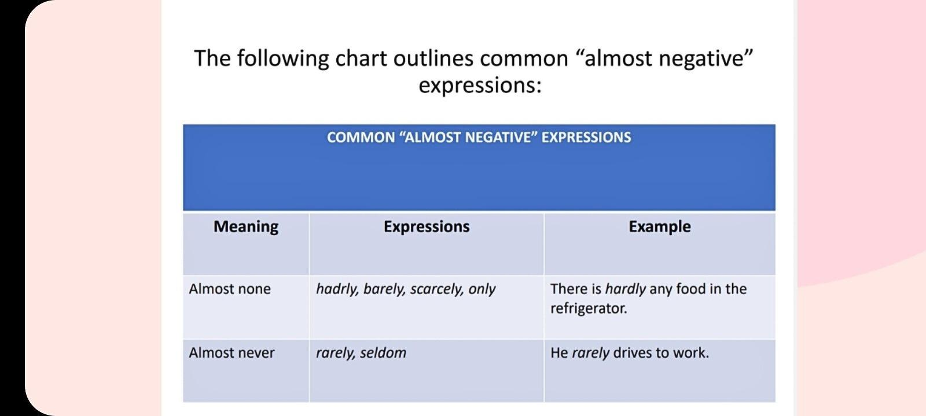
SKILL 9: LISTEN FOR “ALMOST NEGATIVE” EXPRESSIONS

Slide 16
EXERCISE 9
In this exercise, underline the “almost negative” expression in the last line of each short dialogue. Then read the question and choose the best answer. Remember that the best answer is one that means that it is true but it is almost not true.
1.
(Man) I hear that Mona’s been offered the manager’s job.
(Woman) But she has hardly any work experience!
(Narrator) What does the woman say about Mona?
(A)Mona hasn’t worked hard.
(B)Mona’s experience has been hard.
(C)Mona’s job as manager is hard.
(D)Mona hasn’t worked for very long.

Slide 17
2.
(Woman) How much time did Sam spend on his paper for economics class?
(Man) Sam has seldom taken so much time on a research paper.
(Narrator) What does the man mean?
(A) Sam usually spends this much time on his schoolwork.
(B) Sam has rarely worked so hard.
(C) Sam took too much time on this paper.
(D) Sam should’ve worked harder on this paper.
(Woman) Does Steve usually park his car there?
(Man) Only once has he parked his car in that lot.
(Narrator) What does the man mean?
(A) He parks his car there once in a while.
(B) He’s parked his car there a lot.
(C) He only leaves his car there for short periods of time.
(D) He left his car there on just one occasion.
3.

Slide 18
SKILL 10: LISTEN FOR NEGATIVES WITH COMPARATIVES.
Example:
On the recording, you hear:
(Woman) What do you think of the new student in math class?
(Man) No one is more intelligent than she is.
(Narrator) What does the man say about the new student?
In your test book or on the computer screen, you read:
(A) She is not very smart.
(B) He is smarter that she is.
(C) Other students are smarter than she is.
(D) She is the smartest student in the class.
The man responds to the woman’s question with the negative. No and and the comparative more intelligent, and this combination has a superlative meaning, the smartest. The best answer is therefore answer (D).

Slide 19
SKILL 10: LISTEN FOR NEGATIVES WITH COMPARATIVES.
COMPARATIVES WITH NEGATIVES
COMPARATIVE | EXAMPLE | MEANING
more | No one is more beautiful than she is | she is the most beautiful
-er | he couldn’t be happier | he is extremely happy

Slide 20
EXERCISE 10
In this exercise, underline the negative and the comparative in the second line of each short dialogue. Then read the question and choose the best answer to that question. Remember that the best answer is one that expresses a superlative, or very strong, idea.
1.
(Woman) Have you gotten over your cold yet?
(Man) I couldn’t be feeling any better today.
(Narrator) What does the man mean?
(A) He’s feeling terrific.
(B) He felt a lot worse today.
(C) He’s not feeling too well today.
(D) He’s a bit better today

Slide 21
2.
(woman) What did you think of Mike when you first met him?
(man) He couldn’t have been more unfriendly.
(narrator) What does the man mean?
(A) Mike was extremely friendly when he met him.
(B) Mike could have met him sooner.
(C) Mike didn’t seem to like him at all.
(D) When he met Mike, he didn’t have a friend.
(man) Did you see Theresa’s grade on the math exam? It was unbelievable!
(woman) No one else could have done better.
(narrator) What does the woman mean?
(A) Theresa could’ve gotten a higher grade.
(B) Anyone could get a good grade.
(C) Theresa got the highest grade.
(D) A high grade is impossible for anyone.
3.

Slide 22
TOEFL EXERCISE (SKILLS 7-10):
In this exercise, listen carefully to each short dialogue and question on the recording, and then choose the best answer to the question. Toefl exercise 7-10.wav
1.
(A) She can try a little harder.
(B) There is a lot more that she can do.
(C) She’s doing the best that she can.
(D) it is impossible for her to do anything.
(A) She’s always been late for the bus.
(B) The bus has always been late.
(C) The bus only left on time once.
(D) Only on this trip has the bus been on time.
2.

Slide 23
3.
(A) There wasn’t enough soup to go around.
(B) We had so much soup that we couldn’t finish it.
(C) Everyone got one serving of soup, but there wasn’t enough for seconds.
(D) Everyone around the table had a lot of soup.
(A) She does want to see the movie.
(B) It’s extremely important to her to go.
(C) She doesn’t want to go there anymore.
(D) She really couldn’t move there.
(A) She handed the paper in on time.
(B) She was able to complete the paper, but she didn’t turn it in.
(C) The paper was a complete mess, so she didn’t turn it in.
(D) The paper was unfinished.
(A) Neither Tim nor Sylvia is taking care of Art.
(B) Sylvia likes modern art even less than Tim does.
(C) Sylvia doesn’t care for anything Tim does.
(D) Sylvia and Tim agree in their opinion of modern art.
4.
5.
6.

Slide 24
7.
(A) They always work hard in the afternoon.
(B) They don’t do much after lunch.
(C) After noon they never work.
(D) It’s never hard for them to work in the afternoon.
(A) It’s hard for him to work when it gets warm.
(B) Whenever it gets warm, he turns on the air-conditioner.
(C) The air-conditioner only works when it isn’t needed.
(D) He likes to use the air-conditioner when it is warm.
(A) He did really poorly.
(B) He’s felt worse before.
(C) The results could not have been better.
(D) He’s not too unhappy with the results.
(A) With so many members present, the committee couldn’t reach a decision.
(B) The committee should’ve waited until more members were present.
(C) The issue shouldn’t have been decided by all the committed members.
(D) The issue wasn’t decided because so many members were absent
8.
9.
10.

Slide 25
THANK YOU

