Slide 1
MARTe Framework a Middleware for Real-time Applications Development
André Neto*⁺, F. Sartori,
D. Alves, A. Barbalace,
L. Boncagni, B.B. Carvalho,
P. J. Carvalho, G. De Tommasi,
H. Fernandes, G. Manduchi,
P. McCullen, A. Stephen,
D. Valcarcel, R. Vitelli,
L. Zabeo and JET EFDA Contributors*
*Associação EURATOM/IST
Instituto de Plasmas e Fusão Nuclear-Laboratório Associado
Instituto Superior Técnico, Universidade Técnica de Lisboa
Portugal
http://www.ipfn.ist.utl.pt
⁺JET-EFDA
Culham Science Centre, UK
http://www.jet.efda.org/

Slide 2
Framework important functions
Provides development and execution environment for control systems
Defines a way of designing/developing
  Limits what you can do to what is needed!
  Reduces mistakes
Provides standard interfaces to plant configuration and data retrieval
Facilitates test and commissioning
Ensures and monitors real-time

Slide 3
Main ideas
  Multi-platform C++ middleware
    Simulink-like way of describing the problem
  Modular
    Clear boundary between algorithms, hardware interaction and system configuration
    Reusability and maintainability
    Simulation
  Minimise constraints with the operational environments (portability)
  Data driven
  Provide live introspection tools
    Without sacrificing RT

Slide 4
Multi-platform?
Why?
  Debug and develop in non RT targets
  Eases the debugging process
  Usually better developing environment
    Debugger
    IDE
How?
  Provide an abstraction layer/library which solves all the specificities of a given OS
    Optimise code here
Possible?
  Yes, runs in Linux, Linux+RTAI, VxWorks, Solaris and MS Windows

Slide 5
Data driven components
Define common language
  As simple as possible
    But complete
    Human understandable configuration
  Should provide built-in validation
  Should provide a clear way of expressing the problem
Components are expected to be parsed only once per configuration request

Slide 6
Object configuration
+HttpServer = {
Class = HttpService
Port = 8084
}
...
+Control = {
Class = ControlGAM
Controller = {
NoPlasmaVelocityGain = 0.0
NoPlasmaCurrentGain = 40.0
IPWaveform = {
Times = {0 120}
Amplitudes = {0.5 0.5}
Rounding = 50
}
...
Structured syntax
Similar to XML
Classes are automatically instantiated
Configuration is validated by the created object
Asserting and parsing functions available

Slide 7
MARTe language
Graph simulink like control schemes translates into serial execution
Can it run in parallel? Yes
Scheduling order is preset
Distributed control (network or same machine)
I1
I2
O
I1
I2
P1
P1
P2
P2
P3
P3
P4
P4
O

Slide 8

Modularity (GAMs)
Define boundaries
  Algorithms and hardware don't mix!
  Modules do only what they advertise
  No interdependence or a priori knowledge
Generic by design
  Same goals, same module
  Reusability and maintainability
Simulation
  Replace actuators and plants with models
    Keep all the other modules untouched

Slide 9
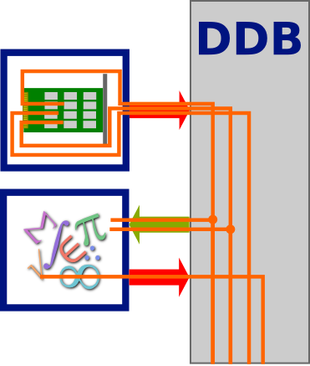
Dynamic Data Buffer
GAMs share data through a memory bus
MARTe guarantees coherency between requested and produced signals
Set of GAMs allow to stream data to different MARTe systems

Slide 10
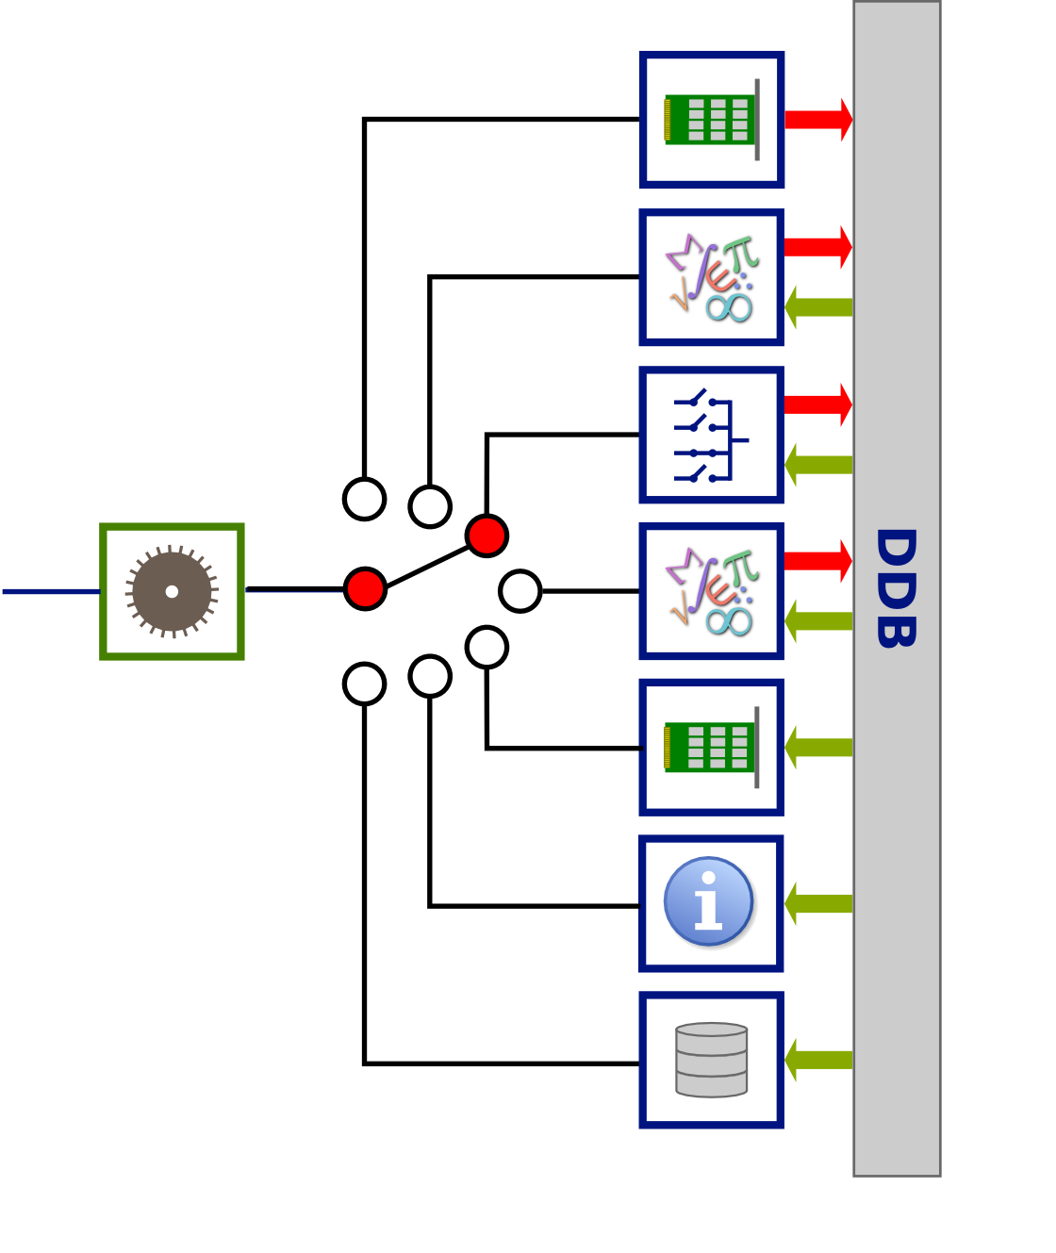
Real-time thread
Sequentially executes GAMs
  Works as micro-scheduler
  Can be allocated to specific CPUs
Keeps accurate information about execution times
Requires an external time and triggering mechanism
Multiple RTThreads can run in parallel
  synchronously or asynchronously

Slide 11
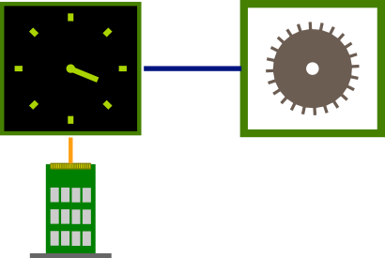
Synchronisation
Asynchronous
  Get latest available value
  Verify acceptable latency (sample too late?)
Synchronous
Routinely used both schemes
ADC, time input, ...
Network
From other control loop

Slide 12
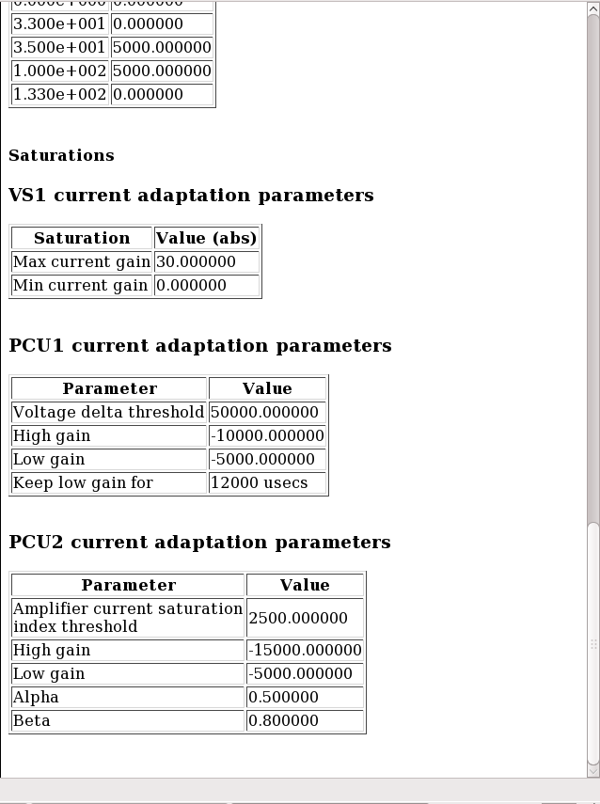
Introspection
Probe the system
  Without sacrificing RT
Crucial for an expedite debugging
Network continuous data streaming
  No impact in RT performances
Automatically built

Slide 13
MARTe World
MARTe
RTThread 1
Internal state machine
GAM 1
DDB
GAM N
GAM 2
Driver pool
RTThread N
GAM 1
DDB
External time
triggering services
GAM N
GAM 2

Slide 14
MARTe Universe
State machine
Logger Server
HTTP Server
MARTe
Any other
Object N
Configuration
provider
Data retrieval
facility

Slide 15
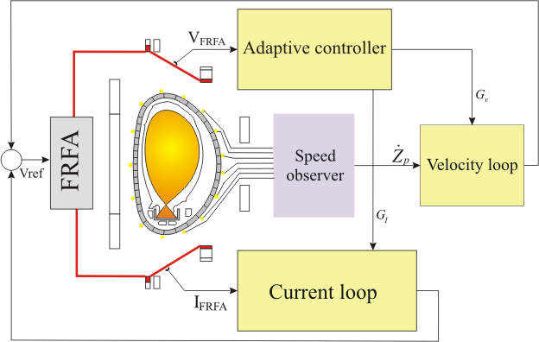
VS – An example
Elongated tokamak plasmas are susceptible to a vertical axisymmetric instability
Dedicated Vertical Stabilisation System required
Essential system for operation
Growth rate of 1000s-1
Loss of control can produce forces in the order of the 100's of tonnes

Slide 16
VS-GAMs

Slide 17
Conclusions
MARTe
  Designed for real-time systems
  Multi-platform
    Key for simulation and commissioning
  Modular
    Reusability and maintainability
    Clear boundary between algorithms, hardware interaction and system configuration
  Portable
  Data-driven
  Live introspection

Slide 18
Does it work?
e.g. Vertical Stabilisation
  Essential to operation
    Loss of control can produce forces in the order of the 100's of tonnes
  50 ± 0.10 μs
    Always running
Working systems
JET VS
JET EFCC
COMPASS SC
COMPASS VS
ISTTOK Tomography
FTU RT
RFX MHD Control
JET RTPS
JET VTM
JET WALLS
IST FPSH
Linux-RTAI
VxWorks
Linux*
Linux*
Linux-RTAI
Linux-RTAI
Linux*
VxWorks
Linux*
Linux*
Linux*
50 μs
200 μs
500 μs
50 μs
100 μs
500 μs
125 μs
2 ms
10 ms
10 ms
100 μs

