Slide 1
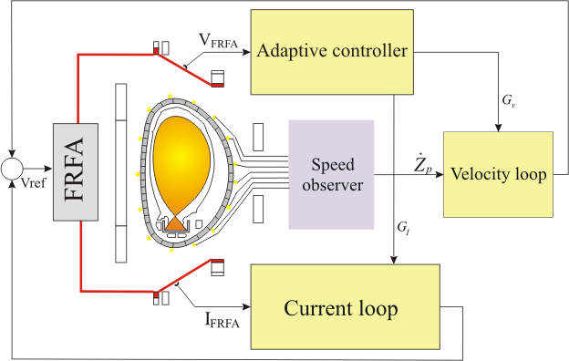
Introduction
Elongated tokamak plasmas are susceptible to a vertical axisymmetric instability
Dedicated Vertical Stabilisation System required
Essential system for operation
Growth rate of 1000s⁻¹
Loss of control can produce forces in the order of the 100's of tonnes

Slide 2
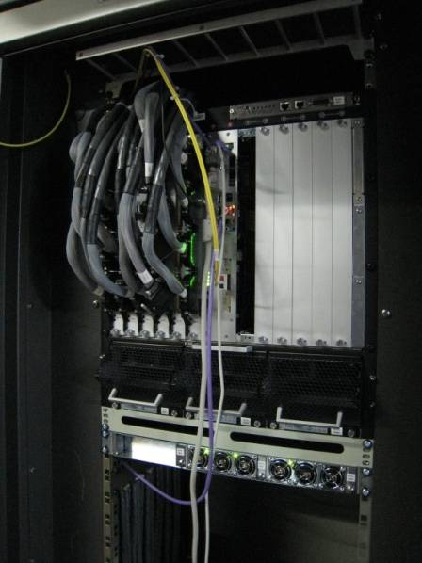
VS New Hardware
192 signals acquired by ADCs and transferred at each cycle
50 μs control loop cycle time with jitter < 1 μs
• Always in real-time (24 hours per day)
  1.728 x 10⁹ 50 μs cycles/day
  Crucial for ITER very long pulses
192 input signals

Slide 3
VS requirements
18 GAM instances
  Altogether execute in less than 40 μs
  Synchronization always achieved within 0.8 μs
192 signals acquired by ADCs and transferred at each loop
Enable advanced experimental features
  ELM pacing
  Complex time windows with different controller features and settings

Slide 4
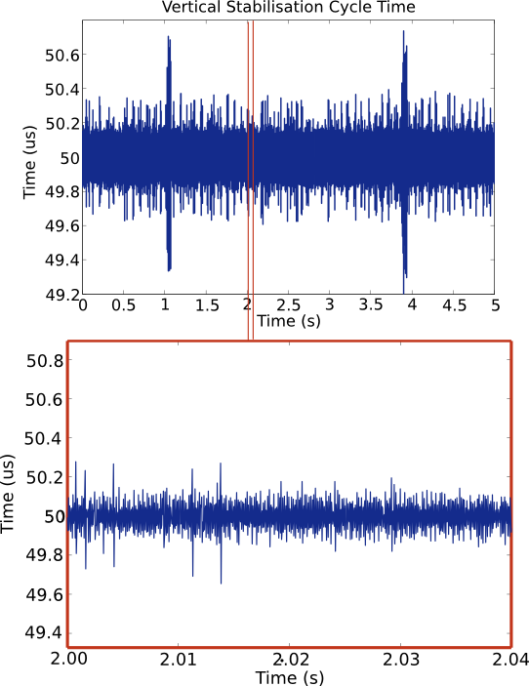
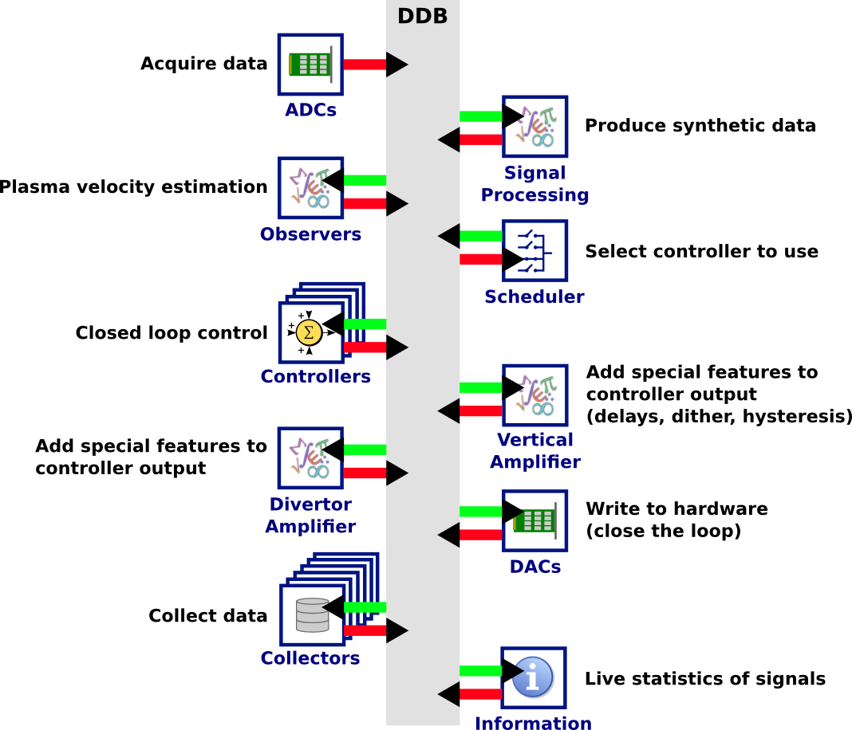
MARTe for the new VS
Low Jitter (<<1us)

