Slide 1
T-CTRL · ISCI method · Researcher Track
Which genes actually steer a T cell —
and which just change the most?
An auditable method that separates effect size from functional direction and cross-donor repeatability in CD4+ T-cell Perturb-seq. The deliverable is not a target list — it is a tested scope map that knows when to call PASS, and when to stop.
Abel Costa · clinical research & hematology
T-CTRL · ISCI method · Built with Claude: Life Sciences
1

Slide 2
THE CLINICAL QUESTION
A large effect can still be the wrong answer.
Some patients respond to a T-cell therapy, then relapse. To engineer better T cells we must tell apart the genes that control a cell's state from those that merely change when perturbed. A candidate controller must answer three questions:
REACH
PRECISION
REPEATABILITY
How much did the cell move?
Which state program moved?
Did independent units agree?
The size of the abnormal result — necessary, not sufficient.
Direction toward activation, Th1/Th2, memory, Treg or exhaustion.
Different guides and donors must reproduce the direction.
Magnitude alone is necessary — but not sufficient. Most screens stop at magnitude.
T-CTRL · ISCI method · Built with Claude: Life Sciences
2

Slide 3
HOW THE STUDY READS A PERTURBATION
The useful question is: where did the T cell go?
→
→
→
CRISPR
silence one gene
PRIMARY CD4+ T CELL
rest & stimulation
PERTURB-SEQ
read the state shift
AUDITED COMPARISON
guide × donor × context
M
Magnitude — how far the profile moved
C₁
Precision — movement along a frozen state axis
C₂
Repeatability — agreement across biological units
ISCI asks whether C adds information after M is known — the pre-specified M → M+C test.
T-CTRL · ISCI method · Built with Claude: Life Sciences
3

Slide 4
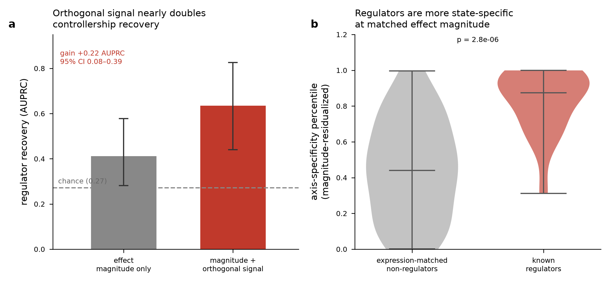
PRIMARY RESULT
Direction and repeatability add signal beyond magnitude.
+0.357
+0.215
0.415→0.722
authoritative full-sample
M → M+C test
leakage-free grouped
out-of-fold gain
separate descriptive
ranking view
95% CI [+0.117, +0.538]
95% CI [+0.074, +0.560] · p = 0.010
AUPRC on the detectable set
These are two different measurements — not one number shrinking. We report both.
T-CTRL · ISCI method · Built with Claude: Life Sciences
4

Slide 5
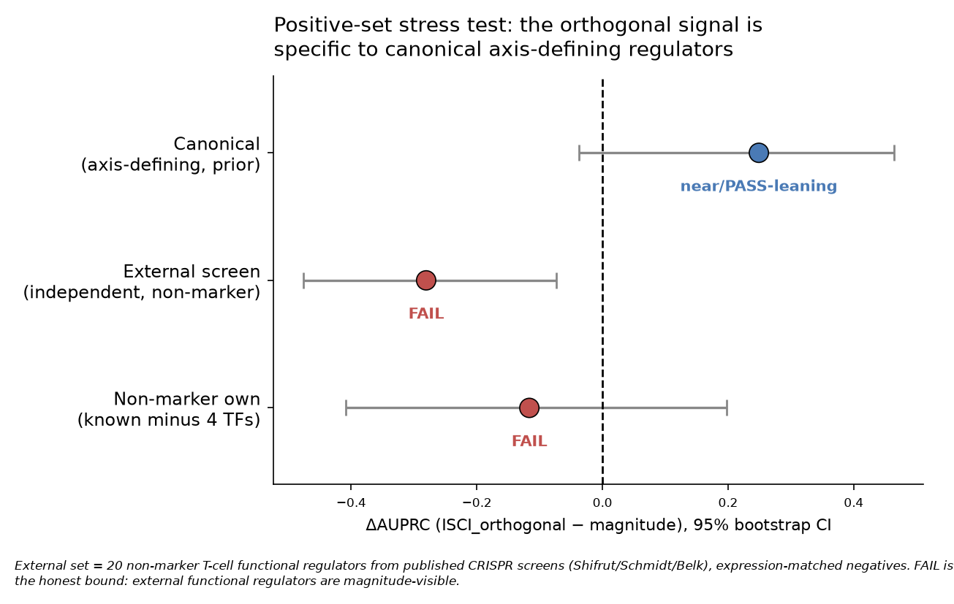
TESTS DESIGNED TO BREAK THE RESULT
The signal is real — and biologically narrow.
We went looking for where it breaks.
External functional-regulator set
FAIL — ΔAUPRC −0.281 [−0.476, −0.073]
Interval sits entirely below zero.
Remove the four master TFs
GATA3, TBX21, STAT6, IRF1 → gain ≈ 0 (n=9)
The claim narrows, honestly, to canonical
axis-defining regulators in T cells.
T-CTRL · ISCI method · Built with Claude: Life Sciences
5

Slide 6
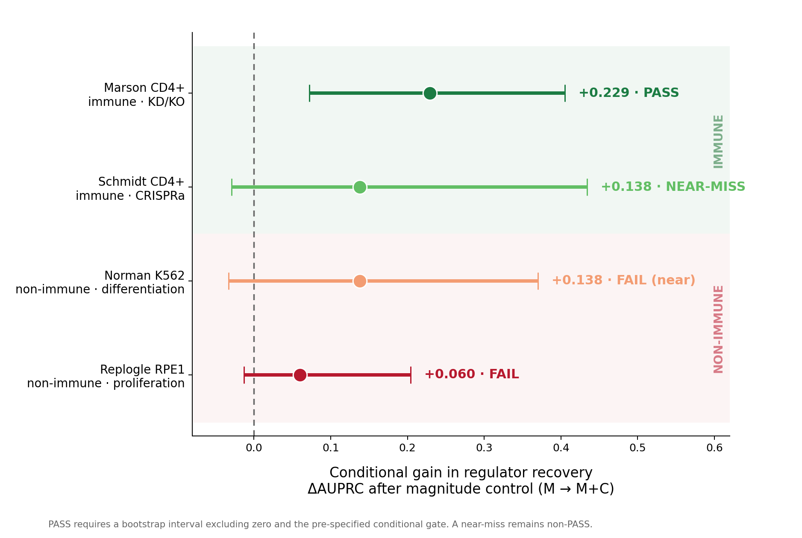
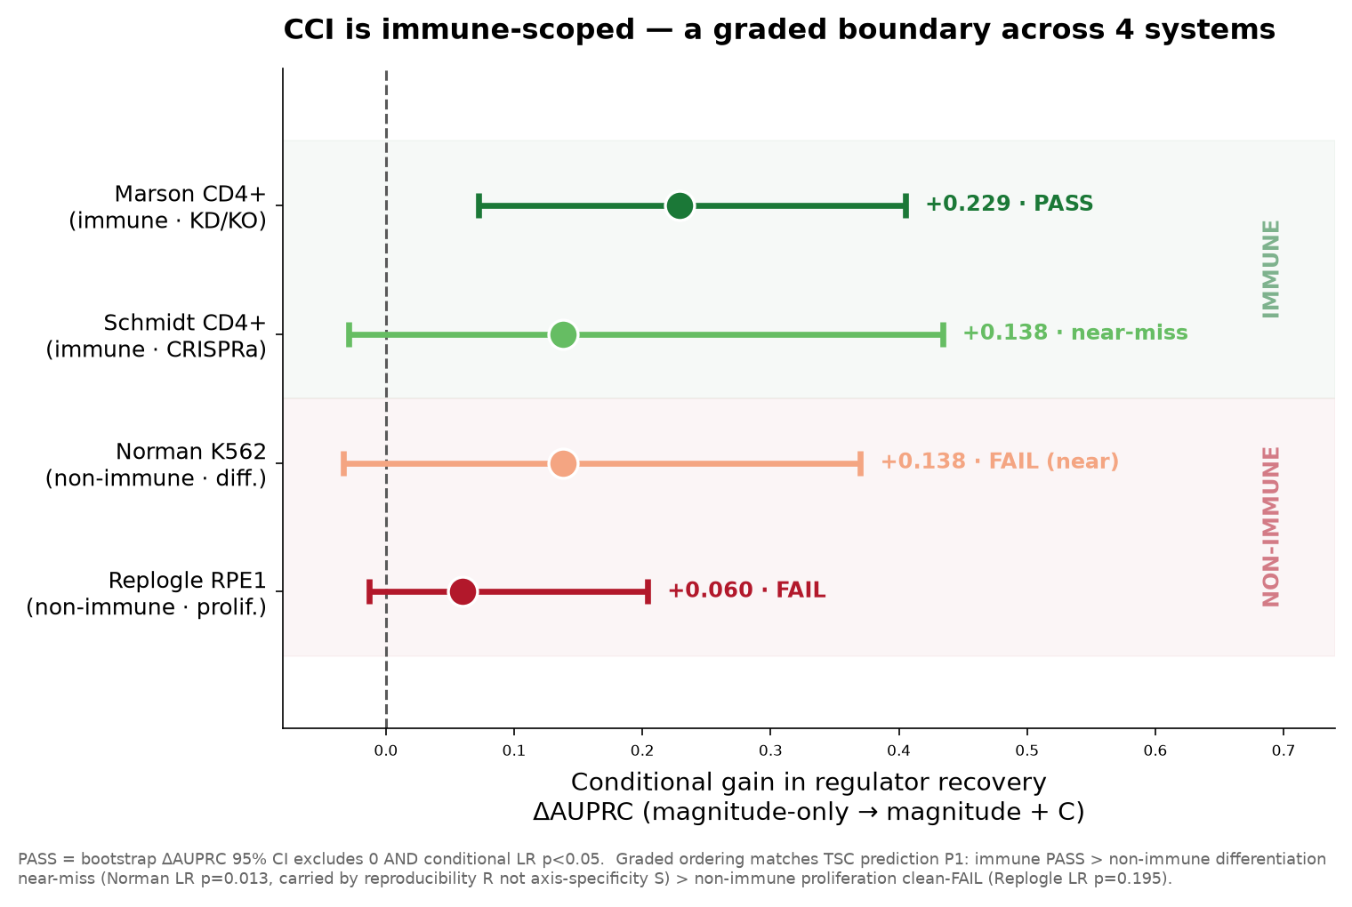
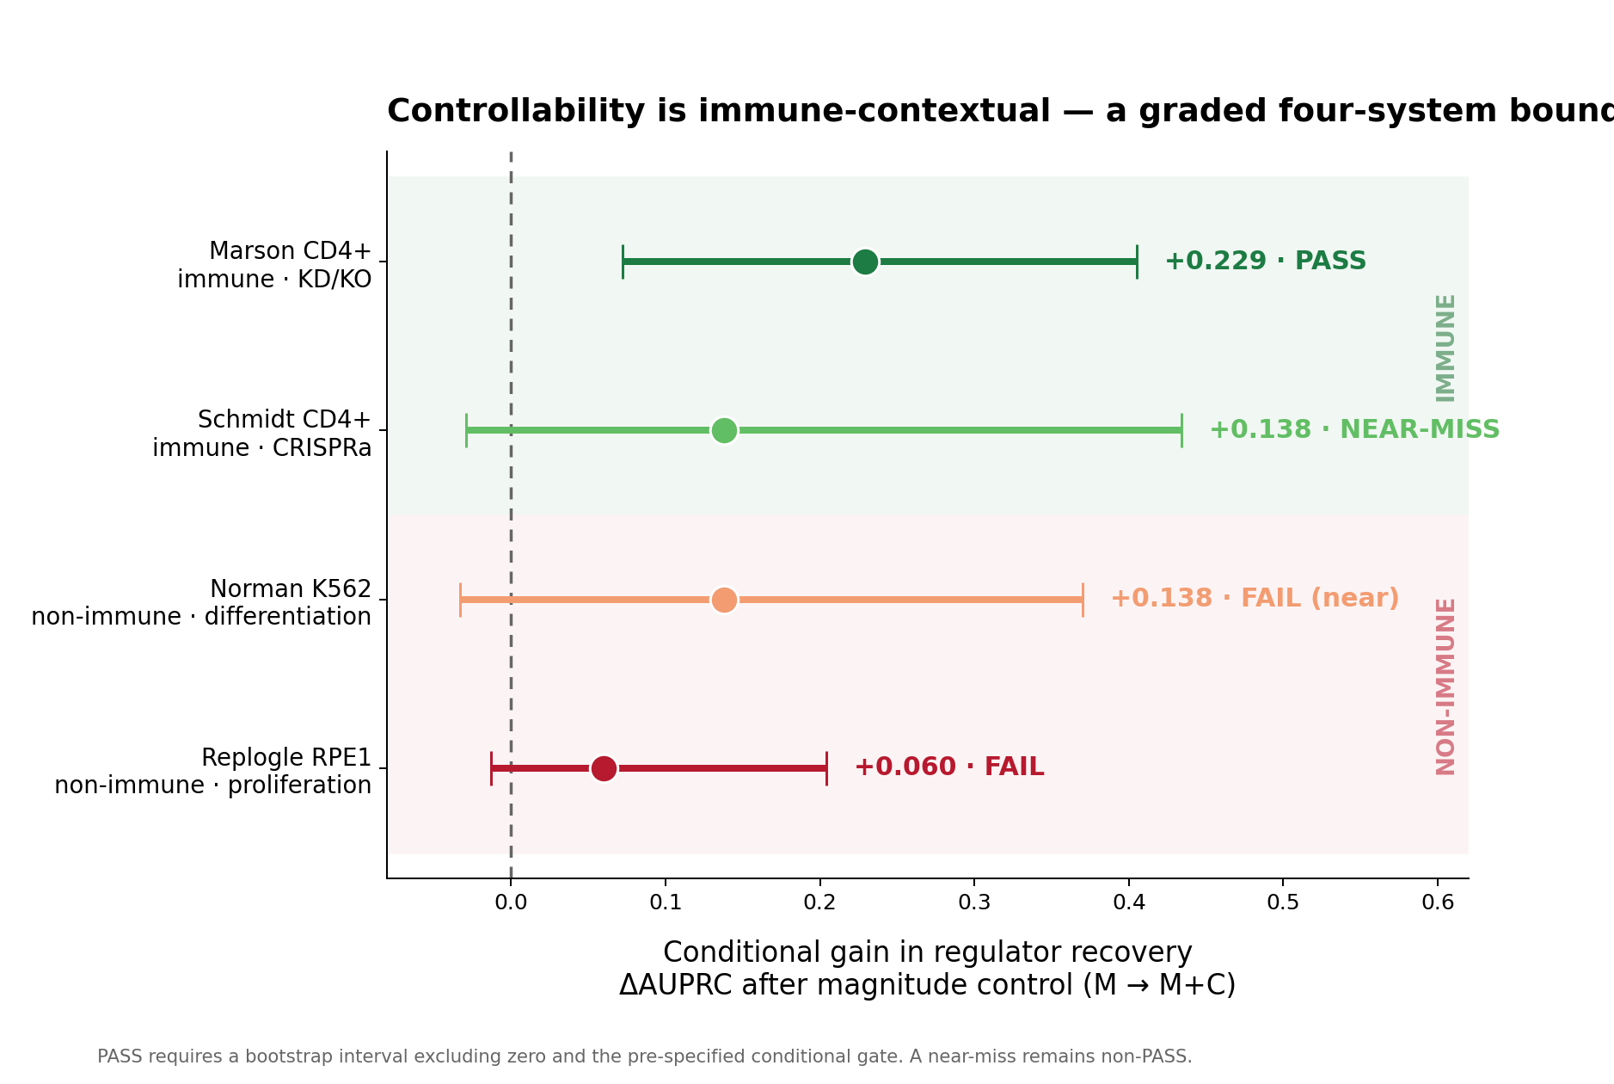
BOUNDARY ACROSS SYSTEMS
The property is immune-contextual, not universal.
Marson CD4+
PASS
Schmidt / THP-1
NEAR-MISS
K562 · RPE1
FAIL
A boundary is also a result. We do not use the word invariant.
T-CTRL · ISCI method · Built with Claude: Life Sciences
6

Slide 7
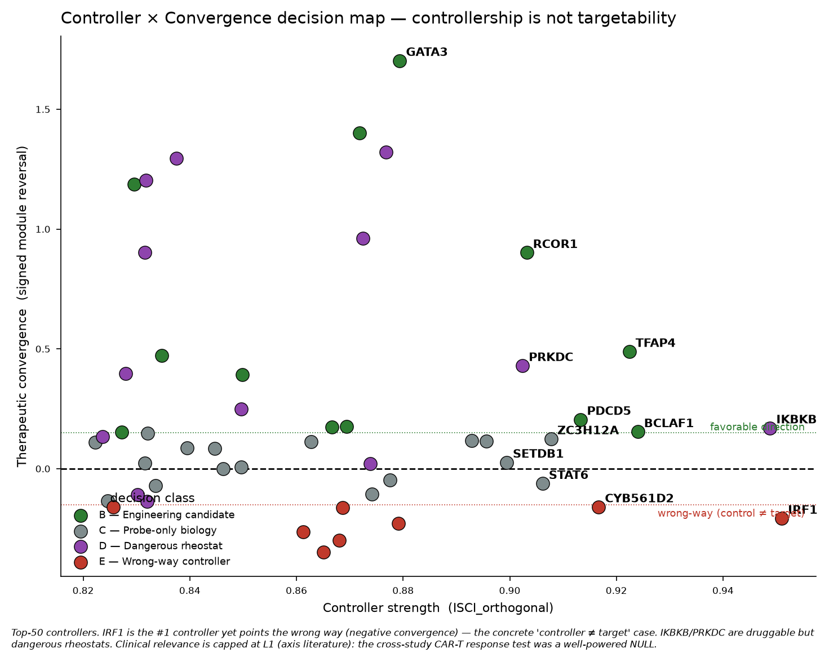
TRANSLATION LIMITS
Controller ≠ therapeutic target ≠ clinical biomarker.
IRF1 ranks #1 as a controller
but points in an unfavorable
intervention direction.
CAR-T response: NULL
study-out AUROC 0.533
CD8 baseline 0.585 beats it
87 patients · 9 studies
High controllership is not a
promise of clinical benefit.
T-CTRL · ISCI method · Built with Claude: Life Sciences
7

Slide 8
THE INNOVATION IS JUDGMENT
The product also knows when to stop.
PASS
FAIL
Pre-specified direction holds and every required gate passes.
The claim is testable and a required gate fails.
NULL
NOT-EVALUABLE
The test is valid but adds no supported signal.
A required input is absent; no biology is forced.
Every FAIL and NULL came from a correction loop: Claude challenged the headline, exposed a leakage path, forced the stricter test. The code owns the numbers; the skepticism is the science.
T-CTRL · ISCI method · Built with Claude: Life Sciences
8

Slide 9
GLADSTONE BRIDGE
A prospective experiment that can falsify the next claim.
DONOR-RESOLVED DESIGN
A frozen ~54-guide CD4 panel across paired rest / stimulation contexts in 8–12 independent donors. The donor is the biological replicate — guides, wells and channels do not inflate n. Promotion requires concordant direction across the pre-declared panel.
FALSIFICATION
The extension fails if:
• residual precision gain below the frozen bound
• donor-bootstrap interval crosses zero
• gene-label / context-exchange p ≥ 0.05
STOP BEFORE SYNTHESIS
Reference sequence, vector compatibility,
on-target activity and off-target risk must
pass first. A proposed panel is a design —
not an experimentally validated result.
T-CTRL · ISCI method · Built with Claude: Life Sciences
9

Slide 10
OPEN-SOURCE DELIVERY
Executable, reusable, auditable.
1 · CONTRACTS
Frozen axes, claims, gates, DatasetSpec
2 · PYTHON ENGINE
CLI, adapters, block-bounded H5AD
3 · EVIDENCE
JSON/CSV, figures, hashes, tests, ledger
4 · EXPERIENCE
Notebook, offline HTML, video, deck
Run it on any compatible dataset: uv run isci pipeline dataset.yaml
21 / 21 automated release gates passed
MIT code · third-party data retain source terms · CITATION.cff · a tested scope map, not a target list
T-CTRL · ISCI method · Built with Claude: Life Sciences
10

