Slide 1
TOPIC
Library Book Inventory Manager
ANET SHERON M VIJAY
Internship Project for SYNTEX HUB

Slide 2
Introduction
In many educational institutions and small community libraries, managing books is still done manually using registers, spreadsheets, or handwritten logs. These traditional methods are time-consuming, prone to human errors, and make it difficult to track book availability, issued records, or search for specific titles. As the number of books grows, maintaining accurate records becomes increasingly challenging.

Slide 3
Introduction
To address these issues, this project aims to build a lightweight and efficient Library Book Inventory Manager using Python. The system focuses on simplifying day-to-day library operations such as adding new books, searching for books, issuing or returning them, and maintaining accurate reports. The application uses fundamental programming concepts like Object-Oriented Programming (OOP), collections, and file handling, making it both educational and practical.

Slide 4
Project Aim
To develop a Python application using OOP, lists/dicts, and JSON persistence.

Slide 5
Features Implemented
• Add books
• Search by title/author
• Issue/return
• Reports (total & issued count)
• JSON data saving
• Fast lookup using dict indexes

Slide 6
Technologies Used
• Python
• JSON
• OOP (Classes)
• Dictionaries & Lists
• CLI Interface

Slide 7
System Design
Book Class – Stores Book Details
The Book class represents each individual book in the library.
It stores all essential information such as:
Book ID
Title
Author
Publication year
ISBN
Issue status (issued or available)
Issue date and issued-to details
This class encapsulates all book-related attributes, making the system organized and object-oriented.

Slide 8
System Design
JSON File – Persistent Storage
To ensure that data is not lost when the program closes, all book information is saved in a JSON file named library.json.
This file stores:
All book records
Issue details
Next book ID
When the application restarts, it automatically loads this file and restores the library’s state.
This makes the project feel like a real system with permanent storage.

Slide 9
System Design
Dictionaries – HashMap-like Lookup for Fast Search
Python dictionaries (dict) are used as indexes for:
books_by_id
ids_by_title
ids_by_author
These work like HashMaps, giving:
O(1) average lookup time
Very fast search even for large collections
This makes title/author search efficient and scalable.

Slide 10
Code Architecture
Book Dataclass
The Book class is implemented using Python’s @dataclass decorator.
It stores all attributes related to a book such as:
ID
Title
Author
Year
ISBN
Issued status and issue date
Using a dataclass automatically generates methods like __init__() and __repr__(), making the code cleaner and easier to maintain.

Slide 11
Code Architecture
Library Functions
The Library class contains all main operations of the system.
It provides methods to:
Add new books
Remove books
Search by title or author
Issue and return books
View reports
This class serves as the business logic layer of the application.

Slide 12
Code Architecture
Search Algorithm
The system uses dictionary-based lookup for fast searching (HashMap-like).
Two indexes are maintained:
ids_by_title
ids_by_author
Searching becomes O(1) for exact matches and very fast for partial matches.
This makes the system efficient even with many books.

Slide 13
Code Architecture
Issue / Return Logic
Issuing and returning books is handled by:
Checking if the book exists
Verifying whether it is already issued or available
Updating fields issued_to and issued_date
This ensures accurate tracking of book availability.

Slide 14
Code Architecture
JSON Save / Load
To make the system persistent:
All books are saved into a library.json file
On startup, the file is read and the library state is restored
This feature ensures that data is never lost, even when the program closes.

Slide 15
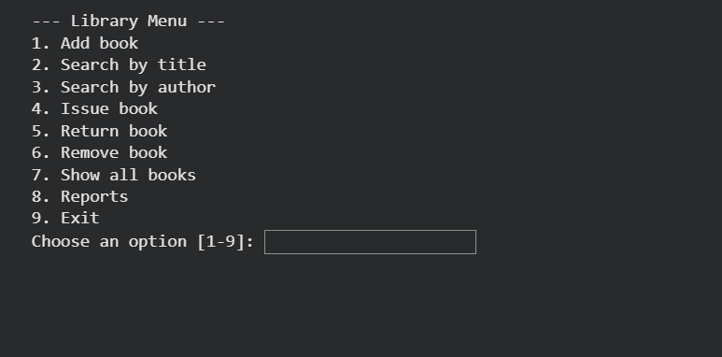
Output Screenshots

Slide 16
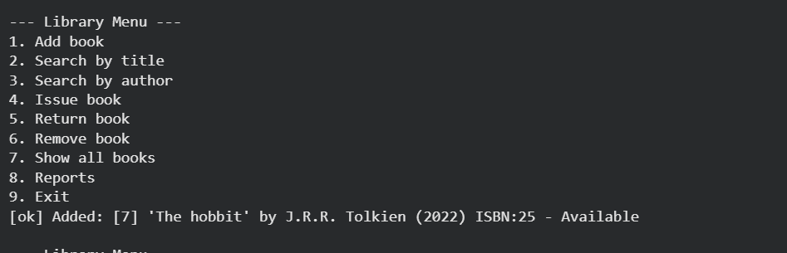
Output Screenshots

Slide 17
Learning Outcomes
• Python OOP
• Collections & indexing
• File handling
• Software design
• Debugging & problem solving

Slide 18
Conclusion
The Library Book Inventory Manager project successfully demonstrates how Python can be used to build a functional and efficient book management system using core programming concepts. By applying Object-Oriented Programming, collections, and JSON-based persistent storage, this project provides a clean, modular, and scalable solution for managing library operations such as adding books, searching, issuing, returning, and generating reports.

Slide 19
Conclusion
Through this project, I gained hands-on experience in designing classes, working with dictionaries for fast lookup, implementing search algorithms, handling file storage, and structuring a real-world application. The system is lightweight, easy to extend, and forms a solid foundation for future enhancements such as user accounts, due dates, GUI integration, or database connectivity. Overall, this project strengthened my understanding of Python application development and improved my ability to design practical, real-world software solutions.

