Slide 1
Rainnie
The Weather Man App
Anita Emefa Hato && Raphael Amponsah

Slide 2
Use cases
Student
Ralph is going out today and needs to check what the weather is and know what to wear and whether to carry an umbrella/raincoat or not
Farmer
Appiah is planning on growing new crops for the next season and wants to check the weather to know when it will be a good idea to start growing the seedlings

Slide 3
The Idea
Rannie is a mobile phone application that utilizes the python/ruby API to retrieve meteorological data to the user, enabling the user to make informative decision about the weather and what the user needs to do or where to go.
The retrieved information about the weather, is dependent on the informational input of the user (at the client side) in relation to the user’s location. And through the use of ruby/python, communicates with the dynamic weather database to inform the user about the weather forecast concerning the user’s location or destination.
Scope
Local weather information about places in Ghana

Slide 4
Users
Businessmen
Students
Lecturers
Market Women
Nurse and Doctors
Android mobile phone users in Ghana

Slide 5
FLOW CHARTS
(Client Side)
Start
Client Side
Generate meteor data
Enter Custom details
Is it time?
Fetch data
Display content data
end

Slide 6
Server Side
start
Is user requesting data?
Fetch data from external source
Process data
Send results to user
end

Slide 7
Requirements
DEVELOPERS:
Android SDK, Ruby and python, eclipse, Open Weather map api, database (optional)
USERS:
Android OS version > 2.0
Smartphone

Slide 8
Timeline & Rocky Milestones
5-06-13 to 6-06-13 Get a general knowledge on Ruby programming language
7-06-13 Understand how the weather api works
8-06-13 to 9-06-13 Server side coding
10-06-13 to 12-06-13 Client side coding
13-06-13 Presentation of the Weatherman App… WooHooo…!

Slide 9
Rannie’s Architecture
Stakeholders
Lecturers/Students:
Rannie would be beneficial to this group of users as it would help them to decide whether their lectures would come on or not. They will also use it to decide what to wear.
Businessmen/travelers:
Rannie would help them know the weather conditions of the country they may be visiting to transact business.
MeteoR unit of Ghana:
Probable collaboration with developers to help exchange or offer meteor data.
general users:
anyone interested in the weather.
Farmers:
Rannie will be useful to in helping them to know when there will be rain and prepare their seedlings

Slide 10
Design pattern (style)
client server
the client or user of the app will request\query data from the database
event driven
upon the touch of an icon of the widget there will be a change in the state if there is an update.

Slide 11
Code layout
server side:
REQUEST/QUERY DATA
-FUNCTION CALLED “REQUESTDATA” WOULD PERFORM THIS JOB.
FETCH DATA
-FUNCTION CALLED “FETCHDATA” WOULD PERFORM THIS JOB.
PROCESS DATA
-FUNCTION CALLED “PROCESS_json” would convert the data fetched to be able to be viewed in the user interface

Slide 12
Code layout ctd.
Client Side:
function (touch_event) that executes when client touches the icon
condition
if: time of query is this…..??
generate: a particular image with relation to the time of query
display content data
function to display data.
end.

Slide 13
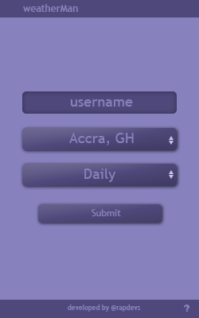
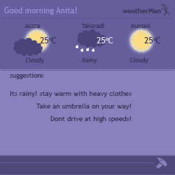
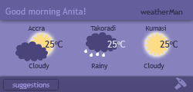
Rannie’s Interface

Slide 14
Implementation
Tools:
Motorola Rhomobile Studio v 2.
Photoshop
Languages:
Ruby
JavaScript
Html
Ajax

Slide 15
Sample code
<div>
<a name="#jsonp-ajax"></a>
<div id="example-section39">
<div>Check weather</div>
<div id="div391">
This is today's weather
</div>
<button id="btn392" type="button">Fetch</button>
</div>

Slide 16
<!-- Javascript -->
<script type="text/javascript">
$(document).ready(function (){
$("#btn392").click(function(){
var url = "http://api.openweathermap.org/data/2.5/weather", loc='London,uk';
var invocation = new XMLHttpRequest();
if(invocation){
$.ajax({
type: 'GET',
url: url,
data:{q:loc},
dataType: "json",
crossDomain: true,
cache:false,
success: success,
error:function(jqXHR, textStatus, error){
alert([textStatus,error]);
}
});

Slide 17
var success = function(data){
var html = [];
/* parse JSON */
data = $.parseJSON(data);
/* loop through array */
$.get(data, function(data){
html.push(data)
});
$("#div391").html(html.join('')).css("background-color", "orange");
};
}
});

Slide 18

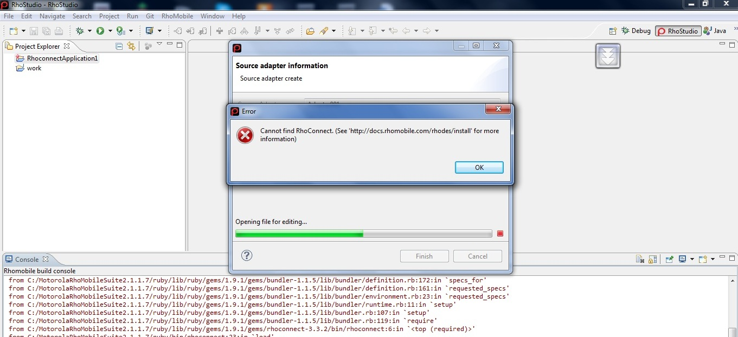
Problems encountered
Rhomobile:
The is a framework called the Rhoconnect that enables the application to connect itself to an external server and retrieve data. But the Rhoconnect wasn’t working even though we followed the procedure
The routing wasn’t working i.e connecting to the external server.

Slide 19
Problems encountered contd…
We were down to 2 members in the team

Slide 20
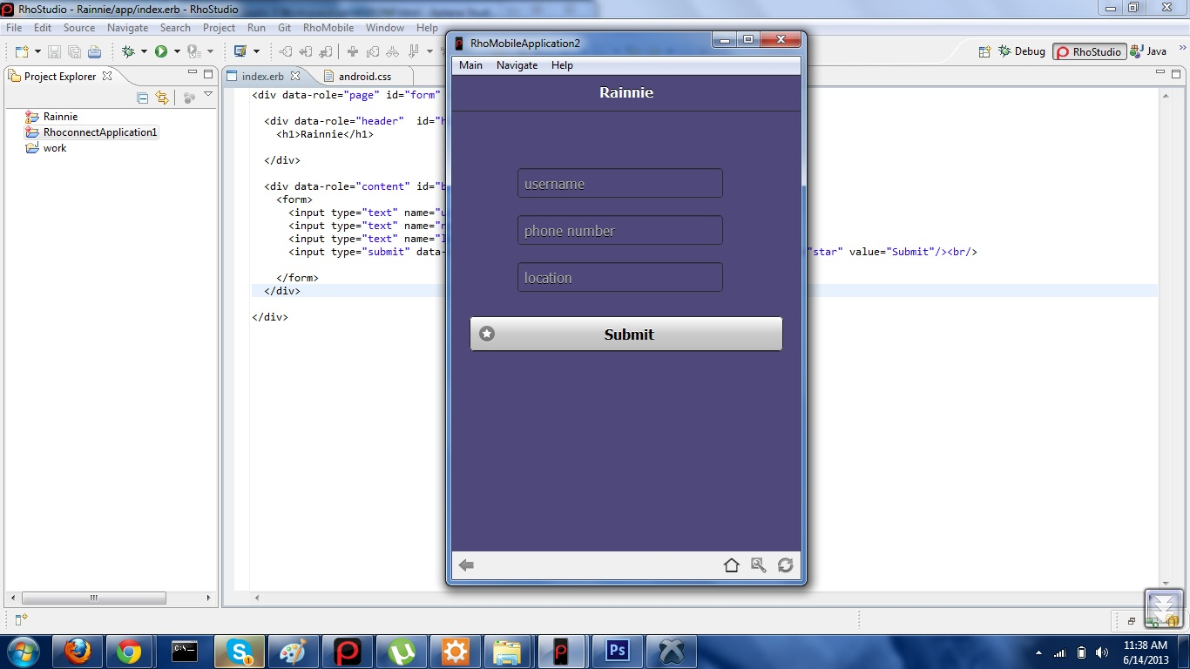
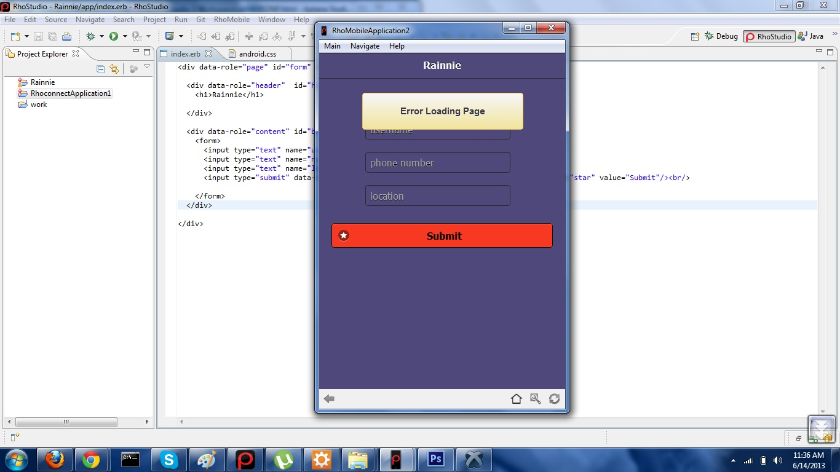
Problems encountered contd…
Effect in our application

Slide 21
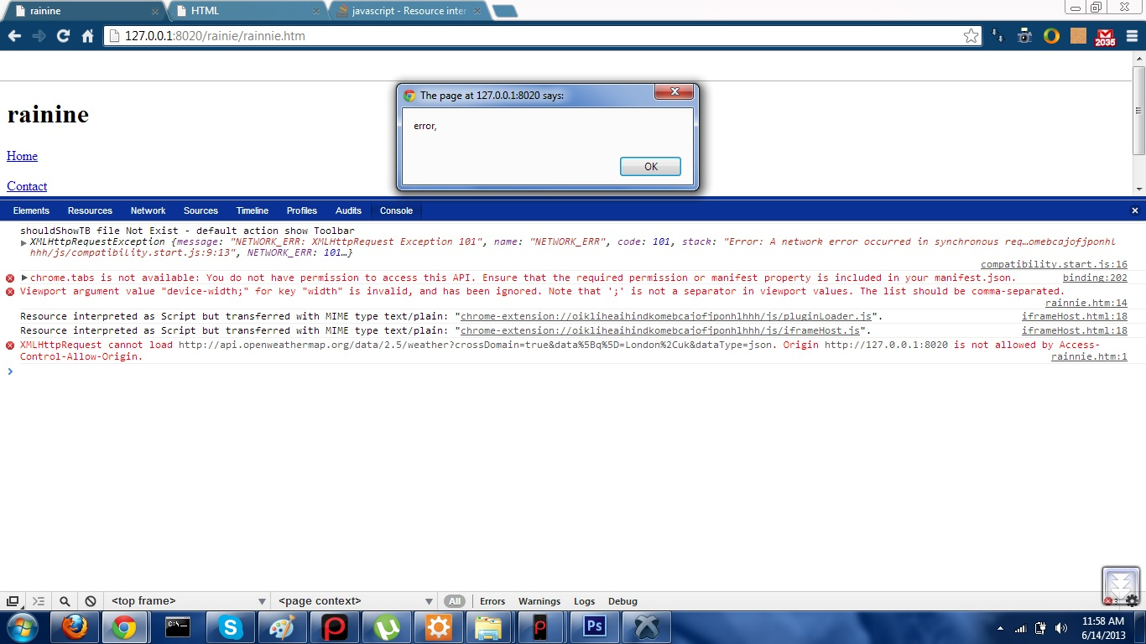
Problems encountered
Optimal Solution
We resorted to change our platform and rather do a web application
Problems encountered:
We encountered a cross domain error: i.e we had a restriction that we could not access the api because our request was coming from a local server

Slide 22
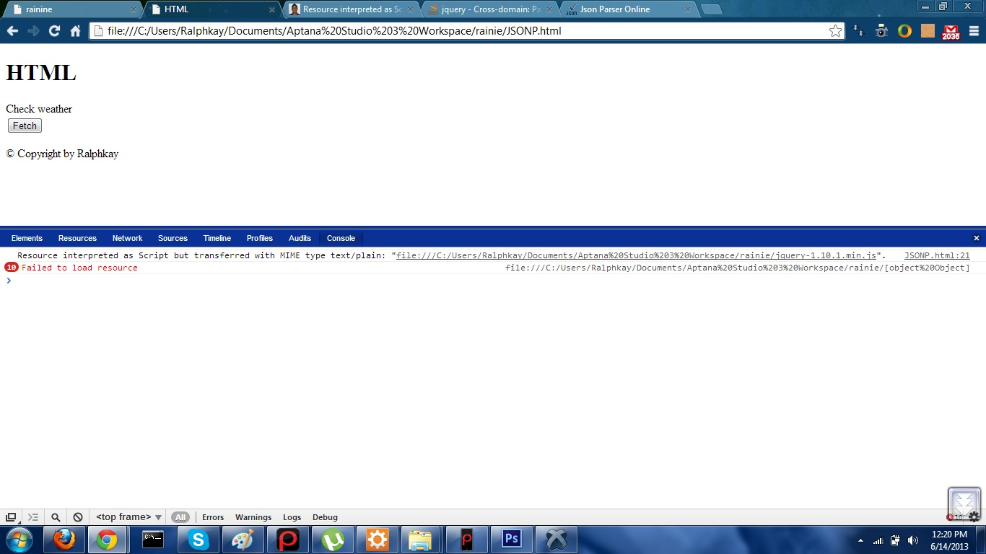
Problems encountered
We changed a few things in our code by setting the cross domain to “true” and we had this error

Slide 23
Lessons
Ruby is not popular so it is difficult to get resources
Learning the programming language and its syntax is crucial to the success of any project
We discovered other frameworks we never thought of
Discovering new frameworks doesn’t necessarily mean it can help solve your problem
Teamwork is good
Possibility of defending a project even though the final product isn’t working.
Team members dropping out shouldn’t discourage u

Slide 24
Recommendation
More time
More resources
Commitment from team members

Slide 25
references
Stackoverflow.com
Github.com
Rhohub.com
www.openweather.com
Google documents

Slide 26
Thank you

