Slide 1
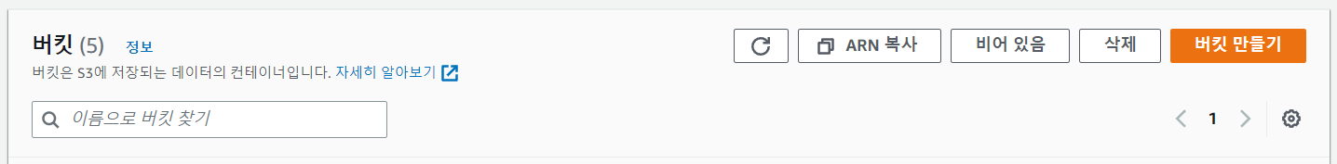

Slide 2
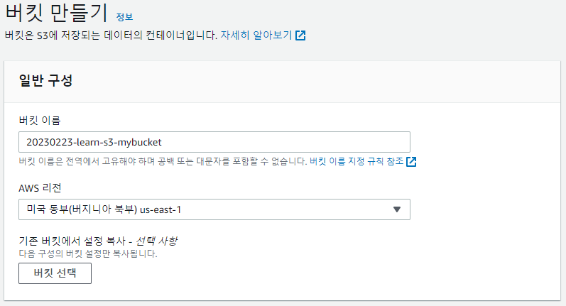
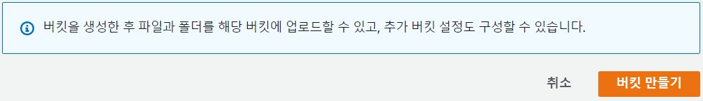

Slide 3
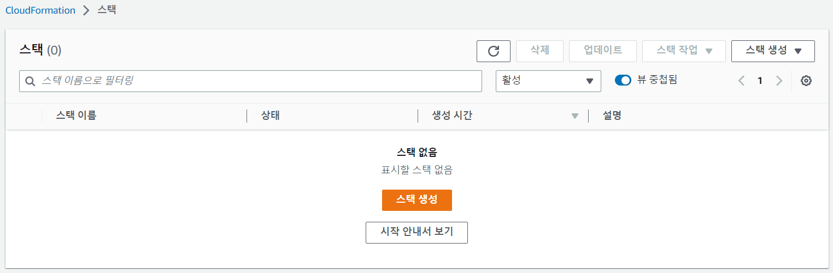

Slide 4
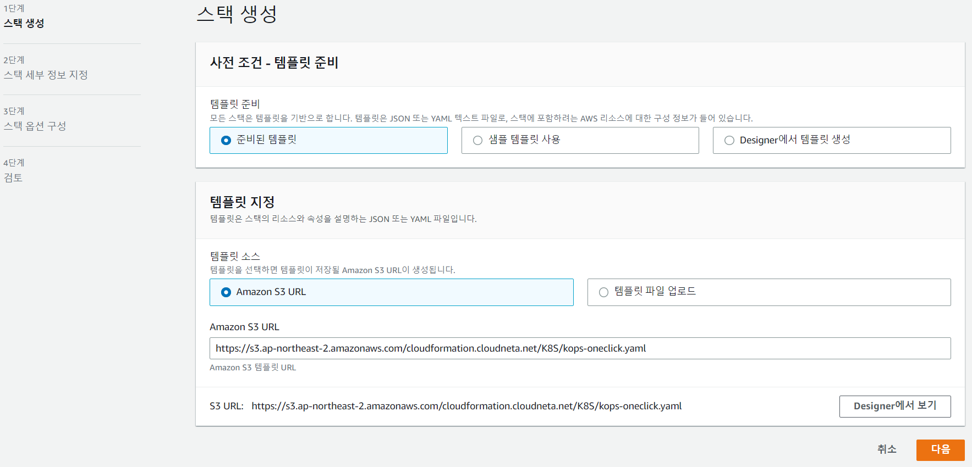

Slide 5
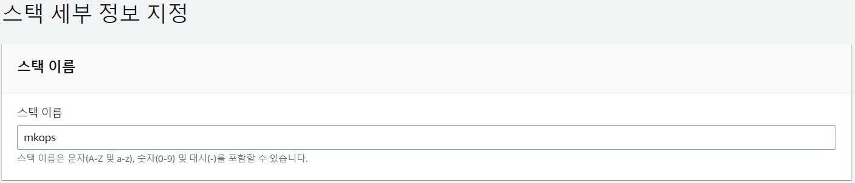

Slide 6
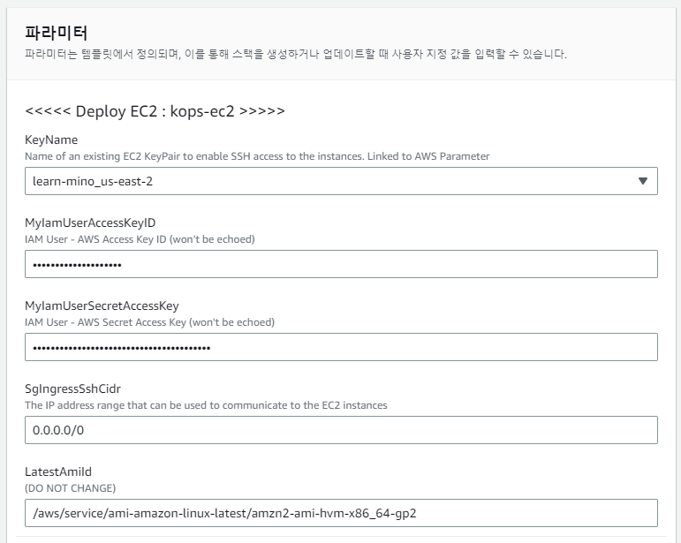

Slide 7
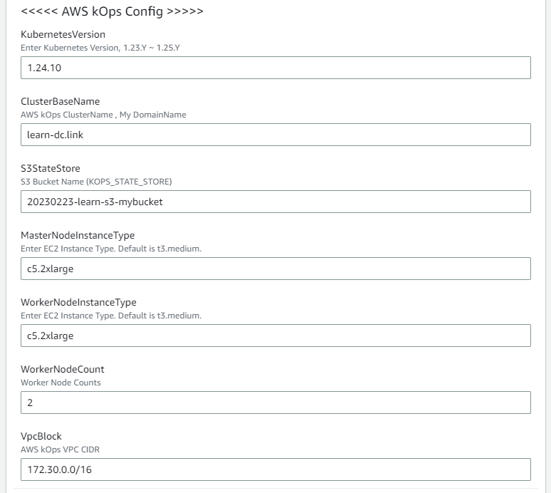

Slide 8
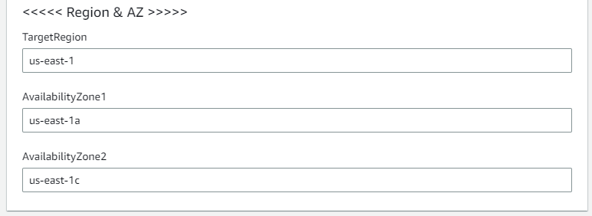

Slide 10
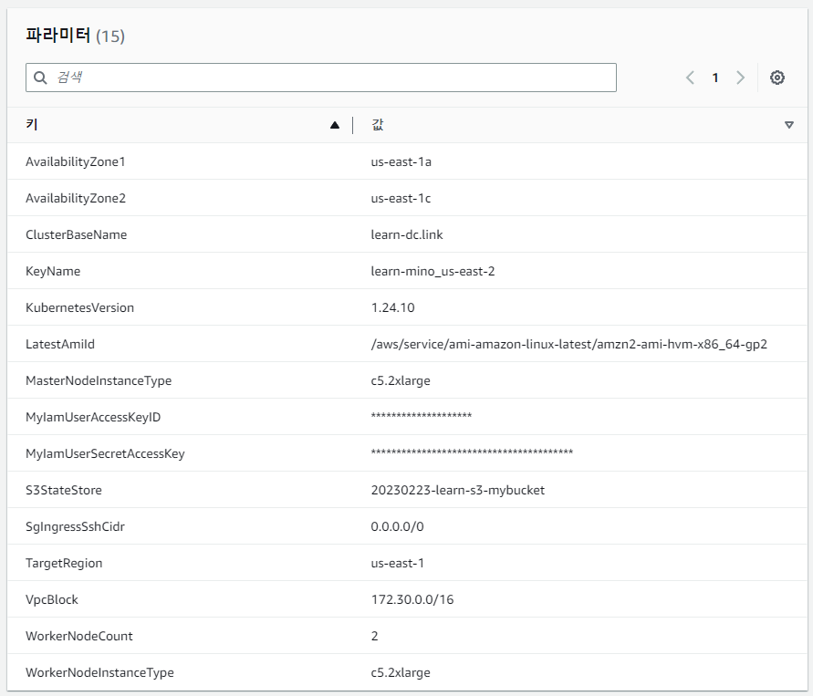

Slide 12
https://us-east-1.console.aws.amazon.com/cloudformation/home?region=us-east-1#/stacks/quickcreate?templateURL=https%3A%2F%2Fs3.ap-northeast-2.amazonaws.com%2Fcloudformation.cloudneta.net%2FK8S%2Fkops-oneclick.yaml&stackName=mkops&param_KubernetesVersion=1.24.10&param_TargetRegion=us-east-1&param_AvailabilityZone1=us-east-1a&param_AvailabilityZone2=us-east-1c&param_WorkerNodeCount=2&param_LatestAmiId=%2Faws%2Fservice%2Fami-amazon-linux-latest%2Famzn2-ami-hvm-x86_64-gp2&param_VpcBlock=172.30.0.0%2F16&param_ClusterBaseName=learn-dc.link&param_KeyName=learn-mino_us-east-2&param_S3StateStore=20230203-learn-s3-mybucket&param_SgIngressSshCidr=0.0.0.0%2F0&param_WorkerNodeInstanceType=c5d.large&param_MasterNodeInstanceType=c5d.large

Slide 13
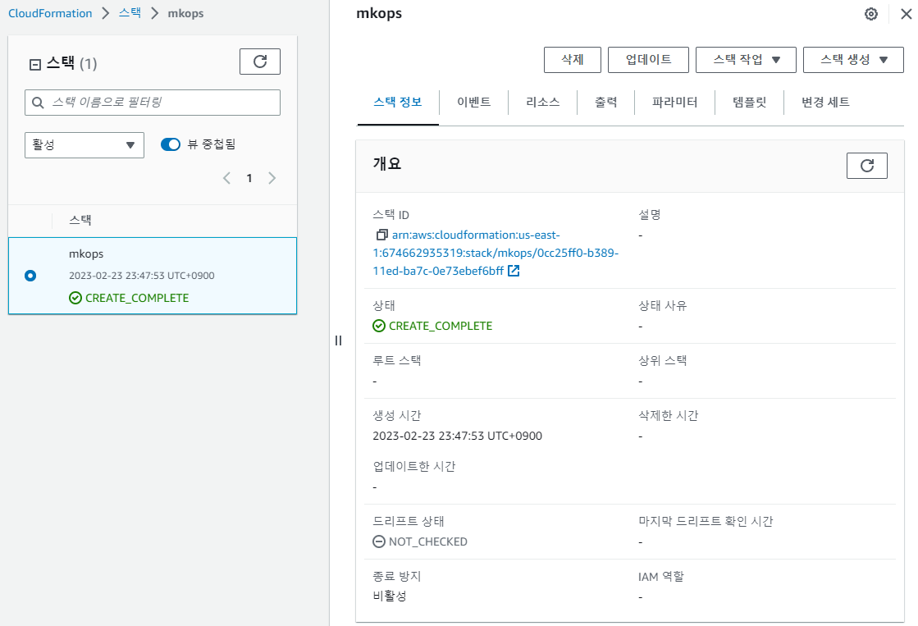

Slide 14
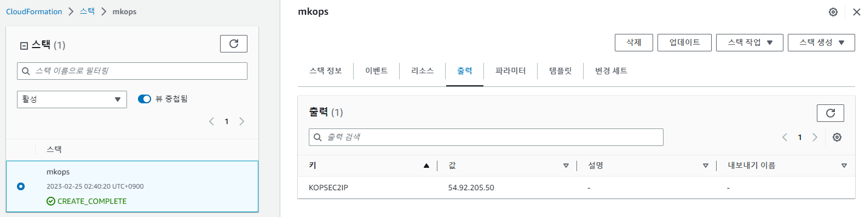

Slide 18
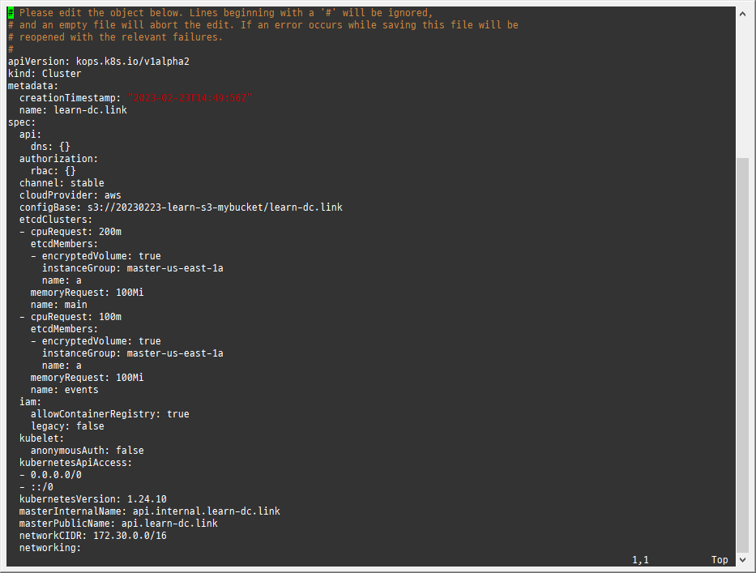
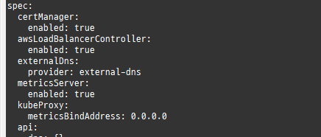
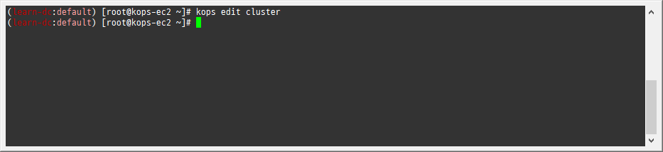

Slide 20
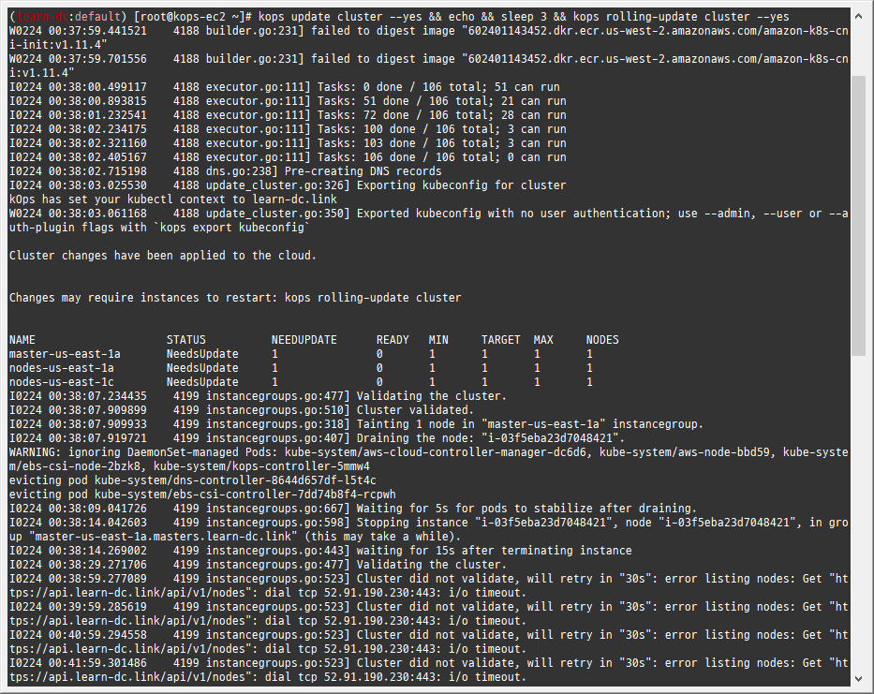

Slide 21
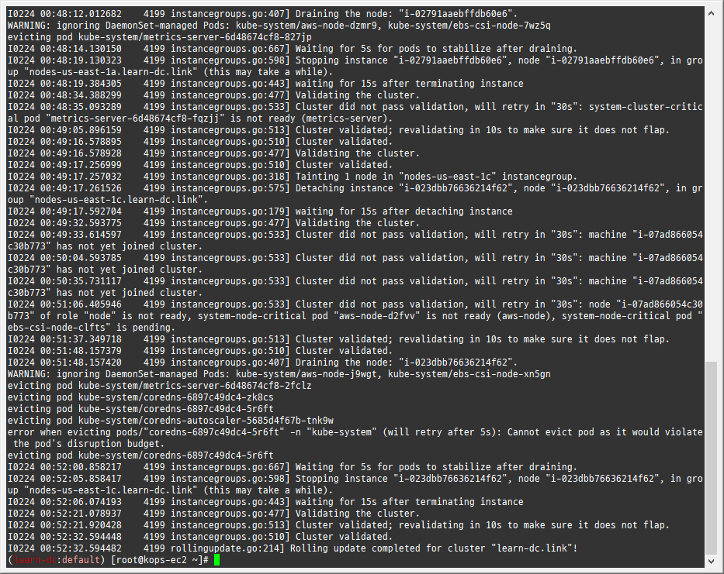

Slide 23
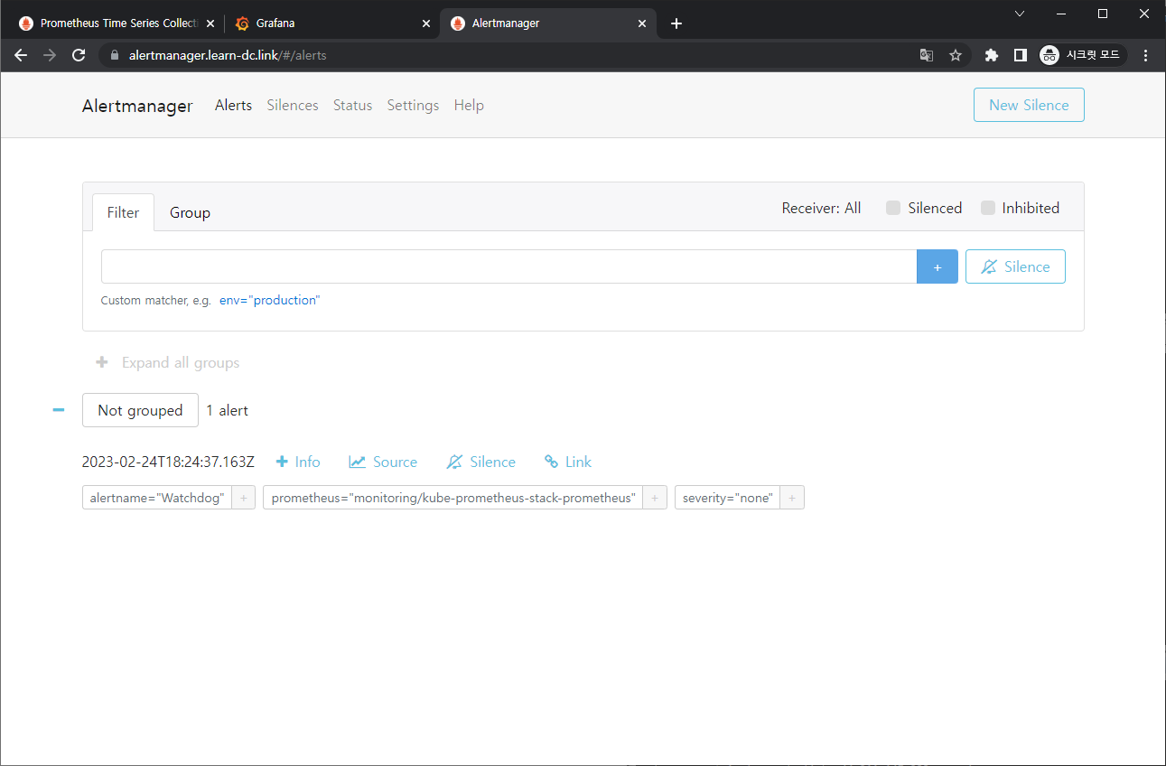

Slide 25
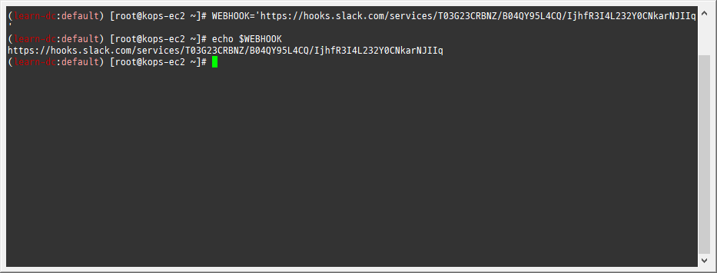

Slide 26
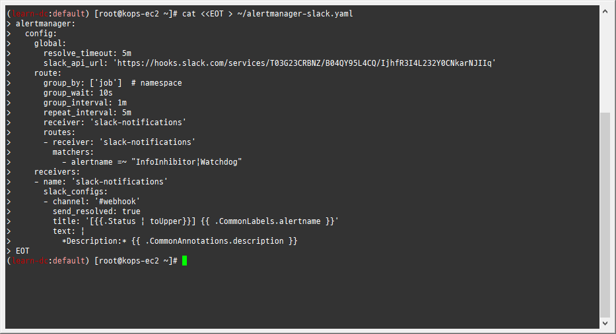

Slide 28
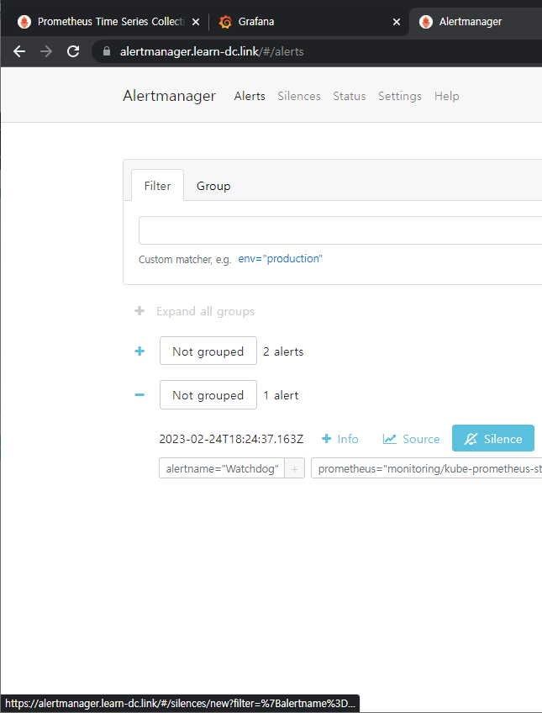
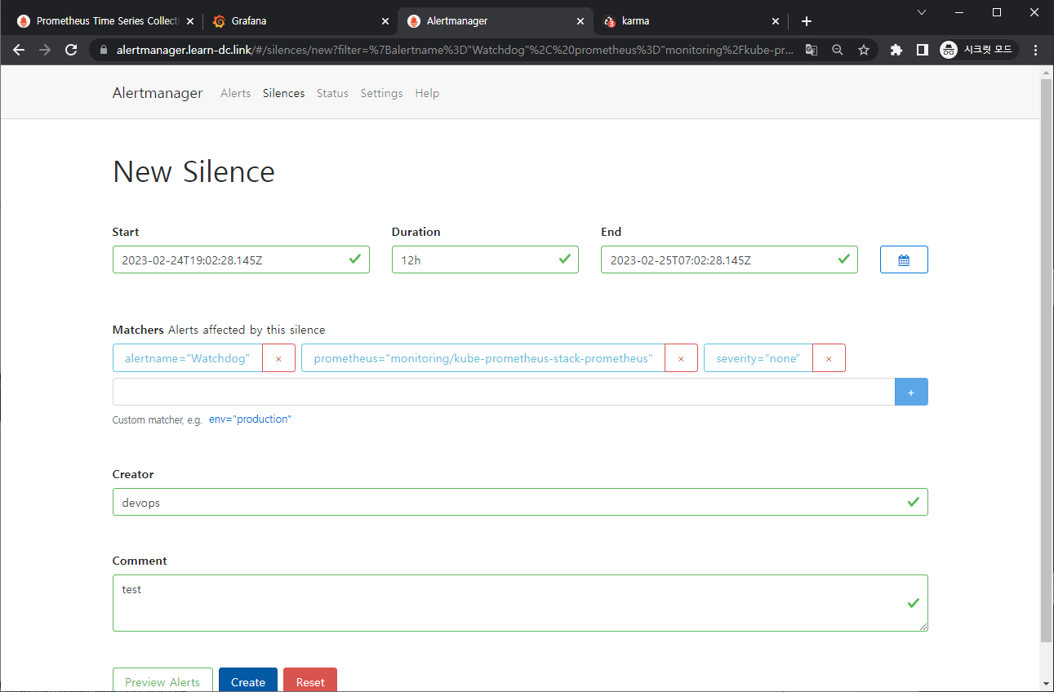
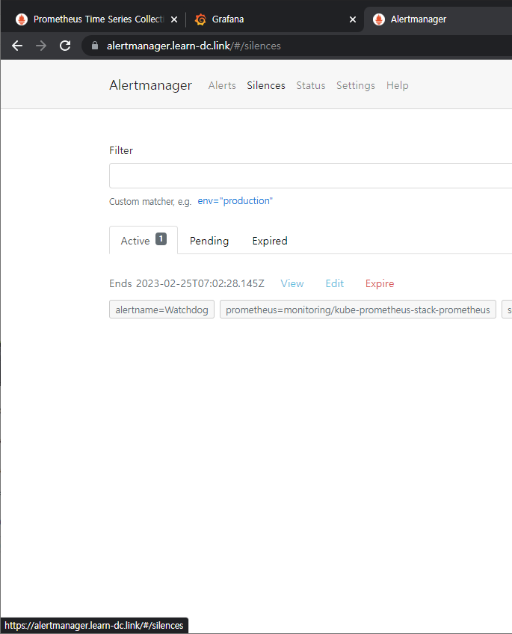
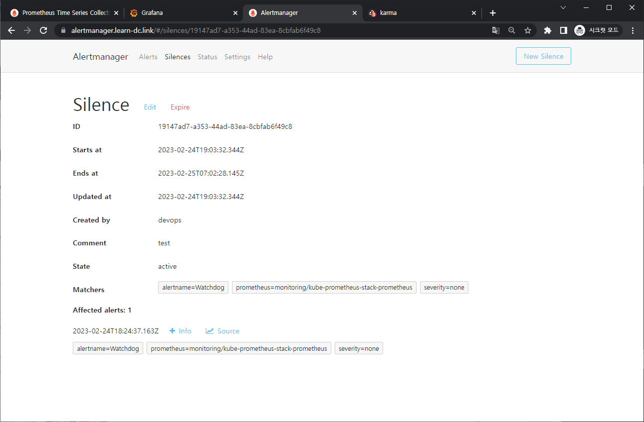

Slide 30
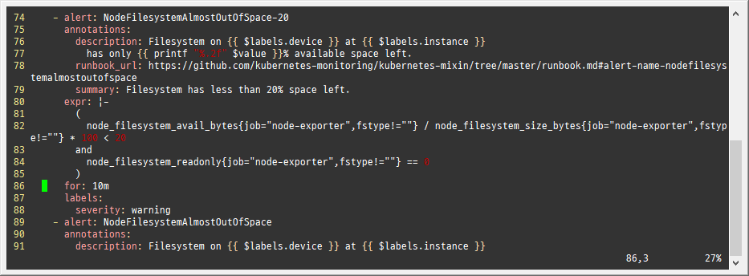

Slide 31
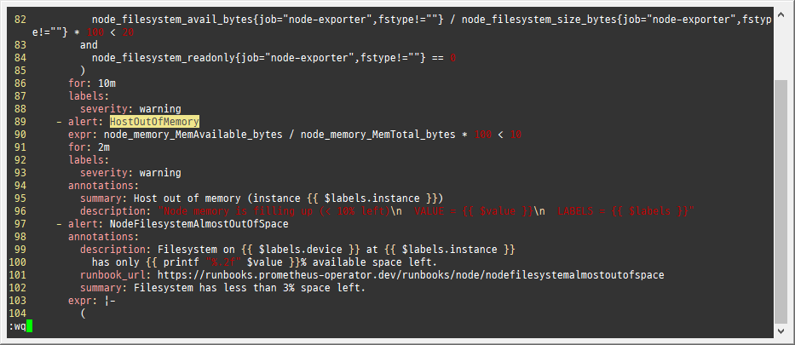

Slide 33
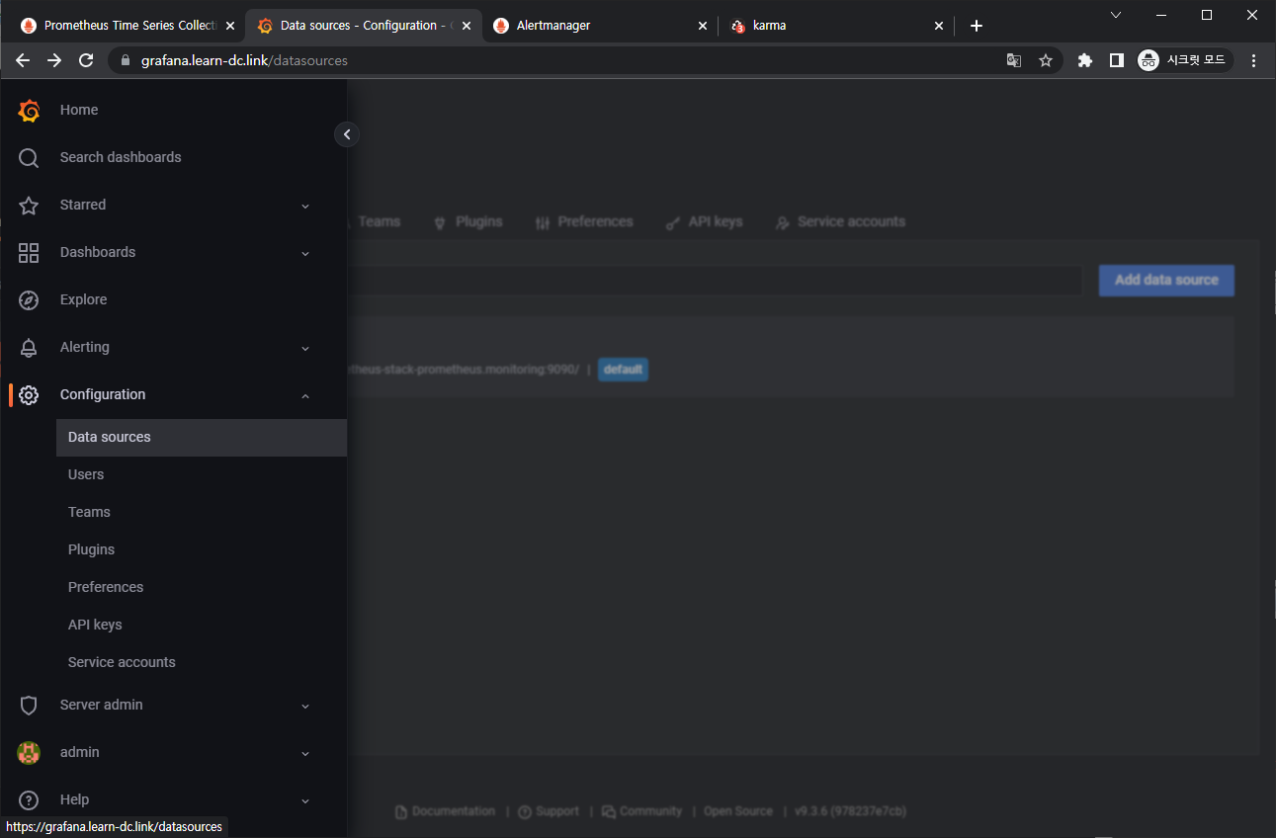
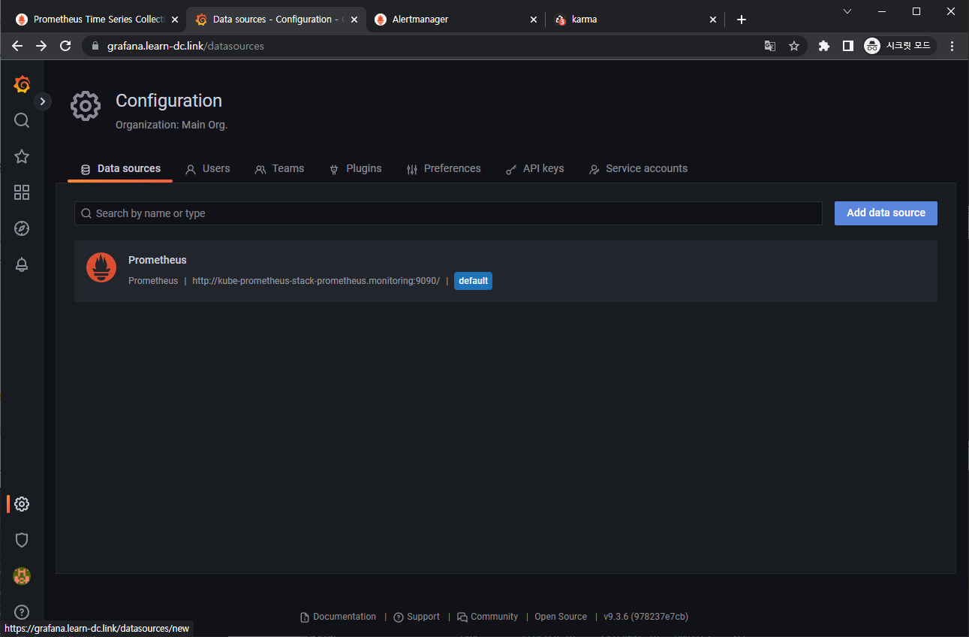
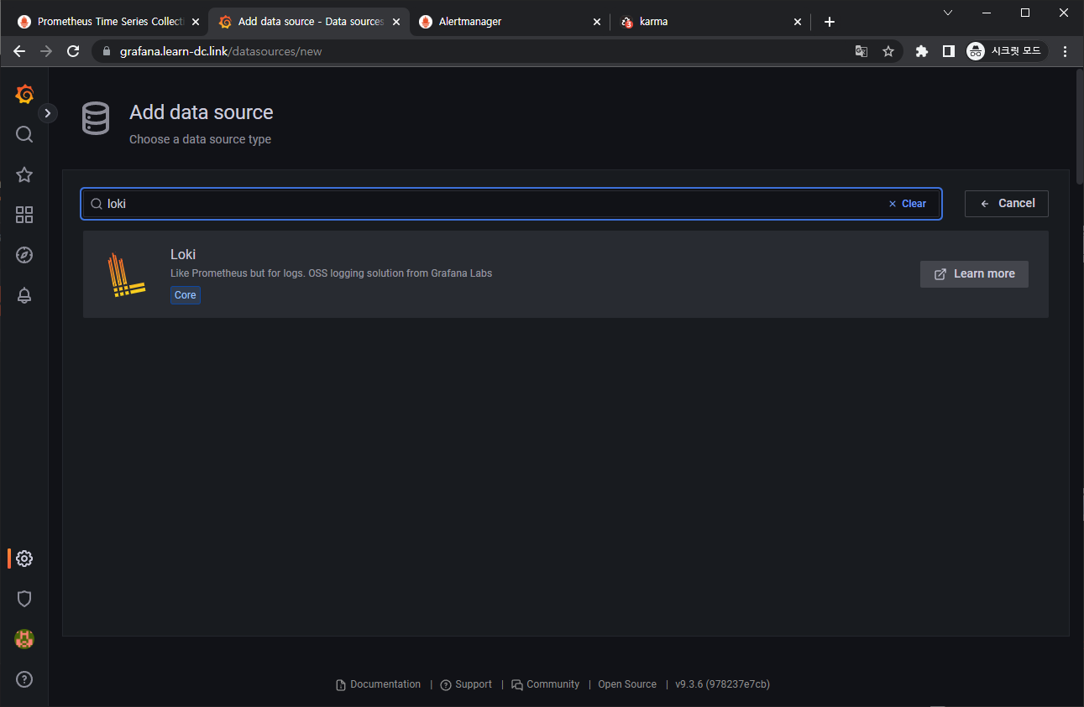
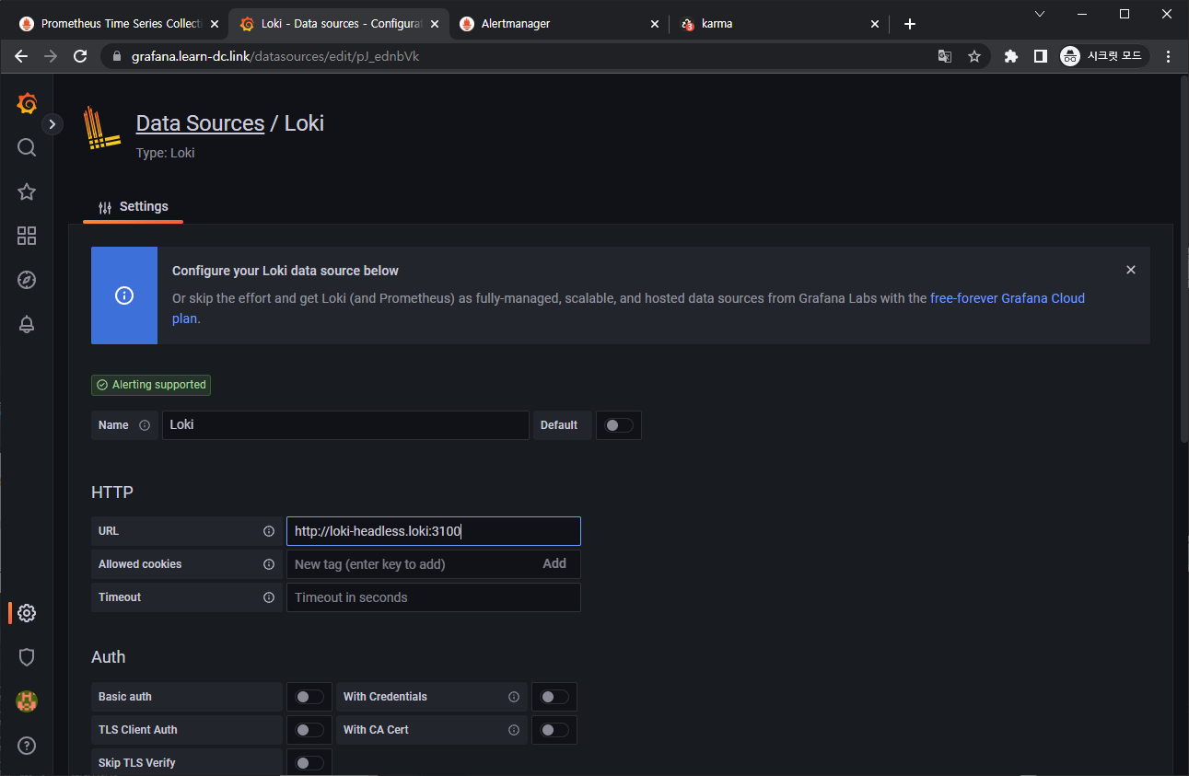
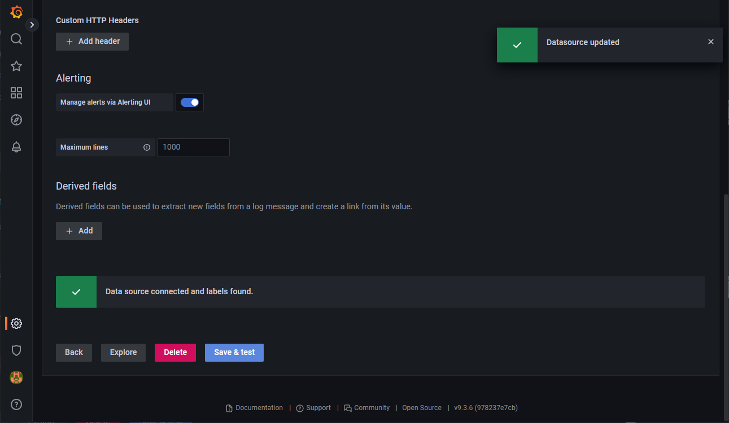

Slide 35
