Slide 1
Computing Lab
Song Liu (song.liu@bristol.ac.uk)

Slide 2
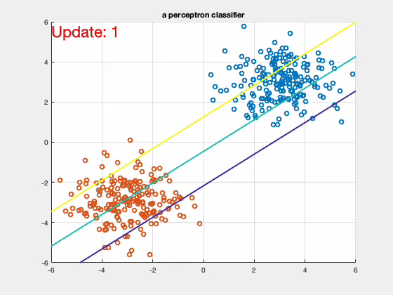

Slide 3

From Perceptron to SVM
We modify the perceptron classifier implemented last week by just a bit, to make it a proper SVM classifier!
Recall our perceptron classifier:
Initialize $w$ by random
For iter = 1 to max_iteration
Set step size $η=\frac{η_{0}}{iter}$
For $i∈D$
If $y_{i}⋅f\left(x_{i};w\right)≤0$
$w^{′}=w+{η⋅y_{i}⋅{\tilde{x}}_{i}}_{}$, where $\tilde{x}=[x,1]$

Slide 4
Perceptron Does Not Care Margin
This decision boundary has a thin margin!

Slide 5
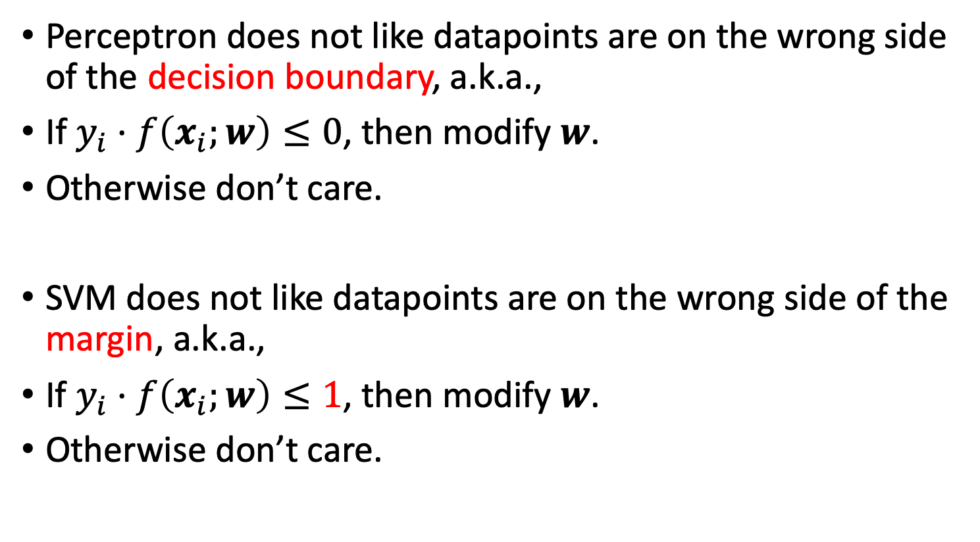
From Perceptron to SVM
Perceptron does not like datapoints are on the wrong side of the decision boundary, a.k.a.,
If $y_{i}⋅f\left(x_{i};w\right)≤0$, then modify $w$.
Otherwise don’t care.
SVM does not like datapoints are on the wrong side of the margin, a.k.a.,
If $y_{i}⋅f\left(x_{i};w\right)≤1$, then modify $w$.
Otherwise don’t care.

Slide 6
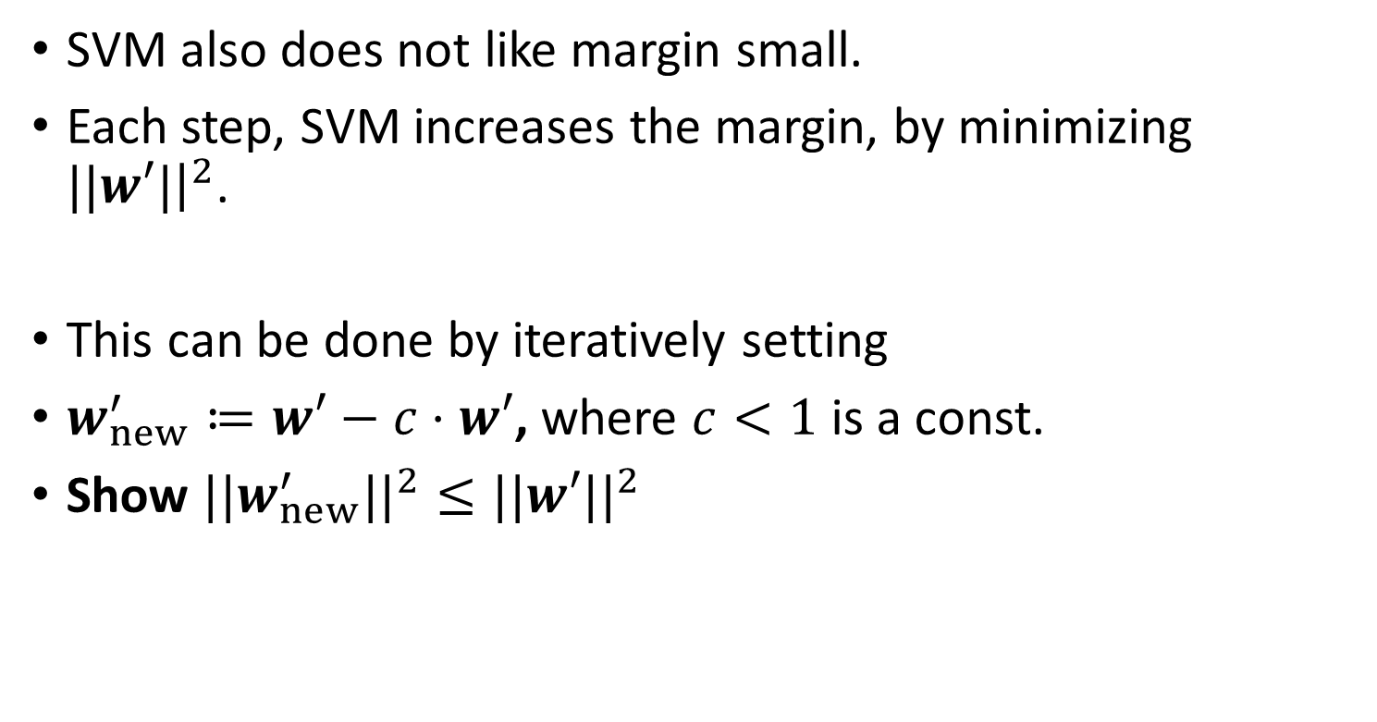
Maximizing Margin
SVM also does not like margin small.
Each step, SVM increases the margin, by minimizing $||w′|{\left.​\right|}^{2}$.
This can be done by iteratively setting
$w_{new}^{′}≔w′−c⋅w′$, where $c<1$ is a const.
Show $||w_{new}^{′}||^{2}≤||w′||^{2}$

Slide 7
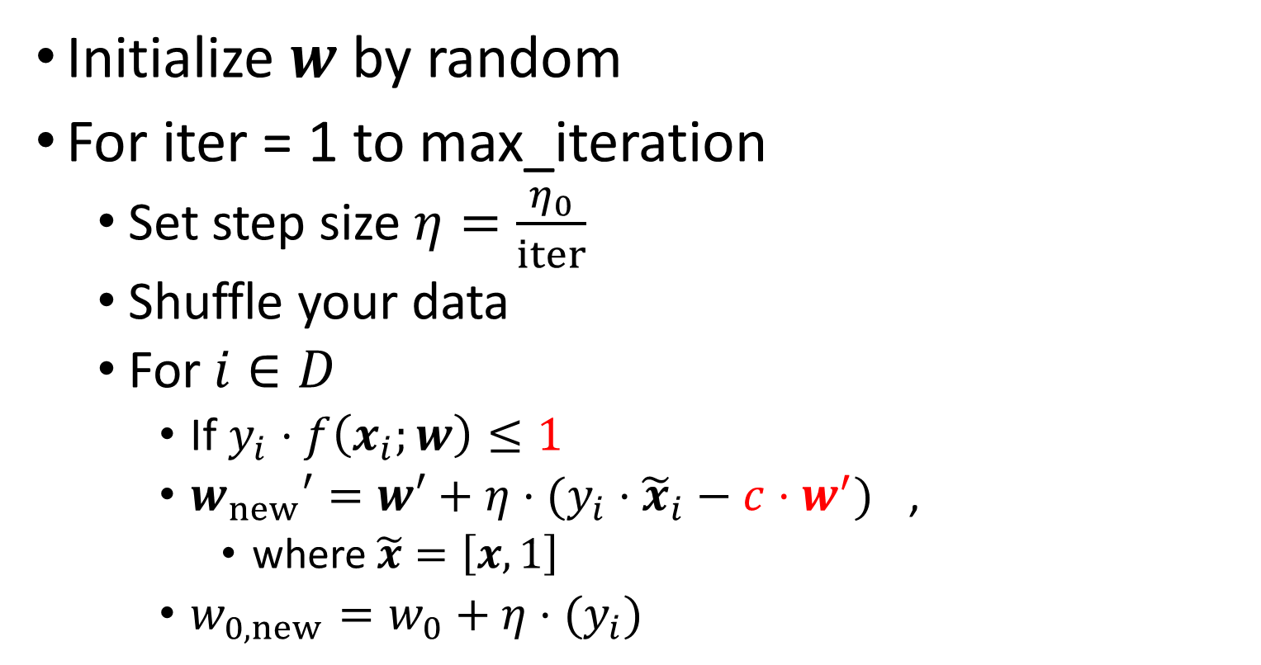
SVM Implementation
Initialize $w$ by random
For iter = 1 to max_iteration
Set step size $η=\frac{η_{0}}{iter}$
Shuffle your data
For $i∈D$
If $y_{i}⋅f\left(x_{i};w\right)≤1$
$w_{new}′=w′+{η⋅(y_{i}⋅{\tilde{x}}_{i}−c⋅w^{′})}_{}$,
where $\tilde{x}=\left[x,1\right]$
$w_{0,new}=w_{0}+{η⋅(y_{i})}_{}$

Slide 8
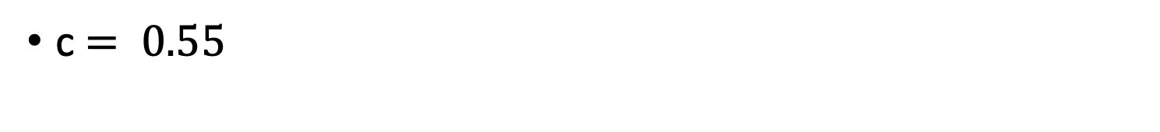
Toy Example
c$= 0.55$

Slide 9
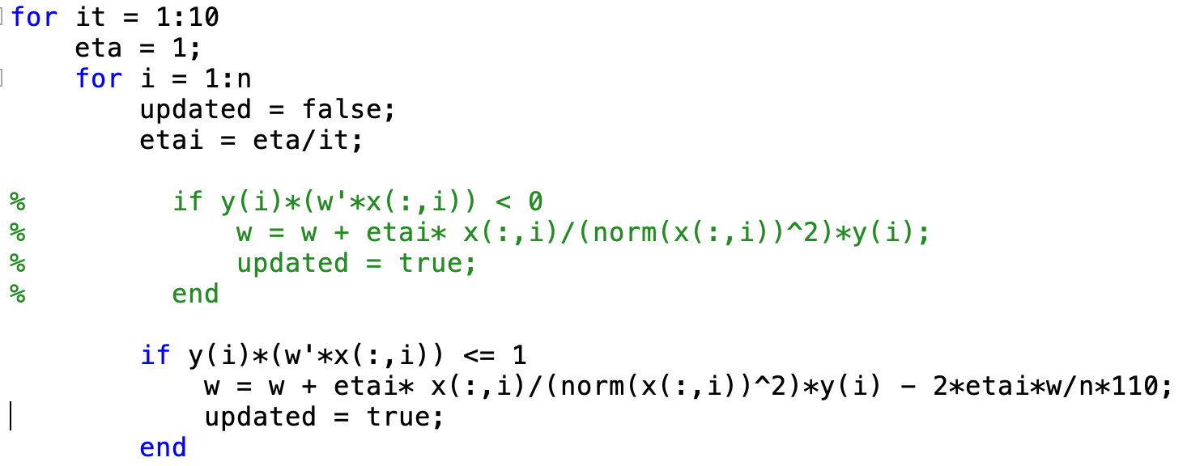

MATLAB Code
Try different $c$ and see what happens!
perceptron
SVM

