Slide 1
Understanding Mass Assembly of Luminous Red Galaxies in HSC
Amanda Newmark
Notes:
Is there any correlation between the Mass Assembly History and the underlying Dark Matter Halo in Luminous Red Galaxies (LRGs)?
We focus on LRGs because they are a well defined, homogenous population: higher mass elliptical galaxies with little to no star formation.

Slide 2
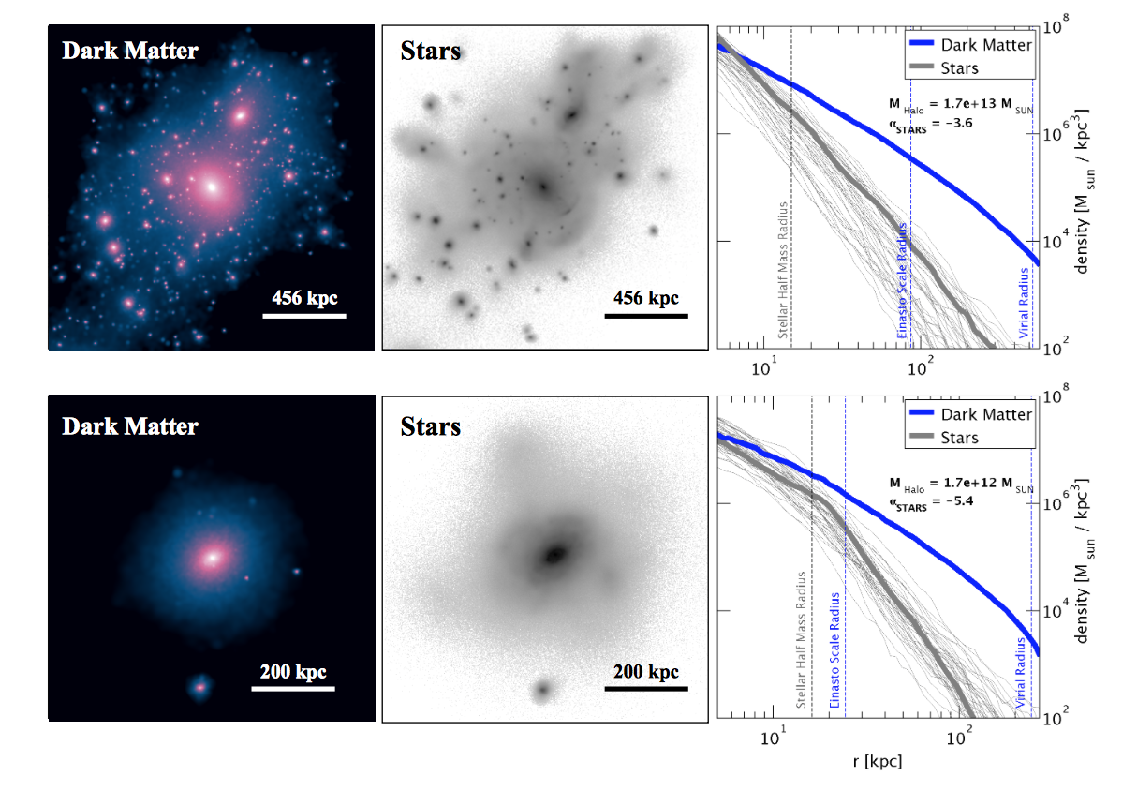
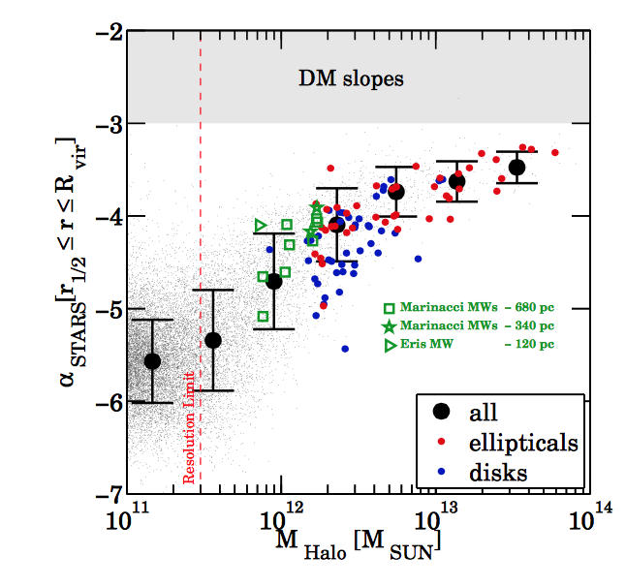
Mass Assembly
Elliptical
Disk
Pillepich et al 2014
Notes:
In Pillepich et al, Stellar Halo slopes (alpha stars) are thought to be direct evidence of the evolution of Cold Dark Matter Halos and their mass assembly histories. We are interested in what governs the buildup of the envelope. As galaxies merge with satellites, they build from the inside out, forming larger stellar envelopes.
2D projections of dark matter density and stellar light. Spherically averaged mass density
In the first figure, we see the mass assembly of two different types of galaxies, a disk and an elliptical. The environment around the elliptical is lumpier, showing how it is collecting the halos of different nearby galaxies. Pillepich fit the outer averaged density profiles to a single power law. Her boundaries were r1/2 to the virial radius. We see that the slopes of the mass density profiles for the stars and Dark matter both decrease as our comoving distance increases. We eventually want to get our research to be the right-handed figure, plotting the relationship between the slope of the stellar halo and the total mass of the dark matter halo. In that figure, LRGs are the red data points– highmass ellipticals.
We want to better understand the coevolution of dark and visible matter throughout the formation of LRGs. Like in Pillepich, we believe this will be accomplished through plotting the luminosity density profile of the LRGs and stacking these profiles. By fitting the slopes of the stacked luminosity profiles, we hope to connect the stellar envelope to the Dark Matter Halo

Slide 3
Hyper Supreme-Cam Survey
Layer | Area (deg²) | # of 1.8 deg² HSC fields | Filters& Depths
Wide | 1400 | 916 | grizy(r~26)
Deep | 27 | 15 | grizy+4NBs(r~27)
Ultradeep | 3.5 | 2 | grizy+4NBs(r~28)
Flags
Interpolated Centers
Edge Galaxies
Saturated Centers
Cosmic Ray Center
Bad Pixels
Suspect Centers
Any Clipped Galaxies
Bright Objects?
Notes:
Main Objective of HSC: understand the correlation between a Luminous Red Galaxy’s mass assembly history and the Dark Matter Halo.
HSC is a multi-band imaging survey, covering the bands g,r,i,z,y. It gets multi-aperture magnitudes for every galaxy. I specifically use the I band throughout my tests.
For our survey, we are using HSC’s Wide field. It is important to note that there has been other observational studies that use stellar profiles as a probe of mass assembly. However, HSC goes to very low surface brightness for more galaxies and can probe the envelope better. Therefore, it is the best tool for this technique.
In order to certify the validity of our results, it is essential that we test the photometric contamination caused by fainter galaxies that are not properly resolved. Our catalogue flags certain galaxies we suspect might contaminate our data. As seen in the table, there are a variety of different flags that we determined negatively impact our results, and are therefore necessary to disregard. For example…
My first task was to determine whether or not galaxies flagged as bright objects should be disregraded. Galaxies not properly resolved can saturate the apparent magnitude of the galaxy, most prominently at the outer stellar halo of the galaxy. Thus, they appear to be brighter. Since galaxies flagged as this make up almost half of our remaining sample, it is crucial to determine whether or not these should be removed.

Slide 4
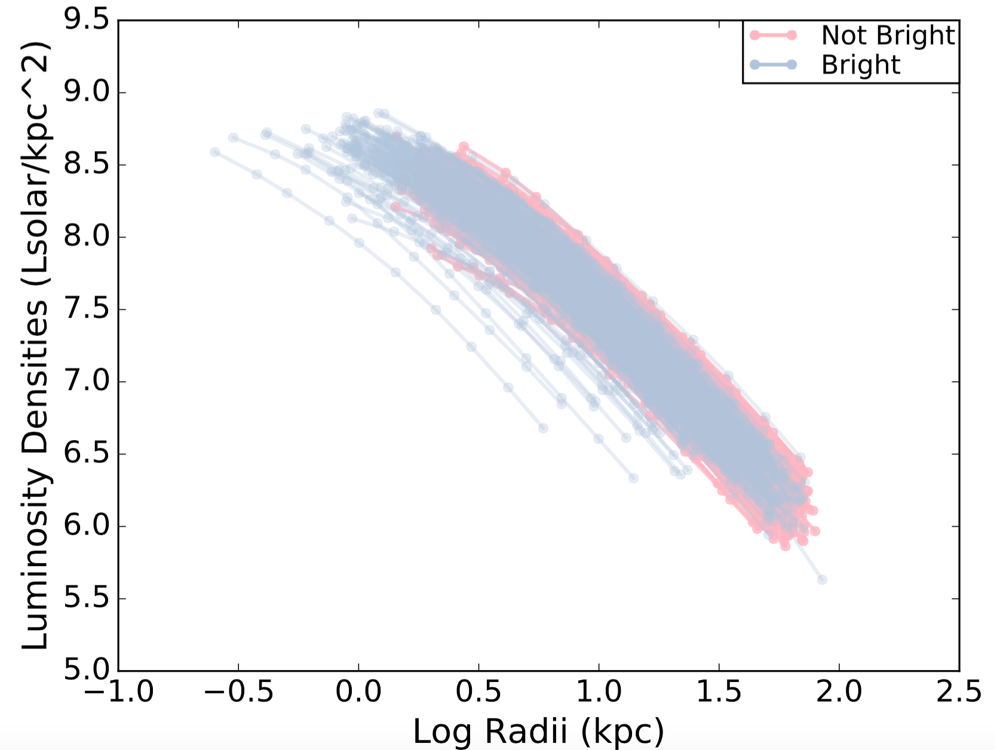
Making Luminosity Profiles
Notes:
we separate them into two populations, Bright Objects and not bright objects.
To start, we plot the luminosity profiles of the individual galaxies. Light pink is not bright, and light blue is bright

Slide 5
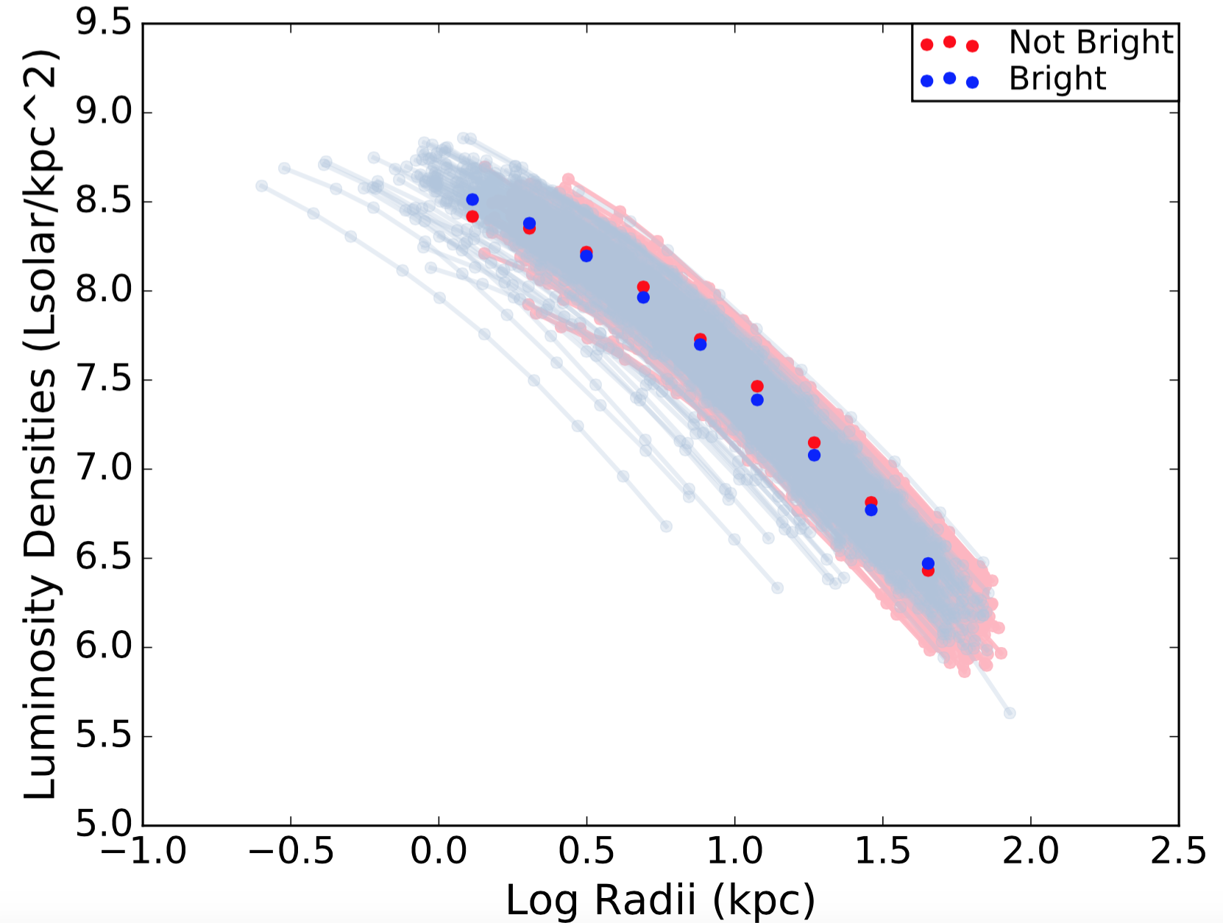
Making Luminosity Profiles
Notes:
I make my stacked luminosity profiles by binning my galaxies originally into 10 bins spaced evenly in logspace. Based on my individual galaxy profiles, I start my binning at 1 kpc and end at 80kpc. I weight each bin by the luminosity densities in each bin and divide by total number of data points per bin. My result is the stacked luminosity density profile.
However, I notice that at the first bin, there are considerably more bright galaxies than not bright galaxies. While we would expect bright galaxies to be more luminous at the lower apertures, just to be sure I made distribution of the apparent magnitudes and redshifts for our sample.

Slide 6
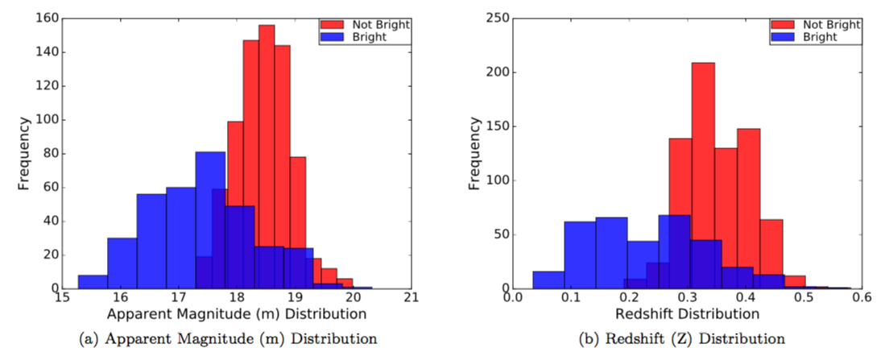
Making the Luminosity Profiles
Notes:
Varying parts of the stacked profile use distinct galaxies at different redshifts. The apparent magnitudes and redshifts for the flagged galaxies aren't normally distributed like the non-flagged galaxies. While the blue bars trail off at m=17, we also notice that they trail off at z=0.2. these galaxies were of lower redshift, they appear to be more luminous. Since we are measuring intrinsic brightness, our stacked profile was falsely brighter.
This is evidence that those LRGs are flagged as Bright Objects because they offset our stacked profile. Therefore, we set a lower limit of 0.2 to our redshift distribution.

Slide 7
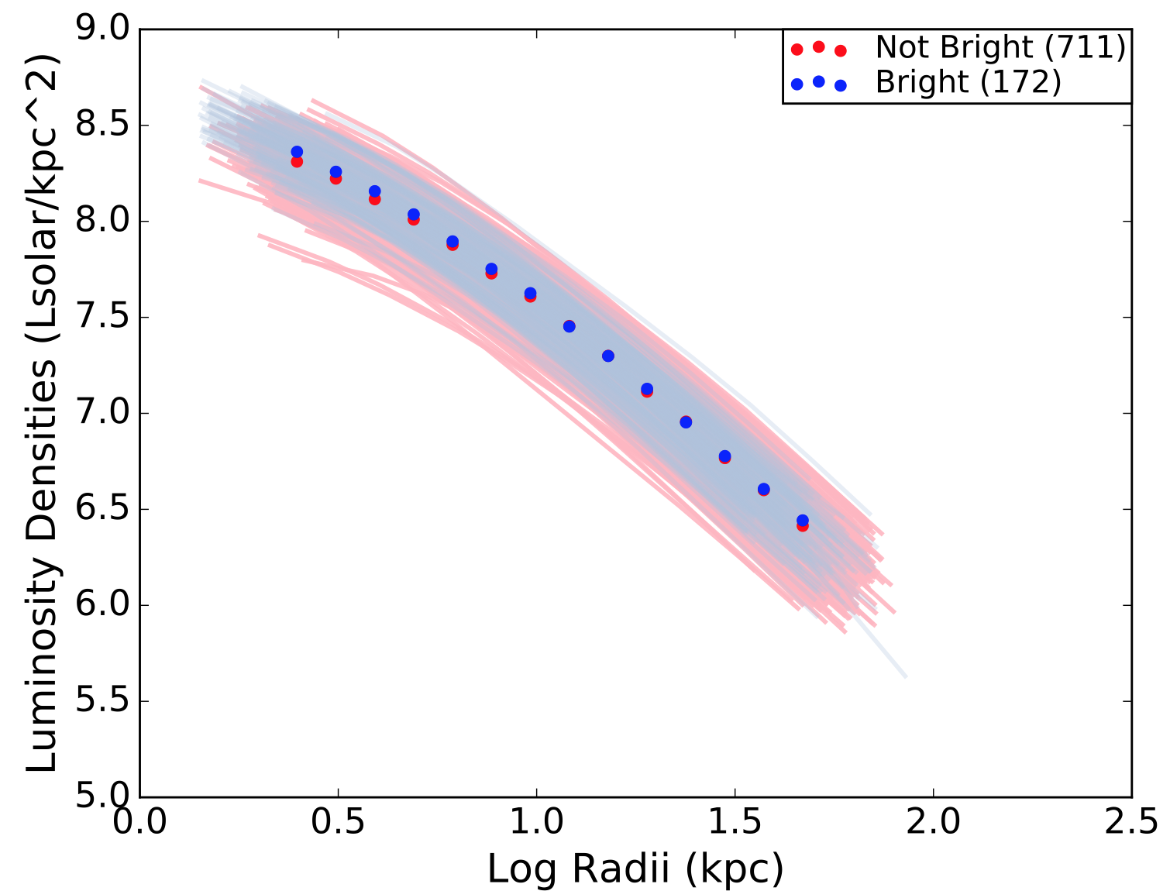
Now with Redshift Cut
Notes:
Now, we can see that there are more even numbers of bright galaxies and not bright galaxies in each bin. I also increased the number of bins for our next step, when we calculate the logarithmic slope of the luminosity density profile.

Slide 8
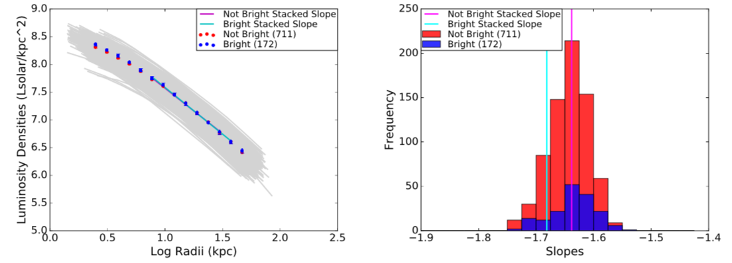
Flagged vs. Not Flagged
Notes:
Finally, we fit a line of best fit (using linear regression) to the stacked profile and the individual profiles. The fitting procedure is done in log space. In order to homogenize our results, so they are all fit to the same physical boundary, we set an inner boundary of r1/2 and an outer boundary of exactly 6r1/2 to both individual luminosity profiles and stacked profiles. The half radii typically marks the inner boundary of the stellar envelope. While typically the virial radius is used for the outer boundary, we found that the virial radius extended beyond our largest aperture. This helps avoid contamination from un-blended sources at the edge of bright galaxies’ envelopes.
Interestingly, we see that our stacked profiles for Bright Objects are in Agreement with our stacked profiles for Not Bright Objects

Slide 9
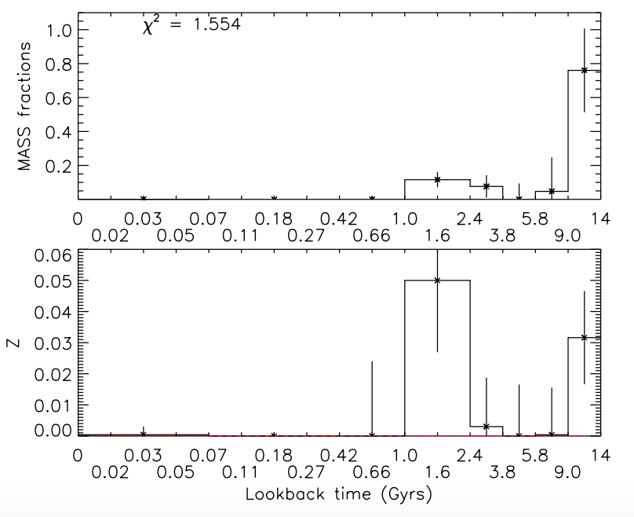
Applying to Star Formation History
Tojeiro et al 2009
Notes:
As mentioned before, a main focus of this project is to find the relationship between mass assembly history and the dark matter halo. Every time a galaxy goes through a merger (and therefore accumulates more mass), visible aspects of a galaxy’s spectrum is affected, such as the distribution of stars in the stellar envelope. However, the Dark matter in its halo is also tidally disrupted. Because LRGs are all early-type galaxies, they have already undergone mergers and accumulated most of their mass. we first need to find if there is a correlation between mass assembly and star formation history.
Using a code that fits the spectra of all LRGs, we match those galaxies with the ones in our first catalogue to get their total spectral data. We now have access to each galaxies metallicity, as well as their mass formation histories.
These are all early-type galaxies, but we can still distinguish them by SFH based on when they accumulated the most mass. We choose to label the older galaxies those which had most of their mass formed in the oldest age bin (between 9.06 and 14 billion years ago.) All of the other galaxies we consider “younger.” Since we are trying to connect when these mergers occur, it is necessary to separate into older and younger populations.

Slide 10
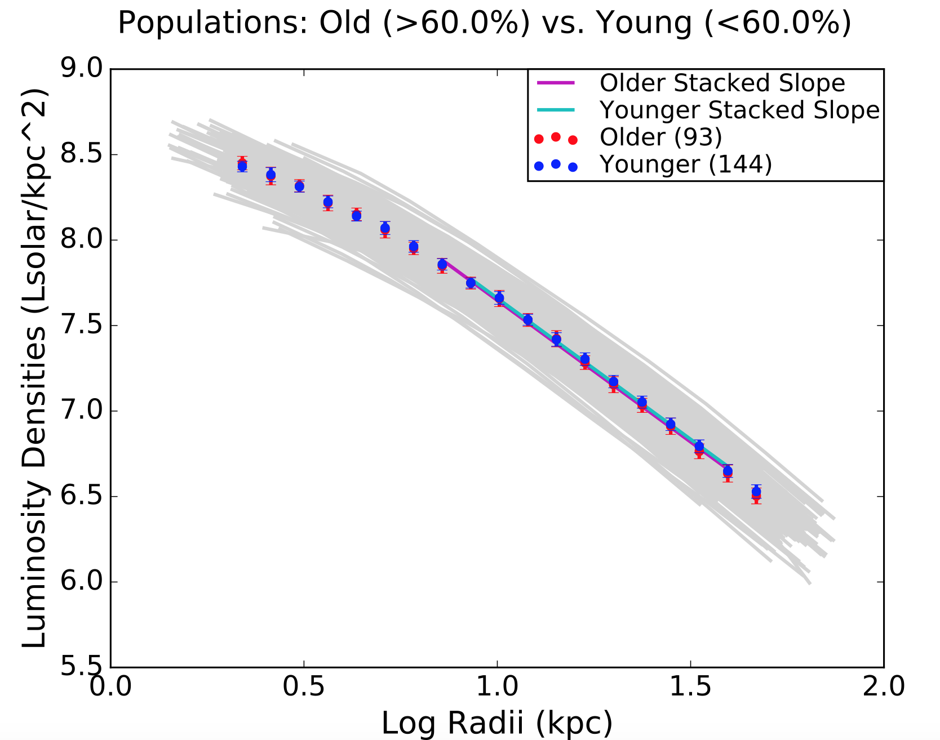
Old v Young Profiles
 | Stacked Slope
Older | -1.66 ± 0.06
Younger | -1.65 ± 0.05
Older, Bright | -1.58 ± 0.07
Older, Not Bright | -1.67 ± 0.06
Younger, Bright | -1.656 ± 0.074
Younger, Not Bright | -1.645 ± 0.05
Notes:
Slopes of the older and younger galaxies, they would appear to be in agreement. It is important to note that about half of the galaxies in each older and younger population are flagged as Bright Objects. In the table that shows the Bright and not Bright stacked slopes for every subsample, we confirm that the flag has little effect on the overall luminosity profile.

Slide 11
Slopes v Median Age
Notes:
When plotting the stacked slope vs Median age, we see that the slope of the luminosity density profile is not dependent upon the formation time. (1/100th of a difference).

Slide 12
Conclusion
Not necessary to remove bright objects
No correlation between accretion history and SFH
Notes:
As long as we fit slopes at same physical range
*dependent for lower mass end?
As determined by stellar envelope slope (alpha star)

Slide 13
Future Tests
The next step: Weak Gravitational Lensing
Use another HSC Wide Field
Use another galaxy population
Pillepich et al 2014
Notes:
Use Gravitational Lensing to obtain the masses of all these galaxies and ultimately quantify the underlying Dark Matter Halo. Want to show dependence on Halo mass
LRGs might contain too narrow of a SFH range. Might want to use younger, more active bright galaxies.

Slide 14
Thank You!!

Slide 16
Relevant Equations
K correct
Comoving Distance
Deriving Luminosity Density
Linear regression/standard error

Slide 17
Bootstrapping for Errors

