Slide 1
Understanding Mass Assembly of Luminous Red Galaxies in HSC
Amanda Newmark
Notes:
Is there any correlation between the Mass Assembly History and the underlying Dark Matter Halo in Luminous Red Galaxies (LRGs)?
We focus on LRGs because they are a well defined, homogenous population: higher mass elliptical galaxies with little to no star formation.

Slide 2
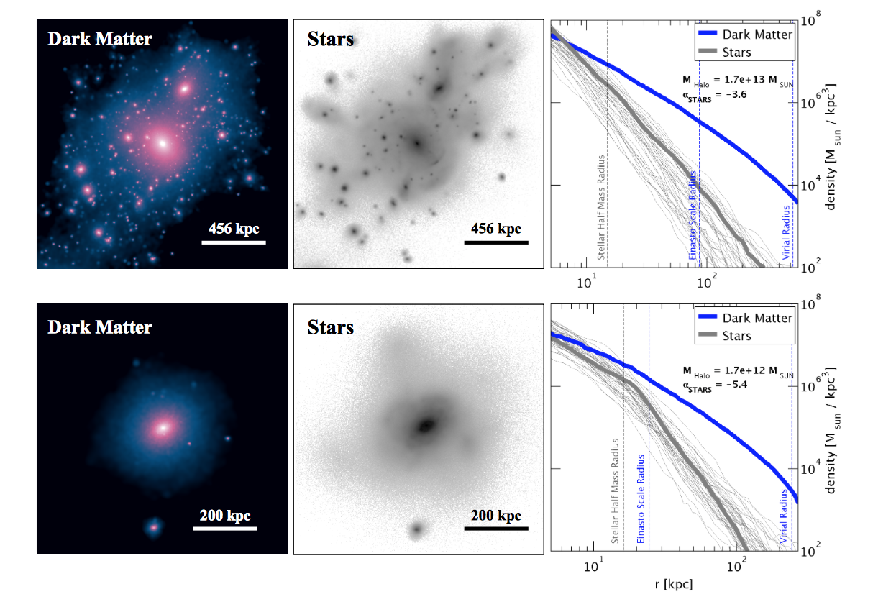
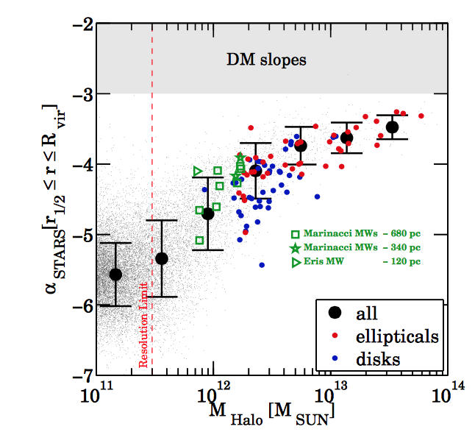
Mass Assembly
Elliptical
Disk
Pillepich et al 2014
Notes:
*Stellar Halo slopes direct evidence of the evolution of Cold Dark Matter Halos and their mass assembly histories.
We are interested in what governs the buildup of the envelope, merge with satellites, they build from the inside out, forming larger stellar envelopes.
2D projections of dark matter density and stellar light. Spherically averaged mass density
we see the mass assembly of two different types of galaxies, a disk and an elliptical. is lumpier, showing how it is collecting the halos of different nearby galaxies. fit the outer averaged density profiles to a single power law. r1/2 to the virial radius
We eventually want to get our research to be the right-handed figure, plotting the relationship between the slope of the stellar halo and the total mass of the dark matter halo. In that figure, LRGs are the red data points– highmass ellipticals.
coevolution of dark and visible matter throughout the formation of LRGs. plotting the stacked luminosity density profile of the LRGs. By fitting the slopes of the stacked luminosity profiles, we hope to connect the stellar envelope to the Dark Matter Halo

Slide 3
Hyper Supreme-Cam Survey
Layer | Area (deg²) | # of 1.8 deg² HSC fields | Filters& Depths
Wide | 1400 | 916 | grizy(r~26)
Deep | 27 | 15 | grizy+4NBs(r~27)
Ultradeep | 3.5 | 2 | grizy+4NBs(r~28)
Flags
Interpolated Centers
Edge Galaxies
Saturated Centers
Cosmic Ray Center
Bad Pixels
Suspect Centers
Any Clipped Galaxies
Bright Objects?
Notes:
Main: correlation between a Luminous Red Galaxy’s mass assembly history and the DMHalo.
HSC is a multi-band imaging survey, (g,r,i,z,y). multi-aperture magnitudes for every galaxy. HSC’s Wide field.
Other observational studies that use stellar profiles as a probe of mass assembly. However, HSC goes to very low surface brightness for more galaxies and can probe the envelope better.
test the photometric contamination caused by fainter galaxies that are not properly resolved. Our catalogue flags certain galaxies we suspect might contaminate our data. necessary to disregard.
Bright Objects disregard? not properly resolved can saturate the apparent magnitude of the galaxy, prominently outer stellar halo of the galaxy. Appear brighter. Half remaining sample

Slide 4
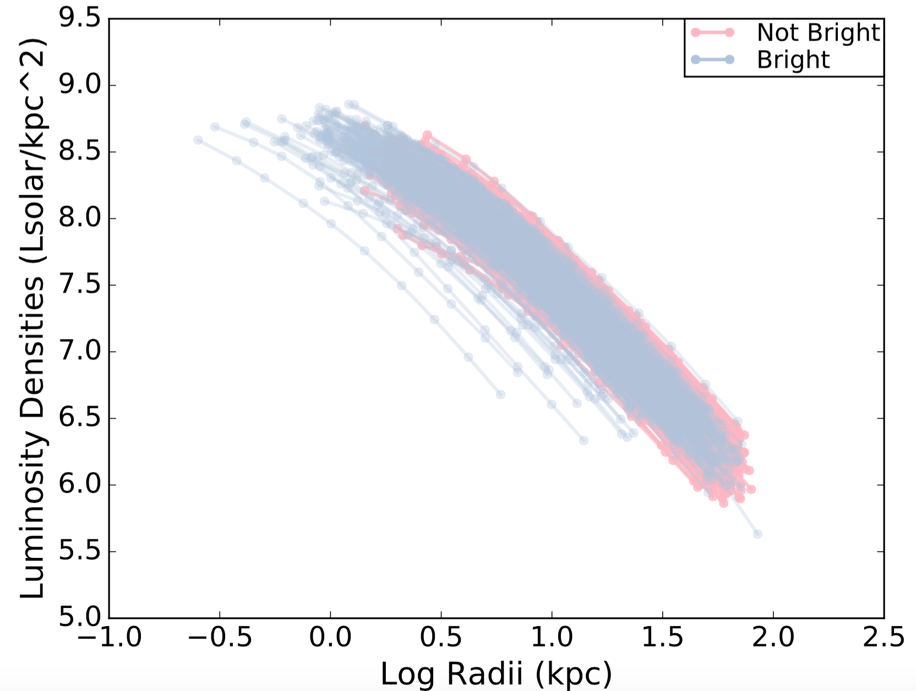
Making Luminosity Profiles
Notes:
we separate them into two populations, Bright Objects and not bright objects. plot the luminosity profiles of the individual galaxies. Light pink is not bright, and light blue is bright

Slide 5
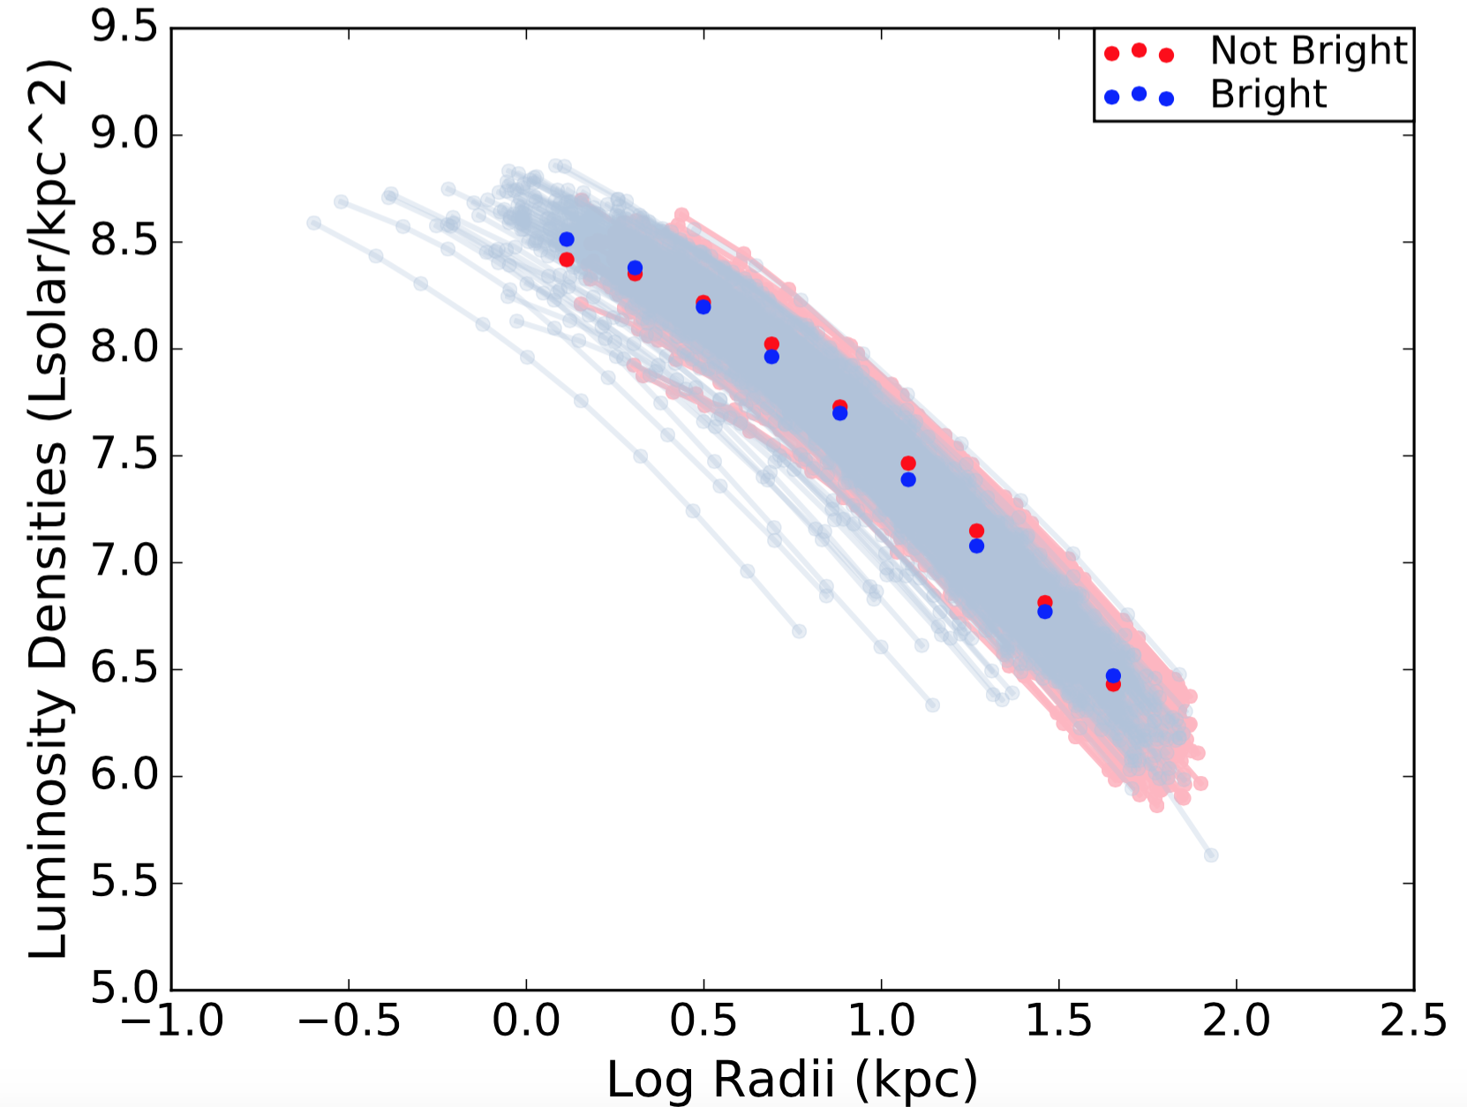
Making Luminosity Profiles
Notes:
Originally: 10 bins spaced evenly in logspace.
1 kpc and end at 80kpc. I weight each bin by the luminosity densities in each bin and divide by total number of data points per bin.
more bright galaxies than not bright galaxies in first bin. While we would expect bright galaxies to be more luminous at the lower apertures, just to be sure I made distribution of the apparent magnitudes and redshifts for our sample.

Slide 6
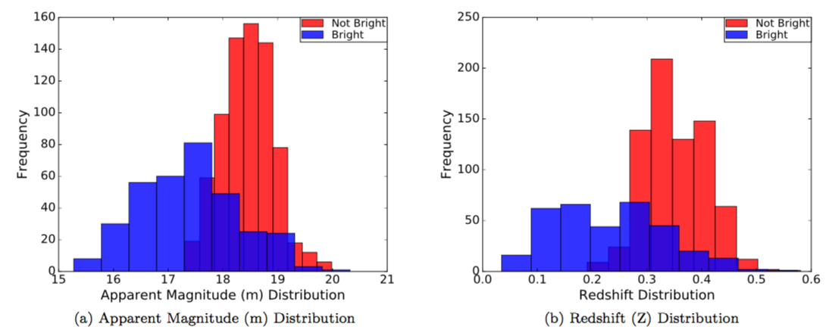
Making the Luminosity Profiles
Notes:
Varying parts of the stacked profile use distinct galaxies at different redshifts.
aren't normally distributed like the non-flagged galaxies. these galaxies were of lower redshift, they appear to be more luminous.
evidence that those LRGs are flagged as Bright Objects because they offset our stacked profile. lower limit of 0.2 to our redshift distribution.

Slide 7
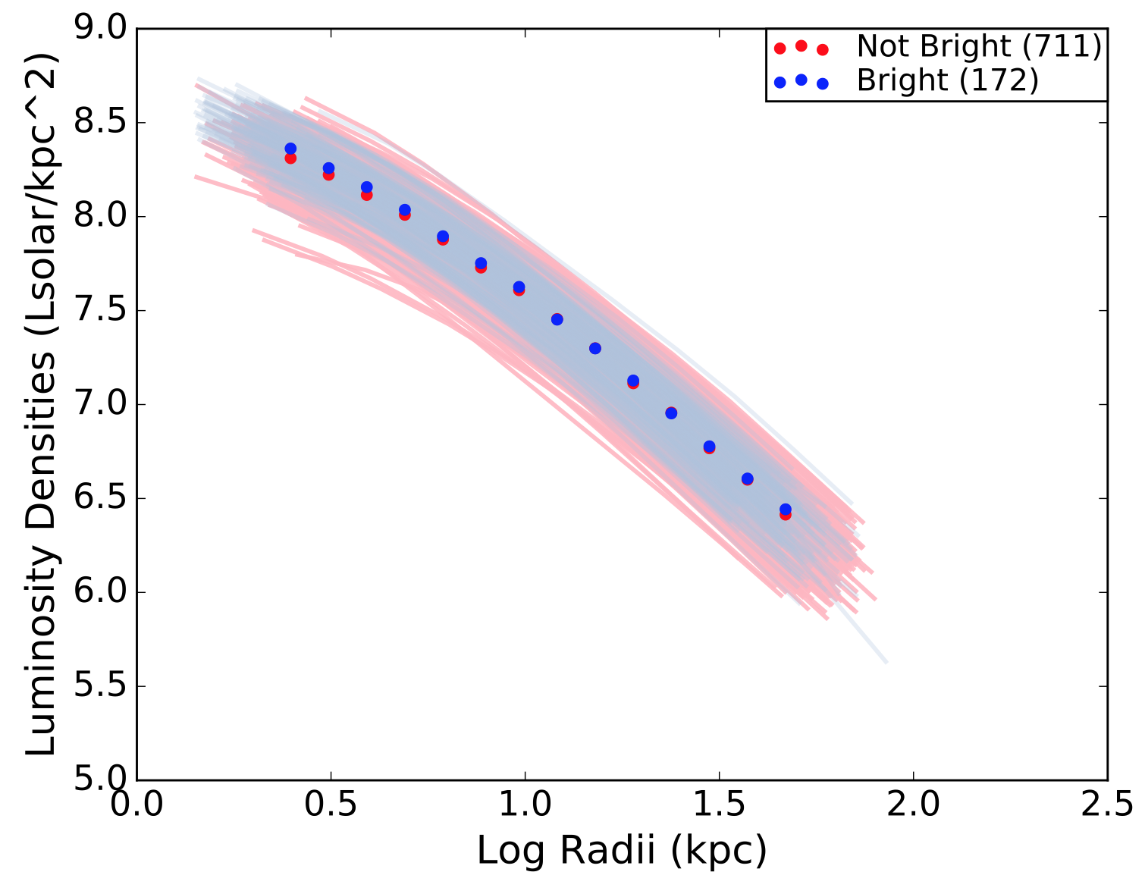
Now with Redshift Cut
Notes:
even numbers of bright galaxies and not bright galaxies in each bin.
increased the number of bins for our next step, when we calculate the logarithmic slope of the luminosity density profile.

Slide 8
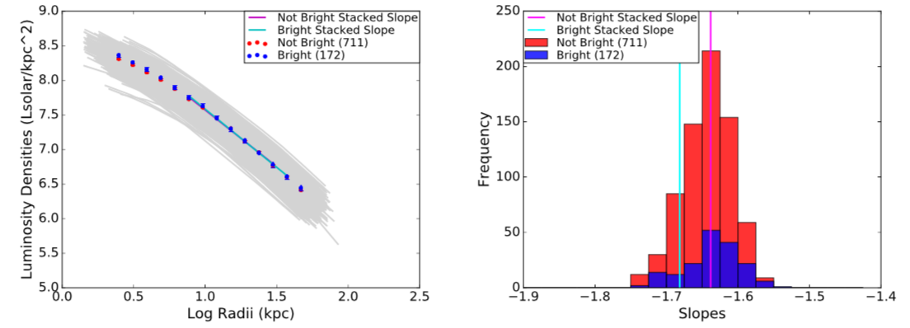
Flagged vs. Not Flagged
Notes:
we fit a line of best fit (using linear regression) to the log-log stacked profile and the individual profiles.
homogenize our results, all fit to the same physical boundary, r1/2 to r61/2.
half radii → marks inner boundary of the stellar envelope. Virial radius. Setting limit avoid contamination from un-blended sources at the edge of bright galaxies’ envelopes.
Interestingly, we see that our stacked profiles for Bright Objects are in Agreement with our stacked profiles for Not Bright Objects

Slide 9
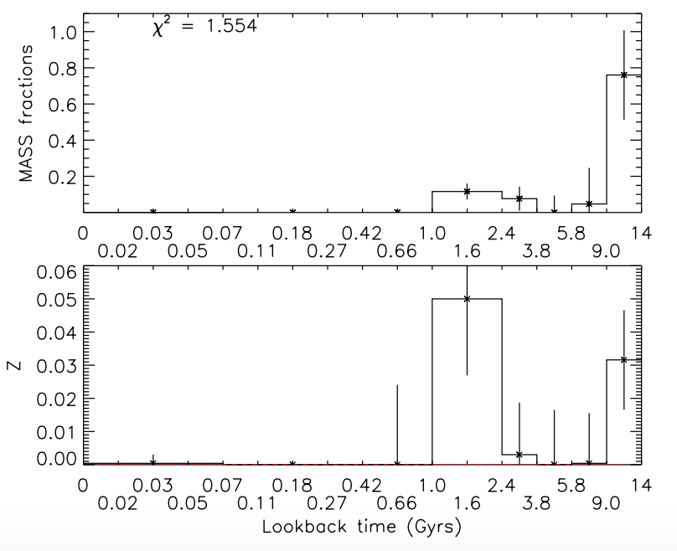
Applying to Star Formation History
Tojeiro et al 2009
Notes:
main focus of this project is to find the relationship between mass assembly history and the dark matter halo.
Galaxy merger, accumulates more mass, visible aspects affected(distribution of stars in the stellar envelope). the Dark matter tidally disrupted. LRGs early-type galaxies→undergone mergers and accumulated most of their mass.
we first need to find if there is a correlation between mass assembly and star formation history.
Using a code that fits the spectra of all LRGs, we match to get their total spectral data (metallicity, star formation histories)
distinguish them by SFH based on when they accumulated the most mass. most of their mass formed in the oldest age bin.
Since we are trying to connect when these mergers occur, it is necessary to separate into older and younger populations.

Slide 10
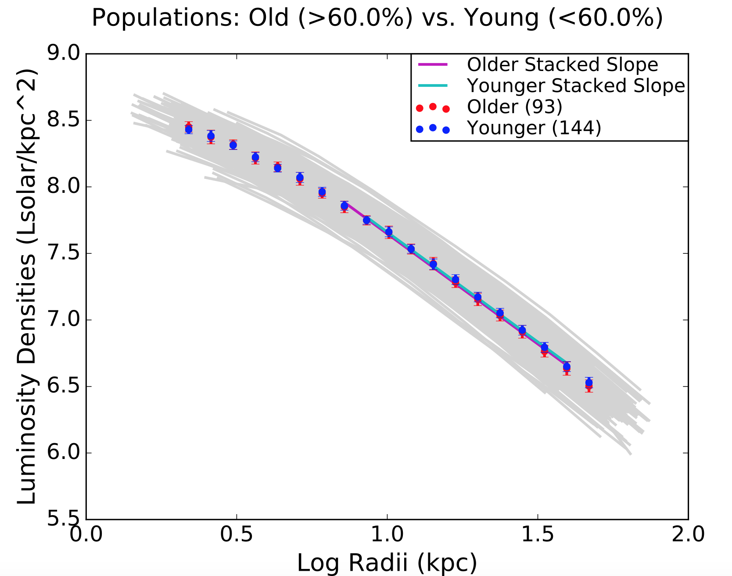
Old v Young Profiles
 | Stacked Slope
Older | -1.66 ± 0.06
Younger | -1.65 ± 0.05
Older, Bright | -1.58 ± 0.07
Older, Not Bright | -1.67 ± 0.06
Younger, Bright | -1.656 ± 0.074
Younger, Not Bright | -1.645 ± 0.05
Notes:
Slopes of the older and younger galaxies appear to be in agreement.
It is important to note that about half of the galaxies in each older and younger population are flagged as Bright Objects.
In the table that shows the Bright and not Bright stacked slopes for every subsample, we confirm that the flag has little effect on the overall luminosity profile.

Slide 11
Slopes v Median Age
Notes:
Slope not dependent upon the formation time. (1/100th of a difference).

Slide 12
Conclusion
Not necessary to remove bright objects
No correlation between accretion history and SFH
Notes:
As long as we fit slopes at same physical range
*dependent for lower mass end?
As determined by stellar envelope slope (alpha star)

Slide 13
Future Tests
The next step: Weak Gravitational Lensing
Use another HSC Wide Field
Use another galaxy population
Try another band
Pillepich et al 2014
Notes:
Use Gravitational Lensing to obtain the masses of all these galaxies and ultimately quantify the underlying Dark Matter Halo. Want to show dependence on Halo mass
LRGs might contain too narrow of a SFH range. Might want to use younger, more active bright galaxies.

Slide 14
Thank You!!

Slide 16
Relevant Equations
K correct
Comoving Distance
Deriving Luminosity Density
Linear regression/standard error

Slide 17
Bootstrapping for Errors

