Slide 1
Understanding Star Formation Histories of Luminous Red Galaxies
Amanda Newmark

Slide 2
The Big Question
Is there any correlation between the Mass Assembly History and the underlying Dark Matter Halo in Luminous Red Galaxies (LRGs)?
Notes:
Main Objective of HSC: understand the correlation between a Luminous Red Galaxy’s mass assembly history and the underlying Dark Matter Halo..
We focus on LRGs because they are a well defined, homogenous population: higher mass elliptical galaxies with little to no star formation.

Slide 3
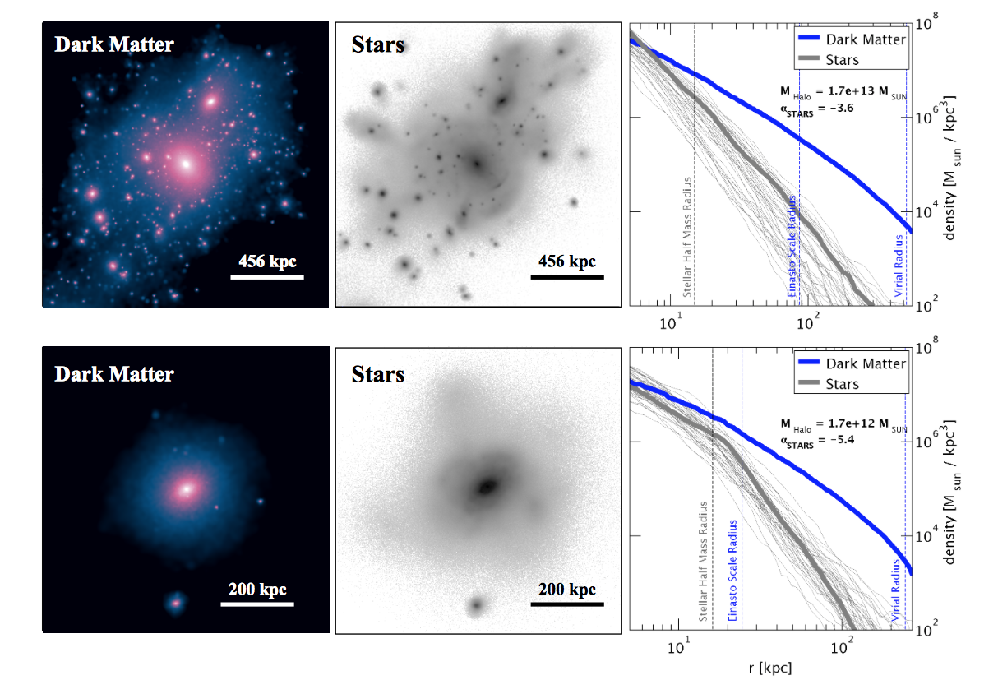
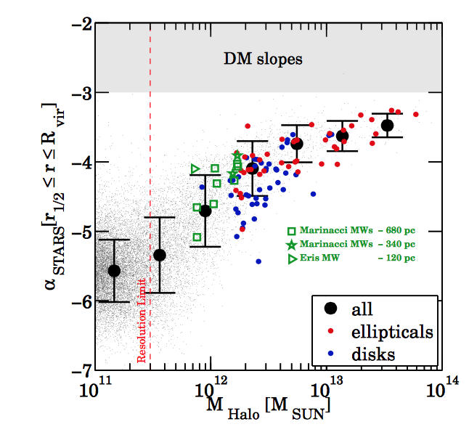
Mass Assembly
Pillepich et al 2014
Notes:
In Pillepich et al, stellar halos are characterized by the logarithmic slope of the luminosity density profiles, which were then related to the properties of the underlying Dark Matter. Stellar Halo slopes (alpha stars) are thought to be direct evidence of the evolution of Cold Dark Matter Halos and their mass assembly histories. Like in the paper, we are interested in the component that extends beyond the main body of the galaxy, the stellar envelope.
Figure 1 shows two different projections of dark matter density and stellar light, as well as the corresponding spherically averaged density profile. (elliptical is upper). Pillepich fit the outer averaged density profiles to a single power law. Her boundaries were r1/2 to the virial radius. We see that the slopes of the mass density profiles for the stars and Dark matter both decrease as our comoving distance increases. We eventually want to get our research to be the right-handed figure, plotting the relationship between the slope of the stellar halo and the total mass of the dark matter halo. In that figure, LRGs are the red data points– highmass ellipticals.
We want to better understand the coevolution of dark and visible matter throughout the formation of LRGs. Like in Pillepich, we believe this will be accomplished through plotting the luminosity density profile of the LRGs and stacking these profiles. LRGs have little star formation (which causes their red hue). This is important because the luminosity profiles can be homogeneous, and not affected by various rates of star formation. By fitting the slopes of the stacked luminosity profiles, we hope to connect the stellar envelope to the Dark Matter Halo

Slide 4
Hyper Supreme-Cam Survey
Layer | Area (deg²) | # of 1.8 deg² HSC fields | Filters& Depths
Wide | 1400 | 916 | grizy(r~26)
Deep | 27 | 15 | grizy+4NBs(r~27)
Ultradeep | 3.5 | 2 | grizy+4NBs(r~28)
Flags
flags.pixel.interpolated.center
flags.pixel.edge
flags.pixel.saturated.center
flags.pixel.cr.center
flags.pixel.bad
flags.pixel.suspect.center
flags.pixel.clipped.any
Aperture number | Radius (pix) | Diameter (arcsec)
aperture00 | 3.0 | 1.01
aperture01 | 4.5 | 1.51
aperture02 | 6.0 | 2.02
aperture03 | 9.0 | 2.02
aperture04 | 12.0 | 4.03
aperture05 | 17.0 | 5.71
aperture06 | 25.0 | 8.40
aperture07 | 35.0 | 11.8
aperture08 | 50.0 | 16.8
aperture09 | 70.0 | 23.5
flags.pixel.bright.object?
Notes:
Main Objective of HSC: understand the correlation between a Luminous Red Galaxy’s mass assembly history and the underlying Dark Matter Halo.
HSC is a multi-band imaging survey, covering the bands g,r,i,z,y. It gets multi-aperture magnitudes for every galaxy. I specifically use the I band throughout my tests.
For our survey, we are using HSC’s Wide field. It is important to note that there has been other observational studies that use stellar profiles as a probe of mass assembly. However, HSC goes to very low surface brightness and can probe the envelope better and for more galaxies. Therefore, it is the best tool for this technique.
In order to certify the validity of our results, it is essential that we test the photometric contamination caused by fainter galaxies that are not properly resolved. Our catalogue flags certain galaxies we suspect might contaminate our data. As seen in the table, there are a variety of different flags that we determined negatively impact our results, and are therefore necessary to disregard. For example…
My first task was to determine whether or not galaxies flagged as bright objects should be disregraded. Galaxies not properly resolved, or deblended, can saturate the apparent magnitude of the galaxy, most prominently at the outer stellar halo of the galaxy. Thus, they appear to be brighter. Since galaxies flagged as this make up almost half of our sample, it is crucial to determine whether or not these should be removed.

Slide 5
Making Luminosity Profiles
Notes:
To determine whether or not bright object centers negatively impact our luminosity profiles, we separate them into two populations, once where flags.pixel.bright.object is TRUE and one where it is FALSE.
We want plot luminosity density vs the comoving distance
HSC gets the multi-aperture magnitudes of every galaxy. These 10 aperture radii are given in arcseconds. Since every galaxy is located at varying distances from Earth, and we use the same aperture radii on each galaxy, we must convert these radii to comoving distances, which is given in kpc. This normalizes our distances to the outer stellar halos.
We derive the luminosity from the given apparent magnitudes and divide by the square of the comoving distance.

Slide 6
Making the Luminosity Profiles
Notes:
Before we make the luminosity profiles, we want to check that all of our galaxies have a gaussian distribution of redshifts and luminosities. I plot the distributions of both.
Varying parts of the stacked profile use distinct galaxies at different redshifts. The apparent magnitudes and redshifts for the flagged galaxies aren't normally distributed like the non-flagged galaxies. While the blue bars trail off at m=17, we also notice that they trail off at z=0.2. Since these galaxies were of lower redshift, they appear to be more luminous. Since we are measuring intrinsic brightness, our stacked profile was falsely brighter.
This is evidence that those LRGs are flagged as Bright Objects because they offset our stacked profile. Therefore, we set a lower limit of 0.2 to our redshift distribution.

Slide 7
Flagged vs. Not Flagged
Notes:
Finally, we fit a line of best fit (using linear regression) to the stacked profile and the individual profiles. In order to homogenize our results, so they are all fit to the same physical boundary, we set an inner boundary of r1/2 and an outer boundary of exactly 6r1/2 to both individual luminosity profiles and stacked profiles. The half radii typically marks the inner boundary of the galactic halo. While typically the virial radius is used for the outer boundary, we found that the virial radius extended beyond our largest aperture. This helps avoid contamination from un-blended sources at the edge of bright galaxies’ envelopes.
Getting the slope is important because…
Interestingly, we see that galaxies flagged as bright objects are in agreement with those not flagged. The error is negligent, and the bright objects are barely, if any, more luminous than the galaxies not flagged as bright objects.

Slide 8
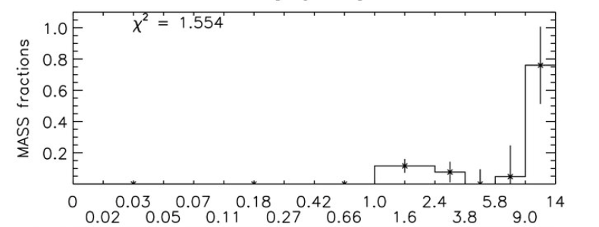
Applying to Star Formation History
Tojeiro et al. 2009
Notes:
Every time a galaxy goes through a merger, visible aspects of a galaxy’s spectrum is affected, such as the distribution of stars in the stellar envelope. However, the Dark matter in its halo is also tidally disrupted.
Because LRGs are all early-type (old) galaxies, they are more likely to have already undergone mergers and we can more easily uncover the Dark matter distribution.
One test we want to accomplish is determining if there is a relationship between the luminosity profile slopes and star formation history.
Using a code that fits the spectra of all LRGs, we match those galaxies with the ones in our first catalogue to get their total spectral data. We now have access to each galaxies metallicity, as well as their mass formation histories.
These are all early-type galaxies, but we can still distinguish them by SFH based on when they accumulated the most mass. We choose to label the older galaxies those which had most of their mass formed in the oldest age bin (between 9.06 and 14 billion years ago.) All of the other galaxies we consider “younger.”
Above, after separating the LRGs into two separate populations, I find the mass fraction (by dividing the mass of a galaxy in each age bin by the total current mass of the galaxy) for each galaxy and stacking those mass fractions into each age bin. As expected, the majority of the mass is formed in the oldest age bin, remains the same regardless of the age of the LRGs.

Slide 9
Old v Young Profiles
Notes:
If we were to solely compare slopes of the older and younger galaxies, they would appear to be in agreement. The stacked slopes coincide with the Gaussian distribution of the individual slopes within one sigma. While it is easy to automatically conclude that star formation history doesn’t affect mass accretion, it is important to note that about half of the galaxies in each older and younger population are flagged as Bright Objects. Next, individually for each population, we must compare the flagged and not flagged subsamples

Slide 10
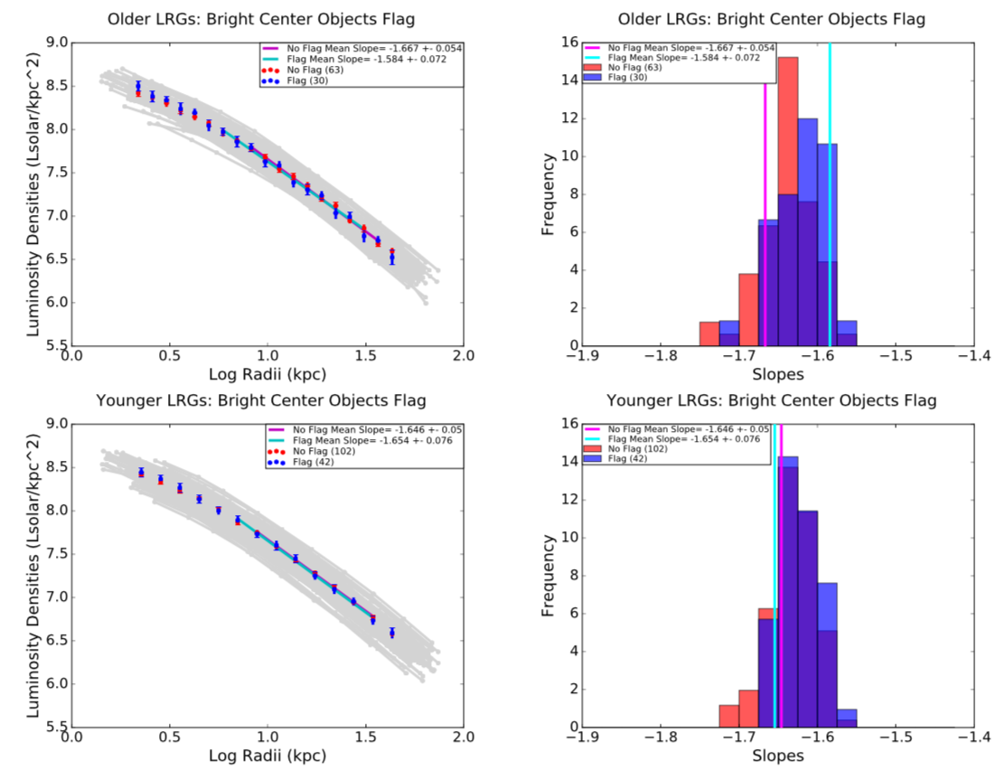
With and Without Flags
Newmark et al 2016
Notes:
Just as we saw when we plotted the luminosity profiles of all the flagged and not flagged galaxies, there is no significant difference between the flagged and not flagged stacked profiles for the different SFH.

Slide 11
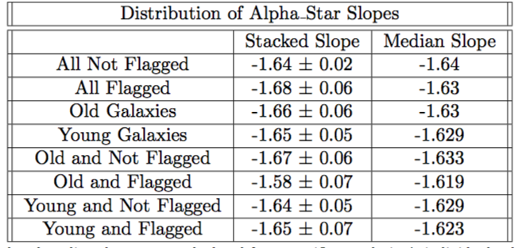
Looking at All the Slopes
Notes:
This table compares the alpha_star slopes of all the stacked galaxies with the medians of the individual galaxies. Wedon’t expect the log stacked slopes to exactly meet up with the median of the distribution.

Slide 12
Conclusion
Not necessary to remove these flags
Redshift >0.2 cut is enough

Slide 13
Future Tests
Weak Gravitational Lensing
Use different galaxies
Notes:
Use Gravitational Lensing to obtain the masses of all these galaxies and ultimately quantify the underlying Dark Matter Halo.
LRGs might contain too narrow of a SFH range. Might want to use younger, more active bright galaxies.

Slide 14
Extra Slides!

Slide 15
Relevant Equations
K correct
Comoving Distance
Deriving Luminosity Density
Linear regression/standard error

Slide 16
Bootstrapping for Errors

