Slide 1



Machine learning in Oil&Gas Industry
Institute of Applied
Mathematics and Mechanics
Andrey Murachev

Slide 2
Day 1: Linear regression and Classification
Day 2: Gradient boosting and Decision trees
Day 3: Neural networks, Segmentation and Kuggle
Notes:
schedule
competition

Slide 3
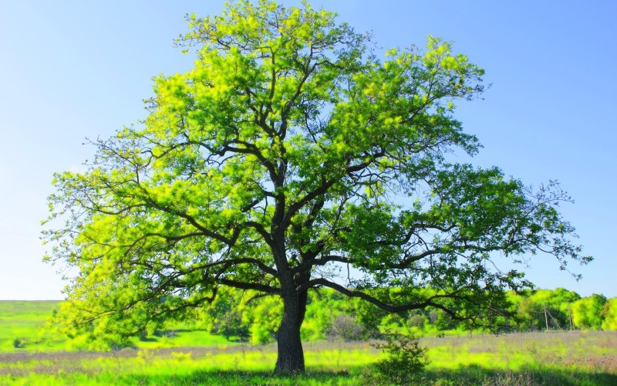
Decision trees

Slide 4
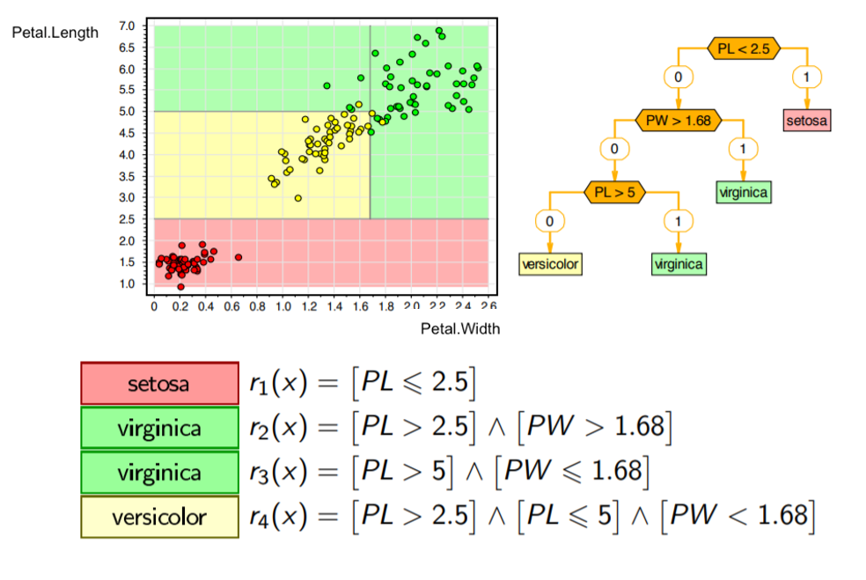
Iris classification
The data set contains
50 objects from
each class.

Slide 5
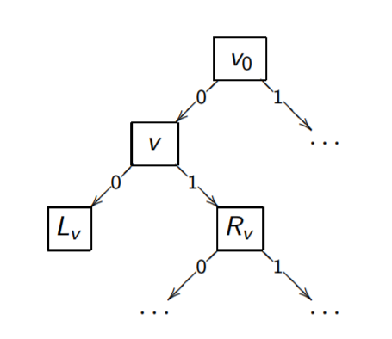
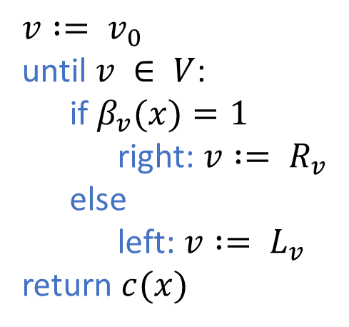
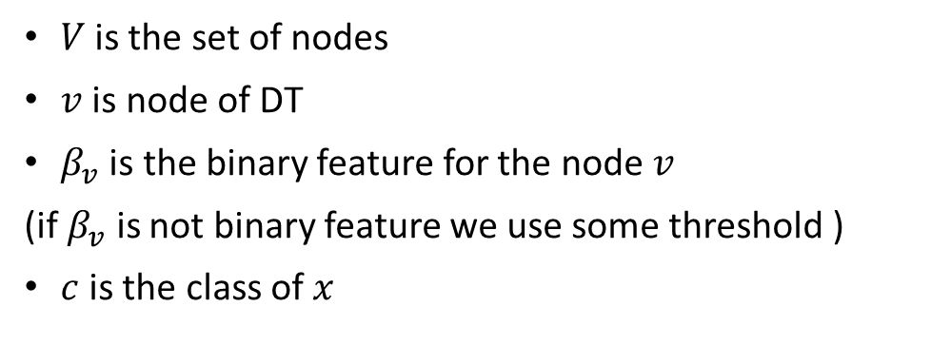
Binary decision tree
$V$is the set of nodes
$v$ is node of DT
$β_{v}$ is the binary feature for the node$v$
(if $β_{v}$ is not binary feature we use some threshold )
$c$is the class of $x$
$v := v_{0}$
until $v ∈ V$:
if $β_{v}(x)=1$
right: $v := R_{v}$
else
left: $v := L_{v}$
return $c(x)$

Slide 6
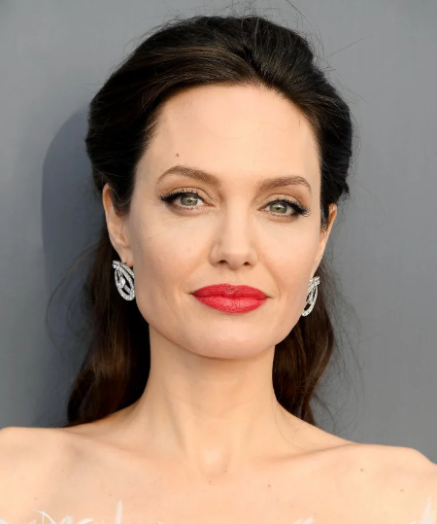
How to Build a Decision Tree
The game: One person thinks of a celebrity while the other tries to guess by asking only "Yes" or "No“. questions. What question will the guesser ask first?
Is it Adriano Celentano?
Is the celebrity a woman?
Is it Spanish?
Does he or she love football?
Angelina Jolie

Slide 7
How to Build a Decision Tree
The game: One person thinks of a celebrity while the other tries to guess by asking only "Yes" or "No“. questions. What question will the guesser ask first?
Is it Angelina Jolie?
Is the celebrity a woman?
Is it Spanish?
Does he or she love football?
(We reduce the possibilities to roughly half)
Angelina Jolie

Slide 8
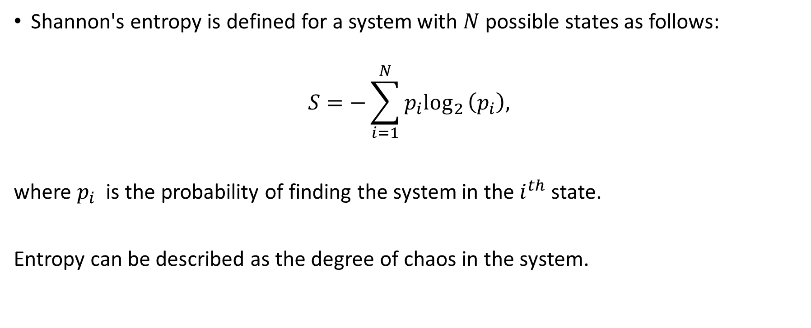
Shannon's entropy
Shannon's entropy is defined for a system with $N$ possible states as follows:
$$S=−\sum_{i=1}^{N}{p_{i}\log_{2}}\left(p_{i}\right),$$
where $p_{i}$ is the probability of finding the system in the $i^{th}$ state.
Entropy can be described as the degree of chaos in the system.

Slide 9
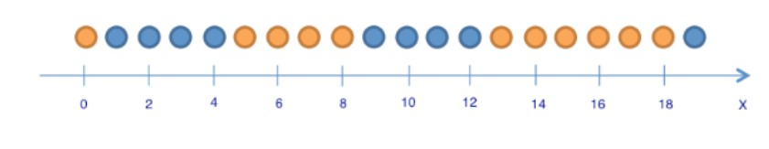
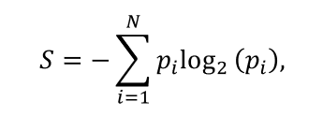


Example:
$p_{1}=\frac{9}{20}$
$p_{2}=\frac{11}{20}$

Slide 10
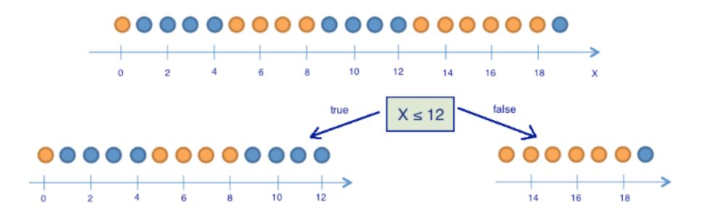


Example:

Slide 11
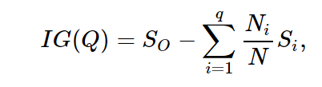

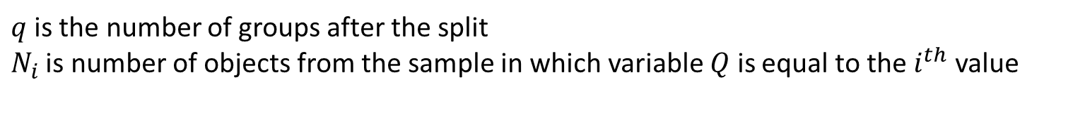
Example:
The information gain ($IG$) for a split based on the variable $Q$ (in this example it's a variable "$x≤12$") is defined as
$q$is the number of groups after the split
$N_{i}$ is number of objects from the sample in which variable $Q$ is equal to the $i^{th}$ value

Slide 12
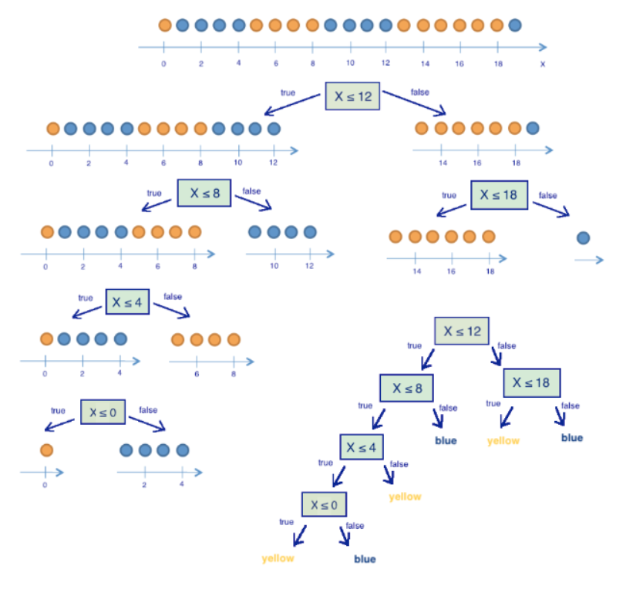
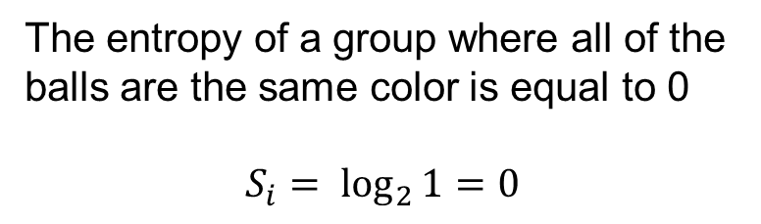
Decision trees
are interpretable algorithms!
The entropy of a group where all of the balls are the same color is equal to 0
$$S_{i}=\log_{2}{1=0}$$

Slide 13
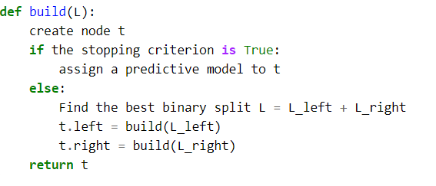

Effective data splitting
At the heart of the popular algorithms for decision tree construction, lies the principle of greedy maximization of information gain: at each step, the algorithm chooses the variable that gives the greatest information gain upon splitting.
$$∑S_{i}≈0$$

Slide 14
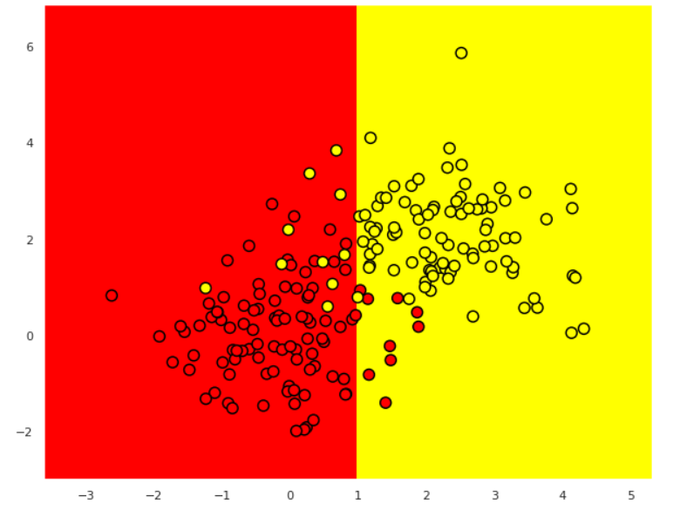
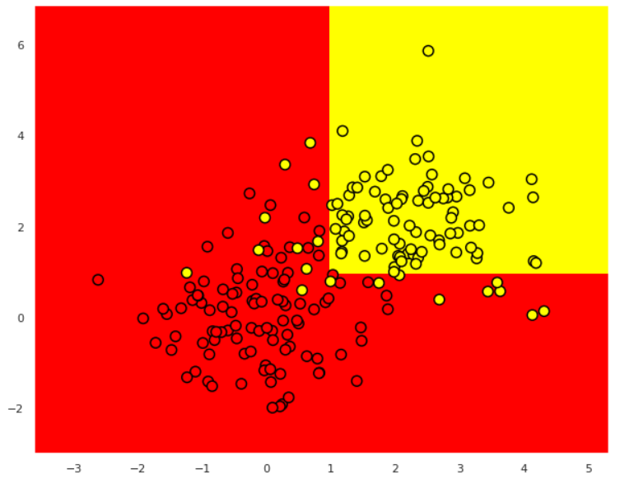
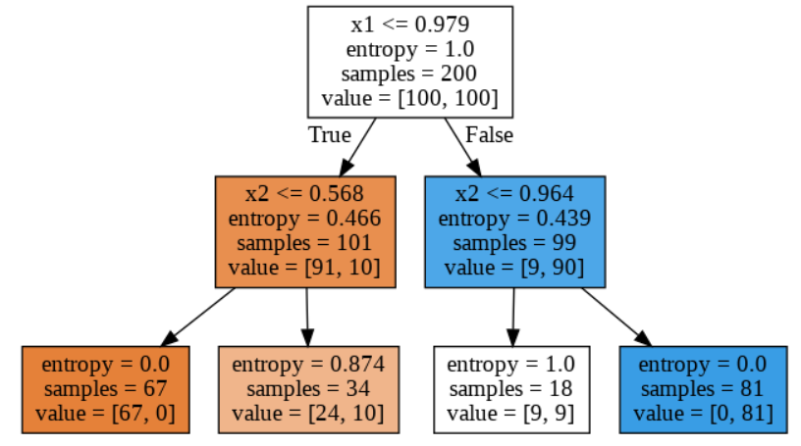
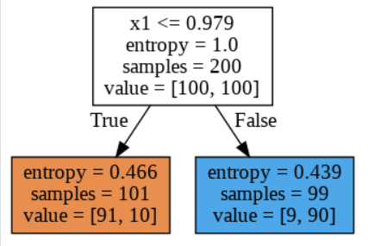

Slide 15
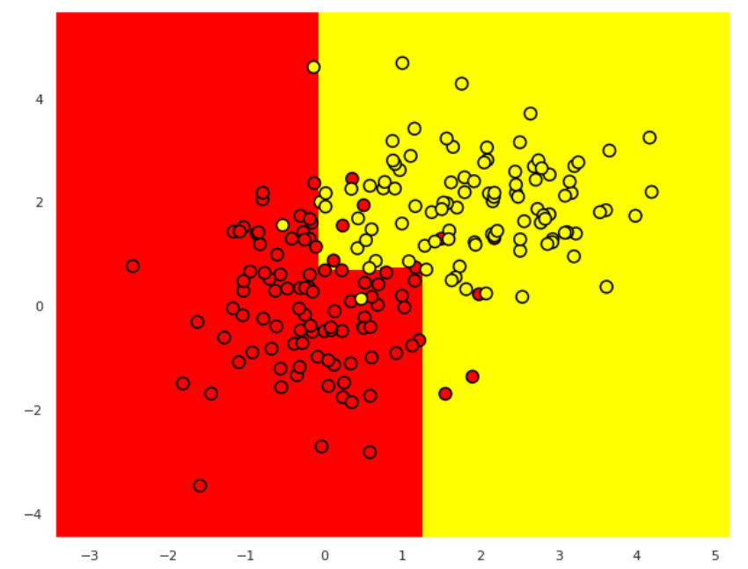
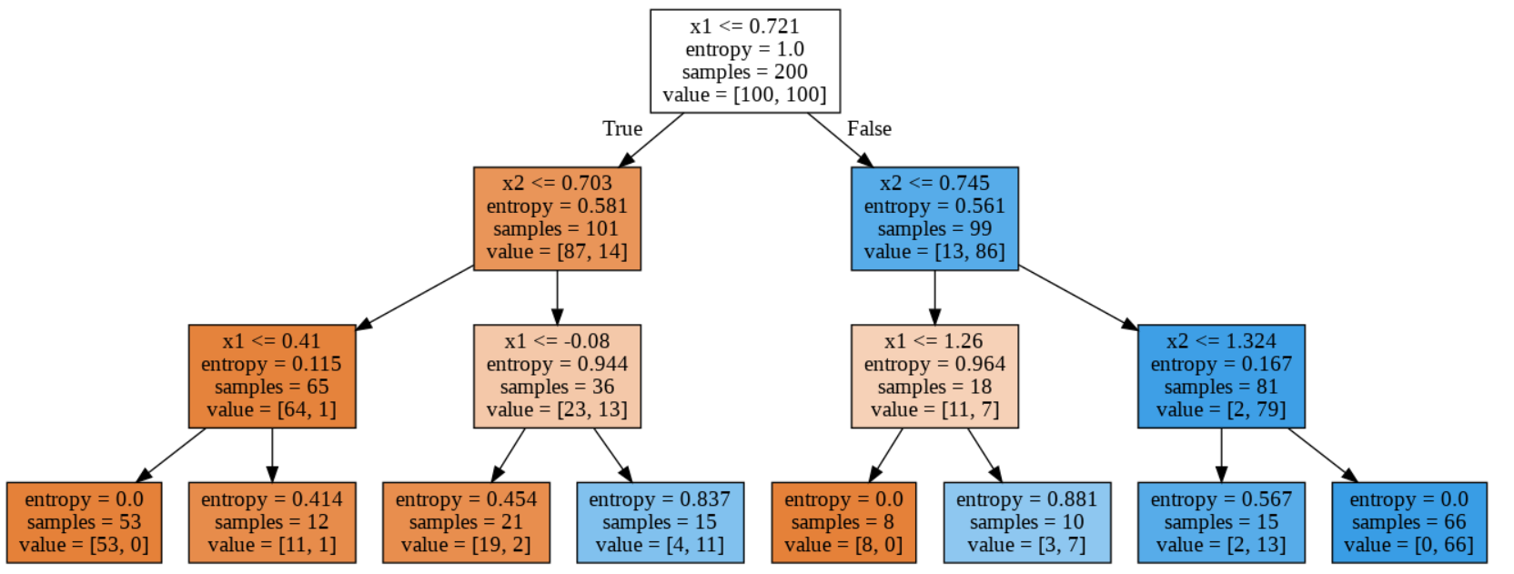

Slide 16
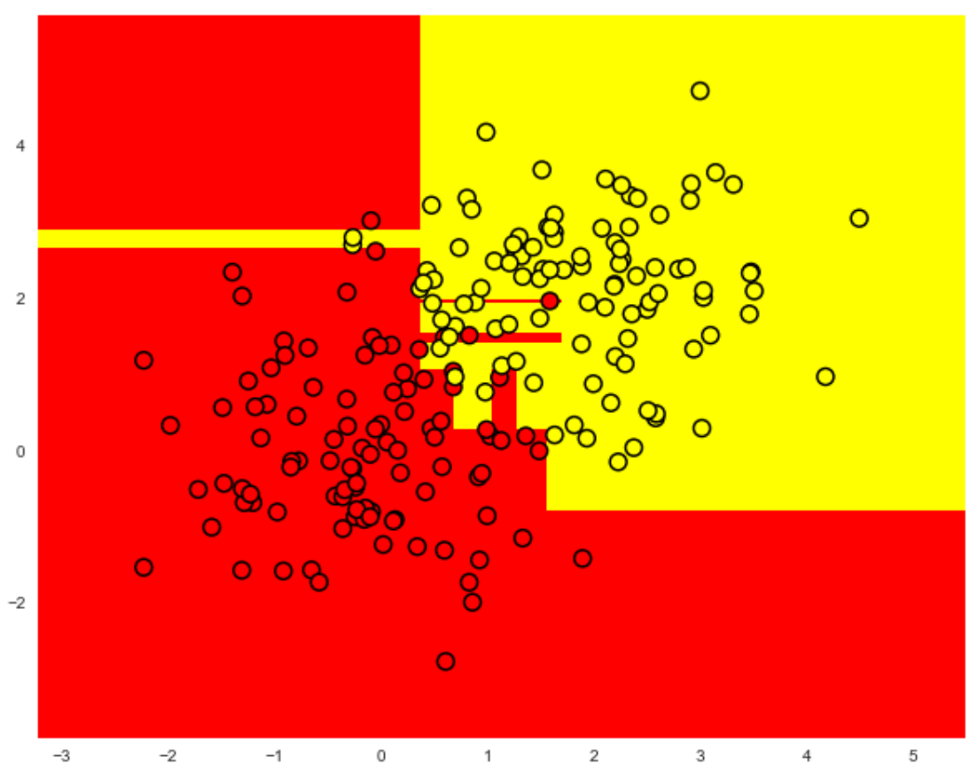
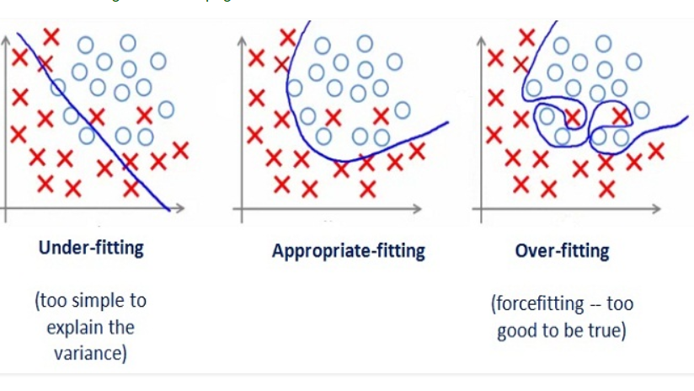
Otherfitting
In practice, we do not build a tree to the maximum depth, because it will be overfitting (it doesn’t have the ability to generalize)

Slide 17
The main parameters of the sklearn.tree.DecisionTreeClassifier class are:
max_depth – the maximum depth of the tree;
max_features - the maximum number of features with which to search for the best partition (this is necessary with a large number of features because it would be "expensive" to search for partitions for all features);
min_samples_leaf – the minimum number of samples in a leaf. This parameter prevents creating trees where any leaf would have only a few members.

Slide 18


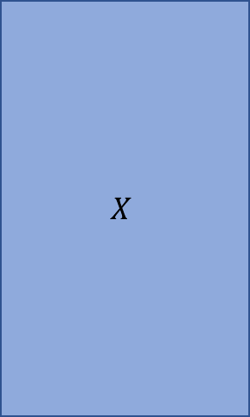
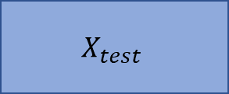

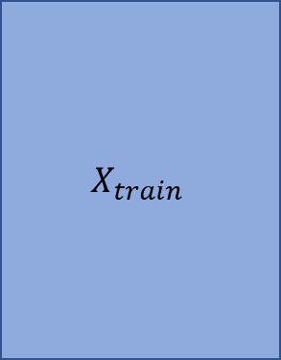
Train and test
Learning.
Building tree
$$X$$
$$y$$
$$X_{train}$$
$$y_{train}$$
TRAIN 70%
TEST 30%
Testing
$$X_{test}$$
$$y_{test}$$
Prediction

Slide 19
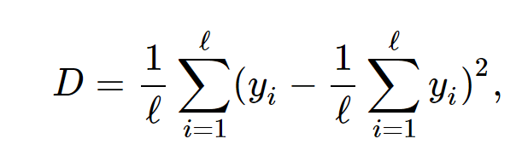
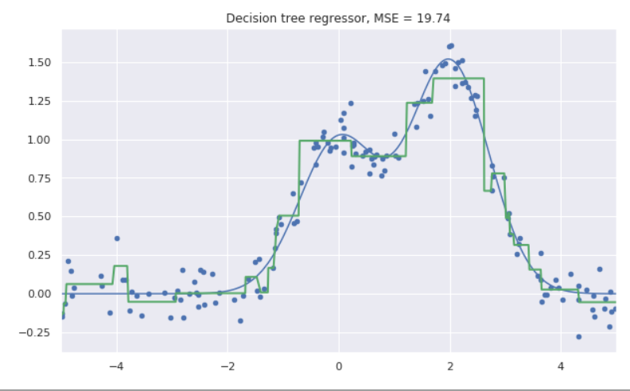
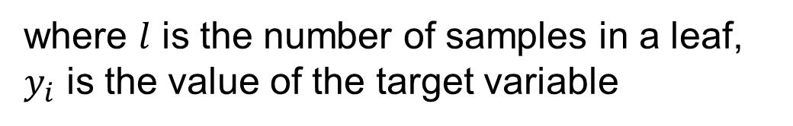
Decision Tree in a Regression Problem
where $l$ is the number of samples in a leaf,
$y_{i}$ is the value of the target variable

Slide 20
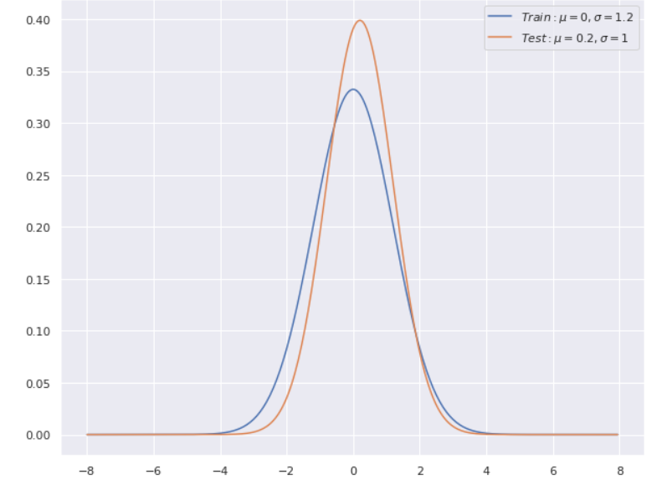



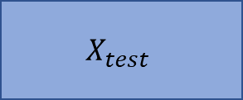
Train and test
$$X_{train}$$
$$y_{train}$$
$$X_{test}$$
$$y_{test}$$

Slide 21
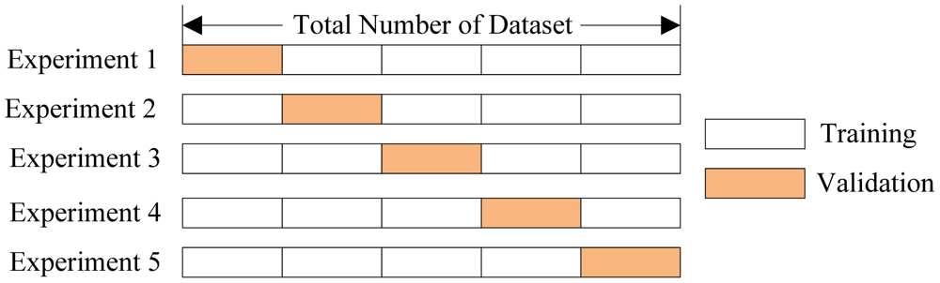

Cross-validation
$k$ subsamples (usually $k=5,7,10)$
sklearn.model_selection.StratifiedKFold

Slide 22
How to choose the optimal tree depth?
70% CRROSS_VALIDATION
30% HOLD
What mоdel is better?

Slide 23
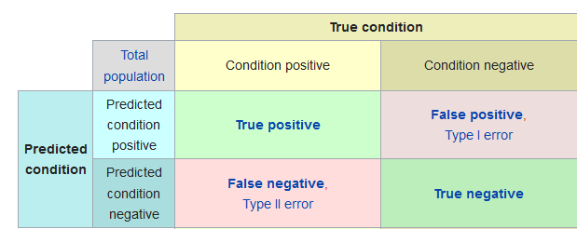
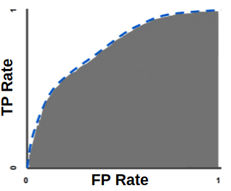
Roc – curve and AUC metrics
The ROC curve is created by plotting the true positive rate (TPR) against the false positive rate (FPR) at various threshold settings.
AUC is area under the ROC Curve. One way to interpret AUC is to treat it as a probability that the model ranks a random positive example higher than a random negative example.

Slide 24
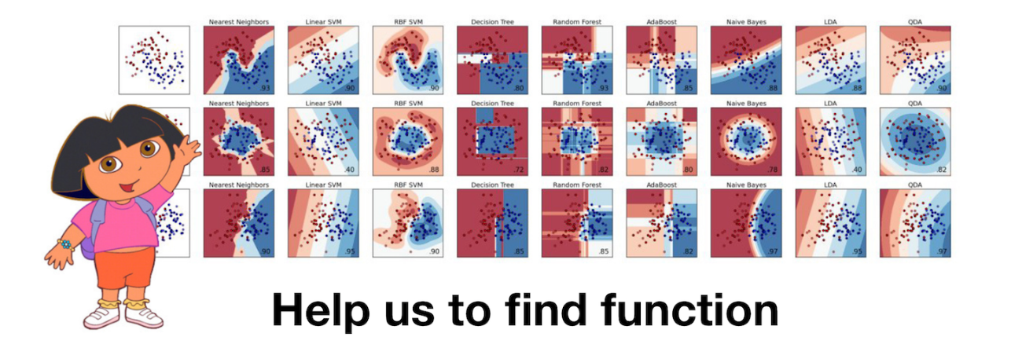
Gradient Boosting
Help Dasha to find function

Slide 25
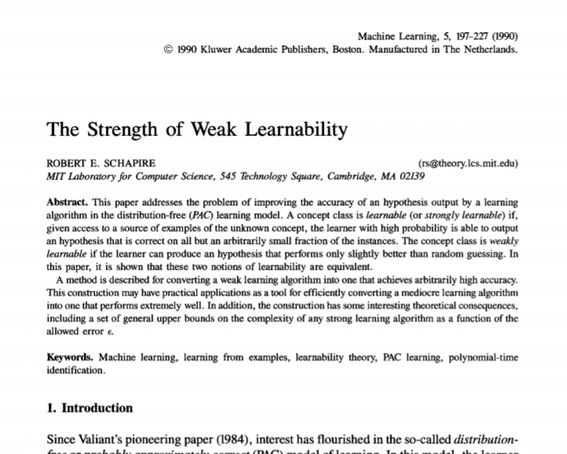
History
is it possible to get one strong model from a large amount of relatively weak and simple models?
Notes:
Almost everyone in machine learning has heard about gradient boosting. Many data scientists include this algorithm in their data scientist's toolbox because of the good results it yields on any given (unknown) problem.
XGBoost is often the standard recipe for winning ML competitions
but it took a few years to develop fully functioning algorithms based on this solution e.g. AdaBoost. These algoritms take a greedy approach: first, they build a linear combination of simple models (basic algorithms) by re-weighing the input data. Then, the model (usually a decision tree) is built on earlier incorrectly predicted objects, which are now given larger weights.
.

Slide 26
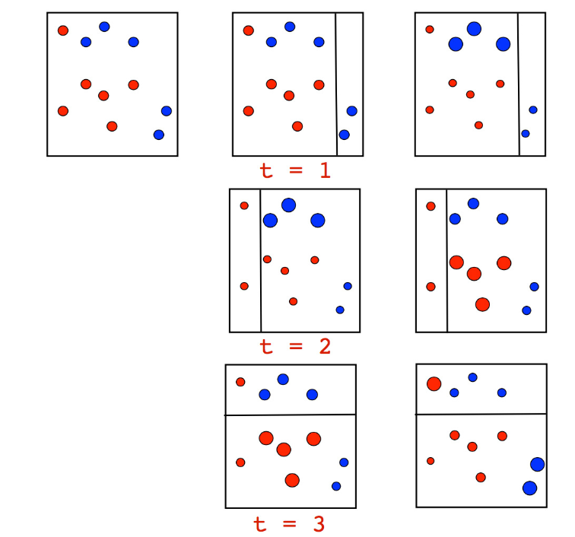
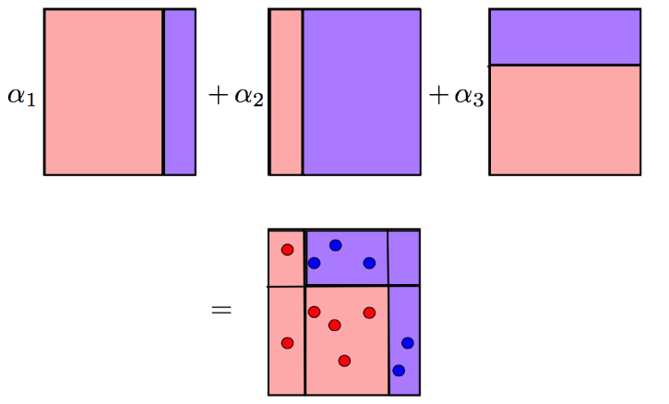
Adaboost
Notes:
The size of point corresponds to its weight, which was assigned for an incorrect prediction. On each iteration, we can see that these weights are growing -- the stumps cannot cope with this problem. Although, if we take a weighted vote for the stumps, we will get the correct classifications:
Adaboost worked well. However, the justification of the algorithm was not enough. There was speculation and controversy: someone thought it was a super-algorithm and a magic bullet, someone was skeptical and shared the view that this is an inappropriate approach with hard overfitting. This was particularly true of the applicability of data with powerful emissions, to which Adaboost was unstable.

Slide 27
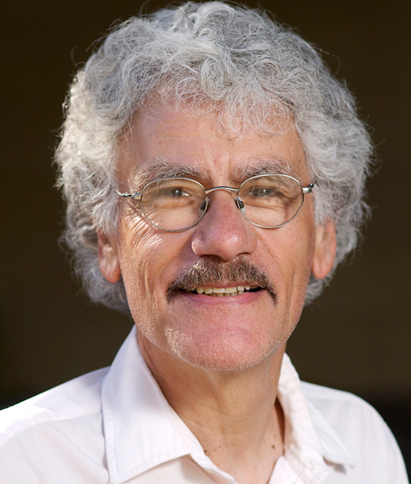


Gradient boosting
Jerome Friedman
Notes:
in 1999 from Jerome Friedman there was a generalization of the developments of the algorithms for boosting - gradient boosting,
At the same time, boosting had been actively used in search ranking. This problem was rewritten in terms of a loss function that penalizes errors in the output order, so it became convenient to simply insert it into GBM. AltaVista was one of the first companies who introduced boosting to ranking. Soon, the ideas spread to Yahoo, Yandex, Bing, etc.
ML competitions, especially Kaggle, played a major role in boosting's popularization. Kaggle winners starting from 2011 mostly used boosting

Slide 28
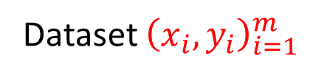
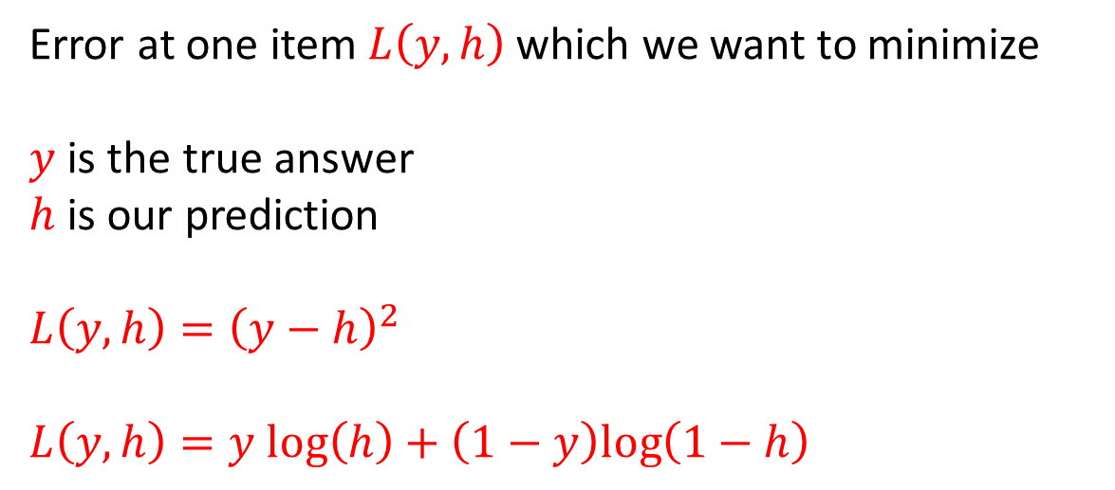
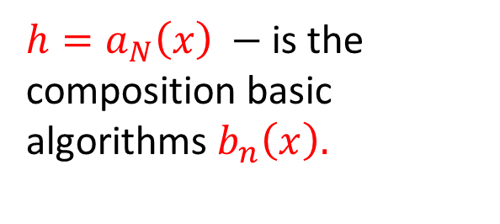
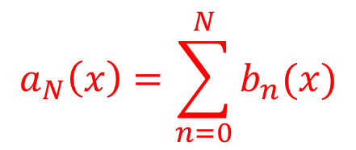
Gradient boosting
Dataset ${\left(x_{i}, y_{i}\right)}_{i=1}^{m}$
Error at one item $L\left(y,h\right)$ which we want to minimize
$y$ is the true answer
$h$ is our prediction
$L\left(y,h\right)={\left(y−h\right)}^{2}$
$L\left(y,h\right)=y log\left(h\right)+\left(1−y\right)log\left(1−h\right)$
$$a_{N}\left(x\right)=\sum_{n=0}^{N}{b_{n}(x)}$$
${h=a}_{N}\left(x\right) −$ is the composition basic algorithms $b_{n}\left(x\right).$
Notes:
We are going to solve the problem of function approximation in a general supervised learning setting. We have a set of features xx and target variables y.
We restore the dependence by approximating h and by understanding which approximation is better.
Please note that we do not average, but add the algorithms. Each following algorithm corrects errors of the previous one.

Slide 29
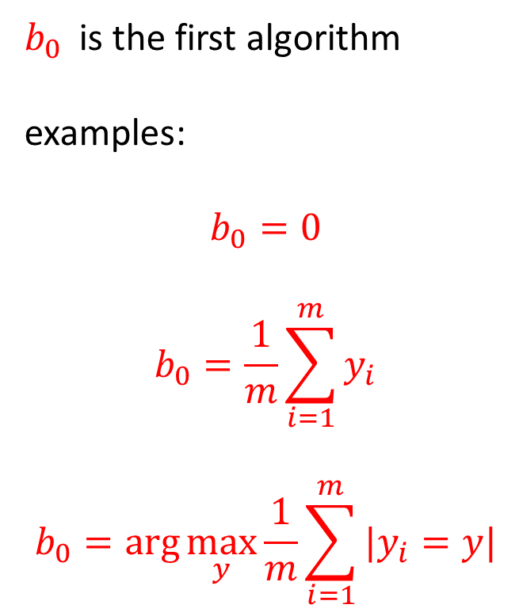
Initialization
$b_{0}$ is the first algorithm
examples:
$$b_{0}=0$$
$$b_{0}=\frac{1}{m}\sum_{i=1}^{m}{y_{i}}$$
$$b_{0}=\arg{\max_{y}{\frac{1}{m}\sum_{i=1}^{m}{|y_{i}=y|}}}$$

Slide 30
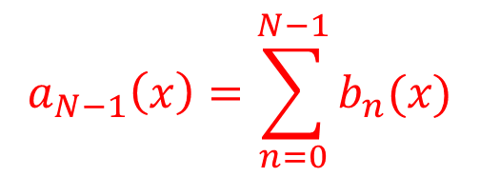
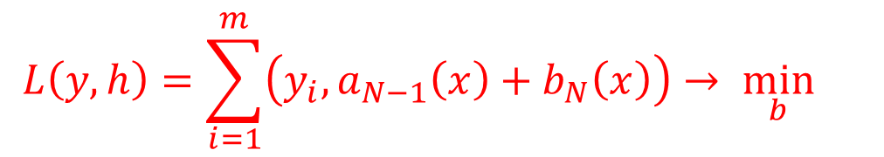
Base algorithm learning
Assume that
$$a_{N−1}\left(x\right)=\sum_{n=0}^{N−1}{b_{n}(x)}$$
already has built.
Then our task is
$$L\left(y,h\right)=\sum_{i=1}^{m}{\left(y_{i},a_{N−1}\left(x\right)+b_{N}\left(x\right)\right)→ \min_{b}{}}$$

Slide 31
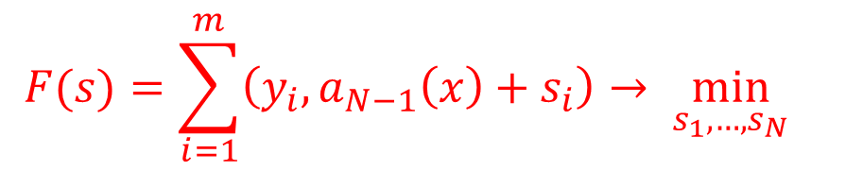

Base algorithm learning
$$F(s)=\sum_{i=1}^{m}{\left(y_{i},a_{N−1}\left(x\right)+s_{i}\right)→ \min_{s_{1},…,s_{N}}{}}$$
What are the best predictions for the training sample?
$$s=−∇F\left(s\right)=(−L_{h}^{′}\left(y_{1},a_{N−1}\left(x_{1}\right),…,−L_{h}^{′}\left(y_{m},a_{N−1}\left(x_{m}\right)\right)\right)$$
first object shift
$m^{th}$ object shift
Notes:
What values should our basic algorithm use on the training set to reduce the error?
We need to find such values S that they reduce the value as much as possible.
We know how way this problem is solved
The vector that most decreases the function is an anti-gradient, because it is directed in the direction of the fastest decreaseof the function.

Slide 32
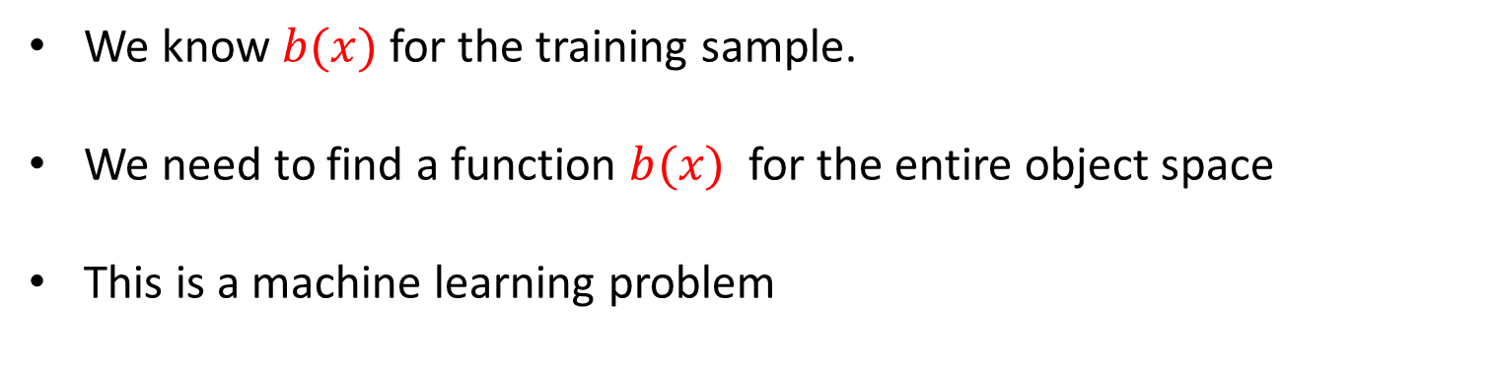
Base algorithm learning
We know $b(x)$ for the training sample.
We need to find a function $b(x)$ for the entire object space
This is a machine learning problem
Notes:
we know exactly how to shift the predictions on the training set in order to reduce the error function
We know what values the algorithm should have on the training sample. so ML

Slide 33
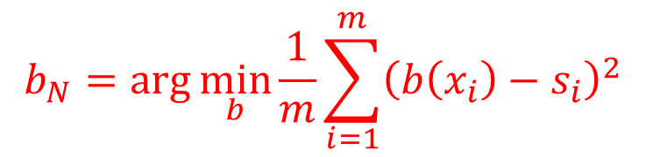

Base algorithm learning
$$b_{N}=\arg{\min_{b}{\frac{1}{m}\sum_{i=1}^{m}{{\left(b\left(x_{i}\right)−s_{i}\right)}^{2}}}}$$
All important information about $L$ is contained in the shift vector $s$
We use MSE regardless of the initial problem.
Notes:
The functionality of our task will look like this.

Slide 34

Gradient boosting
To build initial algorithm $b_{0}(x)$
For $n=1,…,N$
To calculate shift vector
$$s=(−L_{h}^{′}\left(y_{1},a_{N−1}\left(x_{1}\right),…,−L_{h}^{′}\left(y_{m},a_{N−1}\left(x_{m}\right)\right)\right)$$
To calculate new base algorithm
$$b_{N}=\arg{\min_{b}{\frac{1}{m}\sum_{i=1}^{m}{{\left(b\left(x_{i}\right)−s_{i}\right)}^{2}}}}$$
To add the algorithm to composition
$$a_{n}\left(x\right)=\sum_{l=0}^{n}{b_{l}(x)}$$
Notes:
On each iteration we make a shift vector

Slide 35
Gradient boosting
Gradient boosting sequentially builds a composition of functions for the hypothesis
The basic algorithm approximates the error of the antigradient function
The result is a gradient descent in the function space.
Notes:
2)…due to which it greatly reduces the error of an already constructed composition.
Unfortunately, gradient boosts can be overfitting

Slide 36

Reasons of overfitting
test
The basic algorithm should approximate the anti-gradient vector
Basic algorithms are very weak.
Bad approximation
Instead of a gradient descent, we get a random walk
error
train
number of function
Notes:
2)…due to which it greatly reduces the error of an already constructed composition.
Unfortunately, gradient boosts can be overfitting

Slide 37



Step reduction
Do not trust the basic algorithm:
$$a_{N}\left(x\right)=a_{N−1}\left(x\right)+ηb_{N}\left(x\right)$$
$η=0..1−$ step length
The smaller the step $η$, the more basic algorithms are needed
Step $η$ is hyperparameter
2 strategies:
fix $η$ and pick up $N$
fix $N$and pick up $η$
Notes:
We will not trust the direction. In this way, we move slowly and carefully and we hope to arrive at a local minimum.

Slide 38

Stochastic gradient boosting
We train each basic algorithm on a random subsample (bagging).
Notes:
We will not trust the direction. In this way, we move slowly and carefully and we hope to arrive at a local minimum.

Slide 39
gradient boosting
Basic algorithms - decision trees
depth limit (2-8)
step reduction
subsample training
http://arogozhnikov.github.io/2016/06/24/gradient_boosting_explained.html
http://arogozhnikov.github.io/2016/07/05/gradient_boosting_playground.html
Notes:
We will not trust the direction. In this way, we move slowly and carefully and we hope to arrive at a local minimum.

