Slide 1
Real Estate Investment Proposal
August 21, 2020

Slide 2
Summary
Goal
Define the Problem
Data Understanding
Predictive Analysis
Model Performance
Prediction
Conclusion
Recommendations
Areas for Growth

Slide 3
Goal:
Predict top 5 zip codes in United States for real estate firm to invest in.
Notes:
Why important, who’s the audience?

Slide 4
Define the Problem
Rank “top 5” zip codes by Return on Investment (ROI) after filtering for historical fluctuations:
Predicted Price Increase
ROI =
Initial Investment
Notes:
Why Machine Learning?
Large Amount of Data
Create accurate predictions
Time Series analysis
Filter median prices based on historical trends to find best ROI:
Seasonality
Stationarity
Autocorrelation

Slide 5
Data Understanding
Raw data from Zillow
1996 - 2018, Zip Codes across US
Limited to post-2008 market crash
Improves the model performance, since (hopefully) it was an anomaly
Narrowed focus: 60 zip codes w/ largest ROI in 5-year rolling window
Selected smaller subset of this initial filtering to enable faster model training

Slide 6
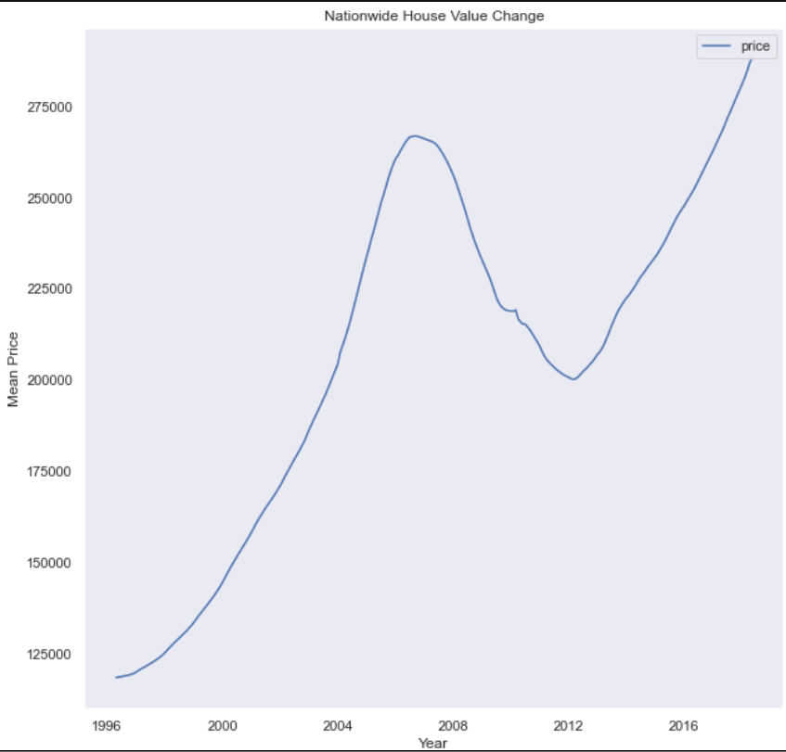
Data Understanding
Nationwide Mean House Price Value Change
1996 - 2018
Time Series Analysis:
Eliminates noise in data (trend, seasonality, autocorrelation, stationarity)
Enables value prediction

Slide 7
Predictive Analysis

Slide 8
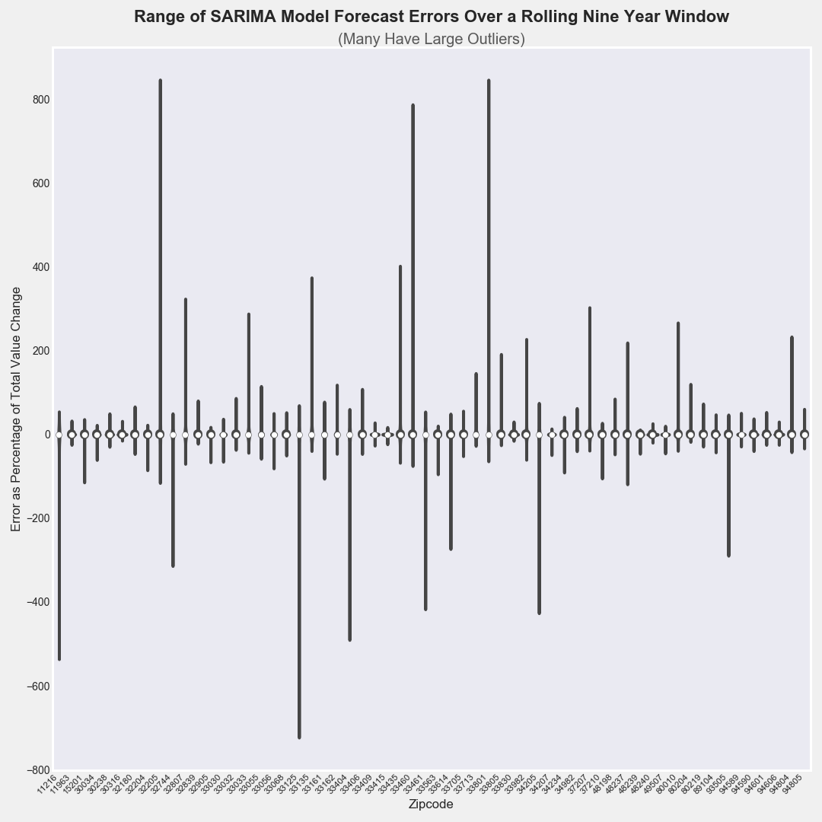
Model Performance
Large errors in several zip codes
Limited to 10 w/ smallest range of error over time
35
22

Slide 9
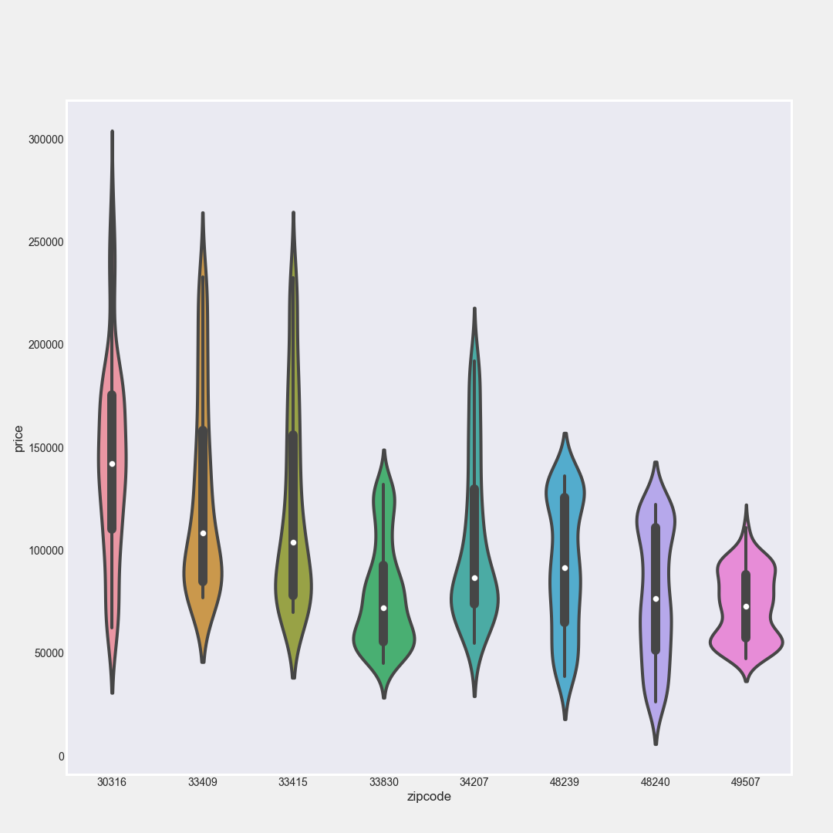
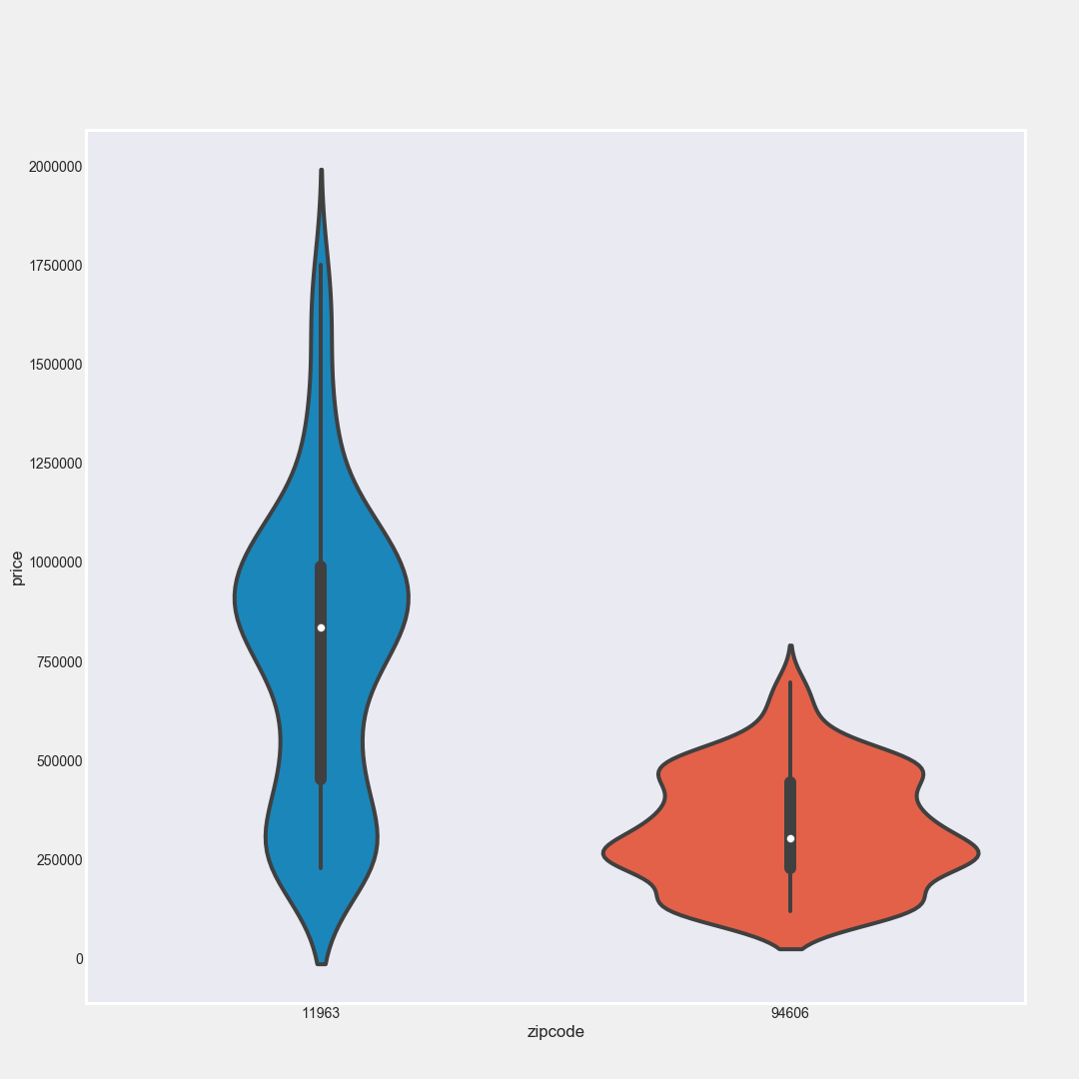
Model Performance: Two Investment Points
Lower Median Price
(lower capital investment)
Higher Median Price
(higher capital investment)
Notes:
The Ten Zip Codes we selected appeared to represent two distinct entry points in terms of initial investment
Higher: One Zip Code in particular required substantial capital

Slide 10
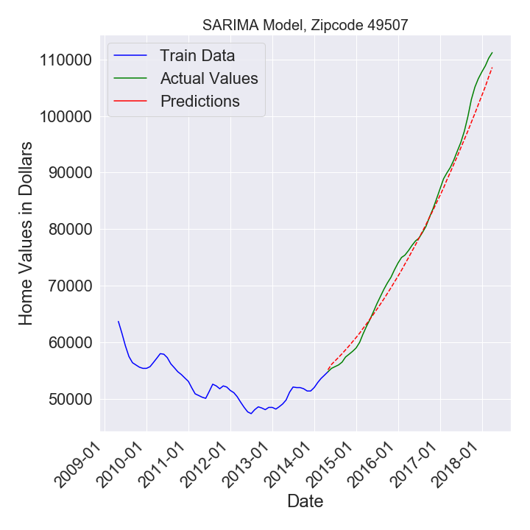
Model Performance

Slide 11
Conclusion

Slide 12
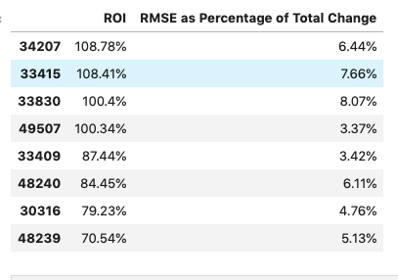
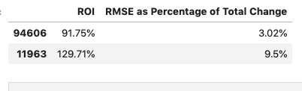
Recommendations: Zip Codes to Invest In
Low Medians
High Medians
Zip Codes beginning w/ 3 are mostly Florida
Zip Codes beginning w/ 4 are mostly Michigan
Outlier, 11963, is in New York State

Slide 13
Areas for Growth
Include Zillow Rent Data
Predicted rent would provide another way to predict return on investment
Extend time frame for analysis
With more data, predict longer term frames of reference
Improve Model
Train model on nationwide data for more precise “drill-down” ability

Slide 14




Thank You!
Jake Miller Brooks
Alexander Newton

