Slide 1

BRITISH AIRWAYS
CUSTOMER RATINGS ANALYSIS AND INSIGHTS

Slide 2

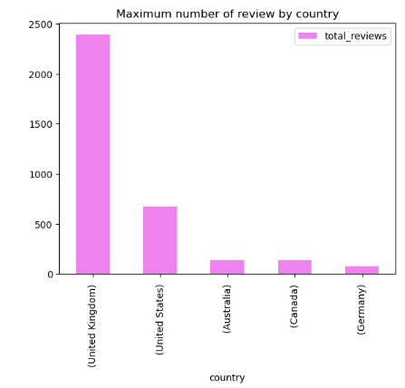
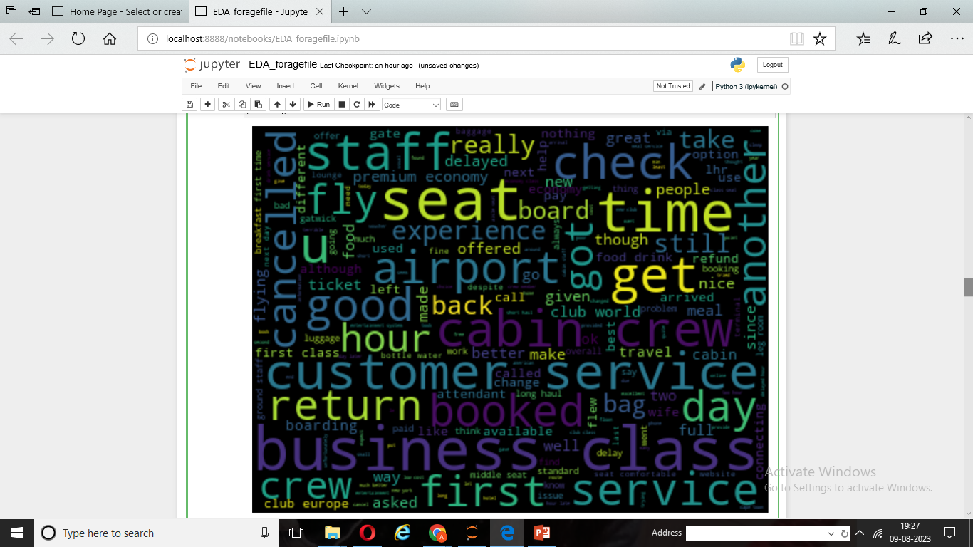

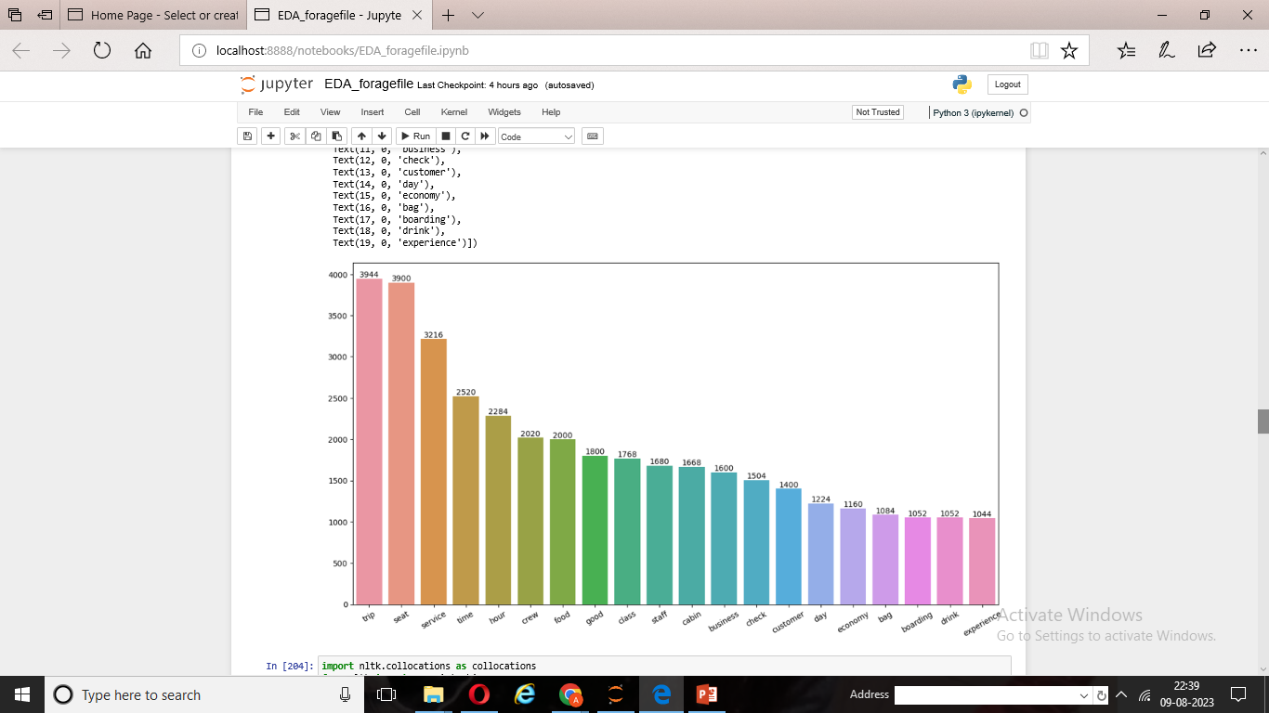

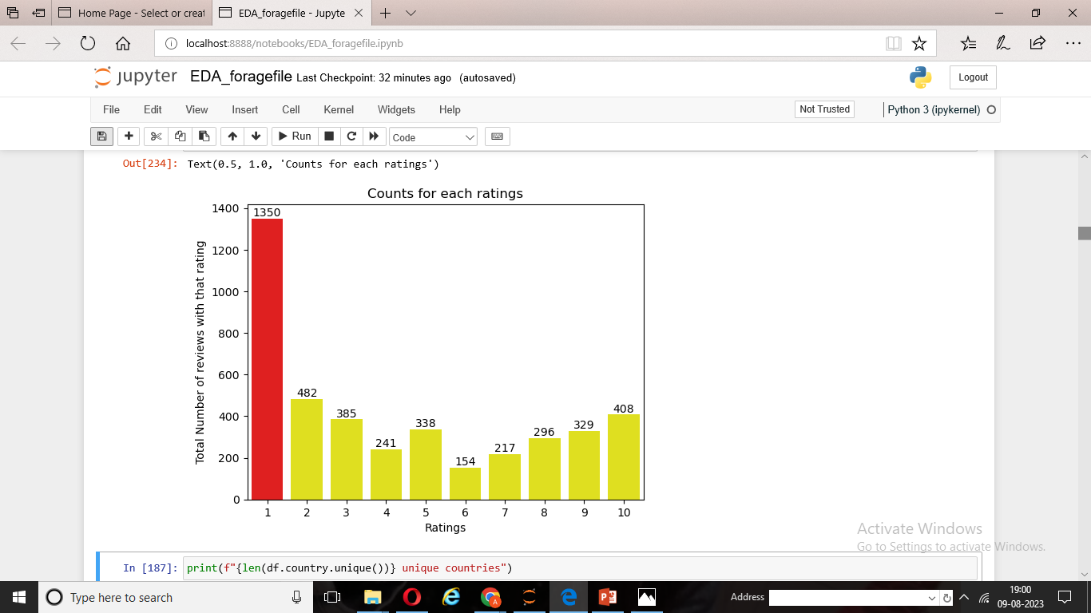

BRITISH AIRWAYS
Average Overall
Rating
4.27/10
Reviews from
56 Countries
4200 Total reviews collected
ALL Customers liked Cabin Crew service and staff, seats , landing time
What Customers are happy and unsatisfied about for different rating class
7-10 ratings wrote about comfortable seat , landing before time ,friendly cabin crew
4-6 ratings faced problems with bad business class experience while they like Cabin crew
1-3 ratings wrote dissatisfaction on lack of customer service
Focus on - Economy class ,seat, food and importantly delays . Enhance the Experience of business class , it seems customers want value for money . Improve Customer service on refund requests and process

