Slide 1

BRITISH AIRWAYS
CUSTOMER RATINGS ANALYSIS AND INSIGHTS

Slide 2

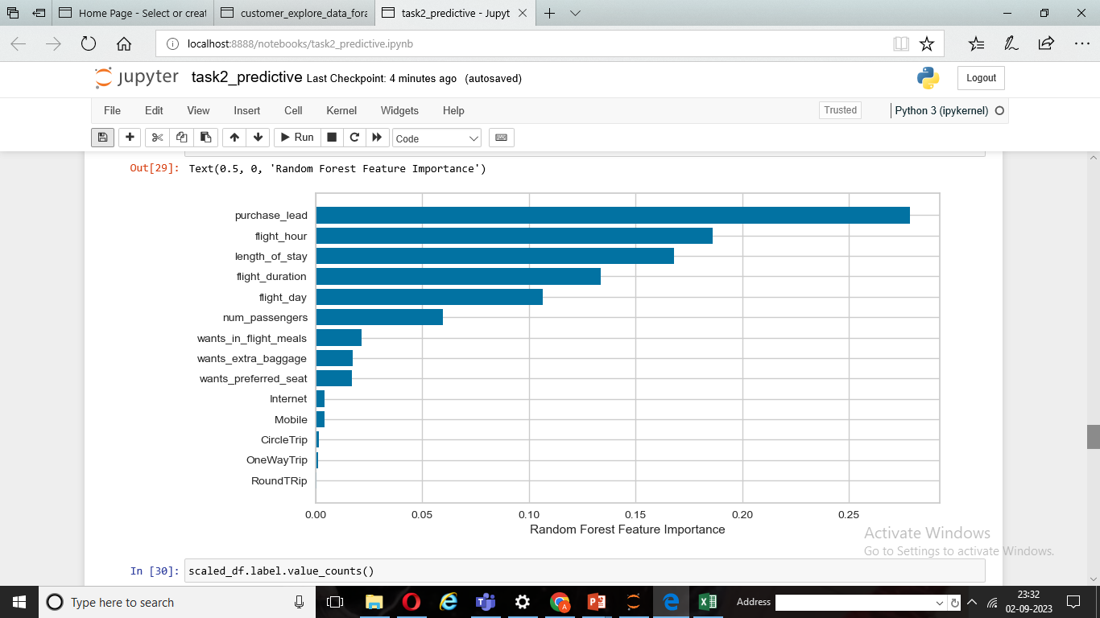
BRITISH AIRWAYS
Recall Rate
58 %
Precision
63 %
Chance of predicting true successful bookings
Will be predicted as actually completed bookings out of all successfully completed bookings.
66% chance of predicting true incomplete bookings correctly
Accuracy
62 %
Accuracy of the model predicting successful or incomplete booking is
Top Features that can drive successful flight

