Slide 1
Docker
Docker workshop VSB – Centrum vzdelaveni
Ivo Klimša

Slide 2
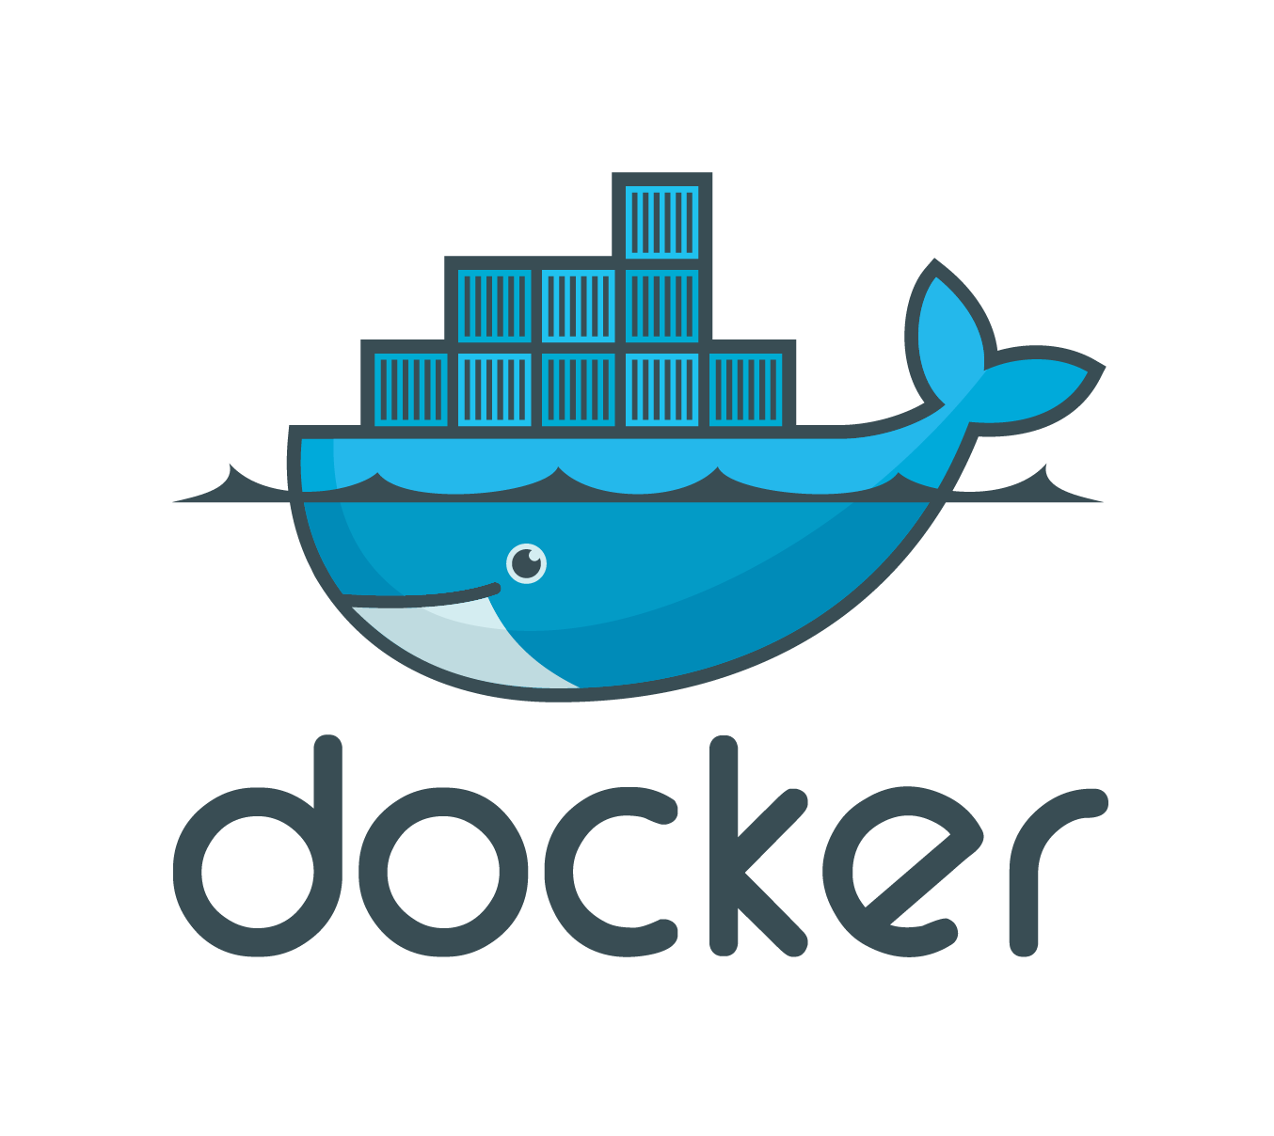
Agenda
Basic overview about Containers
Benefits
Workshop
Volumes
Networking
Swarm (Optional)

Slide 3
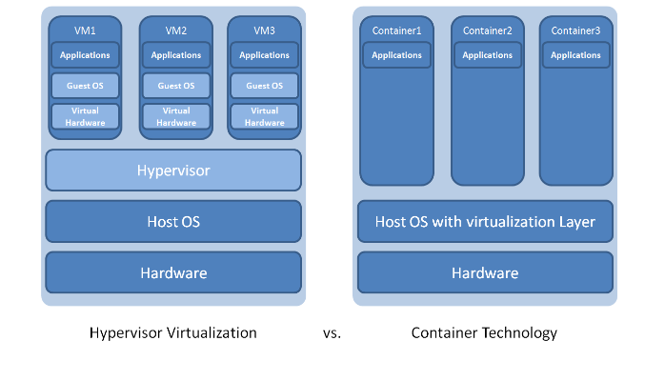
Containers?#!
What are containers?
Containers are a solution to the problem of how to get software to run reliably when moved from one computing environment to another. This could be from a developer's laptop to a test environment, from a staging environment into production and perhaps from a physical machine in a data center to a virtual machine in a private or public cloud.
Notes:
It's lightweight VM
The industry standard today is to use Virtual Machines (VMs) to run software applications. VMs run applications inside a guest Operating System, which runs on virtual hardware powered by the server’s host OS.
VMs are great at providing full process isolation for applications: there are very few ways a problem in the host operating system can affect the software running in the guest operating system, and vice-versa. But this isolation comes at great cost — the computational overhead spent virtualizing hardware for a guest OS to use is substantial.
Containers take a different approach: by leveraging the low-level mechanics of the host operating system, containers provide most of the isolation of virtual machines at a fraction of the computing power.
A full virtualized system gets its own set of resources allocated to it, and does minimal sharing. You get more isolation, but it is much heavier (requires more resources). With docker you get less isolation, but the containers are lightweight (require fewer resources). So you could easily run thousands of containers on a host, and it won't even blink. Try doing that with Xen, and unless you have a really big host, I don't think it is possible.

Slide 4
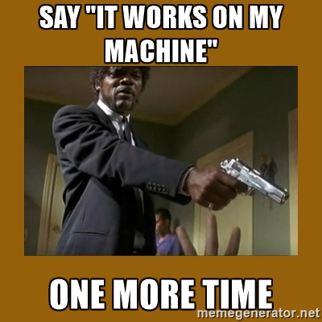
Standardized environment for your product
“Hmmm, but it works on my machine”
Notes:
4
1/5/17

Slide 5

Standardized interface between OS and container
Just install docker and everything will work
Notes:
5
1/5/17

Slide 6
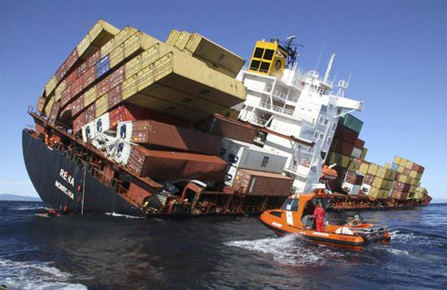
Porting images among developers is easy
Just pack it into an image and send anywhere – it will work the same everywhere
Notes:
6
1/5/17

Slide 7
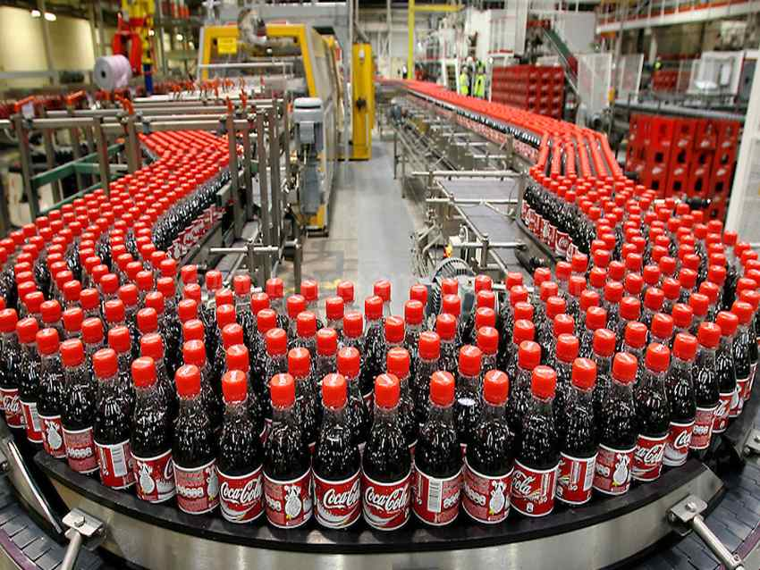
Fast and repeatable deployment
Create as many instances as you want
Notes:
7
1/5/17

Slide 8
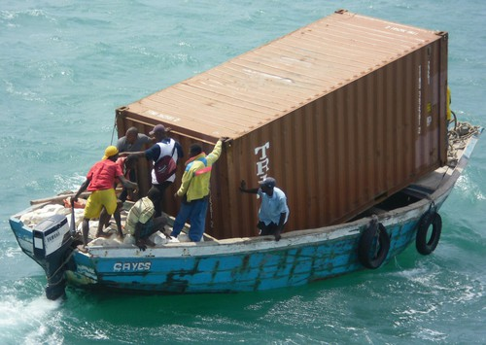
Containers are lightweight
Only application processes consume resources
Notes:
8
1/5/17

Slide 9

Minimal upgrade downtime
Suitable application architecture allows minimize downtime
Notes:
9
1/5/17

Slide 10
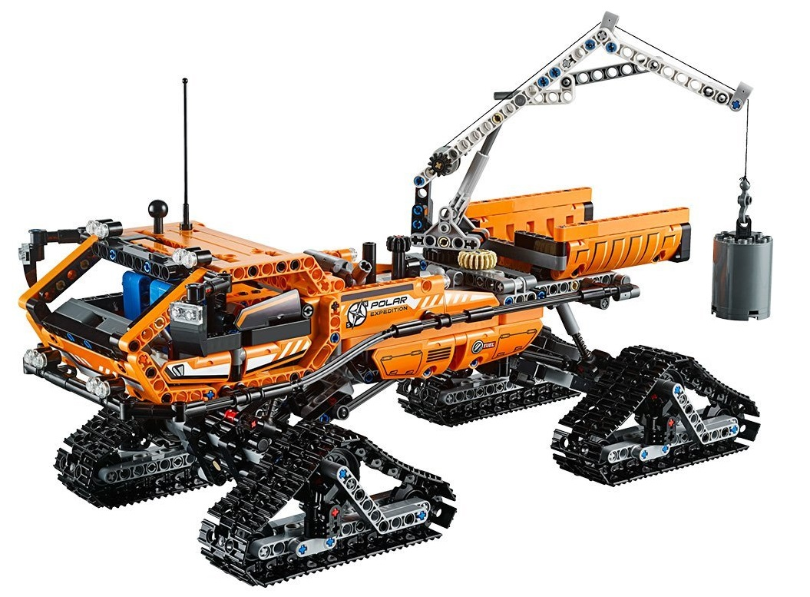
Supports microservices and modular design
One process per one container
Notes:
10
1/5/17

Slide 11
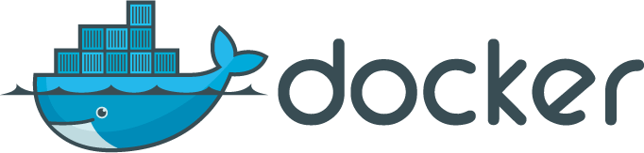
Docker
What is Docker?
Wikipedia defines Docker as:
an open-source project that automates the deployment of software applications inside containers by providing an additional layer of abstraction and automation of OS-level virtualization on Linux.
Developers use Docker to eliminate “works on my machine” problems when collaborating on code with co-workers.
Notes:
Docker is a tool that allows developers, sys-admins etc. to easily deploy their applications in a sandbox (called containers) to run on the host operating system i.e. Linux. The key benefit of Docker is that it allows users to package an application with all of its dependencies into a standardized unit for software development. Unlike virtual machines, containers do not have the high overhead and hence enable more efficient usage of the underlying system and resources.
Using containers, everything required to make a piece of software run is packaged into isolated containers. Unlike VMs, containers do not bundle a full operating system - only libraries and settings required to make the software work are needed. This makes for efficient, lightweight, self-contained systems that guarantees software will always run the same, regardless of where it’s deployed.
A full virtualized system gets its own set of resources allocated to it, and does minimal sharing. You get more isolation, but it is much heavier (requires more resources). With docker you get less isolation, but the containers are lightweight (require fewer resources). So you could easily run thousands of containers on a host, and it won't even blink. Try doing that with Xen, and unless you have a really big host, I don't think it is possible.

Slide 12
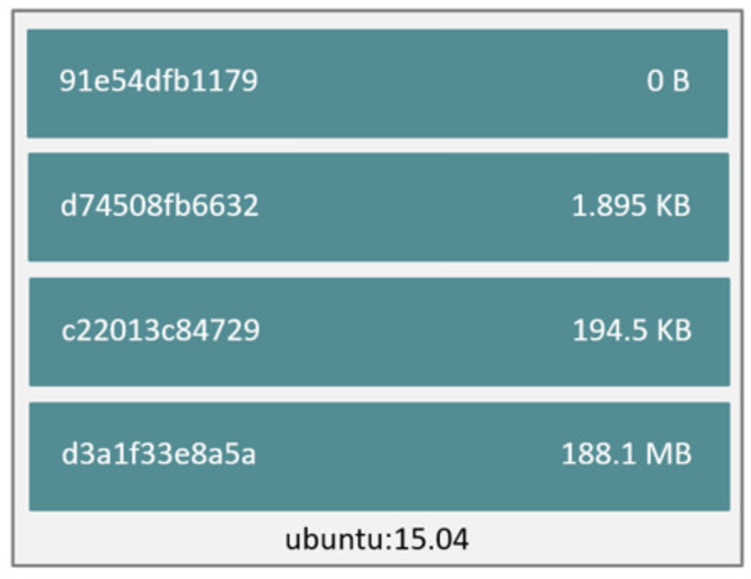
Docker
Images and layers
Notes:
Docker images are the basis of containers.It’s a filesystem. Each time you’ve used docker run you told it which image you wanted.
Each Docker image references a list of read-only layers that represent filesystem differences. Layers are stacked on top of each other to form a base for a container’s root filesystem. The diagram below shows the Ubuntu 15.04 image comprising 4 stacked image layers.

Slide 13
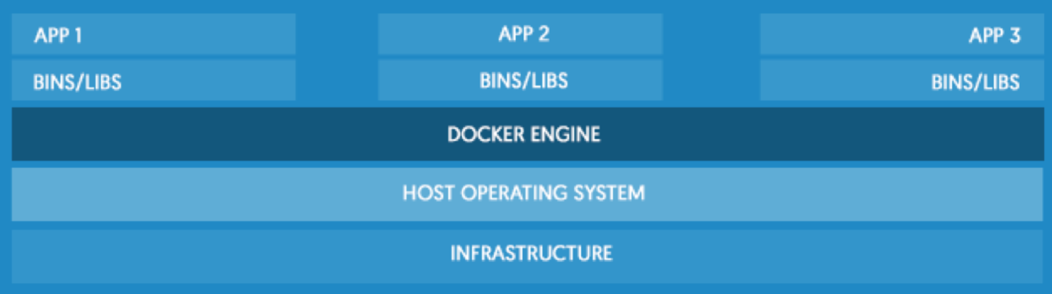
Docker
DOCKER ENGINE
Notes:
is a lightweight container runtime and robust tooling that builds and runs your container. Docker allows you to package up application code and dependencies together in an isolated container that share the OS kernel on the host system. The in-host daemon communicates with the Docker Client to execute commands to build, ship and run containers.

Slide 14
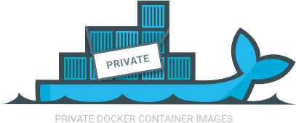
Docker
Registry
The Registry is a stateless, highly scalable server side application that stores and lets you distribute Docker images. The Registry is open-source, under the permissive Apache license.
You should use the Registry if you want to:
Tightly control where your images are being stored
Fully own your images distribution pipeline
Integrate image storage and distribution tightly into your in-house development workflow

Slide 15
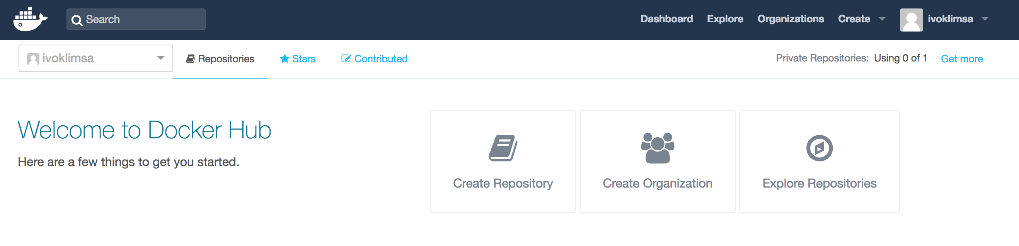
Docker
Docker hub
Notes:
Docker Hub is a cloud-based registry service which allows you to link to code repositories, build your images and test them, stores manually pushed images, and links to Docker Cloud so you can deploy images to your hosts. It provides a centralized resource for container image discovery, distribution and change management, user and team collaboration, and workflow automation throughout the development pipeline.

