Slide 1
计算机系统基础
姚文斌
计算机系统结构中心
13691048256
yaowenbin_cdc@163.com

Slide 2
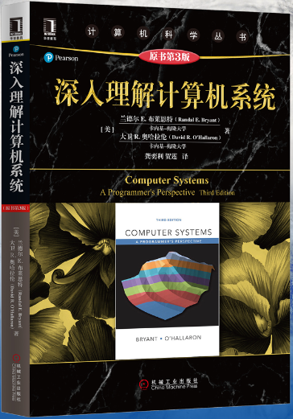
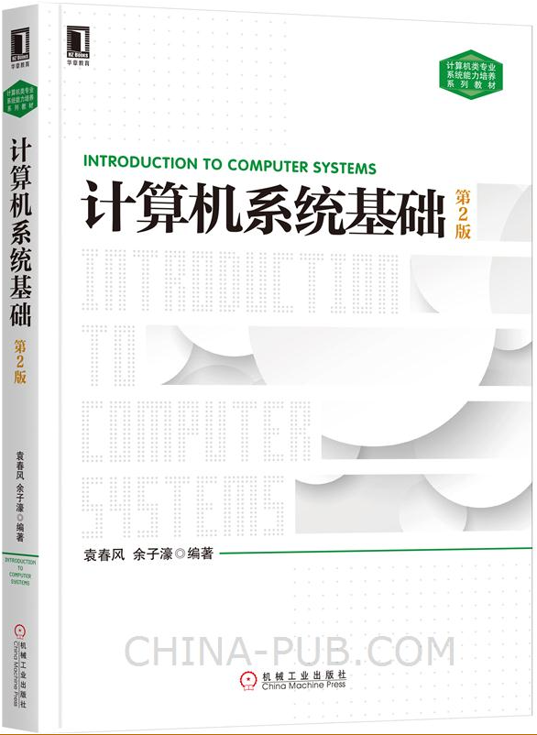
教材
Randal E. Bryant CMU计算机学院院长 ACM fellow、IEEE fellow 美国国家工程院院士 美国人文与科学研究院院士
1、Randal E. Bryant, David R. O’Hallaron. Computer Systems: A Programmer’s Perspective. Third Edition.（含全英文课件）（CMU课程）
深入理解计算机系统(中文版)电子版
2、http://csapp.cs.cmu.edu
3、袁春风，计算机系统基础，南京大学

Slide 3
课程说明
CMU大学
教学方法
本门课程

Slide 4

CMU
1900年卡内基技术学校-〉
1912年卡内基技术学院-〉
1967年卡内基·梅隆大学
一所享誉世界的私立顶级研究型大学，该校拥有全美顶级计算机学院和戏剧学院，该校的艺术学院/商学院/工学院以及公共管理学院也都在全美名列前茅
卡内基先生的名言(My heart is in the work)，是这所大学的校训，即使经历了百年内数次重大革新，这样的信念依旧根深蒂固融于整个大学文化中。在校训的指引下，卡内基梅隆大学对学生的训练异常严格，课业繁重，在普林斯顿评论(Princeton Review)每年“学生累得像狗的大学排名”中，从来高居前几位，与加州理工学院、麻省理工学院、芝加哥大学、普林斯顿大学等同为美国乃至全世界训练最为残酷的大学。
computer science：CMU/MIT/Berkeley/Stanford/
截至2017年卡耐基梅隆大学共培养出了12个图灵奖、20个诺贝尔奖、9个奥斯卡、114个艾米奖、44个托尼奖

Slide 5
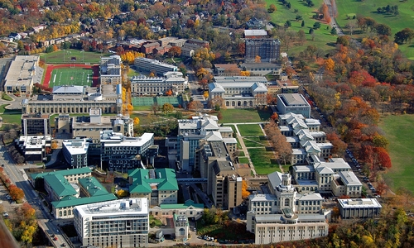

Slide 6
关于本书：CMU精品课程
非常巧妙的把程序设计及优化、数字电路基础、指令集体系、汇编语言、存储器体系结构、链接与装载、进程、虚存这一些来自各不同的内容（软件设计/硬件基础/体系结构/组成原理/底层程序设计/编译原理/操作系统）的核心知识点混合在一起，并以程序员的视角呈现，所以这本书的书名叫A programmer's perspective
这本书属于导论的性质（CSAPP对应CMU的 Introduction to computer systems这门本科课程，属于导论性质）。按照国内CS的课程安排的话，CSAPP介于计算机组成原理和操作系统之间，它的目的就是让你对这些计算机的基础学科有一个Overview，并尽可能的把作为一个程序员所必须了解的那些essence：那不到一成的计算机核心知识，尽早的灌输给你

Slide 7
课程内容涵盖
软件设计
硬件基础
体系结构
组成原理
底层程序设计
编译原理
操作系统
独立C语言编程
读懂汇编语言代码（指令体系：实现从高级语言到机器语言飞跃）
操作系统实践（Linux）
编译实践（gcc编译）
底层程序设计（操作硬件）
涉及课程
掌握操作
涉及多学科交叉知识
全部代码真实可运行
顶级实验设计
真正与
世界顶级课程接轨
遗憾：
时间短，只能讲一小部分
可扩展性、思维方式，有点难！！！

Slide 8
关于学习方法
关于大学的学习方法
培养自我学习能力
计算机专业的学习方法
解决科学问题的能力
快速适应性能力
本书学习建议
书中的练习
勤于思考、举一反三、反对刷题
其它建议
读原版：专业术语/专业知识能力培养

Slide 9
课程计划
总 学 时：32学时
课堂教学：32学时
作 业：6 ∼ 8次
考核方式：期中考试（闭卷）
期末考试（闭卷）
成绩评定：平时作业30%
期中考试10%
期末考试60%
答 疑：课前、课间及课后
微信随时

Slide 10
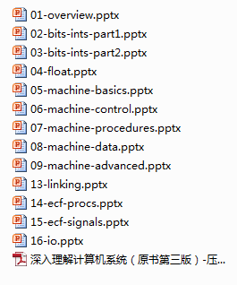
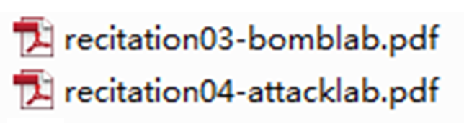
实验
1、linux、gcc等基本操作
2、
3、
4、I/O实验

Slide 11
课程计划 -《计算机系统基础实践》
本课程配套实践课
总 学 时：12学时
课程教学：8学时（7/10/12/15周五）
实验内容：4次实验（基础、炸弹、溢出、I/O）
考核方式：1、人工验收（实验演示、回答问题）
2、机器自动评分
成绩评定：实验验收60%，实验报告40%

Slide 12
《计算机系统基础实践》配套实践课
Labs
Lab1 (Linux&GNU Toolchain Lab): Basic usage of linux commands，vi commands and GNU toolchain
Lab2 (bomblab): Defusing a binary bomb
Lab3 (attacklab): The basics of code injection attacks
Lab4 (I/Olab): The basics of I/O control program
Facilities
Lab1-3 will use bup1 virtual machine with 12 Intel Core Processor and 48GB RAM which runs on Big Data Computing Platform of our school. Login bupt1 using your Student ID and password
Lab4 will use Ubuntu virtual machine on your own computer

Slide 13
Labs Policies
Lab schedule
Starts in week 8, two weeks for each lab assignment
Work groups
You must work alone on all lab assignments
Hand-ins
Labs are due at 11:59pm usually on Wensday
Electronic handins using email
Penalty for late submission
loss of 5 marks per day
Autograding and Scoreboards for Lab2 and Lab3
Autograding: Providing you with instant feedback
Scoreboards: Real-time, rank-ordered, and summary

Slide 14
Lab Rationale
Each lab has a well-defined goal such as solving a puzzle or winning a contest
Doing the lab should result in new skills and concepts
We try to use competition in a fun and healthy way
Set a reasonable threshold for full credit
Post intermediate results (anonymized) on Autolab scoreboard for glory!

Slide 15
课程目的
从程序员角度出发，理解高级语言中的数据、语句和函数调用等在计算机系统中的实现细节
建立C语言程序、汇编语言、编译器、链接器等之间的关联关系
初步理解基本输入输出控制方式、I/O函数的用法和设备驱动程序基本原理
建立起层次型计算机系统概念，增强在程序设计、程序调试等方面的动手能力，为后续课程打下坚实基础

Slide 16
Course Overview 15-213/18-213/15-513: Introduction to Computer Systems 1st Lecture, Aug 29, 2017
Instructors:
Randy Bryant
Phil Gibbons
Brian Railing

Slide 17
Overview
Big Picture
Course theme
Five realities
How the course fits into the CS/ECE curriculum
Academic integrity
Logistics and Policies

Slide 18
The Big Picture

Slide 19
Course Theme: (Systems) Knowledge is Power!
Systems Knowledge
How hardware (processors, memories, disk drives, network infrastructure) plus software (operating systems, compilers, libraries, network protocols) combine to support the execution of application programs
How you as a programmer can best use these resources
Useful outcomes from taking 213/513
Become more effective programmers
Able to find and eliminate bugs efficiently
Able to understand and tune for program performance
Prepare for later “systems” classes in CS & ECE
Compilers, Operating Systems, Networks, Computer Architecture, Embedded Systems, Storage Systems, etc.

Slide 20
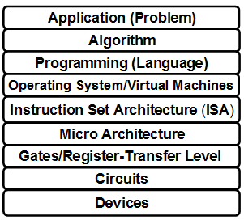
It’s Important to Understand How Things Work
Why do I need to know this stuff?
Abstraction is good, but don’t forget reality
Most CS and CE courses emphasize abstraction
Abstract data types
Asymptotic analysis
These abstractions have limits
Especially in the presence of bugs
Need to understand details of underlying implementations
Sometimes the abstract interfaces don’t provide the level of control or performance you need

Slide 21
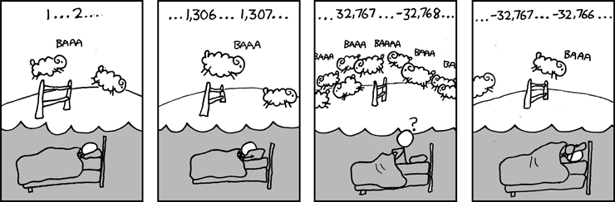
Great Reality #1: Ints are not Integers, Floats are not Reals
Example 1: Is x² ≥ 0?
Float’s: Yes!
Int’s:
40000 * 40000 --> 1600000000
50000 * 50000 --> ?
Example 2: Is (x + y) + z = x + (y + z)?
Unsigned & Signed Int’s: Yes!
Float’s:
(1e20 + -1e20) + 3.14 --> 3.14
1e20 + (-1e20 + 3.14) --> ??
Source: xkcd.com/571

Slide 22
Computer Arithmetic
Does not generate random values
Arithmetic operations have important mathematical properties
Cannot assume all “usual” mathematical properties
Due to finiteness of representations
Integer operations satisfy “ring” properties
Commutativity（交换）, associativity（结合）, distributivity（分配）
Floating point operations satisfy “ordering” properties（排序）
Monotonicity（单调）, values of signs
Observation
Need to understand which abstractions apply in which contexts
Important issues for compiler writers and serious application programmers

Slide 23
Great Reality #2: You’ve Got to Know Assembly
Chances are, you’ll never write programs in assembly
Compilers are much better & more patient than you are
But: Understanding assembly is key to machine-level execution model
Behavior of programs in presence of bugs
High-level language models break down
Tuning program performance
Understand optimizations done / not done by the compiler
Understanding sources of program inefficiency
Implementing system software
Compiler has machine code as target
Operating systems must manage process state
Creating / fighting malware
x86 assembly is the language of choice!

Slide 24
Great Reality #3: Memory Matters Random Access Memory Is an Unphysical Abstraction
Memory is not unbounded
It must be allocated and managed
Many applications are memory dominated
Memory referencing bugs especially pernicious
Effects are distant in both time and space
Memory performance is not uniform
Cache and virtual memory effects can greatly affect program performance
Adapting program to characteristics of memory system can lead to major speed improvements

Slide 25
Memory Referencing Bug Example
typedef struct {
int a[2];
double d;
} struct_t;
double fun(int i) {
volatile struct_t s;
s.d = 3.14;
s.a[i] = 1073741824; /* Possibly out of bounds */
return s.d;
}
fun(0) --> 3.14
fun(1) --> 3.14
fun(2) --> 3.1399998664856
fun(3) --> 2.00000061035156
fun(4) --> 3.14
fun(6) --> Segmentation fault
Result is system specific

Slide 26
Memory Referencing Bug Example
typedef struct {
int a[2];
double d;
} struct_t;
fun(0) --> 3.14
fun(1) --> 3.14
fun(2) --> 3.1399998664856
fun(3) --> 2.00000061035156
fun(4) --> 3.14
fun(6) --> Segmentation fault
Explanation:
Critical State | 6
? | 5
? | 4
d7 ... d4 | 3
d3 ... d0 | 2
a[1] | 1
a[0] | 0
Location accessed by fun(i)
struct_t

Slide 27
Memory Referencing Errors
C and C++ do not provide any memory protection
Out of bounds array references
Invalid pointer values
Abuses of malloc/free
Can lead to nasty bugs
Whether or not bug has any effect depends on system and compiler
Action at a distance
Corrupted object logically unrelated to one being accessed
Effect of bug may be first observed long after it is generated
How can I deal with this?
Program in Java, Ruby, Python, ML, …
Understand what possible interactions may occur
Use or develop tools to detect referencing errors (e.g. Valgrind)

Slide 28
Great Reality #4: There’s more to performance than asymptotic complexity
Constant factors matter too!
And even exact op count does not predict performance
Easily see 10:1 performance range depending on how code written
Must optimize at multiple levels: algorithm, data representations, procedures, and loops
Must understand system to optimize performance
How programs compiled and executed
How to measure program performance and identify bottlenecks
How to improve performance without destroying code modularity and generality

Slide 29
Memory System Performance Example
void copyij(int src[2048][2048],
int dst[2048][2048])
{
int i,j;
for (i = 0; i < 2048; i++)
for (j = 0; j < 2048; j++)
dst[i][j] = src[i][j];
}
void copyji(int src[2048][2048],
int dst[2048][2048])
{
int i,j;
for (j = 0; j < 2048; j++)
for (i = 0; i < 2048; i++)
dst[i][j] = src[i][j];
}
2.0 GHz Intel Core i7 Haswell
Hierarchical memory organization
Performance depends on access patterns
Including how step through multi-dimensional array

Slide 30
Great Reality #5: Computers do more than execute programs
They need to get data in and out
I/O system critical to program reliability and performance
They communicate with each other over networks
Many system-level issues arise in presence of network
Concurrent operations by autonomous processes
Coping with unreliable media
Cross platform compatibility
Complex performance issues

Slide 31
Course Perspective
Most Systems Courses are Builder-Centric
Computer Architecture
Design pipelined processor in Verilog
Operating Systems
Implement sample portions of operating system
Compilers
Write compiler for simple language
Networking
Implement and simulate network protocols

Slide 32
Course Perspective (Cont.)
Our Course is Programmer-Centric
By knowing more about the underlying system, you can be more effective as a programmer
Enable you to
Write programs that are more reliable and efficient
Incorporate features that require hooks into OS
E.g., concurrency, signal handlers
Cover material in this course that you won’t see elsewhere
Not just a course for dedicated hackers
We bring out the hidden hacker in everyone!

Slide 33
系统能力基于对系统的理解
了解计算机系统整体概念，理解计算机系统层次结构
理解高级语言程序、ISA、编译/链接、OS、硬件等之间的关系
高级语言语句与具体指令的对应关系
变量（常量）如何表示和存放
数组、指针等如何在指令级进行访问操作
嵌套和递归等机制如何在指令级实现
堆/栈的结构和动态存储分配机制
程序中的I/O操作和涉及到的系统调用过程
……
理解指令在计算机硬件上的执行过程
算术逻辑运算部件以及运算指令执行过程
层次化存储结构（Cache、TLB、RAID等）以及访存过程
I/O结构（I/O外设和接口、BUS、网络等）以及I/O过程
……
……
理解系统
改革系统
应用系统

Slide 34
计算机专业教学必须思考的问题
程序执行的结果和性能由编译、链接以及操作系统的处理方式和计算机执行指令的方式和执行电路决定！
如果单处理器计算机系统都不明白，何以能明白多核、众核、多核+众核、多处理机、分布式、云计算、……. 呢？

Slide 35
本课程在计算机课程体系中的位置
7
形式语言与自动机
计算机导论与程序设计、离散数学
电子商务
多媒体技术
…
6
软件类
数据结构
软件工程
1
计算机网络
4
C++
JAVA
VB
…
2
3
5
6
计算机系统结构
4
6
数据库
操作系统
编译系统
3
计算机系统基础
4
4
CPU及整机设计（计算机组成原理）
2
2
3
电路基础、 数字逻辑与数字系统
3
外围接口电路设计
嵌入式/单片机系统
硬件类
SOC芯片设计

Slide 36
计算机系统基础—从程序员角度认识系统
目标：
培养学生的系统能力，使其成为一个“高效”程序员，在程序调试、性能提升、程序移植和健壮性等方面成为高手；建立扎实的计算机系统概念，为后续的OS、编译、体系结构等课程打下坚实基础
以 IA-64+Linux+C+gcc 为平台（开源项目平台）
思路：
在程序与执行机制之间的建立关联，强化理解而不是记忆

Slide 37
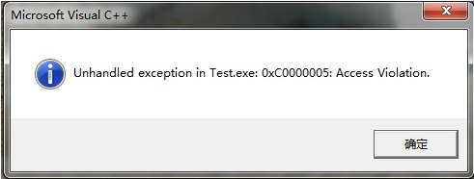
课程内容概要
/*---sum.c---*/
int sum(int a[ ], unsigned len)
{
int i，sum = 0;
for (i = 0; i <= len–1; i++)
sum += a[i];
return sum;
}
数据的表示
数据的运算
各类语句的转换与表示(指令)
各类复杂数据类型的转换表示
过程（函数）调用的转换表示
/*---main.c---*/
int main()
{
int a[1]={100};
int sum; sum=sum(a,0);
printf(“%d”,sum);
}
链接（linker）和加载
程序执行（存储器访问）
异常和中断处理
输入输出(I/O)

Slide 38
课程内容概要
使学生清楚理解：
计算机是如何生成和运行可执行文件的！
重点在高级语言以下各抽象层
C语言程序设计层
数据的机器级表示、运算
语句和过程调用的机器级表示
指令集体系结构（ISA）和汇编层
指令系统、机器代码、汇编语言
微体系结构及硬件层
CPU的通用结构
层次结构存储系统
操作系统、编译和链接的部分内容
“问题求解”课程解决应用→算法（数据结构）→编程层

Slide 39
课程内容概要
三个主题：
表示（Representation）
不同数据类型（带符号整数、无符号整数、浮点数、数组、结构等）在寄存器或存储器中如何表示和存储？
指令如何表示和编码（译码）？
存储地址（指针）如何表示以及如何生成复杂数据结构中数据元素的地址？
转换（Translation）
高级语言程序对应的机器级代码是怎样的？
执行控制流（Control flow）
计算机能理解的“程序”是如何组织和控制的？
如何在计算机中组织多个程序的并发执行？
逻辑控制流中的异常事件及其处理
I/O操作的执行控制流（用户态→内核态）

Slide 40
课程内容概要
前导知识：C语言程序设计+计算机导论
内容组织：两大部分
第一部分 系统概述和可执行文件的生成（表示和转换）
计算机系统概述
数据的机器级表示与处理
程序的转换及机器级表示
程序的链接
第二部分 可执行文件的运行（执行控制流）
程序的执行
异常控制流
I/O操作的实现

Slide 41
计算机系统概述

Slide 42
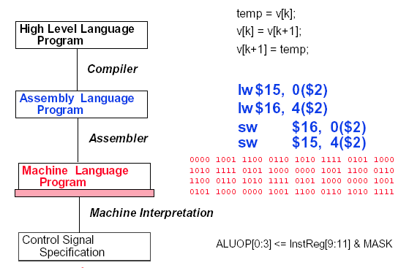
Hardware/Software Interface
temp = v[k];
v[k] = v[k+1];
v[k+1] = temp;
软件
lw $15, 0($2)
lw $16, 4($2)
sw $16, 0($2)
sw $15, 4($2)
1000 1100 0100 1111 0000 0000 0000 0000
1000 1100 0101 0000 0000 0000 0000 0100
1010 1100 0101 0000 0000 0000 0000 0000
1010 1100 0100 1111 0000 0000 0000 0100
硬件
… , EXTop=1,ALUSelA=1,ALUSelB=11,ALUop=add,
IorD=1,Read,MemtoReg=1,RegWr=1,......

Slide 43
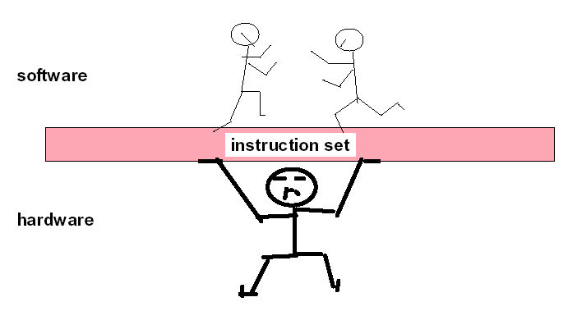
Hardware/Software Interface（接口）
软件
硬件
软件和硬件的界面： ISA（Instruction Set Architecture ）
指令集体系结构
机器语言由指令代码构成，能被硬件直接执行。

Slide 44
Software
System software(系统软件) - 简化编程过程，并使硬件资源被有效利用
操作系统（Operating System）：硬件资源管理，用户接口
语言处理系统：翻译程序+ Linker, Debug, etc …
翻译程序(Translator)有三类：
汇编程序(Assembler)：汇编语言源程序→机器语言目标程序
编译程序(Complier)：高级语言源程序→机器级目标程序
解释程序(Interpreter )：将高级语言语句逐条翻译成机器指令并立即执行,不生成目标文件。
其他实用程序: 如：磁盘碎片整理程序、备份程序等
Application software(应用软件) - 解决具体应用问题/完成具体应用任务
各类媒体处理程序：Word/ Image/ Graphics/…
管理信息系统 (MIS)
Game, …

Slide 45
Computer Hierarchy（计算机系统层次）
应用程序员Application Programmer
最终用户End User
Application
系统管理员
System Administrator
系统程序员System Programmer
Compiler
Operating
Assembler
System
Instruction Set
Architecture
CPU
MM
I/O
Digital Design
Circuit Design
° 上图给出的是计算机系统的层次结构
指令系统（即ISA）是软/硬件的交界面
°不同用户工作在不同层次，所看到的计算机不一样
Notes:
Merits of Abstraction: easy understanding, easy designing, compatibility
Difference between Architecture and Organization.
Computer Architecture: 1)how the software looks at the hardware? 2) functional, abstract view of hardware reflected in software.
每一层用户看到的计算机是不一样的。最终用户工作在应用程序层面，看到的是应用程序虚拟机，只知道如何使用相应的应用程序；应用程序开发人员在程序设计语言层面工作，看到的是高级语言虚拟机，只要会使用各种程序设计语言编程；系统维护人员工作在操作系统层面，看到的是操作系统虚拟机，只要知道系统中的命令和工具如何使用；系统程序员（OS和编译器开发人员）工作在计算机逻辑结构层面，看到的是汇编语言虚拟机；而汇编语言就是一台计算机指令系统的符号化表示，计算机的功能和性能就由机器的指令系统集中体现出来。

Slide 46
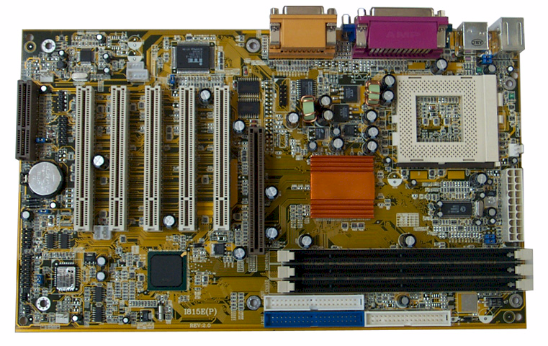
PC主板
CPU插座
PCI总线插槽
内存条

Slide 47
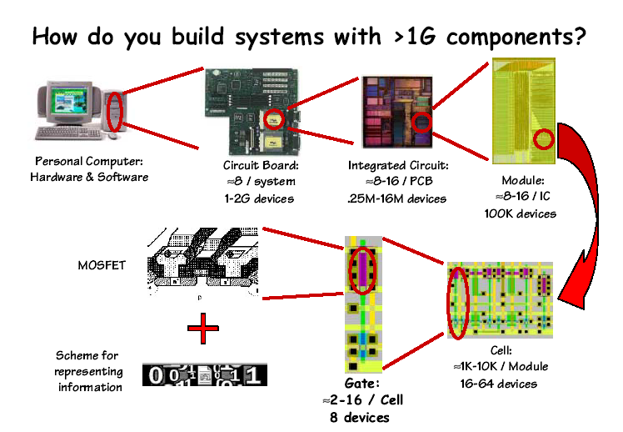
解剖一台计算机（分而治之）
个人计算机由主机和外设组成
主机中包含多个电路板
每个电路板中有十几个集成电路
每个集成电路中有十几个模块
每个门电路实现基本的逻辑运算
所有信息都用二进制编码表示
每个模块中有上千万个单元
每个单元中有十几个门电路

Slide 48
冯诺依曼体系结构
“存储程序”的思想确立了现代计算机的结构

Slide 49
8086CPU内部结构框图
Address Bus
20 bit
通用寄存器组
Σ
AX
Data Bus
16 bit
BX
CX
CS
DX
DS
SP
SS
BP
ES
DI
IP
外部总线
SI
总线
控制
逻辑
内部寄存器
专用寄存器组
暂存器
ALU
EU
控制器
指令队列
标志寄存器
EU
BIU
OF
DF
IF
TF
SF
ZF
AF
PF
CF
Notes:
2018.9.27

Slide 50
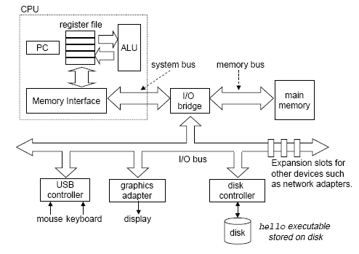
一个典型系统的硬件组成
CPU
MM
Input/Output
PC：程序计数器；ALU：算术/逻辑单元；USB：通用串行总线

Slide 51
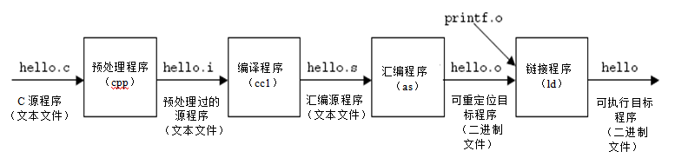
一个典型程序的转换处理过程
经典的“ hello.c ”C-源程序
1 #include <stdio.h>
2
3 int main()
4 {
5 printf("hello, world\n");
6 }
hello.c的ASCII文本表示
# i n c l u d e <sp> < s t d i o .
35 105 110 99 108 117 100 101 32 60 115 116 100 105 111 46
h > \n \n i n t <sp> m a i n ( ) \n {
104 62 10 10 105 110 116 32 109 97 105 110 40 41 10 123
\n <sp> <sp> <sp> <sp> p r i n t f ( " h e l
10 32 32 32 32 112 114 105 110 116 102 40 34 104 101 108
l o , <sp> w o r l d \ n " ) ; \n }
108 111 44 32 119 111 114 108 100 92 110 34 41 59 10 125
程序的功能是：
输出“hello,world”
计算机能够直接识别hello.c源程序吗？
不能，需要转换为机器语言代码! 即：编译、汇编等

Slide 52

Hello程序的数据流动过程
Unix>./hello
hello, world
unix>
[Enter]
Red：shell命令行处理
Blue：可执行文件加载
Cyan：hello程序执行过程
“hello”
“hello,world/n”
“hello”
“hello,world/n”
Hello可执行文件
数据经常在各存储部件间传送。故现代计算机大多采用“缓存”技术！
所有过程都是在CPU执行指令所产生的控制信号的作用下进行的。
Notes:
Hello程序被启动后，计算机的动作过程如下：
Shell程序读取字符串“./hello”中各字符到寄存器，然后存放到主存；
“Enter”键输入后，操作系统内核（载入程序）根据主存中的字符串“hello”到磁盘上找到特定的hello目标文件，将其包含的指令代码和数据（“hello, world\n”）从磁盘读到主存，并将控制权转交给hello程序，即将hello程序的第一条指令的地址送到PC中；处理器从hello主程序的指令代码开始执行；Hello程序将“hello, world\n”串中的字节从主存读到寄存器，再从寄存器输出到显示器上。

Slide 53
Academic Integrity
Please pay close attention, especially if this is your first semester at CMU
Notes:
学术诚信

Slide 54
Cheating/Plagiarism: Description
Unauthorized use of information
Borrowing code: by copying, retyping, looking at a file
Describing: verbal description of code from one person to another.
Searching the Web for solutions
Copying code from a previous course or online solution
Reusing your code from a previous semester (here or elsewhere)
If specific to 213/513, and you received credit
Notes:
Plagiarism：剽窃

Slide 55
Cheating/Plagiarism: Description (cont.)
Unauthorized supplying of information
Providing copy: Giving a copy of a file to someone
Providing access:
Putting material in unprotected directory
Putting material in unprotected code repository (e.g., Github)
Applies to this term and the future
There is no statute of limitations for academic integrity violations

Slide 56
Cheating/Plagiarism: Description
What is NOT cheating?
Explaining how to use systems or tools
Helping others with high-level design issues
Using code supplied by us
Using code from the CS:APP web site
See the course syllabus for details.
Ignorance is not an excuse

Slide 57
Cheating: Consequences
Penalty for cheating:
Best case: -100% for assignment
You would be better off to turn in nothing
Worst case: Removal from course with failing grade
This is the default
Permanent mark on your record
Loss of respect by you, the instructors and your colleagues
If you do cheat – come clean asap!
Detection of cheating:
We have sophisticated tools for detecting code plagiarism
In Fall 2015, 20 students were caught cheating and failed the course.
Some were expelled from the University
In January 2016, 11 students were penalized for cheating violations that occurred as far back as Spring 2014.
Don’t do it!
Manage your time carefully
Ask the staff for help when you get stuck

Slide 58
Some Concrete Examples:
This is Cheating:
Searching the internet with the phrase 15-213, 15213, 213, 18213, malloclab, etc.
That’s right, just entering it in a search engine
Looking at someone’s code on the computer next to yours
Giving your code to someone else, now or in the future
Posting your code in a publicly accessible place on the Internet, now or in the future
Hacking the course infrastructure
This is OK (and encouraged):
Googling a man page for fputs
Asking a friend for help with gdb
Asking a TA or course instructor for help, showing them your code, …
Looking in the textbook for a code example
Talking about a (high-level) approach to the lab with a classmate

Slide 59
How it Feels: Student and Instructor
Fred is desperate. He can’t get his code to work and the deadline is drawing near. In panic and frustration, he searches the web and finds a solution posted by a student at U. Oklahoma on Github. He carefully strips out the comments and inserts his own. He changes the names of the variables and functions. Phew! Got it done!
The course staff run checking tools that compare all submitted solutions to the solutions from this and other semesters, along with ones that are on the Web.
Remember: We are as good at web searching as you are
Meanwhile, Fred has had an uneasy feeling: Will I get away with it? Why does my conscience bother me?
Fred gets email from an instructor: “Please see me tomorrow at 9:30 am.”
Fred does not sleep well that night

Slide 60
How it Feels: Student and Instructor
The instructor feels frustrated. His job is to help students learn, not to be police. Every hour he spends looking at code for cheating is time that he cannot spend providing help to students. But, these cases can’t be overlooked
At the meeting:
Instructor: “Explain why your code looks so much like the code on Github.”
Fred: “Gee, I don’t know. I guess all solutions look pretty much alike.”
Instructor: “I don’t believe you. I am going to file an academic integrity violation.”
Fred will have the right to appeal, but the instructor does not need him to admit his guilt in order to penalize him.
Consequences
Fred may (most likely) will be given a failing grade for the course
Fred will be reported to the university
A second AIV will lead to a disciplinary hearing
Fred will go through the rest of his life carrying a burden of shame
The instructor will experience a combination of betrayal and distress

Slide 61
A Scenario: Cheating or Not?
Alice is working on malloc lab and is just plain stuck. Her code is seg faulting and she doesn't know why. It is only 2 days until malloc lab is due and she has 3 other assignments due this same week. She is in the cluster.
Bob is sitting next to her. He is pretty much done.
Sitting next to Bob is Charlie. He is also stuck.
1. Charlie gets up for a break and Bob makes a printout of his own code and leaves it on Charlie’s chair.
Who cheated: Charlie? Bob?
2. Charlie finds the copy of Bob’s malloc code, looks it over, and then copies one function, but changes the names of all the variables.
Who cheated: Charlie? Bob?

Slide 62
Another Scenario
Alice is working on malloc lab and is just plain stuck. Her code is seg faulting and she doesn't know why. It is only 2 days until malloc lab is due and she has 3 other assignments due this same week. She is in the cluster.
Bob is sitting next to her. He is pretty much done.
Sitting next to Bob is Charlie. He is also stuck.
1. Bob offers to help Alice and they go over her code together.
Who cheated: Bob? Alice?
2. Bob gets up to go to the bathroom and Charlie looks over at his screen to see how Bob implemented his free list.
Who cheated: Charlie? Bob?

Slide 63
Another Scenario (cont.)
3. Alice is having trouble with GDB. She asks Bob how to set a breakpoint, and he shows her.
Who cheated: Bob? Alice?
4. Charlie goes to a TA and asks for help
Who cheated: Charlie?
If you are uncertain which of these constitutes cheating, and which do not, please read the syllabus carefully. If you’re still uncertain, ask one of the staff

Slide 64
Version Control: Your Good Friend
Students will have access to the ECE GIT version control server
https://git.ece.cmu.edu
Please use instead of GitHub
Use as you should a version server
Commit early and often
Document your commits
Missing GIT history can count against you
How we use it
If we suspect academic integrity issues, we can see if commit history looks reasonable.
Steady, consistent, and sustained work
It can serve as your character witness

Slide 65
Logistics

Slide 66


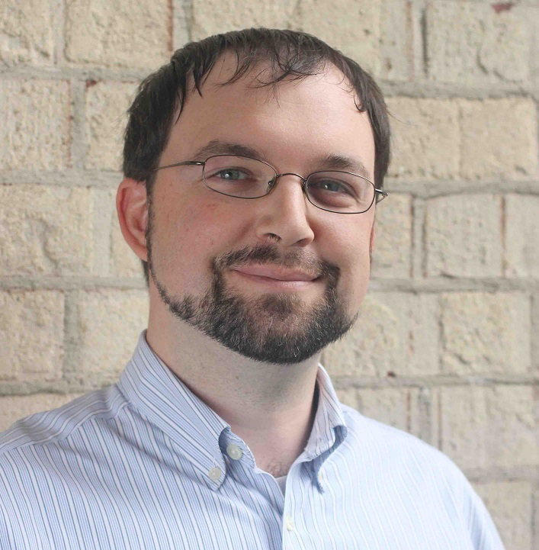
Instructors
Carnegie Mellon
Randy Bryant
Phil Gibbons
15-213/18-213
Lectures
Brian Railing
15-513

Slide 67
15-213/18-213 and 15-513
Carnegie Mellon
15-213/18-213
Only undergraduates
Live lectures
In-class quizzes via Canvas
Recitations
15-513
Only Masters students
Lectures by video (on the website and panopto)
Everything else is the same for all the courses

Slide 68
Textbooks
Randal E. Bryant and David R. O’Hallaron,
Computer Systems: A Programmer’s Perspective, Third Edition (CS:APP3e), Pearson, 2016
http://csapp.cs.cmu.edu
This book really matters for the course!
How to solve labs
Practice problems typical of exam problems
Brian Kernighan and Dennis Ritchie,
The C Programming Language, Second Edition, Prentice Hall, 1988
Still the best book about C, from the originators
Even though it does not cover more recent extensions of C

Slide 69
Course Components
Lectures
Higher level concepts
15-213/18-213: Will run in-class quizzes via Canvas
Your performance could tilt you to a higher grade if it’s a borderline case.
Labs (8)
The heart of the course
1-2+ weeks each
Provide in-depth understanding of an aspect of systems
Programming and measurement
Exams (midterm + final)
Test your understanding of concepts & mathematical principles

Slide 70
Getting Help
Carnegie Mellon
Class Web page: http://www.cs.cmu.edu/~213
Complete schedule of lectures, exams, and assignments
Copies of lectures, assignments, exams, solutions
FAQ
Piazza
Best place for questions about assignments
By default, your posts will be private
Do not post code (even privately). Put on autolab and then make post.
We will fill the FAQ and Piazza with answers to common questions
Canvas
We will use Canvas for in-class quizzes

Slide 71
Getting Help
Carnegie Mellon
Email
Send email to individual instructors or TAs only to schedule appointments
Office hours (starting Tue Sep 5):
SMTWR, 5:00–9:00pm, WeH 5207 [Thursdays are 5:30–9:00]
Walk-in Tutoring
Details TBA. Will put information on class webpage.
1:1 Appointments
You can schedule 1:1 appointments with any of the teaching staff

Slide 72
Policies: Labs And Exams
Work groups
You must work alone on all lab assignments
Handins
Labs due at 11:59pm
Electronic handins using Autolab (no exceptions!)
Exams
Exams will be online in network-isolated clusters
Held over multiple days. Self-scheduled; just sign up!
Appealing grades
Via detailed private post to Piazza within 7 days of completion of grading
Follow formal procedure described in syllabus

Slide 73
Facilities
Labs will use the Intel Computer Systems Cluster
The “shark machines”
linux> ssh shark.ics.cs.cmu.edu
21 servers donated by Intel for 213/513
10 student machines (for student logins)
1 head node (for instructor logins)
10 grading machines (for autograding)
Each server: Intel Core i7: 8 Nehalem cores, 32 GB DRAM, RHEL 6.1
Rack-mounted in Gates machine room
Login using your Andrew ID and password

Slide 74
Timeliness
Grace days
5 grace days for the semester
Limit of 0, 1, or 2 grace days per lab used automatically
Covers scheduling crunch, out-of-town trips, illnesses, minor setbacks
Lateness penalties
Once grace day(s) used up, get penalized 15% per day
No handins later than 3 days after due date
Catastrophic events
Major illness, death in family, …
Formulate a plan (with your academic advisor) to get back on track
Advice
Once you start running late, it’s really hard to catch up
Try to save your grace days until the last few labs

Slide 75
Other Rules of the Lecture Hall
Laptops: permitted
Electronic communications: forbidden
No email, instant messaging, cell phone calls, etc
Presence in lectures (213): strongly encouraged (and can count in your favor for borderline grades)
No recordings of ANY KIND

Slide 76
Policies: Grading
Exams (50%): midterm (20%), final (30%)
Labs (50%): weighted according to effort
Final grades based on a straight scale (90/80/70/60) with a small amount of curving
Only upward

Slide 77
Programs and Data
Topics
Bit operations, arithmetic, assembly language programs
Representation of C control and data structures
Includes aspects of architecture and compilers
Assignments
L0 (C programming Lab): Test/refresh your C programming abilities
L1 (datalab): Manipulating bits
L2 (bomblab): Defusing a binary bomb
L3 (attacklab): The basics of code injection attacks

Slide 78
The Memory Hierarchy
Topics
Memory technology, memory hierarchy, caches, disks, locality
Includes aspects of architecture and OS
Assignments
L4 (cachelab): Building a cache simulator and optimizing for locality.
Learn how to exploit locality in your programs.

Slide 79
Exceptional Control Flow
Topics
Hardware exceptions, processes, process control, Unix signals, nonlocal jumps
Includes aspects of compilers, OS, and architecture
Assignments
L5 (tshlab): Writing your own Unix shell.
A first introduction to concurrency

Slide 80
Virtual Memory
Topics
Virtual memory, address translation, dynamic storage allocation
Includes aspects of architecture and OS
Assignments
L6 (malloclab): Writing your own malloc package
Get a real feel for systems-level programming

Slide 81
Networking, and Concurrency
Topics
High level and low-level I/O, network programming
Internet services, Web servers
concurrency, concurrent server design, threads
I/O multiplexing with select
Includes aspects of networking, OS, and architecture
Assignments
L7 (proxylab): Writing your own Web proxy
Learn network programming and more about concurrency and synchronization.

Slide 82
Lab Rationale
Each lab has a well-defined goal such as solving a puzzle or winning a contest
Doing the lab should result in new skills and concepts
We try to use competition in a fun and healthy way
Set a reasonable threshold for full credit
Post intermediate results (anonymized) on Autolab scoreboard for glory!

Slide 83
Doing the Lab
https://theproject.zone/f17-15213
The project zone will contain the lab write-ups.
You canNOT submit your work until you have completed the writeup.
Please get started on the writeup early!
After you have completed the writeup,
https://autolab.andrew.cmu.edu/courses/15213-f17
Download the lab materials
(Usually as a tar file, so you will need to untar them in a new directory)
https://git.ece.cmu.edu/
Create a new repository for this lab
Add all the files from the download and commit.
If you have questions
Piazza
Office hours
Walkin-tutoring

Slide 84
Theproject.zone
Lab writeups will be online
As you read the writeup there will be assessment questions.
When you have completed all the assessment questions you will get a submission code.
Use the submission code when submitting your lab to autolab.
Not required for L0

Slide 85
Autolab (https://autolab.andrew.cmu.edu)
Labs are provided by the CMU Autolab system
Project page: http://autolab.andrew.cmu.edu
Developed by CMU faculty and students
Key ideas: Autograding and Scoreboards
Autograding: Providing you with instant feedback.
Scoreboards: Real-time, rank-ordered, and anonymous summary.
Used by over 3,000 students each semester
With Autolab you can use your Web browser to:
Download the lab materials
Handin your code for autograding by the Autolab server
View the class scoreboard
View the complete history of your code handins, autograded results, instructor’s evaluations, and gradebook.
View the TA annotations of your code for Style points.

Slide 86
Autolab accounts
Students enrolled 1:00pm on Mon, Aug 28 have Autolab accounts
You must be enrolled to get an account
Autolab is not tied in to the Hub’s rosters
If you add in, sign up with Google form:
https://docs.google.com/forms/d/1kZzg2nVWDJzt8QIbEiao1ZFTNJ21L_Rcaf5BaFq-5ZM/edit?usp=sharing
We will update the autolab accounts once a day, so check back in 24 hours.
For those who are waiting to add in, the first lab (C Programming Lab) will be available on the Schedule page of the course Web site.

Slide 87
Linux/Git bootcamp
Monday, Sept. 4, 7pm, GHC 4401 (Rashid Auditorium)
How to tar and untar files
How to set permissions on local and afs directories
How to set up GIT repository
How to recover old files from git
How to ssh to the lab machines
How to use a make file
And all the other things you were always afraid to ask …

Slide 88
Waitlist questions
15-213: Mary Widom (marwidom@cs.cmu.edu)
18-213: ECE Academic services (ece-asc@andrew.cmu.edu)
15-513: Mary Widom (marwidom@cs.cmu.edu)
Please don’t contact the instructors with waitlist questions.

Slide 89
Welcome and Enjoy!

