Slide 1
Bits, Bytes and Integers – Part 1 15-213/18-213/15-513: Introduction to Computer Systems 2nd Lecture, Aug. 31, 2017
Today’s Instructor:
Randy Bryant

Slide 2
数据的表示和运算(chapter2,课件2-4)
分三个部分介绍
非数值数据的表示、数据的存储
数据宽度单位
硬件特征：大端/小端、对齐存放
数值数据的表示
定点数的编码表示
整数的表示
无符号整数、带符号整数
浮点数的表示
C语言程序的整数类型和浮点数类型

Slide 3
数据的表示和运算
分三个部分介绍（续）
数据的运算
按位运算和逻辑运算
移位运算
位扩展和位截断运算
无符号和带符号整数的加减运算
无符号和带符号整数的乘除运算
变量与常数之间的乘除运算
浮点数的加减乘除运算
围绕C语言中的运算，解释其在底层机器级的实现方法
从高级语言程序中的表达式出发，用机器数在具体电路中的执行过程，来解释表达式的执行结果

Slide 4
Today: Bits, Bytes, and Integers
Representing information as bits
Bit-level manipulations
Integers
Representation: unsigned and signed
Conversion, casting
Expanding, truncating
Addition, negation, multiplication, shifting
Summary
Representations in memory, pointers, strings

Slide 5
Everything is bits
Each bit is 0 or 1
By encoding/interpreting sets of bits in various ways
Computers determine what to do (instructions)
… and represent and manipulate numbers, sets, strings, etc…
Why bits? Electronic Implementation
Easy to store with bistable elements
Reliably transmitted on noisy and inaccurate wires
0
1
0
1.1V
0.9V
0.2V
0.0V

Slide 6
For example, can count in binary
Base 2 Number Representation
Represent 15213₁₀ as 11101101101101₂
Represent 1.20₁₀ as 1.0011001100110011[0011]…₂
Represent 1.5213 X 10⁴ as 1.1101101101101₂ X 2¹³

Slide 7
Encoding Byte Values
Decimal
Hex
Binary
0
0
0000
Byte = 8 bits
Binary 000000002 to 111111112
Decimal: 010 to 25510
Hexadecimal 0016 to FF16
Base 16 number representation
Use characters ‘0’ to ‘9’ and ‘A’ to ‘F’
Write FA1D37B16 in C as
0xFA1D37B
0xfa1d37b
1
1
0001
2
2
0010
3
3
0011
4
4
0100
5
5
0101
6
6
0110
7
7
0111
8
8
1000
9
9
1001
A
10
1010
B
11
1011
C
12
1100
D
13
1101
E
14
1110
F
15
1111
15213: 0011 1011 0110 1101
3
B
6
D
Notes:
C语言中表示16进制时，a-f大小写一致？

Slide 8
数据量的度量单位
存储二进制信息时的度量单位要比字节或字大得多
容量经常使用的单位有：
“千字节”(KB)，1KB=2¹⁰字节=1024B
“兆字节”(MB)，1MB=2²⁰字节=1024KB
“千兆字节”(GB)，1GB=2³⁰字节=1024MB
“兆兆字节”(TB)，1TB=2⁴⁰字节=1024GB
通信中的带宽使用的单位有：
“千比特/秒”(kb/s)，1kbps=10³ b/s=1000 bps
“兆比特/秒”(Mb/s)，1Mbps=10⁶ b/s =1000 kbps
“千兆比特/秒”(Gb/s)，1Gbps=10⁹ b/s =1000 Mbps
“兆兆比特/秒”(Tb/s)，1Tbps=10¹² b/s =1000 Gbps
如果把b换成B，则表示字节而不是比特（位）
例如，10MBps表示 10兆字节/秒

Slide 9
Byte-Oriented Memory Organization
00•••0
FF•••F
• • •
Programs refer to data by address
Conceptually, envision it as a very large array of bytes
In reality, it’s not, but can think of it that way
An address is like an index into that array
and, a pointer variable stores an address
Note: system provides private address spaces to each “process”
Think of a process as a program being executed
So, a program can clobber its own data, but not that of others

Slide 10
数据的基本宽度
“字”和 “字长”的概念不同
“字长”指数据通路的宽度。
（数据通路指CPU内部数据流经的路径以及路径上的部件，主要是CPU内部进行数据运算、存储和传送的部件，这些部件的宽度基本上要一致，才能相互匹配。因此，”字长”等于CPU内部总线的宽度、运算器的位数、通用寄存器的宽度等。 ）
“字”表示被处理信息的单位，用来度量数据类型的宽度。
字和字长的宽度可以一样，也可不同。
例如，x86体系结构定义“字”的宽度为16位，但从386开始字长就是32位了。

Slide 11
Machine Words
Any given computer has a “Word Size”
Nominal size of integer-valued data
and of addresses
Until recently, most machines used 32 bits (4 bytes) as word size
Limits addresses to 4GB (2³² bytes)
Increasingly, machines have 64-bit word size
Potentially, could have 18 EB (exabytes) of addressable memory
That’s 18.4 X 10¹⁸
Machines still support multiple data formats
Fractions or multiples of word size
Always integral number of bytes

Slide 12
Word-Oriented Memory Organization
32-bit
Words
64-bit
Words
Bytes
Addr.
Addresses Specify Byte Locations
Address of first byte in word
Addresses of successive words differ by 4 (32-bit) or 8 (64-bit)
0000
Addr
=
??
0001
0000
0002
Addr
=
??
0003
0000
0004
Addr
=
??
0005
0004
0006
0007
0008
Addr
=
??
0009
0008
0010
Addr
=
??
0011
0008
0012
Addr
=
??
0013
0012
0014
0015

Slide 13
Example Data Representations
C Data Type | Typical 32-bit | Typical 64-bit | x86-64
char | 1 | 1 | 1
short | 2 | 2 | 2
int | 4 | 4 | 4
long | 4 | 8 | 8
float | 4 | 4 | 4
double | 8 | 8 | 8
pointer | 4 | 8 | 8
So, how are the bytes within a multi-byte word ordered in memory?
Notes:
字节
整形是32位

Slide 14
数据的存储和排列顺序
80年代开始，几乎所有机器都用字节编址
ISA设计时要考虑的两个问题：
如何根据一个字节地址取到一个32位的字？- 字的存放问题
一个字能否存放在任何字节边界？- 字的边界对齐问题
例如，若 int i = -65535，存放在内存100号单元（即占100#～103#），则用“取数”指令访问100号单元取出 i 时，必须清楚 i 的4个字节是如何存放的。
FF FF 00 01
65535=2¹⁶-1
[-65535]_{补}=FFFF0001H
103 102 101 100
little endian word 100#
Word:
msb
lsb
100 101 102 103
big endian word 100#
大端方式（Big Endian）: MSB所在的地址是数的地址
e.g. IBM 360/370, Motorola 68k, MIPS, Sparc, HP PA
小端方式（ Little Endian）: LSB所在的地址是数的地址
e.g. Intel 80x86, DEC VAX
有些机器两种方式都支持，可通过特定控制位来设定采用哪种方式。

Slide 15
Representing Integers
Decimal: 15213
Binary: 0011 1011 0110 1101
Hex: 3 B 6 D
int A = 15213;
long int C = 15213;
Increasing addresses
IA32, x86-64
Sun
IA32
x86-64
Sun
6D
00
3B
00
6D
6D
00
00
3B
3B
3B
00
00
6D
00
00
3B
00
00
6D
00
int B = -15213;
00
IA32, x86-64
Sun
00
00
93
FF
C4
FF
FF
C4
FF
93
Two’s complement representation

Slide 16
BIG Endian versus Little Endian
Ex3: Memory layout of a instruction located in 1000
假定小端机器中指令：mov AX, 0x12345(BX)
其中操作码mov为40H，寄存器AX和BX的编号分别为0001B和0010B，立即数占32位，则存放顺序为：
00
01
23
45
12
40
1005
1004
1003
1002
1001
1000
45
23
01
00
12
40
40
1
2
45 23 01 00
若在大端机器上，则存放顺序如何？
40
1
2
00 01 23 45
地址
只需要考虑指令中立即数的顺序！

Slide 17
Byte Swap Problem（字节交换问题）
78
3
12
3
56
2
34
2
34
1
increasing
byte
address
56
1
12
0
78
0
Big Endian
Little Endian
上述存放在0号单元的数据（字）是什么？
12345678H？ 78563412H？
存放方式不同的机器间程序移植或数据通信时，会发生什么问题？
每个系统内部是一致的，但在系统间通信时可能会发生问题！
因为顺序不同，需要进行顺序转换
音、视频和图像等文件格式或处理程序都涉及到字节顺序问题
ex. Little endian: GIF, PC Paintbrush, Microsoft RTF,etc
Big endian: Adobe Photoshop, JPEG, MacPaint, etc

Slide 18
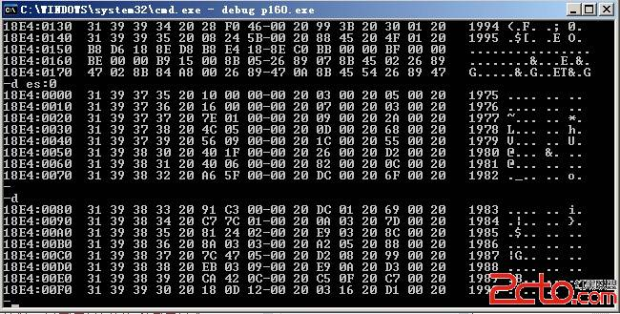

Slide 19
Alignment(对齐)
Alignment: 要求数据的地址是相应的边界地址
目前机器字长一般为32位或64位，而存储器地址按字节编址
指令系统支持对字节、半字、字及双字的运算，也有位处理指令
各种不同长度的数据存放时，有两种处理方式:
按边界对齐 （假定存储字的宽度为32位，按字节编址）
字地址：4的倍数(低两位为0)
半字地址：2的倍数(低位为0)
字节地址：任意
不按边界对齐
坏处：可能会增加访存次数！
（学了存储器组织后会更明白！）
每4个字节可同时读写

Slide 20


Alignment(对齐)
按边界对齐
边界不对齐
如：int i, short k, double x, char c, short j,……
存储器按字节编址
每次只能读写某个字地址开始的4个单元中连续的1个、2个、3个或4个字节
0 字节 1字节 2字节 3字节
0004081216
x：2个周期
j：1个周期
则：&i=0; &k=4; &x=8; &c=16; &j=18;……
字节0 字节1 字节2 字节3
虽节省了空间，但增加了访存次数！
需要权衡，目前来看，浪费一点存储空间没有关系！
0004081216
x：3个周期
j：2个周期
则： &i=0; &k=4; &x=6; &c=14; &j=15;……

Slide 21
Alignment(对齐) 举例
struct S2 {
int i；
int j；
char c；
}；
例如，考虑下列两个结构声明：
struct S1 {
int i；
char c；
int j；
}；
在要求对齐的情况下，哪种结构声明更好？
S2比S1好
0
4
8
S1：
i
c
X X X
j
需要12个字节
0
4
8
S2：
i
j
c
只需要9个字节
对于“struct S2 d[4]”，只分配9个字节能否满足对齐要求？
不能！
0
4
8
S2：
i
j
c
X X X
也需要12个字节
Notes:
2018.10.11

Slide 22
Today: Bits, Bytes, and Integers
Representing information as bits
Bit-level manipulations
Integers
Representation: unsigned and signed
Conversion, casting
Expanding, truncating
Addition, negation, multiplication, shifting
Summary
Representations in memory, pointers, strings
Notes:
Manipulations：操作

Slide 23
逻辑数据的编码表示
表示
用一位表示 。例如，真：1 / 假：0
N位二进制数可表示N个逻辑数据，或一个位串
运算
按位进行
如:按位与 / 按位或 / 逻辑左移 / 逻辑右移 等
识别
逻辑数据和数值数据在形式上并无差别，也是一串0/1序列，机器靠指令来识别。
位串
用来表示若干个状态位或控制位（OS中使用较多）
例如，x86的标志寄存器含义如下：
OF
DF
IF
TF
SF
ZF
AF
PF
CF

Slide 24
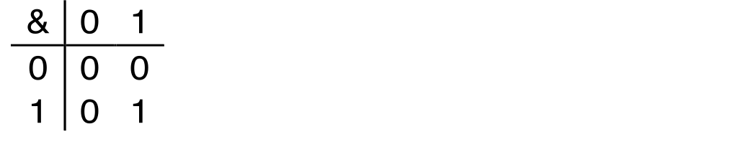
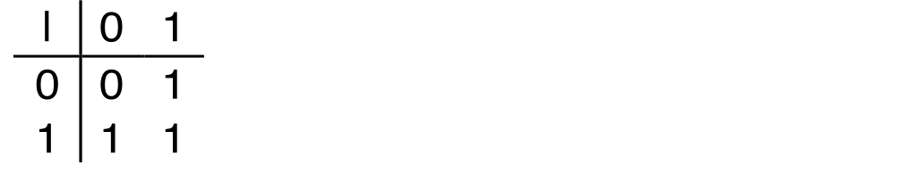
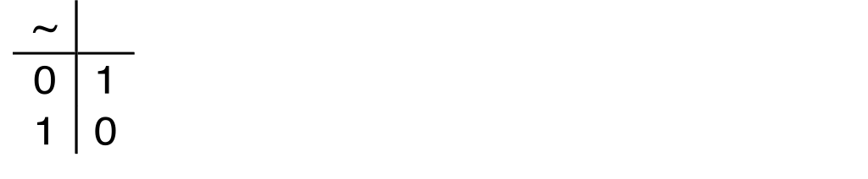
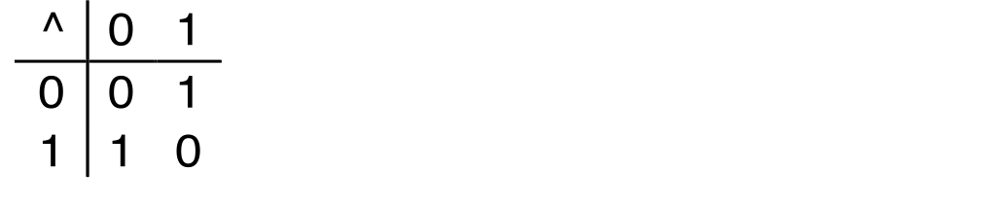
Boolean Algebra
Developed by George Boole in 19th Century
Algebraic representation of logic
Encode “True” as 1 and “False” as 0
And
A&B = 1 when both A=1 and B=1
Or
A|B = 1 when either A=1 or B=1
Not
~A = 1 when A=0
Exclusive-Or (Xor)
A^B = 1 when either A=1 or B=1, but not both
Notes:
Algebra: 代数

Slide 25
General Boolean Algebras
Operate on Bit Vectors
Operations applied bitwise
All of the Properties of Boolean Algebra Apply
01101001
& 01010101
01000001
01101001
| 01010101
01111101
01101001
^ 01010101
00111100
~ 01010101
10101010
01000001
01111101
00111100
10101010

Slide 26
Example: Representing & Manipulating Sets
Representation
Width w bit vector represents subsets of {0, …, w–1}
a_{j} = 1 if j ∈ A
01101001 { 0, 3, 5, 6 }
76543210
01010101 { 0, 2, 4, 6 }
76543210
Operations
& Intersection 01000001 { 0, 6 }
| Union 01111101 { 0, 2, 3, 4, 5, 6 }
^ Symmetric difference 00111100 { 2, 3, 4, 5 }
~ Complement 10101010 { 1, 3, 5, 7 }

Slide 27
Bit-Level Operations in C
Decimal
Hex
Binary
Operations &, |, ~, ^ Available in C
Apply to any “integral” data type
long, int, short, char, unsigned
View arguments as bit vectors
Arguments applied bit-wise
Examples (Char data type)
~0x41 → 0xBE
~010000012 → 101111102
~0x00 → 0xFF
~000000002 → 111111112
0x69 & 0x55 → 0x41
011010012 & 010101012 → 010000012
0x69 | 0x55 → 0x7D
011010012 | 010101012 → 011111012
0
0
0000
1
1
0001
2
2
0010
3
3
0011
4
4
0100
5
5
0101
6
6
0110
7
7
0111
8
8
1000
9
9
1001
A
10
1010
B
11
1011
C
12
1100
D
13
1101
E
14
1110
F
15
1111

Slide 28
Bit-Level Operations in C
Decimal
Hex
Binary
Operations &, |, ~, ^ Available in C
Apply to any “integral” data type
long, int, short, char, unsigned
View arguments as bit vectors
Arguments applied bit-wise
Examples (Char data type)
~0x41 → 0xBE
~010000012 → 101111102
~0x00 → 0xFF
~000000002 → 111111112
0x69 & 0x55 → 0x41
011010012 & 010101012 → 010000012
0x69 | 0x55 → 0x7D
011010012 | 010101012 → 011111012
Operations &, |, ~, ^ Available in C
Apply to any “integral” data type
long, int, short, char, unsigned
View arguments as bit vectors
Arguments applied bit-wise
Examples (Char data type)
~0x41 → 0xBE
~0100 00012 → 1011 11102
~0x00 → 0xFF
~0000 00002 → 1111 11112
0x69 & 0x55 → 0x41
0110 10012 & 0101 01012 → 0100 00012
0x69 | 0x55 → 0x7D
0110 10012 | 0101 01012 → 0111 11012
0
0
0000
1
1
0001
2
2
0010
3
3
0011
4
4
0100
5
5
0101
6
6
0110
7
7
0111
8
8
1000
9
9
1001
A
10
1010
B
11
1011
C
12
1100
D
13
1101
E
14
1110
F
15
1111

Slide 29
Contrast: Logic Operations in C
Contrast to Bit-Level Operators
Logic Operations: &&, ||, !
View 0 as “False”
Anything nonzero as “True”
Always return 0 or 1
Early termination
Examples (char data type)
!0x41 → 0x00
!0x00 → 0x01
!!0x41→ 0x01
0x69 && 0x55 → 0x01
0x69 || 0x55 → 0x01
p && *p (avoids null pointer access)
Watch out for && vs. & (and || vs. |)…
one of the more common oopsies in
C programming

Slide 30
Shift Operations
Left Shift: x << y
Shift bit-vector x left y positions
Throw away extra bits on left
Fill with 0’s on right
Right Shift: x >> y
Shift bit-vector x right y positions
Throw away extra bits on right
Logical shift
Fill with 0’s on left
Arithmetic shift
Replicate most significant bit on left
Undefined Behavior
Shift amount < 0 or ≥ word size
Argument x
01100010
<< 3
00010000
00010000
00010000
Log. >> 2
00011000
00011000
00011000
Arith. >> 2
00011000
00011000
00011000
Argument x
10100010
<< 3
00010000
00010000
00010000
Log. >> 2
00101000
00101000
00101000
Arith. >> 2
11101000
11101000
11101000
Notes:
Here

Slide 31
西文字符的编码表示
特点
是一种拼音文字，用有限几个字母可拼写出所有单词
只对有限个字母和数学符号、标点符号等辅助字符编码
所有字符总数不超过256个，使用7或8个二进位可表示
表示（常用编码为7位ASCII码）
十进制数字：0/1/2…/9（30H）
英文字母：A/B/…/Z/a/b/…/z（41H、61H）
专用符号：+/-/%/*/&/……
控制字符（不可打印或显示）（回车：0DH；换行：0AH）
操作
字符串操作，如:传送/比较 等
必须熟悉对应的ASCII码！

Slide 32
ASCII码 | 控制字符 | ASCII码 | 字符 | ASCII码 | 字符 | ASCII码 | 字符
0 | NUL | 32 | (space) | 64 | @ | 96 | ‵
1 | SOH | 33 | ! | 65 | A | 97 | a
2 | STX | 34 | ″ | 66 | B | 98 | b
3 | ETX | 35 | # | 67 | C | 99 | c
4 | EOT | 36 | % | 68 | D | 100 | d
5 | ENQ | 37 | % | 69 | E | 101 | e
6 | ACK | 38 | & | 70 | F | 102 | f
7 | BEL | 39 | ′ | 71 | G | 103 | g
8 | BS | 40 | ( | 72 | H | 104 | h
9 | HT | 41 | ) | 73 | I | 105 | i
10 | LF | 42 | * | 74 | J | 106 | j
11 | VT | 43 | + | 75 | K | 107 | k
12 | FF | 44 | , | 76 | L | 108 | l
13 | CR | 45 | - | 77 | M | 109 | m
14 | SO | 46 | . | 78 | N | 110 | n
15 | SI | 47 | / | 79 | O | 111 | o
16 | DLE | 48 | 0 | 80 | P | 112 | p
17 | DC1 | 49 | 1 | 81 | Q | 113 | q
18 | DC2 | 50 | 2 | 82 | R | 114 | r
19 | DC3 | 51 | 3 | 83 | S | 115 | s
20 | DC4 | 52 | 4 | 84 | T | 116 | t
21 | NAK | 53 | 5 | 85 | U | 117 | u
22 | SYN | 54 | 6 | 86 | V | 118 | v
23 | ETB | 55 | 7 | 87 | W | 119 | w
24 | CAN | 56 | 8 | 88 | X | 120 | x
25 | EM | 57 | 9 | 89 | Y | 121 | y
26 | SUB | 58 | : | 90 | Z | 122 | z
27 | ESC | 59 | ; | 91 | [ | 123 | {
28 | FS | 60 | < | 92 | \ | 124 | │
29 | GS | 61 | = | 93 | ] | 125 | }
30 | RS | 62 | > | 94 | ^ | 126 | ~
31 | US | 63 | ? | 95 | - | 127 | DEL
ASCⅡ码

Slide 33
汉字及国际字符的编码表示
特点
汉字是表意文字，一个字就是一个方块图形。
汉字数量巨大，总数超过6万字，给汉字在计算机内部的表示、汉字的传输与交换、汉字的输入和输出等带来了一系列问题。
编码形式
有以下几种汉字代码：
输入码：对汉字用相应按键进行编码表示，用于输入
内码：用于在系统中进行存储、查找、传送等处理
字模点阵或轮廓描述: 描述汉字字模点阵或轮廓，用于显示/打印

Slide 34
Today: Bits, Bytes, and Integers
Representing information as bits
Bit-level manipulations
Integers
Representation: unsigned and signed
Conversion, casting
Expanding, truncating
Addition, negation, multiplication, shifting
Summary
Representations in memory, pointers, strings
Summary

Slide 35
Encoding Integers
Unsigned
Two’s Complement
short int x = 15213;
short int y = -15213;
Sign Bit
C short 2 bytes long
Sign Bit
For 2’s complement, most significant bit indicates sign
0 for nonnegative
1 for negative
Notes:
B2U:二进制到无符号数；B2T:二进制到真值
Complement: 补码

Slide 36
Two-complement: Simple Example
-16 | 8 | 4 | 2 | 1
0 | 1 | 0 | 1 | 0
10 =
8+2 = 10
-16 | 8 | 4 | 2 | 1
1 | 0 | 1 | 1 | 0
-10 =
-16+4+2 = -10

Slide 37
Two-complement Encoding Example (Cont.)
x = 15213: 00111011 01101101
y = -15213: 11000100 10010011

Slide 38
Numeric Ranges
Unsigned Values
UMin = 0
000…0
UMax = 2^{w} – 1
111…1
Two’s Complement Values
TMin = –2^{w–1}
100…0
TMax = 2^{w–1} – 1
011…1
Minus 1
111…1
Values for W = 16

Slide 39
Values for Different Word Sizes
Observations
|TMin | = TMax + 1
Asymmetric range
UMax = 2 * TMax + 1
C Programming
#include <limits.h>
Declares constants, e.g.,
ULONG_MAX
LONG_MAX
LONG_MIN
Values platform specific

Slide 40
Unsigned & Signed Numeric Values
Equivalence
Same encodings for nonnegative values
Uniqueness
Every bit pattern represents unique integer value
Each representable integer has unique bit encoding
⇒ Can Invert Mappings
U2B(x) = B2U⁻¹(x)
Bit pattern for unsigned integer
T2B(x) = B2T⁻¹(x)
Bit pattern for two’s comp integer
X
B2U(X)
B2T(X)
0000
0
0
0001
1
1
0010
2
2
0011
3
3
0100
4
4
0101
5
5
0110
6
6
0111
7
7
1000
8
–8
1001
9
–7
1010
10
–6
1011
11
–5
1100
12
–4
1101
13
–3
1110
14
–2
1111
15
–1

Slide 41
Today: Bits, Bytes, and Integers
Representing information as bits
Bit-level manipulations
Integers
Representation: unsigned and signed
Conversion, casting
Expanding, truncating
Addition, negation, multiplication, shifting
Summary
Representations in memory, pointers, strings

Slide 42
Mapping Between Signed & Unsigned
Two’s Complement
Unsigned
T2U
x
T2B
B2U
ux
X
Maintain Same Bit Pattern
Unsigned
U2T
Two’s Complement
ux
U2B
B2T
x
X
Maintain Same Bit Pattern
Mappings between unsigned and two’s complement numbers: Keep bit representations and reinterpret
Notes:
T2B：真值（有符号数）到二进制；B2U：二进制到无符号数

Slide 43
Mapping Signed ↔ Unsigned
Bits
0000
0001
0010
0011
0100
0101
0110
0111
1000
1001
1010
1011
1100
1101
1110
1111
Signed
0
1
2
3
4
5
6
7
-8
-7
-6
-5
-4
-3
-2
-1
Unsigned
0
1
2
3
4
5
6
7
8
9
10
11
12
13
14
15
T2U
U2T

Slide 44
Mapping Signed ↔ Unsigned
Bits
0000
0001
0010
0011
0100
0101
0110
0111
1000
1001
1010
1011
1100
1101
1110
1111
Signed
0
1
2
3
4
5
6
7
-8
-7
-6
-5
-4
-3
-2
-1
Unsigned
0
1
2
3
4
5
6
7
8
9
10
11
12
13
14
15
=
+/- 16

Slide 45
Relation between Signed & Unsigned
Two’s Complement
Unsigned
T2U
x
T2B
B2U
ux
X
Maintain Same Bit Pattern
w–1
0
ux
+
+
+
• • •
+
+
+
x
-
+
+
• • •
+
+
+
Large negative weight
becomes
Large positive weight

Slide 46
Conversion Visualized
UMax
2’s Comp. → Unsigned
Ordering Inversion
Negative → Big Positive
UMax – 1
TMax + 1
Unsigned
Range
TMax
TMax
2’s Complement Range
0
0
–1
–2
TMin
Notes:
例如：八位二进制，无符号数最大：11111111，有符号数中负数最小：11111111

Slide 47
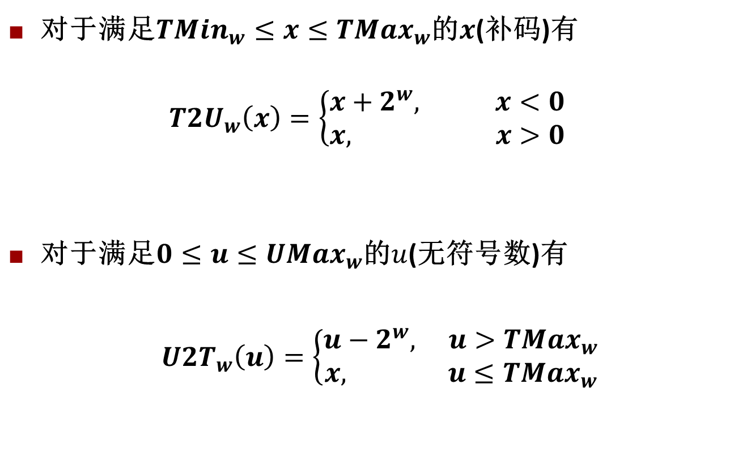
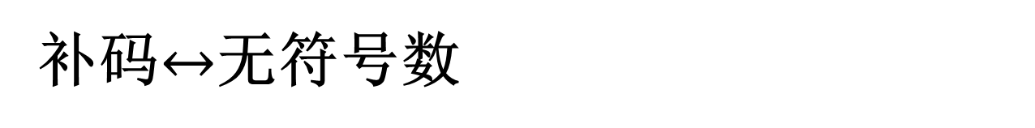
补码$↔$无符号数
对于满足${TMin}_{w}≤x≤{TMax}_{w}$的$x$(补码)有
$${T2U}_{w}\left(x\right)=\left\{\begin{matrix}x+2^{w}, x<0 \\ x, x>0\end{matrix}\right.$$
对于满足$0≤u≤{UMax}_{w}$的$u$(无符号数)有
${U2T}_{w}\left(u\right)=\left\{\begin{matrix}u−2^{w}, u>{TMax}_{w} \\ x, u≤{TMax}_{w}\end{matrix}\right.$

Slide 48
Signed vs. Unsigned in C
Constants
By default are considered to be signed integers
Unsigned if have “U” as suffix
0U, 4294967259U
Casting
Explicit casting between signed & unsigned same as U2T and T2U
int tx, ty;
unsigned ux, uy;
tx = (int) ux;
uy = (unsigned) ty;
Implicit casting also occurs via assignments and procedure calls
tx = ux; int fun(unsigned u);
uy = ty; uy = fun(tx);
Notes:
Explicit casting：显式转换

Slide 49
Casting Surprises
Expression Evaluation
If there is a mix of unsigned and signed in single expression, signed values implicitly cast to unsigned
Including comparison operations <, >, ==, <=, >=
Examples for W = 32: TMIN = -2,147,483,648 , TMAX = 2,147,483,647
关系表达式 | 运算类型 | 结果 | 说明
0 == 0U -1 < 0 -1 < 0U 2147483647 > -2147483647-1 2147483647U > -2147483647-1 2147483647 > (int) 2147483648U -1 > -2 (unsigned) -1 > -2

Slide 50
C语言程序中的整数
关系 表达式 | 类 型 | 结 果 | 说明
0 = = 0U -1 < 0 -1 < 0U 2147483647 > -2147483647 - 1 2147483647U > -2147483647 - 1 2147483647 > (int) 2147483648U -1 > -2 (unsigned) -1 > -2 | 无 带 无 带 无 带 带 无 | 1 1 0* 1 0* 1* 1 1 | 00…0B = 00…0B 11…1B (-1) < 00…0B (0) 11…1B (2³²-1) > 00…0B(0) 011…1B (2³¹-1) > 100…0B (-2³¹) 011…1B (2³¹-1) < 100…0B(2³¹) 011…1B (2³¹-1) > 100…0B (-2³¹) 11…1B (-1) > 11…10B (-2) 11…1B (2³²-1) > 11…10B (2³²-2)
带*的结果与常规预想的相反！

Slide 51
C语言程序中的整数
例如，考虑以下C代码：
1 int x = –1;
2 unsigned u = 2147483648;
3
4 printf ( “x = %u = %d\n”, x, x);
5 printf ( “u = %u = %d\n”, u, u);
在32位机器上运行上述代码时，它的输出结果是什么？为什么？
x = 4294967295 = –1
u = 2147483648 = –2147483648
因为–1的补码整数表示为“11…1”，作为32位无符号数解释时，其值为2³²–1= 4 294 967 296–1 = 4 294 967 295。
2³¹的无符号数表示为“100…0”，被解释为32位带符号整数时，其值为最小负数：–2³²⁻¹ = –2³¹ = –2 147 483 648。

Slide 52
C语言程序中的整数
1）在有些32位系统上，C表达式-2147483648 < 2147483647的执行结果为false。Why？
2）若定义变量“int i=-2147483648;”，则“i < 2147483647”的执行结果为true。Why？
3）如果将表达式写成“-2147483647-1 < 2147483647”，则结果会怎样呢？Why？
1）在ISO C90标准下 ，2147483648为unsigned类型，因此
“-2147483648 < 2147483647”按无符号数比较，
10……0B比01……1大，结果为false。
在ISO C99标准下 ，2147483648为int类型，因此
“-2147483648 < 2147483647”按带符号整数比较，
10……0B比01……1小，结果为true。
2）i < 2147483647 按int型数比较，结果为true。
3）-2147483647-1 < 2147483647 按int型比较，结果为true。

Slide 53
Unsigned vs. Signed: Easy to Make Mistakes
unsigned i;
for (i = cnt-2; i >= 0; i--)
a[i] += a[i+1];
Can be very subtle
#define DELTA sizeof(int)
int i;
for (i = CNT; i-DELTA >= 0; i-= DELTA)
. . .

Slide 54
Summary Casting Signed ↔ Unsigned: Basic Rules
Bit pattern is maintained
But reinterpreted
Can have unexpected effects: adding or subtracting 2^{w}
Expression containing signed and unsigned int
int is cast to unsigned!!

Slide 55
Today: Bits, Bytes, and Integers
Representing information as bits
Bit-level manipulations
Integers
Representation: unsigned and signed
Conversion, casting
Expanding, truncating
Addition, negation, multiplication, shifting
Summary
Representations in memory, pointers, strings

Slide 56
Sign Extension
Task:
Given w-bit signed integer x
Convert it to w+k-bit integer with same value
Rule:
Make k copies of sign bit:
X ′ = x_{w–1} ,…, x_{w–1} , x_{w–1} , x_{w–2} ,…, x₀
k copies of MSB
w
X
• • •
• • •
X ′
• • •
• • •
k
w

Slide 57
Sign Extension: Simple Example
Positive number
Negative number
-16 | 8 | 4 | 2 | 1
0 | 1 | 0 | 1 | 0
-16 | 8 | 4 | 2 | 1
1 | 0 | 1 | 1 | 0
10 =
-10 =
-32 | 16 | 8 | 4 | 2 | 1
0 | 0 | 1 | 0 | 1 | 0
-32 | 16 | 8 | 4 | 2 | 1
1 | 1 | 0 | 1 | 1 | 0
10 =
-10 =

Slide 58
Larger Sign Extension Example
short int x = 15213;
int ix = (int) x;
short int y = -15213;
int iy = (int) y;
Decimal
Hex
Binary
x
15213
3B 6D
00111011 01101101
ix
15213
00 00 3B 6D
00000000 00000000 00111011 01101101
y
-15213
C4 93
11000100 10010011
iy
-15213
FF FF C4 93
11111111 11111111 11000100 10010011
Converting from smaller to larger integer data type
C automatically performs sign extension

Slide 59
Truncation
Task:
Given k+w-bit signed or unsigned integer X
Convert it to w-bit integer X’ with same value for “small enough” X
Rule:
Drop top k bits:
X ′ = x_{w–1} , x_{w–2} ,…, x₀
k
w
X
• • •
• • •
• • •
X ′
• • •
w
Notes:
Truncation：截断

Slide 60
Truncation: Simple Example
No sign change
Sign change
-16 | 8 | 4 | 2 | 1
0 | 0 | 0 | 1 | 0
-16 | 8 | 4 | 2 | 1
0 | 1 | 0 | 1 | 0
2 =
10 =
 | -8 | 4 | 2 | 1
 | 0 | 0 | 1 | 0
 | -8 | 4 | 2 | 1
 | 1 | 0 | 1 | 0
2 =
-6 =
2 mod 16 = 2
10 mod 16 = 10U mod 16 = 10U = -6
-16 | 8 | 4 | 2 | 1
1 | 1 | 0 | 1 | 0
-16 | 8 | 4 | 2 | 1
1 | 0 | 1 | 1 | 0
-6 =
-10 =
 | -8 | 4 | 2 | 1
 | 1 | 0 | 1 | 0
 | -8 | 4 | 2 | 1
 | 0 | 1 | 1 | 0
-6 =
6 =
-6 mod 16 = 26U mod 16 = 10U = -6
-10 mod 16 = 22U mod 16 = 6U = 6

Slide 61
举例
例1（扩展操作）：在大端机上输出si, usi, i, ui的十进制和十六进制值是什么？
short si = -32768;
unsigned short usi = si;
int i = si;
unsingned ui = usi ;
例2（截断操作）：i和j是否相等？
int i = 32768;
short si = (short) i;
int j = si;
不相等！
i = 32768 00 00 80 00
si = -32768 80 00
j = -32768 FF FF 80 00
si = -32768 80 00
usi = 32768 80 00
i = -32768 FF FF 80 00
ui = 32768 00 00 80 00
原因：对i截断时发生了“溢出”，即：32768截断为16位数时，因其超出16位能表示的最大值，故无法截断为正确的16位数！

Slide 62
Summary: Expanding, Truncating: Basic Rules
Expanding (e.g., short int to int)
Unsigned: zeros added
Signed: sign extension
Both yield expected result
Truncating (e.g., unsigned to unsigned short)
Unsigned/signed: bits are truncated
Result reinterpreted
Unsigned: mod operation
Signed: similar to mod
For small (in magnitude) numbers yields expected behavior

Slide 63
小结
非数值数据的表示
逻辑数据用来表示真/假或N位位串，按位运算
西文字符：用ASCII码表示
汉字编码
数据的宽度
位、字节、字（不一定等于字长）
k /K / M / G / T / P / E / Z / Y 有不同的含义
数据的存储排列
数据的地址：连续若干单元中最小的地址，即：从小地址开始存放数据
问题：若一个short型数据si存放在单元0x08000100和0x08000101中，那么si的地址是什么？
大端方式：用MSB存放的地址表示数据的地址
小端方式：用LSB存放的地址表示数据的地址
按边界对齐可减少访存次数

Slide 64
小结
在机器内部编码后的数称为机器数，其值称为真值
定义数值数据有三个要素：进制、定点/浮点、编码
整数的表示
无符号数：正整数，用来表示地址等；带符号整数：用补码表示
C语言中的整数
无符号数：unsigned int ( short / long)；带符号数： int ( short / long)
十进制数的表示：用ASCII码或BCD码表示
整形运算
算术运算：无符号整数、有符号整数
按位运算：“|”、“&”、“~”、“^”
逻辑运算： “| |”、“& &”、“！”
移位运算：“<<”、“>>”（逻辑移位、算术移位）
位扩展和位截断：无符号和有符号

