Slide 1
Bits, Bytes, and Integers – Part 2 15-213: Introduction to Computer Systems 3rd Lecture, Sept. 5, 2017
Today’s Instructor:
Randy Bryant

Slide 2
Summary From Last Lecture
Representing information as bits
Bit-level manipulations
Integers
Representation: unsigned and signed
Conversion, casting
Expanding, truncating
Addition, negation, multiplication, shifting
Representations in memory, pointers, strings
Summary

Slide 3
Encoding Integers
Unsigned
Two’s Complement
Sign Bit
Two’s Complement Examples (w = 5)
-16 | 8 | 4 | 2 | 1
0 | 1 | 0 | 1 | 0
10 =
8+2 = 10
-16 | 8 | 4 | 2 | 1
1 | 0 | 1 | 1 | 0
-10 =
-16+4+2 = -10

Slide 4
Unsigned & Signed Numeric Values
Equivalence
Same encodings for nonnegative values
Uniqueness
Every bit pattern represents unique integer value
Each representable integer has unique bit encoding
Expression containing signed and unsigned int: int is cast to unsigned
X
B2U(X)
B2T(X)
0000
0
0
0001
1
1
0010
2
2
0011
3
3
0100
4
4
0000
0101
5
5
1111
0001
0110
6
6
1110
0010
0111
7
7
1000
8
–8
1101
0011
1001
9
–7
1010
10
–6
1100
0100
1011
11
–5
1100
12
–4
1011
0101
1101
13
–3
1110
14
–2
1010
0110
1111
15
–1
1001
1000
0111

Slide 5
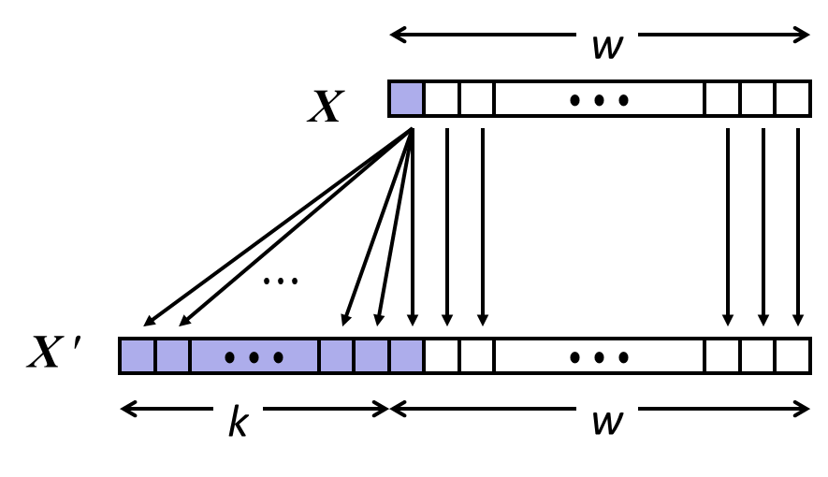
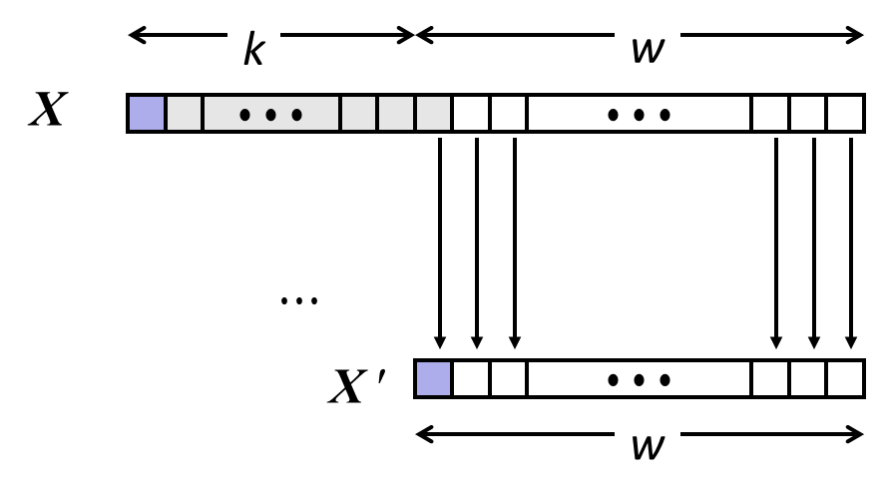
Sign Extension and Truncation
Sign Extension
Truncation

Slide 6
Today: Bits, Bytes, and Integers
Representing information as bits
Bit-level manipulations
Integers
Representation: unsigned and signed
Conversion, casting
Expanding, truncating
Addition, negation, multiplication, shifting
Representations in memory, pointers, strings
Summary

Slide 7
数据的运算
高级语言程序中涉及的运算（以C语言为例）
整数算术运算、浮点数算术运算
按位、逻辑、移位、位扩展和位截断
指令集中涉及到的运算
涉及到的定点数运算
算术运算
带符号整数运算：取负 / 符号扩展 / 算术移位/ 加 / 减 / 乘 / 除
无符号整数运算：0扩展 / 加 / 减 / 乘 / 除
逻辑运算
逻辑操作：与 / 或 / 非 / …
移位操作：逻辑左移 / 逻辑右移
涉及到的浮点数运算：加、减、乘、除
基本运算部件ALU的设计

Slide 8
如何实现高级语言源程序中的运算？
计算机如何实现高级语言程序中的运算？
将各类表达式编译（转换）为指令序列
计算机直接执行指令来完成运算
例：C语言赋值语句“f = (g+h) – (i+j);”中变量i、j、f、g、h由编译器分别分配给MIPS寄存器$t0~$t4。寄存器$t0~$t7的编号对应8~15，上述程序段对应的MIPS机器代码和汇编表示（#后为注释）如下：
000000 01011 01100 01101 00000 100000 add $t5, $t3, $t4 # g+h
000000 01000 01001 01110 00000 100000 add $t6, $t0, $t1 # i+j
000000 01101 01110 01010 00000 100010 sub $t2, $t5, $t6 # f =(g+h)–(i+j)

Slide 9
Unsigned Addition
u
Operands: w bits
• • •
+
v
• • •
True Sum: w+1 bits
u + v
• • •
Discard Carry: w bits
UAdd_{w}(u , v)
• • •
Decimal
Hex
Binary
Standard Addition Function
Ignores carry output
Implements Modular Arithmetic
s = UAdd_{w}(u , v) = u + v mod 2^{w}
0
0
0000
1
1
0001
2
2
0010
3
3
0011
4
4
0100
5
5
0101
6
6
0110
7
7
0111
unsigned char
1110 1001
+ 1101 0101
E9
+ D5
223
+ 213
8
8
1000
9
9
1001
A
10
1010
1 1011 1110
1BE
446
B
11
1011
C
12
1100
1011 1110
BE
190
D
13
1101
E
14
1110
F
15
1111

Slide 10
Visualizing (Mathematical) Integer Addition
Integer Addition
4-bit integers u, v
Compute true sum Add₄(u , v)
Values increase linearly with u and v
Forms planar surface
Add₄(u , v)
v
u

Slide 11
Visualizing Unsigned Addition
Wraps Around
If true sum ≥ 2^{w}
At most once
Overflow
UAdd₄(u , v)
True Sum
2^{w+1}
Overflow
2^{w}
v
0
Modular Sum
u

Slide 12
Two’s Complement Addition
Operands: w bits
u
• • •
+
v
• • •
True Sum: w+1 bits
u + v
• • •
Discard Carry: w bits
TAdd_{w}(u , v)
• • •
TAdd and UAdd have Identical Bit-Level Behavior
Signed vs. unsigned addition in C:
int s, t, u, v;
s = (int) ((unsigned) u + (unsigned) v);
t = u + v
Will give s == t
1110 1001
+ 1101 0101
E9
+ D5
-23
+ -43
1 1011 1110
1BE
446
1011 1110
BE
-66

Slide 13
TAdd Overflow
Functionality
True sum requires w+1 bits
Drop off MSB
Treat remaining bits as 2’s comp. integer
True Sum
0 111…1
2^{w}–1
PosOver
TAdd Result
0 100…0
2^{w –1}–1
011…1
0 000…0
0
000…0
1 011…1
–2^{w –1}
100…0
1 000…0
–2^{w}
NegOver

Slide 14
Visualizing 2’s Complement Addition
NegOver
Values
4-bit two’s comp.
Range from -8 to +7
Wraps Around
If sum ≥ 2^{w–1}
Becomes negative
At most once
If sum < –2^{w–1}
Becomes positive
At most once
TAdd₄(u , v)
v
u
PosOver

Slide 15
Characterizing TAdd
Positive Overflow
Functionality
True sum requires w+1 bits
Drop off MSB
Treat remaining bits as 2’s comp. integer
TAdd(u , v)
> 0
v
< 0
< 0
> 0
u
Negative Overflow
2^{w}
(NegOver)
2^{w}
(PosOver)

Slide 16
整数加减运算及其部件
补码加减运算公式
[A+B]_{补} = [A]_{补} + [B] _{补} ( MOD 2^{n} )
[A–B]_{补} = [A]_{补} + [–B] _{补} ( MOD 2^{n} )
补码加减运算要点和运算部件
加、减法运算统一采用加法来处理
符号位(最高有效位MSB)和数值位一起参与运算
直接用Adder实现两个数的加运算（模运算系统）
问题：模是多少？运算结果高位丢弃，保留低n位，相当于取模2^{n}
实现减法的主要工作在于：求[–B] _{补}
问题：Adder中执行的是什么运算？
相当于无符号数加！
Sub
问题：如何求[–B]_{补}？
A
Cin
n
ZF
[–B] _{补}=B+1
Adder
n
Result
Sel
B
0
OF
当Sub为1时，做减法
当Sub为0时，做加法
n
B
Mux
1
n
n
Cout

Slide 17
重要认识1：计算机中所有运算都基于加法器实现！
重要认识2：加法器不知道所运算的是带符号数还是无符号数。
重要认识3：加法器不判定对错，总是取低n位作为结果，并生成标志信息。
当Sub为1时，做减法
当Sub为0时，做加法
Sub
各个标志如何生成呢？
n
Cin
A
ZF
零标志
SF
符号标志
加/减运算部件
n
Sum
加法器
OF
溢出标志
n
0
CF=Co⊕Sub
B
B
多路选择器
进/借位标志
n
n
1
Cout

Slide 18
条件标志位（条件码CC）
Sub
A
Cin
所有其他运算都基于整数加/减运算器来实现。
4
ZF
SF
Adder
4
Sum
Sel
B＇
CF
B
0
OF
4
B
Mux
1
4
4
Cout
整数加/减运算部件
问题：OF=？ZF=？SF=？CF=？
OF：若A与B’同号但与Sum不同号，则1；否则0。SF：sum符号
ZF：如Sum为0，则1，否则0。CF：Cout ⊕ sub
零标志ZF、溢出标志OF、进/借位标志CF、符号标志SF称为条件标志。
条件标志（Flag）在运算电路中产生，被记录到专门的寄存器中，以便在分支指令中被用来作为条件。
存放标志的寄存器通常称为程序/状态字寄存器或标志寄存器。每个标志对应标志寄存器中的一个标志位。 如，IA-32中的EFLAGS寄存器

Slide 19
整数加减运算及其部件
unsigned int x=134;
unsigned int y=246;
int m=x;
int n=y;
unsigned int z1=x-y;
unsigned int z2=x+y;
int k1=m-n;
int k2=m+n;
无符号数加减运算也用该部件执行
Sub
A
Cin
假定 n=8
n
ZF
SF
Adder
n
Sum
Sel
CF
B
0
OF
n
B
Mux
1
n
n
Cout
x和m的机器数一样：1000 0110，y和n的机器数一样：1111 0110
z1和k1的机器数一样：1001 0000，CF=1，OF=0，SF=1
z1的值为144（=134-246+256，x-y<0），k1的值为-112。
z2和k2的机器数一样：0111 1100，CF=1，OF=1，SF=0
z2的值为124（=134+246-256，x+y>256）
k2的值为124（=134+246-256，x+y>128，即正溢出）
结果说明什么？
仅k1的值正确！

Slide 20
Multiplication
Goal: Computing Product of w-bit numbers x, y
Either signed or unsigned
But, exact results can be bigger than w bits
Unsigned: up to 2w bits
Result range: 0 ≤ x * y ≤ (2^{w} – 1) ² = 2^{2w} – 2^{w+1} + 1
Two’s complement min (negative): Up to 2w-1 bits
Result range: x * y ≥ (–2^{w–1})*(2^{w–1}–1) = –2^{2w–2} + 2^{w–1}
Two’s complement max (positive): Up to 2w bits, but only for (TMin_{w})²
Result range: x * y ≤ (–2^{w–1}) ² = 2^{2w–2}
So, maintaining exact results…
would need to keep expanding word size with each product computed
is done in software, if needed
e.g., by “arbitrary precision” arithmetic packages
Notes:
Here

Slide 21
Unsigned Multiplication in C
u
• • •
Operands: w bits
*
v
• • •
True Product: 2*w bits
u · v
• • •
• • •
UMult_{w}(u , v)
Discard w bits: w bits
• • •
Standard Multiplication Function
Ignores high order w bits
Implements Modular Arithmetic
UMult_{w}(u , v) = u · v mod 2^{w}
1110 1001
* 1101 0101
E9
* D5
223
* 213
1100 0001 1101 1101
C1DD
47499
1101 1101
DD
221

Slide 22
Signed Multiplication in C
u
• • •
Operands: w bits
*
v
• • •
True Product: 2*w bits
u · v
• • •
• • •
TMult_{w}(u , v)
Discard w bits: w bits
• • •
Standard Multiplication Function
Ignores high order w bits
Some of which are different for signed vs. unsigned multiplication
Lower bits are the same
1110 1001
* 1101 0101
E9
* D5
-23
* -43
0000 0011 1101 1101
03DD
989
1101 1101
DD
-35

Slide 23
整数的乘运算
高级语言中两个n位整数相乘得到的结果通常也是一个n位整数，也即结果只取2n位乘积中的低n位。
例如，在C语言中，参加运算的两个操作数的类型和结果的类型必须一致，如果不一致则会先转换为一致的数据类型再进行计算。
x² ≥ 0?
对于带符号整数，不一定！
例如，当n=4时, 5²=-7<0!

Slide 24
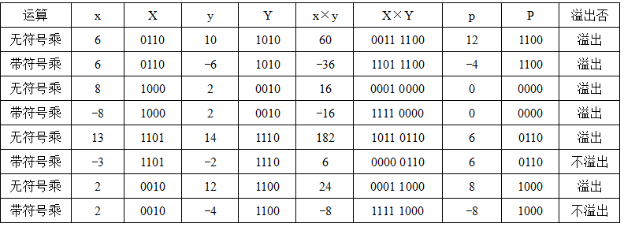
整数的乘运算
X×Y的高n位可以用来判断溢出，规则如下：
无符号：若高n位全0，则不溢出，否则溢出
带符号：若高n位全0或全1且等于低n位的最高位，则不溢出。

Slide 25
整数的乘运算
通常硬件不判断乘法是否溢出，而是保留2n位乘积
分无符号数乘指令和带符号整数乘指令
乘法指令无法得到溢出标志或无法自动判断是否溢出，如果程序本身不采用防止溢出的措施，而且编译器也不生成相应的用于溢出处理的代码的话，就会发生一些由于整数溢出而带来的问题。
乘法指令的操作数长度为n,而乘积长度为2n，例如：
IA-32中，若指令只给出一个操作数SRC，则另一个源操作数隐含在累加器AL/AX/EAX中，将SRC和累加器内容相乘，结果存放在AX（16位时）或DX-AX（32位时）或EDX-EAX（64位时）中。
在MIPS处理器中，带符号整数乘法指令mult会将两个32位带符号整数相乘得到的64位乘积置于两个32位内部寄存器Hi和Lo中，因此，可以根据Hi寄存器中的每一位是否等于Lo寄存器中的第一位来进行溢出判断。

Slide 26
整数溢出漏洞
说明以下程序存在什么漏洞，引起该漏洞的原因是什么。
2002年，Sun Microsystems公司的RPC XDR库带的xdr_array函数发生整数溢出漏洞，攻击者可利用该漏洞从远程或本地获取root权限。
/* 复制数组到堆中，count为数组元素个数 */
int copy_array(int *array, int count) {
int i;
/* 在堆区申请一块内存 */
int *myarray = (int *) malloc(count*sizeof(int));
if (myarray == NULL)
return -1;
for (i = 0; i < count; i++)
myarray[i] = array[i];
return count;
}
攻击者可构造特殊参数来触发整数溢出，以一段预设信息覆盖一个已分配的堆缓冲区，造成远程服务崩溃或者改变内存数据并执行任意代码。
当参数count很大时，则count*sizeof(int)会溢出。如count=2³⁰+1时， count*sizeof(int)=4。
堆（heap）中大量数据被破坏！

Slide 27
变量与常数之间的乘运算
整数乘法运算比移位和加法等运算所用时间长得多，通常一次乘法运算需要10个左右时钟周期，而一次移位、加法和减法等运算只要一个或更少的时钟周期，因此，编译器在处理变量与常数相乘时，往往以移位、加法和减法的组合运算来代替乘法运算。
例如，对于表达式x*20，编译器可以利用20=16+4=2⁴+2²，将x*20转换为(x<<4)+(x<<2)，这样，一次乘法转换成了两次移位和一次加法。
不管是无符号数还是带符号整数的乘法，即使乘积溢出时，利用移位和加减运算组合的方式得到的结果都是和采用直接相乘的结果是一样的。

Slide 28
Power-of-2 Multiply with Shift
Operation
u << k gives u * 2^{k}
Both signed and unsigned
Examples
u << 3 == u * 8
(u << 5) – (u << 3) == u * 24
Most machines shift and add faster than multiply
Compiler generates this code automatically
k
u
• • •
Operands: w bits
*
2^{k}
0
•••
0
1
0
•••
0
0
True Product: w+k bits
u · 2^{k}
• • •
0
•••
0
0
Discard k bits: w bits
UMult_{w}(u , 2^{k})
•••
0
•••
0
0
TMult_{w}(u , 2^{k})

Slide 29
变量与常数之间的除运算
对于整数除法运算，由于计算机中除法运算比较复杂，而且不能用流水线方式实现，所以一次除法运算大致需要30个或更多个时钟周期。为了缩短除法运算的时间，编译器在处理一个变量与一个2的幂次形式的整数相除时，常采用右移运算来实现。
无符号数除法采用逻辑右移方式，带符号整数采用算术右移方式。
结果一定取整数，能整除时，直接右移得到结果。
例如，12/4=3：0000 1100>>2=0000 0011
-12/4=-3：1111 0100 >>2=1111 1101
不能整除时，其商采用朝零方向舍入的方式，也就是截断方式，即：移出的低位数直接丢弃。带符号负整数则不对！（需加偏移量(2^{k}-1)，然后再右移k 位 ，低位截断）
无符号整数：14/4=3：0000 1110>>2=0000 0011
带符号整数：-14/4=-3：1111 0010 >>2=1111 1100=-4≠-3
纠偏: k=2, 故(-14+2²-1)/4=-3： 1111 0101>>2=1111 1101=-3

Slide 30
Unsigned Power-of-2 Divide with Shift
Quotient of Unsigned by Power of 2
u >> k gives ⎣ u / 2^{k} ⎦
Uses logical shift
k
u
•••
•••
Binary Point
Operands:
/
2^{k}
0
•••
0
1
0
•••
0
0
Division:
u / 2^{k}
0
.
0
•••
0
0
•••
•••
Result:
⎣ u / 2^{k} ⎦
0
0
•••
0
0
•••

Slide 31
Signed Power-of-2 Divide with Shift
Quotient of Signed by Power of 2
x >> k gives ⎣ x / 2^{k} ⎦
Uses arithmetic shift
Rounds wrong direction when u < 0
k
x
•••
•••
Binary Point
Operands:
/
2^{k}
0
•••
0
1
0
•••
0
0
Division:
x / 2^{k}
0
•••
•••
.
•••
Result:
RoundDown(x / 2^{k})
0
•••
•••

Slide 32
Correct Power-of-2 Divide
Quotient of Negative Number by Power of 2
Want ⎡ x / 2^{k} ⎤ (Round Toward 0)
Compute as ⎣ (x+2^{k}-1)/ 2^{k} ⎦
In C: (x + (1<<k)-1) >> k
Biases dividend toward 0
Case 1: No rounding
k
Dividend:
u
1
•••
0
•••
0
0
+2^{k} –1
0
•••
0
0
1
•••
1
1
Binary Point
1
•••
1
•••
1
1
Divisor:
/
2^{k}
0
•••
0
1
0
•••
0
0
⎡ u / 2^{k} ⎤
0
.
1
•••
1
1
1
•••
1
•••
1
1
Biasing has no effect

Slide 33
Correct Power-of-2 Divide (Cont.)
Case 2: Rounding
k
Dividend:
x
1
•••
•••
+2^{k} –1
0
•••
0
0
1
•••
1
1
1
•••
•••
Incremented by 1
Binary Point
Divisor:
/
2^{k}
0
•••
0
1
0
•••
0
0
⎡ x / 2^{k} ⎤
.
0
1
•••
1
1
1
•••
•••
Incremented by 1
Biasing adds 1 to final result

Slide 34
Negation: Complement & Increment
Negate through complement and increase ~x + 1 == -x
Example
Observation: ~x + x == 1111…111 == -1
x
1
0
0
1
1
1
0
1
+
~x
0
1
1
0
0
0
1
0
-1
1
1
1
1
1
1
1
1
x = 15213

Slide 35
Complement & Increment Examples
x = 0
x = TMin
Canonical counter example

Slide 36
Today: Bits, Bytes, and Integers
Representing information as bits
Bit-level manipulations
Integers
Representation: unsigned and signed
Conversion, casting
Expanding, truncating
Addition, negation, multiplication, shifting
Summary
Representations in memory, pointers, strings

Slide 37
Arithmetic: Basic Rules
Addition:
Unsigned/signed: Normal addition followed by truncate, same operation on bit level
Unsigned: addition mod 2^{w}
Mathematical addition + possible subtraction of 2^{w}
Signed: modified addition mod 2^{w} (result in proper range)
Mathematical addition + possible addition or subtraction of 2^{w}
Multiplication:
Unsigned/signed: Normal multiplication followed by truncate, same operation on bit level
Unsigned: multiplication mod 2^{w}
Signed: modified multiplication mod 2^{w} (result in proper range)

Slide 38
Why Should I Use Unsigned?
Don’t use without understanding implications
Easy to make mistakes
unsigned i;
for (i = cnt-2; i >= 0; i--)
a[i] += a[i+1];
Can be very subtle
#define DELTA sizeof(int)
int i;
for (i = CNT; i-DELTA >= 0; i-= DELTA)
. . .

Slide 39
Counting Down with Unsigned
Proper way to use unsigned as loop index
unsigned i;
for (i = cnt-2; i < cnt; i--)
a[i] += a[i+1];
See Robert Seacord, Secure Coding in C and C++
C Standard guarantees that unsigned addition will behave like modular arithmetic
0 – 1 → UMax
Even better
size_t i;
for (i = cnt-2; i < cnt; i--)
a[i] += a[i+1];
Data type size_t defined as unsigned value with length = word size
Code will work even if cnt = UMax
What if cnt is signed and < 0?

Slide 40
Why Should I Use Unsigned? (cont.)
Do Use When Performing Modular Arithmetic
Multiprecision arithmetic
Do Use When Using Bits to Represent Sets
Logical right shift, no sign extension
Do Use In System Programming
Bit masks, device commands,…

Slide 41
Today: Bits, Bytes, and Integers
Representing information as bits
Bit-level manipulations
Integers
Representation: unsigned and signed
Conversion, casting
Expanding, truncating
Addition, negation, multiplication, shifting
Summary
Representations in memory, pointers, strings

Slide 42
Examining Data Representations
Code to Print Byte Representation of Data
Casting pointer to unsigned char * allows treatment as a byte array
typedef unsigned char *pointer;
void show_bytes(pointer start, size_t len){
size_t i;
for (i = 0; i < len; i++)
printf(”%p\t0x%.2x\n",start+i, start[i]);
printf("\n");
}
Printf directives:
%p: Print pointer
%x: Print Hexadecimal

Slide 43
show_bytes Execution Example
int a = 15213;
printf("int a = 15213;\n");
show_bytes((pointer) &a, sizeof(int));
Result (Linux x86-64):
int a = 15213;
0x7fffb7f71dbc 6d
0x7fffb7f71dbd 3b
0x7fffb7f71dbe 00
0x7fffb7f71dbf 00

Slide 44
Representing Pointers
int B = -15213;
int *P = &B;
Sun
IA32
x86-64
EF
FF
FB
2C
AC
28
F5
FF
3C
1B
FE
82
FD
7F
00
00
Different compilers & machines assign different locations to objects
Even get different results each time run program

Slide 45
Representing Strings
char S[6] = "18213";
Strings in C
Represented by array of characters
Each character encoded in ASCII format
Standard 7-bit encoding of character set
Character “0” has code 0x30
Digit i has code 0x30+i
String should be null-terminated
Final character = 0
Compatibility
Byte ordering not an issue
IA32
Sun
31
38
32
31
33
00
31
38
32
31
33
00

Slide 46
Reading Byte-Reversed Listings
Disassembly
Text representation of binary machine code
Generated by program that reads the machine code
Example Fragment
Deciphering Numbers
Value: 0x12ab
Pad to 32 bits: 0x000012ab
Split into bytes: 00 00 12 ab
Reverse: ab 12 00 00
Address Instruction Code Assembly Rendition
8048365: 5b pop %ebx
8048366: 81 c3 ab 12 00 00 add $0x12ab,%ebx
804836c: 83 bb 28 00 00 00 00 cmpl $0x0,0x28(%ebx)

Slide 47


Integer C Puzzles
x < 0 ⇒ ((x*2) < 0)
ux >= 0
x & 7 == 7 ⇒ (x<<30) < 0
ux > -1
x > y ⇒ -x < -y
x * x >= 0
x > 0 && y > 0 ⇒ x + y > 0
x >= 0 ⇒ -x <= 0
x <= 0 ⇒ -x >= 0
(x|-x)>>31 == -1
ux >> 3 == ux/8
x >> 3 == x/8
x & (x-1) != 0
Initialization
int x = foo();
int y = bar();
unsigned ux = x;
unsigned uy = y;

Slide 48
Summary
Representing information as bits
Bit-level manipulations
Integers
Representation: unsigned and signed
Conversion, casting
Expanding, truncating
Addition, negation, multiplication, shifting
Representations in memory, pointers, strings
Summary

