Slide 1
Floating Point 15-213/18-213/15-513: Introduction to Computer Systems 4th Lecture, Sept. 7, 2017
Today’s Instructor:
Phil Gibbons

Slide 2
Today: Floating Point
Background: Fractional binary numbers
IEEE floating point standard: Definition
Example and properties
Rounding, addition, multiplication
Floating point in C
Summary

Slide 3
科学计数法(Scientific Notation)与浮点数
Example:
mantissa (尾数) exponent(阶码、指数)
6.02 x 10 ²¹
decimal point radix (base，基)
° Normalized form（规格化形式）: 小数点前只有一位非0数
° 同一个数有多种表示形式。例：对于数 1/1,000,000,000
• Normalized (唯一的规格化形式): 1.0 x 10⁻⁹
• Unnormalized（非规格化形式不唯一）: 0.1 x 10⁻⁸, 10.0 x 10⁻¹⁰
for Binary Numbers:
mantissa（尾数） exponent（指数）
0.101_{two} x 2 ⁻¹⁰
binary point 基为2
只要对尾数和指数分别编码，就可表示一个浮点数（即：实数）

Slide 4
Fractional binary numbers
What is 1011.101₂?

Slide 5
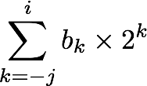
Fractional Binary Numbers
2^{i}
2^{i-1}
4
2
1
• • •
bi | bi-1 | ••• | b2 | b1 | b0 | b-1 | b-2 | b-3 | ••• | b-j
1/2
1/4
1/8
2^{-j}
• • •
Representation
Bits to right of “binary point” represent fractional powers of 2
Represents rational number:
Notes:
Latex source for equation: \sum_{k=-j}^i b_k \times 2^k

Slide 6
Fractional Binary Numbers: Examples
Value Representation
5 3/4 = 23/4 101.112 = 4 + 1 + 1/2 + 1/4
2 7/8 = 23/8 010.1112 = 2 + 1/2 + 1/4 + 1/8
1 7/16 = 23/16 001.01112 = 1 + 1/4 + 1/8 + 1/16
Observations
Divide by 2 by shifting right (unsigned)
Multiply by 2 by shifting left
Numbers of form 0.111111…2 are just below 1.0
1/2 + 1/4 + 1/8 + … + 1/2^{i} + … ➙ 1.0
Use notation 1.0 – ε

Slide 7
Representable Numbers
Limitation #1
Can only exactly represent numbers of the form x/2^{k}
Other rational numbers have repeating bit representations
Value Representation
1/3 0.0101010101[01]…2
1/5 0.001100110011[0011]…2
1/10 0.0001100110011[0011]…2
Limitation #2
Just one setting of binary point within the w bits
Limited range of numbers (very small values? very large?)
Notes:
Rational numbers：有理数

Slide 8
浮点数的表示
°Normal format（规格化数形式） ：
+/-1.xxxxxxxxxx × R^{Exponent}
°32-bit 规格化数：
31 0
S Exponent Significand
1 bit ? bits ? bits
S 是符号位（Sign）
Exponent用移码（增码）来表示
Significand 表示 xxxxxxxxxxxxx，尾数部分
(基可以是 2/ 4 / 8 / 16，约定信息，无需显式表示 )
°早期的计算机，各自定义自己的浮点数格式
问题：浮点数表示不统一会带来什么问题？

Slide 9
Today: Floating Point
Background: Fractional binary numbers
IEEE floating point standard: Definition
Example and properties
Rounding, addition, multiplication
Floating point in C
Summary

Slide 10


“Father” of the IEEE 754 standard
直到80年代初，各个机器内部的浮点数表示格式还没有统一
因而相互不兼容，机器之间传送数据时，带来麻烦
1970年代后期, IEEE成立委员会着手制定浮点数标准
1985年完成浮点数标准IEEE 754的制定
This standard was primarily the work of one person, UC Berkeley math professor William Kahan.
现在所有计算机都采用IEEE 754来表示浮点数
www.cs.berkeley.edu/~wkahan/
ieee754status/754story.html
Prof. William Kahan

Slide 11
IEEE Floating Point
IEEE Standard 754
Established in 1985 as uniform standard for floating point arithmetic
Before that, many idiosyncratic formats
Supported by all major CPUs
Some CPUs don’t implement IEEE 754 in full e.g., early GPUs, Cell BE processor
Driven by numerical concerns
Nice standards for rounding, overflow, underflow
Hard to make fast in hardware
Numerical analysts predominated over hardware designers in defining standard
Notes:
数字分析人员往往比硬件设计师更占据优势
Rounding：舍入

Slide 12
Floating Point Representation
Example: 15213₁₀ = (-1)⁰ x 1.1101101101101₂ x 2¹³
Numerical Form: (–1)^{s} M 2E
Sign bit s determines whether number is negative or positive
Significand M normally a fractional value in range [1.0,2.0).
Exponent E weights value by power of two
Encoding
MSB s is sign bit s
exp field encodes E (but is not equal to E)
frac field encodes M (but is not equal to M)
s | exp | frac

Slide 13
Precision options
Single precision: 32 bits ≈ 7 decimal digits, 10^{±38}
Double precision: 64 bits ≈ 16 decimal digits, 10^{±308}
Other formats: half precision, quad precision
s | exp | frac
1 | 8-bits | 23-bits
s | exp | frac
1 | 11-bits | 52-bits

Slide 14
Three “kinds” of floating point numbers
s | exp | frac
1 | e-bits | f-bits
00…00
exp ≠ 0 and exp ≠ 11…11
11…11
denormalized
normalized
special

Slide 15
“Normalized” Values
v = (–1)^{s} M 2E
When: exp ≠ 000…0 and exp ≠ 111…1
Exponent coded as a biased value: E = exp – Bias
exp: unsigned value of exp field
Bias = 2^{k-1} - 1, where k is number of exponent bits
Single precision: 127 (exp: 1…254, E: -126…127)
Double precision: 1023 (exp: 1…2046, E: -1022…1023)
Significand coded with implied leading 1: M = 1.xxx…x2
xxx…x: bits of frac field
Minimum when frac=000…0 (M = 1.0)
Maximum when frac=111…1 (M = 2.0 – ε)
Get extra leading bit for “free”
Notes:
Bias：[ˈbaɪəs]

Slide 16
Normalized Encoding Example
v = (–1)^{s} M 2E
E = exp – Bias
Value: float F = 15213.0;
15213₁₀ = 11101101101101₂
= 1.1101101101101₂ x 2¹³
Significand
M = 1.1101101101101₂
frac = 11011011011010000000000₂
Exponent
E = 13
Bias = 127
exp = 140 = 10001100₂
Result: 0 10001100 11011011011010000000000
s
exp
frac
Notes:
Significand：尾数

Slide 17
Ex: Converting Binary FP to Decimal
BEE00000H is the hex. Rep. Of an IEEE 754 SP FP number
1011 11101 110 0000 0000 0000 0000 0000
(-1)^{S} x (1 + Significand) x 2^{(Exponent-127)}
°Sign: 1 => negative
°Exponent:
• 0111 1101_{two} = 125_{ten}
• Bias adjustment: 125 - 127 = -2
°Significand:
1 + 1x2⁻¹+ 1x2⁻² + 0x2⁻³ + 0x2⁻⁴ + 0x2⁻⁵ +...
=1+2⁻¹ +2⁻² = 1+0.5 +0.25 = 1.75
°Represents: -1.75_{ten}x2⁻² = - 0.4375
Notes:
If we know the hexadecimal representation of an IEEE 754 single precision number, how to calculate the actual value of this number? Here is an example. Suppose the hex form is BEE00000H. At first, we should convert the hex form to binary form, we get the binary form 1011 1110 1110 0000 0000 …0000, and for single precision, we have 1 sign bit, which is 1, 8 bits for exponent, which is 0111 11101, and the remainder is 23-bit significand. Then we can use the formula to calculate the value.
Step 1: sign bit is 1, it means the number is negative
Step 2: exponent is 01111101=2⁶ +2⁵ + 2⁴ +2³ +2¹ =64+32+16+8+1=125, because we use excess 127, so we should subtract 127 to get the actual value of exponent. 125-127=-2
Step 3: here actual mantissa is 1.1100..0, so the value should be 1+…., …. The result is 1.75
Step 4: So the actual value is
Any question about that?

Slide 18
Ex: Converting Decimal to FP
-12.75
1. Denormalize: -12.75
2. Convert integer part:
12 = 8 + 4 = 1100₂
3. Convert fractional part:
.75 = .5 + .25 = .11₂
4. Put parts together and normalize:
1100.11 = 1.10011 x 2³
5. Convert exponent: 127 + 3 = 128 + 2 = 1000 0010₂
11000 0010 100 1100 0000 0000 0000 0000
The Hex rep. is C14C0000H
Notes:
If we know the value of an number, how to represent it in floating-point form? Here is an exercise. Please spend 4 minutes to try it.
Let’s check your answers. Firstly, then, and then, finally, the result is C14C0000H. Have you got that? Any question?

Slide 19
Normalized numbers（规格化数）
前面的定义都是针对规格化数（normalized form）
How about other patterns?
Exponent Significand Object
1-254 anything Norms
implicit leading 1
0 0 ?
0 nonzero ?
255 0 ?
255 nonzero ?

Slide 20
Denormalized Values
v = (–1)^{s} M 2E
E = 1 – Bias
Condition: exp = 000…0
Exponent value: E = 1 – Bias (instead of exp – Bias)
Significand coded with implied leading 0: M = 0.xxx…x2
xxx…x: bits of frac
Cases
exp = 000…0, frac = 000…0
Represents zero value
Note distinct values: +0 and –0 (表示不同含义)
exp = 000…0, frac ≠ 000…0
Numbers closest to 0.0
Equispaced（可能的数值分布均匀地接近0）
Notes:
规格化数不能表示0，只有M=0时为+0和-0.

Slide 21
Special Values
Condition: exp = 111…1
Case: exp = 111…1, frac = 000…0
Represents value ∞ (infinity)
Operation that overflows
Both positive and negative
E.g., 1.0/0.0 = −1.0/−0.0 = +∞, 1.0/−0.0 = −∞
Case: exp = 111…1, frac ≠ 000…0
Not-a-Number (NaN)
Represents case when no numeric value can be determined
E.g., sqrt(–1), ∞ − ∞, ∞ × 0

Slide 22
Visualization: Floating Point Encodings
−∞
+∞
−Normalized
−Denorm
+Denorm
+Normalized
NaN
NaN
−0
+0

Slide 23
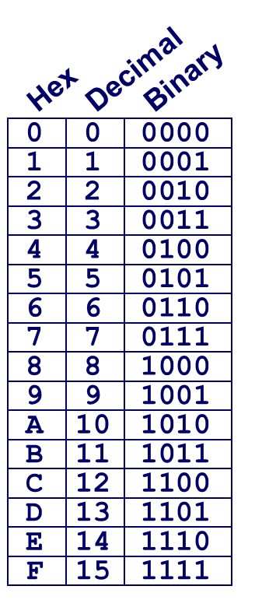
C float Decoding Example
v = (–1)^{s} M 2E
E = exp – Bias
float: 0xC0A00000
Bias = 2^{k-1} – 1 = 127
binary:
1 | 8-bits | 23-bits
E = 129
S = 1 -> negative number
M = 1.010 0000 0000 0000 0000 0000
M = 1 + 1/4 = 1.25
v = (–1)^{s} M 2E =

Slide 24
C float Decoding Example
v = (–1)^{s} M 2E
E = exp – Bias
float: 0xC0A00000
binary: 1100 0000 1010 0000 0000 0000 0000 0000
1 | 1000 0001 | 010 0000 0000 0000 0000 0000
1 | 8-bits | 23-bits
E = 129
S = 1 -> negative number
M = 1.010 0000 0000 0000 0000 0000
M = 1 + 1/4 = 1.25
v = (–1)^{s} M 2E =

Slide 25
C float Decoding Example
v = (–1)^{s} M 2E
E = exp – Bias
float: 0xC0A00000
Bias = 2^{k-1} – 1 = 127
binary: 1100 0000 1010 0000 0000 0000 0000 0000
1 | 1000 0001 | 010 0000 0000 0000 0000 0000
1 | 8-bits | 23-bits
E = exp – Bias = 129 – 127 = 2 (decimal)
S = 1 -> negative number
M = 1.010 0000 0000 0000 0000 0000
M = 1 + 1/4 = 1.25
v = (–1)^{s} M 2E = (-1)¹ * 1.25 * 2² = -5

Slide 26
Today: Floating Point
Background: Fractional binary numbers
IEEE floating point standard: Definition
Example and properties
Rounding, addition, multiplication
Floating point in C
Summary

Slide 27
Floating Point in C
C Guarantees Two Levels
float single precision
double double precision
Conversions/Casting
Casting between int, float, and double changes bit representation
double/float → int
Truncates fractional part
Like rounding toward zero
Not defined when out of range or NaN: Generally sets to TMin
int → double
Exact conversion, as long as int has ≤ 53 bit word size
int → float
Will round according to rounding mode
Notes:
Int到float会舍入，位数相同，float到int会舍弃小数部分

Slide 28


Floating Point Puzzles
For each of the following C expressions, either:
Argue that it is true for all argument values
Explain why not true
x == (int)(float) x
x == (int)(double) x
f == (float)(double) f
d == (double)(float) d
f == -(-f);
int x = …;
float f = …;
double d = …;
Assume neither
d nor f is NaN

Slide 29
C语言中的浮点数类型-32位
C语言中有float和double类型，分别对应IEEE 754单精度浮点数格式和双精度浮点数格式
long double类型的长度和格式随编译器和处理器类型的不同而有所不同，IA-32中是80位扩展精度格式
从int转换为float时，不会发生溢出，但可能有数据被舍入
从int或 float转换为double时，因为double的有效位数更多，故能保留精确值
从double转换为float和int时，可能发生溢出，此外，由于有效位数变少，故可能被舍入
从float 或double转换为int时，因为int没有小数部分，所以数据可能会向0方向被截断

Slide 30




浮点运算举例-1
欧洲阿丽亚娜5火箭
37秒
10年
70亿美元
故障原因：64位→16位舍入错误
故障归类：软件设计/重用错误！

Slide 31
浮点运算举例
1996年6月4日，Ariana 5火箭初次航行，在发射仅仅37秒钟后，偏离了飞行路线，然后解体爆炸，火箭上载有价值5亿美元的通信卫星。
原因是在将一个64位浮点数转换为16位带符号整数时，产生了溢出异常。溢出的值是火箭的水平速率，这比原来的Ariana 4火箭所能达到的速率高出了5倍。在设计Ariana 4火箭软件时，设计者确认水平速率决不会超出一个16位的整数，但在设计Ariana 5时，他们没有重新检查这部分，而是直接使用了原来的设计。
在不同数据类型之间转换时，往往隐藏着一些不容易被察觉的错误，这种错误有时会带来重大损失，因此，编程时要非常小心。

Slide 32
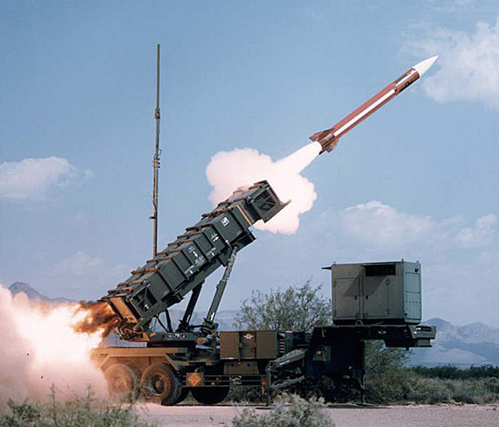
浮点运算举例-2
海湾战中的爱国者导弹事故
100小时
0.36秒
28人死亡(8%)
故障原因：积累导致性能下降
故障归类：软件老化错误！

Slide 33
浮点运算举例
1991年2月25日，海湾战争中，美国在沙特阿拉伯达摩地区设置的爱国者导弹拦截伊拉克的飞毛腿导弹失败，致使飞毛腿导弹击中了沙特阿拉伯载赫蓝的一个美军军营，杀死了美国陆军第十四军需分队的28名士兵。其原因是由于爱国者导弹系统时钟内的一个软件错误造成的，引起这个软件错误的原因是浮点数的精度问题。
爱国者导弹系统中有一个内置时钟，用计数器实现，每隔0.1秒计数一次。程序用0.1的一个24位定点二进制小数x来乘以计数值作为以秒为单位的时间。
0.1的二进制表示是一个无限循环序列：0.00011[0011]…，x=0.000 1100 1100 1100 1100 1100B。显然，x是0.1的近似表示，0.1-x
= 0.000 1100 1100 1100 1100 1100 [1100]… -
0.000 1100 1100 1100 1100 1100B，即为：
=0.000 0000 0000 0000 0000 0000 1100 [1100]…B
=2⁻²⁰×0.1 ≈ 9.54×10⁻⁸

Slide 34

浮点运算举例
已知在爱国者导弹准备拦截飞毛腿导弹之前，已经连续工作了100小时，飞毛腿的速度大约为2000米/秒，则由于时钟计算误差而导致的距离误差是多少？
100小时相当于计数了100×60×60×10=36×10⁵次，因而导弹的时钟已经偏差了9.54×10⁻⁸×36×10⁵≈0.343秒
因此，距离误差是2000×0.343秒 ≈ 687米

Slide 35
浮点运算举例
若x用float型表示，则x的机器数是什么？0.1与x的偏差是多少？系统运行100小时后的时钟偏差是多少？在飞毛腿速度为2000米/秒的情况下，预测的距离偏差为多少？
0.1= 0.0 0011[0011]B=+1.1 0011 0011 0011 0011 0011 00B×2⁻⁴，故x的机器数为0 011 1101 1 100 1100 1100 1100 1100 1100
Float型仅24位有效位数，后面的有效位全被截断，故x与0.1之间的误差为：|x–0.1|=0.000 0000 0000 0000 0000 0000 0000 1100 [1100]…B。这个值等于2⁻²⁴×0.1 ≈ 5.96×10⁻⁹。100小时后时钟偏差5.96×10⁻⁹×36×10⁵ ≈ 0.0215秒。距离偏差0.0215×2000≈43米。比爱国者导弹系统精确约16倍。
若用32位二进制定点小数x=0.000 1100 1100 1100 1100 1100 1100 1101 B表示0.1，则误差比用float表示误差更大还是更小？
当x=0.000 1100 1100 1100 1100 1100 1100 1101 B时，与0.1之间的误差约为：|x–0.1|=0.000 0000 0000 0000 0000 0000 0000 0000 00 1100 [1100]…B。这个值等于2⁻³⁰×0.1 ≈ 9.31×10⁻¹¹。100小时后时钟偏差9.31×10⁻¹¹×36×10⁵ ≈ 0.000335秒。预测的距离偏差仅为0.000335×2000 ≈ 0.67米。
爱国者导弹采用全向爆炸破片弹头！

Slide 36
浮点运算举例
从上述结果可以看出：
用32位定点小数表示0.1，比采用float精度高64倍
用float表示在计算速度上更慢，必须先把计数值转换为IEEE 754格式浮点数，然后再对两个IEEE 754格式的数相乘，故采用float比直接将两个二进制数相乘要慢得多
Ariana 5火箭和爱国者导弹的例子带来的启示
程序员应对底层机器级数据的表示和运算有深刻理解
计算机世界里，经常是“差之毫厘，失之千里”，需要细心再细心，精确再精确
不能遇到小数就用浮点数表示，有些情况下（如需要将一个整数变量乘以一个确定的小数常量），可先用一个确定的定点整数与整数变量相乘，然后再通过移位运算来确定小数点

Slide 37
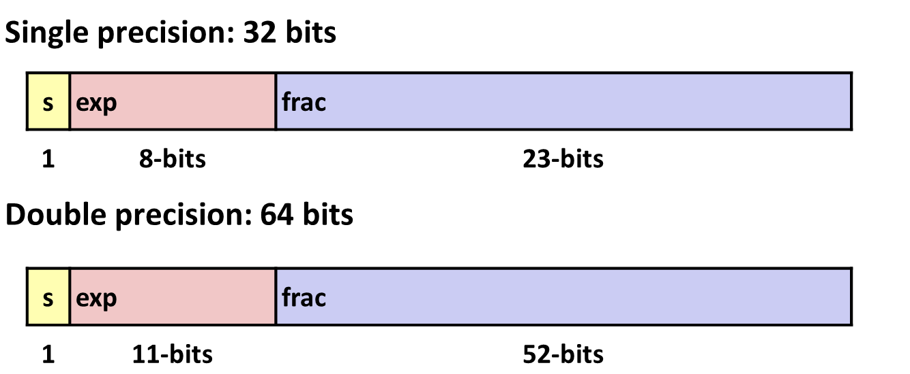
Summary
IEEE Floating Point has clear mathematical properties
Represents numbers of form M x 2E
One can reason about operations independent of implementation
As if computed with perfect precision and then rounded
Not the same as real arithmetic
Violates associativity/distributivity
Makes life difficult for compilers & serious numerical applications programmers

