Slide 1
Machine-Level Programming I: Basics 15-213/18-213/15-213: Introduction to Computer Systems 5th Lecture, September 12, 2017
Today’s Instructor:
Phil Gibbons

Slide 2
程序的转换与机器级表示
主要教学目标
了解高级语言与汇编语言、汇编语言与机器语言之间的关系
掌握有关指令格式、操作数类型、寻址方式、操作类型等内容
了解高级语言源程序中的语句与机器级代码之间的对应关系
了解复杂数据类型（数组、结构等）的机器级实现
主要教学内容
介绍C语言程序与机器级指令之间的对应关系。
主要包括：程序转换概述、IA-64指令系统、C语言中控制语句和过程调用等机器级实现、复杂数据类型（数组、结构等）的机器级实现等。
本章所用的机器级表示主要以汇编语言形式表示为主。
采用逆向工程方法！

Slide 3
程序的机器级表示
分以下五个部分介绍
第一讲：程序转换概述
机器指令和汇编指令
机器级程序员感觉到的属性和功能特性
高级语言程序转换为机器代码的过程
第二讲：IA-32 /x86-64指令系统
第三讲： C语言程序的机器级表示
选择语句的机器级表示
循环结构的机器级表示
过程调用的机器级表示
第四讲：复杂数据类型的分配和访问
数组的分配和访问
结构体数据的分配和访问
联合体数据的分配和访问
数据的对齐
第五讲：越界访问和缓冲区溢出
从高级语言程序出发，用其对应的机器级代码以及内存（栈）中信息的变化来说明底层实现
围绕C语言中的语句和复杂数据类型，解释其在底层机器级的实现方法

Slide 4
“指令”的概念
计算机中的指令有微指令、机器指令和伪（宏）指令之分
微指令是微程序级命令，指在微程序控制的计算机中，同时发出的控制信号所执行的一组微操作，属于硬件范畴
伪指令是用于对汇编过程进行控制的指令，该类指令并不是可执行指令，没有机器代码，只用于汇编过程中为汇编程序提供汇编信息，由若干机器指令组成的指令序列，属于软件范畴
机器指令介于二者之间，处于硬件和软件的交界面
本章中提及的指令都指机器指令
汇编指令是机器指令的汇编表示形式，即符号表示
机器指令和汇编指令一一对应，它们都与具体机器结构有关，都属于机器级指令

Slide 5
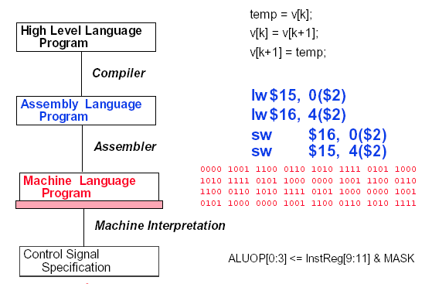
回顾：Hardware/Software Interface
temp = v[k];
v[k] = v[k+1];
v[k+1] = temp;
汇编指令
软件
lw $15, 0($2)
lw $16, 4($2)
sw $16, 0($2)
sw $15, 4($2)
机器指令
1000 1100 0100 1111 0000 0000 0000 0000
1000 1100 0101 0000 0000 0000 0000 0100
1010 1100 0101 0000 0000 0000 0000 0000
1010 1100 0100 1111 0000 0000 0000 0100
硬件
… , EXTop=1,ALUSelA=1,ALUSelB=11,ALUop=add,
IorD=1,Read,MemtoReg=1,RegWr=1,......
微指令
… 1 1 11 100 1 0 1 1 …

Slide 6

机器级指令
机器指令和汇编指令一一对应，都是机器级指令
机器指令是一个0/1序列，由若干字段组成
汇编指令是机器指令的符号表示（可能有不同的格式）
mov、movb、bx、%bx等都是助记符
指令的功能为：M[R[bx]+R[di]-6]←R[cl]
补码11111010的真值为多少？
操作码 寻址方式 寄存器编号 立即数(位移量)
mov [bx+di-6], cl
或
movb %cl, -6(%bx,%di)
Intel格式
AT&T 格式
R：寄存器内容
M：存储单元内容
寄存器传送语言 RLT（Register Transfer Language）

Slide 7
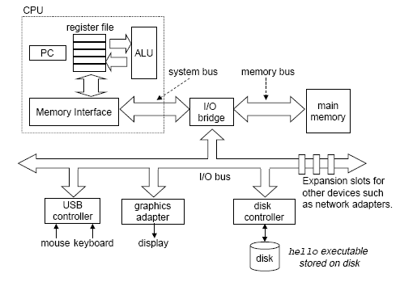
计算机中数据的存储
计算机中的数据存放在哪里？
寄存器文件
通用寄存器组GPRs
存储器
指令中需给出的信息：
操作性质（操作码）
源操作数1 或/和 源操作数2 （立即数、寄存器编号、存储地址）
目的操作数地址 （寄存器编号、存储地址）
存储地址的描述与操作数的数据结构有关！

Slide 8
指令集体系结构ISA
ISA（Instruction Set Architecture）位于软件和硬件之间
硬件的功能通过ISA提供出来
软件通过ISA规定的”指令”使用硬件
ISA规定了：
可执行的指令的集合，包括指令格式、操作种类以及每种操作对应的操作数的相应规定；
指令可以接受的操作数的类型；
操作数所能存放的寄存器组的结构，包括每个寄存器的名称、编号、长度和用途；
操作数所能存放的存储空间的大小和编址方式；
操作数在存储空间存放时按照大端还是小端方式存放；
指令获取操作数的方式，即寻址方式；
指令执行过程的控制方式，包括程序计数器、条件码定义等。
Application
Compiler
Operating
Assembler
System
Instruction Set
Architecture
CPU
MM
I/O
Digital Design
Circuit Design

Slide 9
Today: Machine Programming I: Basics
History of Intel processors and architectures
Assembly Basics: Registers, operands, move
Arithmetic & logical operations
C, assembly, machine code

Slide 10
Intel x86 Processors
Dominate laptop/desktop/server market
Evolutionary design
Backwards compatible up until 8086, introduced in 1978
Added more features as time goes on
Complex instruction set computer (CISC)
Many different instructions with many different formats
But, only small subset encountered with Linux programs
Hard to match performance of Reduced Instruction Set Computers (RISC)
But, Intel has done just that!
In terms of speed. Less so for low power.

Slide 11
Intel x86 Evolution: Milestones
Name Date Transistors MHz
8086 1978 29K 5-10
First 16-bit Intel processor. Basis for IBM PC & DOS
1MB address space
386 1985 275K 16-33
First 32 bit Intel processor , referred to as IA32
Added “flat addressing”, capable of running Unix
Pentium 4E 2004 125M 2800-3800
First 64-bit Intel x86 processor, referred to as x86-64
Core 2 2006 291M 1060-3333
First multi-core Intel processor
Core i7 2008 731M 1600-4400
Four cores (our shark machines)

Slide 12
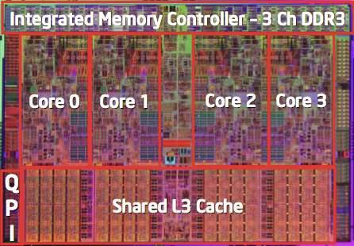
Intel x86 Processors, cont.
Machine Evolution
386 1985 0.3M
Pentium 1993 3.1M
Pentium/MMX 1997 4.5M
PentiumPro 1995 6.5M
Pentium III 1999 8.2M
Pentium 4 2000 42M
Core 2 Duo 2006 291M
Core i7 2008 731M
Added Features
Instructions to support multimedia operations
Instructions to enable more efficient conditional operations
Transition from 32 bits to 64 bits
More cores

Slide 13
Intel x86 Processors, cont.
Past Generations
1st Pentium Pro 1995 600 nm
1st Pentium III 1999 250 nm
1st Pentium 4 2000 180 nm
1st Core 2 Duo 2006 65 nm
Recent & Upcoming Generations
Nehalem 2008 45 nm
Sandy Bridge 2011 32 nm
Ivy Bridge 2012 22 nm
Haswell 2013 22 nm
Broadwell 2014 14 nm
Skylake 2015 14 nm
Kaby Lake 2016 14 nm
Coffee Lake 2017? 14 nm
Cannonlake 2018? 10 nm
Process technology
Process technology dimension = width of narrowest wires
(10 nm ≈ 100 atoms wide)

Slide 14
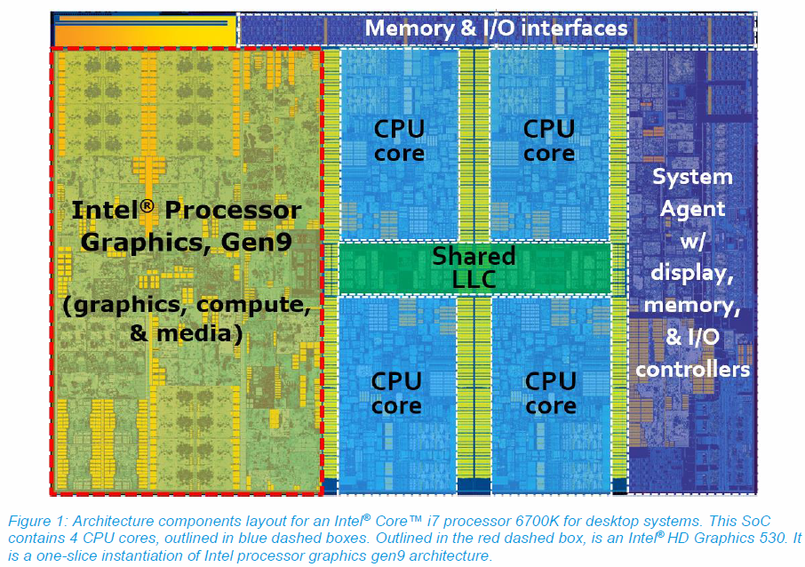
2017 State of the Art: Skylake
Mobile Model: Core i7
2.6-2.9 GHz
45 W
Desktop Model: Core i7
Integrated graphics
2.8-4.0 GHz
35-91 W
Server Model: Xeon
Integrated graphics
Multi-socket enabled
2-3.7 GHz
25-80 W
华为mate20的麒麟980处理器于2018年10月国内发布，全球首款7纳米工艺的soc芯片，ARM Cortex-A76内核，主频2133MHz
1平方厘米集成晶体管数量69亿

Slide 15
x86 Clones: Advanced Micro Devices (AMD)
Historically
AMD has followed just behind Intel
A little bit slower, a lot cheaper
Then
Recruited top circuit designers from Digital Equipment Corp. and other downward trending companies
Built Opteron: tough competitor to Pentium 4
Developed x86-64, their own extension to 64 bits
Recent Years
Intel got its act together
Leads the world in semiconductor technology
AMD has fallen behind
Relies on external semiconductor manufacturer

Slide 16
Intel’s 64-Bit History
2001: Intel Attempts Radical Shift from IA32 to IA64
Totally different architecture (Itanium)
Executes IA32 code only as legacy
Performance disappointing
2003: AMD Steps in with Evolutionary Solution
x86-64 (now called “AMD64”)
Intel Felt Obligated to Focus on IA64
Hard to admit mistake or that AMD is better
2004: Intel Announces EM64T extension to IA32
Extended Memory 64-bit Technology
Almost identical to x86-64!
All but low-end x86 processors support x86-64
But, lots of code still runs in 32-bit mode
Notes:
Intel Felt Obligated to Focus on IA64-英特尔感到有责任专注于IA64

Slide 17
Our Coverage
IA32
The traditional x86
x86-64
The standard
bupt1> gcc hello.c
Presentation
Book covers x86-64
Web aside on IA32
We will only cover x86-64

Slide 18
Today: Machine Programming I: Basics
History of Intel processors and architectures
Assembly Basics: Registers, operands, move
Arithmetic & logical operations
C, assembly, machine code

Slide 19
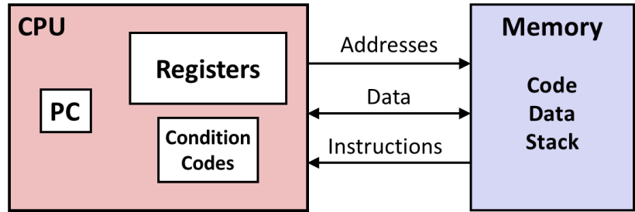
Levels of Abstraction
C code
C programmer
Nice clean layers, but beware…
Assembly programmer
Computer Designer
Caches, clock freq, layout, …
Of course, you know that: It’s why you are taking this course.

Slide 20
Definitions
Architecture: (also ISA: instruction set architecture) The parts of a processor design that one needs to understand for writing correct machine/assembly code
Examples: instruction set specification, registers
Machine Code: The byte-level programs that a processor executes
Assembly Code: A text representation of machine code
Microarchitecture: Implementation of the architecture
Examples: cache sizes and core frequency
Example ISAs:
Intel: x86, IA32, Itanium, x86-64
ARM: Used in almost all mobile phones
RISC V: New open-source ISA

Slide 21
Assembly/Machine Code View
CPU
Memory
Registers
Addresses
Data
Code
Data
Stack
PC
Condition
Codes
Instructions
Programmer-Visible State
PC: Program counter
Address of next instruction
Called “RIP” (x86-64)
Register file
Heavily used program data
Condition codes
Store status information about most recent arithmetic or logical operation
Used for conditional branching
Memory
Byte addressable array
Code and user data
Stack to support procedures

Slide 22
Assembly Characteristics: Data Types
“Integer” data of 1, 2, 4, or 8 bytes
Data values
Addresses (untyped pointers)
Floating point data of 4, 8, or 10 bytes
(SIMD vector data types of 8, 16, 32 or 64 bytes)
Code: Byte sequences encoding series of instructions
No aggregate types such as arrays or structures
Just contiguously allocated bytes in memory

Slide 23
x86-64 Integer Registers
%rax
%r8
%eax
%r8d
%rbx
%r9
%ebx
%r9d
%rcx
%r10
%ecx
%r10d
%rdx
%r11
%edx
%r11d
%rsi
%r12
%esi
%r12d
%rdi
%r13
%edi
%r13d
%rsp
%r14
%esp
%r14d
%rbp
%r15
%ebp
%r15d
Can reference low-order 4 bytes (also low-order 1 & 2 bytes)
Not part of memory (or cache)

Slide 24
Some History: IA32 Registers
Origin
(mostly obsolete)
%eax
%ax
%ah
%al
accumulate
%ecx
%cx
%ch
%cl
counter
%edx
%dx
%dh
%dl
data
general purpose
%ebx
%bx
%bh
%bl
base
%esi
source
index
%si
%edi
destination
index
%di
%esp
stack
pointer
%sp
%ebp
base
pointer
%bp
16-bit virtual registers
(backwards compatibility)
Notes:
%al,%ah,%ax,%eax,%rax这些寄存器可以直接使用
Obsolete-废弃的；老式的

Slide 25
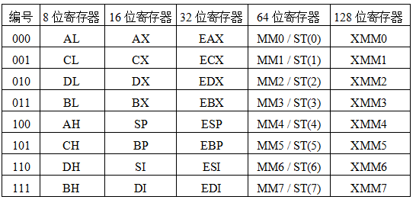
IA-32中通用寄存器中的编号
反映了体系结构发展的轨迹，字长不断扩充，指令保持兼容
ST（0）~ ST（7）是80位，MM0 ~MM7使用其低64位

Slide 26
Assembly Characteristics: Operations
Transfer data between memory and register
Load data from memory into register
Store register data into memory
Perform arithmetic function on register or memory data
Transfer control
Unconditional jumps to/from procedures
Conditional branches
Indirect branches

Slide 27
IA-32的寻址方式
寻址方式
根据指令给定信息得到操作数或操作数地址
操作数所在的位置
指令中：立即寻址
寄存器中：寄存器寻址
存储单元中（属于存储器操作数，按字节编址）：其他寻址方式
存储器操作数的寻址方式与微处理器的工作模式有关
两种工作模式：实地址模式和保护模式
实地址模式（基本用不到）
为与8086/8088兼容而设，加电或复位时
寻址空间为1MB，20位地址：(CS)<<4+(IP)
保护模式（需要掌握）
加电后进入，采用虚拟存储管理，多任务情况下隔离、保护
80286以上高档微处理器最常用的工作模式
寻址空间为2³²B，32位线性地址分段（段基址+段内偏移量）

Slide 28
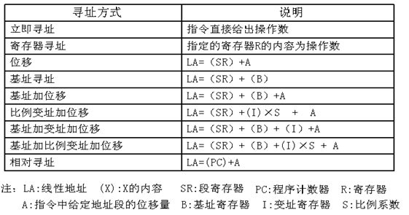
保护模式下的寻址方式
存储器操作数
跳转目标指令地址
SR段寄存器（间接）确定操作数所在段的段基址
有效地址给出操作数在所在段的偏移地址

Slide 29
存储器操作数的寻址方式(32位)
int x；
float a[100];
short b[4][4];
char c;
long *c1;
double d[10];
b31 b0
d[9]
616
d[0]
544
对齐
c
536
a[i]的地址如何计算？
104+i×4
i=99时，104+99×4=500
b[i][j]的地址如何计算？
504+i×8+j×2
i=3、j=2时，504+24+4=532
d[i]的地址如何计算？
544+i×8
i=9时，544+9×8=616
b[3][3]
b[3][2]
532
b[0][1]
b[0][0]
504
a[99]
500
a[0]
104
x
100

Slide 30
Example Data Representations
C Data Type | Typical 32-bit | Typical 64-bit | x86-64
char | 1 | 1 | 1
short | 2 | 2 | 2
int | 4 | 4 | 4
long | 4 | 8 | 8
float | 4 | 4 | 4
double | 8 | 8 | 8
pointer | 4 | 8 | 8

Slide 31
存储器操作数的寻址方式
int x；
float a[100];
short b[4][4];
char c;
long *c1;
double d[10];
b31 b0
d[9]
616
d[0]
544
各变量应采用什么寻址方式？
x、c：位移 / 基址
a[i]：104+i×4，比例变址+位移
d[i]：544+i×8，比例变址+位移
b[i][j]： 504+i×8+j×2，
基址+比例变址+位移
c
536
b[3][3]
b[3][2]
532
b[0][1]
b[0][0]
504
a[99]
500
将b[i][j]取到EAX中的指令可以是：
“movw 504(%ebp,%esi,2), %eax”
其中， i×8在EBP中，j在ESI中，
2为比例因子
a[0]
104
x
100

Slide 32
Moving Data
ATT格式
%rax
%rcx
Moving Data
movq Source, Dest
Operand Types
Immediate: Constant integer data
Example: $0x400, $-533
Like C constant, but prefixed with ‘$’
Encoded with 1, 2, or 4 bytes
Register: One of 16 integer registers
Example: %rax, %r13
But %rsp reserved for special use
Others have special uses for particular instructions
Memory: 8 consecutive bytes of memory at address given by register
Simplest example: (%rax)
Various other “addressing modes”
%rdx
C，C++规定，16进制数必须以 0x开头
%rbx
%rsi
%rdi
%rsp
%rbp
%rn(n=8~15)
Warning: Intel docs use mov Dest, Source

Slide 33
movq Operand Combinations
Source
Dest
Src,Dest
C Analog
Reg
movq $0x4,%rax
temp = 0x4;
Imm
Mem
movq $-147,(%rax)
*p = -147;
Reg
movq %rax,%rdx
temp2 = temp1;
movq
Reg
Mem
movq %rax,(%rdx)
*p = temp;
Mem
Reg
movq (%rax),%rdx
temp = *p;
Cannot do memory-memory transfer with a single instruction

Slide 34
Simple Memory Addressing Modes
Normal (R) Mem[Reg[R]]
Register R specifies memory address
Aha! Pointer dereferencing in C movq (%rcx),%rax
Displacement D(R) Mem[Reg[R]+D]
Register R specifies start of memory region
Constant displacement D specifies offset movq 8(%rbp),%rdx
Notes:
（）：表示间接寻址
Pointer dereferencing：指针的间接引用

Slide 35
Example of Simple Addressing Modes
void
whatAmI(<type> a, <type> b)
{
????
}
whatAmI:
movq (%rdi), %rax
movq (%rsi), %rdx
movq %rdx, (%rdi)
movq %rax, (%rsi)
ret
%rsi
%rdi

Slide 36
Example of Simple Addressing Modes
void swap
(long *xp, long *yp)
{
long t0 = *xp;
long t1 = *yp;
*xp = t1;
*yp = t0;
}
swap:
movq (%rdi), %rax
movq (%rsi), %rdx
movq %rdx, (%rdi)
movq %rax, (%rsi)
ret

Slide 37
Understanding Swap()
Memory
void swap
(long *xp, long *yp)
{
long t0 = *xp;
long t1 = *yp;
*xp = t1;
*yp = t0;
}
Registers
%rdi
%rsi
%rax
%rdx
Register Value
%rdi xp
%rsi yp
%rax t0
%rdx t1
swap:
movq (%rdi), %rax # t0 = *xp
movq (%rsi), %rdx # t1 = *yp
movq %rdx, (%rdi) # *xp = t1
movq %rax, (%rsi) # *yp = t0
ret

Slide 38
Understanding Swap()
Memory
Registers
Address
123
0x120
%rdi
0x120
0x118
%rsi
0x100
0x110
%rax
0x108
%rdx
456
0x100
swap:
movq (%rdi), %rax # t0 = *xp
movq (%rsi), %rdx # t1 = *yp
movq %rdx, (%rdi) # *xp = t1
movq %rax, (%rsi) # *yp = t0
ret

Slide 39
Understanding Swap()
Memory
Registers
Address
123
0x120
%rdi
0x120
0x118
%rsi
0x100
0x110
%rax
123
0x108
%rdx
456
0x100
swap:
movq (%rdi), %rax # t0 = *xp
movq (%rsi), %rdx # t1 = *yp
movq %rdx, (%rdi) # *xp = t1
movq %rax, (%rsi) # *yp = t0
ret

Slide 40
Understanding Swap()
Memory
Registers
Address
123
0x120
%rdi
0x120
0x118
%rsi
0x100
0x110
%rax
123
0x108
%rdx
456
456
0x100
swap:
movq (%rdi), %rax # t0 = *xp
movq (%rsi), %rdx # t1 = *yp
movq %rdx, (%rdi) # *xp = t1
movq %rax, (%rsi) # *yp = t0
ret

Slide 41
Understanding Swap()
Memory
Registers
Address
456
0x120
%rdi
0x120
0x118
%rsi
0x100
0x110
%rax
123
0x108
%rdx
456
456
0x100
swap:
movq (%rdi), %rax # t0 = *xp
movq (%rsi), %rdx # t1 = *yp
movq %rdx, (%rdi) # *xp = t1
movq %rax, (%rsi) # *yp = t0
ret

Slide 42
Understanding Swap()
Memory
Registers
Address
456
0x120
%rdi
0x120
0x118
%rsi
0x100
0x110
%rax
123
0x108
%rdx
456
123
0x100
swap:
movq (%rdi), %rax # t0 = *xp
movq (%rsi), %rdx # t1 = *yp
movq %rdx, (%rdi) # *xp = t1
movq %rax, (%rsi) # *yp = t0
ret

Slide 43
Simple Memory Addressing Modes
Normal (R) Mem[Reg[R]]
Register R specifies memory address
Aha! Pointer dereferencing in C movq (%rcx),%rax
Displacement D(R) Mem[Reg[R]+D]
Register R specifies start of memory region
Constant displacement D specifies offset movq 8(%rbp),%rdx

Slide 44
Complete Memory Addressing Modes
Most General Form
D(Rb,Ri,S) Mem[Reg[Rb]+S*Reg[Ri]+ D]
D: Constant “displacement” 1, 2, or 4 bytes
Rb: Base register: Any of 16 integer registers
Ri: Index register: Any, except for %rsp
S: Scale: 1, 2, 4, or 8 (why these numbers?)
Special Cases
(Rb,Ri) Mem[Reg[Rb]+Reg[Ri]]
D(Rb,Ri) Mem[Reg[Rb]+Reg[Ri]+D]
(Rb,Ri,S) Mem[Reg[Rb]+S*Reg[Ri]]

Slide 45
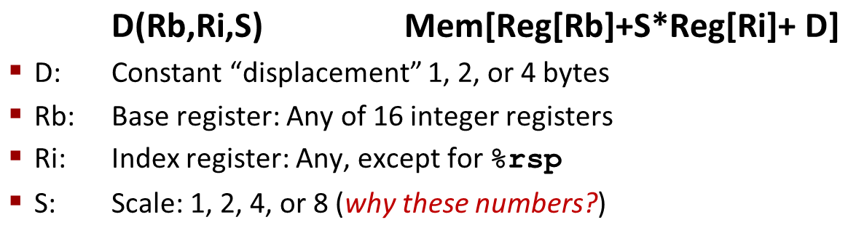
Address Computation Examples
%rdx | 0xf000
%rcx | 0x0100
Expression | Address Computation | Address
0x8(%rdx)
(%rdx,%rcx)
(%rdx,%rcx,4)
0x80(,%rdx,2)
Expression | Address Computation | Address
0x8(%rdx) | 0xf000 + 0x8 | 0xf008
(%rdx,%rcx) | 0xf000 + 0x100 | 0xf100
(%rdx,%rcx,4) | 0xf000 + 4*0x100 | 0xf400
0x80(,%rdx,2) | 2*0xf000 + 0x80 | 0x1e080
Notes:
0xf000 + 0x8 = 0xf008
0xf000 + 0x0100 = 0xf100
0xf000 + 4*0x0100 = 0xf400
2*0xf000 + 0x80 = 0x1d080

Slide 46
Today: Machine Programming I: Basics
History of Intel processors and architectures
Assembly Basics: Registers, operands, move
Arithmetic & logical operations
C, assembly, machine code

Slide 47
IA-32常用指令类型
（1）传送指令
通用数据传送指令
MOV：一般传送，包括movb、movw和movl等
MOVS：符号扩展传送，如movsbw、movswl等
MOVZ：零扩展传送，如movzwl、movzbl等
XCHG：数据交换
PUSH/POP：入栈/出栈，如pushl,pushw,popl,popw等
地址传送指令
LEA：加载有效地址，如leal (%edx,%eax), %eax”的功能为R[eax]←R[edx]+R[eax]，执行前，若R[edx]=i，R[eax]=j，则指令执行后，R[eax]=i+j
输入输出指令
IN和OUT：I/O端口与寄存器之间的交换
标志传送指令
PUSHF、POPF：将EFLAG压栈，或将栈顶内容送EFLAG

Slide 48
IA-32常用指令类型
（2）定点算术运算指令
加 / 减运算（影响标志、不区分无/带符号）
ADD：加，包括addb、addw、addl等
SUB：减，包括subb、subw、subl等
增1 / 减1运算（影响除CF以外的标志、不区分无/带符号）
INC：加，包括incb、incw、incl等
DEC：减，包括decb、decw、decl等
取负运算（影响标志、若对0取负，则结果为0/CF=0,否则CF=1）
NEG：取负，包括negb、negw、negl等
比较运算（做减法得到标志、不区分无/带符号）
CMP：比较，包括cmpb、cmpw、cmpl等
乘 / 除运算（不影响标志、区分无/带符号）
MUL / IMUL：无符号乘 / 带符号乘
DIV/ IDIV：带无符号除 / 带符号除

Slide 49
IA-32常用指令类型
（3）按位运算指令
逻辑运算（仅NOT不影响标志，其他指令OF=CF=0，而ZF和SF根据结果设置：若全0，则ZF=1；若最高位为1，则SF=1 ）
NOT：非，包括 notb、notw、notl等
AND：与，包括 andb、andw、andl等
OR：或，包括 orb、orw、orl等
XOR：异或，包括 xorb、xorw、xorl等
TEST：做“与”操作测试，仅影响标志
移位运算（左/右移时，最高/最低位送CF）
SHL/SHR：逻辑左/右移，包括 shlb、shrw、shrl等
SAL/SAR：算术左/右移，左移判溢出，右移高位补符
ROL/ROR: 循环左/右移，包括 rolb、rorw、roll等
RCL/RCR: 带循环左/右移，将CF作为操作数一部分循环移位
以上内容不要死记硬背，遇到具体指令时能查阅到并理解即可。

Slide 50
IA-32常用指令类型
（4）控制转移指令
指令执行可按顺序 或 跳转到转移目标指令处执行
无条件转移指令
JMP DST：无条件转移到目标指令DST处执行
条件转移
Jcc DST：cc为条件码，根据标志（条件码）判断是否满足条件，若满足，则转移到目标指令DST处执行，否则按顺序执行
条件设置
SETcc DST：将条件码cc保存到DST（通常是一个8位寄存器 ）
调用和返回指令 （用于过程调用）
CALL DST：返回地址RA入栈，转DST处执行
RET：从栈中取出返回地址RA，转到RA处执行
以上内容不要死记硬背，遇到具体指令时能查阅到并理解即可。

Slide 51
Address Computation Instruction
leaq Src, Dst
Src is address mode expression
Set Dst to address denoted by expression
Uses
Computing addresses without a memory reference
E.g., translation of p = &x[i];
Computing arithmetic expressions of the form x + k*y
k = 1, 2, 4, or 8
Example
leaq ($0x1000), %rax # %rax = 1000H
leaq (%rbx), %rax # %rax = %rbx
long m12(long x)
{
return x*12;
}
Converted to ASM by compiler:
leaq (%rdi,%rdi,2), %rax # t = x+2*x
salq $2, %rax # return t<<2
Notes:
Lea-load effective address
Computing addresses without a memory reference-计算地址，但没有引用内存

Slide 52
Some Arithmetic Operations
Two Operand Instructions:
Format Computation
addq Src,Dest Dest = Dest + Src
subq Src,Dest Dest = Dest − Src
imulq Src,Dest Dest = Dest * Src
salq Src,Dest Dest = Dest << Src Also called shlq
sarq Src,Dest Dest = Dest >> Src Arithmetic
shrq Src,Dest Dest = Dest >> Src Logical
xorq Src,Dest Dest = Dest ^ Src
andq Src,Dest Dest = Dest & Src
orq Src,Dest Dest = Dest | Src
Watch out for argument order! Src,Dest (Warning: Intel docs use “op Dest,Src”)
No distinction between signed and unsigned int (why?)

Slide 53
Some Arithmetic Operations
One Operand Instructions
incq Dest Dest = Dest + 1
decq Dest Dest = Dest − 1
negq Dest Dest = − Dest
notq Dest Dest = ~Dest
See book for more instructions

Slide 54
Arithmetic Expression Example
arith:
leaq (%rdi,%rsi), %rax
addq %rdx, %rax
leaq (%rsi,%rsi,2), %rdx
salq $4, %rdx
leaq 4(%rdi,%rdx), %rcx
imulq %rcx, %rax
ret
long arith
(long x, long y, long z)
{
long t1 = x+y;
long t2 = z+t1;
long t3 = x+4;
long t4 = y * 48;
long t5 = t3 + t4;
long rval = t2 * t5;
return rval;
}
Interesting Instructions
leaq: address computation
salq: shift
imulq: multiplication
But, only used once
Notes:
解释c语言代码和汇编语言对应关系，汇编语言：1、rax=x+y；2、rax=x+y+z；3、rdx=3y；4、rdx=48y；5、rcx=x+48y+4；6、rax=rcx*rax

Slide 55
Understanding Arithmetic Expression Example
arith:
leaq (%rdi,%rsi), %rax # t1
addq %rdx, %rax # t2
leaq (%rsi,%rsi,2), %rdx
salq $4, %rdx # t4
leaq 4(%rdi,%rdx), %rcx # t5
imulq %rcx, %rax # rval
ret
long arith
(long x, long y, long z)
{
long t1 = x+y;
long t2 = z+t1;
long t3 = x+4;
long t4 = y * 48;
long t5 = t3 + t4;
long rval = t2 * t5;
return rval;
}
Register | Use(s)
%rdi | Argument x
%rsi | Argument y
%rdx | Argument z, t4
%rax | t1, t2, rval
%rcx | t5

Slide 56
Machine Programming I: Summary
History of Intel processors and architectures
Evolutionary design leads to many quirks and artifacts
C, assembly, machine code
New forms of visible state: program counter, registers, ...
Compiler must transform statements, expressions, procedures into low-level instruction sequences
Assembly Basics: Registers, operands, move
The x86-64 move instructions cover wide range of data movement forms
Arithmetic
C compiler will figure out different instruction combinations to carry out computation

