Slide 1
Machine-Level Programming IV: Data 15-213/18-213/15-513: Introduction to Computer Systems 8th Lecture, September 21, 2017
Today’s Instructor:
Phil Gibbons

Slide 2
Today
Arrays
One-dimensional
Multi-dimensional (nested)
Multi-level
Structures
Allocation
Access
Alignment
Unions

Slide 3
Array Allocation
Basic Principle
T A[L];
Array of data type T and length L
Contiguously allocated region of L * sizeof(T) bytes in memory
char string[12];
x
x + 12
int val[5];
x
x + 4
x + 8
x + 12
x + 16
x + 20
double a[3];
x
x + 8
x + 16
x + 24
char *p[3];
x
x + 8
x + 16
x + 24

Slide 4
Array Access
Basic Principle
T A[L];
Array of data type T and length L
Identifier A can be used as a pointer to array element 0: Type T*
Reference Type Value
val[4] int 3
val int *
val+1 int *
&val[2] int *
val[5] int
*(val+1) int
val + i int *
int val[5];
1
5
2
1
3
x
x + 4
x + 8
x + 12
x + 16
x + 20

Slide 5
Array Access
Basic Principle
T A[L];
Array of data type T and length L
Identifier A can be used as a pointer to array element 0: Type T*
Reference Type Value
val[4] int 3
val int * x
val+1 int * x + 4
&val[2] int * x + 8
val[5] int ??
*(val+1) int 5 //val[1]
val + i int * x + 4 * i //&val[i]
int val[5];
1
5
2
1
3
x
x + 4
x + 8
x + 12
x + 16
x + 20

Slide 6
Array Example
#define ZLEN 5
typedef int zip_dig[ZLEN];
zip_dig cmu = { 1, 5, 2, 1, 3 };
zip_dig mit = { 0, 2, 1, 3, 9 };
zip_dig ucb = { 9, 4, 7, 2, 0 };
zip_dig cmu;
1
5
2
1
3
16
20
24
28
32
36
zip_dig mit;
0
2
1
3
9
36
40
44
48
52
56
zip_dig ucb;
9
4
7
2
0
56
60
64
68
72
76
Declaration “zip_dig cmu” equivalent to “int cmu[5]”
Example arrays were allocated in successive 20 byte blocks
Not guaranteed to happen in general

Slide 7
Array Accessing Example
zip_dig cmu;
1
5
2
1
3
16
20
24
28
32
36
int get_digit
(zip_dig z, int digit)
{
return z[digit];
}
Register %rdi contains starting address of array
Register %rsi contains array index
Desired digit at %rdi + 4*%rsi
Use memory reference (%rdi,%rsi,4)
x86-64
# %rdi = z
# %rsi = digit
movl (%rdi,%rsi,4), %eax # z[digit]

Slide 8
Array Loop Example
# %rdi = z
movl $0, %eax # i = 0
jmp .L3 # goto middle
.L4: # loop:
addl $1, (%rdi,%rax,4) # z[i]++
addq $1, %rax # i++
.L3: # middle
cmpq $4, %rax # i:4
jbe .L4 # if <=, goto loop
rep; ret

Slide 9
Array Loop Example
void zincr(zip_dig z) {
size_t i;
for (i = 0; i < ZLEN; i++)
z[i]++;
}
# %rdi = z
movl $0, %eax # i = 0
jmp .L3 # goto middle
.L4: # loop:
addl $1, (%rdi,%rax,4) # z[i]++
addq $1, %rax # i++
.L3: # middle:
cmpq $4, %rax # i:4
jbe .L4 # if <=, goto loop
rep; ret

Slide 10
Understanding Pointers & Arrays #1
Decl | A1 , A2 |  |  | *A1 , *A2
 | Comp | Bad | Size | Comp | Bad | Size
int A1[3]
int *A2
Comp: Compiles (Y/N)
Bad: Possible bad pointer reference (Y/N)
Size: Value returned by sizeof

Slide 11
Understanding Pointers & Arrays #1
Decl | A1 , A2 |  |  | *A1 , *A2
 | Comp | Bad | Size | Comp | Bad | Size
int A1[3] | Y | N | 12 | Y | N | 4
int *A2 | Y | N | 8 | Y | Y | 4
A1
Allocated pointer
Unallocated pointer
A2
Allocated int
Unallocated int
Comp: Compiles (Y/N)
Bad: Possible bad pointer reference (Y/N)
Size: Value returned by sizeof

Slide 12
Understanding Pointers & Arrays #2
Decl | An |  |  | *An |  |  | **An
 | Cmp | Bad | Size | Cmp | Bad | Size | Cmp | Bad | Size
int A1[3]
int *A2[3]
int (*A3)[3]
Allocated pointer
Unallocated pointer
Allocated int
Unallocated int

Slide 13
Understanding Pointers & Arrays #2
Decl | An |  |  | *An |  |  | **An
 | Cmp | Bad | Size | Cmp | Bad | Size | Cmp | Bad | Size
int A1[3]
int *A2[3]
int (*A3)[3]
A1
A2
A3
Allocated pointer
Unallocated pointer
Allocated int
Unallocated int

Slide 14
Understanding Pointers & Arrays #2
Decl | An |  |  | *An |  |  | **An
 | Cmp | Bad | Size | Cmp | Bad | Size | Cmp | Bad | Size
int A1[3] | Y | N | 12 | Y | N | 4 | N | - | -
int *A2[3] | Y | N | 24 | Y | N | 8 | Y | Y | 4
int (*A3)[3] | Y | N | 8 | Y | Y | 12 | Y | Y | 4
A1
A2
A3
Allocated pointer
Unallocated pointer
Allocated int
Unallocated int

Slide 15
Multidimensional (Nested) Arrays
Declaration
T A[R][C];
2D array of data type T
R rows, C columns
Array Size
R * C * sizeof(T) bytes
Arrangement
Row-Major Ordering
A[0][0]
• • •
A[0][C-1]
•
•
•
•
•
•
A[R-1][0]
• • •
A[R-1][C-1]
int A[R][C];
• • •
A
[0]
[0]
A
[0]
[C-1]
• • •
A
[1]
[0]
A
[1]
[C-1]
• • •
• • •
A
[R-1]
[0]
A
[R-1]
[C-1]
4*R*C Bytes

Slide 16
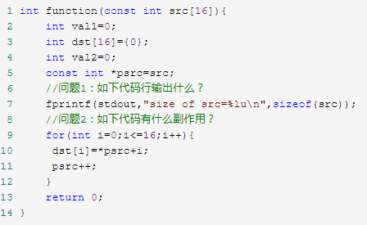
据说是一个面试题

Slide 17
Today
Arrays
One-dimensional
Multi-dimensional (nested)
Multi-level
Structures
Allocation
Access
Alignment
Unions

Slide 18
Structure Representation
r
struct rec {
int a[4];
size_t i;
struct rec *next;
};
a
i
next
0
16
24
32
Structure represented as block of memory
Big enough to hold all of the fields
Fields ordered according to declaration
Even if another ordering could yield a more compact representation
Compiler determines overall size + positions of fields
Machine-level program has no understanding of the structures in the source code

Slide 19
Generating Pointer to Structure Member
r
r+4*idx
struct rec {
int a[4];
size_t i;
struct rec *next;
};
a
i
next
0
16
24
32
Generating Pointer to Array Element
Offset of each structure member determined at compile time
Compute as r + 4*idx
int *get_ap
(struct rec *r, size_t idx)
{
return &r->a[idx];
}
# r in %rdi, idx in %rsi
leaq (%rdi,%rsi,4), %rax
ret

Slide 20
Following Linked List
struct rec {
int a[4];
int i;
struct rec *next;
};
C Code
r
void set_val
(struct rec *r, int val)
{
while (r) {
int i = r->i;
r->a[i] = val;
r = r->next;
}
}
a
i
next
0
16
24
32
Element i
Register | Value
%rdi | r
%rsi | val
.L11: # loop:
movslq 16(%rdi), %rax # i = M[r+16]
movl %esi, (%rdi,%rax,4) # M[r+4*i] = val
movq 24(%rdi), %rdi # r = M[r+24]
testq %rdi, %rdi # Test r
jne .L11 # if !=0 goto loop

Slide 21
Structures & Alignment
Unaligned Data
Aligned Data
Primitive data type requires K bytes
Address must be multiple of K
struct S1 {
char c;
int i[2];
double v;
} *p;
c
i[0]
i[1]
v
p
p+1
p+5
p+9
p+17
c
3 bytes
i[0]
i[1]
4 bytes
v
p+0
p+4
p+8
p+16
p+24
Multiple of 4
Multiple of 8
Multiple of 8
Multiple of 8

Slide 22
Alignment Principles
Aligned Data
Primitive data type requires K bytes
Address must be multiple of K
Required on some machines; advised on x86-64
Motivation for Aligning Data
Memory accessed by (aligned) chunks of 4 or 8 bytes (system dependent)
Inefficient to load or store datum that spans cache lines (64 bytes). Intel states should avoid crossing 16 byte boundaries.
Virtual memory trickier when datum spans 2 pages (4 KB pages)
Compiler
Inserts gaps in structure to ensure correct alignment of fields

Slide 23
Specific Cases of Alignment (x86-64)
1 byte: char, …
no restrictions on address
2 bytes: short, …
lowest 1 bit of address must be 02
4 bytes: int, float, …
lowest 2 bits of address must be 002
8 bytes: double, long, char *, …
lowest 3 bits of address must be 0002

Slide 24
Satisfying Alignment with Structures
Within structure:
Must satisfy each element’s alignment requirement
Overall structure placement
Each structure has alignment requirement K
K = Largest alignment of any element
Initial address & structure length must be multiples of K
Example:
K = 8, due to double element
struct S1 {
char c;
int i[2];
double v;
} *p;
c
3 bytes
i[0]
i[1]
4 bytes
v
p+0
p+4
p+8
p+16
p+24
Multiple of 4
Multiple of 8
Multiple of 8
Multiple of 8

Slide 25
Meeting Overall Alignment Requirement
For largest alignment requirement K
Overall structure must be multiple of K
struct S2 {
double v;
int i[2];
char c;
} *p;
 | v |  |  |  |  |  |  | i[0] |  |  |  | i[1] |  |  |  | c | 7 bytes
p+0 |  |  |  |  |  |  | p+8 |  |  |  |  |  |  |  | p+16 |  |  |  |  |  |  |  | p+24
Multiple of K=8

Slide 26
Arrays of Structures
struct S2 {
double v;
int i[2];
char c;
} a[10];
Overall structure length multiple of K
Satisfy alignment requirement for every element
 | a[0] |  |  |  |  | a[1] |  |  |  |  | a[2] |  |  |  |  | • • •
a+0 |  |  |  |  | a+24 |  |  |  |  | a+48 |  |  |  |  | a+72
 | v |  |  |  |  |  |  | i[0] |  |  |  | i[1] |  |  |  | c | 7 bytes
a+24 |  |  |  |  |  |  | a+32 |  |  |  |  |  |  |  | a+40 |  |  |  |  |  |  |  | a+48

Slide 27
Accessing Array Elements
struct S3 {
short i;
float v;
short j;
} a[10];
Compute array offset 12*idx
sizeof(S3), including alignment spacers
Element j is at offset 8 within structure
Assembler gives offset a+8
Resolved during linking
 | a[0] |  |  |  |  | • • • |  |  |  | a[idx] |  |  |  | • • |  |  | •
a+0 |  |  |  |  | a+12 |  |  |  | a+12*idx
 |  |  |  |  | i | 2 bytes |  | v |  |  | j | 2 bytes
 |  |  |  | a+12*idx |  |  |  |  |  | a+12*idx+8
short get_j(int idx)
{
return a[idx].j;
}
# %rdi = idx
leaq (%rdi,%rdi,2),%rax # 3*idx
movzwl a+8(,%rax,4),%eax

Slide 28
Saving Space
Put large data types first
Effect (largest alignment requirement K=4)
struct S4 {
char c;
int i;
char d;
} *p;
struct S5 {
int i;
char c;
char d;
} *p;
c
3 bytes
i
d
3 bytes
i
c
d
2 bytes

Slide 29
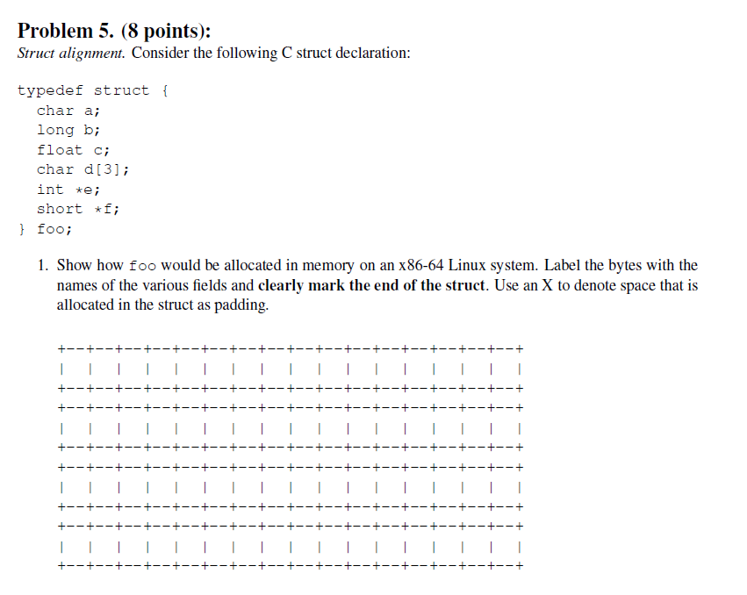
Example Struct Exam Question
http://www.cs.cmu.edu/~213/oldexams/exam1-f12.pdf

Slide 30
Example Struct Exam Question
a
X
X
X
X
X
X
X
b
b
b
b
b
b
b
b
c
c
c
c
d
d
d
X
e
e
e
e
e
e
e
e
f
f
f
f
f
f
f
f
http://www.cs.cmu.edu/~213/oldexams/exam1-f12.pdf

Slide 31
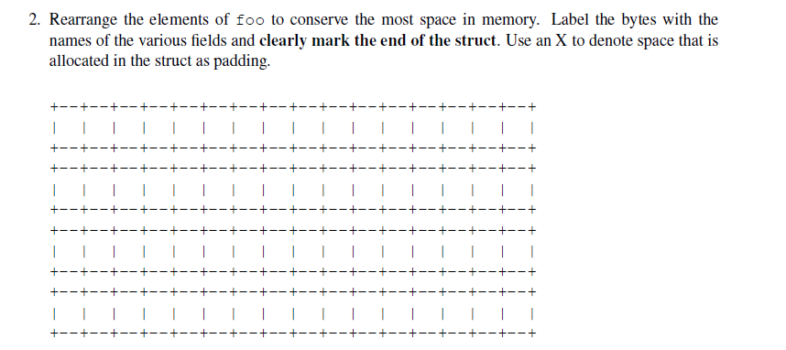
Example Struct Exam Question (Cont’d)
http://www.cs.cmu.edu/~213/oldexams/exam1-f12.pdf

Slide 32
Example Struct Exam Question (Cont’d)
a
d
d
d
c
c
c
c
b
b
b
b
b
b
b
b
e
e
e
e
e
e
e
e
f
f
f
f
f
f
f
f
http://www.cs.cmu.edu/~213/oldexams/exam1-f12.pdf

Slide 33
Today
Arrays
One-dimensional
Multi-dimensional (nested)
Multi-level
Structures
Allocation
Access
Alignment
Unions

Slide 34
Union Allocation
Allocate according to largest element
Can only use one field at a time
union U1 {
char c;
int i[2];
double v;
} *up;
 | c
 | i[0] |  |  |  | i[1]
 | v
up+0 |  |  | up+4 |  |  |  |  | up+8
struct S1 {
char c;
int i[2];
double v;
} *sp;
 | c | 3 bytes |  |  | i[0] |  |  |  | i[1] |  |  |  | 4 bytes |  |  | v
sp+0 |  |  |  | sp+4 |  |  |  | sp+8 |  |  |  |  |  |  | sp+16 |  |  |  |  |  | sp+24

Slide 35
Using Union to Access Bit Patterns
typedef union {
float f;
unsigned u;
} bit_float_t;
 | u
 | f
0 |  |  |  | 4
float bit2float(unsigned u) {
bit_float_t arg;
arg.u = u;
return arg.f;
}
unsigned float2bit(float f) {
bit_float_t arg;
arg.f = f;
return arg.u;
}
Same as (float) u ?
Same as (unsigned) f ?

Slide 36
Byte Ordering Revisited
Idea
Short/long/quad words stored in memory as 2/4/8 consecutive bytes
Which byte is most (least) significant?
Can cause problems when exchanging binary data between machines
Big Endian
Most significant byte has lowest address
Sparc, Internet
Little Endian
Least significant byte has lowest address
Intel x86, ARM Android and IOS
Bi Endian
Can be configured either way
ARM

Slide 37
Byte Ordering Example
union {
unsigned char c[8];
unsigned short s[4];
unsigned int i[2];
unsigned long l[1];
} dw;
How are the bytes inside short/int/long stored?
Memory addresses growing
32-bit
c[0] | c[1] | c[2] | c[3] | c[4] | c[5] | c[6] | c[7]
s[0] |  | s[1] |  | s[2] |  | s[3]
i[0] |  |  |  | i[1]
l[0]
64-bit
c[0] | c[1] | c[2] | c[3] | c[4] | c[5] | c[6] | c[7]
s[0] |  | s[1] |  | s[2] |  | s[3]
i[0] |  |  |  | i[1]
l[0]

Slide 38
Byte Ordering Example (Cont).
int j;
for (j = 0; j < 8; j++)
dw.c[j] = 0xf0 + j;
printf("Characters 0-7 == [0x%x,0x%x,0x%x,0x%x,0x%x,0x%x,0x%x,0x%x]\n",
dw.c[0], dw.c[1], dw.c[2], dw.c[3],
dw.c[4], dw.c[5], dw.c[6], dw.c[7]);
printf("Shorts 0-3 == [0x%x,0x%x,0x%x,0x%x]\n",
dw.s[0], dw.s[1], dw.s[2], dw.s[3]);
printf("Ints 0-1 == [0x%x,0x%x]\n",
dw.i[0], dw.i[1]);
printf("Long 0 == [0x%lx]\n",
dw.l[0]);

Slide 39
Byte Ordering on IA32
Little Endian
f0 | f1 | f2 | f3 | f4 | f5 | f6 | f7
c[0] | c[1] | c[2] | c[3] | c[4] | c[5] | c[6] | c[7]
s[0] |  | s[1] |  | s[2] |  | s[3]
i[0] |  |  |  | i[1]
l[0]
LSB
MSB
LSB
MSB
Print
Output:
Characters 0-7 == [0xf0,0xf1,0xf2,0xf3,0xf4,0xf5,0xf6,0xf7]
Shorts 0-3 == [0xf1f0,0xf3f2,0xf5f4,0xf7f6]
Ints 0-1 == [0xf3f2f1f0,0xf7f6f5f4]
Long 0 == [0xf3f2f1f0]

Slide 40
Byte Ordering on Sun
Big Endian
f0 | f1 | f2 | f3 | f4 | f5 | f6 | f7
c[0] | c[1] | c[2] | c[3] | c[4] | c[5] | c[6] | c[7]
s[0] |  | s[1] |  | s[2] |  | s[3]
i[0] |  |  |  | i[1]
l[0]
MSB
LSB
MSB
LSB
Print
Output on Sun:
Characters 0-7 == [0xf0,0xf1,0xf2,0xf3,0xf4,0xf5,0xf6,0xf7]
Shorts 0-3 == [0xf0f1,0xf2f3,0xf4f5,0xf6f7]
Ints 0-1 == [0xf0f1f2f3,0xf4f5f6f7]
Long 0 == [0xf0f1f2f3]

Slide 41
Byte Ordering on x86-64
Little Endian
f0 | f1 | f2 | f3 | f4 | f5 | f6 | f7
c[0] | c[1] | c[2] | c[3] | c[4] | c[5] | c[6] | c[7]
s[0] |  | s[1] |  | s[2] |  | s[3]
i[0] |  |  |  | i[1]
l[0]
LSB
MSB
Print
Output on x86-64:
Characters 0-7 == [0xf0,0xf1,0xf2,0xf3,0xf4,0xf5,0xf6,0xf7]
Shorts 0-3 == [0xf1f0,0xf3f2,0xf5f4,0xf7f6]
Ints 0-1 == [0xf3f2f1f0,0xf7f6f5f4]
Long 0 == [0xf7f6f5f4f3f2f1f0]

Slide 42
Summary of Compound Types in C
Arrays
Contiguous allocation of memory
Aligned to satisfy every element’s alignment requirement
Pointer to first element
No bounds checking
Structures
Allocate bytes in order declared
Pad in middle and at end to satisfy alignment
Unions
Overlay declarations
Way to circumvent type system

