Slide 1
I/O Systems 15-213: Introduction to Computer Systems 16th Lecture, October 19th, 2017
Instructor:
Randy Bryant

Slide 2
Today
I/O Systems
Unix I/O
Metadata, sharing, and redirection
Standard I/O
Closing remarks

Slide 3
Overview
A computer’s job is to process data
Computer (CPU, cache, and memory)
Move data into and out of a system (between I/O devices and memory)
Challenges with I/O devices
Different categories: storage, networking, displays, etc.
Large number of device drivers to support
Device driver run in kernel mode and can crash systems

Slide 4
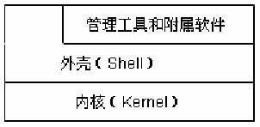
操作系统的三个部分
内核
操作系统五大管理功能一般都由操作系统内核负责。
外壳
外壳程序负责接收用户操作，提供与用户的交互界面。
一般操作系统提供给一般用户的界面主要有两种：文本界面；GUI 图形界面。程序员接口：API
管理工具和附属软件
一般是操作系统在发布时附带提供给用户的，用户安装完操作系统，就可以利用操作系统自带的管理工具和软件进行一些基本的操作。

Slide 5
操作系统的功能
CPU的控制与管理
处理器管理
内存的分配与管理
存储器管理
外部设备的控制与管理
设备管理
文件管理
文件管理
作业管理和控制
用户接口

Slide 6
Overview (Cont.)
I/O management is a major component of operating system
Important aspect of computer operation
I/O devices vary greatly
Various methods to control them
Performance management
New types of devices frequent
Ports, busses, device controllers connect to various devices
Device drivers encapsulate device details
Present uniform device-access interface to I/O subsystem

Slide 7
回顾：Hello程序的数据流动过程
Unix>./hello
hello, world
unix>
Red：shell命令行处理
Blue：可执行文件加载
Cyan：hello程序执行过程
CPU
Register file
ALU
PC
System bus
Memory bus
Main
memory
“hello”
Bus interface
I/O
bridge
“hello,world/n”
I/O bus
Expansion slots for
other devices such
as network adapters
USB
controller
Graphics
adapter
Disk
controller
Mouse
Keyboard
“hello,world/n”
Disk
Hello可执行文件
“hello”
Display

Slide 8
操作系统在程序执行过程中的作用
Shell进程生成子进程，子进程调用execve系统调用启动加载器，以装入Hello程序，并跳转到第一条指令执行
在Hello程序执行过程中，Hello本身不会直接访问键盘、显示器、磁盘和主存储器等硬件资源，而是依靠OS提供的服务来间接访问。
操作系统是在应用程序和硬件之间的中间软件层。
操作系统的两个主要的作用：
硬件资源管理，以达到以下两个目的：
统筹安排和调度硬件资源，以防止硬件资源被用户程序滥用
对于广泛使用的复杂低级设备，为用户程序提供一个简单一致的使用接口
为用户（最终用户、用户程序）使用系统提供一个操作接口
例如，利用printf()函数最终调出内核服务程序访问硬件。

Slide 9
I/O子系统
各类用户的I/O请求需要通过某种方式传给OS：
 最终用户：键盘、鼠标通过操作界面传递给OS
 用户程序：通过函数（高级语言）转换为系统调用传递给OS
大部分I/O软件都属于操作系统内核态程序，最初的I/O请求在用 户程序中提出。

Slide 10
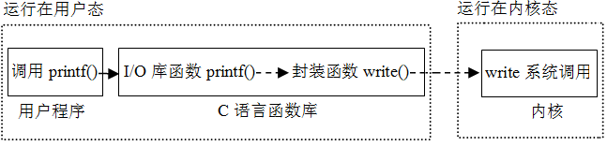
用户程序、C函数和内核
用户程序总是通过某种I/O函数或I/O操作符请求I/O操作。
例如，读一个磁盘文件记录时，可调用C标准I/O库函数fread()，也可直接调用系统调用封装函数read()来提出I/O请求。不管是C库函数、API函数还是系统调用封装函数，最终都通过操作系统内核提供的系统调用来实现I/O。
printf()函数的调用过程如下：

Slide 11
Today
I/O Systems
Unix I/O
Metadata, sharing, and redirection
Standard I/O
Closing remarks

Slide 12
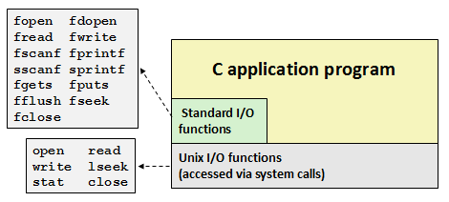
UNIX/Linux的I/O
用户程序可通过调用特定的I/O函数的方式提出I/O请求。
在UNIX/Linux系统中，可以是C标准I/O库函数或系统调用的封装函数，前者如文件I/O函数fopen()、fread()、fwrite()和fclose()或控制台I/O函数printf()、putc()、scanf()和getc()等；后者如open()、read()、write()和close()等。
标准I/O库函数比系统调用封装函数抽象层次高，后者属于系统级I/O函数。与系统提供的API函数一样，前者是基于后者实现的。

Slide 13
Unix I/O Overview
A Linux file is a sequence of m bytes:
B₀ , B₁ , .... , B_{k} , .... , B_{m-1}
Cool fact: All I/O devices are represented as files:
/dev/sda2 (/usr disk partition)
/dev/tty2 (terminal)
Even the kernel is represented as a file:
/boot/vmlinuz-3.13.0-55-generic (kernel image)
/proc (kernel data structures)

Slide 14
Unix I/O Overview
Elegant mapping of files to devices allows kernel to export simple interface called Unix I/O:
Opening and closing files
open()and close()
Reading and writing a file
read() and write()
Changing the current file position (seek)
indicates next offset into file to read or write
lseek()
B₀
B₁
• • •
B_{k-1}
B_{k}
B_{k+1}
• • •
Current file position = k

Slide 15
File Types
Each file has a type indicating its role in the system
Regular file: Contains arbitrary data
Directory: Index for a related group of files
Socket: For communicating with a process on another machine
Other file types beyond our scope
Named pipes (FIFOs)
Symbolic links
Character and block devices

Slide 16
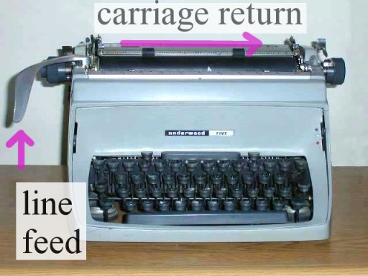
Regular Files
A regular file contains arbitrary data
Applications often distinguish between text files and binary files
Text files are regular files with only ASCII or Unicode characters
Binary files are everything else
e.g., object files, JPEG images
Kernel doesn’t know the difference!
Text file is sequence of text lines
Text line is sequence of chars terminated by newline char (‘\n’)
Newline is 0xa, same as ASCII line feed character (LF)
End of line (EOL) indicators in other systems
Linux and Mac OS: ‘\n’ (0xa)
line feed (LF)
Windows and Internet protocols: ‘\r\n’ (0xd 0xa)
Carriage return (CR) followed by line feed (LF)

Slide 17
Directories
Directory consists of an array of links
Each link maps a filename to a file
Each directory contains at least two entries
. (dot) is a link to itself
.. (dot dot) is a link to the parent directory in the directory hierarchy (next slide)
Commands for manipulating directories
mkdir: create empty directory
ls: view directory contents
rmdir: delete empty directory

Slide 18
Directory Hierarchy
All files are organized as a hierarchy anchored by root directory named / (slash)
Kernel maintains current working directory (cwd) for each process
Modified using the cd command
/
bin/
dev/
etc/
home/
usr/
bash
tty1
group
passwd
droh/
bryant/
include/
bin/
hello.c
stdio.h
sys/
vim
unistd.h

Slide 19
Pathnames
Locations of files in the hierarchy denoted by pathnames
Absolute pathname starts with ‘/’ and denotes path from root
/home/droh/hello.c
Relative pathname denotes path from current working directory
../droh/hello.c
/
cwd: /home/bryant
bin/
dev/
etc/
home/
usr/
bash
tty1
group
passwd
droh/
bryant/
include/
bin/
hello.c
stdio.h
sys/
vim
unistd.h

Slide 20
Opening Files
Opening a file informs the kernel that you are getting ready to access that file
Returns a small identifying integer file descriptor
fd == -1 indicates that an error occurred
Each process created by a Linux shell begins life with three open files associated with a terminal:
0: standard input (stdin)
1: standard output (stdout)
2: standard error (stderr)
int fd; /* file descriptor */
if ((fd = open("/etc/hosts", O_RDONLY)) < 0) {
perror("open");
exit(1);
}

Slide 21
Closing Files
Closing a file informs the kernel that you are finished accessing that file
Closing an already closed file is a recipe for disaster in threaded programs
Moral: Always check return codes, even for seemingly benign functions such as close()
int fd; /* file descriptor */
int retval; /* return value */
if ((retval = close(fd)) < 0) {
perror("close");
exit(1);
}

Slide 22
Reading Files
Reading a file copies bytes from the current file position to memory, and then updates file position
Returns number of bytes read from file fd into buf
Return type ssize_t is signed integer
nbytes < 0 indicates that an error occurred
Short counts (nbytes < sizeof(buf) ) are possible and are not errors!
char buf[512];
int fd; /* file descriptor */
int nbytes; /* number of bytes read */
/* Open file fd ... */
/* Then read up to 512 bytes from file fd */
if ((nbytes = read(fd, buf, sizeof(buf))) < 0) {
perror("read");
exit(1);
}

Slide 23
Writing Files
Writing a file copies bytes from memory to the current file position, and then updates current file position
Returns number of bytes written from buf to file fd
nbytes < 0 indicates that an error occurred
As with reads, short counts are possible and are not errors!
char buf[512];
int fd; /* file descriptor */
int nbytes; /* number of bytes read */
/* Open the file fd ... */
/* Then write up to 512 bytes from buf to file fd */
if ((nbytes = write(fd, buf, sizeof(buf)) < 0) {
perror("write");
exit(1);
}

Slide 24
Simple Unix I/O example
Copying stdin to stdout, one byte at a time
#include "csapp.h"
int main(void)
{
char c;
while(Read(STDIN_FILENO, &c, 1) != 0)
Write(STDOUT_FILENO, &c, 1);
exit(0);
}

Slide 25
On Short Counts
Short counts can occur in these situations:
Encountering (end-of-file) EOF on reads
Reading text lines from a terminal
Reading and writing network sockets
Short counts never occur in these situations:
Reading from disk files (except for EOF)
Writing to disk files
Best practice is to always allow for short counts.

Slide 26
Today
I/O Systems
Unix I/O
Metadata, sharing, and redirection
Standard I/O
Closing remarks

Slide 27
File Metadata
Metadata is data about data, in this case file data
Per-file metadata maintained by kernel
accessed by users with the stat and fstat functions
/* Metadata returned by the stat and fstat functions */
struct stat {
dev_t st_dev; /* Device */
ino_t st_ino; /* inode */
mode_t st_mode; /* Protection and file type */
nlink_t st_nlink; /* Number of hard links */
uid_t st_uid; /* User ID of owner */
gid_t st_gid; /* Group ID of owner */
dev_t st_rdev; /* Device type (if inode device) */
off_t st_size; /* Total size, in bytes */
unsigned long st_blksize; /* Blocksize for filesystem I/O */
unsigned long st_blocks; /* Number of blocks allocated */
time_t st_atime; /* Time of last access */
time_t st_mtime; /* Time of last modification */
time_t st_ctime; /* Time of last change */
};

Slide 28
How the Unix Kernel Represents Open Files
Two descriptors referencing two distinct open files. Descriptor 1 (stdout) points to terminal, and descriptor 4 points to open disk file
Descriptor table
[one table per process]
Open file table
[shared by all processes]
v-node table
[shared by all processes]
File A (terminal)
stdin
fd 0
File access
stdout
fd 1
File pos
File size
Info in
stat struct
stderr
fd 2
fd 3
refcnt=1
File type
fd 4
...
...
File B (disk)
File access
File pos
File size
refcnt=1
File type
File pos is maintained per open file
...
...

Slide 29
File Sharing
Two distinct descriptors sharing the same disk file through two distinct open file table entries
E.g., Calling open twice with the same filename argument
Descriptor table
[one table per process]
Open file table
[shared by all processes]
v-node table
[shared by all processes]
File A (disk)
stdin
fd 0
File access
stdout
fd 1
File pos
File size
stderr
fd 2
fd 3
refcnt=1
File type
fd 4
...
...
File B (disk)
File pos
refcnt=1
...
Different logical but same physical file

Slide 30
Creating Processes
Parent process creates a new running child process by calling fork
int fork(void)
Returns 0 to the child process, child’s PID to parent process
Child is almost identical to parent:
Child get an identical (but separate) copy of the parent’s virtual address space.
Child gets identical copies of the parent’s open file descriptors
Child has a different PID than the parent
fork is interesting (and often confusing) because it is called once but returns twice
Notes:
Identical：完全一致的

Slide 31
Conceptual View of fork
Memory
Memory
parent
child
Stack
➔
Stack
Stack
Heap
Heap
Heap
Data
Data
Data
Code
Code
Code
Saved registers
Saved registers
Saved registers
CPU
CPU
Registers
Registers
Make complete copy of execution state
Designate one as parent and one as child
Resume execution of parent or child

Slide 32
fork Example
Call once, return twice
Concurrent execution
Can’t predict execution order of parent and child
int main(int argc, char** argv)
{
pid_t pid;
int x = 1;
pid = Fork();
if (pid == 0) { /* Child */
printf("child : x=%d\n", ++x);
return 0;
}
/* Parent */
printf("parent: x=%d\n", --x);
return 0;
}
fork.c
linux> ./fork
parent: x=0
child : x=2
linux> ./fork
child : x=2
parent: x=0
linux> ./fork
parent: x=0
child : x=2
linux> ./fork
parent: x=0
child : x=2

Slide 33
Modeling fork with Process Graphs
A process graph is a useful tool for capturing the partial ordering of statements in a concurrent program:
Each vertex is the execution of a statement
a -> b means a happens before b
Edges can be labeled with current value of variables
printf vertices can be labeled with output
Each graph begins with a vertex with no inedges
Any topological sort of the graph corresponds to a feasible total ordering.
Total ordering of vertices where all edges point from left to right

Slide 34
Process Graph Example
int main(int argc, char** argv)
{
pid_t pid;
int x = 1;
pid = Fork();
if (pid == 0) { /* Child */
printf("child : x=%d\n", ++x);
return 0;
}
/* Parent */
printf("parent: x=%d\n", --x);
return 0;
}
child: x=2
Child
printf
exit
x==1
parent: x=0
Parent
main
fork
printf
exit
fork.c

Slide 35
Interpreting Process Graphs
Original graph:
Relabled graph:
child: x=2
printf
exit
x==1
parent: x=0
main
fork
printf
exit
Feasible total ordering:
e
f
a
b
e
c
f
d
a
b
c
d
Infeasible total ordering:
a
b
f
c
e
d

Slide 36
How Processes Share Files: fork
A child process inherits its parent’s open files
Note: situation unchanged by exec functions (use fcntl to change)
Before fork call:
Descriptor table
[one table per process]
Open file table
[shared by all processes]
v-node table
[shared by all processes]
File A (terminal)
stdin
fd 0
File access
stdout
fd 1
File pos
File size
stderr
fd 2
fd 3
refcnt=1
File type
fd 4
...
...
File B (disk)
File access
File pos
File size
refcnt=1
File type
...
...

Slide 37
How Processes Share Files: fork
A child process inherits its parent’s open files
After fork:
Child’s table same as parent’s, and +1 to each refcnt
Descriptor table
[one table per process]
Open file table
[shared by all processes]
v-node table
[shared by all processes]
Parent
File A (terminal)
fd 0
File access
fd 1
File pos
File size
fd 2
File type
fd 3
refcnt=2
fd 4
...
...
Child
File B (disk)
File access
fd 0
File size
fd 1
File pos
fd 2
refcnt=2
File type
fd 3
...
fd 4
...
File is shared between processes

Slide 38
I/O Redirection
Question: How does a shell implement I/O redirection?
linux> ls > foo.txt
Answer: By calling the dup2(oldfd, newfd) function
Copies (per-process) descriptor table entry oldfd to entry newfd
Descriptor table
before dup2(4,1)
Descriptor table
after dup2(4,1)
fd 0
fd 0
fd 1
a
fd 1
b
fd 2
fd 2
fd 3
fd 3
fd 4
b
fd 4
b

Slide 39
I/O Redirection Example
Step #1: open file to which stdout should be redirected
Happens in child executing shell code, before exec
Descriptor table
[one table per process]
Open file table
[shared by all processes]
v-node table
[shared by all processes]
File A
stdin
fd 0
File access
stdout
fd 1
File pos
File size
stderr
fd 2
fd 3
refcnt=1
File type
fd 4
...
...
File B
File access
File pos
File size
refcnt=1
File type
...
...

Slide 40
I/O Redirection Example (cont.)
Step #2: call dup2(4,1)
cause fd=1 (stdout) to refer to disk file pointed at by fd=4
Descriptor table
[one table per process]
Open file table
[shared by all processes]
v-node table
[shared by all processes]
File A
stdin
fd 0
File access
stdout
fd 1
File pos
File size
stderr
fd 2
fd 3
refcnt=0
File type
fd 4
...
...
File B
File access
File pos
File size
refcnt=2
File type
Two descriptors point to the same file
...
...

Slide 41
Warm-Up: I/O and Redirection Example
#include "csapp.h"
int main(int argc, char *argv[])
{
int fd1, fd2, fd3;
char c1, c2, c3;
char *fname = argv[1];
fd1 = Open(fname, O_RDONLY, 0);
fd2 = Open(fname, O_RDONLY, 0);
fd3 = Open(fname, O_RDONLY, 0);
Dup2(fd2, fd3);
Read(fd1, &c1, 1);
Read(fd2, &c2, 1);
Read(fd3, &c3, 1);
printf("c1 = %c, c2 = %c, c3 = %c\n", c1, c2, c3);
return 0;
}
ffiles1.c
What would this program print for file containing “abcde”?

Slide 42
Warm-Up: I/O and Redirection Example
#include "csapp.h"
int main(int argc, char *argv[])
{
int fd1, fd2, fd3;
char c1, c2, c3;
char *fname = argv[1];
fd1 = Open(fname, O_RDONLY, 0);
fd2 = Open(fname, O_RDONLY, 0);
fd3 = Open(fname, O_RDONLY, 0);
Dup2(fd2, fd3);
Read(fd1, &c1, 1);
Read(fd2, &c2, 1);
Read(fd3, &c3, 1);
printf("c1 = %c, c2 = %c, c3 = %c\n", c1, c2, c3);
return 0;
}
c1 = a, c2 = a, c3 = b
dup2(oldfd, newfd)
ffiles1.c
What would this program print for file containing “abcde”?

Slide 43
Master Class: Process Control and I/O
#include "csapp.h"
int main(int argc, char *argv[])
{
int fd1;
int s = getpid() & 0x1;
char c1, c2;
char *fname = argv[1];
fd1 = Open(fname, O_RDONLY, 0);
Read(fd1, &c1, 1);
if (fork()) { /* Parent */
sleep(s);
Read(fd1, &c2, 1);
printf("Parent: c1 = %c, c2 = %c\n", c1, c2);
} else { /* Child */
sleep(1-s);
Read(fd1, &c2, 1);
printf("Child: c1 = %c, c2 = %c\n", c1, c2);
}
return 0;
}
ffiles2.c
What would this program print for file containing “abcde”?

Slide 44
Master Class: Process Control and I/O
#include "csapp.h"
int main(int argc, char *argv[])
{
int fd1;
int s = getpid() & 0x1;
char c1, c2;
char *fname = argv[1];
fd1 = Open(fname, O_RDONLY, 0);
Read(fd1, &c1, 1);
if (fork()) { /* Parent */
sleep(s);
Read(fd1, &c2, 1);
printf("Parent: c1 = %c, c2 = %c\n", c1, c2);
} else { /* Child */
sleep(1-s);
Read(fd1, &c2, 1);
printf("Child: c1 = %c, c2 = %c\n", c1, c2);
}
return 0;
}
Child: c1 = a, c2 = b
Parent: c1 = a, c2 = c
Parent: c1 = a, c2 = b
Child: c1 = a, c2 = c
Bonus: Which way does it go?
ffiles2.c
What would this program print for file containing “abcde”?

Slide 45
Today
I/O Systems
Unix I/O
Metadata, sharing, and redirection
Standard I/O
Closing remarks

Slide 46
I/O子系统
I/O软件被组织成从高到低的四个层次，层次越低，则越接近设备而越远离用户程序。这四个层次依次为：
(1) 用户层I/O软件（I/O函数调用系统调用）
(2) 与设备无关的操作系统I/O软件
(3) 设备驱动程序
(4) I/O中断处理程序
大部分I/O软件都属于操作系统内核态程序，最初的I/O请求在用 户程序中提出。
OS在I/O系统中极其重要！
OS

Slide 47
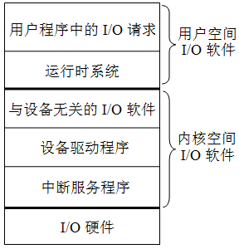
I/O子系统(软件观点)
所有高级语言的运行时（runtime）都提供了执行I/O功能的机制
例如，C语言中提供了包含像printf()和scanf()等这样的标准I/O库函数，C++语言中提供了如 <<（输入）和 >>（输出）这样的重载操作符。
从高级语言程序中通过I/O函数或I/O操作符提出I/O请求，到设备响应并完成I/O请求，涉及到多层次I/O软件和I/O硬件的协作。
I/O子系统也采用层次结构
从用户I/O软件切换到内核I/O软件的唯一办法是“异常”机制：系统调用（自陷）

Slide 48
Standard I/O Functions
The C standard library (libc.so) contains a collection of higher-level standard I/O functions
Documented in Appendix B of K&R
Examples of standard I/O functions:
Opening and closing files (fopen and fclose)
Reading and writing bytes (fread and fwrite)
Reading and writing text lines (fgets and fputs)
Formatted reading and writing (fscanf and fprintf)

Slide 49
用户I/O软件
用户进程请求读磁盘文件操作
用户进程使用标准C库函数fread，或Windows API函数 ReadFile，或Unix/Linux的系统调用函数read等要求读一个磁盘文件块。
用户程序中涉及I/O操作的函数最终会被转换为一组与具体机器架构相关的指令序列，这里我们将其称为I/O请求指令序列。
每个指令系统中一定有一类陷阱指令（有些机器也称为软中断指令或系统调用指令），主要功能是为操作系统提供灵活的系统调用机制。
在I/O请求指令序列中，具体I/O请求被转换为一条陷阱指令，在陷阱指令前面则是相应的系统调用参数的设置指令。

Slide 50
以hello程序为例说明
假定以下用户程序对应的进程为p
sys_write可用三种I/O方式实现：
程序查询、中断 和 DMA
#include <stdio.h>
int main()
{
printf("hello, world\n");
}
可见：字符串输出最终是由内核中的sys_write系统调用服务例程实现
用户空间、运行在用户态
内核空间、运行在内核态
main()
{
…
printf();
…
}
printf()
{
…
xxxx();
…
}
write()
{
…
int $0x80
…
}
system_call()
{
…
xxxx();
…
}
sys_write()
{
…
…
…
}
用户程序
I/O标准库函数
系统调用封装函数
系统调用处理程序
系统调用服务例程

Slide 51
Standard I/O Streams
Standard I/O models open files as streams
Abstraction for a file descriptor and a buffer in memory
C programs begin life with three open streams (defined in stdio.h)
stdin (standard input)
stdout (standard output)
stderr (standard error)
#include <stdio.h>
extern FILE *stdin; /* standard input (descriptor 0) */
extern FILE *stdout; /* standard output (descriptor 1) */
extern FILE *stderr; /* standard error (descriptor 2) */
int main() {
fprintf(stdout, "Hello, world\n");
}

Slide 52
Buffered I/O: Motivation
Applications often read/write one character at a time
getc, putc, ungetc
gets, fgets
Read line of text one character at a time, stopping at newline
Implementing as Unix I/O calls expensive
read and write require Unix kernel calls
> 10,000 clock cycles
Solution: Buffered read
Use Unix read to grab block of bytes
User input functions take one byte at a time from buffer
Refill buffer when empty
Buffer
already read
unread

Slide 53
Buffering in Standard I/O
Standard I/O functions use buffered I/O
Buffer flushed to output fd on “\n”, call to fflush or exit, or return from main.
printf("h");
printf("e");
printf("l");
printf("l");
printf("o");
buf
printf("\n");
h
e
l
l
o
\n
.
.
fflush(stdout);
write(1, buf, 6);

Slide 54
Standard I/O Buffering in Action
You can see this buffering in action for yourself, using the always fascinating Linux strace program:
#include <stdio.h>
int main()
{
printf("h");
printf("e");
printf("l");
printf("l");
printf("o");
printf("\n");
fflush(stdout);
exit(0);
}
linux> strace ./hello
execve("./hello", ["hello"], [/* ... */]).
...
write(1, "hello\n", 6) = 6
...
exit_group(0) = ?

Slide 55
Today
I/O Systems
Unix I/O
Metadata, sharing, and redirection
Standard I/O
Closing remarks

Slide 56
Standard I/O vs. Unix I/O
Standard I/O is implemented using low-level Unix I/O
Which ones should you use in your programs?
fopen fdopen
fread fwrite fscanf fprintf sscanf sprintf fgets fputs fflush fseek
fclose
C application program
Standard I/O
functions
open read
write lseek
stat close
Unix I/O functions
(accessed via system calls)

Slide 57
用户I/O软件
用户软件可用以下两种方式提出I/O请求：
（1）使用高级语言提供的标准I/O库函数。例如，在C语言程序中可以直接使用像fopen、fread、fwrite和fclose等文件操作函数，或printf、putc、scanf和getc等控制台I/O函数。 程序移植性很好！
但是，使用标准I/O库函数有以下几个方面的不足：
(a) 标准I/O库函数不能保证文件的安全性（无加/解锁机制）
(b) 所有I/O都是同步的，程序必须等待I/O操作完成后才能继续执行
(c) 有时不适合甚至无法使用标准I/O库函数实现I/O功能，如，不提供读取文件元数据的函数（元数据包括文件大小和文件创建时间等）
(d) 用它进行网络编程会造成易于出现缓冲区溢出等风险
（2）使用OS提供的API函数或系统调用。例如，在Windows中直接使用像CreateFile、ReadFile、WriteFile、CloseHandle等文件操作API函数，或ReadConsole、WriteConsole等控制台I/O的API函数。对于Unix或Linux用户程序，则直接使用像open、read、write、close等系统调用封装函数。

Slide 58
Pros and Cons of Standard I/O
Pros:
Buffering increases efficiency by decreasing the number of read and write system calls
Short counts are handled automatically
Cons:
Provides no function for accessing file metadata
Standard I/O functions are not async-signal-safe, and not appropriate for signal handlers
Standard I/O is not appropriate for input and output on network sockets
There are poorly documented restrictions on streams that interact badly with restrictions on sockets (CS:APP3e, Sec 10.11)

Slide 59
Pros and Cons of Unix I/O
Pros
Unix I/O is the most general and lowest overhead form of I/O
All other I/O packages are implemented using Unix I/O functions
Unix I/O provides functions for accessing file metadata
Unix I/O functions are async-signal-safe and can be used safely in signal handlers
Cons
Dealing with short counts is tricky and error prone
Efficient reading of text lines requires some form of buffering, also tricky and error prone
Both of these issues are addressed by the standard I/O

Slide 60
系统I/O软件
OS在I/O子系统中的重要性由I/O系统以下三个特性决定：
（1）共享性。I/O系统被多个程序共享，须由OS对I/O资源统一调度管理，以保证用户程序只能访问自己有权访问的那部分I/O设备，并使系统的吞吐率达到最佳。
（2）复杂性。I/O设备控制细节复杂，需OS提供专门的驱动程序进行控制，这样可对用户程序屏蔽设备控制的细节。
（3）异步性。不同设备之间速度相差较大，因而，I/O设备与主机之间的信息交换使用异步的中断I/O方式，中断导致从用户态向内核态转移，因此必须由OS提供中断服务程序来处理。
那么，如何从用户程序对应的用户进程进入到操作系统内核执行呢？
系统调用！

Slide 61
系统调用和API
OS提供一组系统调用为用户进程的I/O请求进行具体的I/O操作。
应用编程接口（API）与系统调用两者在概念上不完全相同，它们都是系统提供给用户程序使用的编程接口，但前者指的是功能更广泛、抽象程度更高的函数，后者仅指通过软中断（自陷）指令向内核态发出特定服务请求的函数。
系统调用封装函数是 API 函数中的一种。
API 函数最终通过调用系统调用实现 I/O。一个API 可能调用多个系统调用，不同 API 可能会调用同一个系统调用。但是，并不是所有 API 都需要调用系统调用。
从编程者来看，API 和 系统调用之间没有什么差别。
从内核设计者来看，API 和 系统调用差别很大。API 在用户态执行，系统调用封装函数也在用户态执行，但具体服务例程在内核态执行。

Slide 62
Choosing I/O Functions
General rule: use the highest-level I/O functions you can
Many C programmers are able to do all of their work using the standard I/O functions
But, be sure to understand the functions you use!
When to use standard I/O
When working with disk or terminal files
When to use raw Unix I/O
Inside signal handlers, because Unix I/O is async-signal-safe
In rare cases when you need absolute highest performance

Slide 63
Aside: Working with Binary Files
Functions you should never use on binary files
Text-oriented I/O: such as fgets, scanf
Interpret EOL characters.
String functions
strlen, strcpy, strcat
Interprets byte value 0 (end of string) as special
Notes:
Scanf专门用于文本文件，不能用于二进制文件，对0xa有特定含义

Slide 64
How does the CPU talk to devices?
Device controller: Hardware that enables devices to talk to the peripheral bus
Host adapter: Hardware that enables the computer to talk to the peripheral
Bus: Wires that transfer data between components inside computer
Device controller: allows OS to specify simpler instructions to access data
Example: a disk controller
Translates “access sector 23” to “move head reader 1.672725272 cm from edge of platter”
Disk controller “advertises” disk parameters to OS, hides internal disk geometry. Most modern hard drives have disk controller embedded as a chip on the physical device
Notes:
Peripheral:外围的

Slide 65
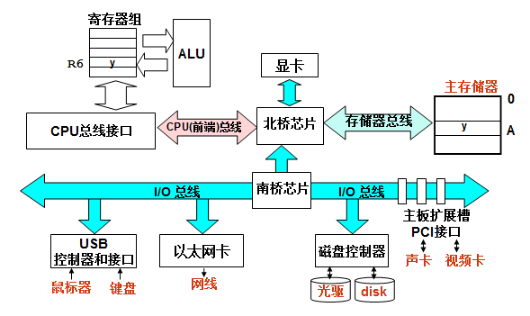
I/O硬件的组成
I/O硬件建立了外设与主机之间的“通路”：
主机----I/O总线（桥）----设备控制器----电缆----外设
如何把用户I/O请求转换为对设备的控制命令并完成设备I/O任务，需要I/O软件与I/O硬件之间的协调工作
如：printf("hello, world\n");

Slide 66
I/O Hardware
Incredible variety of I/O devices
Storage
Transmission
Human-interface
Common concepts – signals from I/O devices interface with computer
Port – connection point for device
Bus - daisy chain or shared direct access
Controller (host adapter) – electronics that operate port, bus, device
Sometimes integrated
Sometimes separate circuit board (host adapter)
Contains processor, microcode, private memory, bus controller, etc
Some talk to per-device controller with bus controller, microcode, memory, etc

Slide 67
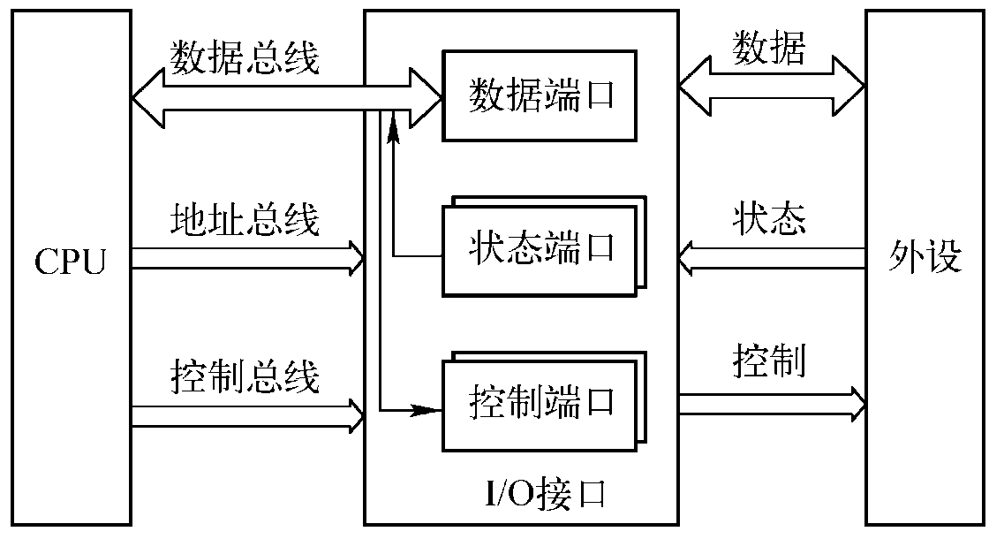
I/O Hardware

Slide 68
I/O Hardware (Cont.)
I/O instructions control devices
Devices usually have registers where device driver places commands, addresses, and data to write, or read data from registers after command execution
Data-in register, data-out register, status register, control register
Typically 1-4 bytes, or FIFO buffer
Devices have addresses, used by
Direct I/O instructions
Memory-mapped I/O
Device data and command registers mapped to processor address space
Especially for large address spaces (graphics)

Slide 69
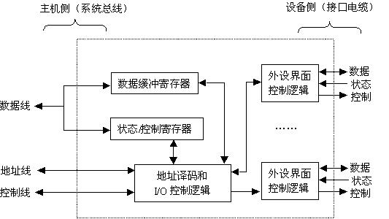
设备控制器的结构
设备控制器的一般结构：不同I/O模块在复杂性和控制外设的数量上相差很大
设备控制器又称 I/O控制器简称 I/O模块 或 I/O接口
通过发送命令字到I/O控制寄存器来向设备发送命令
通过从状态寄存器读取状态字来获取外设或I/O控制器的状态信息
通过向I/O控制器发送或读取数据来和外设进行数据交换
将I/O控制器中CPU能够访问的各类寄存器称为I/O端口
对外设的访问通过向I/O端口发命令、读状态、读/写数据来进行

Slide 70
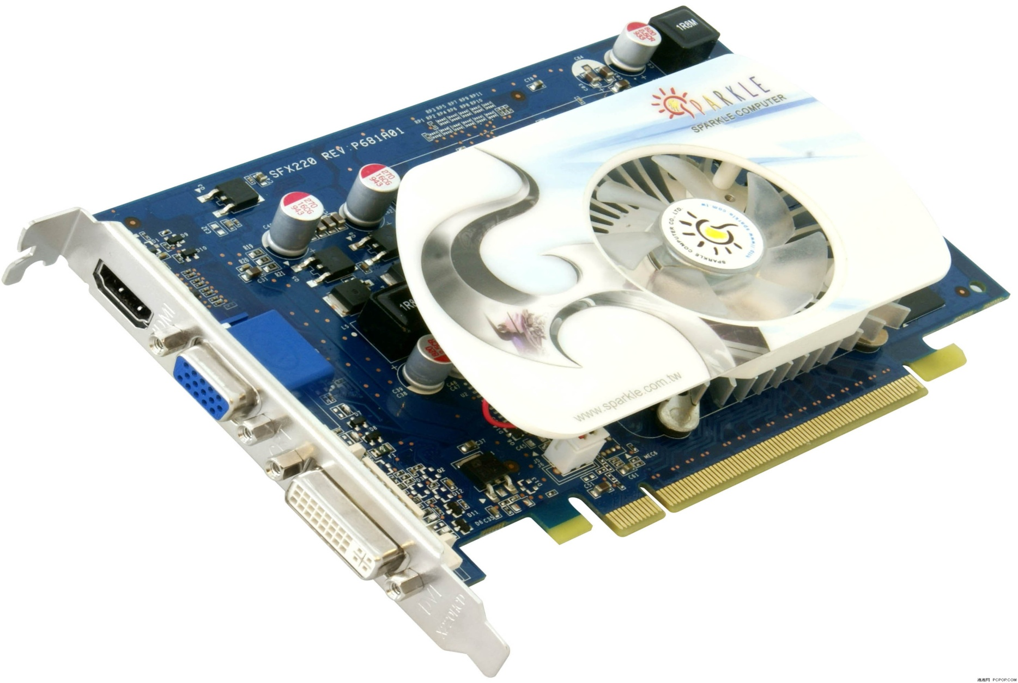
显卡的外部连接特征
VGA连接器
连接到显示器
连接到 I/O总线
（主机侧）
将I/O控制器中CPU能够访问的各类寄存器称为I/O端口
对外设的访问通过向I/O端口发命令、读状态、读/写数据来进行

Slide 71
I/O端口的寻址方式
对I/O端口读写就是向I/O设备送出命令或从设备读状态或读/写数据
一个I/O控制器可能会占有多个端口地址
I/O端口必须编号后，CPU才能访问它
I/O设备的寻址方式就是I/O端口的编号方式
教室和办公室可以连号（统一编址），也可单独编号（独立编址）
（1）统一编址方式（内存映射方式）
与主存空间统一编址，主存单元和I/O端口在同一个地址空间中。
（将I/O端口映射到某个主存区域，故也称“存储器映射方式”）
例如，RISC机器、Motorola公司的处理器等采用该方案
VRAM（显示存储器）通常也和主存统一编址
（2）独立编址方式（特殊I/O指令方式）
单独编号，不和主存单元一起编，使成为一个独立的I/O地址空间
（因为需专门I/O指令，故也称为“特殊I/O指令方式”）
例如，Intel公司和Zilog公司的处理器就是独立编址方式

Slide 72
驱动程序与I/O指令
控制外设进行输入/输出的底层I/O软件是驱动程序
驱动程序设计者应了解设备控制器及设备的工作原理，包括：设备控制器中有哪些用户可访问的寄存器、控制/状态寄存器中每一位的含义、设备控制器与外设之间的通信协议等，而关于外设的机械特性，程序员则无需了解。驱动程序通过访问I/O端口控制外设进行I/O：
将控制命令送到控制寄存器来启动外设工作；
读取状态寄存器了解外设和设备控制器的状态；
访问数据缓冲寄存器进行数据的输入和输出。
对I/O端口的访问操作由I/O指令完成，它们是一种特权指令

Slide 73
Three Types of I/O
Programmed I/O(Polling): continuous attention of the processor is required
无条件传统方式
查询方式
Interrupt driven I/O: processor launches I/O and can continue until interrupted
Direct memory access(DMA): the dma module governs the exchange of data between the I/O unit and the main memory

Slide 74
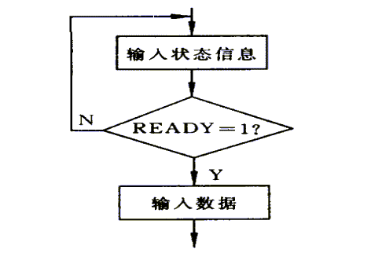
查询方式

Slide 75
程序查询（Polling）方式
I/O设备（包括设备控制器）将自己的状态放到状态寄存器中
打印缺纸、打印机忙、未就绪等都是状态
OS阶段性地查询状态寄存器中的特定状态，以决定下一步动作
如：未“就绪”时，则一直“等待”
例如：sys_write进行字符串打印的程序段大致过程如下：
copy_string_to_kernel ( strbuf, kernelbuf, n); // 将字符串复制到内核缓冲区
for (i=0; i < n; i++) { // 对于每个打印字符循环执行
while ( printer_status != READY); // 等待直到打印机状态为“就绪”
*printer_data_port=kernelbuf[i]; // 向数据端口输出一个字符
*printer_control_port=START; // 发送“启动打印”命令
}
return_to_user ( ); // 返回用户态
如何判断“就绪”？如何“等待”？
读取状态寄存器，判断特定位（1-就绪；0-未就绪）是否为1
等待：读状态、判断是否为1；不是，则继续读状态、判断、…….

Slide 76
打印输出标准子程序
功能：打印AL寄存器中的字符。
PRINT PROC NEAR
PUSH AX ; 保留用到的寄存器
PUSH DX ; 保留用到的寄存器
MOV DX, 378H ; 数据锁存器口地址送DX
OUT DX, AL ; 输出要打印的字符到数据锁存器
MOV DX, 379H ; 状态寄存器口地址送DX
WAIT: IN AL, DX ; 读打印机状态位
TEST AL, 80H ; 检查忙位
JE WAIT ; 等待直到打印机不忙
MOV DX, 37AH ; 命令(控制)寄存器口地址送DX
MOV AL, 0DH ; 置选通位=1（表示启动打印）
OUT DX, AL ;使命令寄存器中选通位置1
POP DX
POP AX ; 恢复寄存器
RET
PRINT ENDP
回顾：过程/函数/子程序中的开始总是先要保护现场，最后总是要恢复现场！

Slide 77
程序查询I/O方式
sys_write系统调用服务例程
工作
工作
外设
CPU
启动
完成
启动
完成
探询
探询
此时，CPU处于停止状态吗？
“踏步”现象
不是！只是不断执行 “ IN-TEST-JE” 3条指令，称为“忙等待”！
“探询”期间，可一直不断查询（独占查询），也可定时查询（需保证数据不丢失！）。
特点：
简单、易控制、外围接口控制逻辑少；
CPU与外设串行工作，效率低、速度慢，适合于慢速设备
查询开销极大 (CPU完全在等待“外设完成”）
工作方式：完全串行或部分串行，CPU用100%的时间为I/O服务！

Slide 78
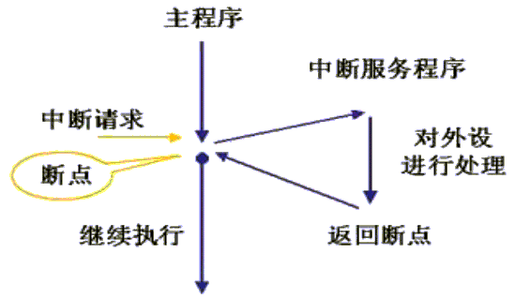
中断方式

Slide 79
中断I/O方式
基本思想：
当外设准备好（ready）时，便向CPU发中断请求，CPU响应后，中止现行程序的执行，转入“中断服务程序”进行输入/出操作，以实现主机和外设接口之间的数据传送，并启动外设工作。 “中断服务程序”执行完后，返回原被中止的程序断点处继续执行。此时，外设和CPU并行工作。
sys_write系统调用服务例程
中断服务程序
工作
完成
工作
完成
工作
外设
启动
Q
启动
P
Q
Q
CPU
启动
请求
响应
返回
请求
响应
P 被阻塞，调其他进程Q执行
上述哪段时间CPU和外设并行工作？
程序切换（响应中断）由硬件完成，即执行“中断隐指令”

Slide 80
中断I/O方式
例子：采用中断方式进行字符串打印
sys_write进行字符串打印的程序段:
copy_string_to_kernel ( strbuf, kernelbuf, n);// 将字符串复制到内核缓冲区
enable_interrupts ( ); // 开中断，允许外设发出中断请求
while ( printer_status != READY); // 等待直到打印机状态为“就绪”
*printer_data_port=kernbuf[i]; // 向数据端口输出第一个字符
*printer_control_port=START; // 发送“启动打印”命令
scheduler ( ); // 阻塞用户进程P，调度其他进程执行
“字符打印”中断服务程序：
sys_write是如何调出来的？
系统调用！
中断服务程序是如何调出来的？
外设完成任务！
if (n==0) { // 若字符串打印完，则
unblock_user ( ); // 用户进程P解除阻塞，P进就绪队列
} else {
*printer_data_port=kernelbuf[i]; // 向数据端口输出一个字符
*printer_control_port=START; // 发送“启动打印”命令
n = n-1; // 未打印字符数减1
i = i+1; // 下一个打印字符指针加1
}
acknowledge_interrupt(); // 中断回答（清除中断请求）
return_from_interrupt(); // 中断返回

Slide 81
中断I/O方式
中断过程
中断检测（硬件实现）
中断响应（硬件实现）
中断处理（软件实现）
中断响应
中断响应是指主机发现外部中断请求，中止现行程序的执行，到调出中断服务程序这一过程。
中断响应的条件
① CPU处于开中断状态
② 在一条指令执行完
至少要有一个未被屏蔽的中断请求
中断处理
中断响应
问题：中断响应的时点与异常处理的时点是否相同？为什么？
通常在指令执行结束时查询有无中断请求，有则立即响应；
而异常发生在指令执行过程中，一旦发现则马上处理。

Slide 82
中断处理流程

Slide 83
DMA方式

Slide 84
DMA方式的基本要点
DMA方式的基本思想
在高速外设和主存间直接传送数据
由专门硬件（即：DMA控制器）控制总线进行传输
DMA方式适用场合
高速设备（如：磁盘、光盘等）
成批数据交换，且数据间间隔时间短，一旦启动，数据连续读写
采用“请求-响应”方式
每当高速设备准备好数据就进行一次“DMA请求”，DMA控制器接受到DMA请求后，申请总线使用权
DMA控制器的总线使用优先级比CPU高，为什么？
与中断控制方式结合使用
在DMA控制器控制总线进行数据传送时，CPU执行其他程序
DMA传送结束时，要通过“DMA结束中断”告知CPU

Slide 85
DMA方式下CPU的工作
例子：采用DMA方式进行字符串输出
sys_write进行字符串输出的程序段:
copy_string_to_kernel(strbuf, kernelbuf, n); // 将字符串复制到内核缓冲区
initialize_DMA ( ); // 初始化DMA控制器（准备传送参数）
*DMA_control_port=START; // 发送“启动DMA传送”命令
scheduler ( ); // 阻塞用户进程P，调度其他进程执行
DMA控制器接受到“启动”命令后，控制总线进行DMA传送。通常用”周期挪用法“：设备每准备好一个数据，挪用一次”存储周期“，使用一次总线事务进行数据传送，计数器减1。计数器为0时，发送DMA结束中断请求
”DMA结束“中断服务程序：
acknowledge_interrupt(); // 中断回答（清除中断请求）
unblock_user ( ); // 用户进程P解除阻塞，进入就绪队列
return_from_interrupt(); // 中断返回
CPU仅在DMA控制器初始化和处理“DMA结束中断“时介入，在DMA传送过程中不参与，因而CPU用于I/O的开销非常小。

Slide 86
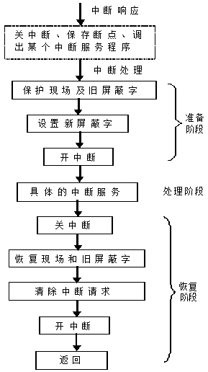
中断服务程序
中断控制和DMA控制两种方式下都需进行中断处理
中断控制方式：中断服务程序主要进行从数缓器取数或写数据到数缓器，然后启动外设工作
DMA控制方式：中断服务程序进行数据校验等后处理工作
在内核I/O软件中用到的I/O指令、“开中断”和“关中断”等指令都是特权指令，只能在操作系统内核程序中使用

Slide 87
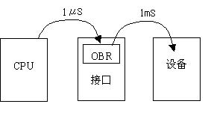
轮询方式和中断方式的比较
举例：假定某机控制一台设备输出一批数据。数据由主机输出到接口的数据缓冲器OBR，需要1μs。再由OBR输出到设备，需要1ms。设一条指令的执行时间为1μs(包括隐指令)。试计算采用程序传送方式和中断传送方式的数据传输速度和对主机的占用率。
问题：CPU如何把数据送到OBR，I/O接口如何把OBR中的数据送到设备？
CPU执行I/O指令来将数据送OBR；而I/O接口则是自动把数据送到设备。
对主机占用率：
在进行I/O操作过程中，处理器有多少时间花费在输入/出操作上。
数据传送速度（吞吐量、I/O带宽）：
单位时间内传送的数据量。
假定每个数据的传送都要重新启动！即是字符型设备

Slide 88
轮询方式和中断方式的比较
（1）程序直接控制传送方式
若查询程序有10条，第5条为启动设备的指令，则：
数据传输率为：1/(1000+5) μs，约为每秒995个数据。
主机占用率=100%
外设
1ms
（2）中断传送方式
若中断服务程序有30条，在第20条启动设备，则：
数据传输率为：1/(1000+1+20)μs，约为每秒979个数据。
主机占用率为：(1+30)/(1000+1+20)=3%
5μs
CPU
轮询方式
外设
1ms
CPU
中断方式
为什么中断服务程序比查询程序长？
因为中断服务程序有额外开销，如：保存现场、保存旧屏蔽字、设置新屏蔽字、开中断、查询中断源等

Slide 89
Extra Slides

Slide 90
Fun with File Descriptors (1)
#include "csapp.h"
int main(int argc, char *argv[])
{
int fd1, fd2, fd3;
char c1, c2, c3;
char *fname = argv[1];
fd1 = Open(fname, O_RDONLY, 0);
fd2 = Open(fname, O_RDONLY, 0);
fd3 = Open(fname, O_RDONLY, 0);
Dup2(fd2, fd3);
Read(fd1, &c1, 1);
Read(fd2, &c2, 1);
Read(fd3, &c3, 1);
printf("c1 = %c, c2 = %c, c3 = %c\n", c1, c2, c3);
return 0;
}
ffiles1.c
What would this program print for file containing “abcde”?
Notes:
a,a,b

Slide 91
Fun with File Descriptors (2)
#include "csapp.h"
int main(int argc, char *argv[])
{
int fd1;
int s = getpid() & 0x1;
char c1, c2;
char *fname = argv[1];
fd1 = Open(fname, O_RDONLY, 0);
Read(fd1, &c1, 1);
if (fork()) { /* Parent */
sleep(s);
Read(fd1, &c2, 1);
printf("Parent: c1 = %c, c2 = %c\n", c1, c2);
} else { /* Child */
sleep(1-s);
Read(fd1, &c2, 1);
printf("Child: c1 = %c, c2 = %c\n", c1, c2);
}
return 0;
}
ffiles2.c
What would this program print for file containing “abcde”?
Notes:
P a,b c a,b
C a,c p a,c

Slide 92
Fun with File Descriptors (3)
#include "csapp.h"
int main(int argc, char *argv[])
{
int fd1, fd2, fd3;
char *fname = argv[1];
fd1 = Open(fname, O_CREAT|O_TRUNC|O_RDWR, S_IRUSR|S_IWUSR);
Write(fd1, "pqrs", 4);
fd3 = Open(fname, O_APPEND|O_WRONLY, 0);
Write(fd3, "jklmn", 5);
fd2 = dup(fd1); /* Allocates descriptor */
Write(fd2, "wxyz", 4);
Write(fd3, "ef", 2);
return 0;
}
ffiles3.c
What would be the contents of the resulting file?

Slide 93
Accessing Directories
Only recommended operation on a directory: read its entries
dirent structure contains information about a directory entry
DIR structure contains information about directory while stepping through its entries
#include <sys/types.h>
#include <dirent.h>
{
DIR *directory;
struct dirent *de;
...
if (!(directory = opendir(dir_name)))
error("Failed to open directory");
...
while (0 != (de = readdir(directory))) {
printf("Found file: %s\n", de->d_name);
}
...
closedir(directory);
}

Slide 94
Example of Accessing File Metadata
linux> ./statcheck statcheck.c
type: regular, read: yes
linux> chmod 000 statcheck.c
linux> ./statcheck statcheck.c
type: regular, read: no
linux> ./statcheck ..
type: directory, read: yes
int main (int argc, char **argv)
{
struct stat stat;
char *type, *readok;
Stat(argv[1], &stat);
if (S_ISREG(stat.st_mode)) /* Determine file type */
type = "regular";
else if (S_ISDIR(stat.st_mode))
type = "directory";
else
type = "other";
if ((stat.st_mode & S_IRUSR)) /* Check read access */
readok = "yes";
else
readok = "no";
printf("type: %s, read: %s\n", type, readok);
exit(0);
}
statcheck.c

Slide 95
For Further Information
The Unix bible:
W. Richard Stevens & Stephen A. Rago, Advanced Programming in the Unix Environment, 2nd Edition, Addison Wesley, 2005
Updated from Stevens’s 1993 classic text
The Linux bible:
Michael Kerrisk, The Linux Programming Interface, No Starch Press, 2010
Encyclopedic and authoritative

Slide 96
I/O software in user space
I/O software is not only in the OS, libraries are routinely linked with user programs, helper programs run outside the kernel.
count = write(fd, buffer, nbytes)
Library routines typically transfer their parameters to the system calls, or do more work:
printf(“%d : %s, %ld\n”, count, person, yearly_income);
cout << count << “ : “ << person << “, “ << y_i << endl;
cin >> y_i;
Spooling systems: a daemon reads jobs from a spooling-directory and sends it to the printer (protected device, only spooler has access)

Slide 97
I/O software in user space (cont)
Spooling may be used in networks, mailing systems,…, spoolers run outside the O.S.
Overview:
user processes | Produce I/O call, format, spool
Device independent software | Naming, protection, blocking, buffering, allocating
Device drivers | Control device registers, status
Interrupt handlers | Wake up driver after I/O task
hardware | Perform I/O

Slide 98
本章小结
用户程序通常通过调用编程语言提供的库函数或操作系统提供的API函数来实现I/O操作
I/O库函数最终都会调用系统调用的封装函数，通过封装函数中的陷阱指令使用户进程从用户态转到内核态执行
在内核态中执行的内核空间I/O软件主要包含三个层次：
与设备无关的操作系统软件
设备驱动程序
中断服务程序
具体I/O操作通过设备驱动程序和中断服务程序控制I/O硬件来实现
设备驱动程序的实现主要取决于具体的I/O控制方式：
程序查询方式、中断方式、DMA方式

Slide 99
练习
10.1、10.2、10.3

