Slide 1

INFLATION NOWCASTING
Real-time CPI prediction using high-frequency macro indicators
TEAM MEMBERS
Anfas Ahammed PP
Muhammed Salman PM
Srinikethan Suresh
Sai Ganesh
Krishnanunni U J

Slide 2


What is Inflation Nowcasting?
Nowcasting = "Now" + "Forecasting"
Estimating the current month's CPI before the BLS publishes it — by fusing high-frequency market signals (daily/weekly) with lagged economic indicators. The Cleveland Fed runs a production nowcaster updated every business day at 10 AM ET, using oil prices, gasoline prices, and past CPI/PCE readings.
THE INFORMATION GAP
Jan 1–31 Month occurs
Feb ~14 BLS releases Jan CPI
Gap 2–4 weeks blind
WEEKLY SIGNALS (REAL-TIME)
MONTHLY INDICATORS (LAGGED 1 MO.)
Oil Price, Gasoline Price, Natural Gas, 10Y & 2Y Treasury Yields, Yield Spread, VIX, Corporate Spread
PPI, Unemployment, Copper, Wheat, Retail Sales, Industrial Prod., Fed Funds Rate, Housing Starts, Home Prices, Import Prices
2005–2026
DAILY
<1% MAPE
21 years of weekly data (1,100+ obs)
Cleveland Fed updates its nowcast every business day at 10 AM ET
Our best model's prediction error — within 1 CPI point

Slide 3




Why nowcast inflation?
CPI is the single most market-moving data release , whoever predicts it first has an asymmetric edge.
$1.5 TRILLION
$15.4 BILLION
in US TIPS outstanding — bonds whose principal adjusts directly with CPI. A 0.1% CPI surprise reprices billions in this market alone.
spent by investment firms on alternative data in 2025 (Neudata). Inflation nowcasting datasets are among the highest-demand products.
THE DATA LAG PROBLEM
FED POLICY & BOND MARKETS
HEDGE FUND ALPHA RACE
CPI is released 2–4 weeks after month-end. Hedge funds can't wait — decisions on rate-sensitive positions worth billions are made in that window using stale data.
A 0.1% CPI miss can move Treasury yields 5–10 basis points intraday. With the 10Y at ~4%, that reprices trillions in global bond portfolios within minutes.
Large multi-strategy funds spend $5M+/year on 43 data vendors (Neudata). 95% plan to increase budgets. Whoever reads inflation first trades before the crowd.

Slide 4


Approach Overview
DATA & TARGET DESIGN
REGRESSION MODELS
Target: CPI monthly change (ΔCPI) and not level.
Predicting the change makes the target stationary and dramatically improves regression accuracy.
Train: Jan 2005 – Apr 2023 (952 weeks)
Test: May 2023 – Mar 2026 (151 weeks)
Leakage prevention: Monthly vars (PPI, unemployment, etc.) are shifted back 1 month. For May CPI, we only see April's monthly indicators — exactly what's available in practice. Weekly vars used as-is (real-time).
Linear, Ridge, LASSO, ElasticNet
Regularised linear models — test if CPI change is a linear function of macro features. LASSO doubles as feature selector.
Decision Tree, Random Forest, Gradient Boosting, NG-Boost
Capture nonlinear interactions and regime effects between variables.
TIME SERIES MODELS (3)
ARIMA(p,1,0)
Pure autoregressive — uses only CPI's own history. Captures momentum/trend.
ARIMAX — AR dynamics + exogenous macro regressors. The hybrid approach.
LSTM (RNN) — Neural network on monthly CPI sequences. Tests non-linear temporal dependencies.
CORE QUESTION: Can cross-sectional macro features (regression) beat CPI's own autoregressive dynamics (time series)? Evaluated on RMSE, Adj R², and MAPE over 3 years of unseen data.

Slide 5
Data Extraction & Feature Engg.
Building a real time CPI prediction system from market signals
DATA SOURCE
19 PREDICTOR VARIABLES
Source
Federal Reserve Economic Data (FRED)
8 WEEKLY VARIABLES (Real-time)
Period
January 2005 - March 2026
Energy Prices: Oil, Gasoline, Natural Gas
Financial Indicators: Treasury 10Y, 2Y, Yield Spread
Market Volatility: VIX, Corporate Spread
Coverage
21 years of weekly data
Observations
1,107 weekly data points
Training
956 weeks (86%)
Testing
151 weeks (14%)
10 MONTHLY VARIABLES (Lagged 1 month)
Economic: PPI, Unemployment, Fed Funds Rate
Commodities: Copper, Wheat, Import Prices
Activity: Retail Sales, Industrial Production, Housing, Home Prices
Frequency
Weekly granularity
KEY RATIONALE
▸ Weekly data captures immediate price pressures
▸ Monthly lag prevents data leakage (real nowcasting)
▸ Target = CPI change (ΔCPI) for stationarity

Slide 6
Exploratory Data Analysis
EDA

Slide 7
Advanced Time Series Analysis
Uncovering hidden patterns, causality, and economic regime changes
1 STL DECOMPOSITION
Seasonal-Trend decomposition using Loess → Separates time series into Trend + Seasonal + Residual
Applied to: CPI, Oil, Gasoline, VIX | Period: 52 weeks | Output: 15+ temporal features
2 GRANGER CAUSALITY ANALYSIS
Tests: Do past values of X help predict future CPI beyond CPI's own history?
Variable | Lag | p-value | Significant
Oil Price | 4 wks | < 0.0001 | ✓ Yes ***
Gasoline | 2 wks | < 0.0001 | ✓ Yes ***
Treasury 10Y | 3 wks | < 0.0001 | ✓ Yes ***
Treasury 2Y | 3 wks | < 0.0001 | ✓ Yes ***
Natural Gas | 1 wk | 0.0274 | ✓ Yes **
3 STRUCTURAL BREAK DETECTION (PELT Algorithm)
2008
2014
2020
2021
Financial Crisis
Oil Collapse
COVID-19
Recovery
→ Regime indicators added as binary features

Slide 8
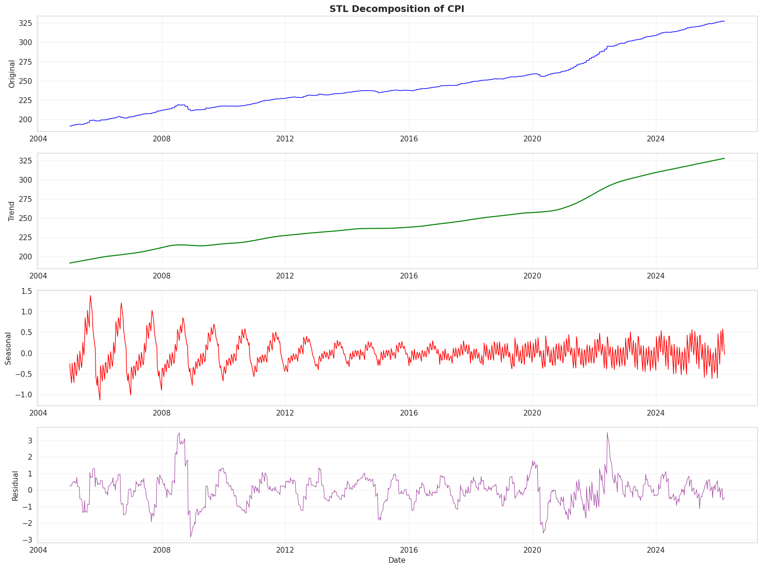

Slide 9
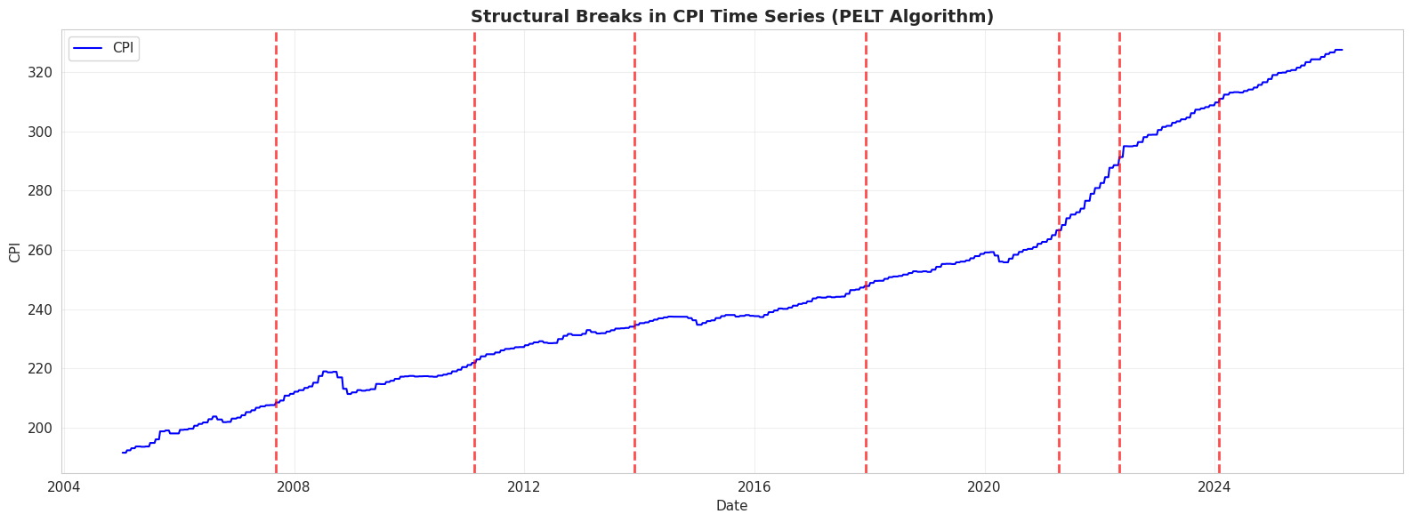

Slide 10
Time Series Models Leveraged
Can CPI's own history beat cross-sectional macro features?
ARIMA (3,2,1)
ARIMAX
LSTM
Pure Autoregressive
AR + Exogenous
Deep Learning RNN
Uses only CPI's own historical values
ARIMA structure + macro predictors
Neural net capturing non-linear patterns
• AR(3): 3 past values
• Combines AR dynamics
• 2 layers, 128 units
• Integrated (2): differencing
• with exogenous variables
• 10-step sequences
• MA(1): 1 forecast error lag
• Hybrid approach
• 20% dropout
• AIC-selected order
• Not implemented
• Lion + Cosine LR
PERFORMANCE
PERFORMANCE
PERFORMANCE
RMSE: 8.74
RMSE: 0.67
RMSE: 0.556
FAILED
SKIPPED
STRONG
INSIGHT: LSTM competitive (0.556 RMSE), but regression models won (LASSO: 0.379)

Slide 11
Optimization Advancements
State-of-the-art techniques for LSTM training
LION OPTIMIZER
COSINE ANNEALING
EvoLved Sign Momentum
Learning Rate Scheduling
State-of-the-art optimizer
Sign-based momentum updates
Advantages:
• More memory efficient than Adam
• Superior generalization
• Faster convergence
Smooth LR decay via cosine curve
No abrupt drops → stable training
Schedule:
Initial LR: 0.001
Final LR: 0.000001 (1000× drop)
T_max: 100 epochs
Benefit: Escapes local minima
Final training loss:
0.0011
TRAINING PROGRESSION
EPOCH | LOSS | LEARNING RATE | STATUS
20 | 0.0461 | 0.000905 | Early - High LR
40 | 0.0132 | 0.000655 | Mid - Decreasing
60 | 0.0060 | 0.000346 | Converging
80 | 0.0016 | 0.000096 | Fine-tuning
100 | 0.0011 | 0.000001 | ✓ Converged

Slide 12
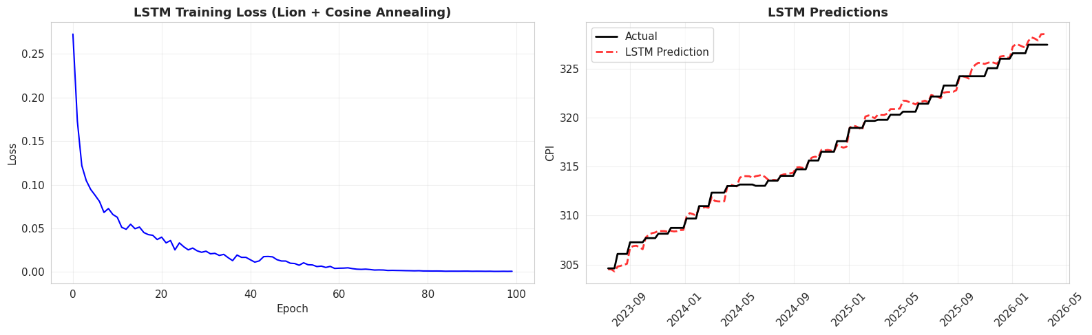

Slide 13
Regression Models - The Winners
Cross-sectional macro features dominate pure time series approaches
RANK | MODEL | TYPE | RMSE | MAE
1 | LASSO | L1 Regularization | 0.379 | 0.297
2 | Quantile Reg | Distribution-free | 0.473 | 0.382
3 | Ridge | L2 Regularization | 0.492 | 0.408
4 | ElasticNet | L1 + L2 | 0.507 | 0.420
5 | NG-Boost | Probabilistic GB | 0.525 | 0.429
6 | Gradient Boost | Tree Ensemble | 0.537 | 0.454
7 | Random Forest | Bagged Trees | 0.590 | 0.492
MODEL INSIGHTS
LASSO:
L1 penalty → sparse coefficients → automatic feature selection → best RMSE (0.379)
Quantile Reg:
Predicts 5th, 50th, 95th percentiles → 90.07% coverage achieved (target: 90%)
NG-Boost:
Probabilistic forecasts with uncertainty (σ=0.116) → natural gradient boosting
CONCLUSION: Regularization critical — LASSO/Ridge/ElasticNet all outperformed baselines

Slide 14
Loss Functions & Statistical Tests
Domain-specific objectives beyond standard MSE
Asymmetric Huber Loss
Pinball (Quantile) Loss
Rationale:
Over-predicting inflation worse than
under-predicting (policy implications)
Config:
δ=1.0, asymmetry=1.5
Used in: LSTM training
Purpose: Generate prediction intervals
Quantiles: Q=0.05, 0.50, 0.95
Result: 90.07% coverage ✓
DIEBOLD-MARIANO TEST
Statistical comparison of forecast accuracy (vs Ridge baseline)
MODEL | DM STAT | p-value
LASSO | -6.63 | < 0.0001 ***
ElasticNet | -3.36 | 0.0010 ***
Random Forest | -2.62 | 0.0097 ***
Gradient Boost | -1.20 | 0.2310
Negative DM = Better | Positive DM = Worse | *** = p < 0.01 (highly significant)

Slide 15
Final Results & Key Insights
7 models, 21 years of data, 1,107 weekly observations
TOP 5 MODELS (by RMSE)
RANK | MODEL | RMSE | MAE | KEY STRENGTH
1 | LASSO | 0.379 | 0.297 | Feature selection
2 | Quantile Reg | 0.473 | 0.382 | 90.07% coverage
3 | Ridge | 0.492 | 0.408 | Stable shrinkage
4 | ElasticNet | 0.507 | 0.420 | Balanced L1+L2
5 | NG-Boost | 0.525 | 0.429 | Uncertainty σ=0.116
KEY INSIGHTS
▸
LASSO dominated: 0.379 RMSE via L1 feature selection
▸
Regression >> Time Series: All beat ARIMA (8.74 RMSE) by massive margins
▸
Advanced features: STL added 15+ temporal; 4 structural breaks detected
▸
Causality validated: VIX, Lag CPI,Retail Prices, Oil, Gasoline, Treasuries confirmed as predictors
▸
Uncertainty quantified: Quantile (90.07% coverage), NG-Boost (σ=0.116)

Slide 16
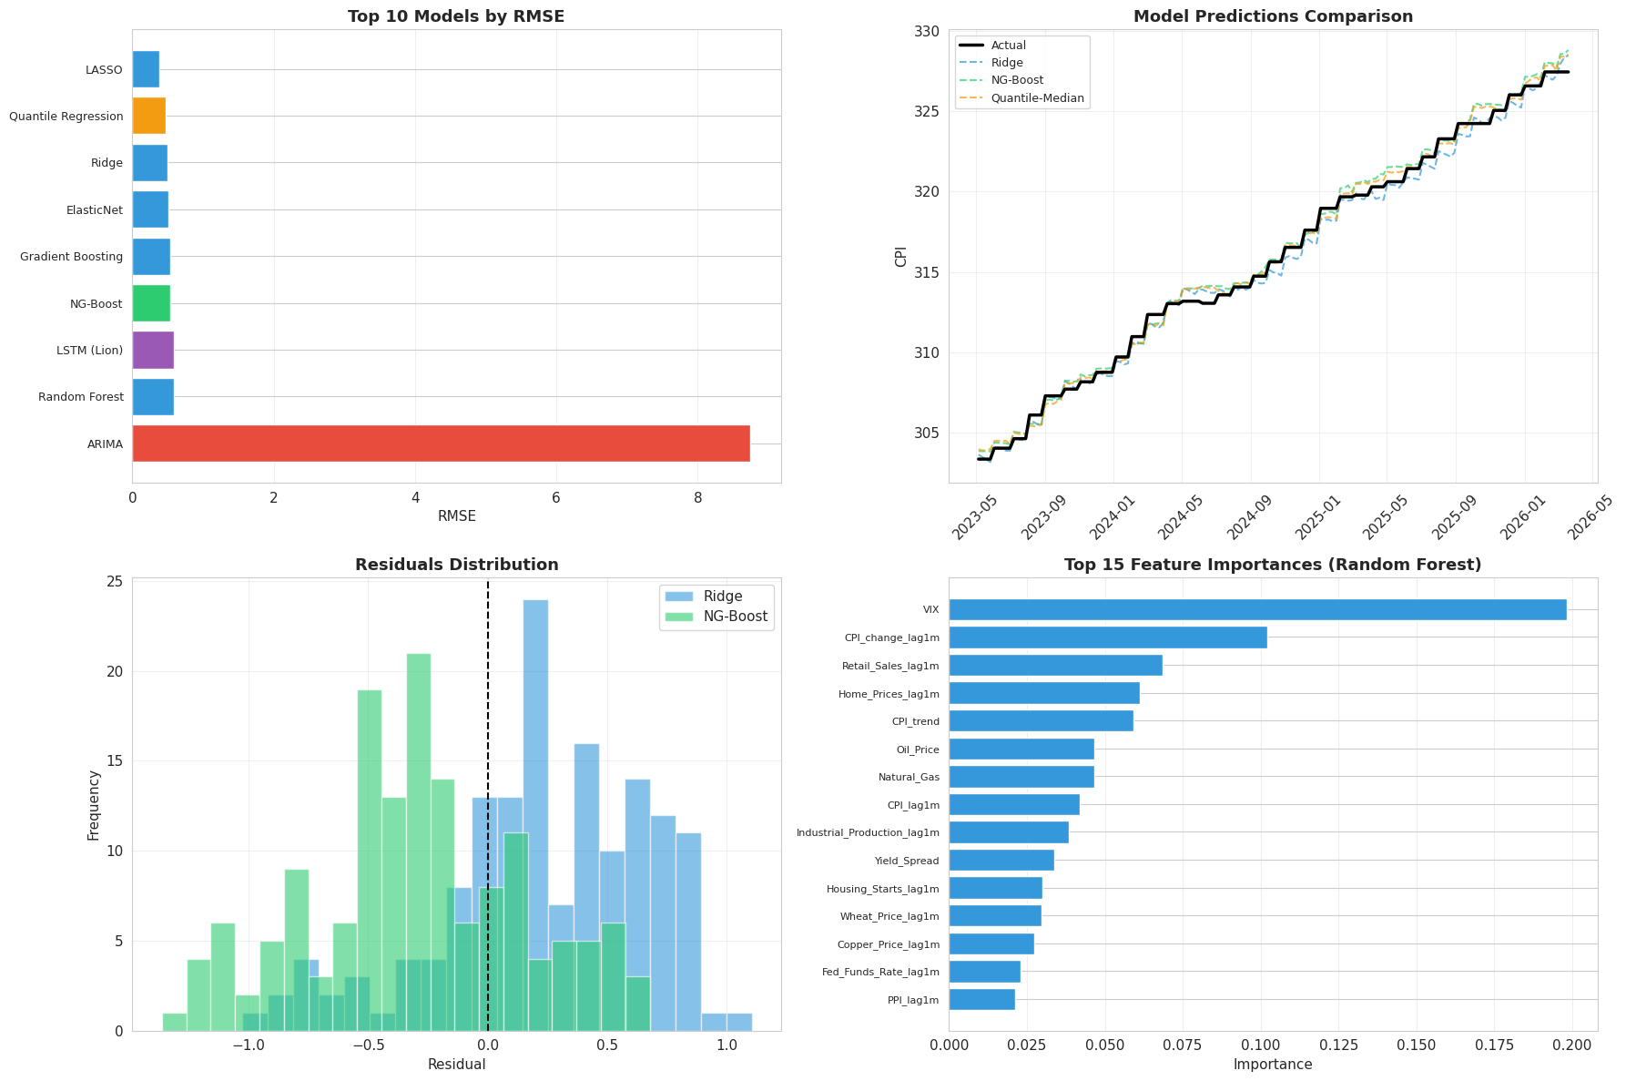

Slide 17
Contributions
Anfas Ahammed
S Srinikethan
Sai Ganesh S
Time Series Analysis
LSTM modelling
Presentation slides
Regression Modelling
QA and ideation vetting
Problem Formulation
Literature Review
Data Extraction
Causality Analysis
Krishnanunni U J
Muhammed Salman
Exploratory Data Analysis
Data Exploration
StreamLit Visuvalizations
1.Fit different types of regression models
2.Statistical test
3. Result Interpretation

Slide 18

THANK
YOU

